Slide 1
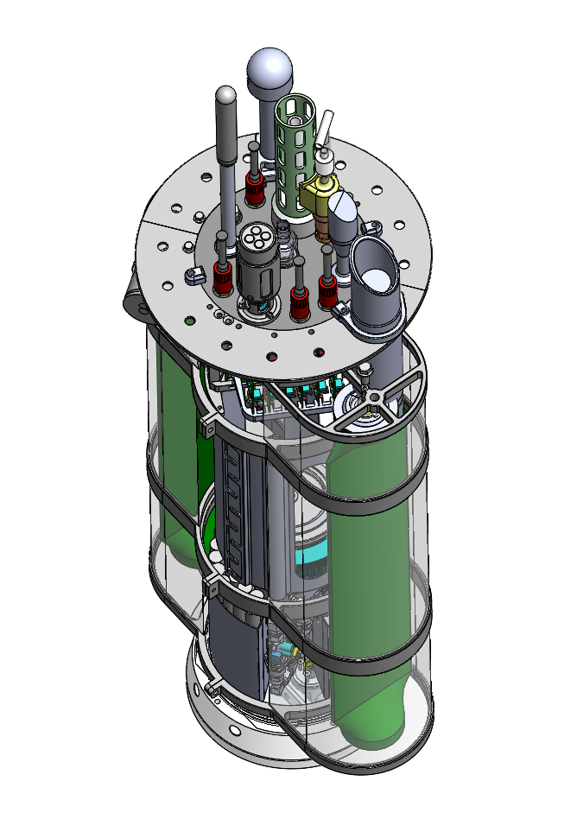
GPS/Iridium Satellite antennas
Stand alone GPS/Iridium tracker (for backup)
SBE41+ CTD
Wetlabs FL/BB2K Fluorometer/backscatter
MBARI pH and ISUS Nitrate
Aandera 4330 Optode
Sonardyne underwater tracking beacon
Pressure Housing
Length = 88 cm
Satlantic OCR500 multispectral radiometer (not installed)
Pressure Housing
Diameter = 22 cm

Slide 2
Buoyancy engine pumps oil (3.5 liters maximum) from inside the pressure housing to a flexible bladder outside the housing. Mass is constant overall volume (= buoyant force) increases as oil is pumped from inner reservoir to external flexible bladder.
Platform velocity = 0 to 50 cm/sec. For your deployment descend rate = 20 cm/sec, ascend = 10 cm/sec.
CTD is pumped, pH is in the pumped flow stream
40 kg in air
1.5 liters negative to 2 liters positive in water
Optode bracket is 6061-T6 aluminum
Measurements are programmable. For you deployment: while parked every 30 minutes and during the ascend process every 5 meters from full depth to 20 meters and every 2 meters from 20 meters to the surface
Programmed to park at 100 meters for 3 hours. If the float hits the bottom before 100 meters it will anchor for the same 3 hour period.
GPS is a u-Blox Max-8Q

