Slide 1
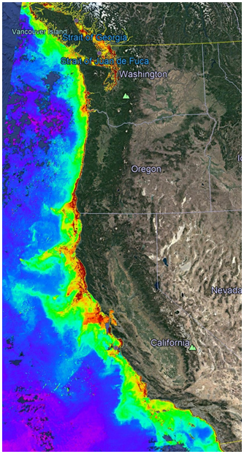
901206 Coastal Profiling Float Science Applications
A lack of high-quality, ecosystem wide, near real-time data is limiting the ability to develop science-based resource management policies.
  Fish (and other organisms) production are based on estimates of photosynthetic primary production rates in the ocean¹
  Coastal margins represent 5-10% of the global surface area, yet they are estimated to contribute as much as 10-30% of global primary production²
  There is no observing system that provides the data required to understand coastal ecosystem processes such as new or net primary production in a way that enables science based management of these resources
MODIS Chlorophyll 2019

Slide 2
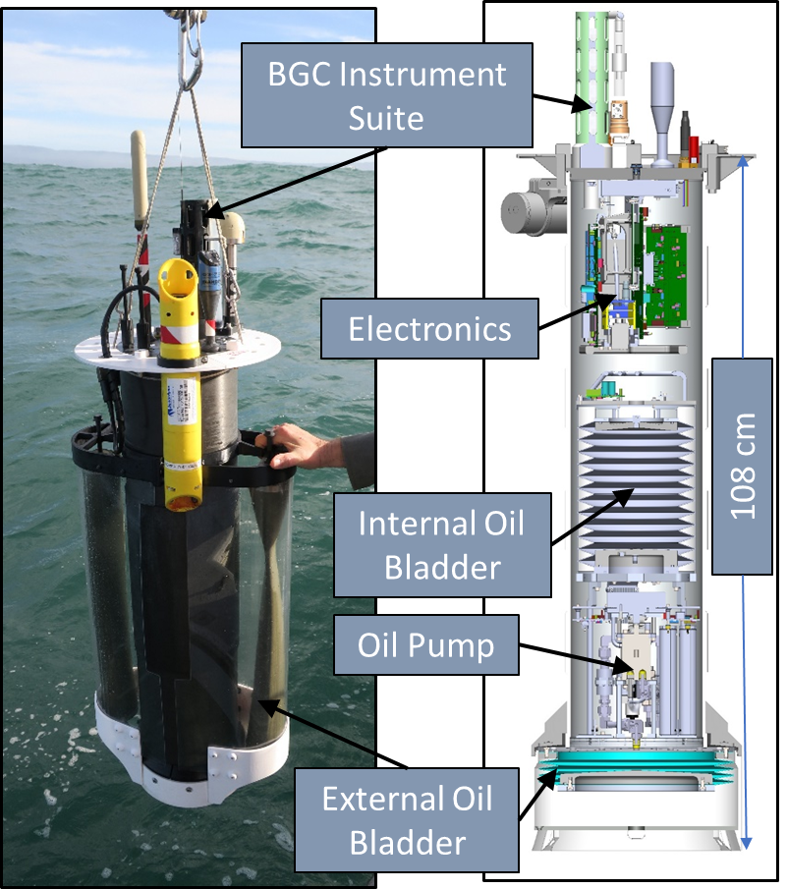
901206 Coastal Profiling Float Science Applications
MBARI has been developing a profiling float targeted at understanding the health of the ocean in coastal regions
Full BGC instrument suite: CTD, Oxygen, pH, Nitrate, Fluorescence, Backscatter, Optical Radiation
Depth Range = 0 to 500 meters
Operations in any density gradient
  Arctic, Columbia River outfalls, etc.
Ability to anchor on bottom to minimize drift

Slide 3
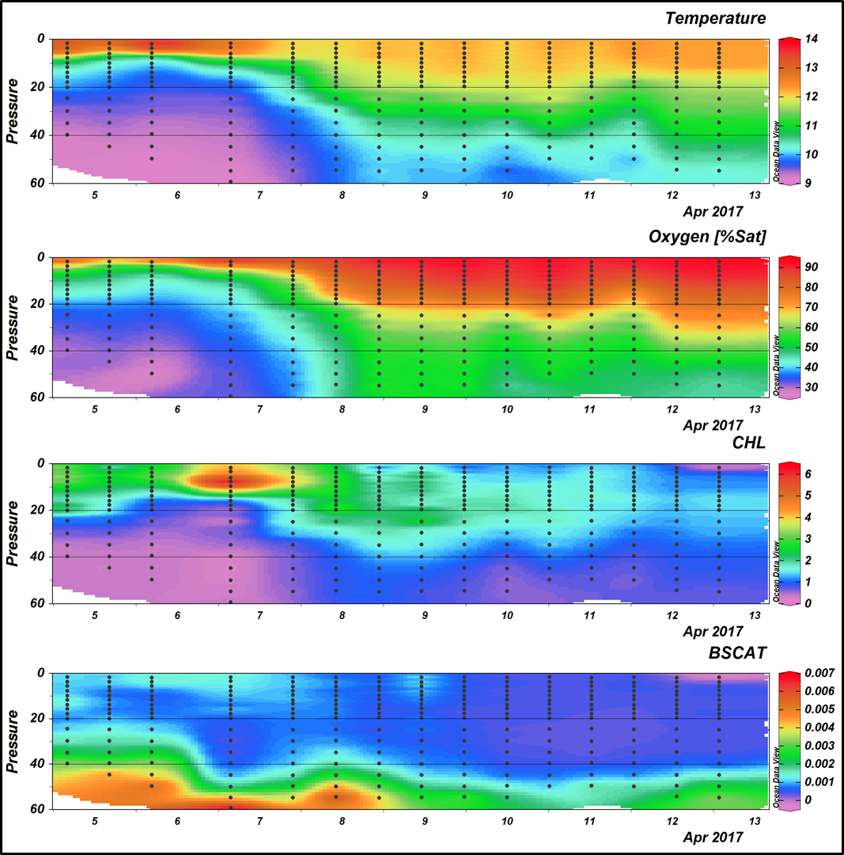
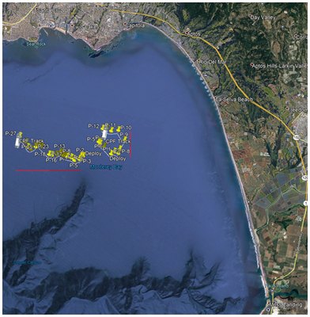
901206 Coastal Profiling Float Science Applications
2020 is the last year of significant development culminating in a science experiment focusing on the influence of lateral nutrient transport from upwelling plumes versus canyon upwelling on the development of high chlorophyll levels in the Monterey Bay.
2021+ will focus on moving the CPF technology outside our current MBARI user base into the greater ocean research community.
We will also be pursuing commercialization opportunities for the CPF technology.
¹ Ryther, J. H. (1969) Photosynthesis and fish production in the sea. Science, 166, 72-76.
² Benway, et. al. (Editors), 2015. An interdisciplinary science plan for research in North American continental margin systems. Report of the Coastal CARbon Synthesis (CCARS) community workshop, August 19-21, 2014, Ocean Carbon and Biogeochemistry Program and North American Carbon Program, 68 pp.

