Slide 1
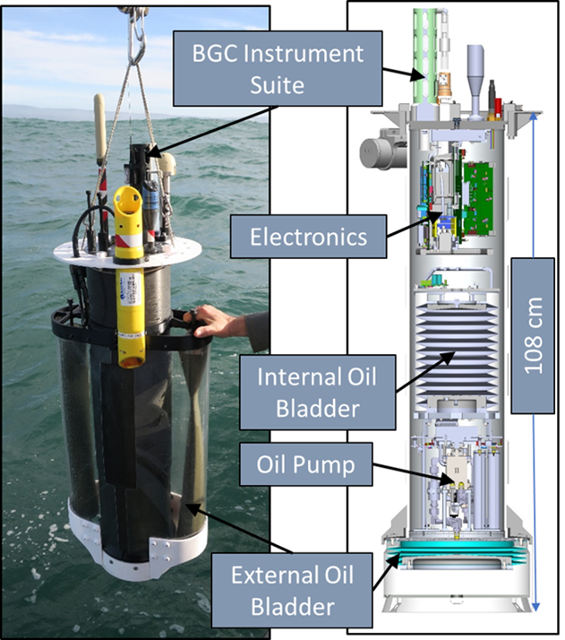
The MBARI Coastal Profiling Float
Target science missions: Sustainable, long term, ecosystem wide observing systems
  Understanding the health of the ocean
  Fisheries management
  Oxygen dead zone monitoring
  HAB research and monitoring …
BGC instrument suite: CTD, dissolved oxygen, pH, Nitrate, 4 channel optical radiometer, fluorescence and backscatter
Optimized for coastal zones
  Can (and does) park on the bottom to minimize drift
  Can park at a user specific depth to drift back into measurement volume using serendipitous subsurface currents

Slide 2
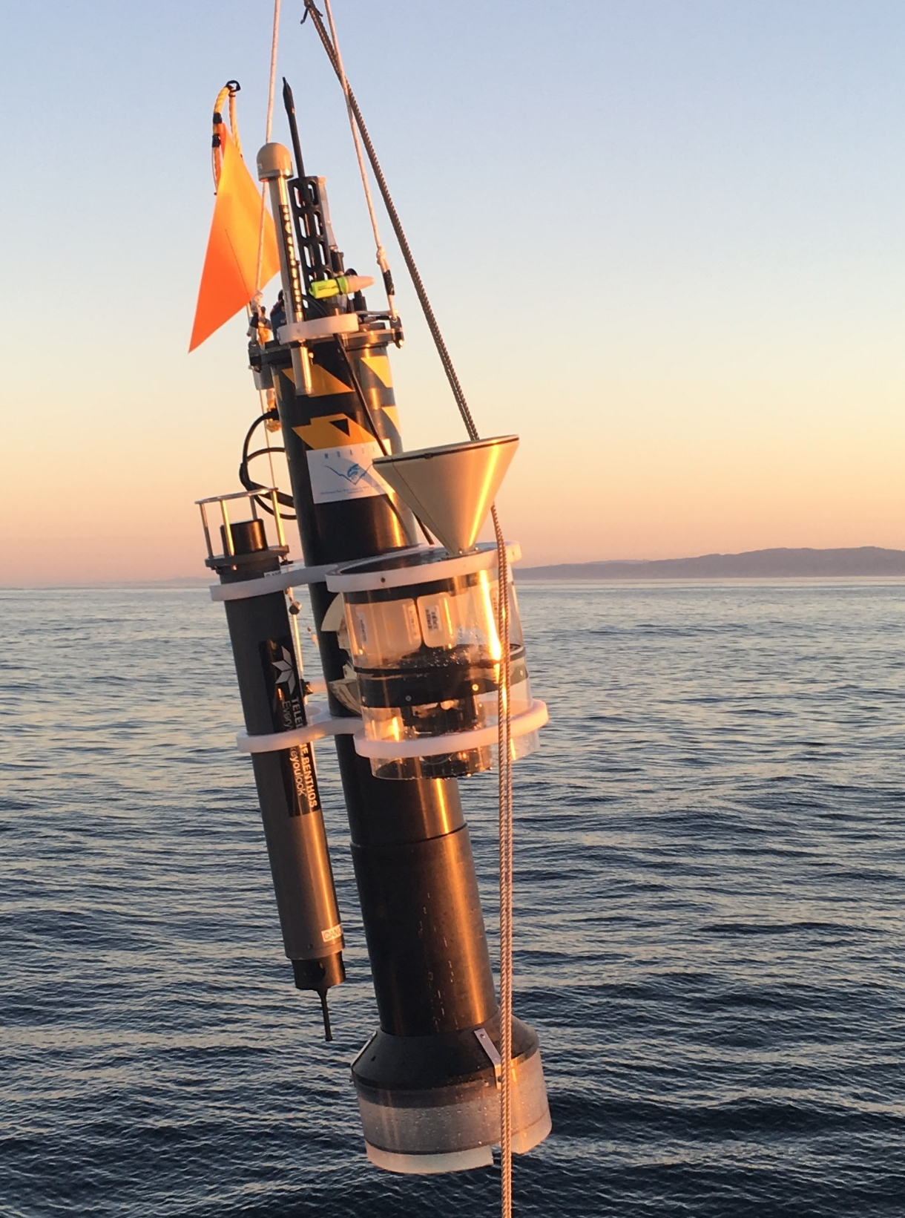
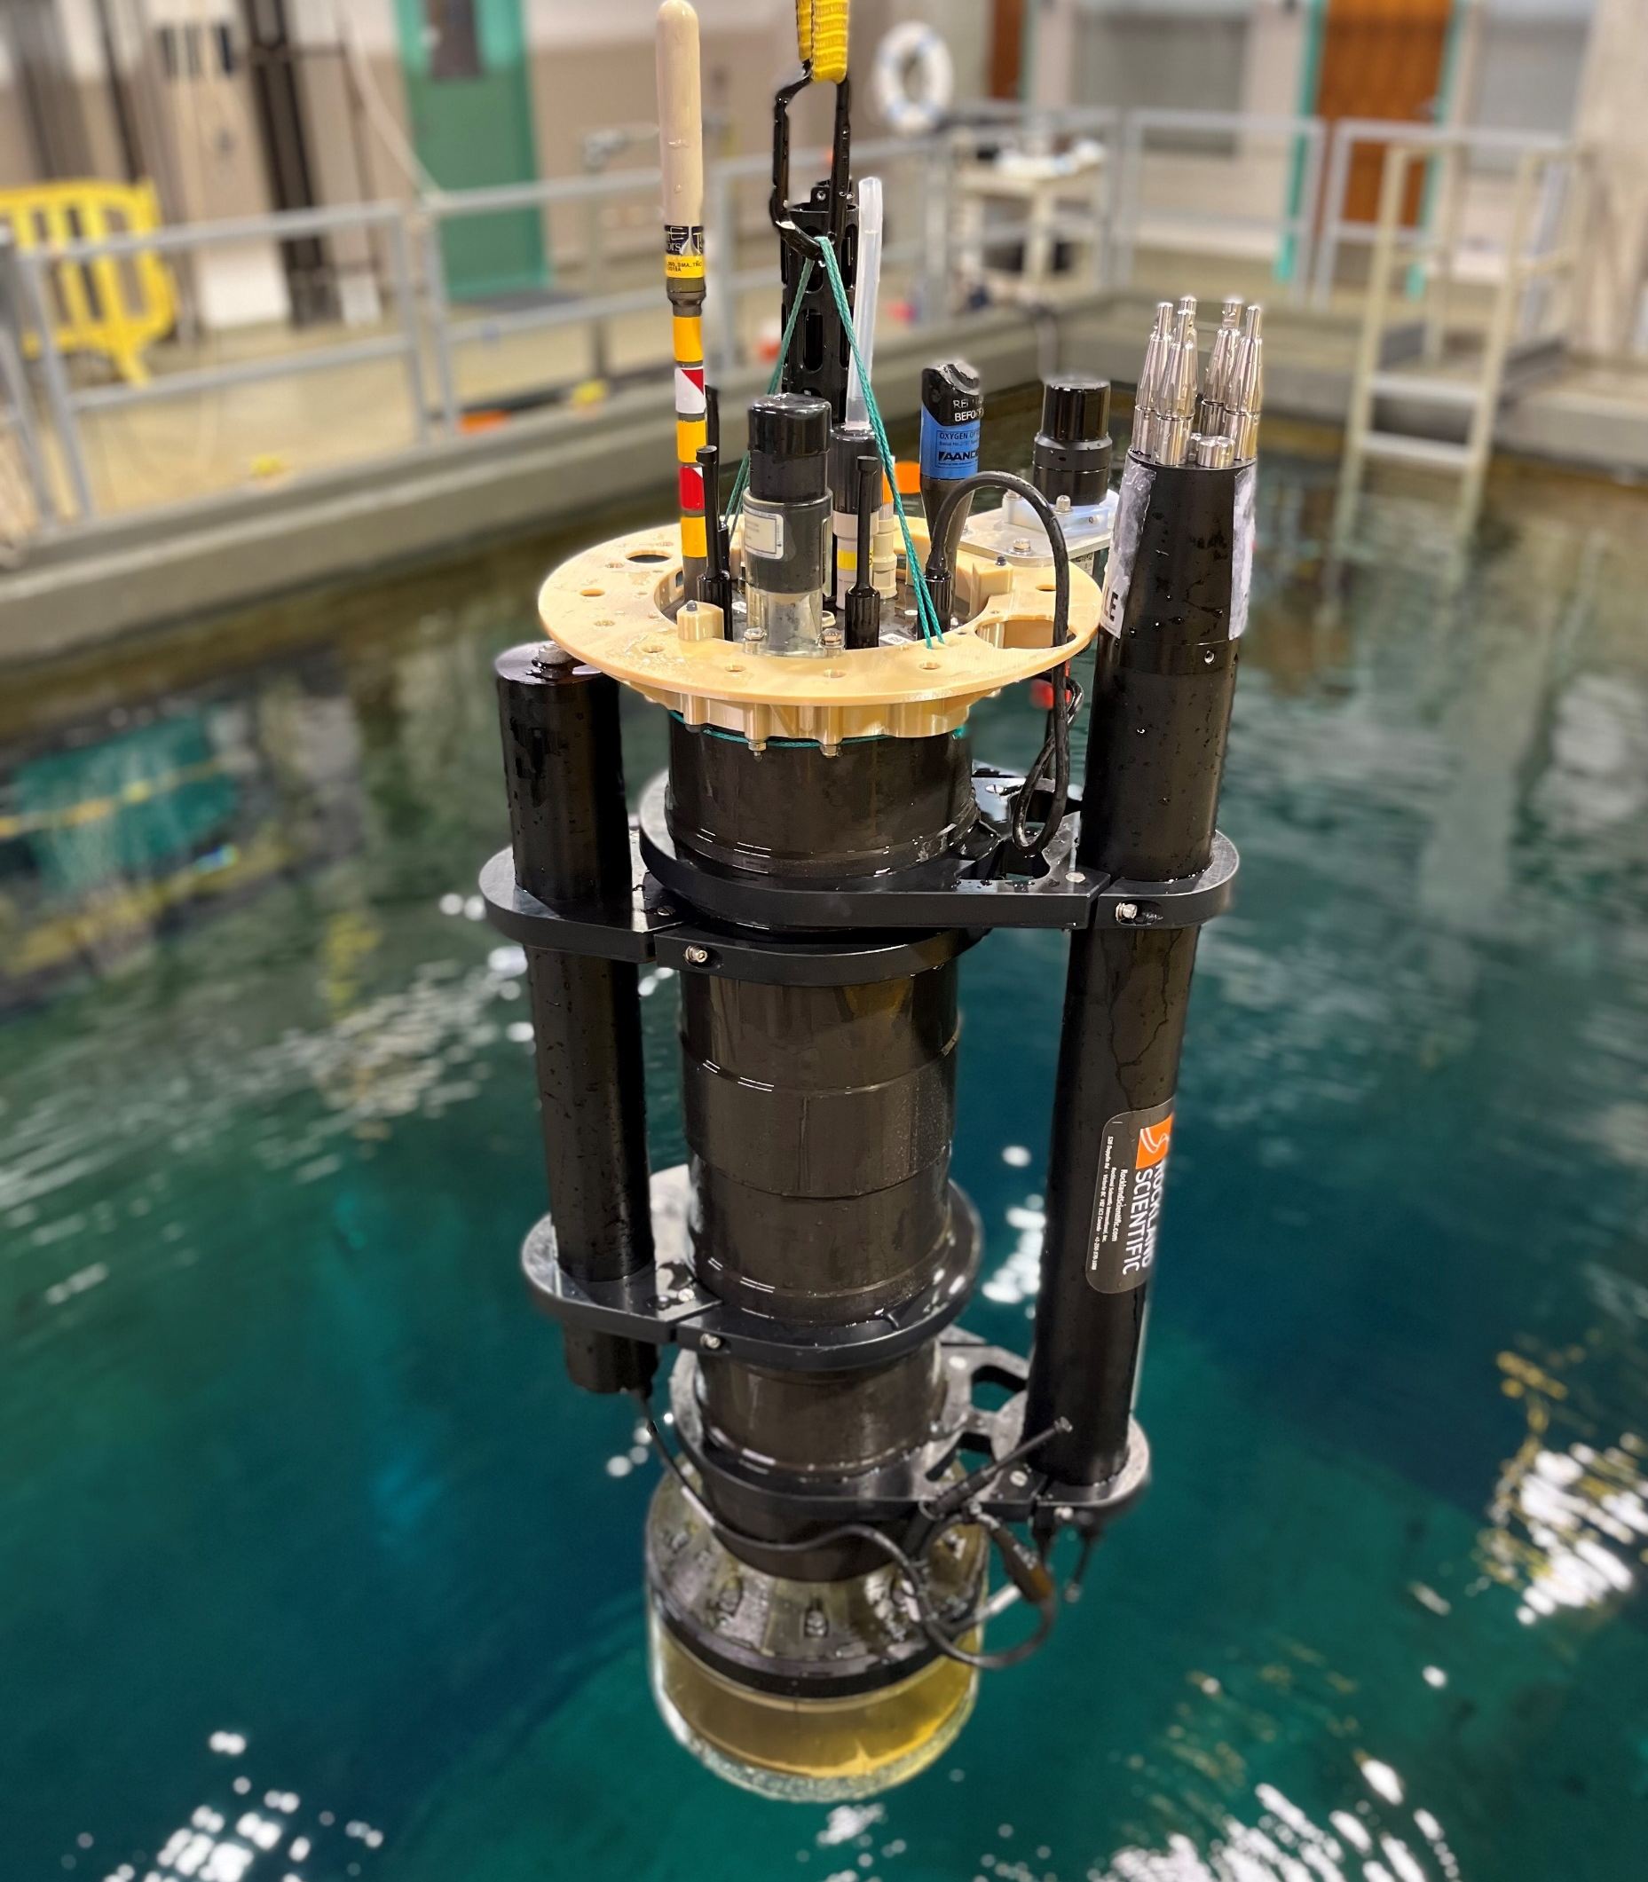
Strengths
CPF with sediment trap and acoustic modem
Full Argo-BGC instrument suite
  Data will get processed, QC’ed and made available through Argo-BGC data centers
  3 additional instrument channels
  Relatively straight forward to integrate new instruments
3.5 liters of volume change (ΔV/V 3-5X most profiling floats)
  Allows anchoring on the bottom
  Can profile through 0-35+ psu pycnocline (Arctic and river mouths)
  Excess buoyancy to deal with biofouling
  Minimizes ballasting headaches
  Allows for some sample retrieval
Closed loop buoyancy control
  Accurate platform velocity and depth control: important for working in shallow water
Mission life goal: 200 profiles spread over 1 year
CPF with RSI MIcroRider turbulence sensor and battery pack
Notes:
Evidence for integrating new instruments in the photos, Not a Ferrari, more like the 10 ton stakebed pickup
MicroRider is called out on the turbulent mixing EOV spec sheet
deltaV/V is the metric
Mission life may increase by a factor of 2

Slide 3
Current Work
  Increase mission life Add RUDICS satellite comms
  On-going MBARI science missions Robustify
Future Work
  Move CPF ecosystem outside MBARI
  Develop an economical, sustainable source for CPFs
    Commercial vendor? or “managed” open source community?
  A moored, winched, shallow water CPF
  Single point BGC instrument platform (no profiling)
  Robustify
One Vision of The Pot of Gold
  An array of robust CPFs in the California current
  Quality controlled data freely available at Argo-BGC data centers
  QC’ed data ingested by BGC models generating data products informing science based fisheries management (NOAA Future Seas)
Notes:
Robustification is an on-going process, particularly for tech developed at research institutes
Succesful community adoption requires an ecosystem of people, products and support, not just a chunk of hardware
Commercializing research equipment can be path to a dead end. Does anyone have a success story from the ocean community that isn’t driven by a DOD need?
Does anyone except me think the CPF can be open sourced?
I’m pleased to see that my pot of gold aligns with some DOOS goals

Slide 4
Is the CPF Cheap and/or Deep?
Deep?
  The current science target is not deep <350 meters
  Only requirement to go deeper is a 2000 meter pressure housing
    Which is very practical
  Answer: No for now, yes if there’s a need
Cheap?
  Up-front capital costs
    ~$30k platform cost (with CTD) + ~$40K for BGC instrument suite
  Overall life cycle cost = cost per useful data point
    Arrays of profiling floats are arguably the lowest cost per data point for long-term, ecosystem scale observing systems
      Argo (3500+ floats world wide), SOCCOM (200 floats Southern Ocean, GO-BGC (500 floats world wide)
  Answer: Yes for certain applications relative to other current solutions
Notes:
Buoyancy engine and instruments are fully capable of 2000 meter operation
It’s useful to talk about both up front capital costs and overall life cycle costs
It’s the cost per useful data point , that matters not the capital cost of the technology, regardless of how cool it is.

Slide 5
Thanks
Gene Massion
Monterey Bay Aquarium Research Institute
May 10, 2023
magene@mbari.org
https://www.mbari.org/news/new-coastal-profiling-floats-for-diagnosing-ocean-health/

Slide 6

The MBARI Coastal Profiling Float
Target science missions: Low cost per data point, long term, ecosystem wide observing systems: Fisheries management, oxygen dead zones, HABs
BGC instrument suite: CTD, Dissolved Oxygen, pH, Nitrate, 4 channel optical radiometer, fluorescence and backscatter: Data files flow into Argo-BGC data centers
Optimized for use in coastal zones or anywhere in the upper 350 meters fresh or salt water
  3.5 liters of buoyance control, closed loop platform velocity and depth control, reserve buoyancy to handle some biofouling, capable of profiling through 0 to 35+ psu pycnocline
  Can anchor on the bottom to minimize drift between profiles
  Can park at a user specified depth to drift back into the target volume
IRIDIUM SBD and RUDICS communication to shore
Mission life goal: 200 profiles spread over 1 year
Future plans:
  “Guided” open source community or commercially available
  Winched version for shallow, no-marine mammal environments
  Non profiling, version for single point BGC measurements
  External (non-MBARI) collaborations

Slide 7
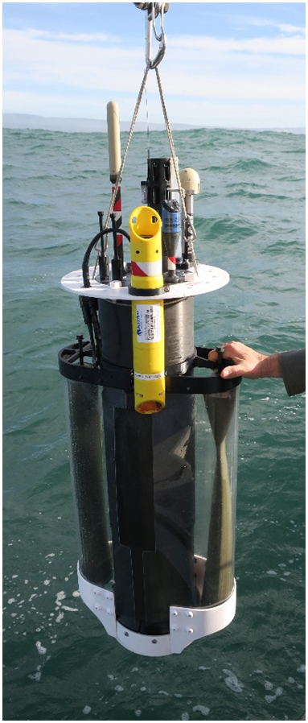
A New Profiling Float for Coastal and Upper Water Column Applications
Gene Massion, Kenneth S Johnson, Eric J Martin, Ed Mellinger, Paul McGill and Paul Coenen
Monterey Bay Aquarium Research Institute, Moss Landing, CA, United States
Ocean Sciences Meeting, 20 February 2020
Notes:
Thanks very much for the opportunity to talk about MBARI’s coastal profiling float project
Describe what this project is

Slide 8

The Initial Motivation
"the widespread pattern of low returns along the West Coast for two species of salmon indicates an environmental anomaly [low nutrient production] occurred in the California Current in 2005."
Notes:
The initial motivation for this project came from a conversations I had with Ken Johnson, the PI of MBARI’s chemical sensor group
He showed me this press release from NOAA marine fisheries from 2008 when only a third of the expected Salmon returned to their breeding streams during the 2007 season and suggested it was primarily due to low food production in 2005
The problem was pretty clear; managing fisheries is a complex task, and data is sparse, real time or near real time data is even less available.
I was hooked even before I knew that ensuring sustainable fisheries is an explicit goal of the David and Lucille Packard foundation, which funds MBARI, makes this an even more compelling challenge

Slide 9


More Motivation
“Further development of event-scale observing capacity (e.g., novel autonomous platforms) in all continental margin systems to better quantify impacts of episodic events on coastal carbon budgets”
A Science Plan for Carbon Cycle Research in North American Coastal Waters 2016, Ocean Carbon and Bio. Program and NA Carbon Program
Navigating the New Arctic
“Current Arctic observations are sparse and inadequate for enabling discovery or simulation … to assess their impacts on the broader Earth system”
Notes:
Additional motivation include the Coastal Carbon Synthesis Group’s community workshop report where the recommended more development of observing systems for continental margins.
Community workshops sponsored by Ocean Carbon and Biogeochemistry Program and North American Carbon Program
NSF also published their 10 big ideas, the areas that will drive their research agenda for the near future. One of the 10 big ideas is Navigating the New Arctic and again, they point out the lack of data limiting our understanding.
While the arctic was not one of our initial research topics, we think it is within the capability of the CPF.

Slide 10
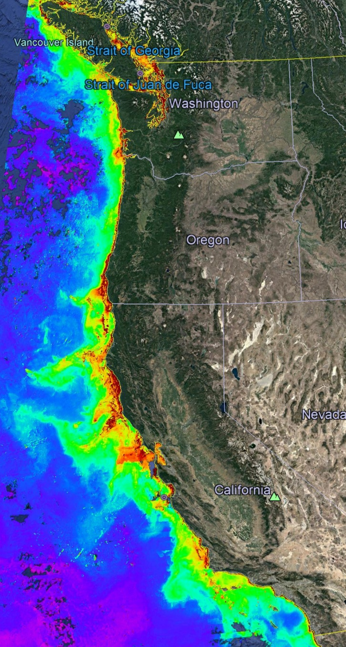
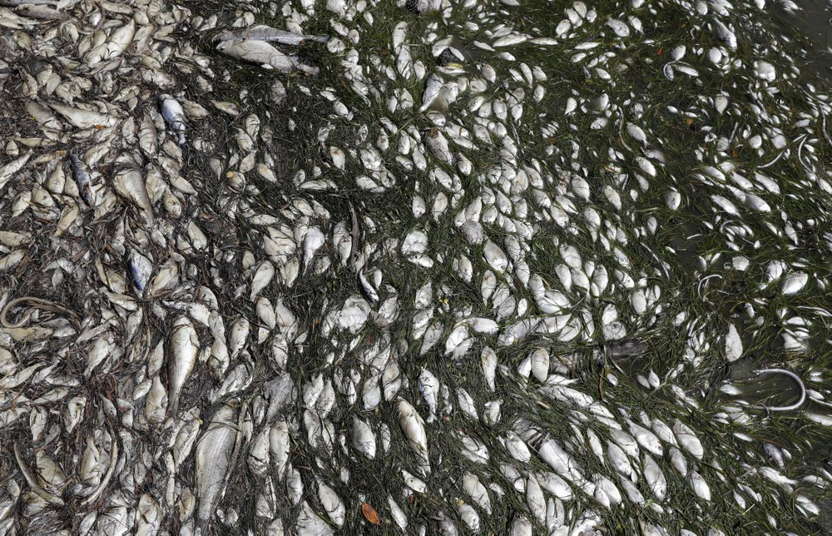
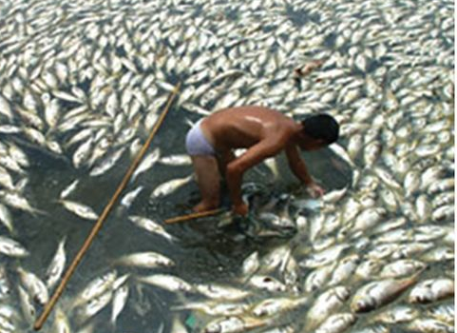
Science Requirements
MODIS Chlorophyll July 2019
A cost-effective, coastal ecosystem size observing system
Sensor suite: CTD, O₂, pH, Nitrate, FL/BB and Optical Radiation
Spatial Scale: coastal ecosystem, e.g., the west coast of North America
Time Scale: up to 4 profiles/day (or more)
100s of profiles spread over several years
Science targets: Fisheries, HABs, Oxygen Dead Zones, …
Devastating toxic algae bloom plagues Florida’s Gulf Coast
By TAMARA LUSH (AP), August 10, 2018
Declining oxygen in the global ocean and coastal waters
Denise Breitburg,et. al., Science 05 Jan 2018: Vol. 359, Issue 6371
Notes:
We started the project with the usual process of defining specific science needs or requirements, identifying risks or more PC, challenges and developing concepts.
We have a fairly detailed document describing these but I can summarize them pretty briefly here.

Slide 11
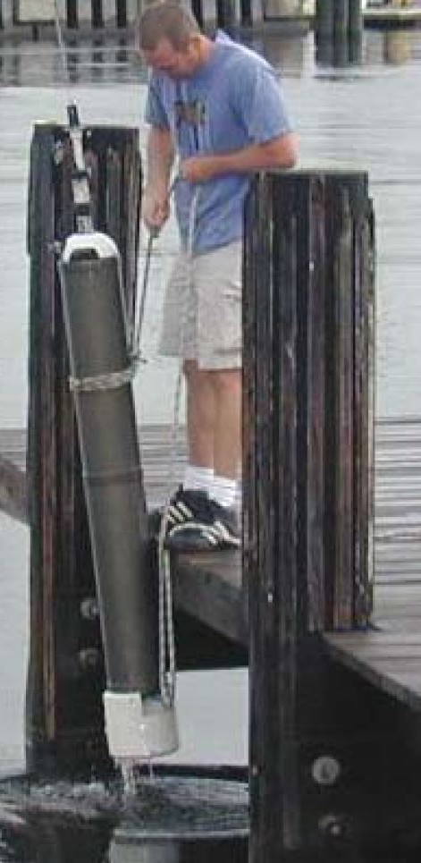
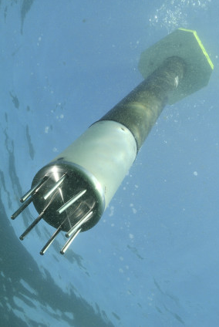
Risks and Relevant Examples
Risks:
  Working in shallow, coastal water
    Can’t drift on or off-shore
    Need accurate velocity and depth control
  Biofouling
Relevant Examples:
  Profiling Floats have proven to be very effective in deep water and open ocean applications, e.g. Argo and SOCCOM
  Coastal Floats: Univ of SF BSOP, NKE Arvor-C, MRV Alamo, etc.
USF BSOP
NKE Arvor-C
Notes:
If you’re working in 20 meters of water you don’t want to spend 15 of those meters reaching a stable profiling velocity
Profiling floats have been very effective platforms for the pH and Nitrates sensors we’ve developed in our lab but so far, only in deep water, open ocean applications
Profiling floats are kind of a base line for evaluating platform concepts and were the only approach that scaled up to the scales we were targeting at a cost that was consistent with reasonable funding assumptions
Say bottom station ocean profiler
https://www.researchgate.net/publication/4010558_Design_and_initial_results_of_a_bottom_stationing_ocean_profiler
Arvor-C FLOAT DIMENSIONS Overall length: 195cm with antenna Hull length: 140cm Hull diameter: 11cm Weight: 22kg
Talk about anchoring, fast profiling, numerical model

Slide 12


Current CPF Version 2.1 and 2.2
Depth range = 0 to 500 meters
Buoyancy engine ΔV/V = 3.5 liters / 40 liters = 9%
Science Payload: 9 sensor ports: 6 BGC sensors plus 3 available ports
Iridium SBD and RUDICS communications
BGC Instrument Suite
Electronics
Internal Oil Bladder
108 cm
Oil Pump
Batteries
External Oil Bladder
Notes:
Webb Apex Float = 1%, MRV S2-A Solo II = 3.4%, BSOP Modular = 3/82 = 3.7%, MRV Alamo = 4.2%
Talk about 2 versions: identical from the bottom end cap up

Slide 13

Science Data Products
Notes:
I used to work in the engineering department at MBARI, now I work in the chem sensor lab and one of the first lessons I learned was that our product was useful science data, and that a really well engineering platform isn’t of any value if it doesn’t produce useful science data. I don’t really understand this thinking but I do accept it, so we’ve been working on the shore side tools we need to effectively interpret the data the CPF acquires.
We can see a cold, low oxygen deep water mass roll up the shelf and presumably transport nutrients (we’ll know when we have the Nitrate sensor on.;

Slide 14



Float Navigation
Experiment: Park the CPF at various depths and compare track to ROMS nowcast and previous missions that anchored on the bottom after every profile
ROMS Predicted Trajectories at 1 m (red, 20 m purple, 30 m yellow
March 2017 Un-navigated, 5km Anchor on Bottom Track
2 km
July 2017 Navigated, Park at User Specified Depth Track
Notes:
This slide is pretty dense, I’ll try to unpack it for you.
I talked about the challenge of keeping the CPF in the coastal zone and not on the beach of off-shore.
We identified this risk at the beginning of the project and suggested we could mitigate this risk to some extent using operational, 3D numerical current models.
The ROMS model runs every day and give a 3 day 3D forecast of currents in the Monterey Bay.
So if the CPF was drifting west, in many coastal zones there would be a high probability there is a sub-surface current heading roughly east and we could park at that depth to move back toward the target volume. This is much like the way Hot air balloons navigate.
So, we ran an experiment, here’s the target area …
Need to run ROMS at higher resolution particularly given the bathymetry
Maybe crop the ROMS window and add a velocity vs depth plot.

Slide 15


Engineering Results
2 m Dead Band
Std Dev = 0.90 m
Notes:
Working in shallow water is a challenge as I mentioned earlier. If you’re working in 20 meters of water you don’t want to spend 15 of those meters getting to a stable vertical velocity
The zoomed inset is for getting off the surface which is harder due to wave action and the fact that we descend at 20 cm/sec and ascend at 10 cm/sec
Sampling is typically done during park, anchor and ascent but can be done on descent if desired.
The depth control has a dead band which in this case is set for +/1 meter.
Tuned for maximum stability and noise rejection and moderate performance
6 meters of overshoot

Slide 16

More Engineering Results
No Dead Band
Std Dev = 0.14 m
Notes:
Exact same control algorithm with no dead band.
After trying several other subsurface Lagrangian floats, the MBARI BOG built 2 for their twice a year field deployments
Ballast in 350 gram increments in the test tank
Control algorithms designed for maximum stability and noise rejection and minimal performance
Pick up truck of the sea

Slide 17

One More Engineering Results
CPF V1.1 with sediment trap and acoustic modem

Slide 18
Next Steps
  Run science missions with all 6 sensors
  Extend the mission duration
  Continue enhancing reliability
  Finish new rechargeable battery pack with 3X higher energy per cm³
  Replace/supplement ROMS model current forecasts with small, low power current sensor e.g. tactical grade MEMS Inertial Measurement Unit
  Make our data freely available on MBARI FloatViz
  Make the CPF tech. available to the community
Notes:
Use action verbs

Slide 19

Acknowledgements
The CPF Village also includes: Jerry Allen, Larry Bird, Luke Coletti, Jared Figurski, Tom Marion, Jim Montgomery, Mike Parker, Josh Plant, Erich Rienecker, Jose Rosal, Aaron Schnittger, Ray Thompson and Mark Tynes
This work has been generously supported by the David and Lucille Packard Foundation
$6 Million of CPFs
Thank you
magene@mbari.org

Slide 20
NOAA scientists are reviewing unusual environmental conditions in the Pacific Ocean as the likely culprit for the dramatically low returns of Chinook and coho salmon to rivers and streams along the West Coast of the United States in 2007.
Researchers from NOAA's Northwest and Southwest Fisheries Science Centers are comparing data on the low food production of the California Current in 2005 that occurred when this year's returning salmon would have been entering the ocean from their natal streams to feed and grow.
The cold waters of the California Current flow southward from the northern Pacific along the West Coast and are associated with upwelling, an ocean condition caused by winds that bring nutrients to the ocean's surface and is the main source of nourishment for the ocean's food web. In 2005 a southward shift in the jet stream, delayed favorable winds and upwelling for the California Current, which normally begins in spring. The winds instead arrived in mid-July, causing high surface water temperatures and very low nutrient production within the near-shore marine ecosystem.
"We are not dismissing other potential causes for this year's low salmon returns," said Usha Varanasi, NOAA Fisheries Service Science Center Director for the Northwest Region. "But the widespread pattern of low returns along the West Coast for two species of salmon indicates an environmental anomaly occurred in the California Current in 2005."
New data released by the Pacific Fisheries Management Council indicate the 2007 returns of fall Chinook salmon to the Sacramento River in California's Central Valley were approximately 33 percent of what fishery biologists expected. Projections for 2008 are substantially lower than last year's estimate.
Coho salmon returning to spawning streams in California and Oregon are also considerably lower than predicted. A preliminary analysis found an average 27 percent of the parental stock returning in 12 streams monitored in California. Even though coho returns appear to improve along the coast from south to north, Oregon Coast coho salmon had less than 30 percent of their parental stock return.
Coho salmon are listed as either endangered or threatened under the Endangered Species Act in the Central/Northern California and Southern Oregon watersheds.

Slide 21
Title
Good afternoon, I appreciate this opportunity to talk about our Coastal Profiling Float project
Initial Motivation
This project started during a conversation I had with Ken Johnson. Ken runs the chemical sensor lab at MBARI and we had just finished a couple of projects that went pretty well. I asked Ken what else he had on his list of future projects and he showed me this press release from NOAA Marine Fisheries. It was released in 2008 and it attributes the low return of Salmon along the West Coast in 2007 to a lack of nutrients in 2005. You don’t have to read very far between the lines to realize that fisheries managers have an exceptionally difficult job to do and very little data, virtually none in real time, to do it with.
More Motivation
Along the way there was more motivation for this project. The US Ocean Carbon and Biogeochemisty Program and the North American Carbon Program held a series of community workshops and released “A Science Plan for Carbon Cycle Research in North American Coastal Waters” A key recommendation of this plan is further development of autonomous platforms for use in continental margins. This is the target for the CPF.
NSF also released their 10 Big Ideas: 10 research topics that will be a focus of their efforts for the near future. One of the Big Ideas is “Navigating the New Arctic” where they point out that observations are “sparse and inadequate”. While the arctic is not an immediate target for our work, it does seem within the capabilities of the CPF.
Science Requirements
We started the project with the usual process of defining the specific science requirements, identifying risks and developing initial concepts. It is a fairly detailed document but I can summarize the important points here …

Slide 22
Risks and relevant examples
The most important risks we identified were first “Working in Shallow Water’. There are a couple of issues here. Most obvious is winding up on the beach or way off shore. So we need a way to “navigate” the floats that doesn’t take any power, doesn’t take up much volume and will continue working without failure for several years. Next, biofouling is always a problem when working in shallow water and I’ll talk about our mitigation strategies for both these issues in a minute.
My standard concept development process starts with looking around to see what good ideas I can beg, borrow or steal. There a plenty of very effective profiling floats to learn from. The Argo array and the SOCCOM project are great examples of using these profiling floats to provide a cost effective observing system at global and regional scales for deep water, open ocean applications. There are even several examples of profiling floats for coastal application but we thought there was an opportunity here to help advance this technology for coastal applications.
Current CPF
Here’s what the CPF looks like today. It has the usual bits and pieces that any profiler has. An external expandable oil bladder. An oil pump, batteries, an internal oil reservoir, the electronics need to run the whole mess and the science sensor suite. We have 2 versions, one with the external bladder mounted concentrically with the pressure housing and a second version with the external bladder mounted coaxially underneath the pressure housing. Earlier, I mentioned the challenge of keeping the floats from winding up on the beach. One of our strategies for minimizing this risk is anchoring on the bottom between profiles. The concentric design minimizes the horizontal surface areas that could serve as places that might accumulate mud every time we anchor and interferes with the expansion and contraction of the external bladder. But this design is more awkward to deploy and recover. The coaxial design is pretty robust but has the potential of building up mud in the protective cover. Everything is identical in the 2 versions above the lower end cap and while we haven’t done it, it is theoretically possible to swap between the versions. We will be fielding both versions to evaluate the relative pros and cons.

Slide 23
The depth range is down to 500 meters. One of the ways we’ve optimized the CPF for coastal applications is the buoyancy engine. We knew we wanted to anchor on the bottom with some modest negative buoyancy, we knew we wanted to descend fast to minimize drift while we were in the water column and we knew we weren’t going to solve the biofouling issue on this project so we needed extra buoyancy to counteract the weight of the crud fouling the float, at least until the fouling made the sensors ineffective. On way to evaluate the capability of a buoyancy engine is to look at its ratio of delta V to V. Delta V is the amount the float can change it volume, basically the amount of oil we can pump from the internal bladder to the external bladder. V is the overall volume of the float. In our case, we have a deltaV / V of about 9%. For reference, if you want to work in an environment that has fresh water at the surface and typical density water at depth, you need a deltaV/V of 2.5% just to make up for the density gradient in the water column. For further reference, the profiling floats I’m aware of have deltaV/Vs of between 1 and 4%.
We knew we wanted to support the standard BGC sensor suite plus a few other, yet to be determined sensors. The current design supports the 6 BGC sensors and provides for at least 3 more. And we Iridium communications both the standard SBD, which is like 1900 byte text message, and RUDICS which is like a really slow, old school, dial up, 2400 baud internet connection.
Science Data Products
I used to work in the Engineering department at MBARI and now I work in the chemical sensor lab. One of the lessons I learned very soon after this move and continue to learn on a regular basis is that you could have the best engineered platform in the world but if you aren’t generating high quality science data you’re still failing. So we’ve been working on the tools we need to turn the files uploaded by the CPF into standard data products. Here’s a few plots from one of our missions; temperature, oxygen, chlorophyll and backscatter. I’m going to play my engineer card and not try to explain the science here but even to my unscientific engineer’s eye, you can see a blob of cold, low oxygen water. This data is from an early version of the CPF that didn’t have the full suite of sensors. The CPFs we’ll be fielding this year have the full suite of instruments and the science story should get more interesting.

Slide 24
Float Navigation
This slide is pretty dense, I’ll try to unpack it for you. I talked about how we were going to keep the floats in the coastal zone and not in the beach without using any power on the platform. One strategy we have is to make use of the 3D current models that are run operationally, that is they get run every day and the data is available to the community. The idea is to find a current somewhere in the water column that is somewhat opposite to the overall drift of the float. UCLA and Remote Sensing Solutions run the Regional Ocean Modeling System, ROMS, which covers the California Coast. It runs every day and make a 3 day forecast. We ran an experiment where instead or our usual strategy of anchoring on the bottom between profiles, we parked at a couple of different depth and compared the track to another mission where we did anchor between profiles. You can see the big picture in the inset. Here’s the northern part of the Monterey Bay, Santa Cruz to the north, MBARI is here in the middle of the Bay and here’s where we have done most of our testing. Here’s a blowup of the 2 missions. The un-navigated, anchoring mission has a pretty clear east west track. The so called navigated track has an overall south north trend but you can see 3 parts of the track with east/west and west/east movement which suggest the possibility of zigging west for a few profiles and then finding a depth that allows us to zig back east. This is the ROMS model output for the same time as the navigated mission. It has a very nice drop a drifter feature that is actually used in search and rescue missions where you can drop a drifter at a depth or your choosing and ROMS will predict the track based on its current forecast. There isn’t an obvious correlation between the ROMS forecast and the observed track. This is very likely due to the fact that they’re running the operational ROMS model with a 3 km spatial resolution for practical reasons which isn’t accurate enough for our needs. The ROMS model can run at higher resolution and we’ve talked to Yi Chao about doing this. We are a long way from solving this problem but our initial experiment provides a slim glimmer of hope for the future.

Slide 25
Engineering Results
There are some engineering results that I hope are worth discussing. This is a typical depth profile. We start at the surface, descend at 20 cm/second hold depth in the water column and ascend at 20 cm/second. I mentioned the challenge of working in shallow water. One potential issue is if you’re working in 20 meters of water you don’t want to spend 15 of those meters trying to reach a stable profiling velocity. The inset is a zoom the first 10 meters and you can see that we acquire the desired profiling velocity in about the first 3 meters. You can also see a fair amount of oscillation while holding depth. Holding depth is expensive in terms of battery usage. Our depth control algorithm has a dead band that we can set where we don’t run the buoyancy engine as a way to conserve energy. In this case we set the dead band to +/- 1 meter and, not surprisingly, the standard deviation while holding depth is about 0.9 meters.
I should point out that when you design a control system, you have to balance performance and stability. Both our depth and velocity control algorithms are designed to maximize stability and noise rejection but we’re still getting pretty decent performance.
More engineering results
We also did a profile with no dead band, the buoyancy engine was running full time. In this case we were able to hold depth with a standard deviation of 14 cm.
Even more engineering results
There’s a couple of points to be made here. First, MBARI’s biological oceanography group built a couple of the earlier versions of the CPF for their CANON missions. Here you can see the BOG team deploying one with more stuff bolted the CPF then there is CPF. There’s a sediment trap, an acoustic modem and room for a second sediment trap around the back. I think it’s fair to say the CPF is much more of a pick-up truck of the sea and not so much a formula 1 race car.
The second and more important point is that it is demonstrably possible to pull off pink sea boots and a pink hard hat at sea as long as you have the right attitude as Marguerite so capably proves here.

