Slide 1
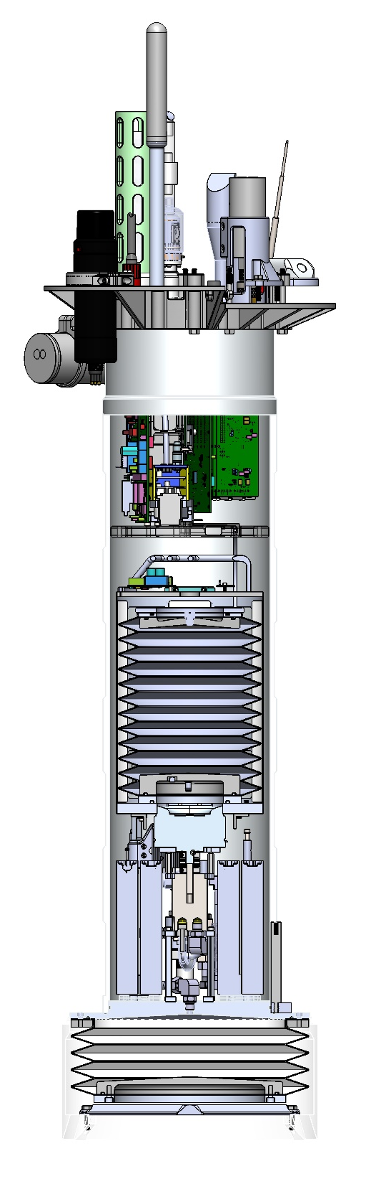
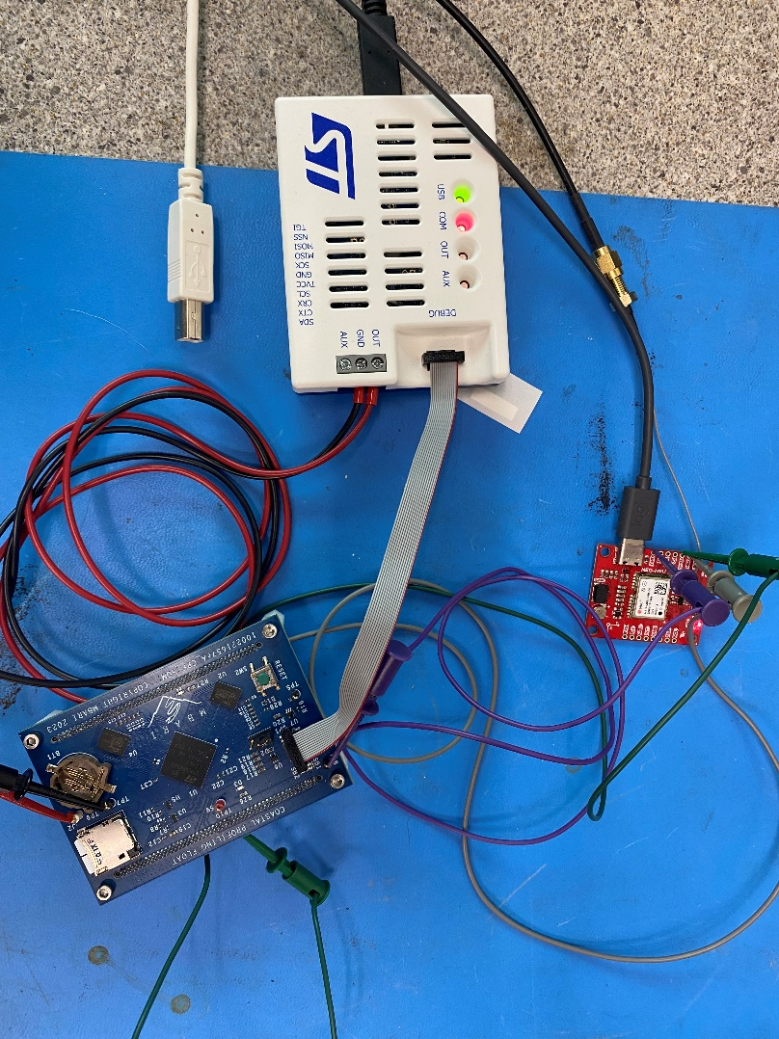
Coastal Profiling Float (CPF) C/C++ Software Review
CTD
Oxygen
pH
Nitrate
OCR
FL/BB
Gene Massion
2023 Dec 18
Elex
Inner Oil Reservoir
0.9 meters (35 inches)
Hydraulic Pump
Batteries
Outer Oil Reservoir

Slide 2
Background
We have a working CPF running C# code that was originally written by me and fixed up to a great extent by Eric Martin
  10,000+ lines of code
  It runs on an obsolete 400 MHz ARM9 SoM board from GHI Electronics
    128 MB SDRAM and 4 MB Flash
    It has become a significant hit on the energy budget
  Much of what I wrote sucks
James McClure and I designed a new SOM using a STM32H7A3 MCU
  10X UARTs/USARTS + 1 low power UART, 4X I2C, 6X SPI, 14 timers + 3 lower power timers, 1.4 MB RAM, 2 MB Flash , 6 low power states
  uSD card, 8 MB HyperRAM, 64 MB HyperFlash external on the SOM
  DC/DC converters, RS232 drivers, external device power management and everything else will go on a motherboard currently being designed
In my spare time, I’m re-writing the C# code in C/C++ trying to implement everything I’ve learned

Slide 3
Goals for this meeting
Review as much of what I’ve done as we can do in an hour (or so)
  From the top down
  With a few dives into the details
Point out areas that can be improved, need improvement or straight up just suck
I’m particularly interested in whether my state machine implementation and my peripheral driver architecture make sense
Question: Is my (or a better) object oriented approach worth the hassle?
We don’t need to fix anything in this hour, just point at ways that might fix issues we identify

Slide 4
Self-inflicted Design Guidelines
Make sure the code is reasonably easy to understand by a competent but not necessarily expert C/C++ developer
The code should be non-blocking anywhere response time matters
Extreme encapsulation is probably worth the effort
The code should be loosely coupled, i.e., there shouldn’t be a long list of #include files
  Except for the BSP and the state machine
I’m using the STM provided low level drivers, not their higher level HAL library
Minimize the number of files a developer needs to look at to understand a specific thing e.g., serial port, buoyancy engine, state
Do as little as possible in the IRQs
Design for unit testing
And others …

Slide 5
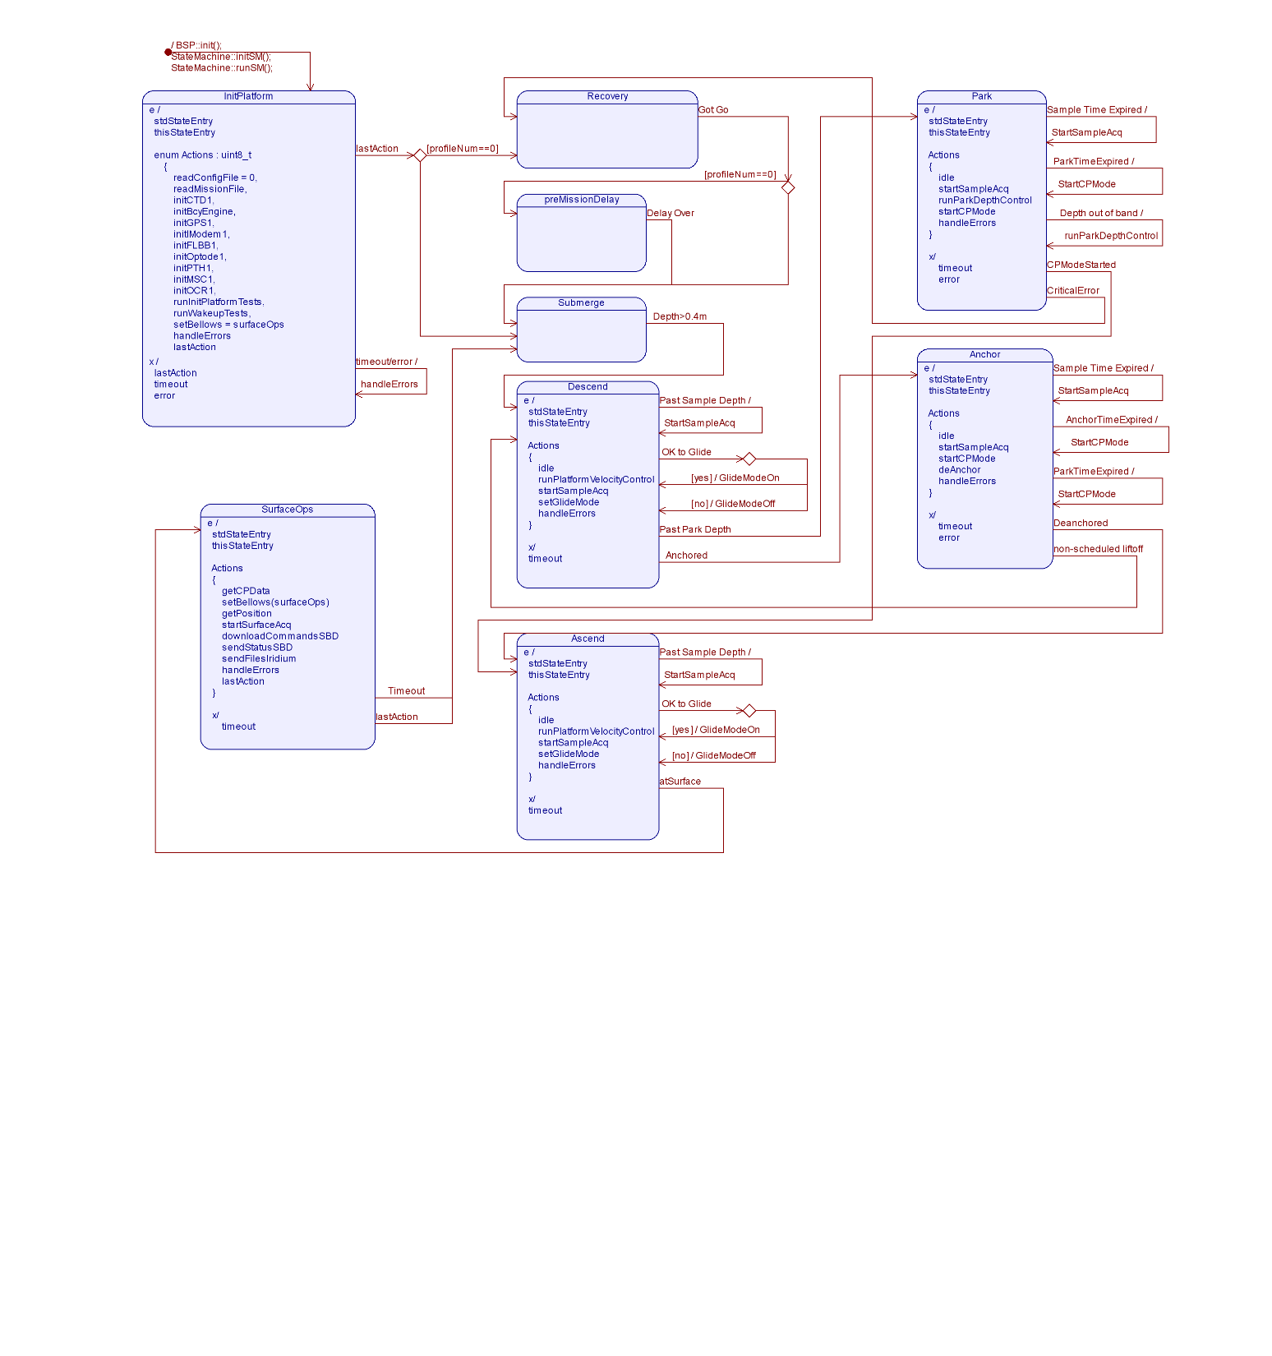
CPF State Diagram
Notes:
All states have a timeout event that transitions to the next state
All states have a transition to their internal handleError action on error detection
All states can transition to the recovery state on a critical error

Slide 6
State Machine Implementation
Note:
  I use STM32CubeMX to generate all the startup and peripheral initialization code
  I really like the Visual GDB development environment and #include the CubeMX files in the VisualGDB solution
  I have a VGDB Tiny Embedded Test Framework project as part of the overall CPF Visual Studio Solution
  I have the Clang static analyzer turned on
  I just enabled a trial version of ReSharper C++ OMG!
  I should turn on all the compiler and linker warnings
See Visual Studio project StateBase.hpp
See Visual Studio project StateMachine.cpp
See Visual Studio project InitPlatform.cpp

Slide 7
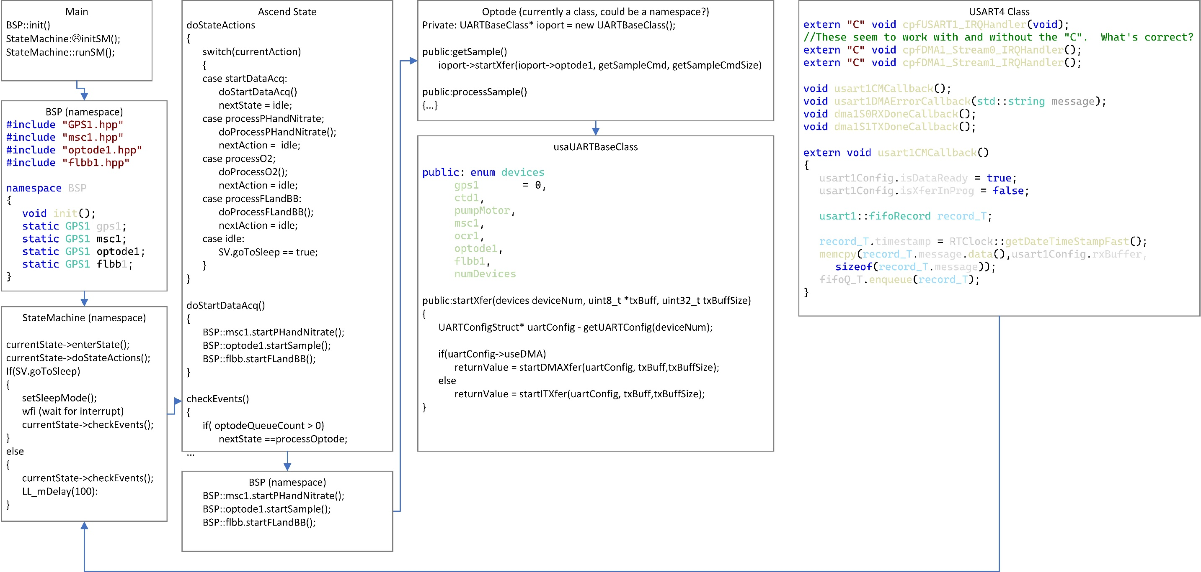
Peripheral sequence/class/flow diagram
Questions:
Is this too much encapsulation?
Are namespaces interrupt safe?
Are multiple copies of functions that don’t need to be copied being generated?
Mutexes?

Slide 8
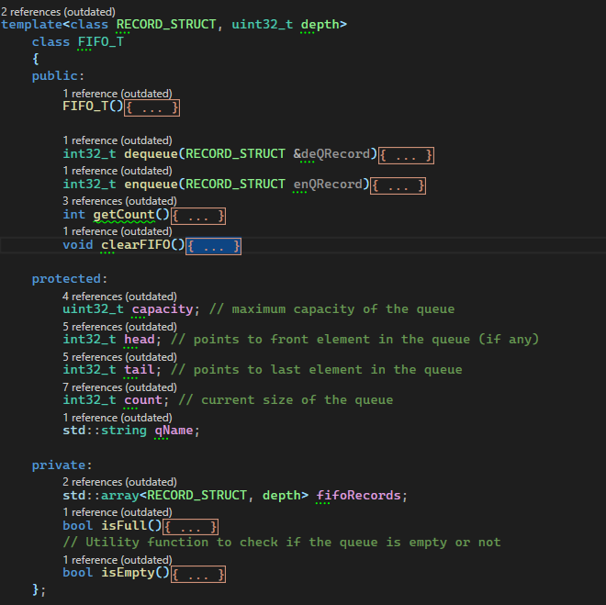
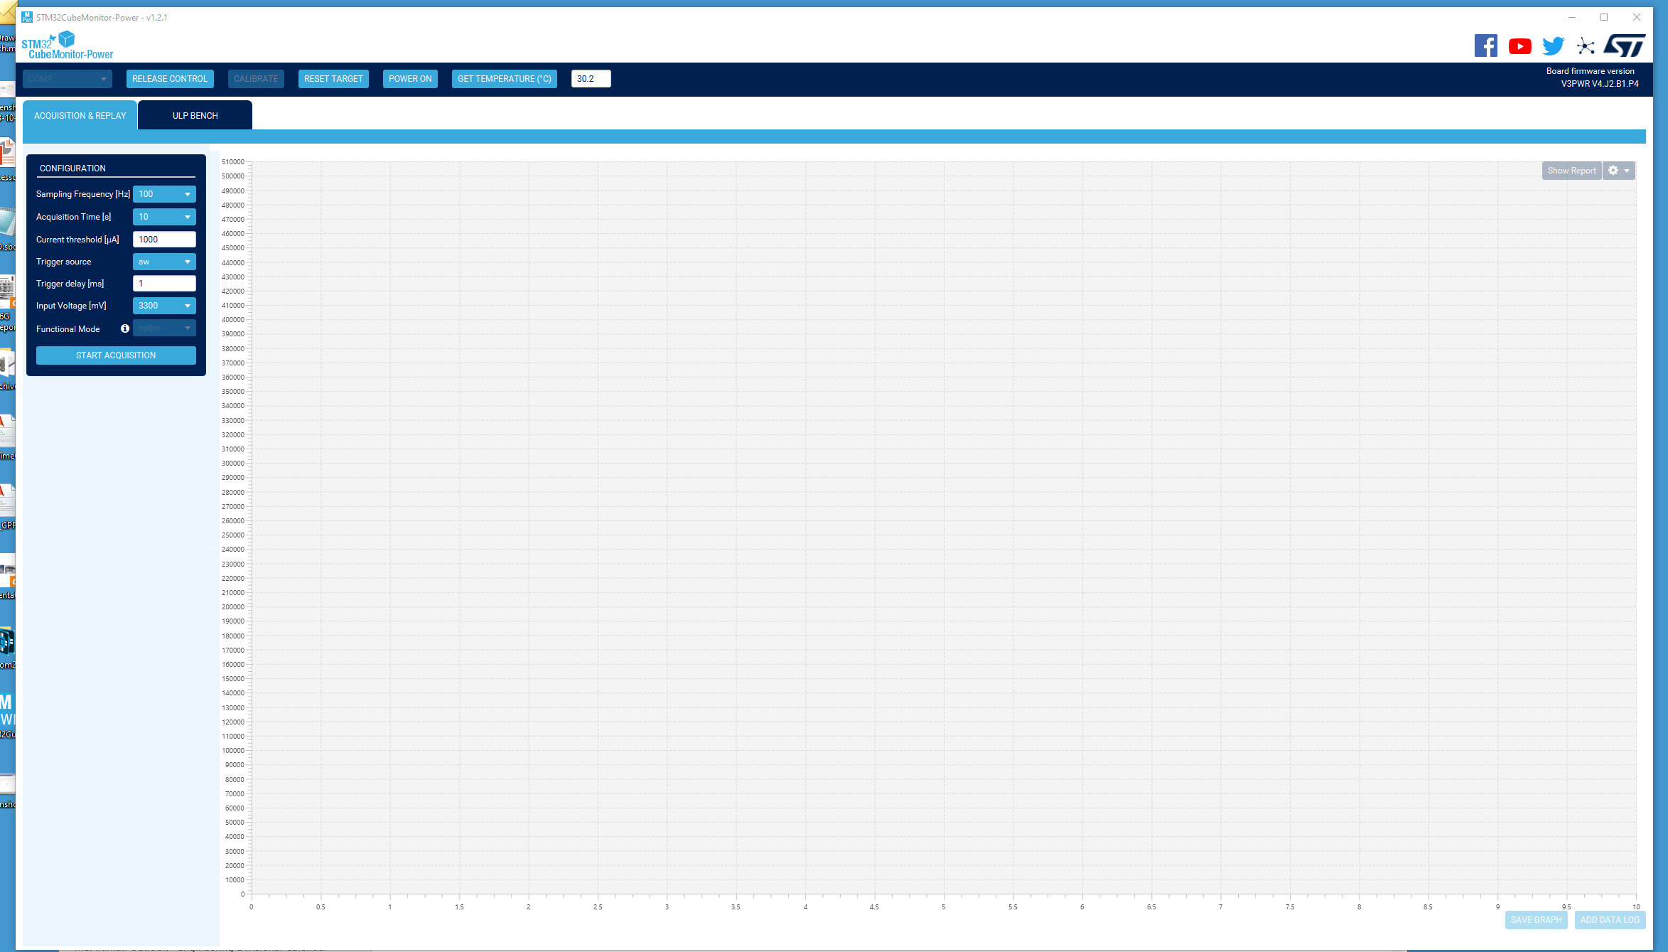
FIFO Queue Class with templated record
Debugger with power monitoring

Slide 9
Next steps:
Implements suggestions from this meeting
Figure out how to get functions from the CPF app into the test framework so I can write more and better unit tests
Implement the state machine sleep function
Implement the recovery state standby function
Write an I2C driver hopefully similar to the current UART driver
Finish coding all the states
Finish coding all the devices
Get the external memory working

