Slide 1
Directions
Answer the questions on the following slides with this guidance:
limit text to bullets that are easy to read (i.e., use large font)
be concise
assume you're audience is the "informed general public”
Please do not add formatting or background to slides.
Additional details can be added in the notes section, if needed.

Slide 2
901206 - Coastal Profiling Float Transition to Science Applications
- Ocean observing systems that provide comprehensive, quality controlled data across an ecosystem and sustainable for 10s of years are almost non-existent
-The Argo array of deep-water profiling floats is arguably the only one
- Many planning efforts highlight the need for data to support fishery management, ocean hypoxia, ocean acidification and a range of other societally relevant issues
- Example: Daily to Decadal Ecological Forecasting along North American Coastlines Workshop
- MBARI is developing a profiling float optimized for the coastal zone that leverages our experience in biogeochemical sensors and profiling floats
-Plans for 2023
- Continue running MBARI science missions
- Scale up our CPF observing system to meet NOAA agency needs

Slide 3
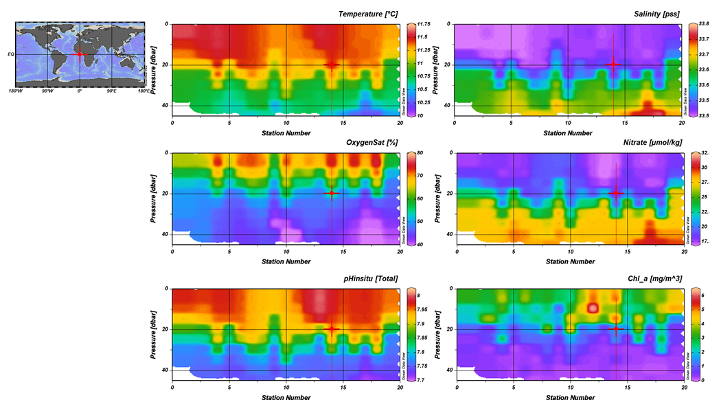
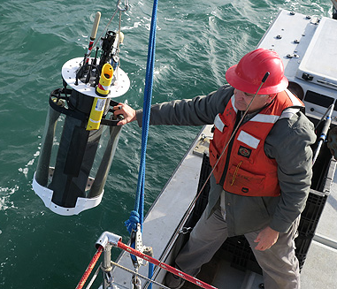
901206 - Coastal Profiling Float Transition to Science Applications

