Slide 1
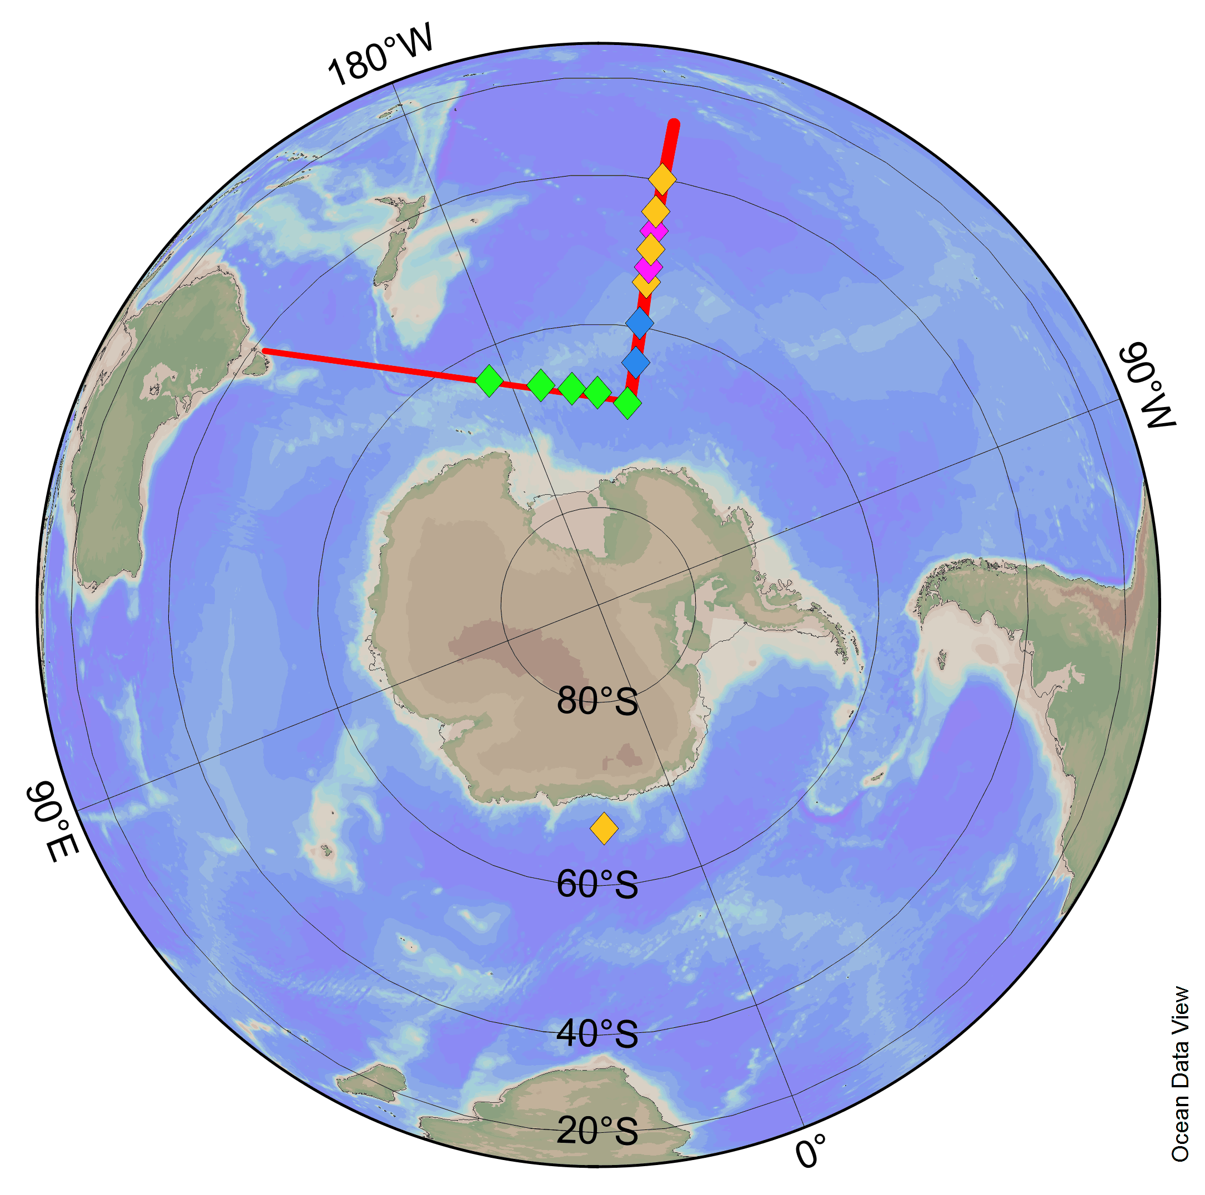

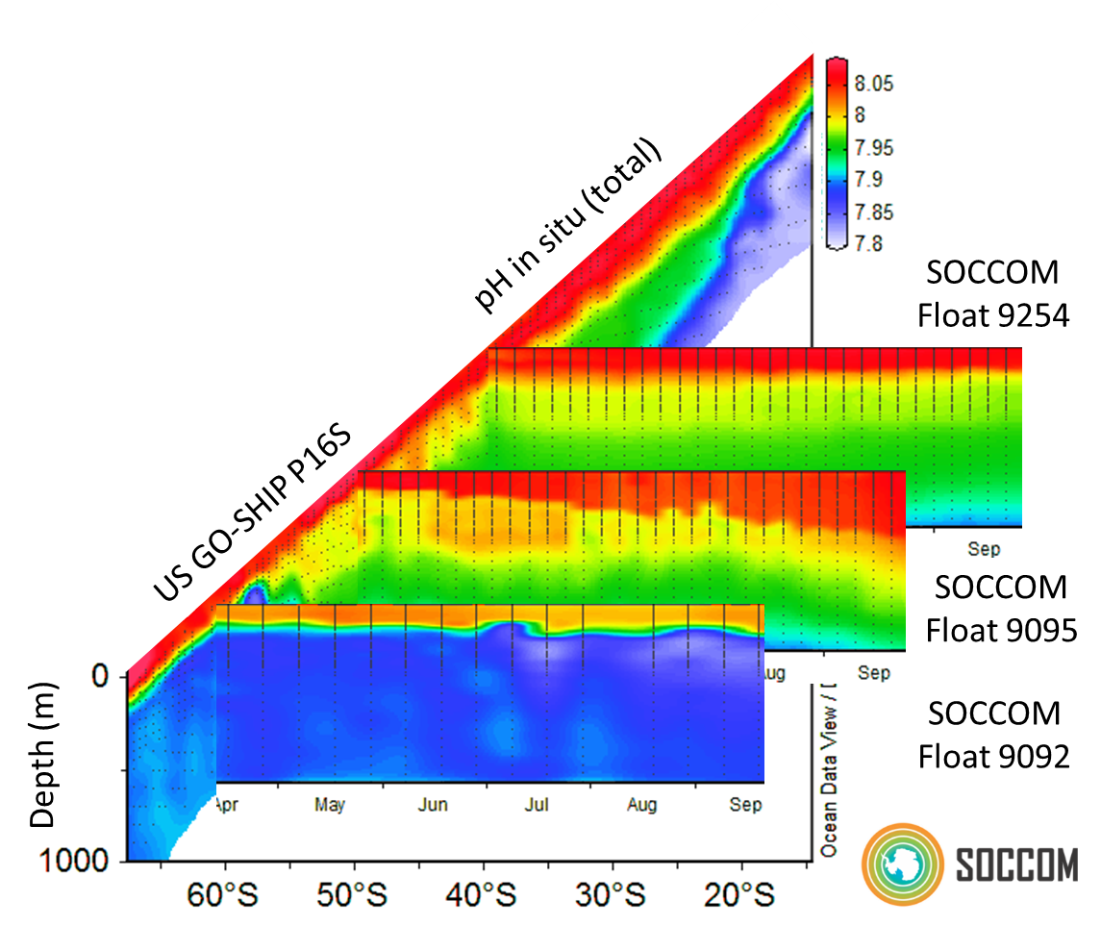
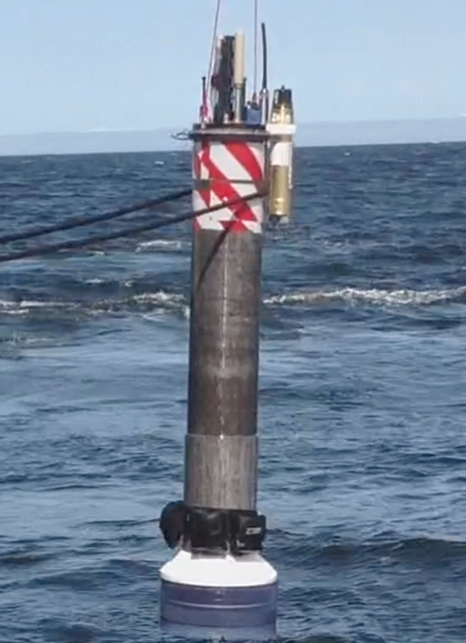
17° S, 150 ° W
68° S
150 ° W
Apr Jun Aug
MBARI chemical sensors now monitoring the Southern Ocean.
MBARI Coastal Float is transitioning our open ocean technology to nearshore ecosystems.

