Slide 1
A New Profiling Float for Coastal and Upper Water Column Applications
Gene Massion, Kenneth S Johnson, Eric J Martin, Ed Mellinger, Paul McGill and Paul Coenen
Monterey Bay Aquarium Research Institute, Moss Landing, CA, United States
Ocean Sciences Meeting, 20 February 2020

Slide 2

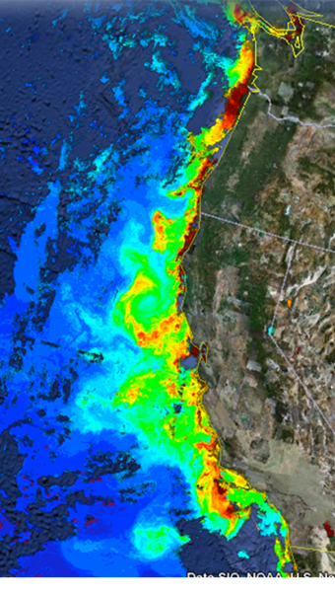
The Science Motivation
“Key recommendations … Further development of event-scale observing capacity (e.g., novel autonomous platforms) in all continental margin systems to better quantify impacts of episodic events on coastal carbon budgets”
NOAA National Marine Fisheries Service. "Unfavorable Ocean Conditions Likely Cause Of Low 2007 Salmon Returns Along West Coast." ScienceDaily. ScienceDaily, 4 March 2008.
Benway, et. al. 2016. A Science Plan for Carbon Cycle Research in North American Coastal Waters. Report of the Coastal CARbon Synthesis (CCARS) community workshop, Ocean Carbon and Biogeochemistry Program and North American Carbon Program
MODIS Chlorophyll June 28, 2011 http://podaac-tools.jpl.nasa.gov/soto/

Slide 3
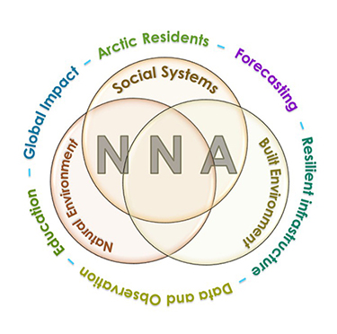
More Motivation
Navigating the New Arctic
“Current Arctic observations are sparse and inadequate for enabling discovery or simulation of the processes underlying Arctic system change or to assess their environmental and economic impacts on the broader Earth system”

Slide 4
Science Needs
A cost-effective platform that can carry an appropriate instrument suite at an appropriate space and time scale in a coastal ecosystem for 100s of profiles spread over several years
  Spatial Scale: the west coast of North America
  Temporal Scale: up to 4 profiles/day (or more)
  BGC instrument suite: CTD, O₂, pH, Nitrate, FL/BB and Optical Radiation
  Science targets: Fisheries management, oxygen dead zones, HABs …

Slide 5
Risks and a Relevant Example
Risks:
  Keeping the platform in the target measurement volume and off the beach
  Working in shallow water
  Biofouling
Relevant Example:
  Profiling Floats have proven to be very effective platforms at many scales up to global scales in deep water, e.g. Argo and SOCCOM

Slide 6
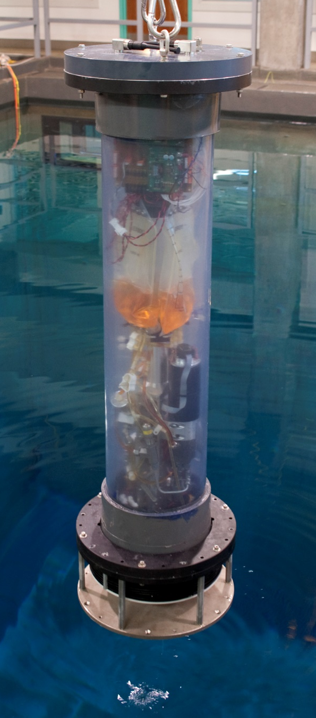
CPF Version 0.1
Depth range: MBARI 10 m deep test tank
Buoyancy engine ΔV/V = 3 liters / 50 liters = 7%
  Webb Apex Float = 1%, MRV S2-A Solo II = 3.4%
  “Target” environment = 1000 kg/m³ / 1025 kg/m³ = 2.5%
  Depth and velocity control suitable for shallow water
CTD and Optode only
Ability to anchor, and more importantly de-anchor, on the test tank floor
Notes:
Lot to learn with a quick prototype

Slide 7


CPF Version 2.0
Depth range: 0 to 500 meters
Improved buoyancy engine ΔV/V = 3.5 liters / 40 liters = 9%
  2 external bellows options: coaxial and concentric
Support for BGC 6 instrument suite plus 3 more
No obvious issues with anchoring, de-anchor, controlling velocity or depth

Slide 8
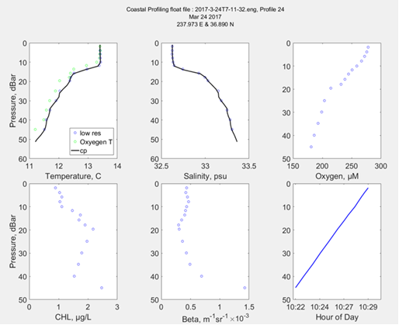
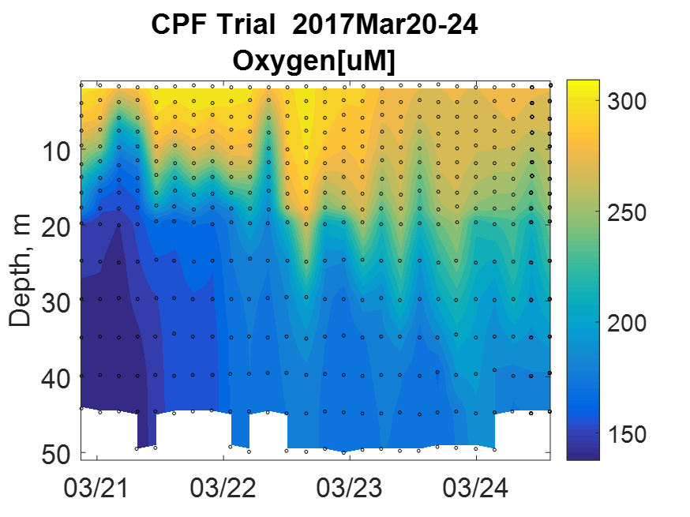
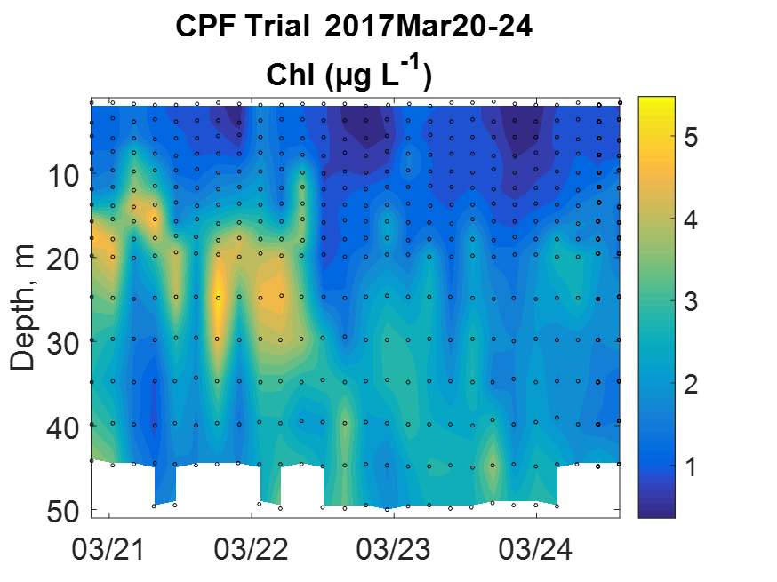
Science Data Products
Iridium SBDs provide reliable but minimal data
Science data files over RUDICs, file format very similar to existing Webb Apex format
Notes:
Need a timescale on backscatter plot
Make sure to identify the 6 plots

Slide 9
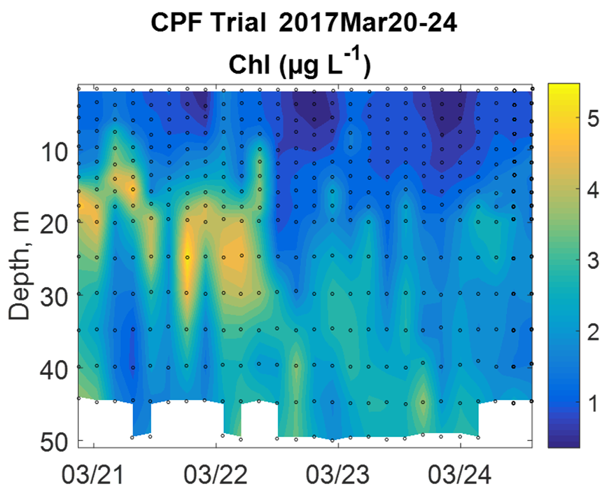
Correlations Between Contemporaneous Measurements

Slide 10
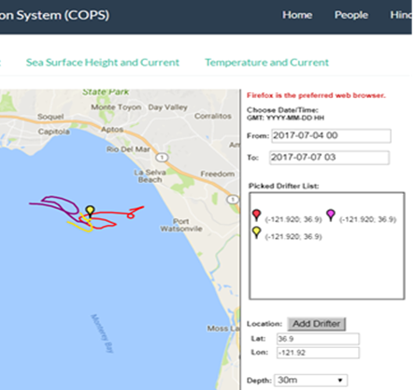
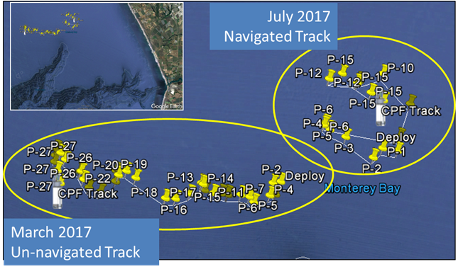
Float Navigation
Experiment – Park the CPF at various depths and compare to ROMS nowcast
ROMS Predicted Trajectories at 1 m (red, 20 m purple, 30 m yellow
Notes:
Navigation like a hot air ballon
Make sure to describe difference between ROMS results vs experiment
Add scale to google earth pix
We can effect the “scope” of the CPF drift by parking at depth as opposed to anchoring on the bottom

Slide 11
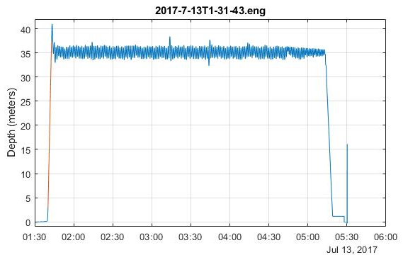
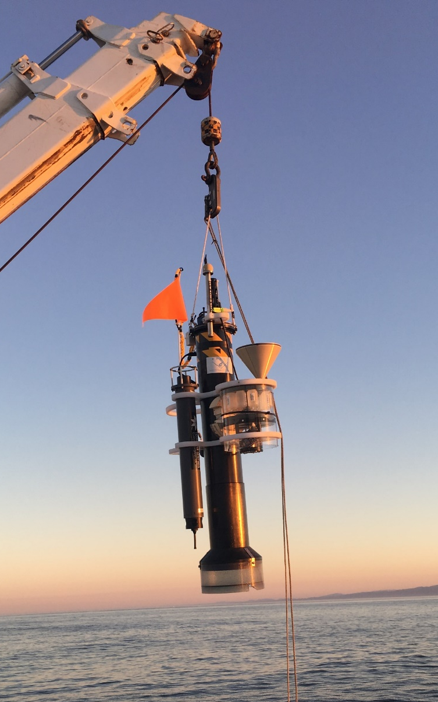
Engineering Results
Std Dev = 0.90m
CPF V1.1 with sediment trap and acoustic modem

Slide 12
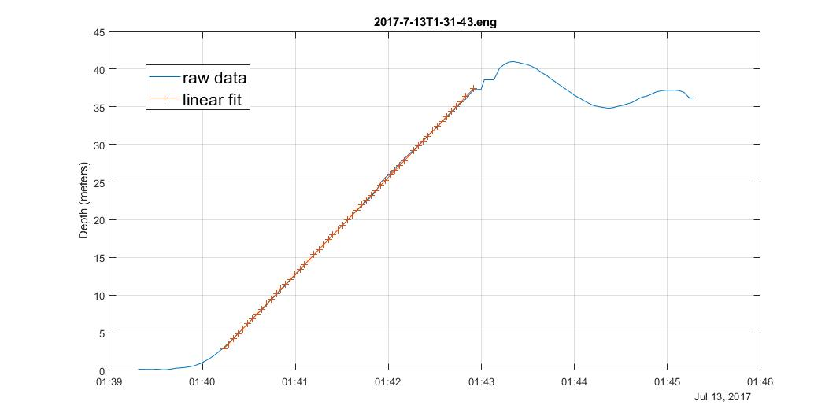
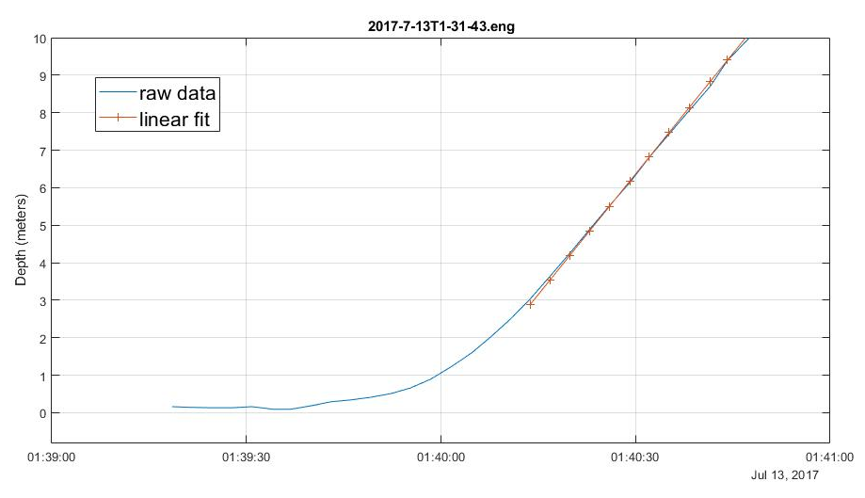
Engineering Results
Std Dev = 0.90m
CPF V1.1 with sediment trap and acoustic modem
Notes:
Bidirectional pump, closed loop control
Tuned for noise rejection

Slide 13
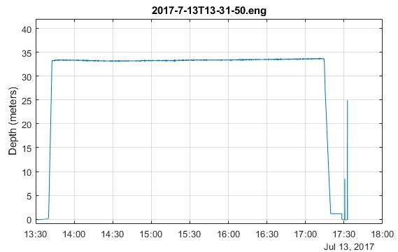
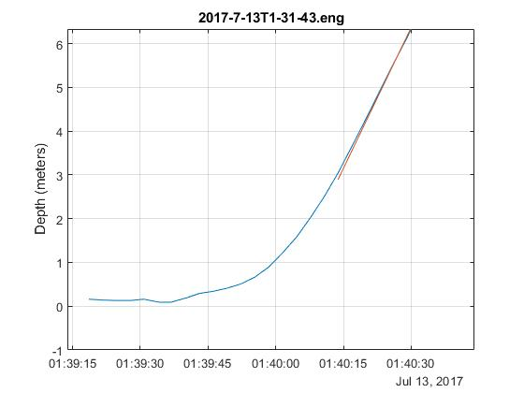
Engineering Results
Std Dev = 0.90m
Std Dev = 0.14m
CPF V1.1 with sediment trap and acoustic modem

Slide 14
Current Work
  Real Science missions
    Finish 2 more CPFs, total = 3
  Extend the mission duration
    Deep sleep between profiles
    Optimize surface and anchoring buoyancy algorithms
    Minimize sensor on-time
    Lower-power system and motor controller
  Make the CPF bullet proof
    Software unit and functional testing
    Benchtop simulator testing
    Continuous test tank prototype runs
    At-sea testing

Slide 15
Future Work
  Safe, high energy density rechargeable Li-ion battery pack
  Estimate current profile with small, non-contact, low power sensor instead of using model forecasts e.g. tactical grade MEMS Inertial Measurement Unit
    Direction resolution: app. +/- 45º
    Depth resolution: app. 2-10 meters
    Velocity resolution: is the velocity +, - or near 0
  Make the science data available in MBARI FloatViz
  Make the CPF bullet proof
  Make the technology available to the community
Notes:
Maybe add a quiver plot

Slide 16
Acknowledgements
The CPF Team also includes: Jerry Allen, Larry Bird, Jared Figurski ,Tom Marion, Jim Montgomery, Mike Parker, Josh Plant, Erich Rienecker, Jose Rosal, Aaron Schnittger, Ray Thompson and Mark Tynes
This work has been generously supported by the David and Lucille Packard Foundation

