Slide 1
A New Profiling Float for Coastal and Upper Water Column Applications
Gene Massion, Kenneth S Johnson, Eric J Martin, Ed Mellinger, Paul McGill and Paul Coenen
Monterey Bay Aquarium Research Institute, Moss Landing, CA, United States
Ocean Sciences Meeting, 20 February 2020
Notes:
Describe what this project is

Slide 2

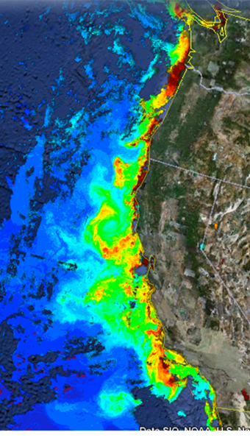
The Science Motivation
“Key recommendations … Further development of event-scale observing capacity (e.g., novel autonomous platforms) in all continental margin systems to better quantify impacts of episodic events on coastal carbon budgets”
Benway, H. et. al., 2016. A Science Plan for Carbon Cycle Research in North American Coastal Waters. Report of the Coastal CARbon Synthesis (CCARS) community workshop, August 19-21, 2014, Ocean Carbon and Biogeochemistry Program and North American Carbon Program.
NOAA National Marine Fisheries Service. "Unfavorable Ocean Conditions Likely Cause Of Low 2007 Salmon Returns Along West Coast." ScienceDaily. ScienceDaily, 4 March 2008.
MODIS Chlorophyll June 28, 2011 http://podaac-tools.jpl.nasa.gov/soto/
Notes:
Move MODIS to science targets

Slide 3
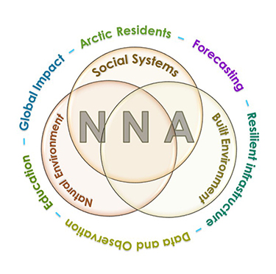
More Motivation
Navigating the New Arctic
“Current Arctic observations are sparse and inadequate for enabling discovery or simulation of the processes underlying Arctic system change or to assess their environmental and economic impacts on the broader Earth system”

Slide 4
Science Needs
A cost-effective, ecosystem size observing system based on a platform(s) that can carry an appropriate instrument suite ...
  BGC instrument suite: CTD, O₂, pH, Nitrate, FL/BB and Optical Radiation
at an appropriate space and time scale …
  Spatial Scale: the west coast of North America
  Time Scale: up to 4 profiles/day (or more)
for 100s of profiles spread over several years
Science goal: Understanding the health of the ocean
  Fisheries management, oxygen dead zones, HABs …
Notes:
Needs pictures of science targets (dead zone)
Including float with sensors at sea

Slide 5
Challenges and a Relevant Example
Challenges:
  Keeping the platform in the target measurement volume and off the beach
  Working in shallow water
  Biofouling
Relevant Example:
  Profiling Floats have proven to be very effective platforms at many scales up to global scales in deep water, e.g. Argo and SOCCOM
  ^{Other coastal floats}
Notes:
bsops

Slide 6
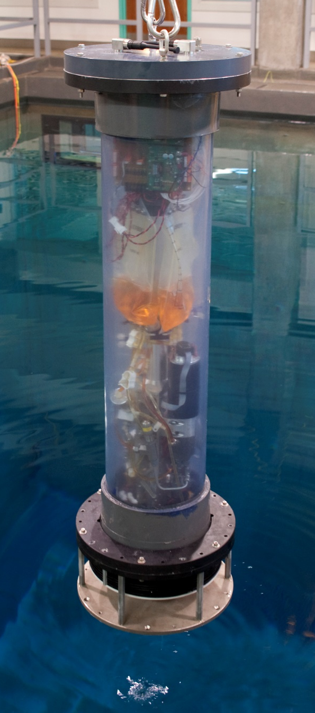
CPF Version 0.1
After initial calculations, concept evaluations and benchtop prototyping a new buoyancy engine
Depth range: MBARI 10 m deep test tank
Buoyancy engine ΔV/V = 3 liters / 50 liters = 7%
  Webb Apex Float = 1%, MRV S2-A Solo II = 3.4%
  “Target” environment = 1000 kg/m³ / 1025 kg/m³ = 2.5%
  Depth and velocity control suitable for shallow water
CTD and Oxygen Optode only
Ability to anchor, and more importantly de-anchor, on the test tank floor
Notes:
Drop this slide

Slide 7


Current CPF Version 2.1 and 2.2
Depth range: 0 to 500 meters
Improved buoyancy engine ΔV/V = 3.5 liters / 40 liters = 9%
  2 external bellows options: concentric and coaxial
  Vertical velocity = zero to ~50 cm/sec
Support for BGC 6 instrument suite plus 3 more science instruments
No obvious issues with anchoring, de-anchoring, parking at depth, controlling velocity or depth after ~45 days of sea tests

Slide 8

Science Data Products
Iridium SBDs provide reliable but minimal data
Science data files over RUDICs, file format very similar to existing Webb Apex format
Notes:
Need a timescale on backscatter plot
Make sure to identify the 6 plots
We cam see a cold deep water mass roll up the shelf and presumably transport nutrients (we’ll know when we have the Nitrate sensor on.;

Slide 9



Float Navigation
Experiment: Park the CPF at various depths and compared track to ROMS nowcast and previous missions that anchored on the bottom after every profile
ROMS Predicted Trajectories at 1 m (red, 20 m purple, 30 m yellow
March 2017 Un-navigated, Anchor on Bottom Track 5 km
2 km
July 2017 Navigated, Park at User Specified Depth Track
Notes:
Need to run ROMS at higher resolution particularly given the bathymetry

Slide 10

Engineering Results
Std Dev = 0.90m

Slide 11
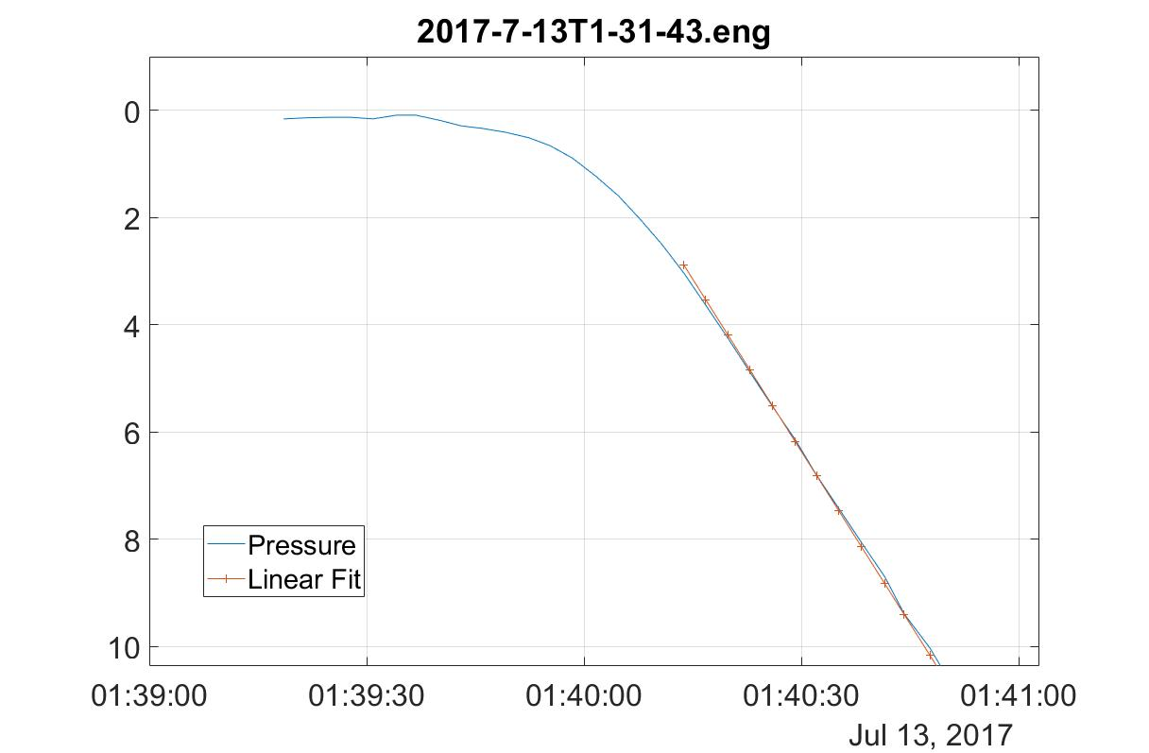
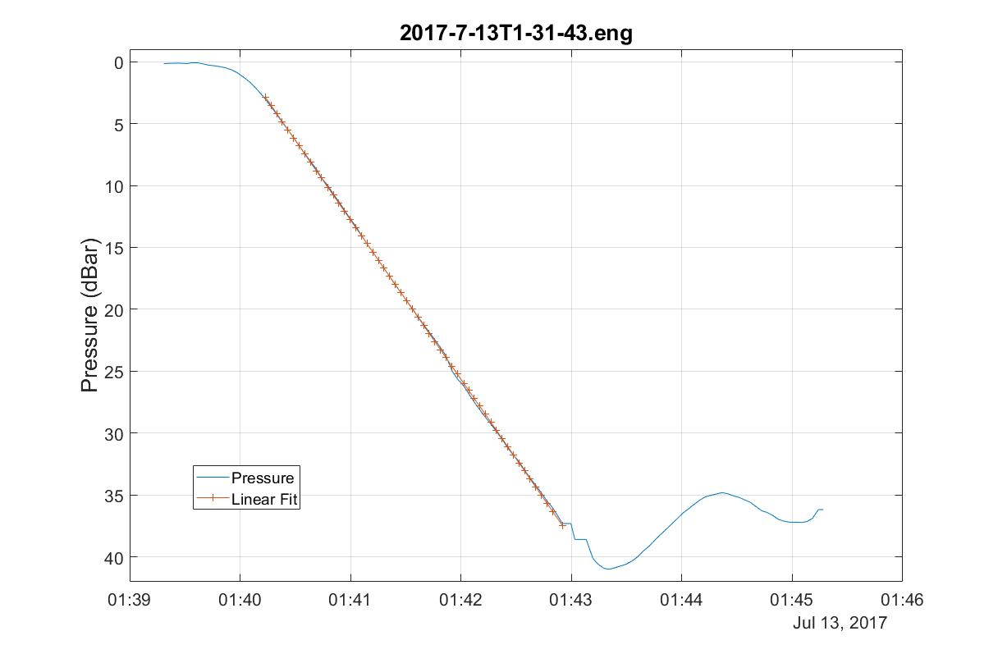
Engineering Results
Notes:
Bidirectional pump, closed loop control
Tuned for noise rejection

Slide 12
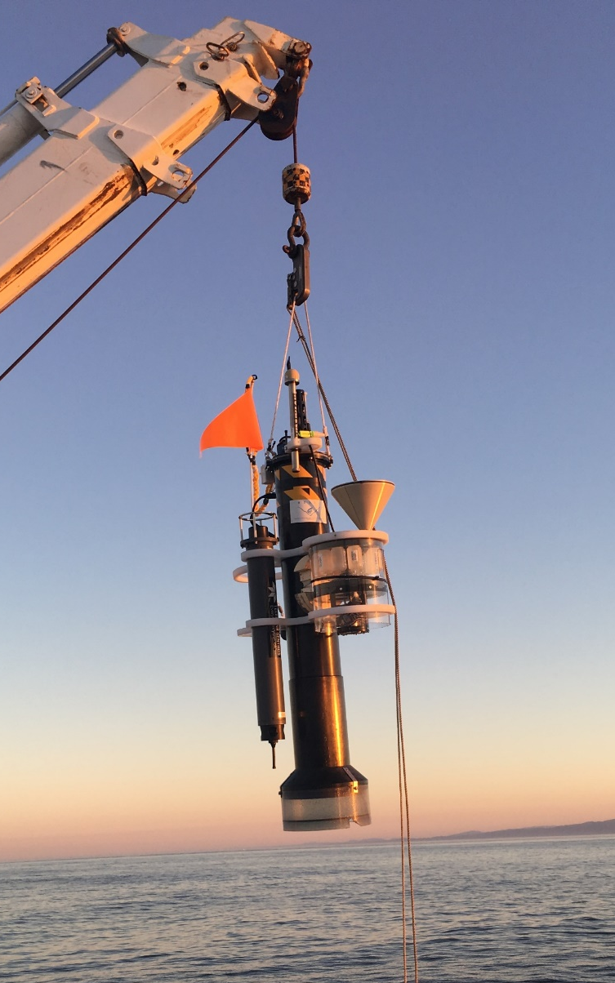

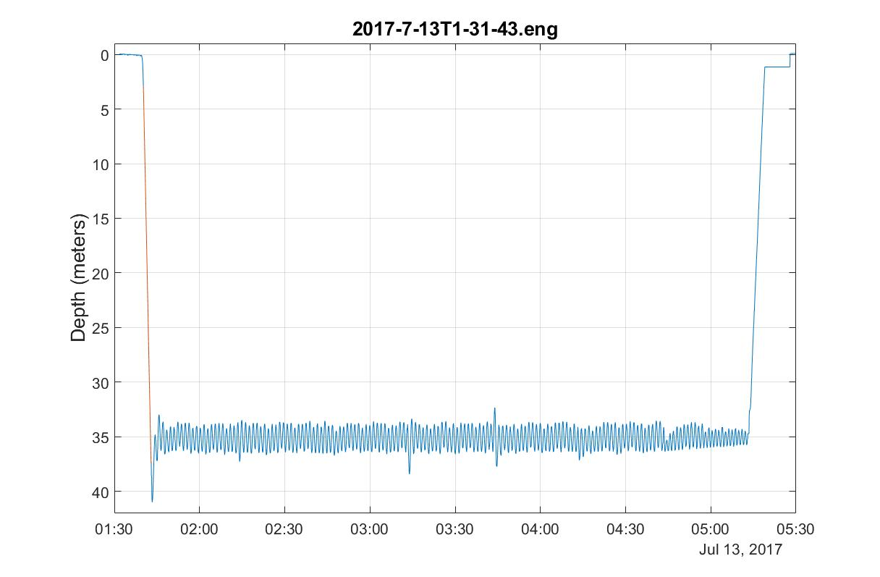
Engineering Results
Std Dev = 0.14m
Std Dev = 0.90m
CPF V1.1 with sediment trap and acoustic modem

Slide 13
Current Work
  Science missions with all 6 sensors
  Extend the mission duration
  Increase reliability
Notes:
Need a picture

Slide 14
Future Work
  Safe, high energy density rechargeable Li-ion battery pack
  Estimate current profile with small, low power sensor instead of using model forecasts e.g. tactical grade MEMS Inertial Measurement Unit
    Direction resolution: app. +/- 45º
    Depth resolution: app. 2-10 meters
    Velocity resolution: is the velocity +, - or near 0
  Make the science data available in MBARI FloatViz
  Make the CPF bullet proof
  Make the technology available to the community
Notes:
Maybe add a quiver plot

Slide 15
Acknowledgements
The CPF Team also includes: Jerry Allen, Larry Bird, Jared Figurski ,Tom Marion, Jim Montgomery, Mike Parker, Josh Plant, Erich Rienecker, Jose Rosal, Aaron Schnittger, Ray Thompson and Mark Tynes
This work has been generously supported by the David and Lucille Packard Foundation

Slide 16
NOAA scientists are reviewing unusual environmental conditions in the Pacific Ocean as the likely culprit for the dramatically low returns of Chinook and coho salmon to rivers and streams along the West Coast of the United States in 2007.
Researchers from NOAA's Northwest and Southwest Fisheries Science Centers are comparing data on the low food production of the California Current in 2005 that occurred when this year's returning salmon would have been entering the ocean from their natal streams to feed and grow.
The cold waters of the California Current flow southward from the northern Pacific along the West Coast and are associated with upwelling, an ocean condition caused by winds that bring nutrients to the ocean's surface and is the main source of nourishment for the ocean's food web. In 2005 a southward shift in the jet stream, delayed favorable winds and upwelling for the California Current, which normally begins in spring. The winds instead arrived in mid-July, causing high surface water temperatures and very low nutrient production within the near-shore marine ecosystem.
"We are not dismissing other potential causes for this year's low salmon returns," said Usha Varanasi, NOAA Fisheries Service Science Center Director for the Northwest Region. "But the widespread pattern of low returns along the West Coast for two species of salmon indicates an environmental anomaly occurred in the California Current in 2005."
New data released by the Pacific Fisheries Management Council indicate the 2007 returns of fall Chinook salmon to the Sacramento River in California's Central Valley were approximately 33 percent of what fishery biologists expected. Projections for 2008 are substantially lower than last year's estimate.
Coho salmon returning to spawning streams in California and Oregon are also considerably lower than predicted. A preliminary analysis found an average 27 percent of the parental stock returning in 12 streams monitored in California. Even though coho returns appear to improve along the coast from south to north, Oregon Coast coho salmon had less than 30 percent of their parental stock return.
Coho salmon are listed as either endangered or threatened under the Endangered Species Act in the Central/Northern California and Southern Oregon watersheds.

