Slide 1
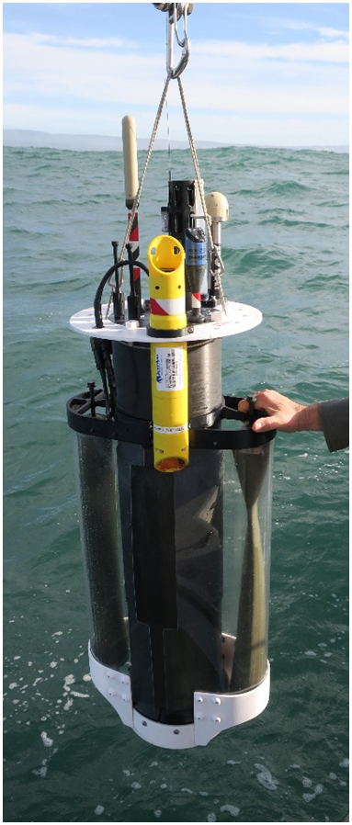
A New Profiling Float for Coastal and Upper Water Column Applications
Gene Massion, Kenneth S Johnson, Eric J Martin, Ed Mellinger, Paul McGill and Paul Coenen
Monterey Bay Aquarium Research Institute, Moss Landing, CA, United States
Ocean Sciences Meeting, 20 February 2020
Notes:
Describe what this project is

Slide 2

The Initial Motivation
"the widespread pattern of low returns along the West Coast for two species of salmon indicates an environmental anomaly occurred in the California Current in 2005."

Slide 3


More Motivation
Benway, H. et. al., 2016. A Science Plan for Carbon Cycle Research in North American Coastal Waters
“Further development of event-scale observing capacity (e.g., novel autonomous platforms) in all continental margin systems to better quantify impacts of episodic events on coastal carbon budgets”
Navigating the New Arctic
“Current Arctic observations are sparse and inadequate for enabling discovery or simulation … to assess their impacts on the broader Earth system”

Slide 4
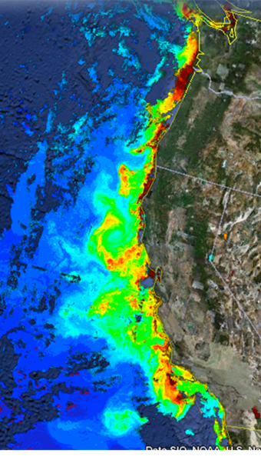
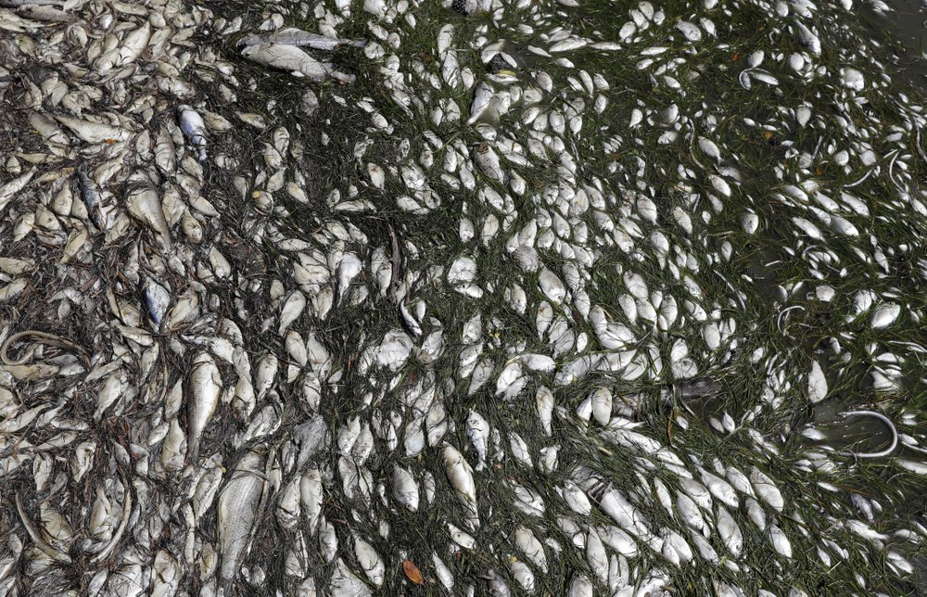
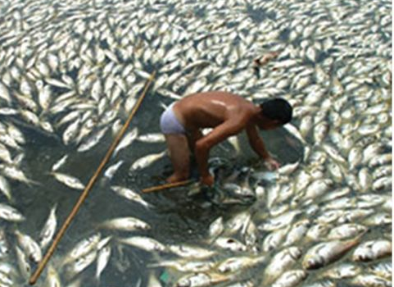
Science Needs
MODIS Chlorophyll June 28, 2011
Devastating toxic algae bloom plagues Florida’s Gulf Coast
By TAMARA LUSH (AP), August 10, 2018
A cost-effective, coastal ecosystem size observing system
Instrument suite: CTD, O₂, pH, Nitrate, FL/BB and Optical Radiation
Spatial Scale: coastal ecosystem, e.g., the west coast of North America
Time Scale: up to 4 profiles/day (or more)
100s of profiles spread over several years
Science targets: Fisheries, HABs, Oxygen Dead Zones, …
Declining oxygen in the global ocean and coastal waters
Denise Breitburg,et. al., Science 05 Jan 2018: Vol. 359, Issue 6371

Slide 5
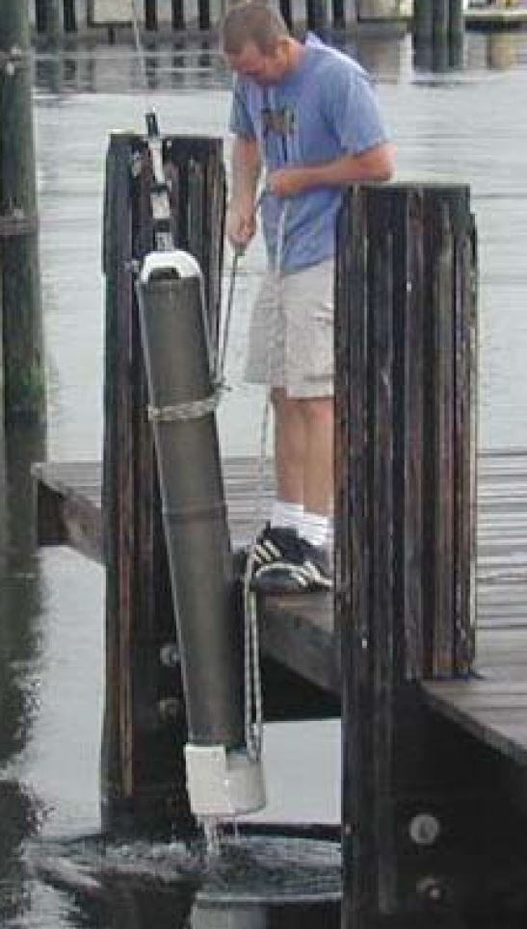
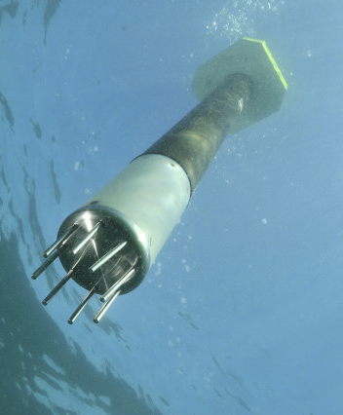
Challenges and Relevant Examples
Challenges:
  Working in shallow, coastal water
  Biofouling
Relevant Examples:
  Profiling Floats have proven to be very effective in deep water and open ocean, e.g. Argo and SOCCOM
  Univ of SF BSOP, NKE Arvor-C, MRV Alamo, etc.
USF BSOP
NKE Arvor-C
Notes:
Say bottom station ocean profiler
https://www.researchgate.net/publication/4010558_Design_and_initial_results_of_a_bottom_stationing_ocean_profiler
Arvor-C FLOAT DIMENSIONS Overall length: 195cm with antenna Hull length: 140cm Hull diameter: 11cm Weight: 22kg
Talk about anchoring, fast profiling, numerical model

Slide 6


Current CPF Version 2.1 and 2.2
Depth range = 0 to 500 meters
BGC Instrument Suite
Electronics
108 cm
Internal Oil Bladder
Oil Pump
External Oil Bladder
Notes:
Webb Apex Float = 1%, MRV S2-A Solo II = 3.4%, BSOP Modular = 3/82 = 3.7%, MRV Alamo = 4.2%
Talk about 2 versions: identical from the bottom end cap up

Slide 7
Current CPF Version 2.1 and 2.2
Depth range = 0 to 500 meters
Buoyancy engine ΔV/V = 3.5 liters / 40 liters = 9%
  Working density gradient = 1000 kg/m³ / 1025 kg/m³ = 2.5%
  Vertical velocity = zero to ~50 cm/sec
BGC Instrument Suite
Electronics
108 cm
Internal Oil Bladder
Oil Pump
External Oil Bladder
Notes:
Webb Apex Float = 1%, MRV S2-A Solo II = 3.4%, BSOP Modular = 3/82 = 3.7%, MRV Alamo = 4.2%
Talk about 2 versions: identical from the bottom end cap up

Slide 8
Current CPF Version 2.1 and 2.2
Depth range = 0 to 500 meters
Buoyancy engine ΔV/V = 3.5 liters / 40 liters = 9%
  Working density gradient = 1000 kg/m³ / 1025 kg/m³ = 2.5%
  Vertical velocity = zero to ~50 cm/sec
Science Payload = 9 sensor ports: 6 BGC sensors plus 3 more
BGC Instrument Suite
Electronics
108 cm
Internal Oil Bladder
Oil Pump
External Oil Bladder
Notes:
Webb Apex Float = 1%, MRV S2-A Solo II = 3.4%, BSOP Modular = 3/82 = 3.7%, MRV Alamo = 4.2%
Talk about 2 versions: identical from the bottom end cap up

Slide 9
Current CPF Version 2.1 and 2.2
Depth range = 0 to 500 meters
Buoyancy engine ΔV/V = 3.5 liters / 40 liters = 9%
  Working environment = 1000 kg/m³ / 1025 kg/m³ = 2.5%
  Vertical velocity = zero to ~50 cm/sec
Science Payload: 9 sensor ports: 6 BGC sensors plus 3 more
Iridium SBD and RUDICS communications
BGC Instrument Suite
Electronics
108 cm
Internal Oil Bladder
Oil Pump
External Oil Bladder
Notes:
Webb Apex Float = 1%, MRV S2-A Solo II = 3.4%, BSOP Modular = 3/82 = 3.7%, MRV Alamo = 4.2%
Talk about 2 versions: identical from the bottom end cap up

Slide 10

Science Data Products
Notes:
We cam see a cold, low oxygen deep water mass roll up the shelf and presumably transport nutrients (we’ll know when we have the Nitrate sensor on.;

Slide 11



Float Navigation
Experiment: Park the CPF at various depths and compare track to ROMS nowcast and previous missions that anchored on the bottom after every profile
ROMS Predicted Trajectories at 1 m (red, 20 m purple, 30 m yellow
March 2017 Un-navigated, 5km Anchor on Bottom Track
2 km
July 2017 Navigated, Park at User Specified Depth Track
Notes:
Hot air balloons navigate this way
Need to run ROMS at higher resolution particularly given the bathymetry
Maybe crop the ROMS window and add a velocity vs depth plot.

Slide 12


Engineering Results
To date, no obvious issues with anchoring, de-anchoring, parking at depth, controlling velocity or depth after ~45 days of sea tests
2 m Dead Band
Std Dev = 0.90 m
Notes:
Working in shallow water is a challenge as I mentioned earlier. If you’re working in 20 meters of water you don’t want to spend 15 of those meters getting to a stable vertical velocity
The zoomed inset is for getting off the surface which is harder due to wave action and the fact that we descend at 20 cm/sec and ascend at 10 cm/sec
Sampling is typically done during park, anchor and ascent but can be done on descent if desired.
The depth control has a dead band which in this case is set for +/1 meter.
Tuned for maximum stability and noise rejection and moderate performance
6 meters of overshoot

Slide 13

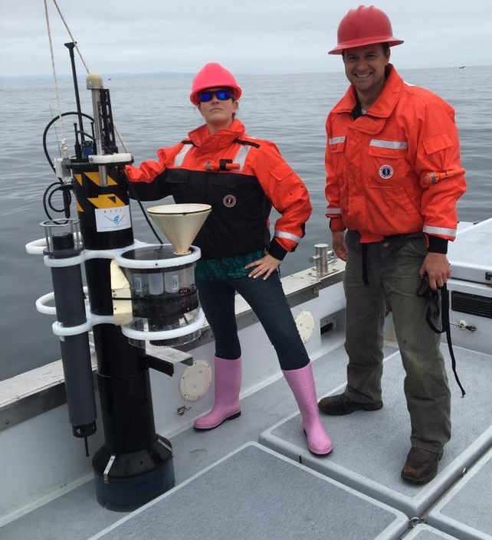
Engineering Results
No Dead Band
Std Dev = 0.14 m
CPF V1.1 with sediment trap and acoustic modem
Notes:
Exact same control algorithm with no dead band.
After trying several other subsurface Lagrangian floats, the MBARI BOG built 2 for their twice a year field deployments
Ballast in 350 gram increments in the test tank
Pick up truck of the sea

Slide 14
Next Steps
  Run science missions with all 6 sensors
Notes:
Use action verbs

Slide 15
Next Steps
  Run science missions with all 6 sensors
  Extend the mission duration
Notes:
Use action verbs

Slide 16
Next Steps
  Run science missions with all 6 sensors
  Extend the mission duration
  Continue enhancing reliability
Notes:
Use action verbs

Slide 17
Next Steps
  Run science missions with all 6 sensors
  Extend the mission duration
  Continue enhancing reliability
  Finish new rechargeable battery pack with 3X higher energy per cm³
Notes:
Use action verbs

Slide 18
Next Steps
  Run science missions with all 6 sensors
  Extend the mission duration
  Continue enhancing reliability
  Finish new rechargeable battery pack with 3X higher energy per cm³
  Replace/supplement ROMS model current forecasts with small, low power current sensor e.g. tactical grade MEMS Inertial Measurement Unit
Notes:
Use action verbs

Slide 19
Next Steps
  Run science missions with all 6 sensors
  Extend the mission duration
  Continue enhancing reliability
  Finish new rechargeable battery pack with 3X higher energy per cm³
  Replace/supplement ROMS model current forecasts with small, low power current sensor e.g. tactical grade MEMS Inertial Measurement Unit
  Make our data freely available on MBARI FloatViz
Notes:
Use action verbs

Slide 20
Next Steps
  Run science missions with all 6 sensors
  Extend the mission duration
  Continue enhancing reliability
  Finish new rechargeable battery pack with 3X higher energy per cm³
  Replace/supplement ROMS model current forecasts with small, low power current sensor e.g. tactical grade MEMS Inertial Measurement Unit
  Make our data freely available on MBARI FloatViz
  Make the CPF tech. available to the community
Notes:
Use action verbs

Slide 21
Acknowledgements
The CPF Team also includes: Jerry Allen, Larry Bird, Jared Figurski ,Tom Marion, Jim Montgomery, Mike Parker, Josh Plant, Erich Rienecker, Jose Rosal, Aaron Schnittger, Ray Thompson and Mark Tynes
This work has been generously supported by the David and Lucille Packard Foundation
Thank you

Slide 22
NOAA scientists are reviewing unusual environmental conditions in the Pacific Ocean as the likely culprit for the dramatically low returns of Chinook and coho salmon to rivers and streams along the West Coast of the United States in 2007.
Researchers from NOAA's Northwest and Southwest Fisheries Science Centers are comparing data on the low food production of the California Current in 2005 that occurred when this year's returning salmon would have been entering the ocean from their natal streams to feed and grow.
The cold waters of the California Current flow southward from the northern Pacific along the West Coast and are associated with upwelling, an ocean condition caused by winds that bring nutrients to the ocean's surface and is the main source of nourishment for the ocean's food web. In 2005 a southward shift in the jet stream, delayed favorable winds and upwelling for the California Current, which normally begins in spring. The winds instead arrived in mid-July, causing high surface water temperatures and very low nutrient production within the near-shore marine ecosystem.
"We are not dismissing other potential causes for this year's low salmon returns," said Usha Varanasi, NOAA Fisheries Service Science Center Director for the Northwest Region. "But the widespread pattern of low returns along the West Coast for two species of salmon indicates an environmental anomaly occurred in the California Current in 2005."
New data released by the Pacific Fisheries Management Council indicate the 2007 returns of fall Chinook salmon to the Sacramento River in California's Central Valley were approximately 33 percent of what fishery biologists expected. Projections for 2008 are substantially lower than last year's estimate.
Coho salmon returning to spawning streams in California and Oregon are also considerably lower than predicted. A preliminary analysis found an average 27 percent of the parental stock returning in 12 streams monitored in California. Even though coho returns appear to improve along the coast from south to north, Oregon Coast coho salmon had less than 30 percent of their parental stock return.
Coho salmon are listed as either endangered or threatened under the Endangered Species Act in the Central/Northern California and Southern Oregon watersheds.

