Slide 1
A New Profiling Float for Coastal and Upper Water Column Applications
Gene Massion, Kenneth S Johnson, Eric J Martin, Ed Mellinger, Paul McGill and Paul Coenen
Monterey Bay Aquarium Research Institute, Moss Landing, CA, United States
Ocean Sciences Meeting, 20 February 2020

Slide 2

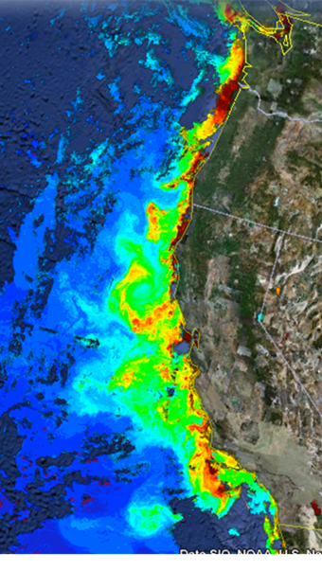
The Science Motivation
“Key recommendations … Further development of event-scale observing capacity (e.g., novel autonomous platforms) in all continental margin systems to better quantify impacts of episodic events on coastal carbon budgets”
NOAA National Marine Fisheries Service. "Unfavorable Ocean Conditions Likely Cause Of Low 2007 Salmon Returns Along West Coast." ScienceDaily. ScienceDaily, 4 March 2008.
Benway, et. al. 2016. A Science Plan for Carbon Cycle Research in North American Coastal Waters. Report of the Coastal CARbon Synthesis (CCARS) community workshop, Ocean Carbon and Biogeochemistry Program and North American Carbon Program
MODIS Chlorophyll June 28, 2011 http://podaac-tools.jpl.nasa.gov/soto/

Slide 3
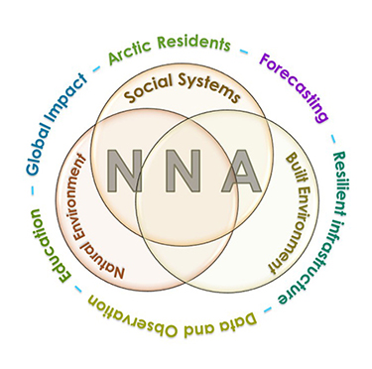
More Motivation
Navigating the New Arctic
“Current Arctic observations are sparse and inadequate for enabling discovery or simulation of the processes underlying Arctic system change or to assess their environmental and economic impacts on the broader Earth system”

Slide 4
Science Needs, Risks and a Relevant Example
Science Needs: a cost effective platform that can carry an appropriate instrument suite at an appropriate space and time scale in a coastal ecosystem for 100s of profiles spread over several years
  Spatial Scale: the west coast of North America
  Temporal Scale: up to 4 profiles/day (or more)
  BGC instrument suite: CTD, O², pH, Nitrate, FL/BB and Optical Radiation
  Science targets: Fisheries management, oxygen dead zones, HABs …
Risks:
  Keeping the platform in the target measurement volume and off the beach
  Biofouling
Relevant Example: Profiling Floats have proven to be very effective platforms at many scales up to global scales in deep water, e.g. Argo and SOCCOM

Slide 5
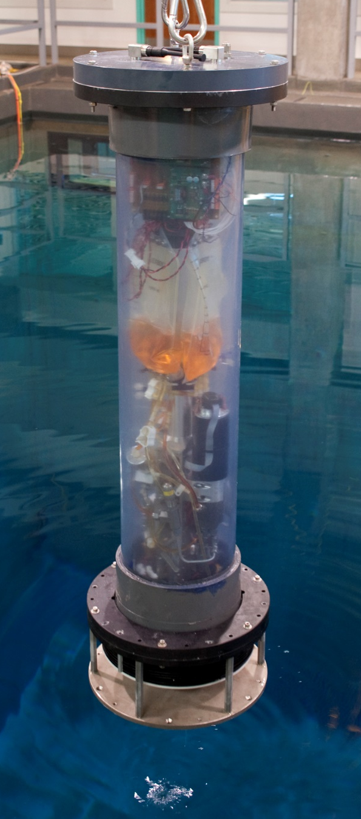
CPF Test Tank Prototype
Depth range: 0 to ~30 meters
Buoyancy engine ΔV/V = 3 liters / 50 liters = 7%
  Webb Apex Float = 1%, MRV S2-A Solo II = 3.4%
  “Target” environment = 1000 kgf/m³ / 1025 kgf/m³ = 2.5%
  Depth and velocity control suitable for shallow water
    Achieve desired profiling velocity with a few meters
    Hold depth to +/- a few meters
  Anchor with ~1 kgf of negative buoyancy
Support for CTD, Optode and 3 more science instruments
Ability to anchor, and more importantly de-anchor, on the test tank floor

Slide 6

Current Design
Depth range: 0 to 500 meters
ΔV/V = 3.5 liters / 40 liters = 9%
  Profiling velocity = 0 to 50+ cm/second
  2 external bellows options
Support for 12 science instruments
Ability to anchor, and more importantly de-anchor, on the test tank floor
Iridium SBD and (soon) RUDICS communications
Identify and park in a current somewhere in the water column roughly opposite to the overall float drift using ROMS current forecast
Need picture of new design with external bellows on bottom

Slide 7
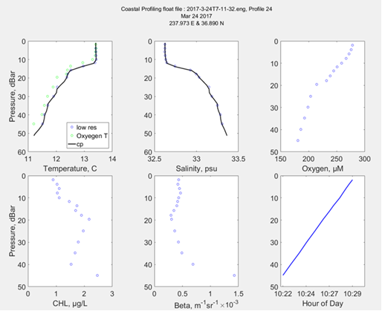
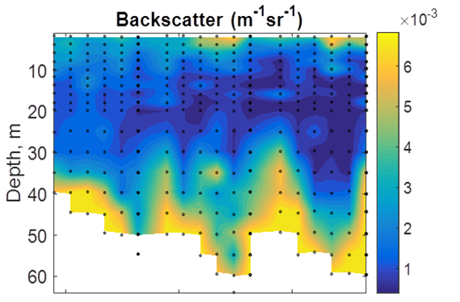
Science Data Products
Iridium SBDs provide reliable but minimal data
Science data files over RUDICs, file format very similar to existing Webb Apex format

Slide 8
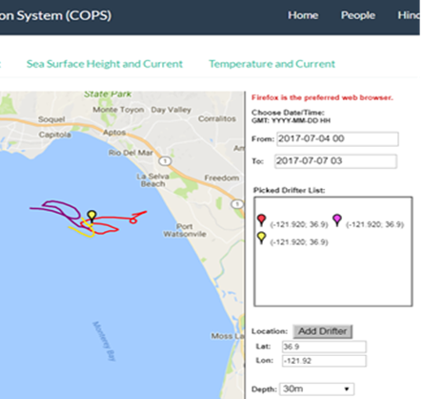
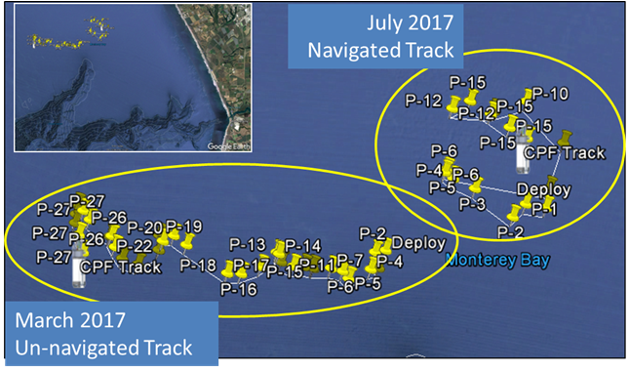
Float Navigation
Experiment – Park the CPF at various depths and compare to ROMS nowcast
ROMS Predicted Trajectories at 1m (red, 20m purple, 30m yellow

Slide 9
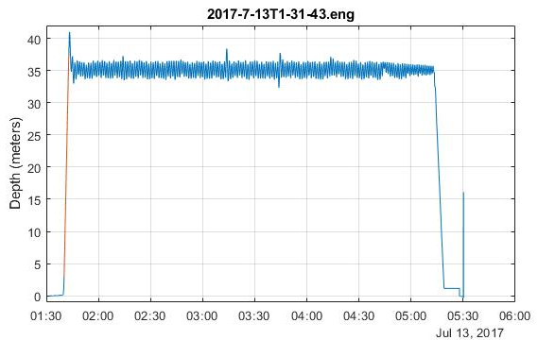
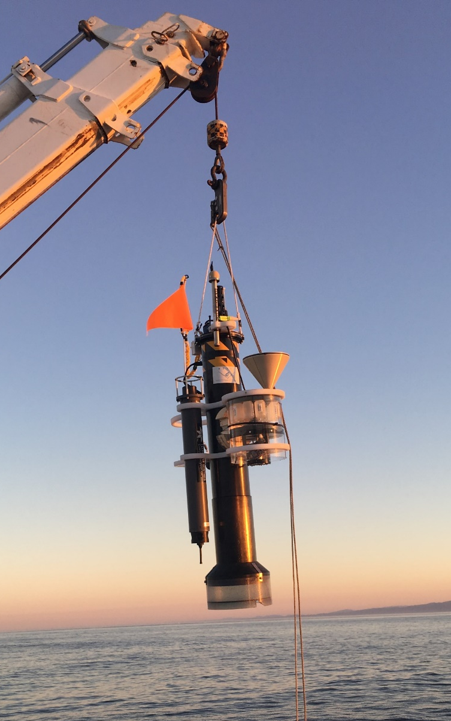
Engineering Results
Std Dev = 0.90m

Slide 10
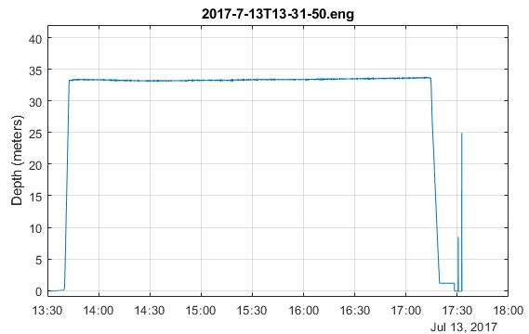
Engineering Results
Std Dev = 0.90m
Std Dev = 0.14m

Slide 11
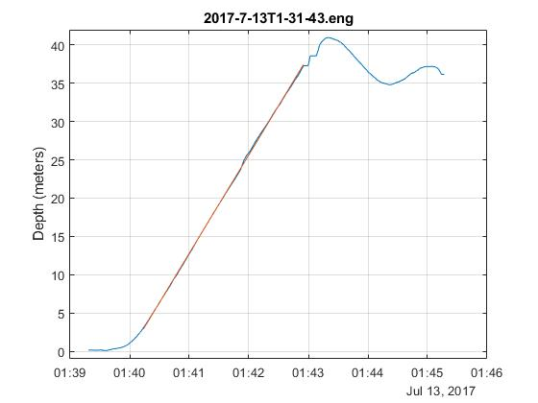
Engineering Results
Std Dev = 0.90m
Std Dev = 0.14m

Slide 12
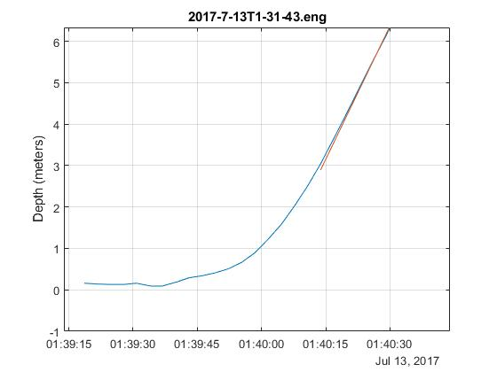
Engineering Results
Std Dev = 0.90m
Std Dev = 0.14m
Early CPF w/Sediment Trap and Acoustic Modem

Slide 13
Current Work
  Real Science missions
    Finish 2 more CPFs, total = 3
  Extend the mission duration
    Deep sleep between profiles
    Optimize surface and anchoring buoyancy algorithms
    Minimize sensor on time
    Lower power controllers
  Make the CPF bullet proof
    Software unit and functional testing
    Continuous Test tank prototype runs
    Benchtop simulator testing
    At sea testing
Future Work
  Safe, high energy density rechargeable Li-ion battery pack
  Small, non-contact, low power current profile estimator
    Velocity res. = +/-/ near 0
    Direction res. = +/- 45º
    Depth res. 2-5 meters
  Make the science data available in MBARI FloatViz
  Make the CPF bullet proof
  Make the technology available to the community

Slide 14
Acknowledgements
The CPF Team also includes: Jerry Allen, Larry Bird, Jared Figurski ,Tom Marion, Jim Montgomery, Mike Parker, Josh Plant, Erich Rienecker, Jose Rosal, Aaron Schnittger, Ray Thompson and Mark Tynes
This work has been generously supported by the David and Lucille Packard Foundation

