Slide 1
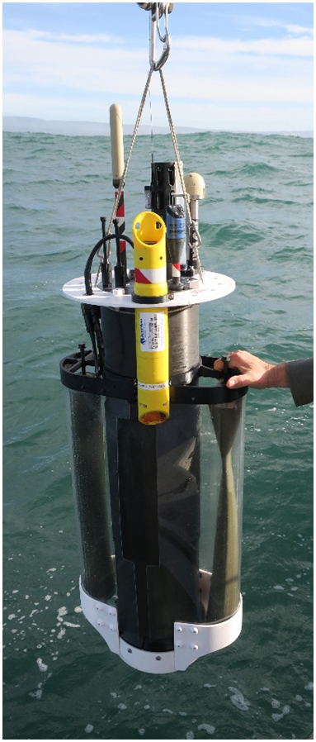
A New Profiling Float for Coastal and Upper Water Column Applications
Gene Massion, Kenneth S Johnson, Eric J Martin, Ed Mellinger, Paul McGill and Paul Coenen
Monterey Bay Aquarium Research Institute, Moss Landing, CA, United States
Ocean Sciences Meeting, 20 February 2020
Notes:
Thanks very much for the opportunity to talk about MBARI’s coastal profiling float project
Describe what this project is

Slide 2

The Initial Motivation
"the widespread pattern of low returns along the West Coast for two species of salmon indicates an environmental anomaly [low nutrient production] occurred in the California Current in 2005."
Notes:
The initial motivation for this project came from a conversations I had with Ken Johnson, the PI of MBARI’s chemical sensor group
He showed me this press release from NOAA marine fisheries from 2008 when only a third of the expected Salmon returned to their breeding streams during the 2007 season and suggested it was primarily due to low food production in 2005
The problem was pretty clear; managing fisheries is a complex task, and data is sparse, real time or near real time data is even less available.
I was hooked even before I knew that ensuring sustainable fisheries is an explicit goal of the David and Lucille Packard foundation, which funds MBARI, makes this an even more compelling challenge

Slide 3


More Motivation
“Further development of event-scale observing capacity (e.g., novel autonomous platforms) in all continental margin systems to better quantify impacts of episodic events on coastal carbon budgets”
A Science Plan for Carbon Cycle Research in North American Coastal Waters 2016, Ocean Carbon and Bio. Program and NA Carbon Program
Navigating the New Arctic
“Current Arctic observations are sparse and inadequate for enabling discovery or simulation … to assess their impacts on the broader Earth system”
Notes:
Additional motivation include the Coastal Carbon Synthesis Group’s community workshop report where the recommended more development of observing systems for continental margins.
Community workshops sponsored by Ocean Carbon and Biogeochemistry Program and North American Carbon Program
NSF also published their 10 big ideas, the areas that will drive their research agenda for the near future. One of the 10 big ideas is Navigating the New Arctic and again, they point out the lack of data limiting our understanding.
While the arctic was not one of our initial research topics, we think it is within the capability of the CPF.

Slide 4
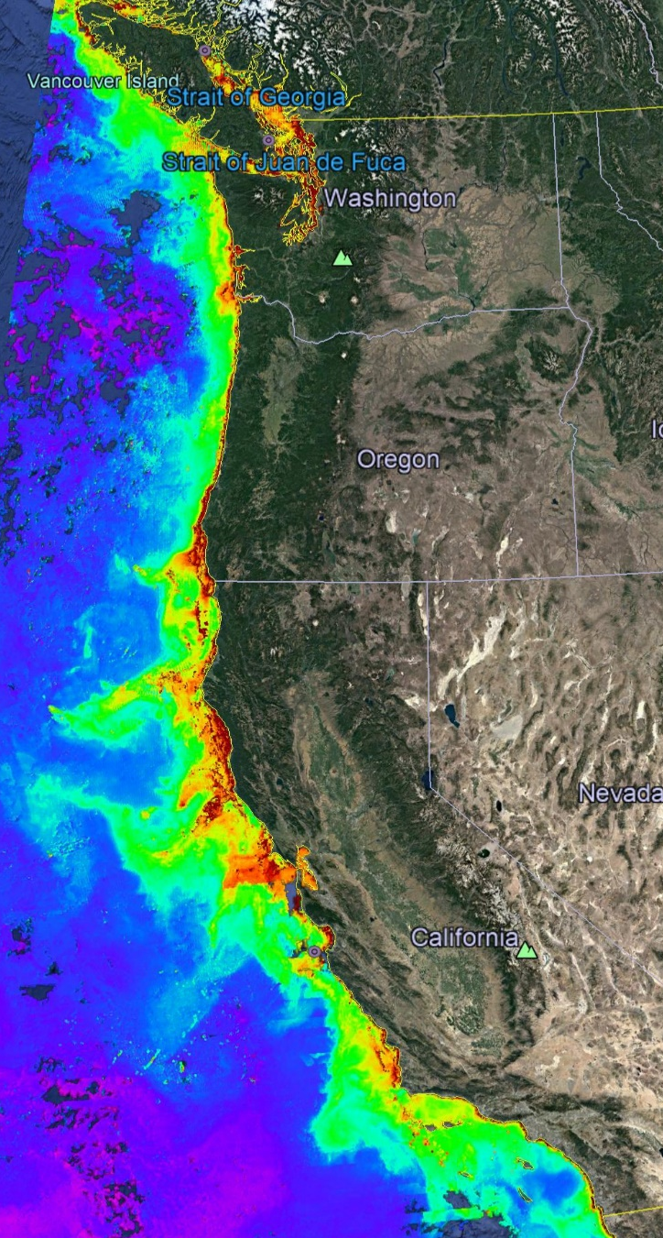
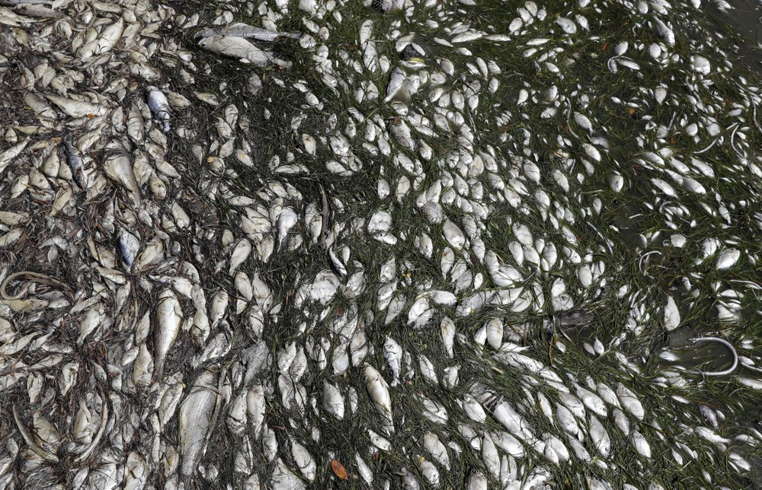
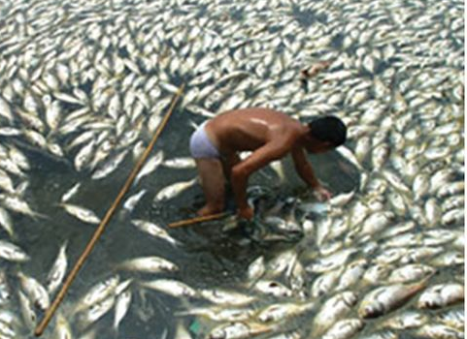
Science Requirements
MODIS Chlorophyll July 2019
A cost-effective, coastal ecosystem size observing system
Sensor suite: CTD, O₂, pH, Nitrate, FL/BB and Optical Radiation
Spatial Scale: coastal ecosystem, e.g., the west coast of North America
Time Scale: up to 4 profiles/day (or more)
100s of profiles spread over several years
Science targets: Fisheries, HABs, Oxygen Dead Zones, …
Devastating toxic algae bloom plagues Florida’s Gulf Coast
By TAMARA LUSH (AP), August 10, 2018
Declining oxygen in the global ocean and coastal waters
Denise Breitburg,et. al., Science 05 Jan 2018: Vol. 359, Issue 6371
Notes:
We started the project with the usual process of defining specific science needs or requirements, identifying risks or more PC, challenges and developing concepts.
We have a fairly detailed document describing these but I can summarize them pretty briefly here.

Slide 5
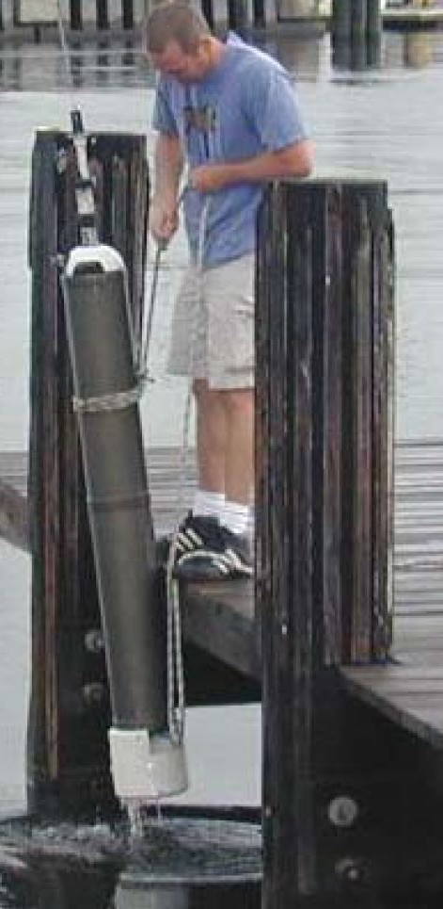
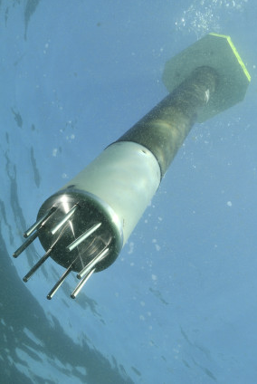
Risks and Relevant Examples
Risks:
  Working in shallow, coastal water
    Can’t drift on or off-shore
    Need accurate velocity and depth control
  Biofouling
Relevant Examples:
  Profiling Floats have proven to be very effective in deep water and open ocean applications, e.g. Argo and SOCCOM
  Univ of SF BSOP, NKE Arvor-C, MRV Alamo, etc.
USF BSOP
NKE Arvor-C
Notes:
If you’re working in 20 meters of water you don’t want to spend 15 of those meters reaching a stable profiling velocity
Profiling floats have been very effective platforms for the pH and Nitrates sensors we’ve developed in our lab but so far, only in deep water, open ocean applications
Profiling floats are kind of a base line for evaluating platform concepts and were the only approach that scaled up to the scales we were targeting at a cost that was consistent with reasonable funding assumptions
Say bottom station ocean profiler
https://www.researchgate.net/publication/4010558_Design_and_initial_results_of_a_bottom_stationing_ocean_profiler
Arvor-C FLOAT DIMENSIONS Overall length: 195cm with antenna Hull length: 140cm Hull diameter: 11cm Weight: 22kg
Talk about anchoring, fast profiling, numerical model

Slide 6


Current CPF Version 2.1 and 2.2
Depth range = 0 to 500 meters
BGC Instrument Suite
Electronics
108 cm
Internal Oil Bladder
Oil Pump
External Oil Bladder
Notes:
Webb Apex Float = 1%, MRV S2-A Solo II = 3.4%, BSOP Modular = 3/82 = 3.7%, MRV Alamo = 4.2%
Talk about 2 versions: identical from the bottom end cap up

Slide 7
Current CPF Version 2.1 and 2.2
Depth range = 0 to 500 meters
Buoyancy engine ΔV/V = 3.5 liters / 40 liters = 9%
  Working density gradient = 1000 kg/m³ / 1025 kg/m³ = 2.5%
  Vertical velocity = zero to ~50 cm/sec
  Ability to anchor/deanchor
BGC Instrument Suite
Electronics
108 cm
Internal Oil Bladder
Oil Pump
External Oil Bladder
Notes:
Webb Apex Float = 1%, MRV S2-A Solo II = 3.4%, BSOP Modular = 3/82 = 3.7%, MRV Alamo = 4.2%
Talk about 2 versions: identical from the bottom end cap up

Slide 8
Current CPF Version 2.1 and 2.2
Depth range = 0 to 500 meters
Buoyancy engine ΔV/V = 3.5 liters / 40 liters = 9%
  Working density gradient = 1000 kg/m³ / 1025 kg/m³ = 2.5%
  Vertical velocity = zero to ~50 cm/sec
  Ability to anchor/deanchor
Science Payload = 9 sensor ports: 6 BGC sensors plus 3 more
BGC Instrument Suite
Electronics
108 cm
Internal Oil Bladder
Oil Pump
External Oil Bladder
Notes:
Webb Apex Float = 1%, MRV S2-A Solo II = 3.4%, BSOP Modular = 3/82 = 3.7%, MRV Alamo = 4.2%
Talk about 2 versions: identical from the bottom end cap up

Slide 9
Current CPF Version 2.1 and 2.2
Depth range = 0 to 500 meters
Buoyancy engine ΔV/V = 3.5 liters / 40 liters = 9%
  Working environment = 1000 kg/m³ / 1025 kg/m³ = 2.5%
  Vertical velocity = zero to ~50 cm/sec
  Ability to anchor/deanchor
Science Payload: 9 sensor ports: 6 BGC sensors plus 3 more
Iridium SBD and RUDICS communications
BGC Instrument Suite
Electronics
108 cm
Internal Oil Bladder
Oil Pump
External Oil Bladder
Notes:
Webb Apex Float = 1%, MRV S2-A Solo II = 3.4%, BSOP Modular = 3/82 = 3.7%, MRV Alamo = 4.2%
Talk about 2 versions: identical from the bottom end cap up

Slide 10

Science Data Products
Notes:
I used to work in the engineering department at MBARI, now I work in the chem sensor lab and one of the first lessons I learned was that our product was useful science data, and that a really well engineering platform isn’t of any value if it doesn’t produce useful science data. I don’t really understand this thinking but I do accept it, so we’ve been working on the shore side tools we need to effectively interpret the data the CPF acquires.
We can see a cold, low oxygen deep water mass roll up the shelf and presumably transport nutrients (we’ll know when we have the Nitrate sensor on.;

Slide 11



Float Navigation
Experiment: Park the CPF at various depths and compare track to ROMS nowcast and previous missions that anchored on the bottom after every profile
ROMS Predicted Trajectories at 1 m (red, 20 m purple, 30 m yellow
March 2017 Un-navigated, 5km Anchor on Bottom Track
2 km
July 2017 Navigated, Park at User Specified Depth Track
Notes:
This slide is pretty dense, I’ll try to unpack it for you.
I talked about the challenge of keeping the CPF in the coastal zone and not on the beach of off-shore.
We identified this risk at the beginning of the project and suggested we could mitigate this risk to some extent using operational, 3D numerical current models.
The ROMS model runs every day and give a 3 day 3D forecast of currents in the Monterey Bay.
So if the CPF was drifting west, in many coastal zones there would be a high probability there is a sub-surface current heading roughly east and we could park at that depth to move back toward the target volume. This is much like the way Hot air balloons navigate.
So, we ran an experiment, here’s the target area …
Need to run ROMS at higher resolution particularly given the bathymetry
Maybe crop the ROMS window and add a velocity vs depth plot.

Slide 12


Engineering Results
Good velocity control, good depth control, can anchor and de-anchor, quick 0-full speed time
2 m Dead Band
Std Dev = 0.90 m
Notes:
Working in shallow water is a challenge as I mentioned earlier. If you’re working in 20 meters of water you don’t want to spend 15 of those meters getting to a stable vertical velocity
The zoomed inset is for getting off the surface which is harder due to wave action and the fact that we descend at 20 cm/sec and ascend at 10 cm/sec
Sampling is typically done during park, anchor and ascent but can be done on descent if desired.
The depth control has a dead band which in this case is set for +/1 meter.
Tuned for maximum stability and noise rejection and moderate performance
6 meters of overshoot

Slide 13

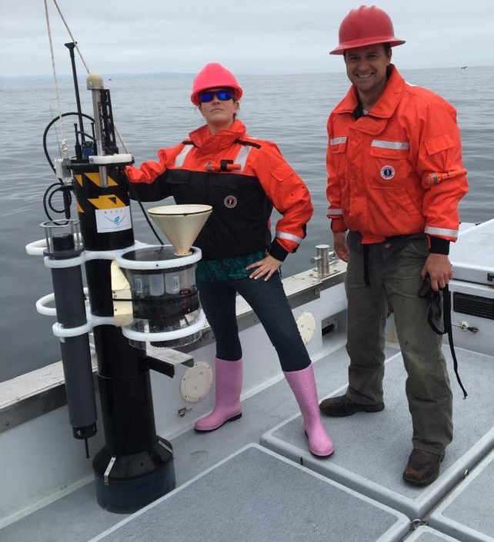
More Engineering Results
No Dead Band
Std Dev = 0.14 m
CPF V1.1 with sediment trap and acoustic modem
Notes:
Exact same control algorithm with no dead band.
After trying several other subsurface Lagrangian floats, the MBARI BOG built 2 for their twice a year field deployments
Ballast in 350 gram increments in the test tank
Control algorithms designed for maximum stability and noise rejection and minimal performance
Pick up truck of the sea

Slide 14
Next Steps
  Run science missions with all 6 sensors
    The influence of lateral nutrient transfer from upwelling plumes versus canyon upwelling on the development of high chlorophyll levels in the Monterey Bay “upwelling shadow”
Notes:
Use action verbs
The primary science focus will be the influence of lateral nutrient transport from upwelling plumes versus canyon upwelling on the development of high chlorophyll levels in the Monterey Bay “upwelling shadow”

Slide 15
Next Steps
  Run science missions with all 6 sensors
  Extend the mission duration
Notes:
Use action verbs

Slide 16
Next Steps
  Run science missions with all 6 sensors
  Extend the mission duration
  Continue enhancing reliability
Notes:
Use action verbs

Slide 17
Next Steps
  Run science missions with all 6 sensors
  Extend the mission duration
  Continue enhancing reliability
  Finish new rechargeable battery pack with 3X higher energy per cm³
Notes:
Use action verbs

Slide 18
Next Steps
  Run science missions with all 6 sensors
  Extend the mission duration
  Continue enhancing reliability
  Finish new rechargeable battery pack with 3X higher energy per cm³
  Replace/supplement ROMS model current forecasts with small, low power current sensor e.g. tactical grade MEMS Inertial Measurement Unit
Notes:
Use action verbs

Slide 19
Next Steps
  Run science missions with all 6 sensors
  Extend the mission duration
  Continue enhancing reliability
  Finish new rechargeable battery pack with 3X higher energy per cm³
  Replace/supplement ROMS model current forecasts with small, low power current sensor e.g. tactical grade MEMS Inertial Measurement Unit
  Make our data freely available on MBARI FloatViz
Notes:
Use action verbs

Slide 20
Next Steps
  Run science missions with all 6 sensors
  Extend the mission duration
  Continue enhancing reliability
  Finish new rechargeable battery pack with 3X higher energy per cm³
  Replace/supplement ROMS model current forecasts with small, low power current sensor e.g. tactical grade MEMS Inertial Measurement Unit
  Make our data freely available on MBARI FloatViz
  Make the CPF tech. available to the community
Notes:
Use action verbs

Slide 21

Acknowledgements
The CPF Village also includes: Jerry Allen, Larry Bird, Luke Coletti, Jared Figurski, Tom Marion, Jim Montgomery, Mike Parker, Josh Plant, Erich Rienecker, Jose Rosal, Aaron Schnittger, Ray Thompson and Mark Tynes
This work has been generously supported by the David and Lucille Packard Foundation
$6 Million of CPFs
Thank you

Slide 22
NOAA scientists are reviewing unusual environmental conditions in the Pacific Ocean as the likely culprit for the dramatically low returns of Chinook and coho salmon to rivers and streams along the West Coast of the United States in 2007.
Researchers from NOAA's Northwest and Southwest Fisheries Science Centers are comparing data on the low food production of the California Current in 2005 that occurred when this year's returning salmon would have been entering the ocean from their natal streams to feed and grow.
The cold waters of the California Current flow southward from the northern Pacific along the West Coast and are associated with upwelling, an ocean condition caused by winds that bring nutrients to the ocean's surface and is the main source of nourishment for the ocean's food web. In 2005 a southward shift in the jet stream, delayed favorable winds and upwelling for the California Current, which normally begins in spring. The winds instead arrived in mid-July, causing high surface water temperatures and very low nutrient production within the near-shore marine ecosystem.
"We are not dismissing other potential causes for this year's low salmon returns," said Usha Varanasi, NOAA Fisheries Service Science Center Director for the Northwest Region. "But the widespread pattern of low returns along the West Coast for two species of salmon indicates an environmental anomaly occurred in the California Current in 2005."
New data released by the Pacific Fisheries Management Council indicate the 2007 returns of fall Chinook salmon to the Sacramento River in California's Central Valley were approximately 33 percent of what fishery biologists expected. Projections for 2008 are substantially lower than last year's estimate.
Coho salmon returning to spawning streams in California and Oregon are also considerably lower than predicted. A preliminary analysis found an average 27 percent of the parental stock returning in 12 streams monitored in California. Even though coho returns appear to improve along the coast from south to north, Oregon Coast coho salmon had less than 30 percent of their parental stock return.
Coho salmon are listed as either endangered or threatened under the Endangered Species Act in the Central/Northern California and Southern Oregon watersheds.

