Slide 1
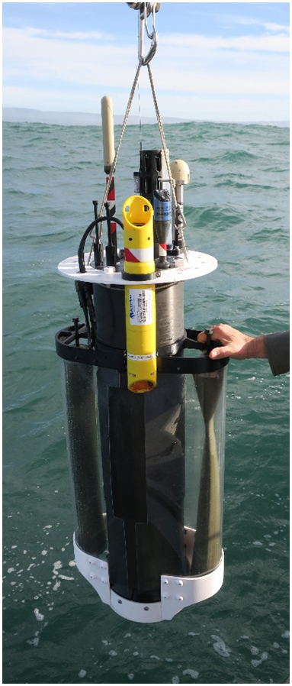
MBARI’s Coastal Profiling Float: Progress, Science Opportunities and Tech Transfer
Gene Massion
Monterey Bay Aquarium Research Institute, Moss Landing, CA, United States
NOAA/PMEL 2024 May 16
Notes:
Thanks very much for the opportunity to talk about MBARI’s coastal profiling float project
Describe what this project is

Slide 2
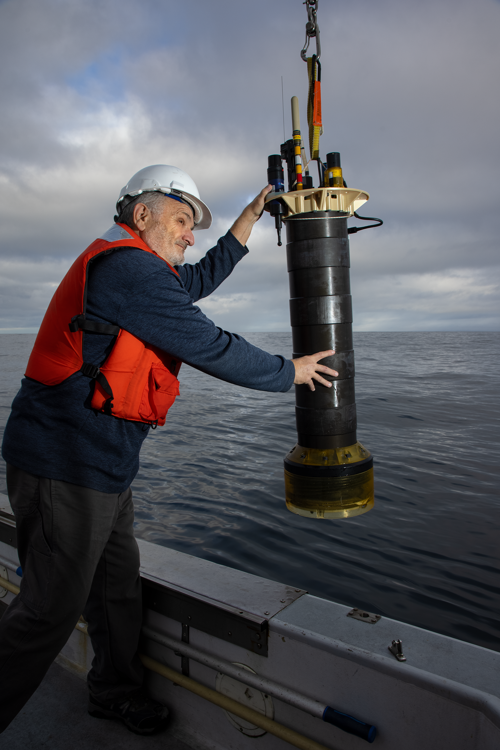
Executive Summary
MBARI is finishing the development of a coastal profiling float (CPF) system targeted at developing a better understanding the health of the ocean
Photo: Lori Eanes/Monterey Bay Aquarium

Slide 3

Executive Summary
MBARI is finishing the development of a coastal profiling float (CPF) system targeted at developing a better understanding of ocean health and how our ocean is changing
The CPF is optimized for use in the coastal zones and upper 350 meters of the world’s oceans: “where the bugs are”
Photo: Lori Eanes/Monterey Bay Aquarium

Slide 4
Executive Summary
MBARI is finishing the development of a coastal profiling float (CPF) system targeted at developing a better understanding of ocean health and how our ocean is changing
The CPF is optimized for use in the coastal zones and upper 350 meters of the world’s oceans: “where the bugs are”
The CPF supports the GO-BGC suite of biogeochemical sensors: CTD, Oxygen, pH, Nitrate, Fluorescence, Backscatter, Optical Radiation and others
Photo: Lori Eanes/Monterey Bay Aquarium

Slide 5
Executive Summary
MBARI is finishing the development of a coastal profiling float (CPF) system targeted at developing a better understanding of ocean health and how our ocean is changing
The CPF is optimized for use in the coastal zones and upper 350 meters of the world’s oceans: “where the bugs are”
The CPF supports the GO-BGC suite of biogeochemical sensors: CTD, Oxygen, pH, Nitrate, Fluorescence, Backscatter, Optical Radiation and others
We are discussing ways to move the CPF technology out to the greater community
Photo: Lori Eanes/Monterey Bay Aquarium

Slide 6

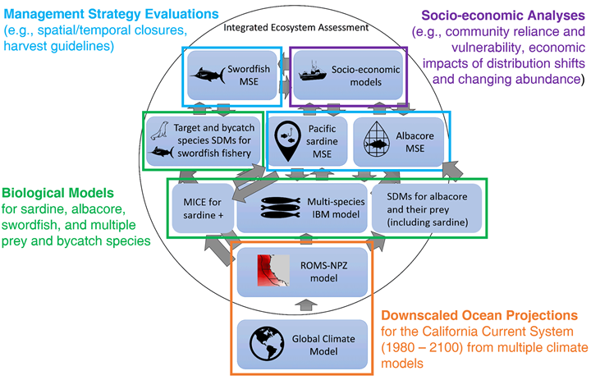
The Initial Motivation
“the widespread pattern of low returns along the West Coast for two species of salmon indicates an environmental anomaly occurred in the California Current in 2005"
NOAA Future Seas
A More Recent Motivation
Physics-to-Fisheries Management systems will need data to calibrate and validate models
Notes:
I’m an ocean engineer, I’m not an fishery scientist but the message I got at the time was that not enough of the right kind of data was getting into the right hands at the right time to effectively manage fisheries.
Obviously things have come a long way. NOAA Future Seas is applying models to explore future scenarios in an “end-to-end” framework. I worked in a modeling group in grad school and, at least back then, we needed a significant volume of data to calibrate and validate our model of PCB transport in Lake Erie.

Slide 7
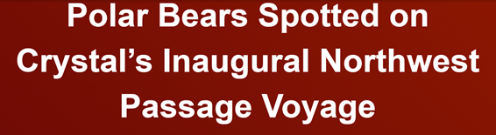


One of My Motivations
Navigating the New Arctic
“Current Arctic observations are sparse and inadequate for enabling discovery or simulation … to assess their impacts on the broader Earth system”
Notes:
Additional motivation include the Coastal Carbon Synthesis Group’s community workshop report where the recommended more development of observing systems for continental margins.
Community workshops sponsored by Ocean Carbon and Biogeochemistry Program and North American Carbon Program
NSF also published their 10 big ideas, the areas that will drive their research agenda for the near future. One of the 10 big ideas is Navigating the New Arctic and again, they point out the lack of data limiting our understanding.
While the arctic was not one of our initial research topics, we think it is within the capability of the CPF.

Slide 8
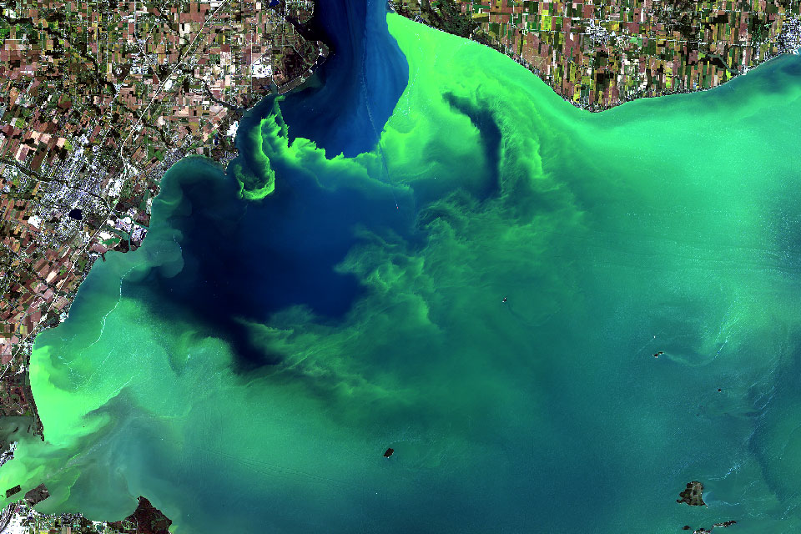
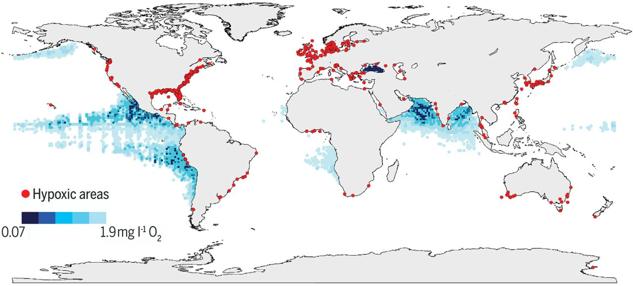
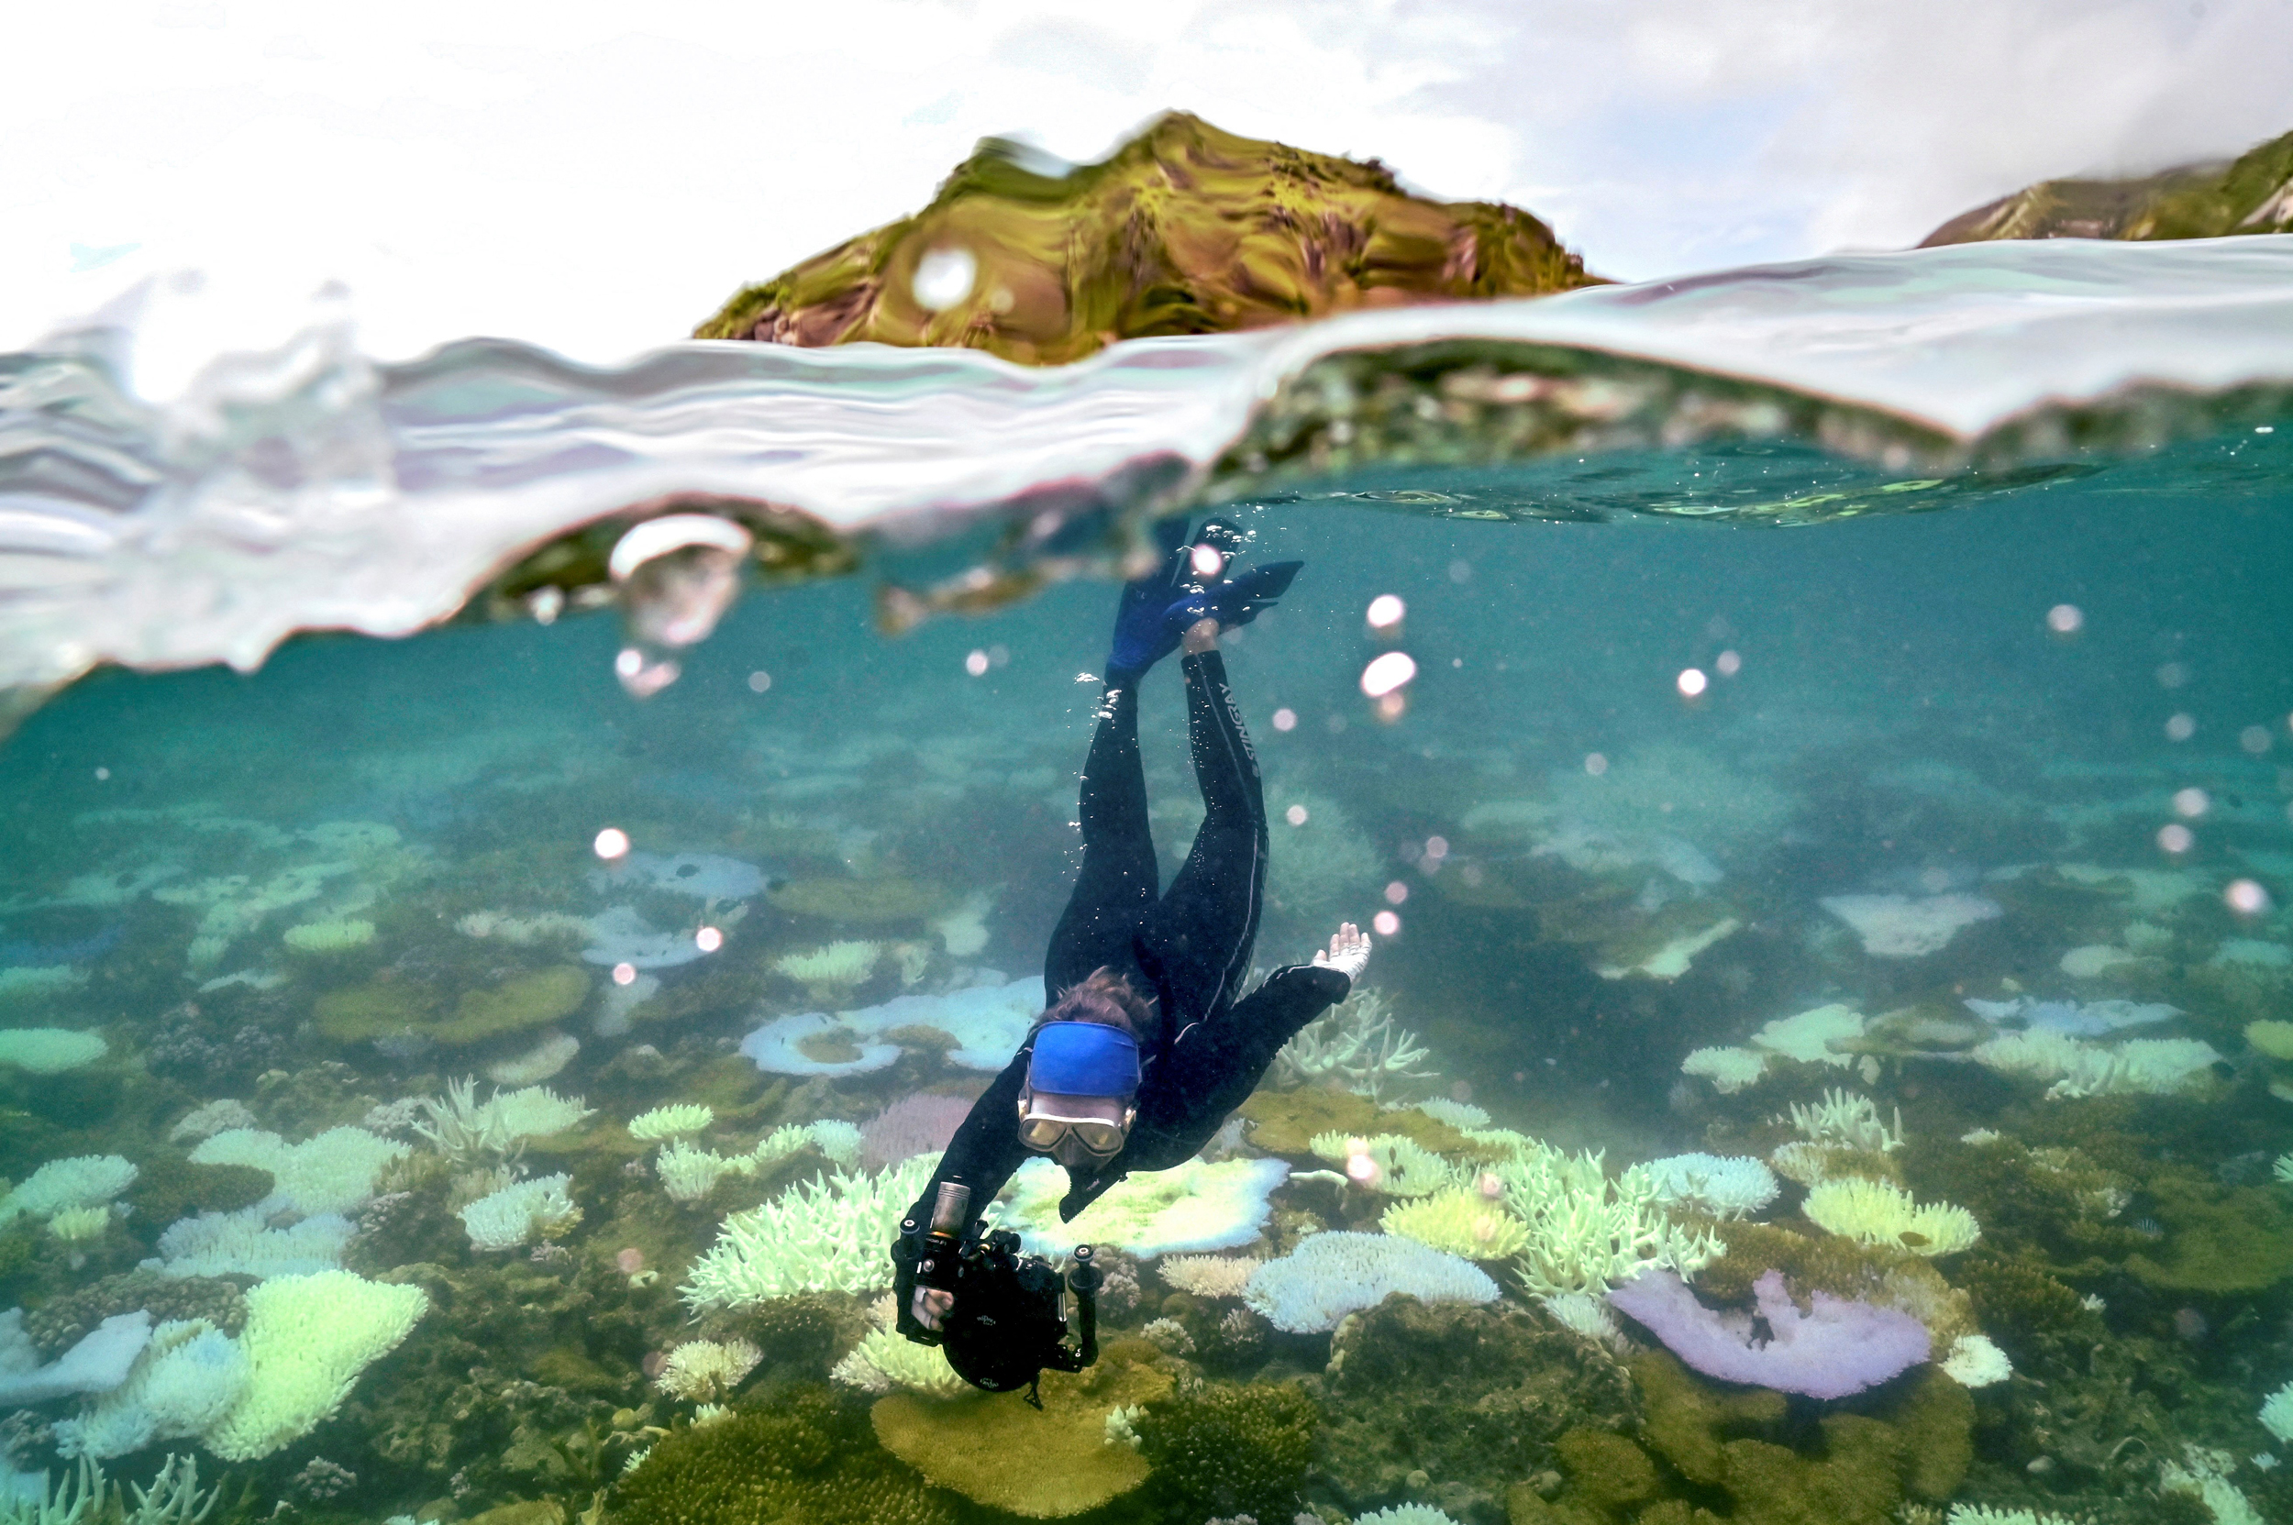
And Lots More Motivation
Can we clean up, stop, or end harmful algal blooms?
https://oceanservice.noaa.gov/facts/hab-solutions.html
Ocean scientists call for global tracking of oxygen loss that causes dead zones
Declining oxygen in the global ocean and coastal waters, Denise Breitburg, et.al, SCIENCE, 5 Jan 2018, Vol 359, Issue 6371 https://www.science.org/doi/10.1126/science.aam7240
Increasingly Frequent Ocean Heat Waves Trigger Mass Die-Offs of Sealife, and Grief in Marine Scientists
https://insideclimatenews.org/news/01052024/ocean-heat-waves-killing-sealife/
Notes:
Low and declining oxygen levels in the open ocean and coastal waters affect processes ranging from biogeochemistry to food security.
The global map indicates coastal sites where anthropogenic nutrients have exacerbated or caused O2 declines to <2 mg liter−1 (<63 μmol liter−1) (red dots) One definition for hypoxia, as well as ocean oxygen-minimum zones at 300 m of depth (blue shaded regions). [Map created from data provided by R. Diaz, updated by members of the GO2NE network, and downloaded from the World Ocean Atlas 2009].

Slide 9

A Current, Compelling Application
Measurement, Reporting and Validation for mCDR
Notes:
Additional motivation include the Coastal Carbon Synthesis Group’s community workshop report where the recommended more development of observing systems for continental margins.
Community workshops sponsored by Ocean Carbon and Biogeochemistry Program and North American Carbon Program
NSF also published their 10 big ideas, the areas that will drive their research agenda for the near future. One of the 10 big ideas is Navigating the New Arctic and again, they point out the lack of data limiting our understanding.
While the arctic was not one of our initial research topics, we think it is within the capability of the CPF.

Slide 10
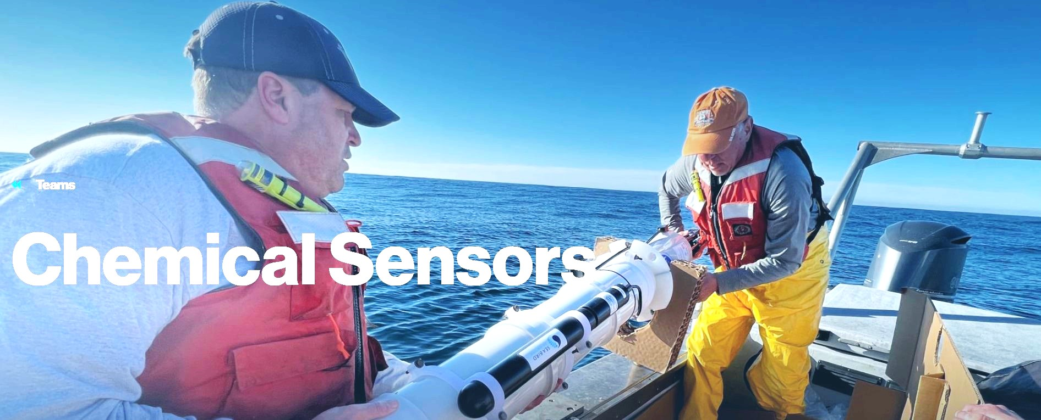

We develop sensor and float technologies to record fundamental ocean properties
Our research target is “understanding the health of the ocean”
We have commercialized pH and Nitrate sensors
We are heavily involved in the SOCCOM and GO-BGC projects https://soccom.princeton.edu/ https://www.go-bgc.org/
Notes:
Additional motivation include the Coastal Carbon Synthesis Group’s community workshop report where the recommended more development of observing systems for continental margins.
Community workshops sponsored by Ocean Carbon and Biogeochemistry Program and North American Carbon Program
NSF also published their 10 big ideas, the areas that will drive their research agenda for the near future. One of the 10 big ideas is Navigating the New Arctic and again, they point out the lack of data limiting our understanding.
While the arctic was not one of our initial research topics, we think it is within the capability of the CPF.

Slide 11
Why Profiling Floats?
Arguably the most cost effective observing platform for long-term, ecosystem scale applications
  Capital cost: ~$90K per BGC float
  Deployment costs: Almost any boat or ship of opportunity that can get to the deployment site
  Maintenance cost: Near $0 for 5-7 years
  On-going operations costs: Almost entirely data processing
Notes:
Webb Apex Float = 1%, MRV S2-A Solo II = 3.4%, BSOP Modular = 3/82 = 3.7%, MRV Alamo = 4.2%
Talk about 2 versions: identical from the bottom end cap up

Slide 12
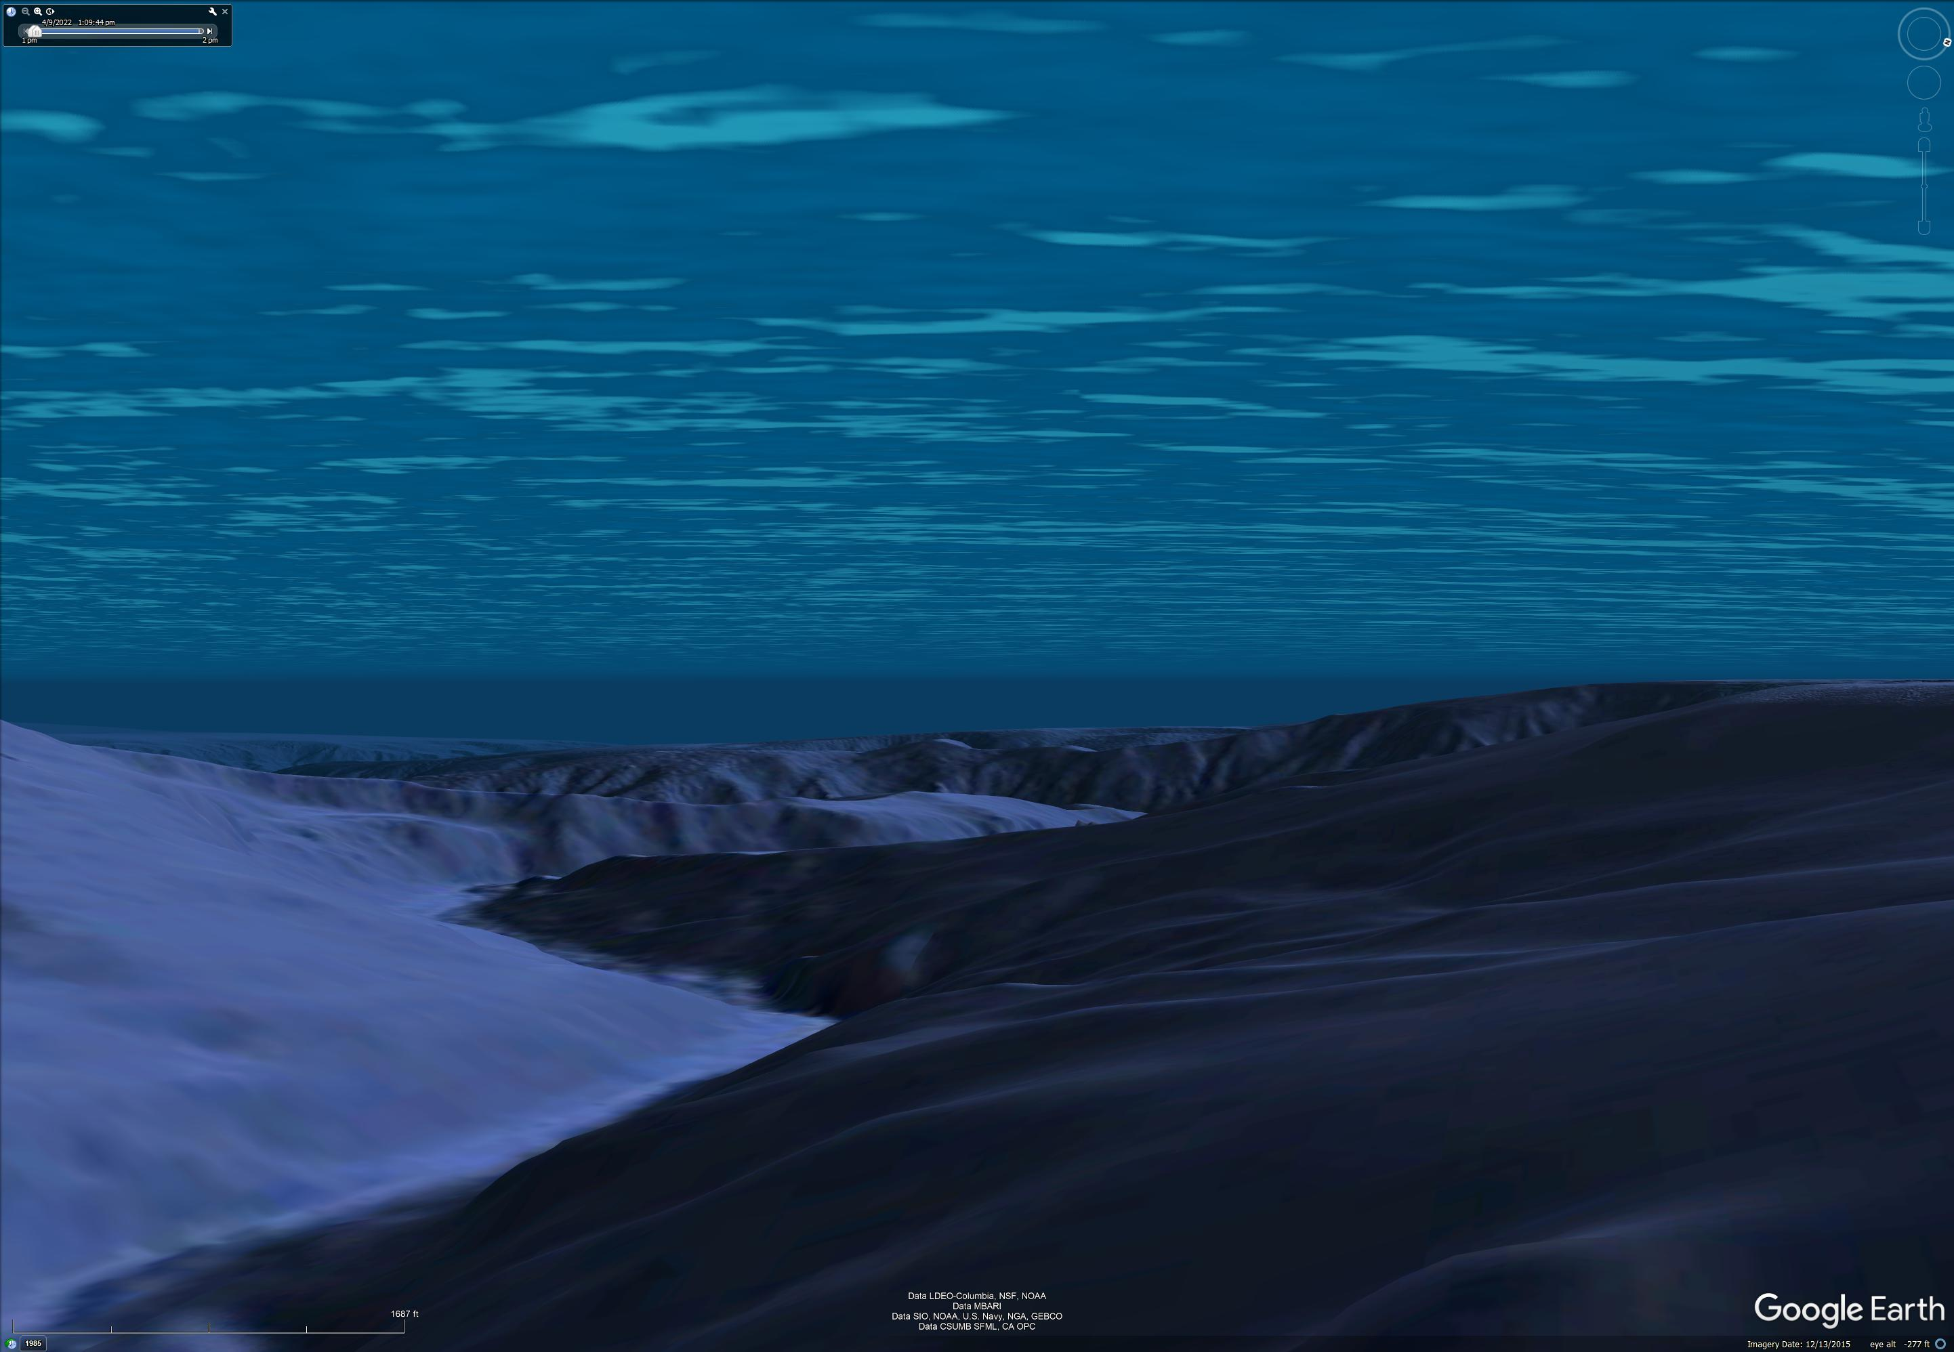
Profiling Float Array + Friends
Notes:
Webb Apex Float = 1%, MRV S2-A Solo II = 3.4%, BSOP Modular = 3/82 = 3.7%, MRV Alamo = 4.2%
Talk about 2 versions: identical from the bottom end cap up

Slide 13
Data
Notes:
Additional motivation include the Coastal Carbon Synthesis Group’s community workshop report where the recommended more development of observing systems for continental margins.
Community workshops sponsored by Ocean Carbon and Biogeochemistry Program and North American Carbon Program
NSF also published their 10 big ideas, the areas that will drive their research agenda for the near future. One of the 10 big ideas is Navigating the New Arctic and again, they point out the lack of data limiting our understanding.
While the arctic was not one of our initial research topics, we think it is within the capability of the CPF.

Slide 14
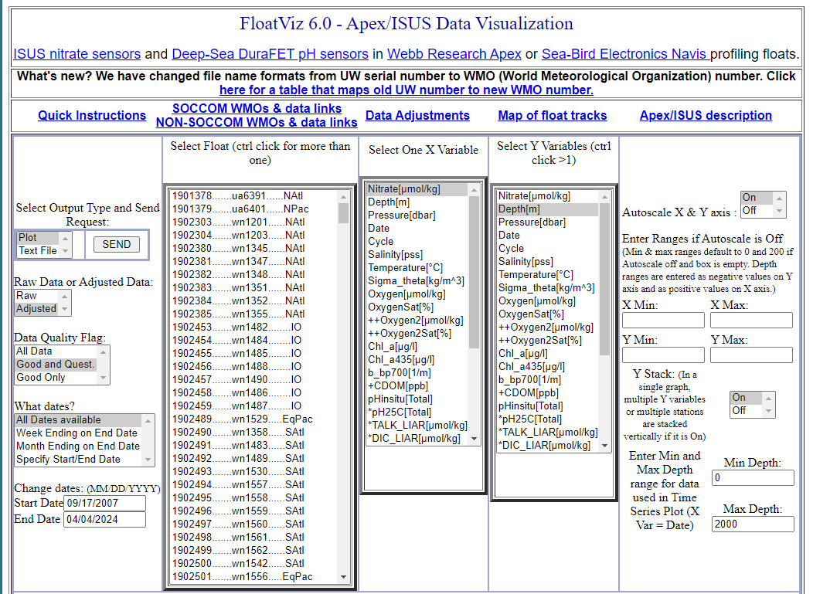
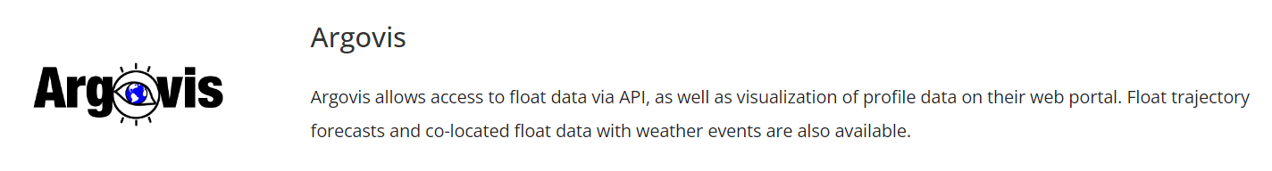
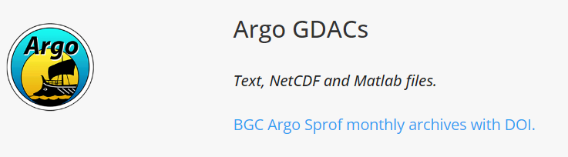

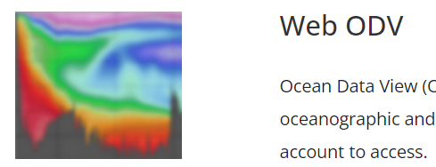
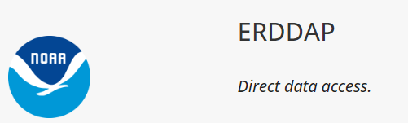
It’s The Economy, Stupid
(apologies to James Carville)
DATA
Right Now
Our “deliverable” is relevant, defensible data products
We’ve focused on generating relevant data products since the early days
Luckily, part of our lab is very involved in the Argo-BGC data processing and QC pipeline
The CPF generates files that can feed the GO-BGC data pipeline
https://www.go-bgc.org/data/access-and-visualization#float-data-access
Eventually

Slide 15
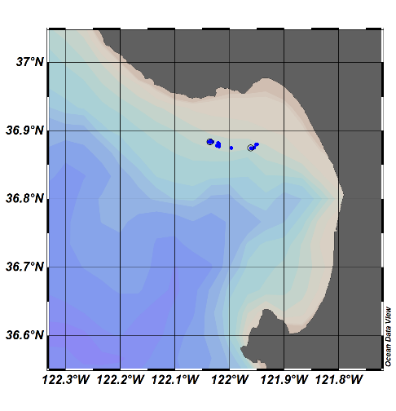

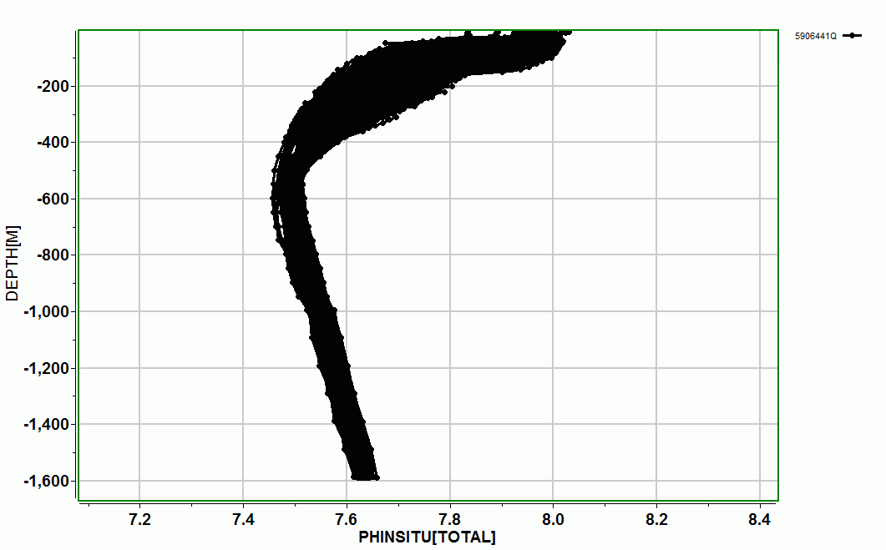
Float Viz
FloatViz ➔ Ocean Data Viz ➔
Notes:
I used to work in the engineering department at MBARI, now I work in the chem sensor lab and one of the first lessons I learned was that our product was useful science data, and that a really well engineering platform isn’t of any value if it doesn’t produce useful science data. I don’t really understand this thinking but I do accept it, so we’ve been working on the shore side tools we need to effectively interpret the data the CPF acquires.
We can see a cold, low oxygen deep water mass roll up the shelf and presumably transport nutrients (we’ll know when we have the Nitrate sensor on.;

Slide 16
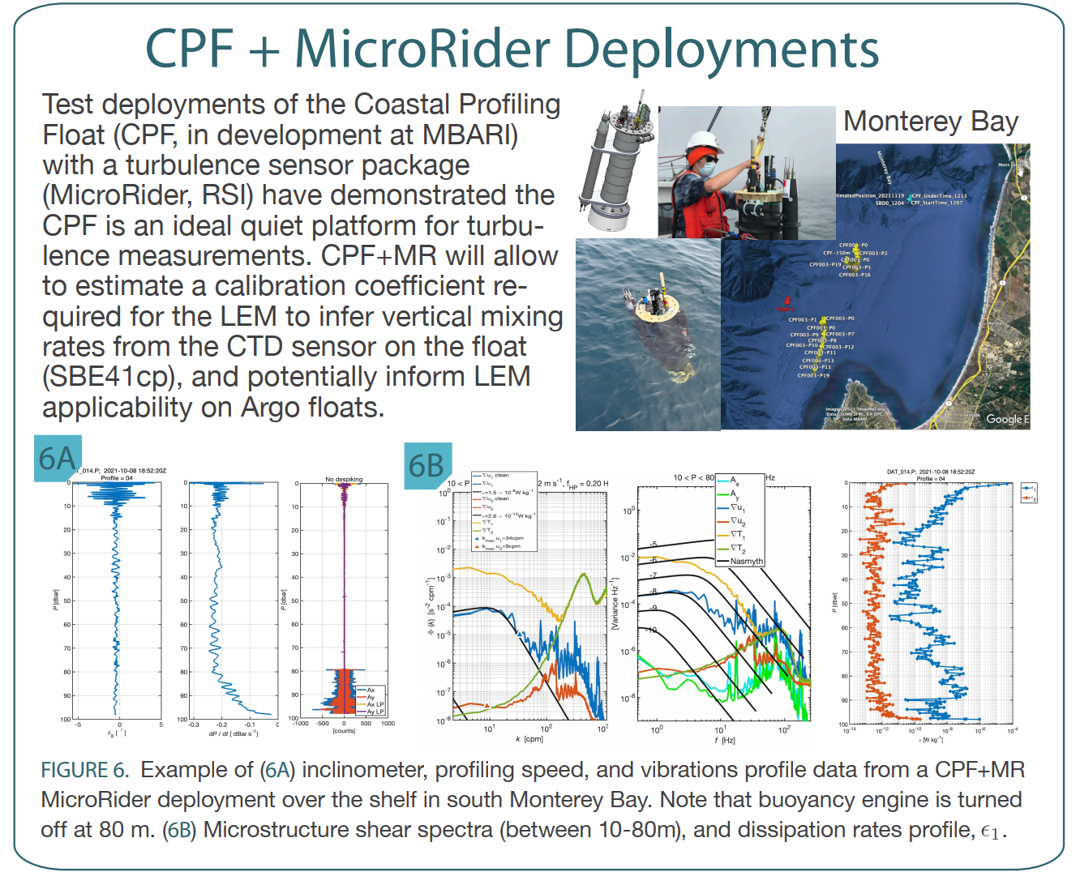
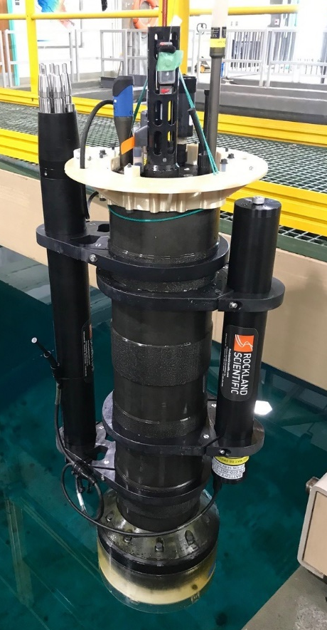
More Science
Can we infer vertical mixing rates from Argo float ascent rates?
Use a CPF with turbulence sensor to acquire high quality turbulence data
See if similar results can be achieved with standard BGC sensors
Magdalena M Carranza(1), Gene Massion, Yui Takeshita and Ken Johnson; Presented at the Gordon Research Conference on Ocean Mixing, Mount Holyoke, MA June 5-10 2022
Acoustics?
Inclination
Profile
Speed
Vibration
Notes:
I used to work in the engineering department at MBARI, now I work in the chem sensor lab and one of the first lessons I learned was that our product was useful science data, and that a really well engineering platform isn’t of any value if it doesn’t produce useful science data. I don’t really understand this thinking but I do accept it, so we’ve been working on the shore side tools we need to effectively interpret the data the CPF acquires.
We can see a cold, low oxygen deep water mass roll up the shelf and presumably transport nutrients (we’ll know when we have the Nitrate sensor on.;

Slide 17
The CPF
Notes:
I used to work in the engineering department at MBARI, now I work in the chem sensor lab and one of the first lessons I learned was that our product was useful science data, and that a really well engineering platform isn’t of any value if it doesn’t produce useful science data. I don’t really understand this thinking but I do accept it, so we’ve been working on the shore side tools we need to effectively interpret the data the CPF acquires.
We can see a cold, low oxygen deep water mass roll up the shelf and presumably transport nutrients (we’ll know when we have the Nitrate sensor on.;

Slide 18


CPF Functionality
Depth range = 0 to 350 meters
BGC Instrument Suite
Electronics
108 cm
Internal Oil Bladder
Oil Pump
External Oil Bladder
Notes:
Webb Apex Float = 1%, MRV S2-A Solo II = 3.4%, BSOP Modular = 3/82 = 3.7%, MRV Alamo = 4.2%
Talk about 2 versions: identical from the bottom end cap up

Slide 19
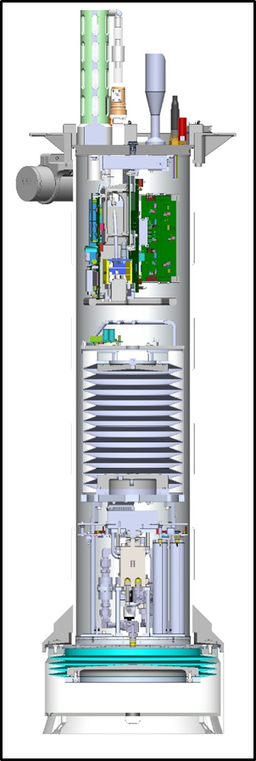
Lots of Volume Change
Depth range = 0 to 350 meters
Buoyancy engine ΔV/V = 3.5 liters / 40 liters = 9%
  Profile from freshwater to 35 psu = 2.5%
  Vertical velocity = zero to ~40 cm/sec
  Ability to anchor and de-anchor
  Reserve buoyancy to offset biofouling and mud accumulation
  Easy ballasting
Notes:
Webb Apex Float = 1%, MRV S2-A Solo II = 3.4%, BSOP Modular = 3/82 = 3.7%, MRV Alamo = 4.2%
Talk about 2 versions: identical from the bottom end cap up

Slide 20
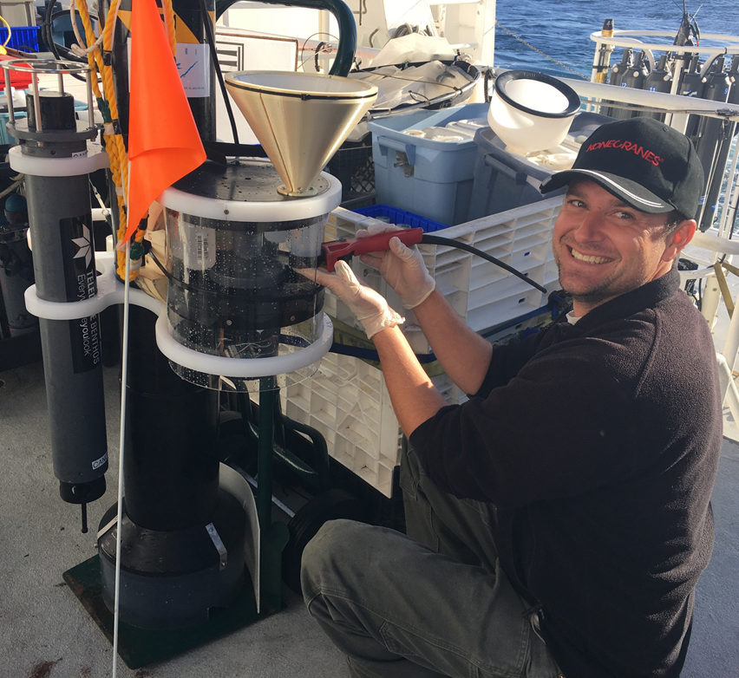
Pickup Truck of the Sea
Depth range = 0 to 350 meters
Buoyancy engine ΔV/V = 3.5 liters / 40 liters = 9%
Sample recovery
  Sediment Traps
Notes:
Webb Apex Float = 1%, MRV S2-A Solo II = 3.4%, BSOP Modular = 3/82 = 3.7%, MRV Alamo = 4.2%
Talk about 2 versions: identical from the bottom end cap up

Slide 21
Lots of Instruments
Depth range = 0 to 350 meters
Buoyancy engine ΔV/V = 3.5 liters / 40 liters = 9%
Sample Recovery
Science Payload = 9 sensor ports
  6 BGC sensors
  Room for 3 more
BGC Instrument Suite
Electronics
108 cm
Internal Oil Bladder
Oil Pump
External Oil Bladder
Notes:
Webb Apex Float = 1%, MRV S2-A Solo II = 3.4%, BSOP Modular = 3/82 = 3.7%, MRV Alamo = 4.2%
Talk about 2 versions: identical from the bottom end cap up

Slide 22
Current CPF Version 2.1 and 2.2
Depth range = 0 to 350 meters
Buoyancy engine ΔV/V = 3.5 liters / 40 liters = 9%
Sample Recovery
Science Payload: 9 sensor ports: 6 BGC sensors plus 3 available ports
Iridium SBD and (soon) RUDICS communications
BGC Instrument Suite
Electronics
Internal Oil Bladder
108 cm
Oil Pump
Batteries
External Oil Bladder
Notes:
Webb Apex Float = 1%, MRV S2-A Solo II = 3.4%, BSOP Modular = 3/82 = 3.7%, MRV Alamo = 4.2%
Talk about 2 versions: identical from the bottom end cap up

Slide 23
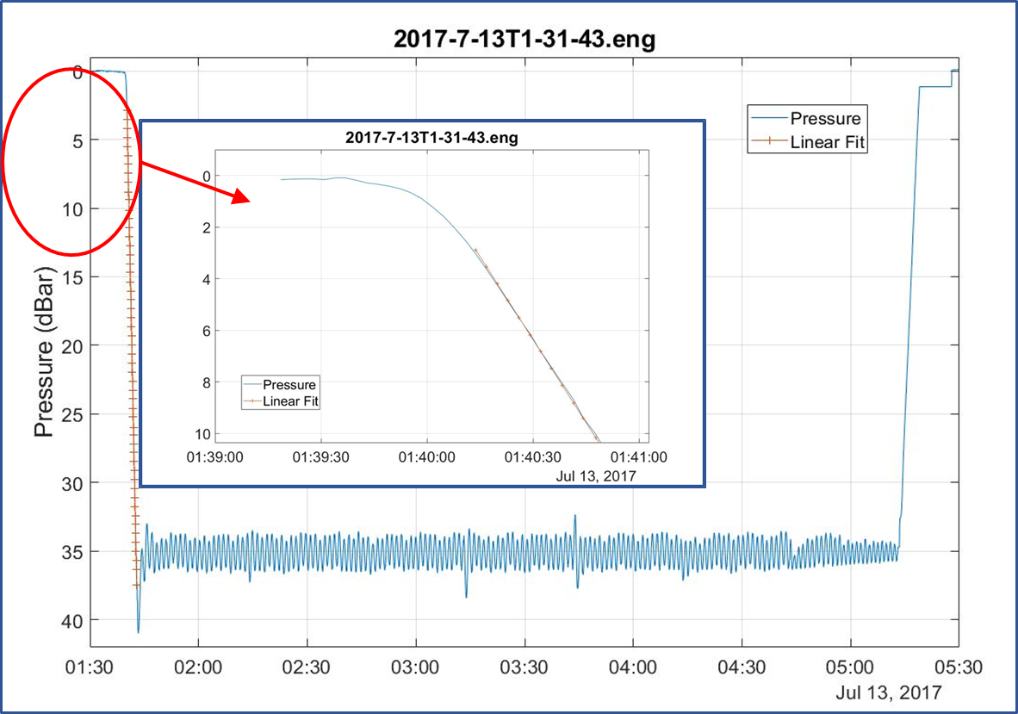
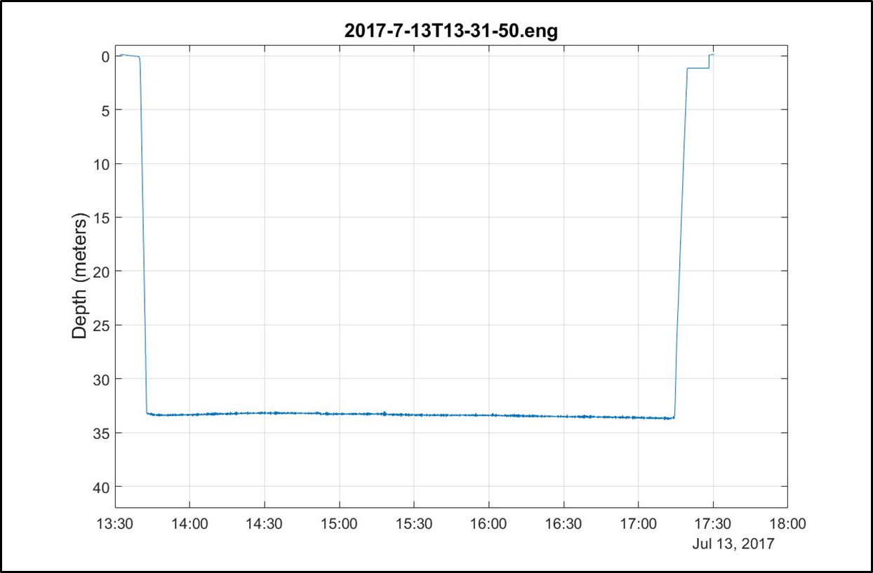
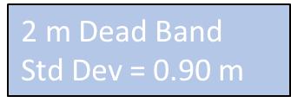
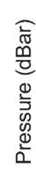
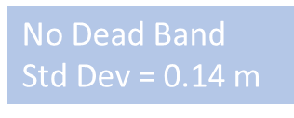
Good Platform Velocity and Depth Control
Depth range = 0 to 350 meters
Buoyancy engine ΔV/V = 3.5 liters / 40 liters = 9%
Sample Recovery
Science Payload: 9 sensor ports: 6 BGC sensors plus 3 available ports
Accurate, closed loop platform velocity and depth control
Notes:
Webb Apex Float = 1%, MRV S2-A Solo II = 3.4%, BSOP Modular = 3/82 = 3.7%, MRV Alamo = 4.2%
Talk about 2 versions: identical from the bottom end cap up

Slide 24
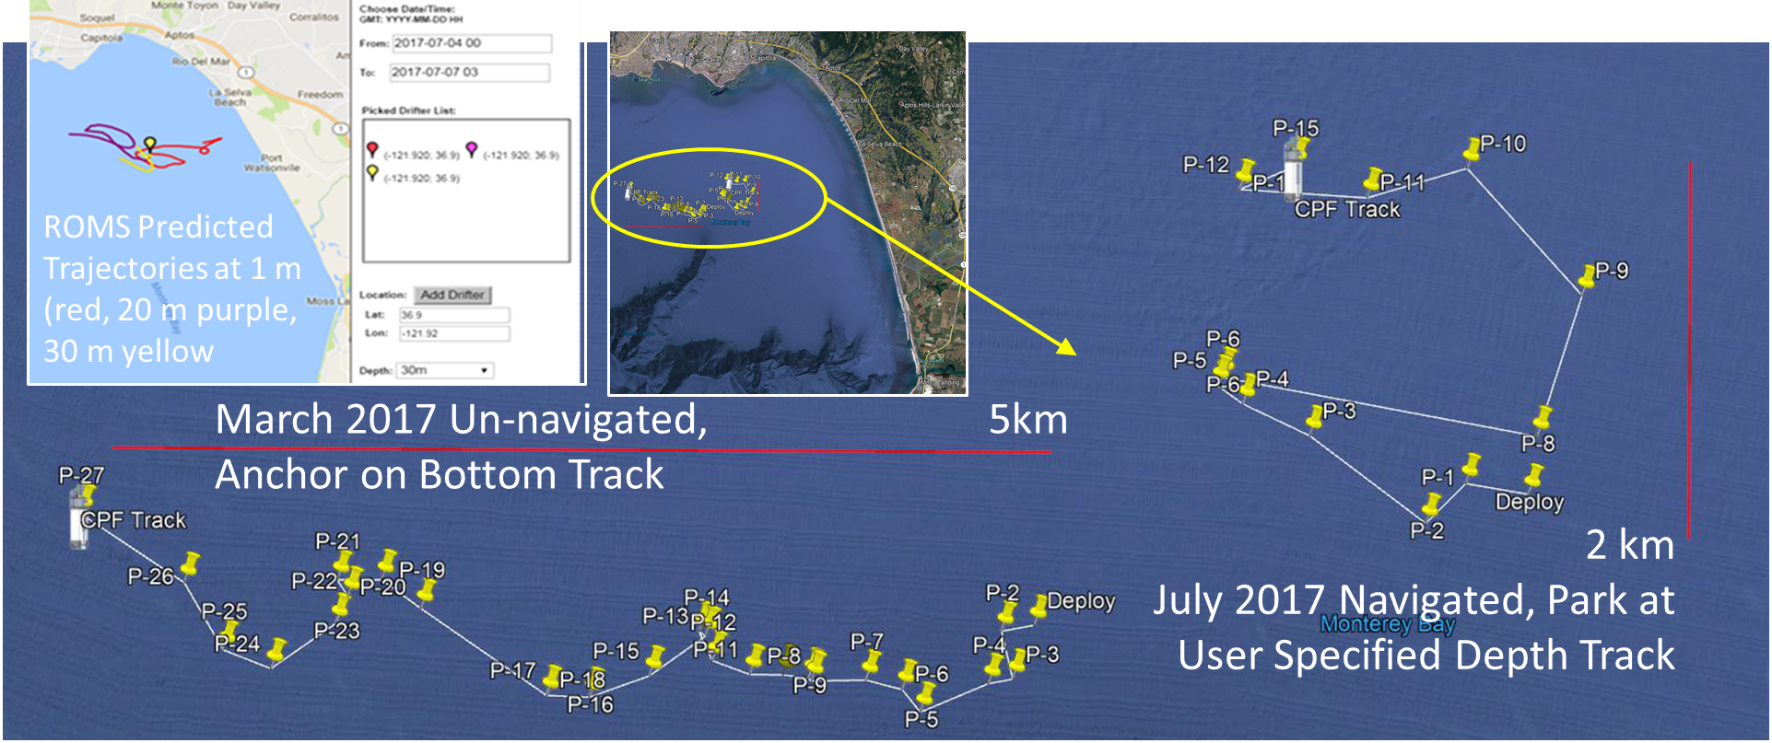
Current and Future Work
Have to do (this year)
  Finish the power management
    Goal = 200 profiles over 1 year
  Finish Iridium RUDICS comms
  Finish building CPF002 and CPF003
  Run more MBARI science missions
Want to do
  Winched version for fixed applications
  Inertial current meter for float “navigation”
  Tech transfer
Notes:
Webb Apex Float = 1%, MRV S2-A Solo II = 3.4%, BSOP Modular = 3/82 = 3.7%, MRV Alamo = 4.2%
Talk about 2 versions: identical from the bottom end cap up

Slide 25
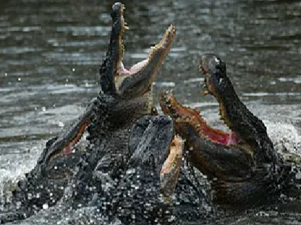
CPF Status Summary
1 CPF with dozens of science and engineering missions in Monterey Bay, some with only modest engineering involvement
2 CPFs nearing completion, operational Q4 2024
Data pipeline demonstrated
2 early CPF prototypes used routinely by MBARI’s BOG group
1 BOG CPF being re-purposed for Colleen Durkin’s carbon export work
TRL 7
TRL 8
TRL 9
NOAA TRL 7: Prototype system… demonstrated in near-real world environment; subsystem components fully integrated into system
NOAA TRL 9: System … deployed and used routinely [without the developers]
Notes:
Webb Apex Float = 1%, MRV S2-A Solo II = 3.4%, BSOP Modular = 3/82 = 3.7%, MRV Alamo = 4.2%
Talk about 2 versions: identical from the bottom end cap up

Slide 26

Technology Transfer
Assumptions:
  MBARI has a TRL 6-7 Coastal Profiling Float system with a very small internal user base
Possible tech transfer options:
    Collaborations
    Commercialization
    Open Sourcing
    Others?
MBARI’s Biological Oceanography Group has been running 2 CPFs for several years (and setting the fashion standard)
Notes:
Webb Apex Float = 1%, MRV S2-A Solo II = 3.4%, BSOP Modular = 3/82 = 3.7%, MRV Alamo = 4.2%
Talk about 2 versions: identical from the bottom end cap up

Slide 27


Tech Transfer Options
  Collaborations
    If a CPF system is interesting to you, let’s talk
  Open Source
    Pros:
      None of the commercialization cons
    Cons:
      I’m only 75% convinced it’s do-able
  Commercialization
    Pros:
      Theoretically, anyone can buy a CPF
    Cons (based on my experience):
      CPFs will be expensive
      Development stagnates
      Degraded reliability
      Sole source risks
      Only provides a product, not the rest of the necessary tools, techniques and processes required for successful projects
      Limited (or no) flexibility to address new applications
      Individual buyers have to cover all the costs even if they only deploy CPFs a couple of months a year
Notes:
Webb Apex Float = 1%, MRV S2-A Solo II = 3.4%, BSOP Modular = 3/82 = 3.7%, MRV Alamo = 4.2%
Talk about 2 versions: identical from the bottom end cap up

Slide 28

Commercialization or Open Source?
Notes:
Webb Apex Float = 1%, MRV S2-A Solo II = 3.4%, BSOP Modular = 3/82 = 3.7%, MRV Alamo = 4.2%
Talk about 2 versions: identical from the bottom end cap up

Slide 29
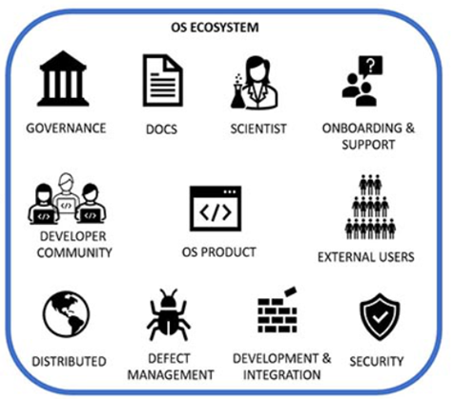
CPF Open Source Ecosystem (COSE)
Critical Infrastructure
  The critical component is an appropriate size group of users
    10 CPFs a year
    OR
    3-5 Projects a year
    OR
    1 immediate, important, large volume need ➔ MRV for mCDR
Pathways to Enable Open-Source Ecosystems (POSE)
PROGRAM SOLICITATION NSF 23-556
Notes:
This is where the talk goes off the rails

Slide 30
CPF Open Source Ecosystem (COSE)
Critical Infrastructure
  Next most critical: A source of CPFs
    Contract Manufacturer
    Equipment supply pool
      e.g., NSF Ocean Bottom Seismograph Instrument Center
    Cooperative CPF-centric groups
    Sponsored builder workshops
    DIY documentation
    Non-exclusive licensees
Pathways to Enable Open-Source Ecosystems (POSE)
PROGRAM SOLICITATION NSF 23-556
Notes:
This is where the talk goes off the rails

Slide 31
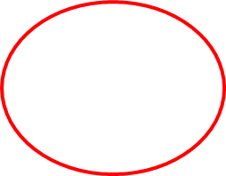
CPF Open Source Ecosystem (COSE)
Critical Infrastructure
  A source of CPFs
  Expertise
    Proposal development
    Project planning
    “Rent-a-Tech”
      Field work design, prep, deploy, operations, recover
    One-stop-shop providers
Pathways to Enable Open-Source Ecosystems (POSE)
PROGRAM SOLICITATION NSF 23-556
Notes:
This is where the talk goes off the rails

Slide 32
CPF Open Source Ecosystem (COSE)
Critical Infrastructure
  A source of CPFs
  Expertise
  Open sourcing an appropriate data pipeline is critical
    Need relevant, defensible standard data products
    Need data product developers
Pathways to Enable Open-Source Ecosystems (POSE)
PROGRAM SOLICITATION NSF 23-556
Notes:
This is where the talk goes off the rails

Slide 33

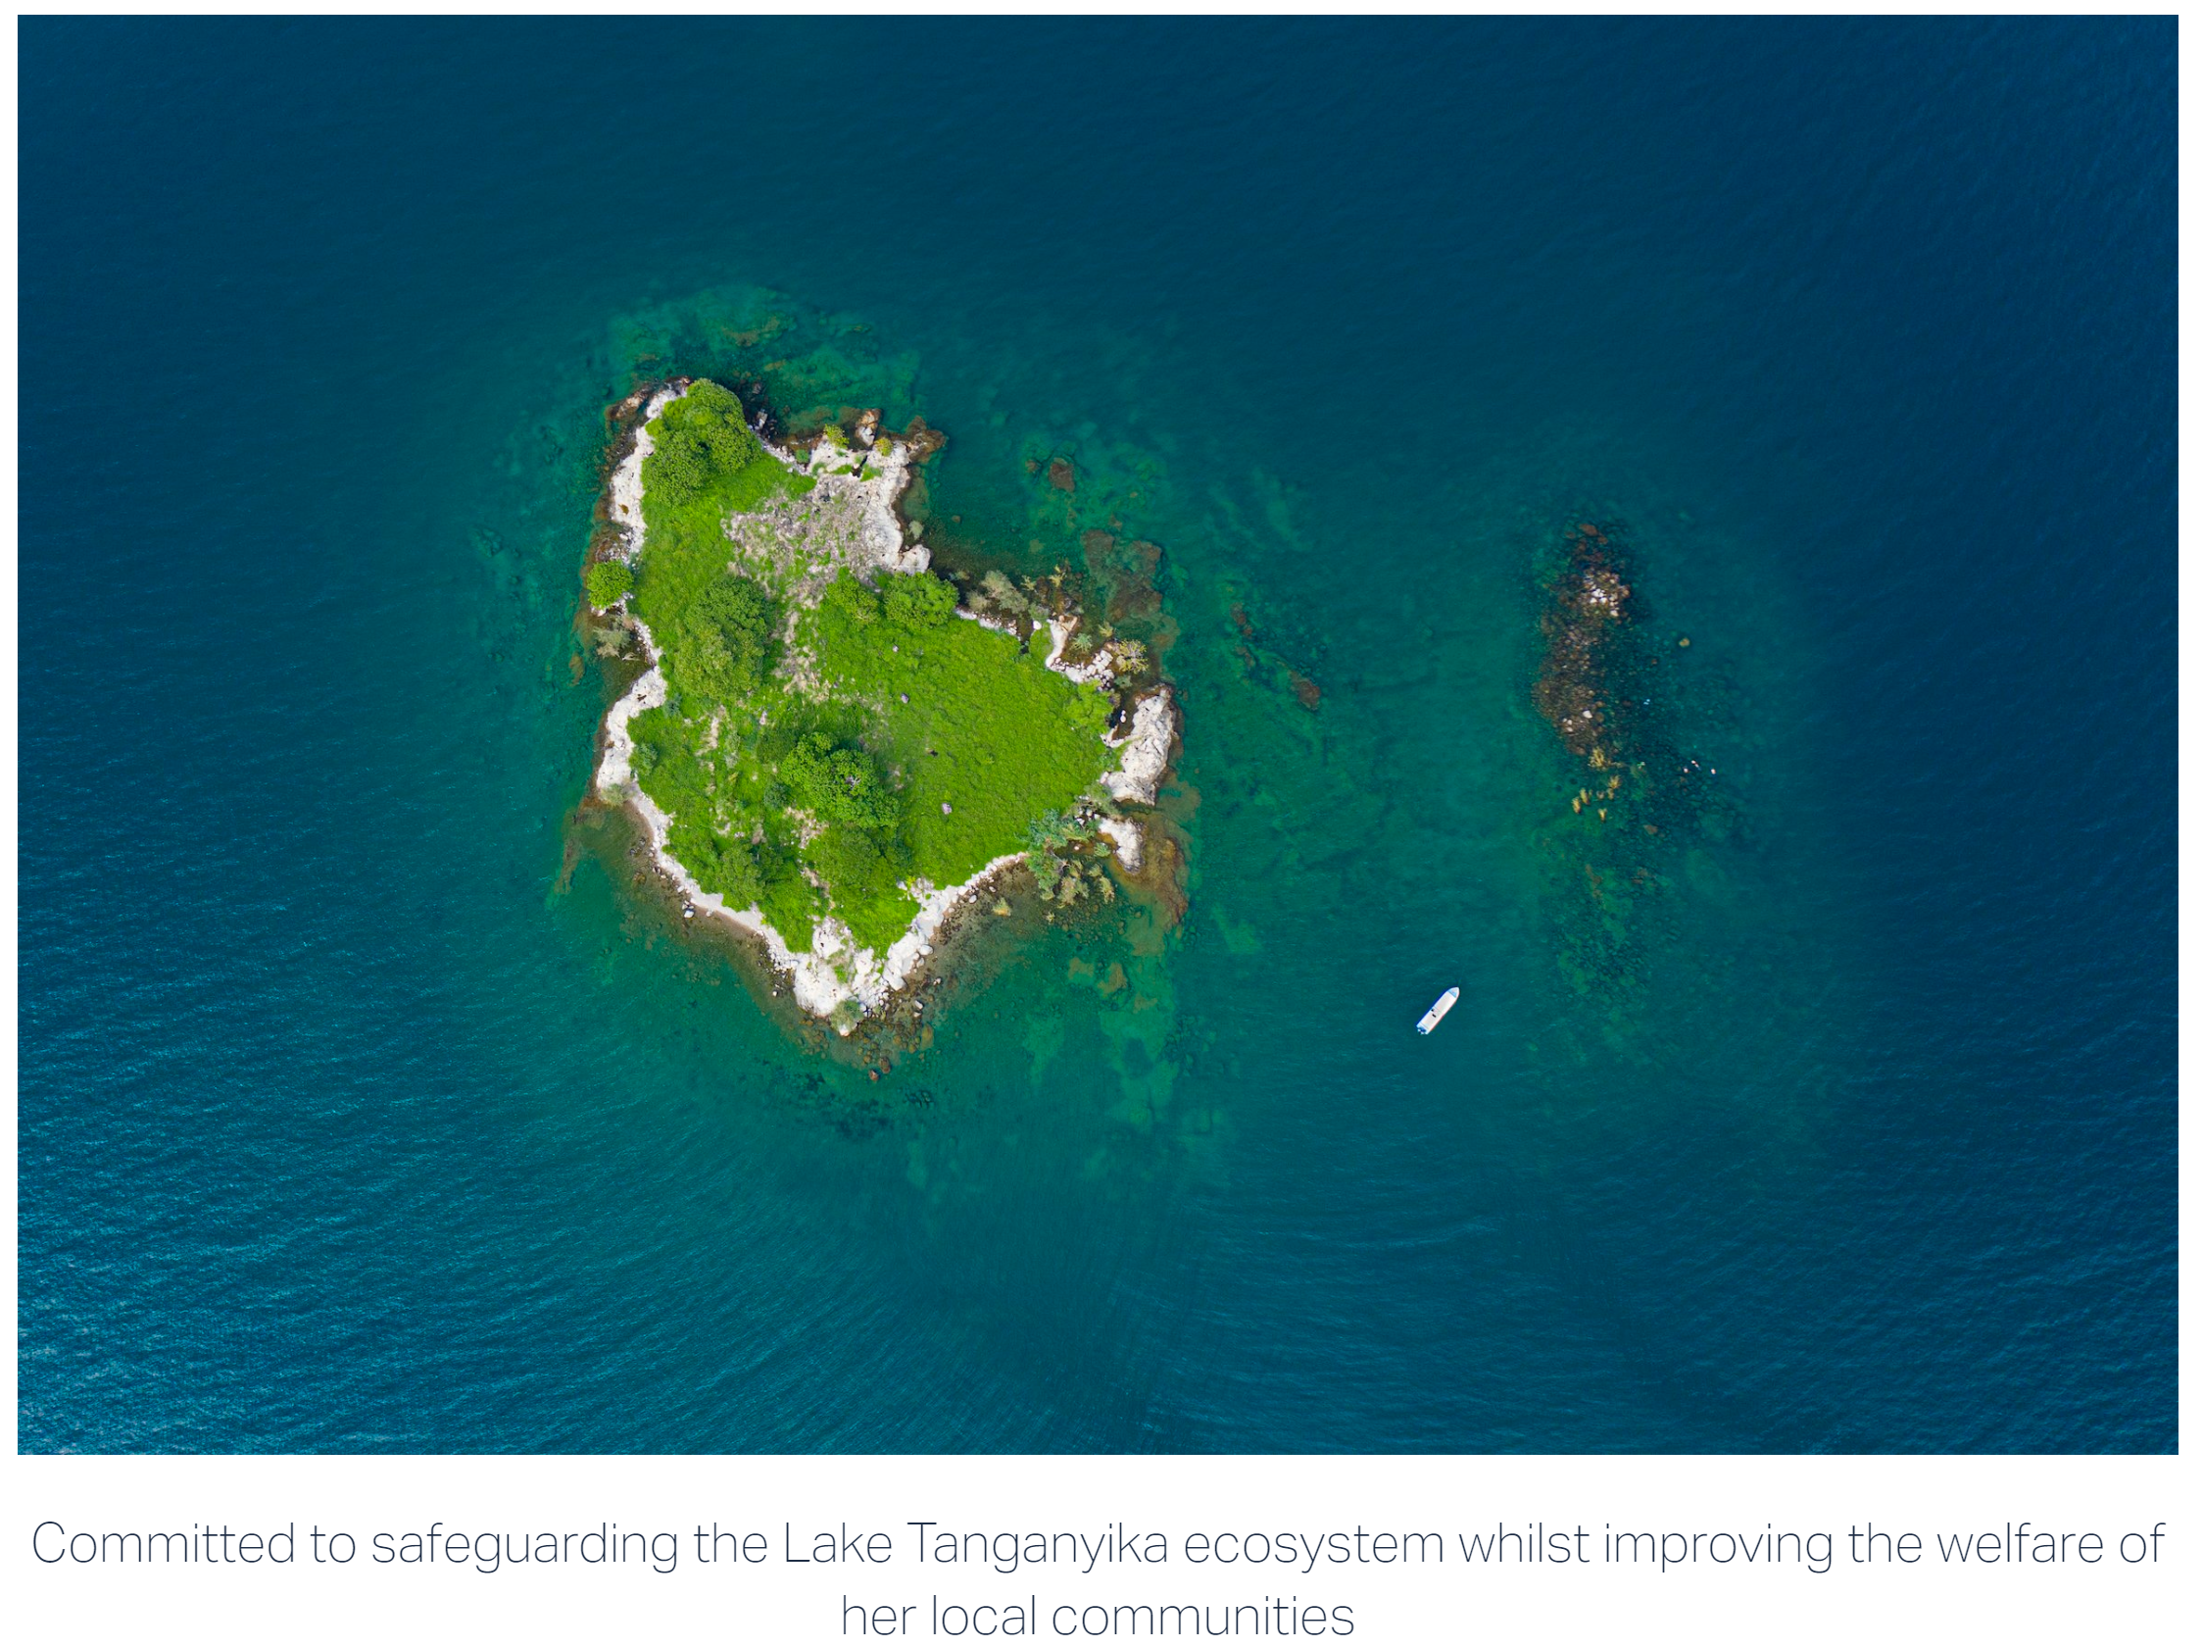
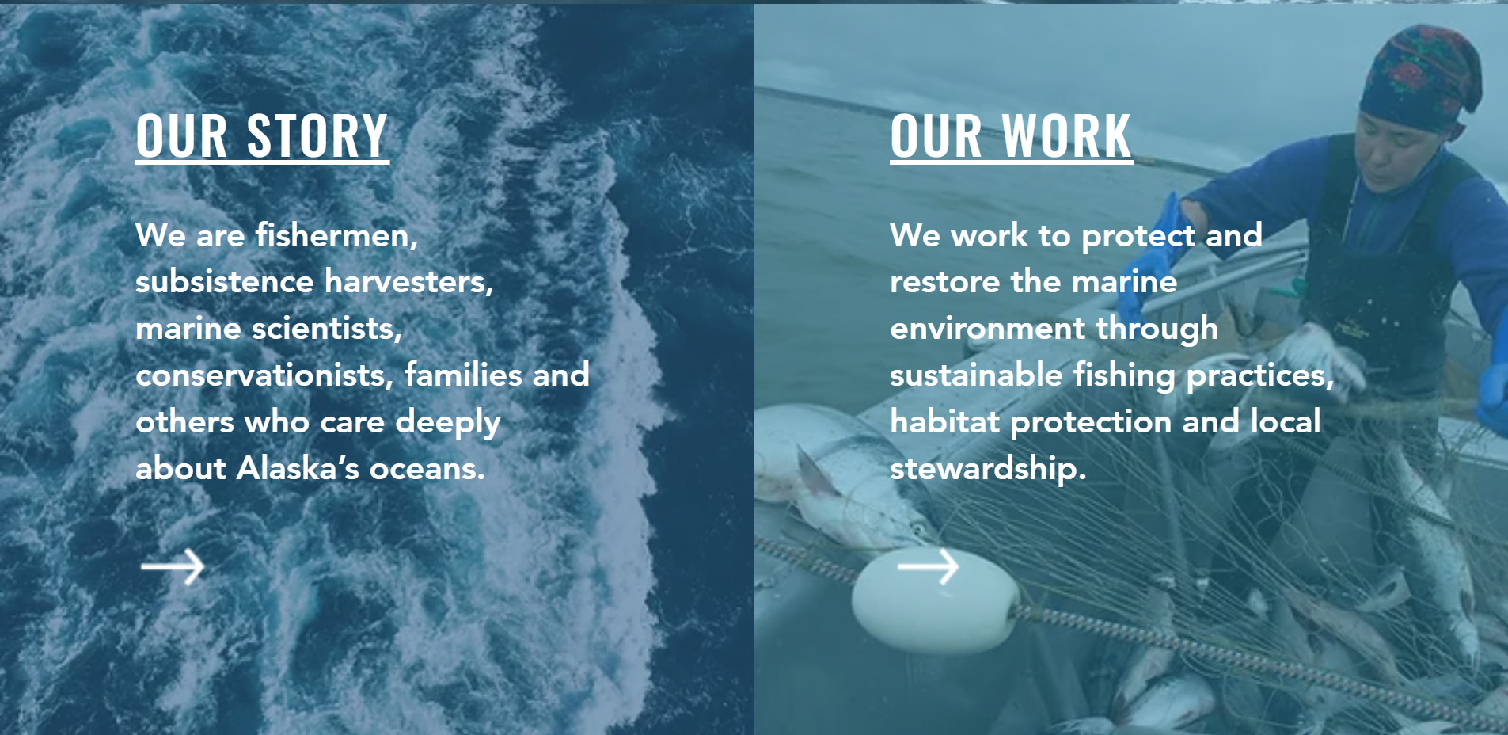
Open Source Targets
    US Regional Fishery Management Councils
    NOAA Integrated Ecosystem Assessment program
      Future Seas “Physics to Fisheries” projections and predictions
    Marine CDR Measurement, Reporting and Validation Mandating projects
    NGOs
INSERT CPF BGC DATA
Alaska Marine Conservation Council
Sustain Lake Tanganyika
Notes:
This is where the talk goes off the rails

Slide 34
Can a COSE Become a Reality?
Or is this just another one of my wild-eyed, bad ideas?
Step 1:
  POSE Phase 1: “The objectives of Phase I projects are … enable scoping activities that will inform the transition of promising research products … into sustainable and robust OSEs that will have broad societal impacts .. provide training to teams interested in building such an OSE” (<1 year <$300K)
Step 2:
  POSE Phase 2: “projects are for open-source research products with a small community of external users and external content developers. The objective of Phase II projects is to support the transition of a promising open-source product into a sustainable and robust OSE” (<2 years <$1.5M)
Step 3:
  In parallel with POSE Phase 2: Win a grant for a marine CO2 removal MRV system pilot project using the CPF Open Source Ecosystem developed through POSE
Notes:
This is where the talk goes off the rails

Slide 35

Thanks for listening
The CPF Village includes: Jerry Allen, Larry Bird, Magdalena Carranza, Paul Conen, Jared Figurski, Tom Marion, Eric Martin, James McClure, Jim Montgomery, Mike Parker, Josh Plant, Erich Rienecker, Jose Rosal, Aaron Schnittger, Ray Thompson, Mark Tynes and Joe Warren
This work has been generously supported by the David and Lucille Packard Foundation
$10 Million of CPFs
magene@mbari.org

Slide 36


More Motivation
“Further development of event-scale observing capacity (e.g., novel autonomous platforms) in all continental margin systems to better quantify impacts of episodic events on coastal carbon budgets”
A Science Plan for Carbon Cycle Research in North American Coastal Waters 2016, Ocean Carbon and Bio. Program and NA Carbon Program
Notes:
Additional motivation include the Coastal Carbon Synthesis Group’s community workshop report where the recommended more development of observing systems for continental margins.
Community workshops sponsored by Ocean Carbon and Biogeochemistry Program and North American Carbon Program
NSF also published their 10 big ideas, the areas that will drive their research agenda for the near future. One of the 10 big ideas is Navigating the New Arctic and again, they point out the lack of data limiting our understanding.
While the arctic was not one of our initial research topics, we think it is within the capability of the CPF.

Slide 37



Float Navigation
Experiment: Park the CPF at various depths and compare track to ROMS nowcast and previous missions that anchored on the bottom after every profile
ROMS Predicted Trajectories at 1 m (red, 20 m purple, 30 m yellow
March 2017 Un-navigated, 5km Anchor on Bottom Track
2 km
July 2017 Navigated, Park at User Specified Depth Track
Notes:
This slide is pretty dense, I’ll try to unpack it for you.
I talked about the challenge of keeping the CPF in the coastal zone and not on the beach of off-shore.
We identified this risk at the beginning of the project and suggested we could mitigate this risk to some extent using operational, 3D numerical current models.
The ROMS model runs every day and give a 3 day 3D forecast of currents in the Monterey Bay.
So if the CPF was drifting west, in many coastal zones there would be a high probability there is a sub-surface current heading roughly east and we could park at that depth to move back toward the target volume. This is much like the way Hot air balloons navigate.
So, we ran an experiment, here’s the target area …
Need to run ROMS at higher resolution particularly given the bathymetry
Maybe crop the ROMS window and add a velocity vs depth plot.

Slide 38
ROMS Predicted Trajectories at 1 m (red, 20 m purple, 30 m yellow
March 2017 Un-navigated, 5km Anchor on Bottom Track
2 km
July 2017 Navigated, Park at User Specified Depth Track
Notes:
This slide is pretty dense, I’ll try to unpack it for you.
I talked about the challenge of keeping the CPF in the coastal zone and not on the beach of off-shore.
We identified this risk at the beginning of the project and suggested we could mitigate this risk to some extent using operational, 3D numerical current models.
The ROMS model runs every day and give a 3 day 3D forecast of currents in the Monterey Bay.
So if the CPF was drifting west, in many coastal zones there would be a high probability there is a sub-surface current heading roughly east and we could park at that depth to move back toward the target volume. This is much like the way Hot air balloons navigate.
So, we ran an experiment, here’s the target area …
Need to run ROMS at higher resolution particularly given the bathymetry
Maybe crop the ROMS window and add a velocity vs depth plot.

Slide 39


Engineering Results
2 m Dead Band
Std Dev = 0.90 m
Notes:
Working in shallow water is a challenge as I mentioned earlier. If you’re working in 20 meters of water you don’t want to spend 15 of those meters getting to a stable vertical velocity
The zoomed inset is for getting off the surface which is harder due to wave action and the fact that we descend at 20 cm/sec and ascend at 10 cm/sec
Sampling is typically done during park, anchor and ascent but can be done on descent if desired.
The depth control has a dead band which in this case is set for +/1 meter.
Tuned for maximum stability and noise rejection and moderate performance
6 meters of overshoot

Slide 40

More Engineering Results
No Dead Band
Std Dev = 0.14 m
Notes:
Exact same control algorithm with no dead band.
After trying several other subsurface Lagrangian floats, the MBARI BOG built 2 for their twice a year field deployments
Ballast in 350 gram increments in the test tank
Control algorithms designed for maximum stability and noise rejection and minimal performance
Pick up truck of the sea

Slide 41
Risks
Risks:
  Working in shallow, coastal water
    Can’t drift on or off-shore
    Need accurate velocity and depth control
  Biofouling
Notes:
If you’re working in 20 meters of water you don’t want to spend 15 of those meters reaching a stable profiling velocity
Profiling floats have been very effective platforms for the pH and Nitrates sensors we’ve developed in our lab but so far, only in deep water, open ocean applications
Profiling floats are kind of a base line for evaluating platform concepts and were the only approach that scaled up to the scales we were targeting at a cost that was consistent with reasonable funding assumptions
Say bottom station ocean profiler
https://www.researchgate.net/publication/4010558_Design_and_initial_results_of_a_bottom_stationing_ocean_profiler
Arvor-C FLOAT DIMENSIONS Overall length: 195cm with antenna Hull length: 140cm Hull diameter: 11cm Weight: 22kg
Talk about anchoring, fast profiling, numerical model

Slide 42
Next Steps
  Run science missions with all 6 sensors
    The influence of lateral nutrient transfer from upwelling plumes versus canyon upwelling on the development of high chlorophyll levels in the Monterey Bay “upwelling shadow”
Notes:
Use action verbs
The primary science focus will be the influence of lateral nutrient transport from upwelling plumes versus canyon upwelling on the development of high chlorophyll levels in the Monterey Bay “upwelling shadow”

Slide 43
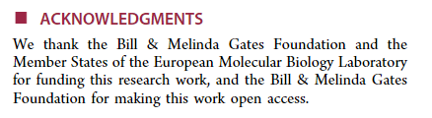
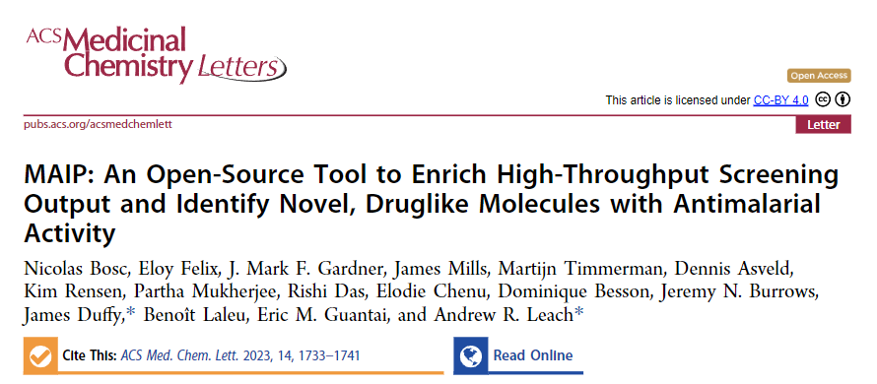

Open Source Examples
  Open source ecosystems (OSEs):
    Arduino (inexpensive, embedded hardware and software)
    Linux (27+ million lines of code, 1000s of developers)
    Open Source Malaria (https://opensourcemalaria.org/)
    NSF Pathways to Enable OSEs program
    Open Source Initiative (software centric https://opensource.org/ )
    Open Source Hardware Association (https://www.oshwa.org/ )
Notes:
This is where the talk goes off the rails

Slide 44
Next Steps
  Run science missions with all 6 sensors
  Extend the mission duration
Notes:
Use action verbs

Slide 45
Next Steps
  Run science missions with all 6 sensors
  Extend the mission duration
  Continue enhancing reliability
Notes:
Use action verbs

Slide 46
Next Steps
  Run science missions with all 6 sensors
  Extend the mission duration
  Continue enhancing reliability
  Finish new rechargeable battery pack with 3X higher energy per cm³
Notes:
Use action verbs

Slide 47
Next Steps
  Run science missions with all 6 sensors
  Extend the mission duration
  Continue enhancing reliability
  Finish new rechargeable battery pack with 3X higher energy per cm³
  Supplement/replace ROMS current forecasts with small, low power current sensor based on new tactical grade moderately expensive Inertial Measurement Unit
Notes:
Use action verbs

Slide 48
Next Steps
  Run science missions with all 6 sensors
  Extend the mission duration
  Continue enhancing reliability
  Finish new rechargeable battery pack with 3X higher energy per cm³
  Supplement/replace ROMS current forecasts with small, low power current sensor based on new tactical grade moderately expensive Inertial Measurement Unit
  Make our data freely available on MBARI FloatViz
Notes:
Use action verbs

Slide 49
Next Steps
  Run science missions with all 6 sensors
  Extend the mission duration
  Continue enhancing reliability
  Finish new rechargeable battery pack with 3X higher energy per cm³
  Replace/supplement ROMS model current forecasts with small, low power current sensor e.g. tactical grade MEMS Inertial Measurement Unit
  Make our data freely available on MBARI FloatViz
  Make the CPF tech. available to the community
Notes:
Use action verbs

Slide 50
NOAA scientists are reviewing unusual environmental conditions in the Pacific Ocean as the likely culprit for the dramatically low returns of Chinook and coho salmon to rivers and streams along the West Coast of the United States in 2007.
Researchers from NOAA's Northwest and Southwest Fisheries Science Centers are comparing data on the low food production of the California Current in 2005 that occurred when this year's returning salmon would have been entering the ocean from their natal streams to feed and grow.
The cold waters of the California Current flow southward from the northern Pacific along the West Coast and are associated with upwelling, an ocean condition caused by winds that bring nutrients to the ocean's surface and is the main source of nourishment for the ocean's food web. In 2005 a southward shift in the jet stream, delayed favorable winds and upwelling for the California Current, which normally begins in spring. The winds instead arrived in mid-July, causing high surface water temperatures and very low nutrient production within the near-shore marine ecosystem.
"We are not dismissing other potential causes for this year's low salmon returns," said Usha Varanasi, NOAA Fisheries Service Science Center Director for the Northwest Region. "But the widespread pattern of low returns along the West Coast for two species of salmon indicates an environmental anomaly occurred in the California Current in 2005."
New data released by the Pacific Fisheries Management Council indicate the 2007 returns of fall Chinook salmon to the Sacramento River in California's Central Valley were approximately 33 percent of what fishery biologists expected. Projections for 2008 are substantially lower than last year's estimate.
Coho salmon returning to spawning streams in California and Oregon are also considerably lower than predicted. A preliminary analysis found an average 27 percent of the parental stock returning in 12 streams monitored in California. Even though coho returns appear to improve along the coast from south to north, Oregon Coast coho salmon had less than 30 percent of their parental stock return.
Coho salmon are listed as either endangered or threatened under the Endangered Species Act in the Central/Northern California and Southern Oregon watersheds.

Slide 51
Title
Good afternoon, I appreciate this opportunity to talk about our Coastal Profiling Float project
Initial Motivation
This project started during a conversation I had with Ken Johnson. Ken runs the chemical sensor lab at MBARI and we had just finished a couple of projects that went pretty well. I asked Ken what else he had on his list of future projects and he showed me this press release from NOAA Marine Fisheries. It was released in 2008 and it attributes the low return of Salmon along the West Coast in 2007 to a lack of nutrients in 2005. You don’t have to read very far between the lines to realize that fisheries managers have an exceptionally difficult job to do and very little data, virtually none in real time, to do it with.
More Motivation
Along the way there was more motivation for this project. The US Ocean Carbon and Biogeochemisty Program and the North American Carbon Program held a series of community workshops and released “A Science Plan for Carbon Cycle Research in North American Coastal Waters” A key recommendation of this plan is further development of autonomous platforms for use in continental margins. This is the target for the CPF.
NSF also released their 10 Big Ideas: 10 research topics that will be a focus of their efforts for the near future. One of the Big Ideas is “Navigating the New Arctic” where they point out that observations are “sparse and inadequate”. While the arctic is not an immediate target for our work, it does seem within the capabilities of the CPF.
Science Requirements
We started the project with the usual process of defining the specific science requirements, identifying risks and developing initial concepts. It is a fairly detailed document but I can summarize the important points here …

Slide 52
Risks and relevant examples
The most important risks we identified were first “Working in Shallow Water’. There are a couple of issues here. Most obvious is winding up on the beach or way off shore. So we need a way to “navigate” the floats that doesn’t take any power, doesn’t take up much volume and will continue working without failure for several years. Next, biofouling is always a problem when working in shallow water and I’ll talk about our mitigation strategies for both these issues in a minute.
My standard concept development process starts with looking around to see what good ideas I can beg, borrow or steal. There a plenty of very effective profiling floats to learn from. The Argo array and the SOCCOM project are great examples of using these profiling floats to provide a cost effective observing system at global and regional scales for deep water, open ocean applications. There are even several examples of profiling floats for coastal application but we thought there was an opportunity here to help advance this technology for coastal applications.
Current CPF
Here’s what the CPF looks like today. It has the usual bits and pieces that any profiler has. An external expandable oil bladder. An oil pump, batteries, an internal oil reservoir, the electronics need to run the whole mess and the science sensor suite. We have 2 versions, one with the external bladder mounted concentrically with the pressure housing and a second version with the external bladder mounted coaxially underneath the pressure housing. Earlier, I mentioned the challenge of keeping the floats from winding up on the beach. One of our strategies for minimizing this risk is anchoring on the bottom between profiles. The concentric design minimizes the horizontal surface areas that could serve as places that might accumulate mud every time we anchor and interferes with the expansion and contraction of the external bladder. But this design is more awkward to deploy and recover. The coaxial design is pretty robust but has the potential of building up mud in the protective cover. Everything is identical in the 2 versions above the lower end cap and while we haven’t done it, it is theoretically possible to swap between the versions. We will be fielding both versions to evaluate the relative pros and cons.

Slide 53
The depth range is down to 500 meters. One of the ways we’ve optimized the CPF for coastal applications is the buoyancy engine. We knew we wanted to anchor on the bottom with some modest negative buoyancy, we knew we wanted to descend fast to minimize drift while we were in the water column and we knew we weren’t going to solve the biofouling issue on this project so we needed extra buoyancy to counteract the weight of the crud fouling the float, at least until the fouling made the sensors ineffective. On way to evaluate the capability of a buoyancy engine is to look at its ratio of delta V to V. Delta V is the amount the float can change it volume, basically the amount of oil we can pump from the internal bladder to the external bladder. V is the overall volume of the float. In our case, we have a deltaV / V of about 9%. For reference, if you want to work in an environment that has fresh water at the surface and typical density water at depth, you need a deltaV/V of 2.5% just to make up for the density gradient in the water column. For further reference, the profiling floats I’m aware of have deltaV/Vs of between 1 and 4%.
We knew we wanted to support the standard BGC sensor suite plus a few other, yet to be determined sensors. The current design supports the 6 BGC sensors and provides for at least 3 more. And we Iridium communications both the standard SBD, which is like 1900 byte text message, and RUDICS which is like a really slow, old school, dial up, 2400 baud internet connection.
Science Data Products
I used to work in the Engineering department at MBARI and now I work in the chemical sensor lab. One of the lessons I learned very soon after this move and continue to learn on a regular basis is that you could have the best engineered platform in the world but if you aren’t generating high quality science data you’re still failing. So we’ve been working on the tools we need to turn the files uploaded by the CPF into standard data products. Here’s a few plots from one of our missions; temperature, oxygen, chlorophyll and backscatter. I’m going to play my engineer card and not try to explain the science here but even to my unscientific engineer’s eye, you can see a blob of cold, low oxygen water. This data is from an early version of the CPF that didn’t have the full suite of sensors. The CPFs we’ll be fielding this year have the full suite of instruments and the science story should get more interesting.

Slide 54
Float Navigation
This slide is pretty dense, I’ll try to unpack it for you. I talked about how we were going to keep the floats in the coastal zone and not in the beach without using any power on the platform. One strategy we have is to make use of the 3D current models that are run operationally, that is they get run every day and the data is available to the community. The idea is to find a current somewhere in the water column that is somewhat opposite to the overall drift of the float. UCLA and Remote Sensing Solutions run the Regional Ocean Modeling System, ROMS, which covers the California Coast. It runs every day and make a 3 day forecast. We ran an experiment where instead or our usual strategy of anchoring on the bottom between profiles, we parked at a couple of different depth and compared the track to another mission where we did anchor between profiles. You can see the big picture in the inset. Here’s the northern part of the Monterey Bay, Santa Cruz to the north, MBARI is here in the middle of the Bay and here’s where we have done most of our testing. Here’s a blowup of the 2 missions. The un-navigated, anchoring mission has a pretty clear east west track. The so called navigated track has an overall south north trend but you can see 3 parts of the track with east/west and west/east movement which suggest the possibility of zigging west for a few profiles and then finding a depth that allows us to zig back east. This is the ROMS model output for the same time as the navigated mission. It has a very nice drop a drifter feature that is actually used in search and rescue missions where you can drop a drifter at a depth or your choosing and ROMS will predict the track based on its current forecast. There isn’t an obvious correlation between the ROMS forecast and the observed track. This is very likely due to the fact that they’re running the operational ROMS model with a 3 km spatial resolution for practical reasons which isn’t accurate enough for our needs. The ROMS model can run at higher resolution and we’ve talked to Yi Chao about doing this. We are a long way from solving this problem but our initial experiment provides a slim glimmer of hope for the future.

Slide 55
Engineering Results
There are some engineering results that I hope are worth discussing. This is a typical depth profile. We start at the surface, descend at 20 cm/second hold depth in the water column and ascend at 20 cm/second. I mentioned the challenge of working in shallow water. One potential issue is if you’re working in 20 meters of water you don’t want to spend 15 of those meters trying to reach a stable profiling velocity. The inset is a zoom the first 10 meters and you can see that we acquire the desired profiling velocity in about the first 3 meters. You can also see a fair amount of oscillation while holding depth. Holding depth is expensive in terms of battery usage. Our depth control algorithm has a dead band that we can set where we don’t run the buoyancy engine as a way to conserve energy. In this case we set the dead band to +/- 1 meter and, not surprisingly, the standard deviation while holding depth is about 0.9 meters.
I should point out that when you design a control system, you have to balance performance and stability. Both our depth and velocity control algorithms are designed to maximize stability and noise rejection but we’re still getting pretty decent performance.
More engineering results
We also did a profile with no dead band, the buoyancy engine was running full time. In this case we were able to hold depth with a standard deviation of 14 cm.
Even more engineering results
There’s a couple of points to be made here. First, MBARI’s biological oceanography group built a couple of the earlier versions of the CPF for their CANON missions. Here you can see the BOG team deploying one with more stuff bolted the CPF then there is CPF. There’s a sediment trap, an acoustic modem and room for a second sediment trap around the back. I think it’s fair to say the CPF is much more of a pick-up truck of the sea and not so much a formula 1 race car.
The second and more important point is that it is demonstrably possible to pull off pink sea boots and a pink hard hat at sea as long as you have the right attitude as Marguerite so capably proves here.

