Slide 1
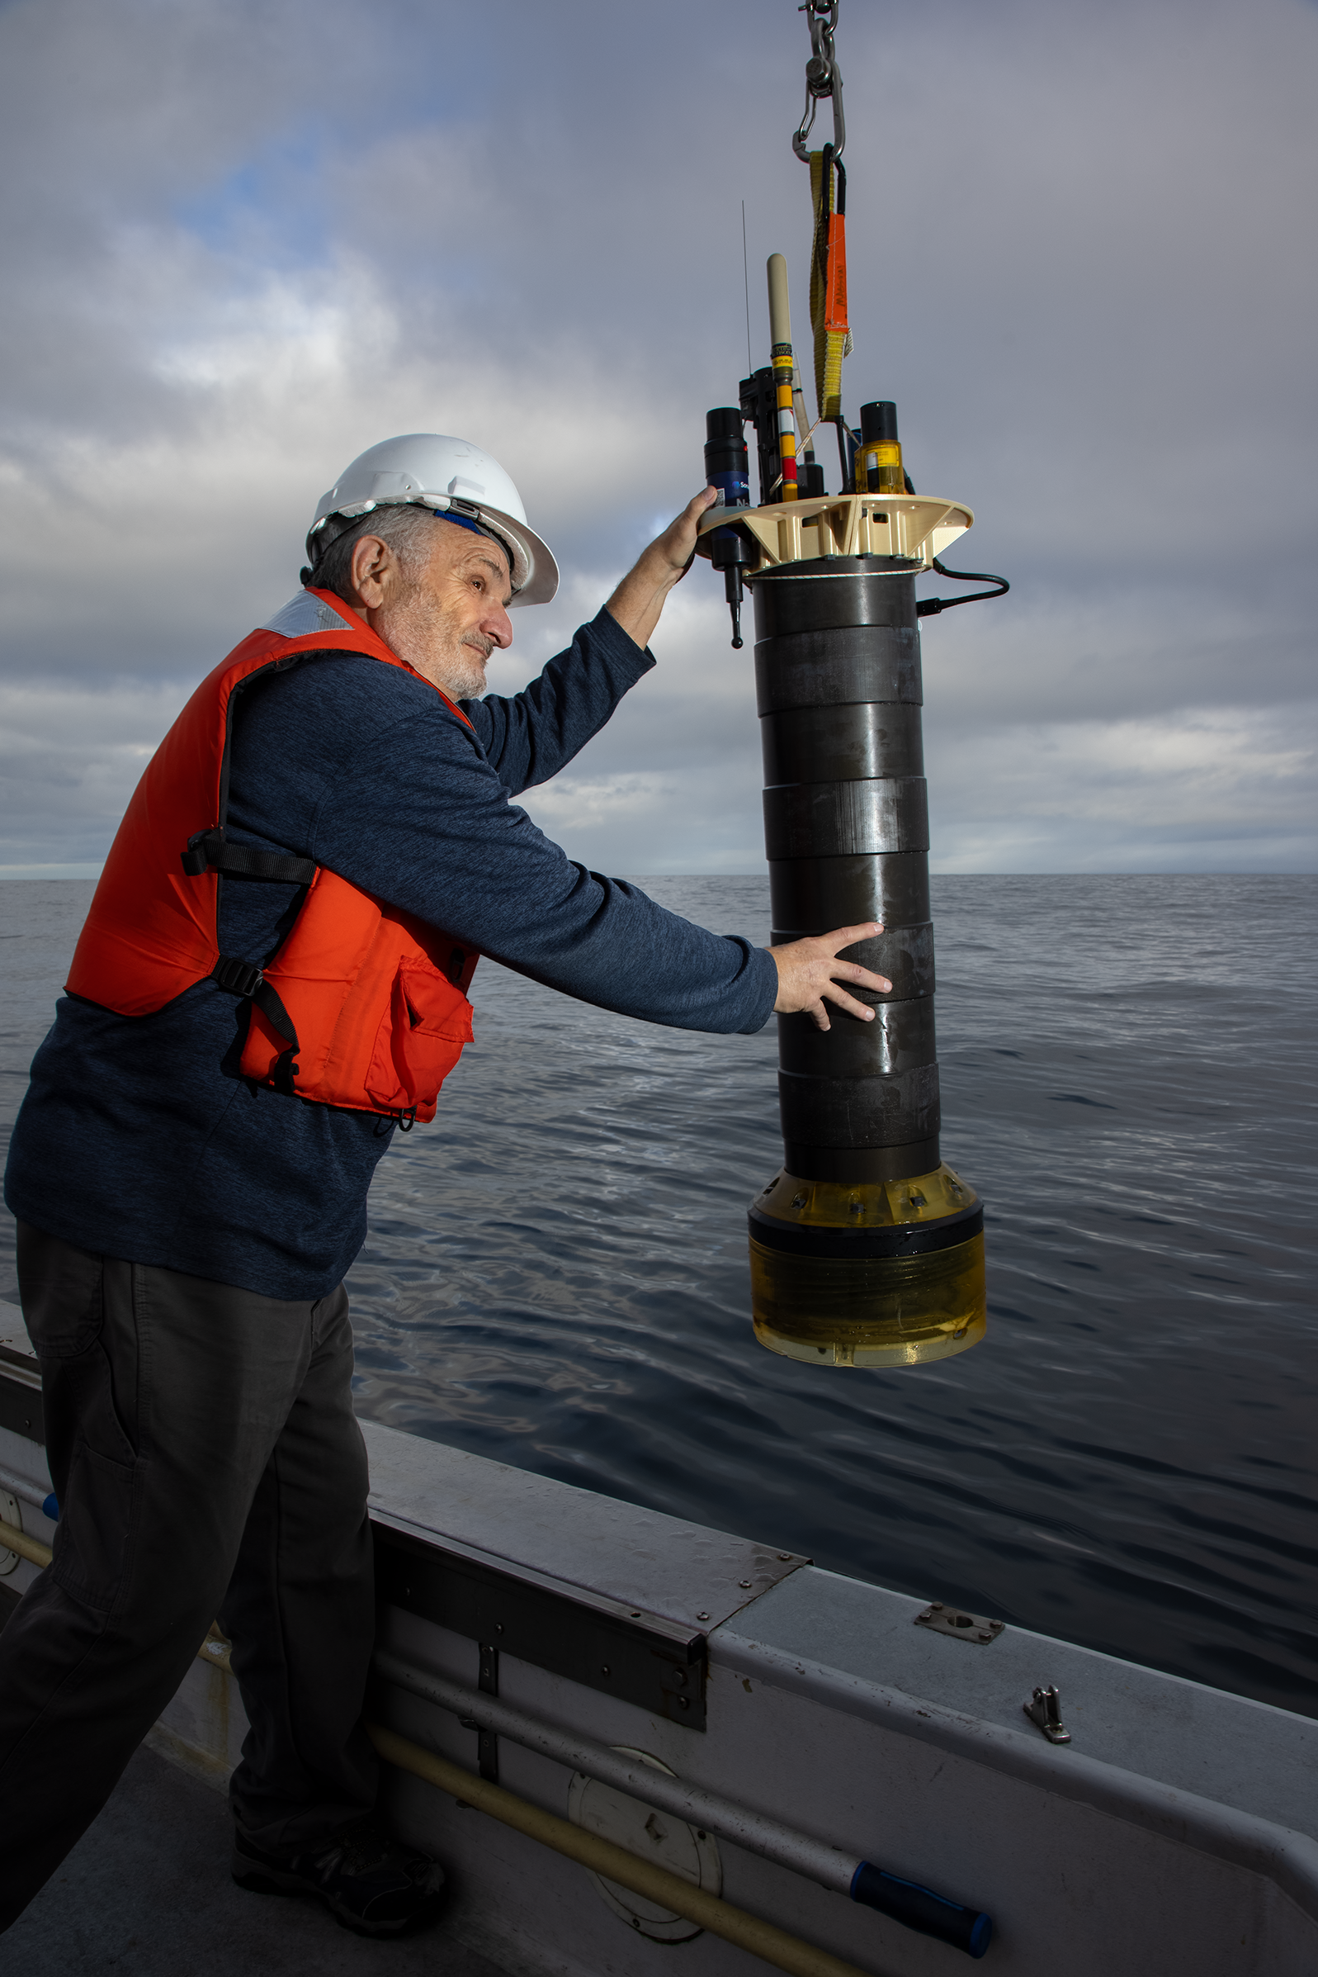
MBARI’s Coastal Profiling Float: Progress, Science Opportunities and Tech Transfer
Gene Massion
Monterey Bay Aquarium Research Institute
NOAA/PMEL 2024 May 16
Photo: Lori Eanes/Monterey Bay Aquarium

Slide 2
Executive Summary
MBARI is finishing the development of a coastal profiling float (CPF) system targeted at better understanding the health of the ocean
Photo: Lori Eanes/Monterey Bay Aquarium

Slide 3

Executive Summary
MBARI is finishing the development of a coastal profiling float (CPF) system targeted at better understanding the health of the ocean
The CPF is optimized for use in the coastal zones and upper 350 meters of the world’s oceans: “where the bugs are”
  And can anchor and de-anchor on the bottom
Photo: Lori Eanes/Monterey Bay Aquarium

Slide 4
Executive Summary
MBARI is finishing the development of a coastal profiling float (CPF) system targeted at developing a better understanding of ocean health and how our ocean is changing
The CPF is optimized for use in the coastal zones and upper 350 meters of the world’s oceans: “where the bugs are”
The CPF supports the GO-BGC suite of biogeochemical sensors: CTD, Oxygen, pH, Nitrate, Fluorescence, Backscatter, Optical Radiation and others
Photo: Lori Eanes/Monterey Bay Aquarium

Slide 5
Executive Summary
MBARI is finishing the development of a coastal profiling float (CPF) system targeted at developing a better understanding of ocean health and how our ocean is changing
The CPF is optimized for use in the coastal zones and upper 350 meters of the world’s oceans: “where the bugs are”
The CPF supports the GO-BGC suite of biogeochemical sensors: CTD, Oxygen, pH, Nitrate, Fluorescence, Backscatter, Optical Radiation and others
We are discussing ways to move the CPF technology out to the greater community
  This seminar, and any follow-up, is part of the conversation
Photo: Lori Eanes/Monterey Bay Aquarium

Slide 6

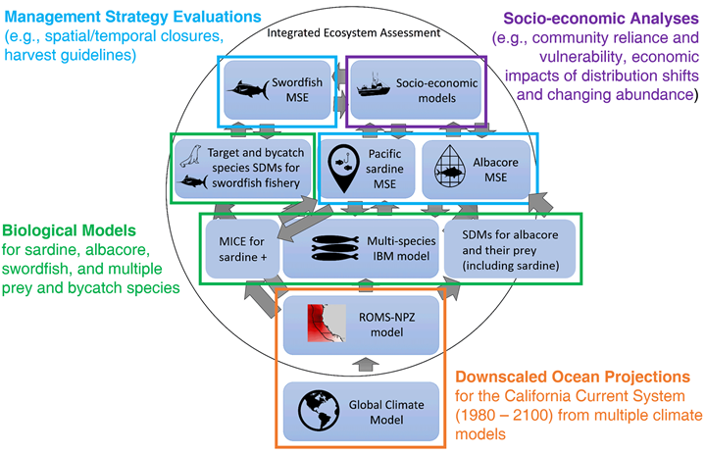
The Initial Motivation
“the widespread pattern of low returns along the West Coast for two species of salmon indicates an environmental anomaly occurred in the California Current in 2005"
NOAA Future Seas
A More Current Motivation
[A model based approach] To evaluate the impacts of climate change on US-managed marine species and identify climate-resilient management strategies.
INSERT DATA HERE
Notes:
ScienceDaily: Unfavorable Ocean Conditions Likely Cause Of Low 2007 Salmon Returns Along West Coast
Date: March 4, 2008 Source: NOAA National Marine Fisheries Service
ScienceDaily: 'Fishery Failure' Declared For West Coast Salmon Fishery
Date: May 2, 2008 Source: National Oceanic And Atmospheric Administration

Slide 7



The New Arctic
Navigating the New Arctic
“Current Arctic observations are sparse and inadequate for enabling discovery or simulation … to assess their impacts on the broader Earth system”

Slide 8
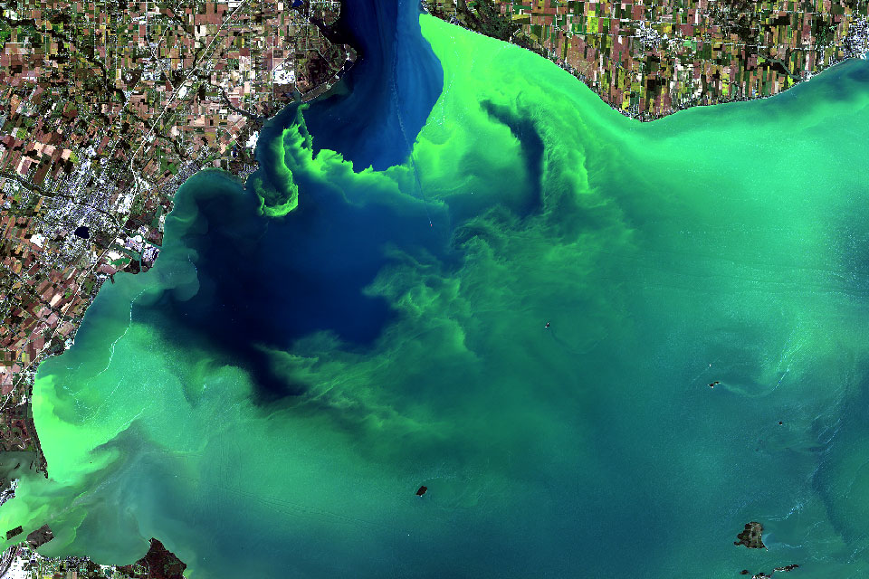
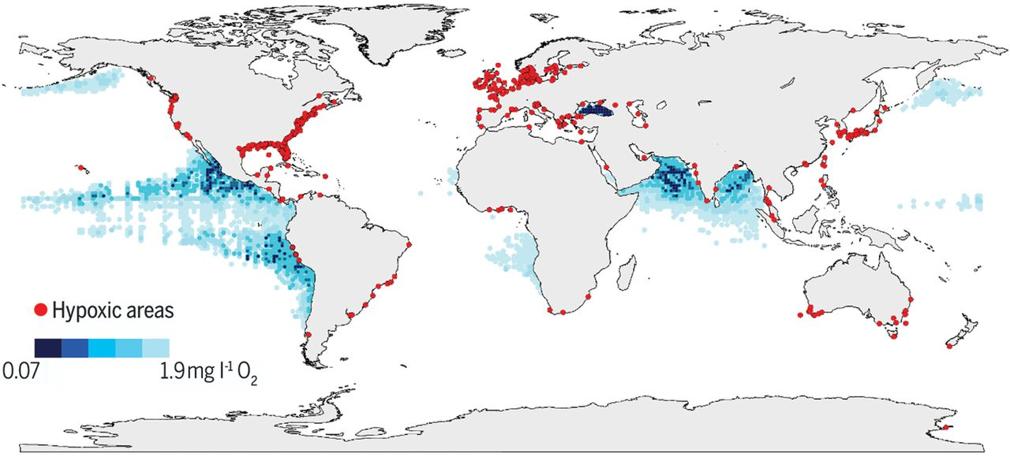
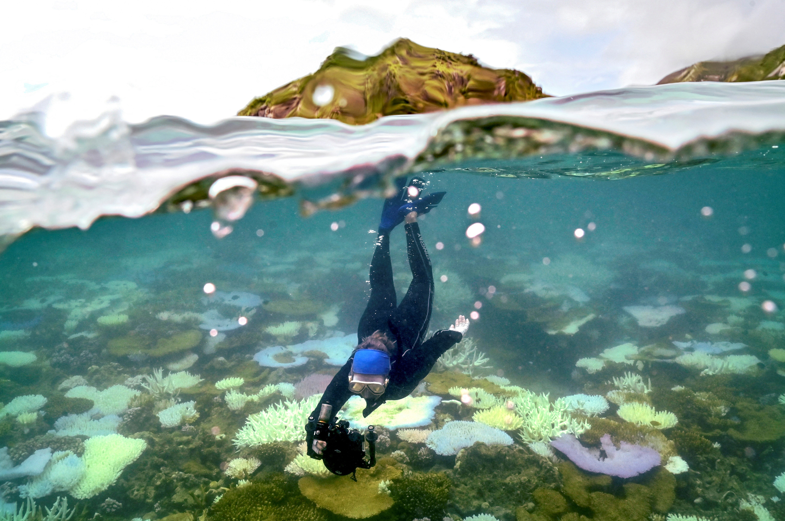
And Lots More Applications
Can we clean up, stop, or end harmful algal blooms?
https://oceanservice.noaa.gov/facts/hab-solutions.html
Ocean scientists call for global tracking of oxygen loss that causes dead zones
Declining oxygen in the global ocean and coastal waters, Denise Breitburg, et.al, SCIENCE, 5 Jan 2018, Vol 359, Issue 6371 https://www.science.org/doi/10.1126/science.aam7240
Increasingly Frequent Ocean Heat Waves Trigger Mass Die-Offs of Sealife, and Grief in Marine Scientists
https://insideclimatenews.org/news/01052024/ocean-heat-waves-killing-sealife/

Slide 9

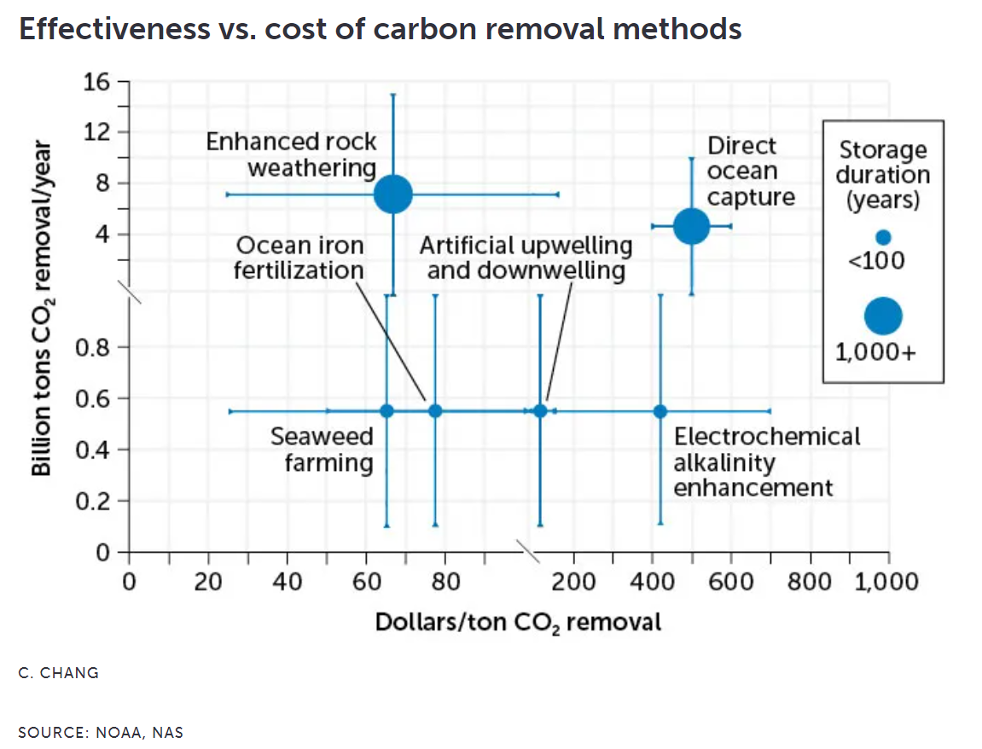
Measurement, Reporting and Validation for mCDR
Interesting Conversations
What are you trying to do?
  What variables?
  What spatial scale?
  What temporal scale?
  How’s the data processed?
  What’s the budget?
Is it only about quantifying the amount of carbon removed?
Is it equally, more or less concerned with the effect on the ecosystem?
Is modelling all that’s required now or in the future?
Science News April 26, 2024
Notes:
Will stashing more CO2 in the ocean help slow climate change?
By Carolyn Gramling Science News April 26, 2024 at 1:15 pm
Cross, J.N., Sweeney, C., Jewett, E.B., Feely, R.A., McElhany, P., Carter, B.,
Stein, T., Kitch, G.D., and Gledhill, D.K., 2023. Strategy for NOAA Carbon
Dioxide Removal Research: A white paper documenting a potential NOAA CDR
Science Strategy as an element of NOAA’s Climate Interventions Portfolio.
NOAA Special Report. NOAA, Washington DC. DOI: 10.25923/gzke-8730

Slide 10
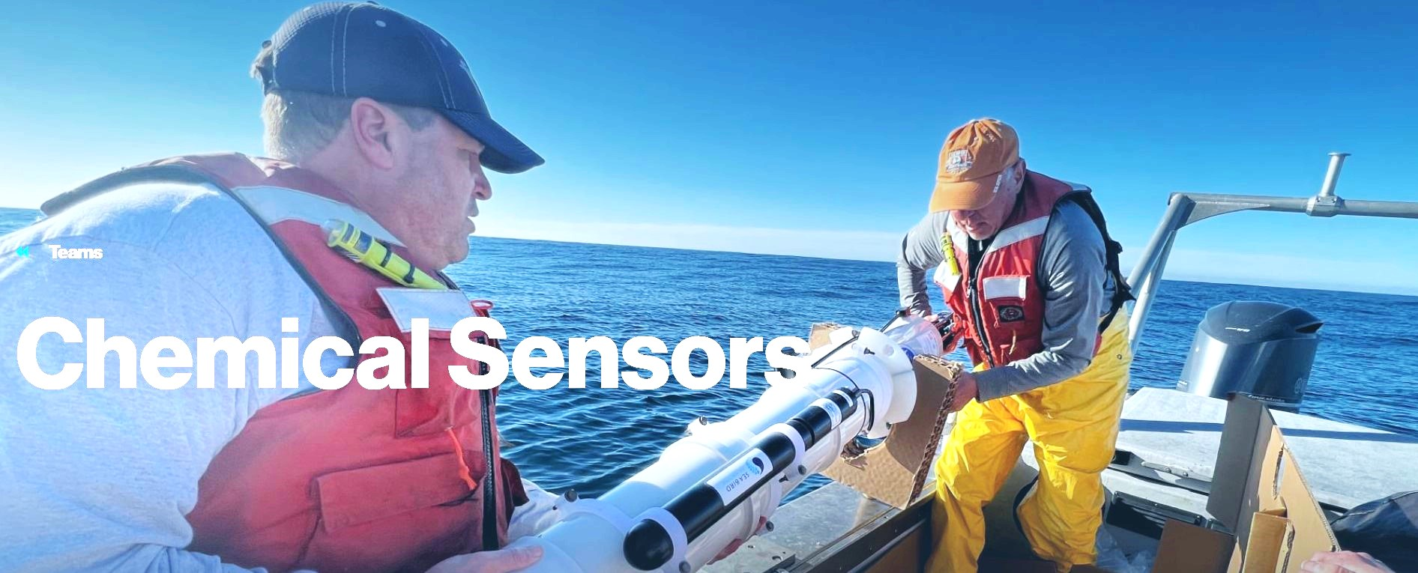

We develop sensor and float technologies to record fundamental ocean properties
Our research target is “understanding the health of the ocean”
THE pH and Nitrate sensors we developed are COTS products
We are heavily involved in the SOCCOM and GO-BGC projects https://soccom.princeton.edu/ https://www.go-bgc.org/

Slide 11
Why Profiling Floats?
Arguably the most cost effective observing platform for long-term, ecosystem scale applications
  Capital cost: ~$90K per BGC float
  Deployment costs: Almost any boat or ship of opportunity that can get to the deployment site
  Maintenance cost: Near $0 for 5-7 years
  On-going operations costs: Almost entirely data processing

Slide 12
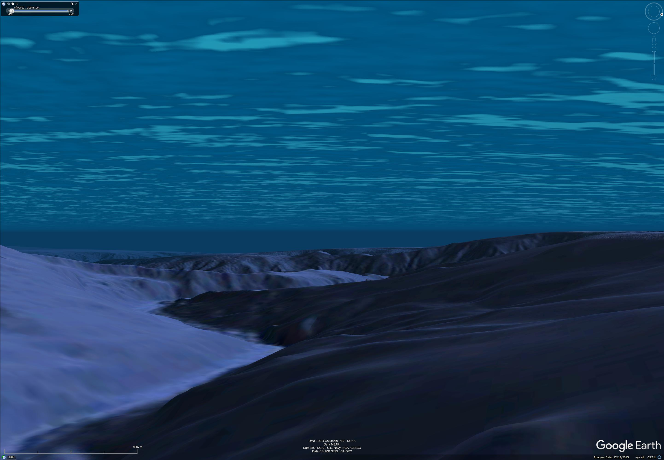
Profiling Float Array + Friends

Slide 13
The CPF Data Pipeline
Notes:
Additional motivation include the Coastal Carbon Synthesis Group’s community workshop report where the recommended more development of observing systems for continental margins.
Community workshops sponsored by Ocean Carbon and Biogeochemistry Program and North American Carbon Program
NSF also published their 10 big ideas, the areas that will drive their research agenda for the near future. One of the 10 big ideas is Navigating the New Arctic and again, they point out the lack of data limiting our understanding.
While the arctic was not one of our initial research topics, we think it is within the capability of the CPF.

Slide 14
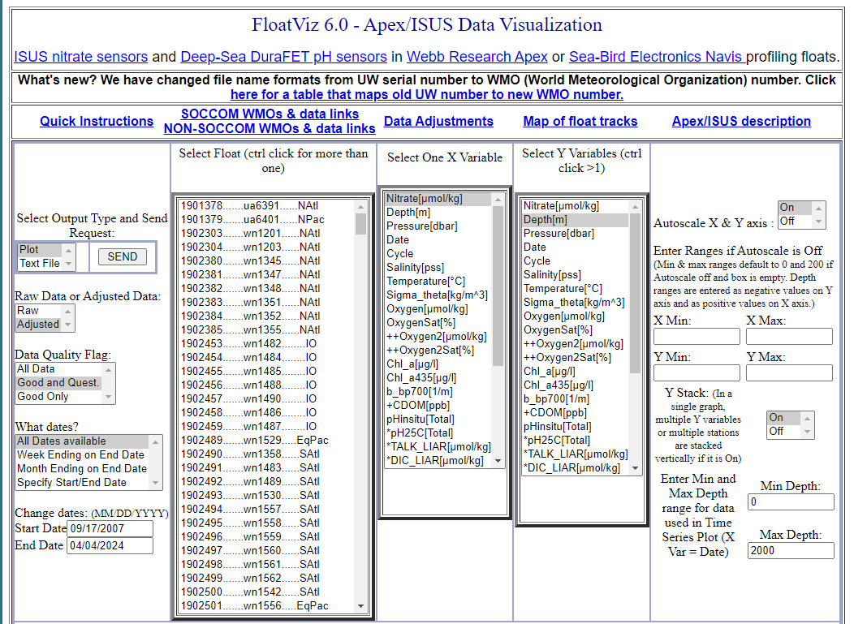
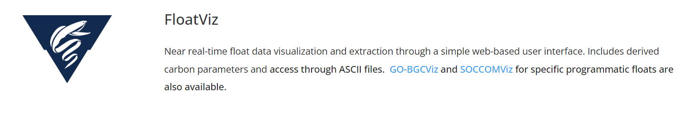
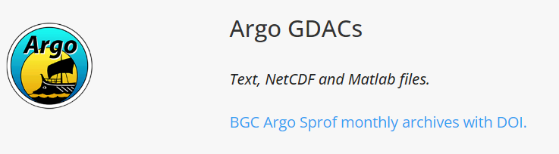

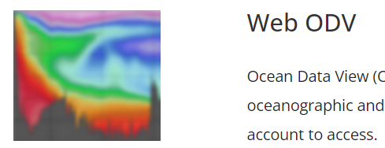
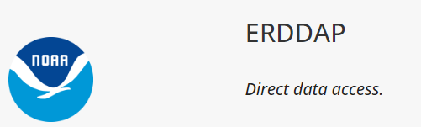
It’s The Economy, Stupid
(apologies to James Carville)
DATA
Current Goal
Our “deliverable” is relevant, defensible data products
Luckily, part of our lab is very involved in the Argo-BGC data processing and QC pipeline
The CPF generates files that can feed the GO-BGC data pipeline
https://www.go-bgc.org/data/access-and-visualization#float-data-access
Eventually

Slide 15
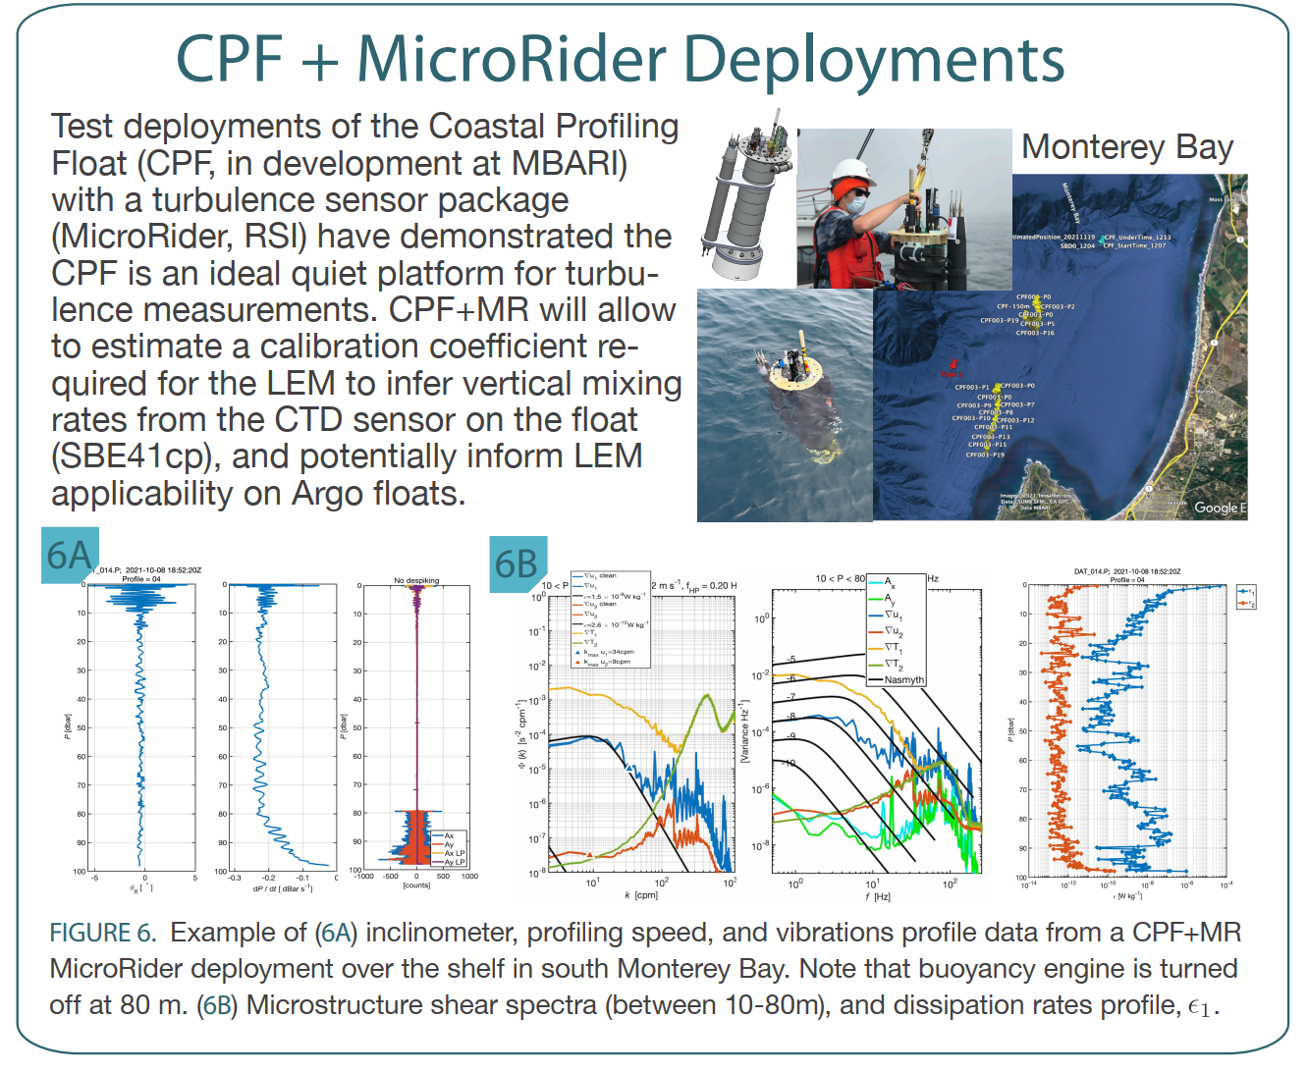
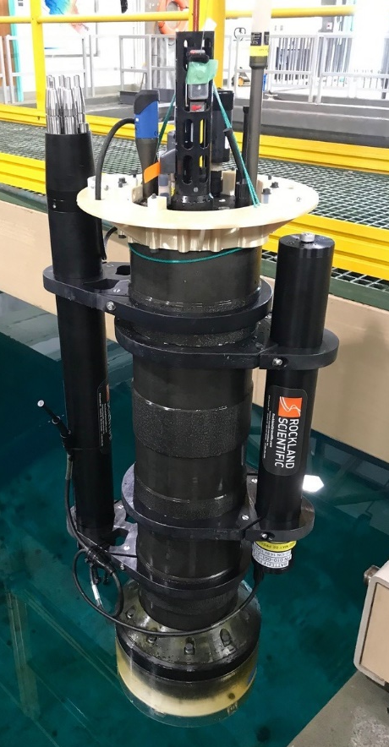
“Other” Science
Can we infer vertical mixing rates from Argo float ascent rates?
Use a CPF with turbulence sensor to acquire high quality turbulence data
See if similar results can be achieved with standard BGC sensors
Magdalena M Carranza(1), Gene Massion, Yui Takeshita and Ken Johnson; Presented at the Gordon Research Conference on Ocean Mixing, Mount Holyoke, MA June 5-10 2022
Acoustics?
Inclination
Profile
Speed
Vibration

Slide 16
The CPF

Slide 17


CPF Functionality
Depth range = 0 to 350 meters
BGC Instrument Suite
Electronics
108 cm
Internal Oil Bladder
Oil Pump
External Oil Bladder

Slide 18
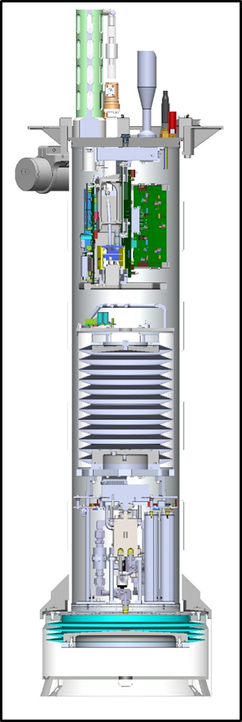
Lots of Volume Change
Depth range = 0 to 350 meters
Buoyancy engine ΔV/V = 3.5 liters / 40 liters = 9%
  Profile from freshwater thru 35 psu = 2.5%
  Vertical velocity = zero to ~40 cm/sec
  Ability to anchor and de-anchor
  Reserve buoyancy to offset biofouling-mud buildup
  Easy ballasting
Notes:
Webb Apex Float = 1%, MRV S2-A Solo II = 3.4%, BSOP Modular = 3/82 = 3.7%, MRV Alamo = 4.2%
Talk about 2 versions: identical from the bottom end cap up

Slide 19
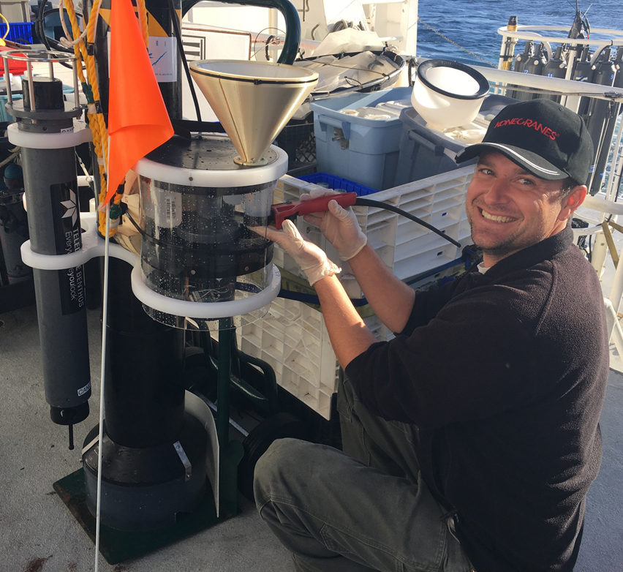
Pickup Truck of the Sea
Depth range = 0 to 350 meters
Buoyancy engine ΔV/V = 3.5 liters / 40 liters = 9%
Sample recovery CPF
  2X Sediment Traps
  Acoustic Modem

Slide 20
Lots of Instruments
Depth range = 0 to 350 meters
Buoyancy engine ΔV/V = 3.5 liters / 40 liters = 9%
Sample Recovery
Science Payload = 9 sensor ports
  6 BGC sensors
  Room for 3 more
BGC Instrument Suite
Electronics
108 cm
Internal Oil Bladder
Oil Pump
External Oil Bladder

Slide 21
Current CPF Version 2.1 and 2.2
Depth range = 0 to 350 meters
Buoyancy engine ΔV/V = 3.5 liters / 40 liters = 9%
Sample Recovery
Science Payload: 9 sensor ports: 6 BGC sensors plus 3 available ports
Iridium SBD and (soon) RUDICS communications
BGC Instrument Suite
Electronics
Internal Oil Bladder
108 cm
Oil Pump
Batteries
External Oil Bladder

Slide 22
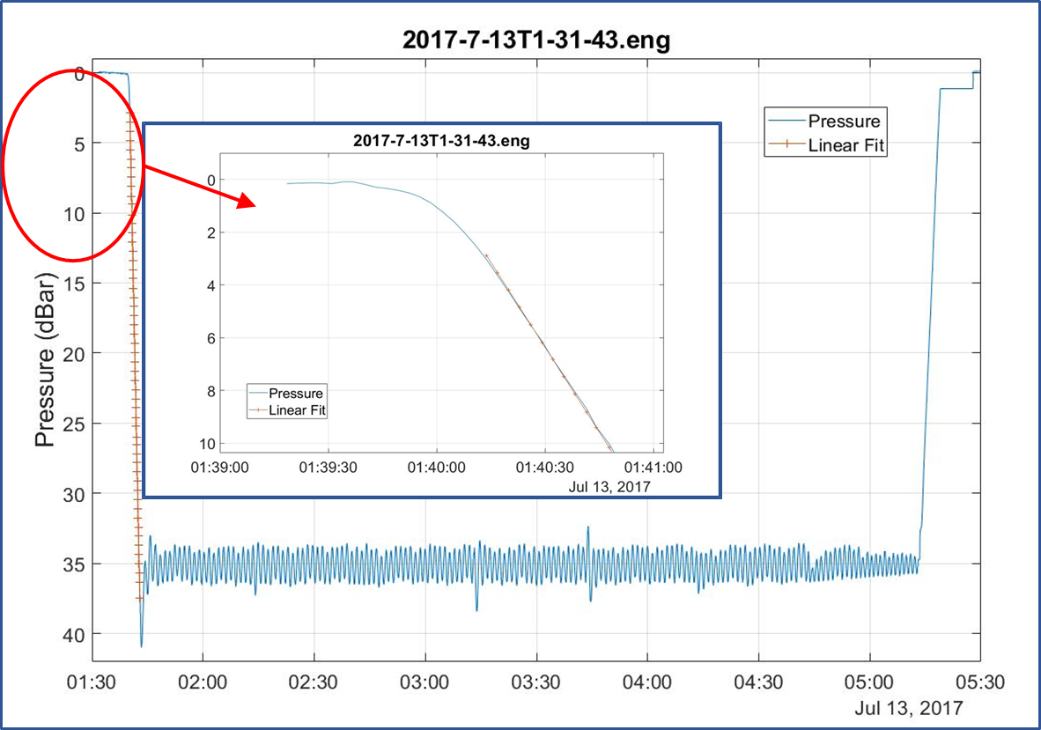
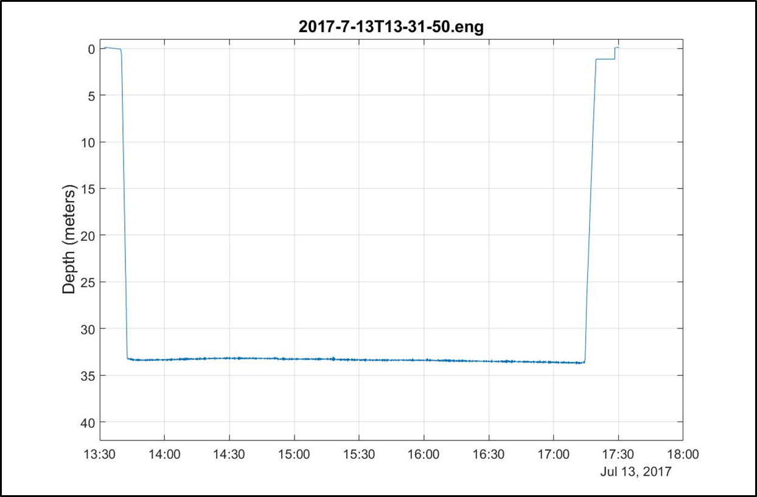
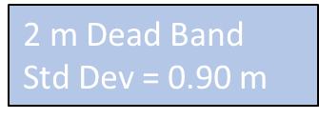
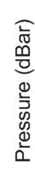
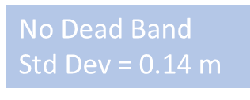
Good Platform Velocity and Depth Control
Depth range = 0 to 350 meters
Buoyancy engine ΔV/V = 3.5 liters / 40 liters = 9%
Sample Recovery
Science Payload: 9 sensor ports: 6 BGC sensors plus 3 available ports
Accurate, closed loop platform velocity and depth control

Slide 23
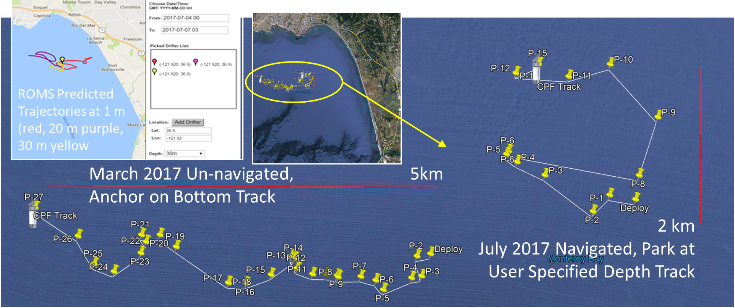
Current and Future Work
Have to do (this year)
  Finish the power management
    Goal = 200X 200m profiles over 1 year
  Finish Iridium RUDICS comms
  Finish building CPF002 and CPF003
  Run more MBARI science missions with the FloatViz data pipeline
Like to do
  Winched version for non-Lagrangian applications
  Inertial current meter for float “navigation”
  Tech transfer

Slide 24
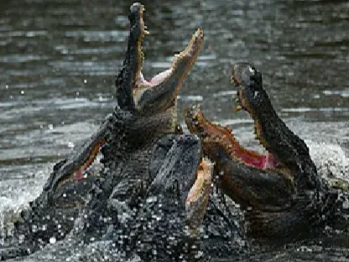
CPF Status Summary
1 CPF with dozens of science and engineering missions in Monterey Bay, some with only modest engineering involvement
2 CPFs nearing completion, operational Q4 2024
Data pipeline demonstrated
2 early CPF prototypes used routinely by MBARI’s BOG group
1 BOG CPF being re-purposed for Colleen Durkin’s carbon export work
TRL 7
TRL 8
TRL 9
  8: Finalized system shown to operate within user’s environment, training and documentation completed
  9: System deployed and used routinely [by non-developers]
NOAA TRL 7-ish: Prototype system demonstrated in near-real world environment; subsystem components fully integrated into system
Notes:
7: Prototype system, process, product, service or tool demonstrated in an operational or other relevant environment (functionality demonstrated in near-real world environment; subsystem components fully integrated into system).
8: Finalized system, process, product, service or tool tested, and shown to operate or function as expected within user’s environment; user training and documentation completed; operator or user approval given.
9: System, process, product, service or tool deployed and used routinely.

Slide 25

Technology Transfer
Possible tech transfer options:
    Collaborations
    Commercialization
    Open Source
    Others?
MBARI’s Biological Oceanography Group has been running 2 CPFs for several years (and setting the fashion standard)

Slide 26
Tech Transfer Options
  Commercialization
    Pros:
      Anyone can buy a CPF (theoretically)
    Cons (based on my experience):
      CPFs will be expensive
      Development stagnates
      Degraded reliability
      Sole source risks
      Only provides a product, not the rest of the system required for successful projects
      Limited (or no) flexibility to address new applications
      Individual buyers have to cover all the capital costs even if they only deploy CPFs a couple of months a year
  Collaborations
    If a CPF system is interesting to you, please let’s talk
  Open Source
    Pros:
      The exact opposite of the commercialization cons
    Cons:
      It may not be feasible

Slide 27

My Preference

Slide 28
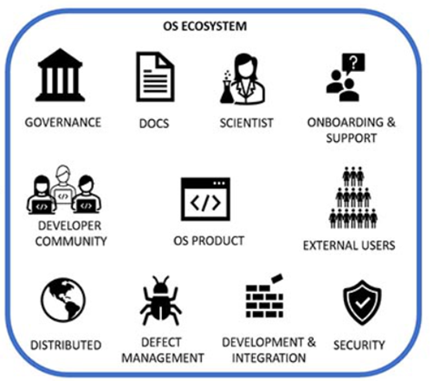

CPF Open Source Ecosystem (COSE)
Critical Infrastructure
  The critical component is an appropriate size group of users
    ~10 CPFs a year for a couple of years
    OR
    3-5 Projects a year
    OR
    1 large volume need and everyone else tags along ➔ MRV for mCDR
Pathways to Enable Open-Source Ecosystems (POSE)
PROGRAM SOLICITATION NSF 23-556
Notes:
This is where the talk goes off the rails

Slide 29
COSE Critical Infrastructure
  2nd most critical: 1 committed, motivated CPF group
ENGINEER
Pathways to Enable Open-Source Ecosystems (POSE)
PROGRAM SOLICITATION NSF 23-556

Slide 30
COSE Critical Infrastructure
  3rd most critical: A source of CPFs
    Contract Manufacturer
    Equipment supply pool
      NSF Ocean Bottom Seismograph Instrument Center
      UNOLS Ships and ROVs
      Philanthropic Organization
    Sponsored builder workshops
    DIY documentation
    Cooperative CPF-centric groups
    Non-exclusive licensees
Pathways to Enable Open-Source Ecosystems (POSE)
PROGRAM SOLICITATION NSF 23-556

Slide 31

COSE Critical Infrastructure
  Also critical: Expertise
    Proposal development
    Project planning
    Project Execution
    “Rent-a-Tech”
      Field work design, prep, deploy, operations, recover
    One-stop-shop providers
      If there’s a high-volume application
Pathways to Enable Open-Source Ecosystems (POSE)
PROGRAM SOLICITATION NSF 23-556

Slide 32
COSE Critical Infrastructure
  Open sourcing an appropriate data pipeline is critical
  Argo-BGC is a model for research data
    Excellent docs but can it be open-sourced?
  Outflow should be scalable, relevant data products
    Need data product developers
    NOAA Future Seas might be an example
Pathways to Enable Open-Source Ecosystems (POSE)
PROGRAM SOLICITATION NSF 23-556

Slide 33
COSE Risks
  Sensor maturity
    e.g., Measuring pH in the ocean requires significant expertise
    Interpreting FLBB and OCR data is an active conversation
  Argo data centers probably don’t have the bandwidth to support non-Argo data streams
  The problem with TRLs is they don’t capture who’s doing the demo
    Demo by the system developers is one thing, demo by others is an entirely different kettle of fish
Pathways to Enable Open-Source Ecosystems (POSE)
PROGRAM SOLICITATION NSF 23-556

Slide 34

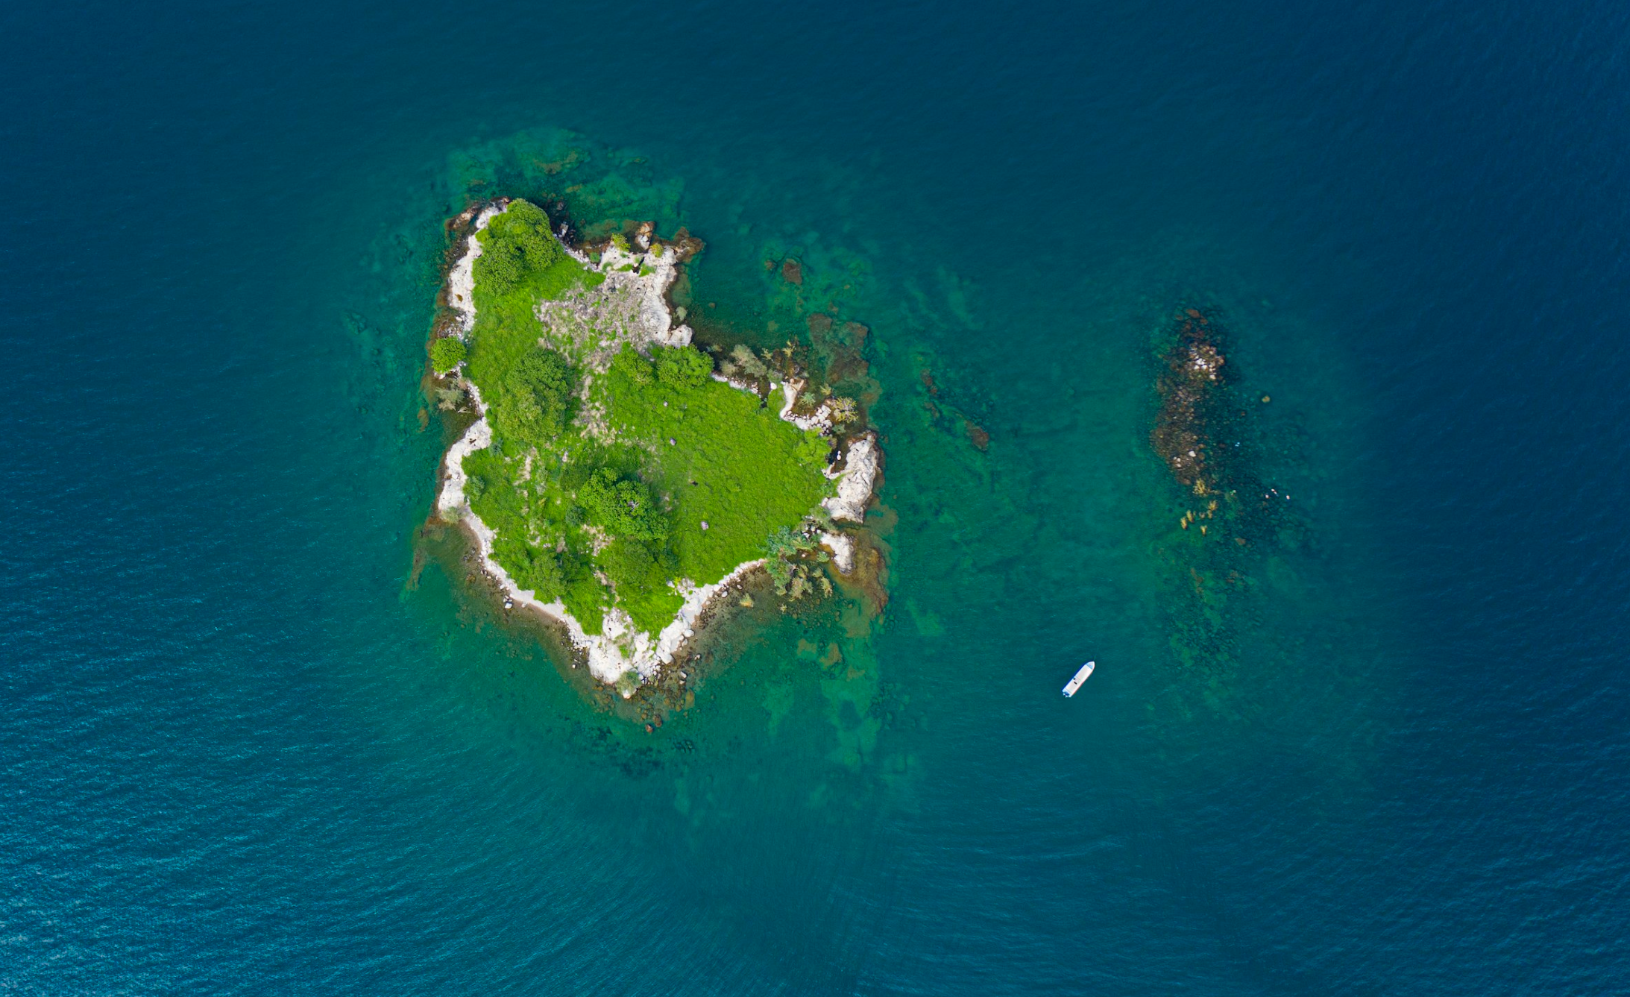
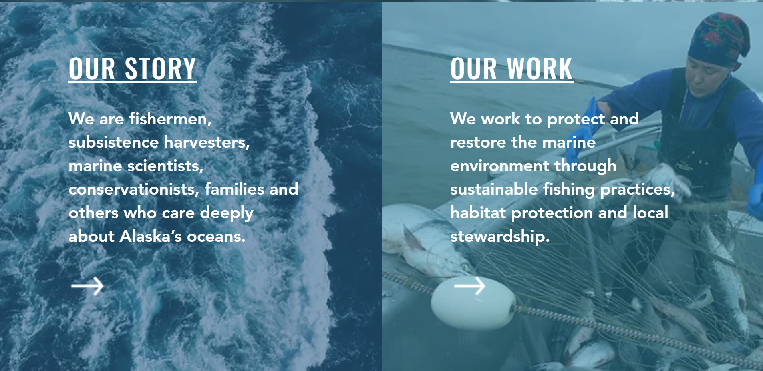
COSE Targets
    US Regional Fishery Management Councils
    NOAA Integrated Ecosystem Assessment program
      Future Seas “Physics to Fisheries” projections and predictions
    mCDR MRV mandated by the government
    Non-MBARI research groups
    NGOs
INSERT COSE DATA HERE
Alaska Marine Conservation Council
Sustain Lake Tanganyika
Committed to safeguarding the Lake Tanganyika ecosystem while improving the welfare of her local communities

Slide 35
Is a COSE a Realistic Possibility?
    Step 1: POSE Phase I
      are for open-source research products with a small community of external users .. may not necessarily have external content developers. The objectives are (1) enable scoping activities 2) provide training to teams interested in building such an OSE (<1 Year and <$300K)
      Develop risk mitigation plan
    Step 2: Simultaneously find funding to support a pilot project with existing CPF assets
    If (POSE Phase 1 == success) then
    Step 3: Pose Phase II
      transition into a sustainable and robust OSE (<2 Years and <$1.5M)
      Execute risk mitigation plan
    Step 4: Execute POSE Phase II with the pilot project as the case study

Slide 36

Thanks for listening
The CPF Village includes: Jerry Allen, Magdalena Carranza, Paul Conen, Jared Figurski, Chad Kecy, Eric Martin, Tanya Maurer, James McClure, Jim Montgomery, Josh Plant, Jose Rosal, Aaron Schnittger, Ray Thompson, Mark Tynes, Joe Warren and others
This work has been generously supported by the David and Lucille Packard Foundation
$10 Million of CPFs
magene@mbari.org

Slide 37
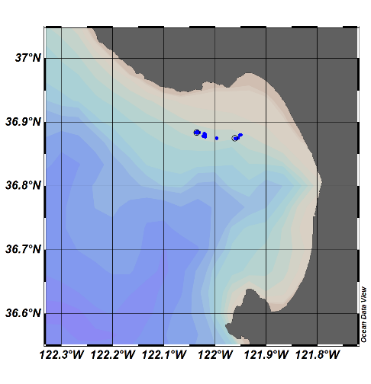

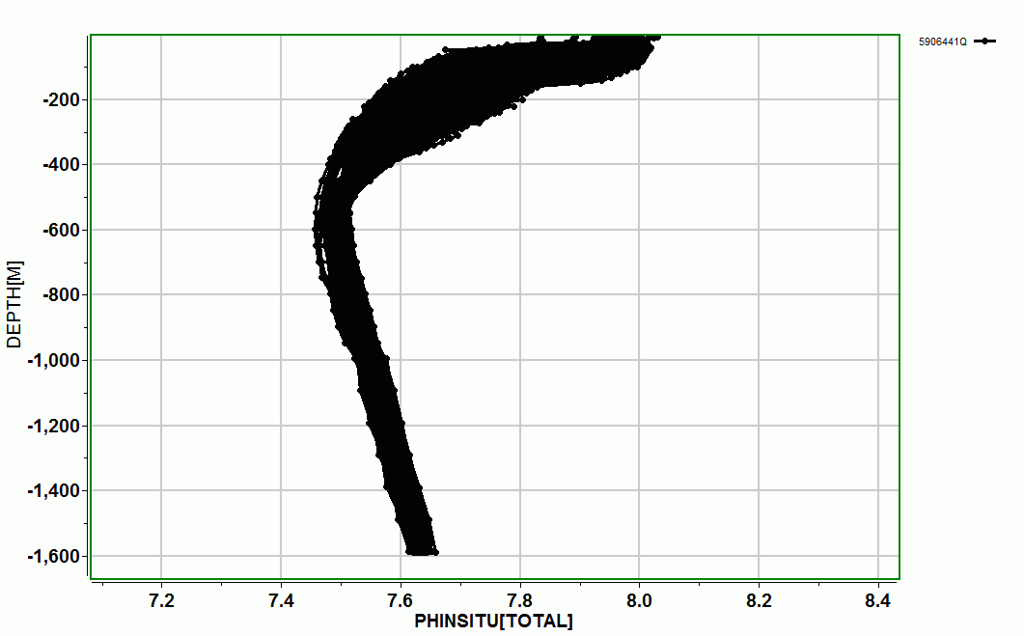
Float Viz
FloatViz ➔ Ocean Data Viz ➔
Notes:
I used to work in the engineering department at MBARI, now I work in the chem sensor lab and one of the first lessons I learned was that our product was useful science data, and that a really well engineering platform isn’t of any value if it doesn’t produce useful science data. I don’t really understand this thinking but I do accept it, so we’ve been working on the shore side tools we need to effectively interpret the data the CPF acquires.
We can see a cold, low oxygen deep water mass roll up the shelf and presumably transport nutrients (we’ll know when we have the Nitrate sensor on.;

Slide 38


More Motivation
“Further development of event-scale observing capacity (e.g., novel autonomous platforms) in all continental margin systems to better quantify impacts of episodic events on coastal carbon budgets”
A Science Plan for Carbon Cycle Research in North American Coastal Waters 2016, Ocean Carbon and Bio. Program and NA Carbon Program
Notes:
Additional motivation include the Coastal Carbon Synthesis Group’s community workshop report where the recommended more development of observing systems for continental margins.
Community workshops sponsored by Ocean Carbon and Biogeochemistry Program and North American Carbon Program
NSF also published their 10 big ideas, the areas that will drive their research agenda for the near future. One of the 10 big ideas is Navigating the New Arctic and again, they point out the lack of data limiting our understanding.
While the arctic was not one of our initial research topics, we think it is within the capability of the CPF.

Slide 39



Float Navigation
Experiment: Park the CPF at various depths and compare track to ROMS nowcast and previous missions that anchored on the bottom after every profile
ROMS Predicted Trajectories at 1 m (red, 20 m purple, 30 m yellow
March 2017 Un-navigated, 5km Anchor on Bottom Track
2 km
July 2017 Navigated, Park at User Specified Depth Track
Notes:
This slide is pretty dense, I’ll try to unpack it for you.
I talked about the challenge of keeping the CPF in the coastal zone and not on the beach of off-shore.
We identified this risk at the beginning of the project and suggested we could mitigate this risk to some extent using operational, 3D numerical current models.
The ROMS model runs every day and give a 3 day 3D forecast of currents in the Monterey Bay.
So if the CPF was drifting west, in many coastal zones there would be a high probability there is a sub-surface current heading roughly east and we could park at that depth to move back toward the target volume. This is much like the way Hot air balloons navigate.
So, we ran an experiment, here’s the target area …
Need to run ROMS at higher resolution particularly given the bathymetry
Maybe crop the ROMS window and add a velocity vs depth plot.

Slide 40
ROMS Predicted Trajectories at 1 m (red, 20 m purple, 30 m yellow
March 2017 Un-navigated, 5km Anchor on Bottom Track
2 km
July 2017 Navigated, Park at User Specified Depth Track
Notes:
This slide is pretty dense, I’ll try to unpack it for you.
I talked about the challenge of keeping the CPF in the coastal zone and not on the beach of off-shore.
We identified this risk at the beginning of the project and suggested we could mitigate this risk to some extent using operational, 3D numerical current models.
The ROMS model runs every day and give a 3 day 3D forecast of currents in the Monterey Bay.
So if the CPF was drifting west, in many coastal zones there would be a high probability there is a sub-surface current heading roughly east and we could park at that depth to move back toward the target volume. This is much like the way Hot air balloons navigate.
So, we ran an experiment, here’s the target area …
Need to run ROMS at higher resolution particularly given the bathymetry
Maybe crop the ROMS window and add a velocity vs depth plot.

Slide 41
Can a COSE Become a Reality?
Step 1:
  POSE Phase 1: “The objectives of Phase I projects are … enable scoping activities that will inform the transition of promising research products … into sustainable and robust OSEs that will have broad societal impacts .. provide training to teams interested in building such an OSE” (<1 year <$300K)
Step 2:
  POSE Phase 2: “projects are for open-source research products with a small community of external users and external content developers. The objective of Phase II projects is to support the transition of a promising open-source product into a sustainable and robust OSE” (<2 years <$1.5M)
Step 3:
  In parallel with POSE Phase 1 and 2: Win a grant for a marine CO2 removal MRV system pilot project (or ?) using the COSE developed through POSE
Notes:
This is where the talk goes off the rails

Slide 42


Engineering Results
2 m Dead Band
Std Dev = 0.90 m
Notes:
Working in shallow water is a challenge as I mentioned earlier. If you’re working in 20 meters of water you don’t want to spend 15 of those meters getting to a stable vertical velocity
The zoomed inset is for getting off the surface which is harder due to wave action and the fact that we descend at 20 cm/sec and ascend at 10 cm/sec
Sampling is typically done during park, anchor and ascent but can be done on descent if desired.
The depth control has a dead band which in this case is set for +/1 meter.
Tuned for maximum stability and noise rejection and moderate performance
6 meters of overshoot

Slide 43

More Engineering Results
No Dead Band
Std Dev = 0.14 m
Notes:
Exact same control algorithm with no dead band.
After trying several other subsurface Lagrangian floats, the MBARI BOG built 2 for their twice a year field deployments
Ballast in 350 gram increments in the test tank
Control algorithms designed for maximum stability and noise rejection and minimal performance
Pick up truck of the sea

