Slide 1

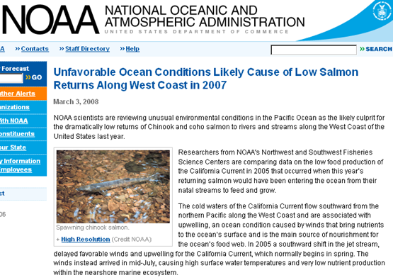
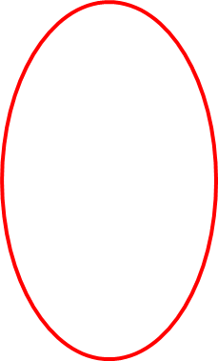
Development of a Coastal Profiling Float
The Science Motivation
Scientists and Policy Makers need plankton biomass and rate data (carbon stocks and production rates) in the coastal zone at the scale of large ecosystems, such as the California Current, for proper understanding and management.
  NOAA Fisheries Science Centers are making progress towards science base policy making but needs dramatically more data at much lower cost
This MODIS chlorophyll satellite image conveys the complexity and scale of the data required to understand a large ecosystem.

Slide 2
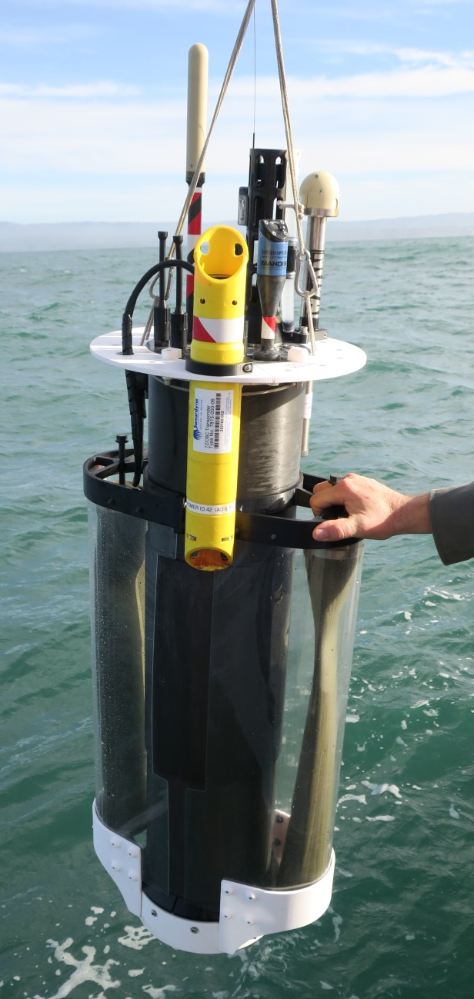
The Coastal Profiling Float (CPF)
The Argo global array of deep water profiling floats is arguably one of the few (maybe the only) ocean observing systems that has scaled to provide the needed data at the ocean basin level at a sustainable cost
The CPF optimizes ARGO profiling float tech for use in the coastal zone with the biogeochemical sensor suite we have developed for ARGO floats
  Profiles to 500 meters, many profiles per day
  Improved buoyancy control for shallow water operations
  Sensor suite: Salinity, temperature, Oxygen, fluorescence, backscatter, pH, Nitrate, multispectral radiometer
  Real time, satellite data telemetry of each profile
  Ability to (gently) anchor and de-anchor on the bottom
  Make use of subsurface currents to offset drift at the surface

Slide 3
CPF Current Status
Prototypes are currently underdoing long term (days to weeks), unattended deployments
Also used for CANON experiments with sediment traps
Long term goal: 1) Run a pilot experiment 2) License this technology to a commercial partner to enable large scale experiments
High resolution profiles of biogeochemical properties
Profiles every ~4 hours

