Slide 1
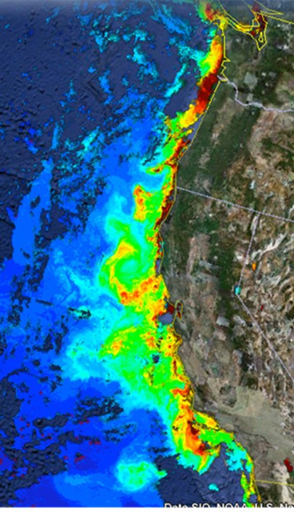
MBARI Coastal Profiling Float
The Problem
Estimates of the production of fish and other organisms of existing or potential food value to man are based on estimates of photosynthetic primary production rates in the ocean¹
Coastal margins represent only 5-10% of the global surface area, yet they are estimated to contribute as much as 10-30% of global primary production²
There is no observing system that provides the synoptic biogeochemical data required to understand coastal ecosystem processes such as new or net primary production in a way that enables science based management of these resources
MODIS Chlorophyll
June 28, 2011

Slide 2
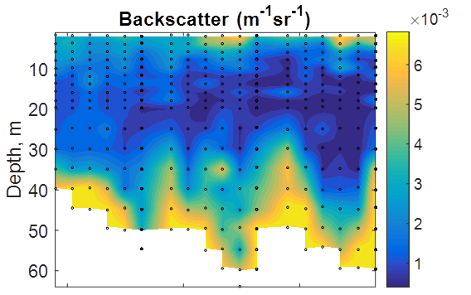
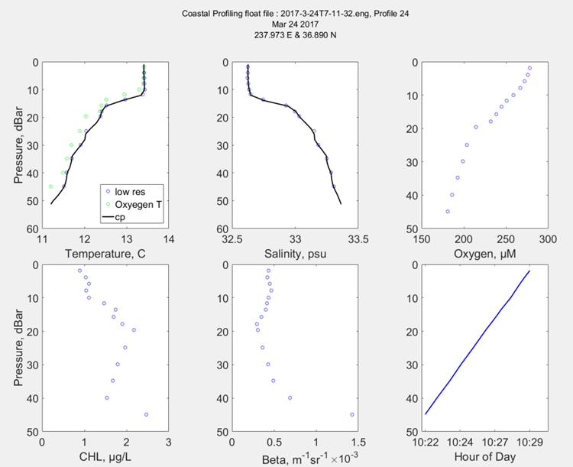
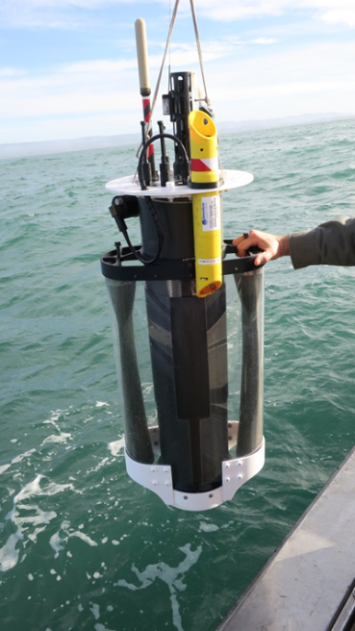
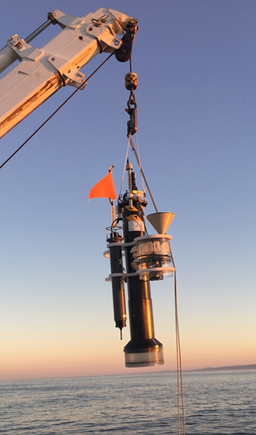
MBARI Coastal Profiling Float
Profiling floats have proven the ability to provide biogeochemical data over ecosystem and decadal scales at a cost ($/data point) that can be sustained by existing national and international research program budgets
The CPF leverages MBARI Chem Sensor Lab deep-water biogeochemical profiling float technology to optimize a profiling float for research in the coastal zone of the world’s oceans
CPF
Prototype 2
CPF
Prototype 1

Slide 3
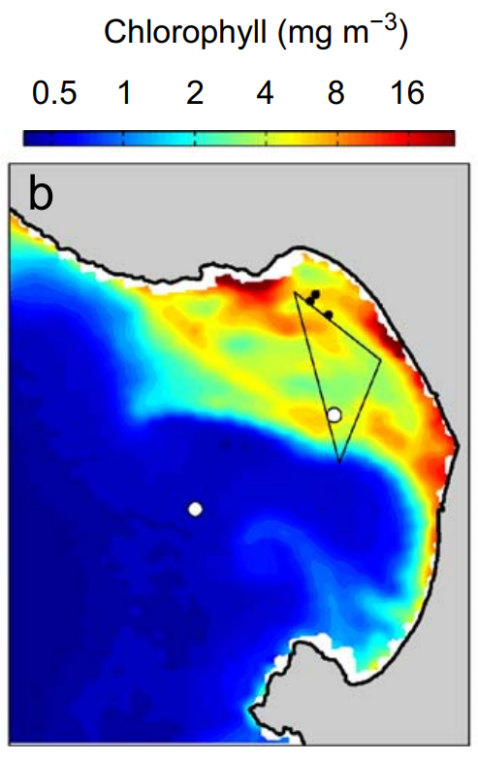
Plans for 2018
Begin preliminary science experiments in collaboration with the MBARI Takeshita and Fassbender labs using a small array of CPFs in the Monterey Bay
Primary science focus: the influence of lateral nutrient transport from upwelling plumes versus canyon upwelling on the development of high chlorophyll levels in the Monterey Bay “upwelling shadow”
Primary engineering focus: 1) learning to “navigate” the floats to maintain a desirable array geometry using the ROMS ocean model 3 day forecasts and 2) minimizing energy consumption in a real world science mission
This experiment will include efforts to calibrate/validate the pCO₂ values estimated from float pH using Wave Gliders equipped with pCO₂ sensors
Chlorophyll in Monterey Bay from MODIS Satellite Image August 25, 2005³
¹ Ryther, J. H. (1969) Photosynthesis and fish production in the sea. Science, 166, 72-76.
² Benway, et. al. (Editors), 2015. An interdisciplinary science plan for research in North American continental margin systems. Report of the Coastal CARbon Synthesis (CCARS) community workshop, August 19-21, 2014, Ocean Carbon and Biogeochemistry Program and North American Carbon Program, 68 pp.
³ Ryan, J. P. et. al. (2010) Interacting physical, chemical and biological forcing of phytoplankton thin-layer variability in Monterey Bay, California. Cont. Shelf Res., 30, 7-16.

