Slide 1
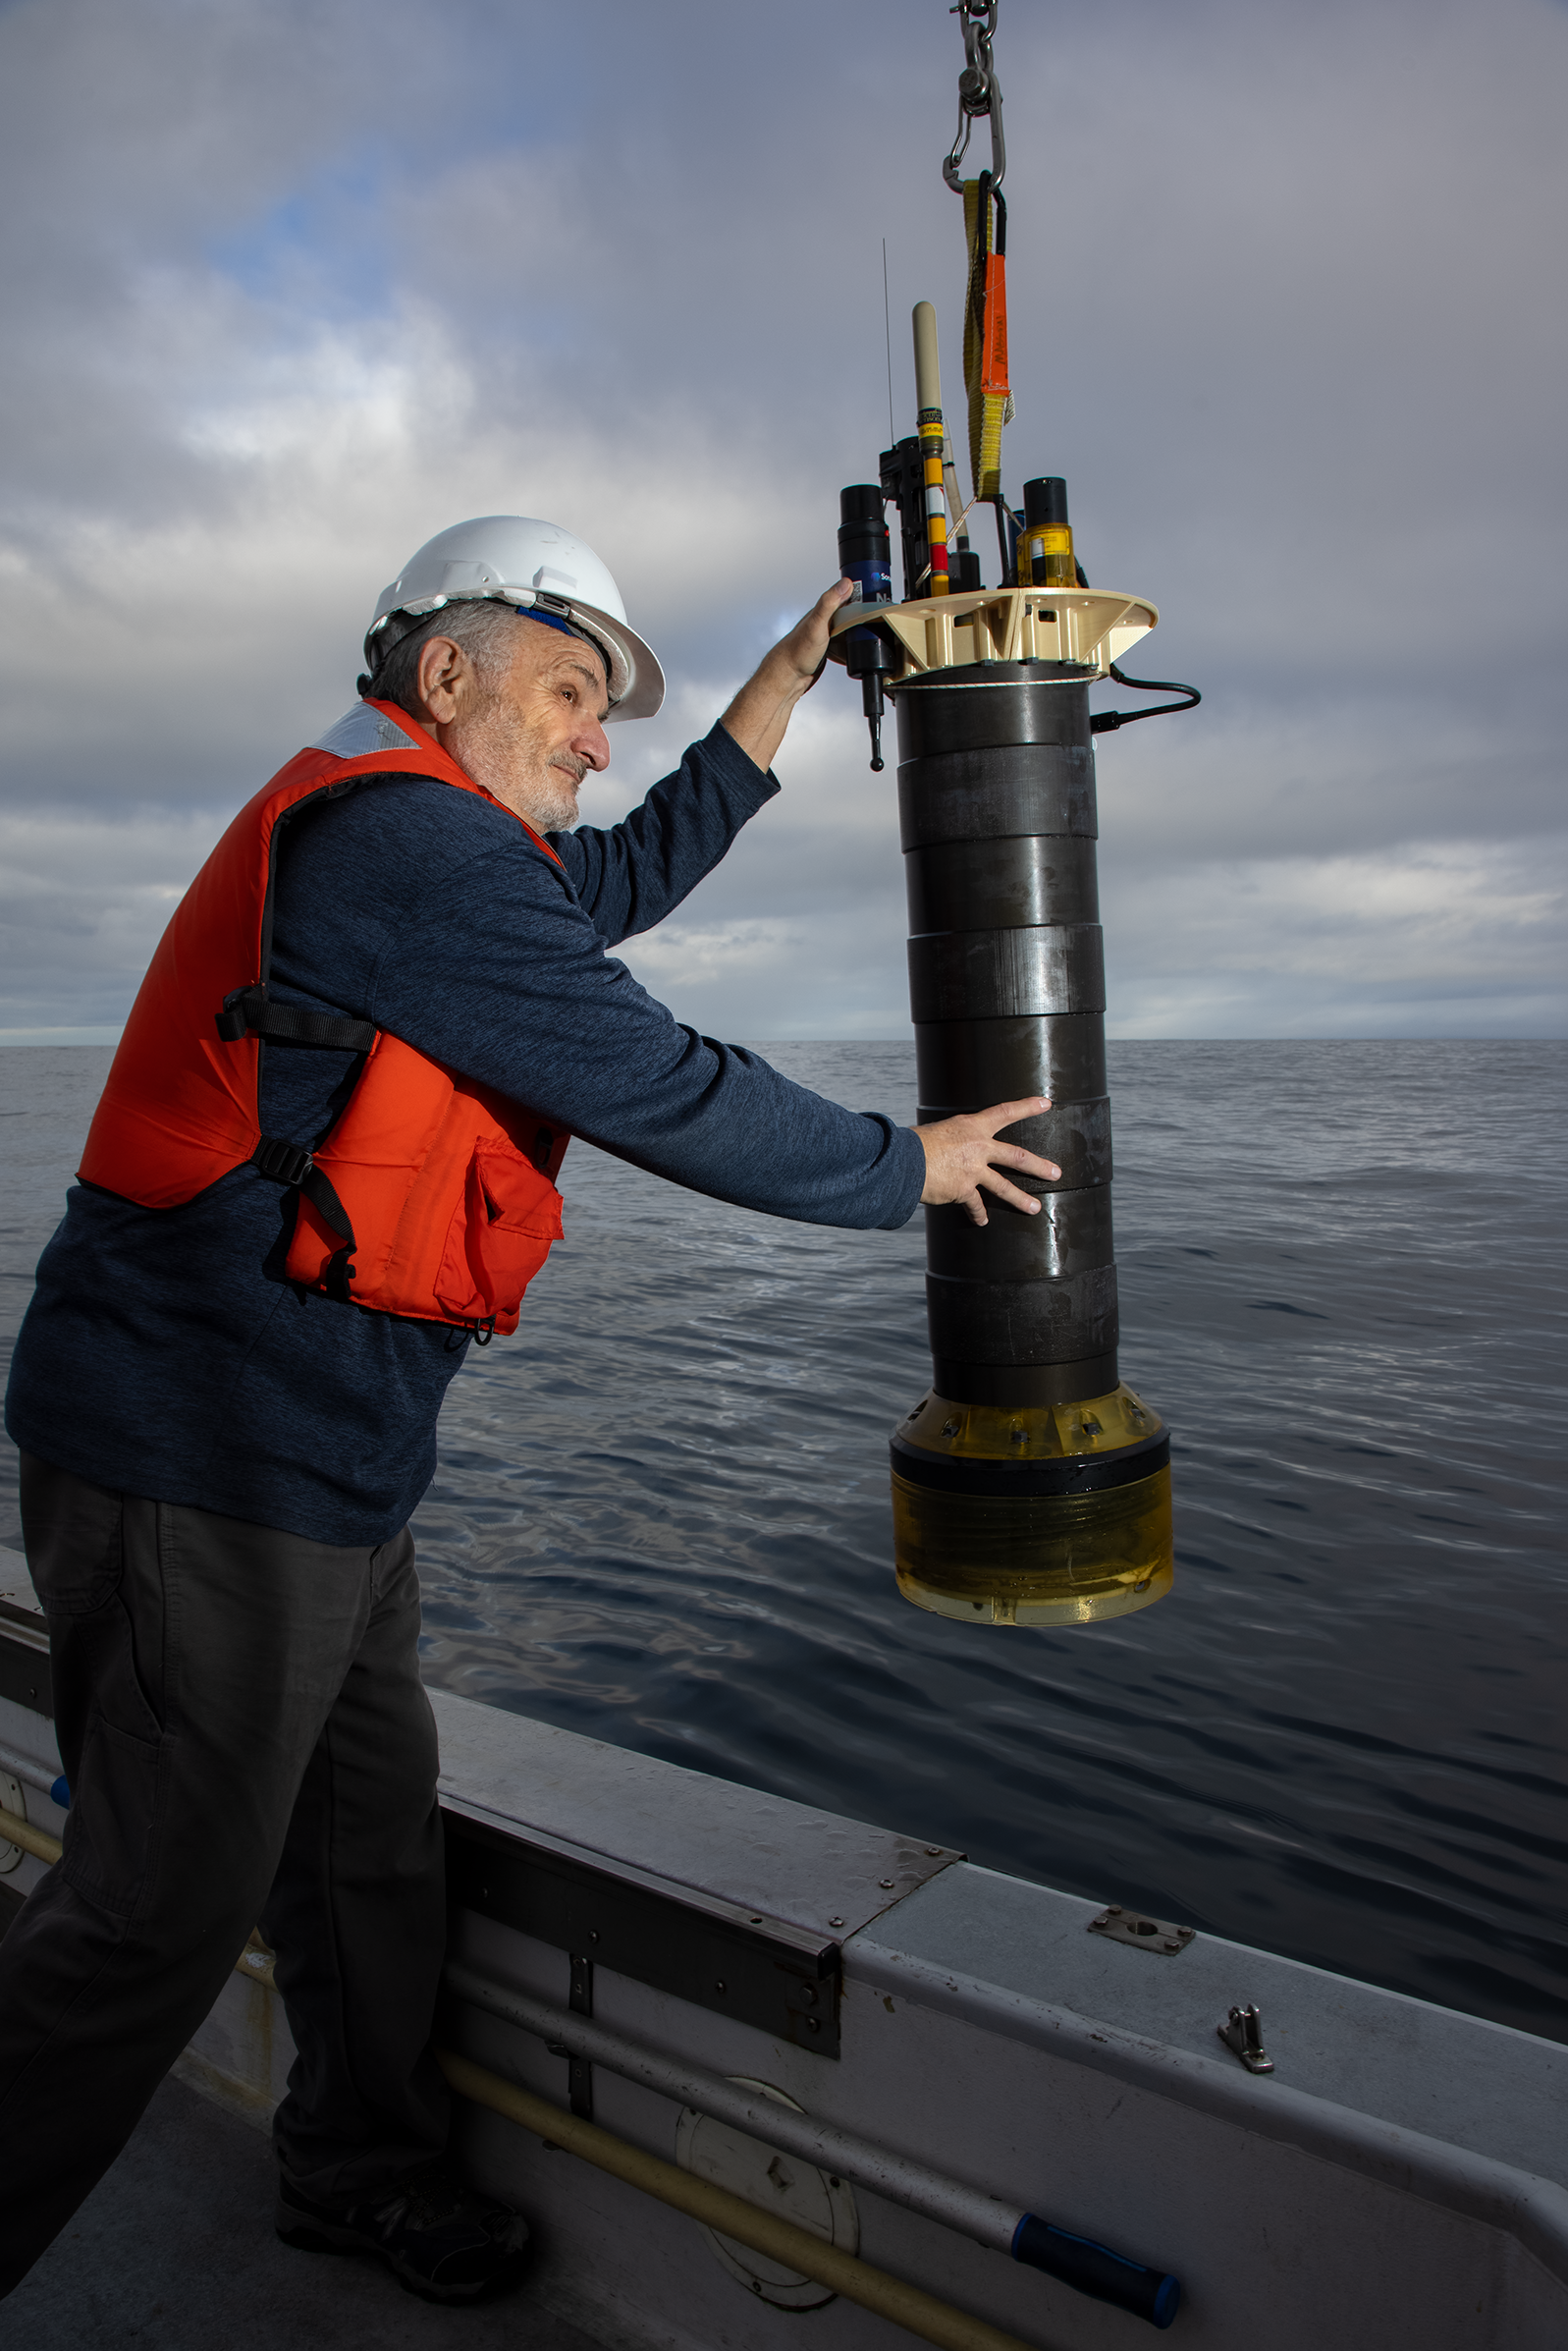
An Ocean Observing System for Coastal Oceanography Applications:
Progress and Opportunities for UCSC Marine Science, Engineering, Robotics, Data Science and Open Source Initiatives
Gene Massion
Monterey Bay Aquarium Research Institute
UCSC Coastal Science and Policy 2024 Nov 20
Photo: Lori Eanes/Monterey Bay Aquarium

Slide 2
Executive Summary
MBARI is finishing the development of a coastal profiling float (CPF) observing system targeted at better understanding the health of the ocean
Photo: Lori Eanes/Monterey Bay Aquarium

Slide 3


Executive Summary
MBARI is finishing the development of a coastal profiling float (CPF) observing system targeted at better understanding the health of the ocean
The CPF is optimized for use in the coastal zones and upper 350 meters of the world’s oceans: “where the bugs are”

Slide 4

Executive Summary
MBARI is finishing the development of a coastal profiling float (CPF) observing system targeted at developing a better understanding of ocean health and how our ocean is changing
The CPF is optimized for use in the coastal zones and upper 350 meters of the world’s oceans: “where the bugs are”
The CPF supports the GO-BGC suite of biogeochemical sensors: CTD, Oxygen, pH, Nitrate, Fluorescence, Backscatter, Optical Radiation and others

Slide 5
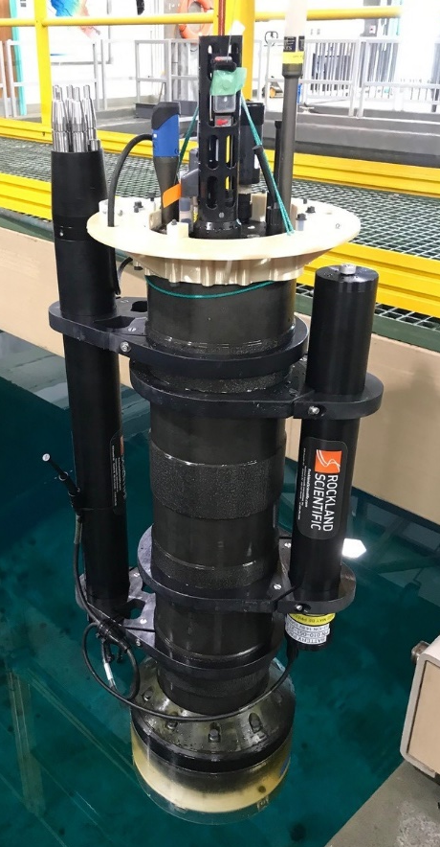
Executive Summary
MBARI is finishing the development of a coastal profiling float (CPF) observing system targeted at developing a better understanding of ocean health and how our ocean is changing
The CPF is optimized for use in the coastal zones and upper 350 meters of the world’s oceans: “where the bugs are”
The CPF supports the GO-BGC suite of biogeochemical sensors: CTD, Oxygen, pH, Nitrate, Fluorescence, Backscatter, Optical Radiation and others
We are discussing ways to move the CPF technology out to the greater community
  This seminar, and any follow-up, is part of the conversation

Slide 6

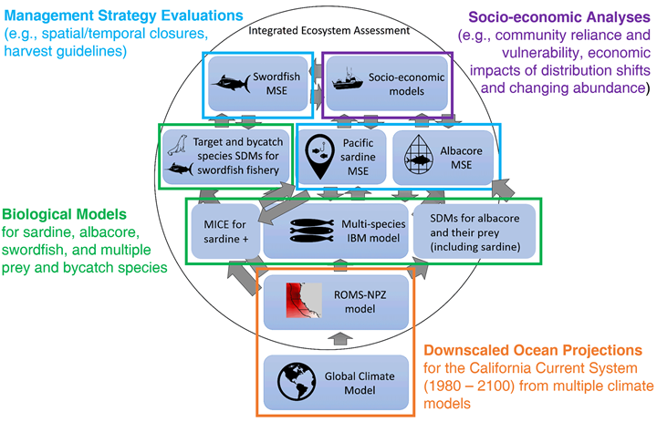
The Initial Motivation
“the widespread pattern of low returns along the West Coast for two species of salmon indicates an environmental anomaly occurred in the California Current in 2005"
NOAA Future Seas
A More Current Motivation
[A model based approach] To evaluate the impacts of climate change on US-managed marine species and identify climate-resilient management strategies. https://oceanmodeling.ucsc.edu/
INSERT DATA HERE
Notes:
ScienceDaily: Unfavorable Ocean Conditions Likely Cause Of Low 2007 Salmon Returns Along West Coast
Date: March 4, 2008 Source: NOAA National Marine Fisheries Service
ScienceDaily: 'Fishery Failure' Declared For West Coast Salmon Fishery
Date: May 2, 2008 Source: National Oceanic And Atmospheric Administration

Slide 7
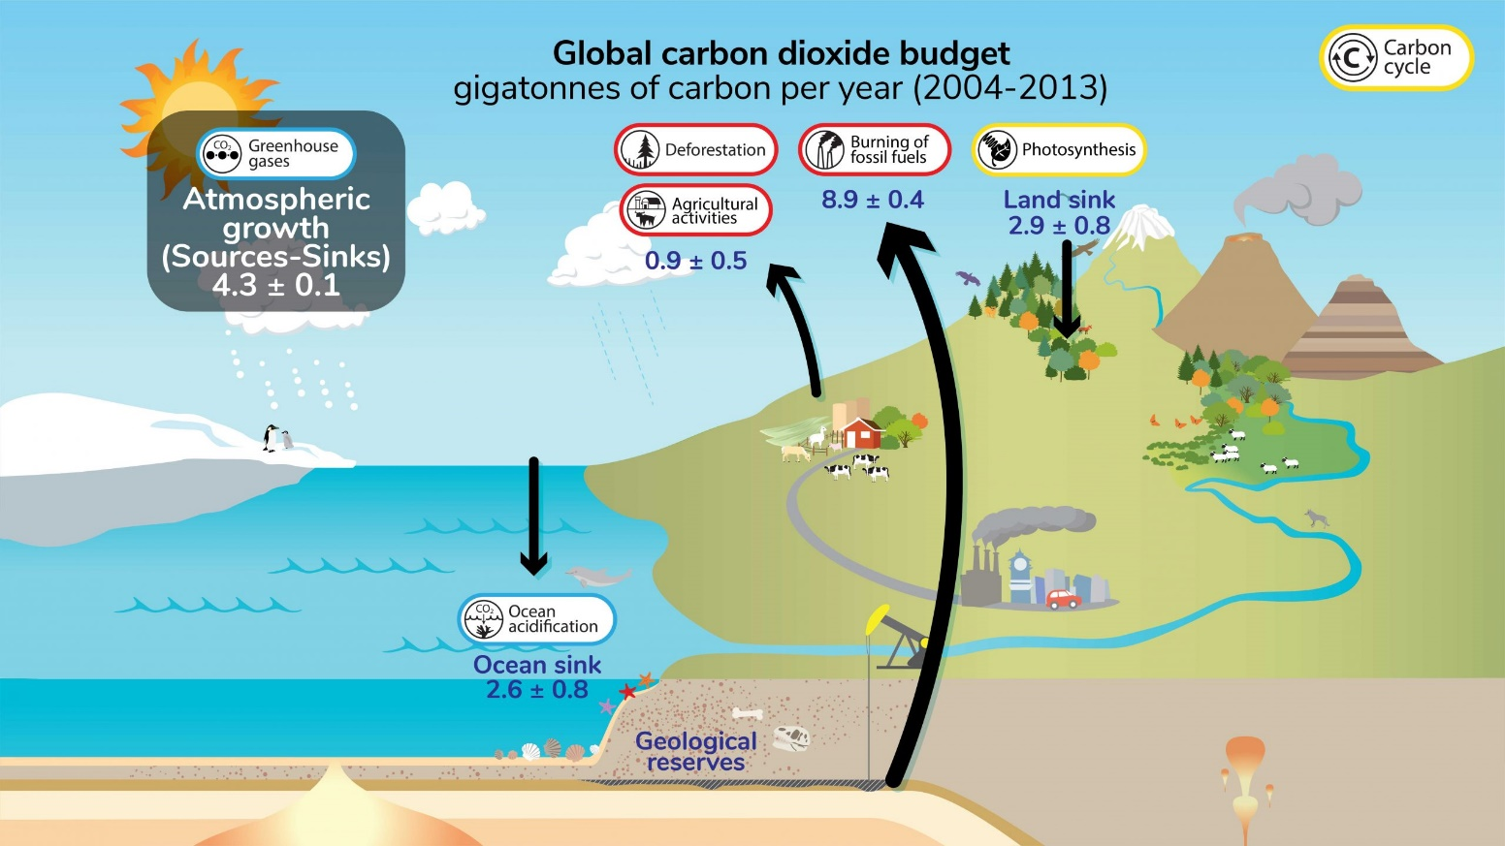
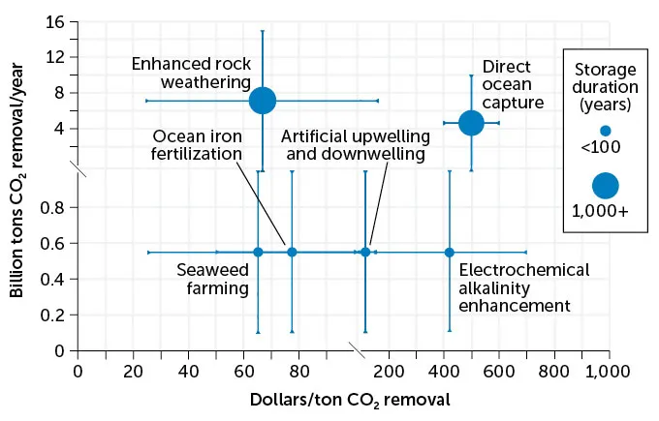
Climate Change, Marine CO₂ Removal and Ocean Acidification
“Recommendations on how best to monitor acidification will evolve … Monitoring networks should continue to be developed at the regional scale with ongoing stakeholder input”
National Science and Technology Council Ocean Acidification Monitoring Prioritization Plan August 2024
https://ugc.berkeley.edu/background-content/carbon-cycle/
37 billion tons of CO₂ emitted each year by humans’ energy consumption
0.6 billion tons/year * $400/ton = $240B/year
Source: NOAA, NAS
Notes:
Good afternoon. I think most people would agree that climate change is a wicked problem.
This graphic shows the carbon cycle part of climate change. Without worrying about the details, the basic problem is the amount of carbon dioxide we, the human race, are throwing up into the atmosphere is much larger than what the earth can absorb. Unfortunately, what isn’t absorbed remains in the atmosphere and warms our planet.
That’s the bad news. The good news is a lot of work is going into understanding this problem. And not surprisingly, lots of studies and reports.
A common recommendation repeated in many of those studies is we need “Further development of event-scale observing capacity”. To provide that capacity we need more effective observing systems, particularly in the ocean. And how to provide effective ocean observing systems is the theme of this challenge.

Slide 8
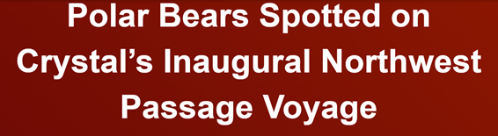


The New Arctic
Navigating the New Arctic
“Current Arctic observations are sparse and inadequate for enabling discovery or simulation … to assess their impacts on the broader Earth system”

Slide 9
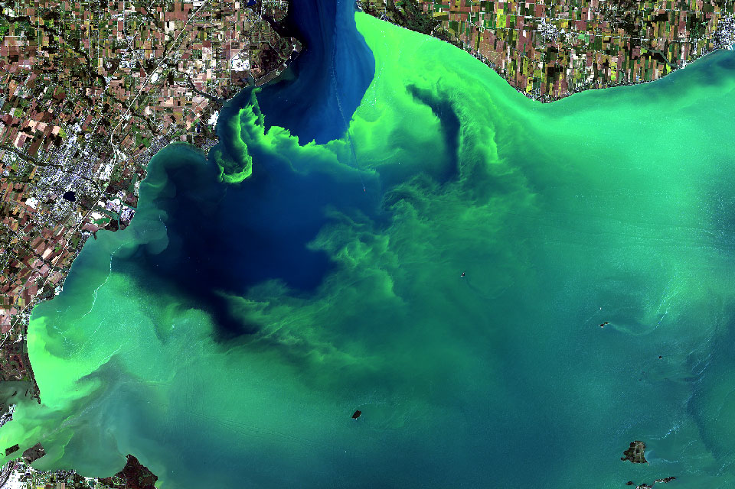
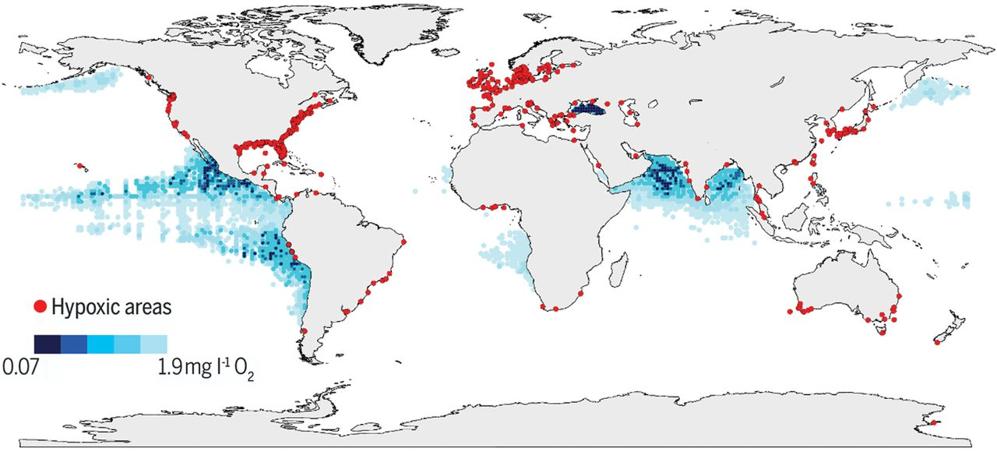
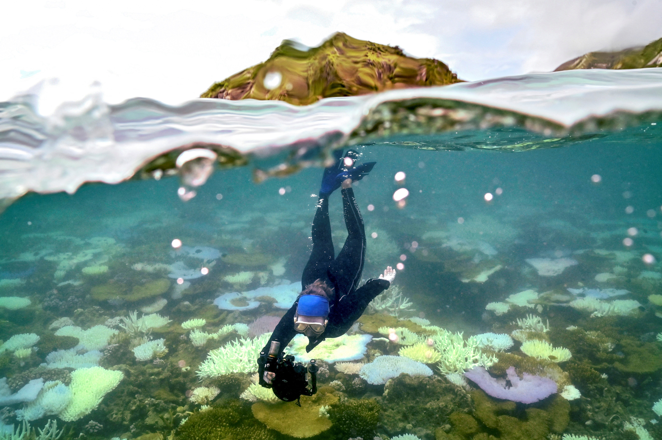
And Lots More Applications
Can we clean up, stop, or end harmful algal blooms?
https://oceanservice.noaa.gov/facts/hab-solutions.html
Ocean scientists call for global tracking of oxygen loss that causes dead zones
Declining oxygen in the global ocean and coastal waters, Denise Breitburg, et.al, SCIENCE, 5 Jan 2018, Vol 359, Issue 6371 https://www.science.org/doi/10.1126/science.aam7240
Increasingly Frequent Ocean Heat Waves Trigger Mass Die-Offs of Sealife, and Grief in Marine Scientists
https://insideclimatenews.org/news/01052024/ocean-heat-waves-killing-sealife/

Slide 10
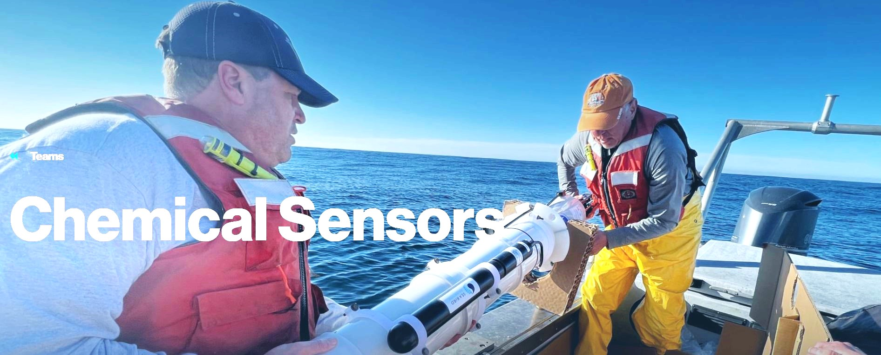

We develop sensor and float technologies to record fundamental ocean properties
Our research target is “understanding the health of the ocean”
THE pH and Nitrate sensors we developed are COTS products
We are heavily involved in the SOCCOM and GO-BGC projects https://soccom.princeton.edu/ https://www.go-bgc.org/

Slide 11
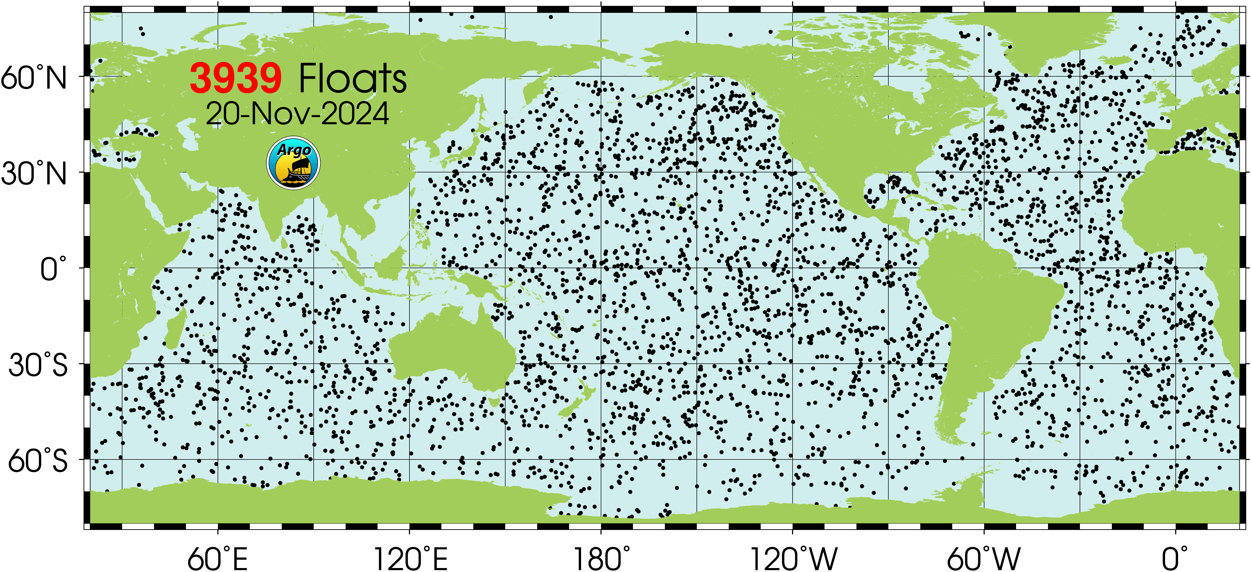
Why Profiling Floats?
Arguably the most cost effective observing platform for long-term, ecosystem scale applications
  Capital cost: ~$90K per BGC float
  Deployment costs: Almost any boat or ship of opportunity that can get to the deployment site
  Maintenance cost: Near $0 for 5-7 years
  On-going operations costs: Almost entirely data processing

Slide 12
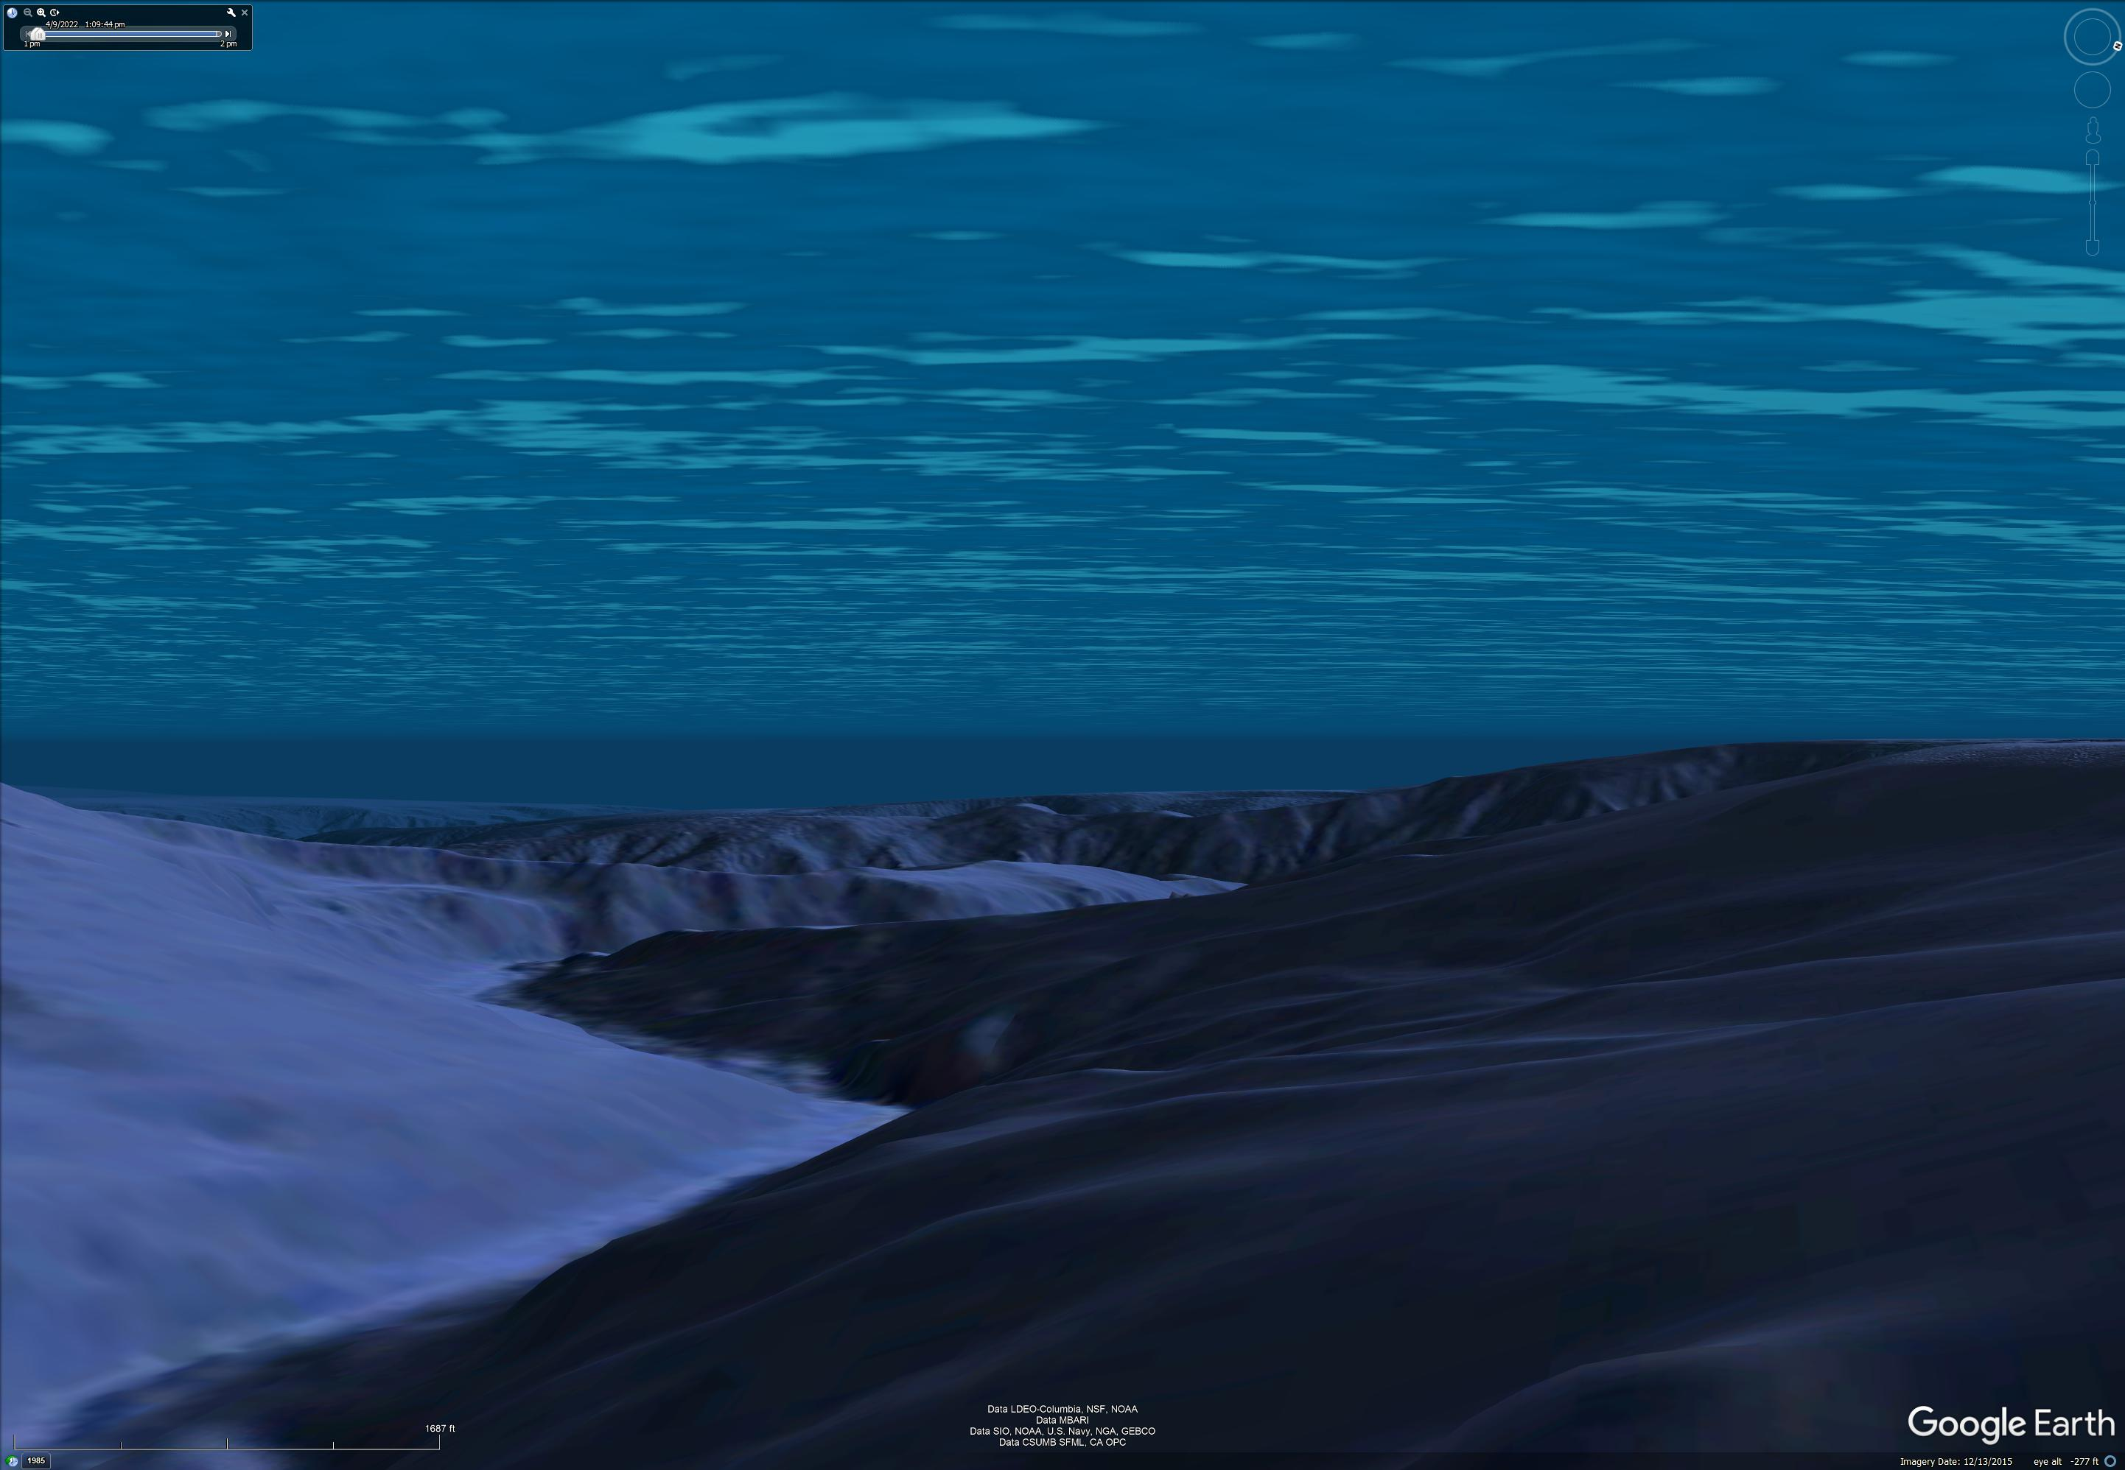
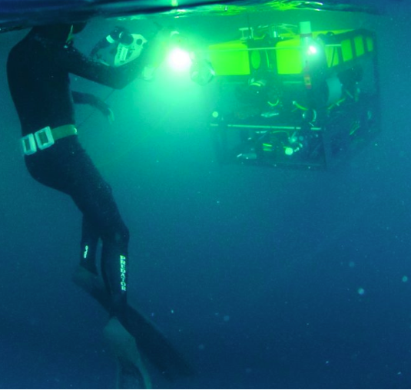
Profiling Float Array + Friends

Slide 13
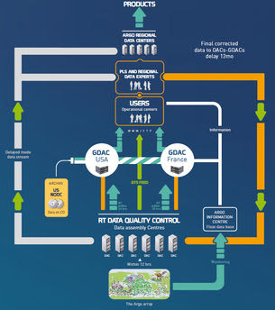
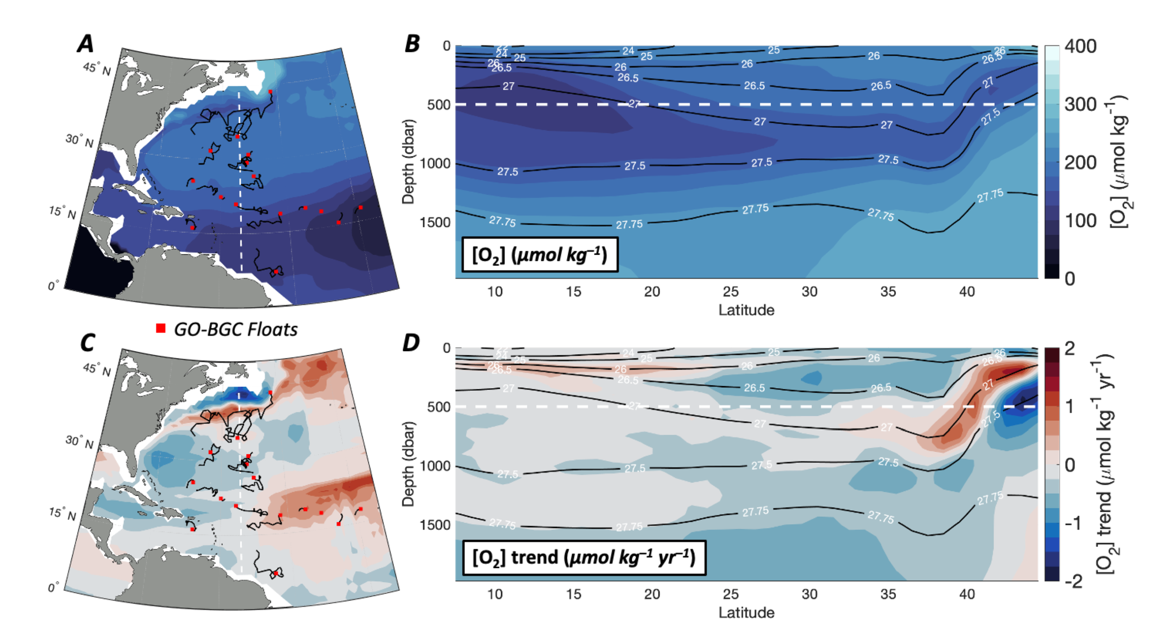
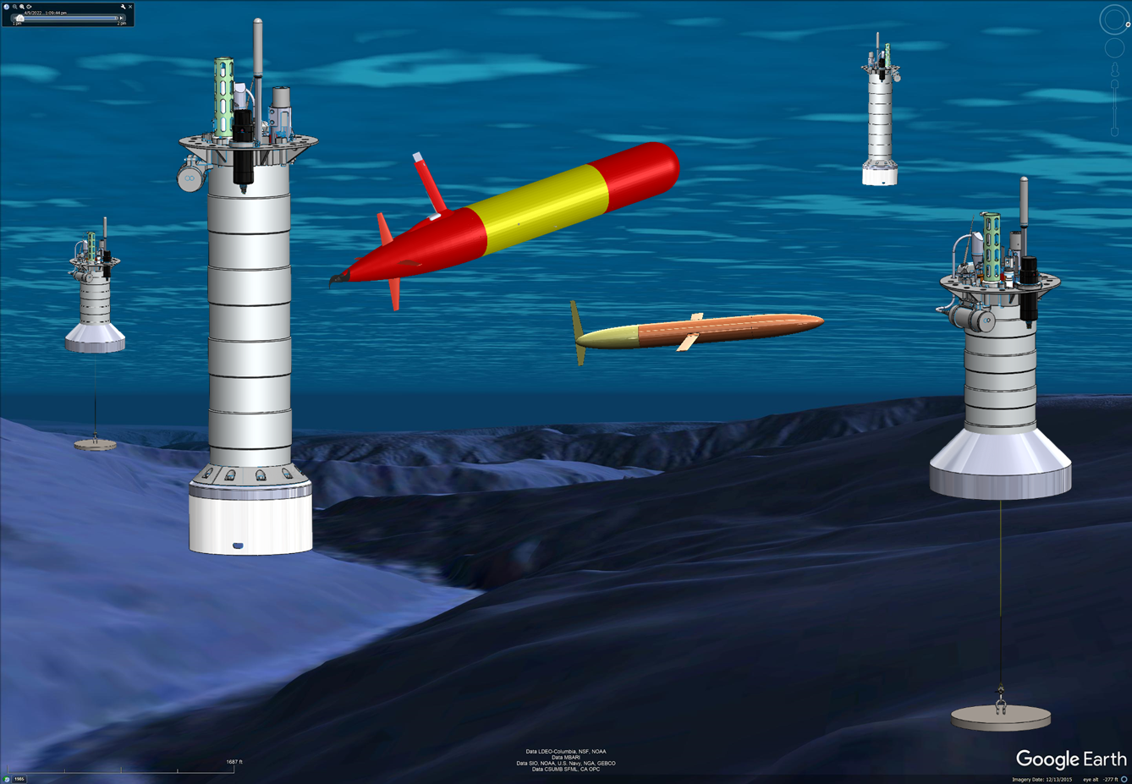
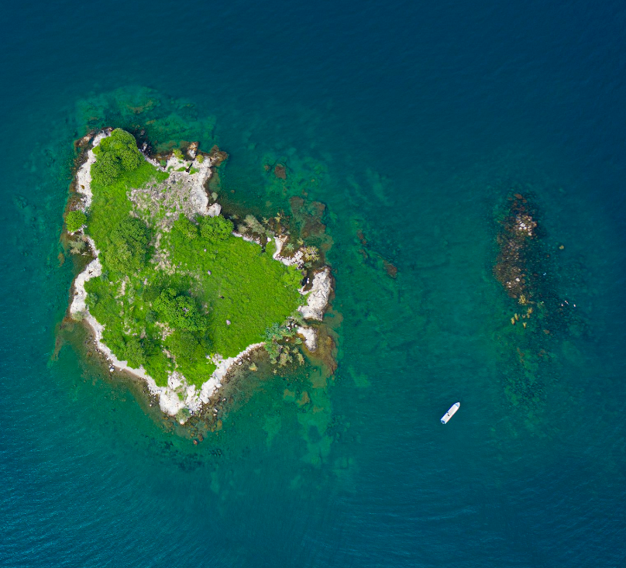
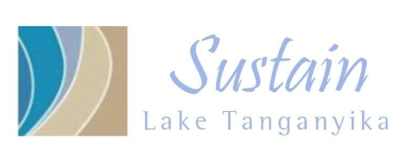
What is an Ocean Observing System?
Data
Center
What’s Missing: Tools to Generate a Range of fit-for-purpose
Data Products
Defensible data
Instrumented observing platforms
Notes:
If that’s the challenge, it’s fair to ask what is an Ocean Observing System?
Starting in the lower left, an ocean observing system has a 3 dimensional array of properly instrumented platforms in the ecosystem of interest acquiring and sending raw data to an on-shore data processing center, which generates defensible, quality controlled research data suitable for experts users.
Examples of these first 3 system elements exist in various forms. What’s mostly missing are tools that can turn research data into data products suitable for a wider range of non-expert users as part of a complete, effective, fit-for-use observing system.
For example, one application I haven’t mentioned is the new technologies coming on line for removing carbon from the ocean.
All of these technologies will need ocean observing systems to quantify the amount of carbon they say they’re removing without doing further harm to our planet. Again, no observing system exists to meet this need.

Slide 14
The CPF Data Pipeline
Notes:
Additional motivation include the Coastal Carbon Synthesis Group’s community workshop report where the recommended more development of observing systems for continental margins.
Community workshops sponsored by Ocean Carbon and Biogeochemistry Program and North American Carbon Program
NSF also published their 10 big ideas, the areas that will drive their research agenda for the near future. One of the 10 big ideas is Navigating the New Arctic and again, they point out the lack of data limiting our understanding.
While the arctic was not one of our initial research topics, we think it is within the capability of the CPF.

Slide 15
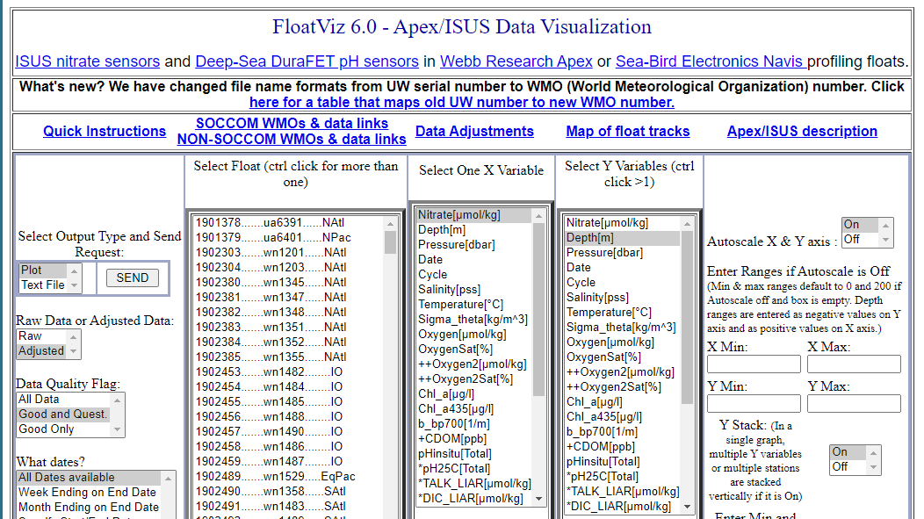
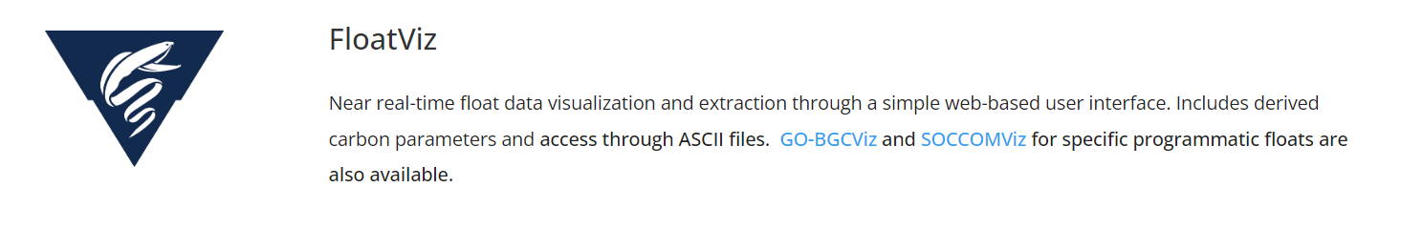
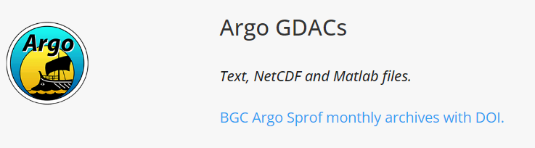

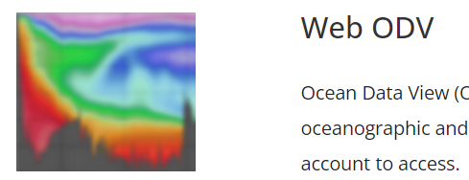
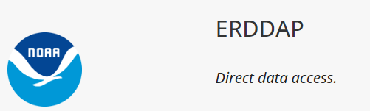
It’s The Economy, Stupid
(apologies to James Carville)
DATA
Our “deliverable” is relevant, defensible data products accessible by the community
Luckily, part of our lab is very involved in the Argo-BGC data processing and QC pipeline
The CPF generates files that can feed the GO-BGC data pipeline
https://www.go-bgc.org/data/access-and-visualization#float-data-access
Current Data System
Eventually

Slide 16
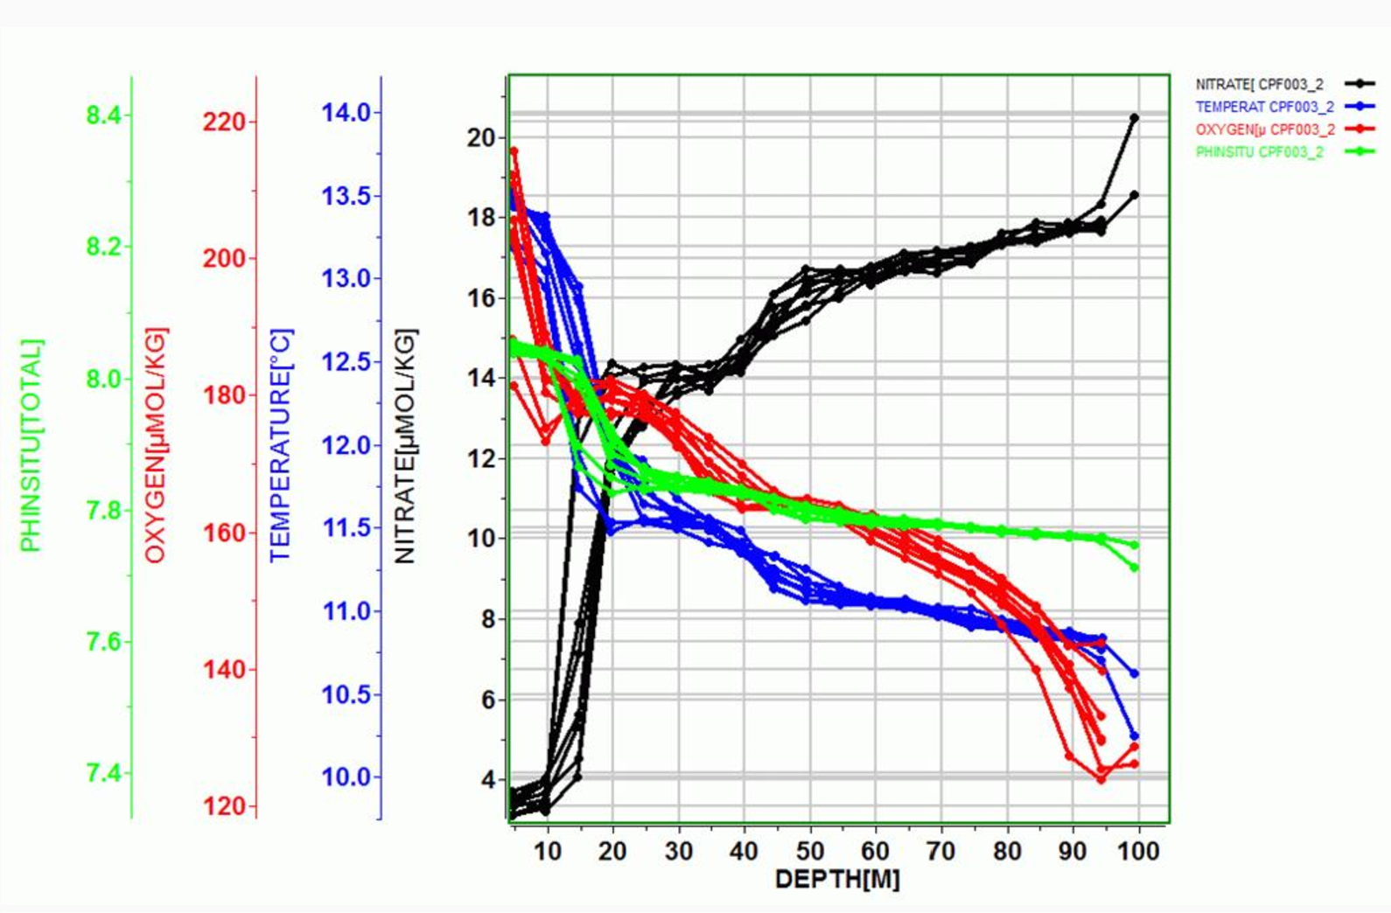

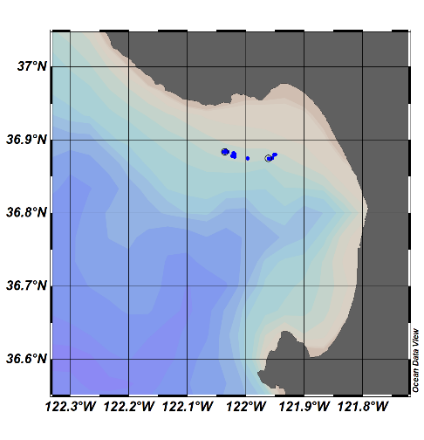
Float Viz
Ocean Data Viz
Notes:
I used to work in the engineering department at MBARI, now I work in the chem sensor lab and one of the first lessons I learned was that our product was useful science data, and that a really well engineering platform isn’t of any value if it doesn’t produce useful science data. I don’t really understand this thinking but I do accept it, so we’ve been working on the shore side tools we need to effectively interpret the data the CPF acquires.
We can see a cold, low oxygen deep water mass roll up the shelf and presumably transport nutrients (we’ll know when we have the Nitrate sensor on.;

Slide 17
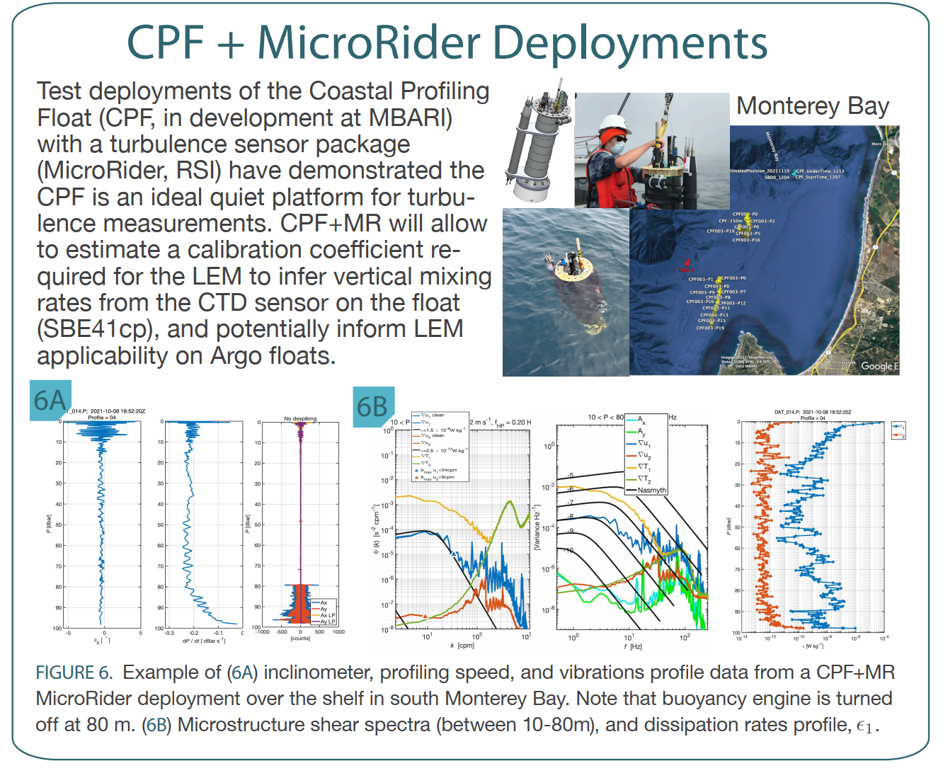
“Other” Science
Can we infer vertical mixing rates from Argo float ascent rates?
Use a CPF with turbulence sensor to acquire high quality turbulence data
See if similar results can be achieved with standard BGC sensors
Magdalena M Carranza(1), Gene Massion, Yui Takeshita and Ken Johnson; Presented at the Gordon Research Conference on Ocean Mixing, Mount Holyoke, MA June 5-10 2022
Acoustics?
Inclination
Profile
Speed
Vibration

Slide 18
The CPF

Slide 19

CPF Functionality
Depth range = 0 to 350 meters
BGC Instrument Suite
Electronics
108 cm
Internal Oil Bladder
Oil Pump
External Oil Bladder

Slide 20
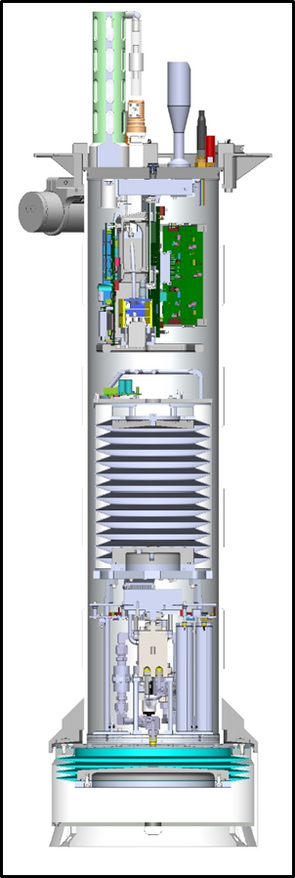
Lots of Volume Change
Depth range = 0 to 350 meters
Buoyancy engine ΔV/V = 3.5 liters / 40 liters = 9% (other floats 0.3-0.8 l)
  Profile from freshwater thru 35 psu = 2.5%
  Vertical velocity = zero to ~40 cm/sec
  Ability to anchor and de-anchor
  Reserve buoyancy to offset biofouling, mud buildup and allow sample recovery
  Easy ballasting
Notes:
Webb Apex Float = 1%, MRV S2-A Solo II = 3.4%, BSOP Modular = 3/82 = 3.7%, MRV Alamo = 4.2%
Talk about 2 versions: identical from the bottom end cap up

Slide 21
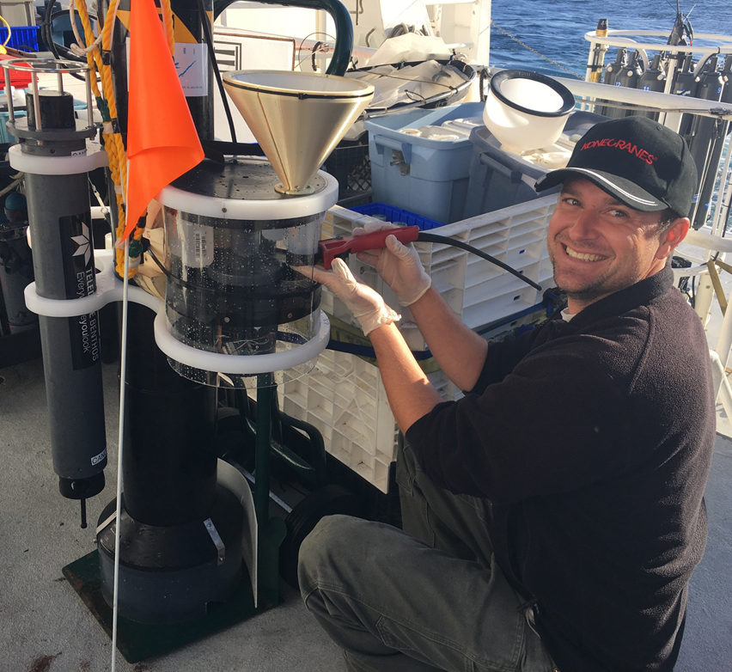
Pickup Truck of the Sea
Depth range = 0 to 350 meters
Buoyancy engine ΔV/V = 3.5 liters / 40 liters = 9%
Sample recovery CPF
  2X Sediment Traps
  Acoustic Modem

Slide 22
Lots of Instruments
Depth range = 0 to 350 meters
Buoyancy engine ΔV/V = 3.5 liters / 40 liters = 9%
Sample Recovery
Science Payload = 9 sensor ports
  6 BGC sensors
  Room for 3 more
BGC Instrument Suite
Electronics
108 cm
Internal Oil Bladder
Oil Pump
External Oil Bladder

Slide 23
Near Real-Time Communications
Depth range = 0 to 350 meters
Buoyancy engine ΔV/V = 3.5 liters / 40 liters = 9%
Sample Recovery
Science Payload: 9 sensor ports: 6 BGC sensors plus 3 available ports
Iridium SBD and (soon) RUDICS communications
BGC Instrument Suite
Electronics
Internal Oil Bladder
108 cm
Oil Pump
Batteries
External Oil Bladder

Slide 24
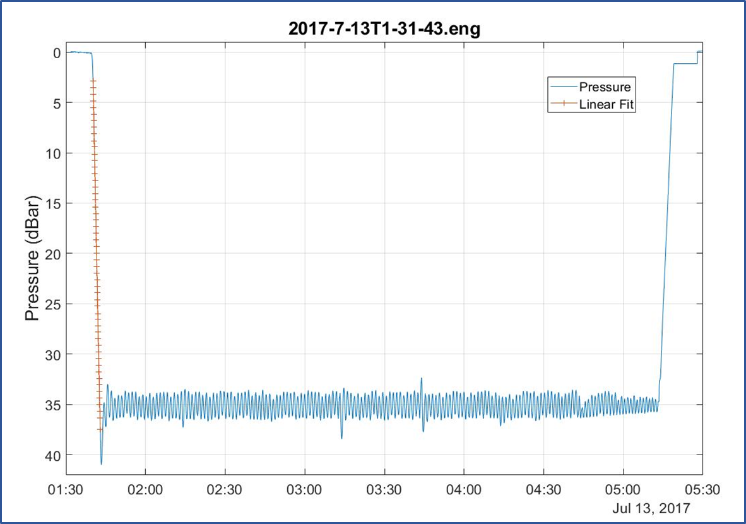
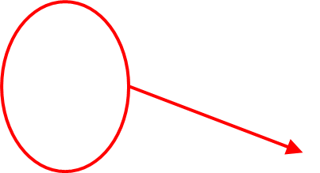
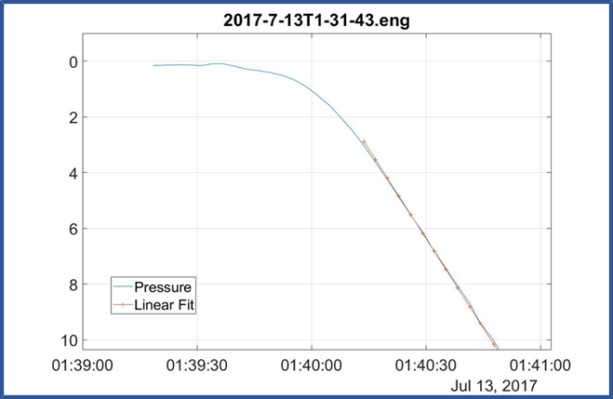
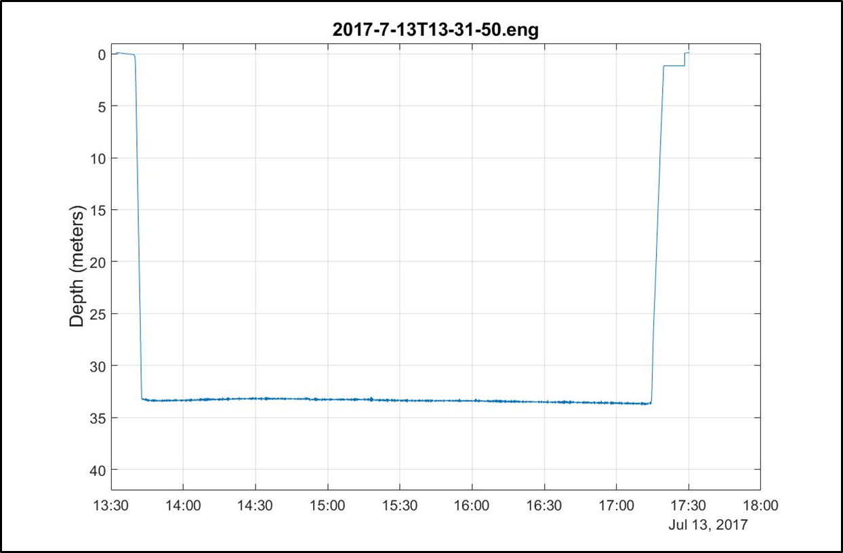
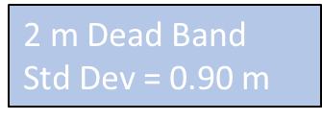

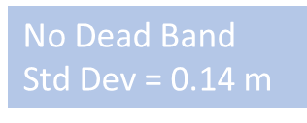
Good Platform Velocity and Depth Control
Depth range = 0 to 350 meters
Buoyancy engine ΔV/V = 3.5 liters / 40 liters = 9%
Sample Recovery
Science Payload: 9 sensor ports: 6 BGC sensors plus 3 available ports
Accurate, closed loop platform velocity and depth control

Slide 25
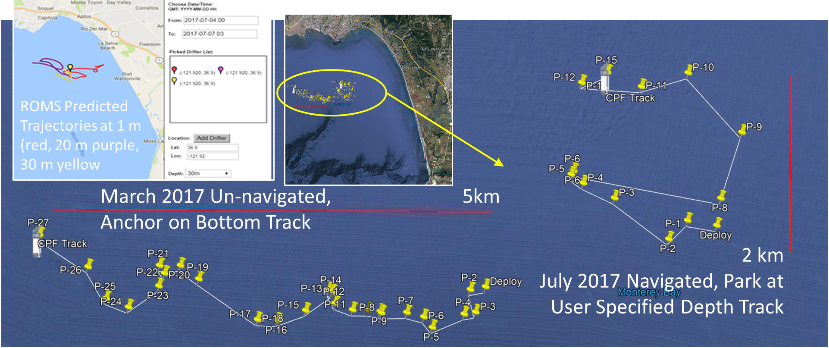
Current and Future Work
Have to do (this year)
  Finish the power management
    Goal = 200X 200m profiles over 1 year
  Finish Iridium RUDICS comms
  Finish building CPF002 and CPF003
  Run more MBARI science missions with the FloatViz data pipeline
Like to do
  Winched version for fixed applications
  Inertial current meter for float “navigation”
  Tech transfer

Slide 26
CPF Status Summary
1 CPF with dozens of science and engineering missions in Monterey Bay, some with only modest engineering involvement
2 CPFs nearing completion, operational Q4 2024
Data pipeline demonstrated
2 early CPF prototypes used routinely by MBARI’s BOG group
1 BOG CPF being re-purposed for Colleen Durkin’s carbon export work
Still a work in progress = lots of opportunities
Notes:
7: Prototype system, process, product, service or tool demonstrated in an operational or other relevant environment (functionality demonstrated in near-real world environment; subsystem components fully integrated into system).
8: Finalized system, process, product, service or tool tested, and shown to operate or function as expected within user’s environment; user training and documentation completed; operator or user approval given.
9: System, process, product, service or tool deployed and used routinely.

Slide 27
Opportunities

Slide 28
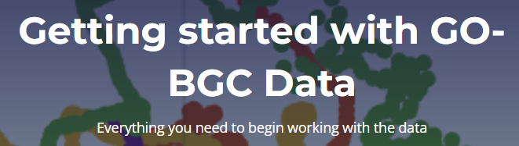
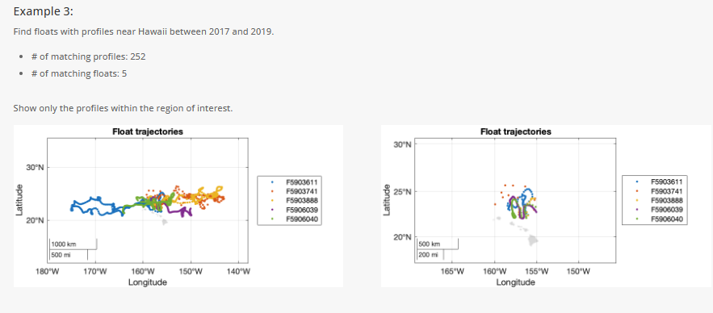
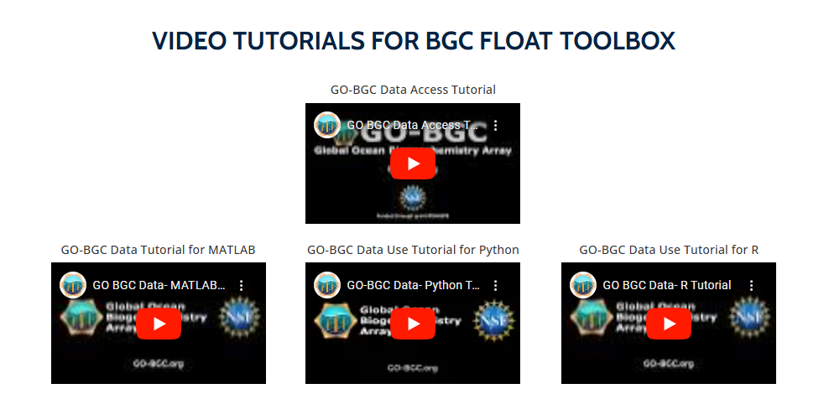
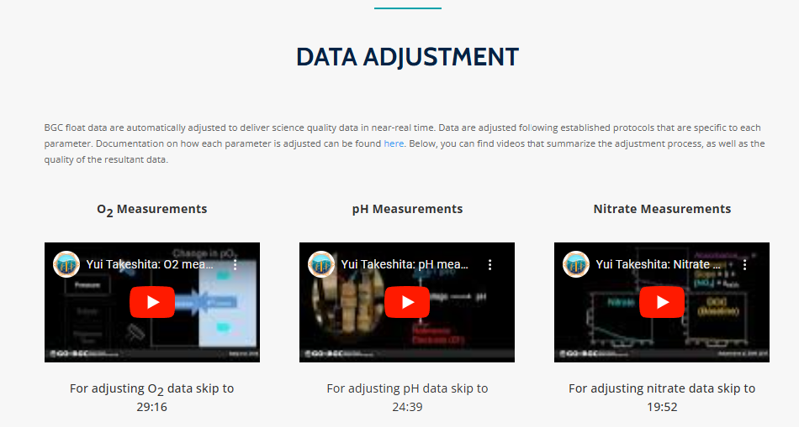
Data Science Opportunities
The GO-BGC data system is arguably the best example of a data system providing defensible oceanographic data and the requisite tools to the community
Not surprisingly, the Argo data processing centers are overwhelmed with their current work load
Golden Opportunity: duplicate, improve, simplify and add new, fit-for-purpose data products
BGC FLOAT TOOLBOX
https://www.go-bgc.org/getting-started-with-go-bgc-data
DELAYED MODE
QUALITY CONTROL
Please read this methods article … to learn more

Slide 29
Engineering Opportunities
Control System Development
  Closed loop control of platform velocity works well with a standard PID control law
  Closed loop of depth works but needs a higher order control law
  Both control laws can be refactored to weight power consumption with performance
Robotics
  How can you keep a fleet of Lagrangian robots that can only control depth in the desired coastal measurement volume?
    Maybe a combination of an inertial current meters and numerical models
  Delivering robust, bullet-proof, embedded software for autonomous robots is a huge challenge
  Design a more cost-effective CPF
The CPF is a pretty good platform for linking engineering and science students collaborating on challenging, satisfying projects

Slide 30
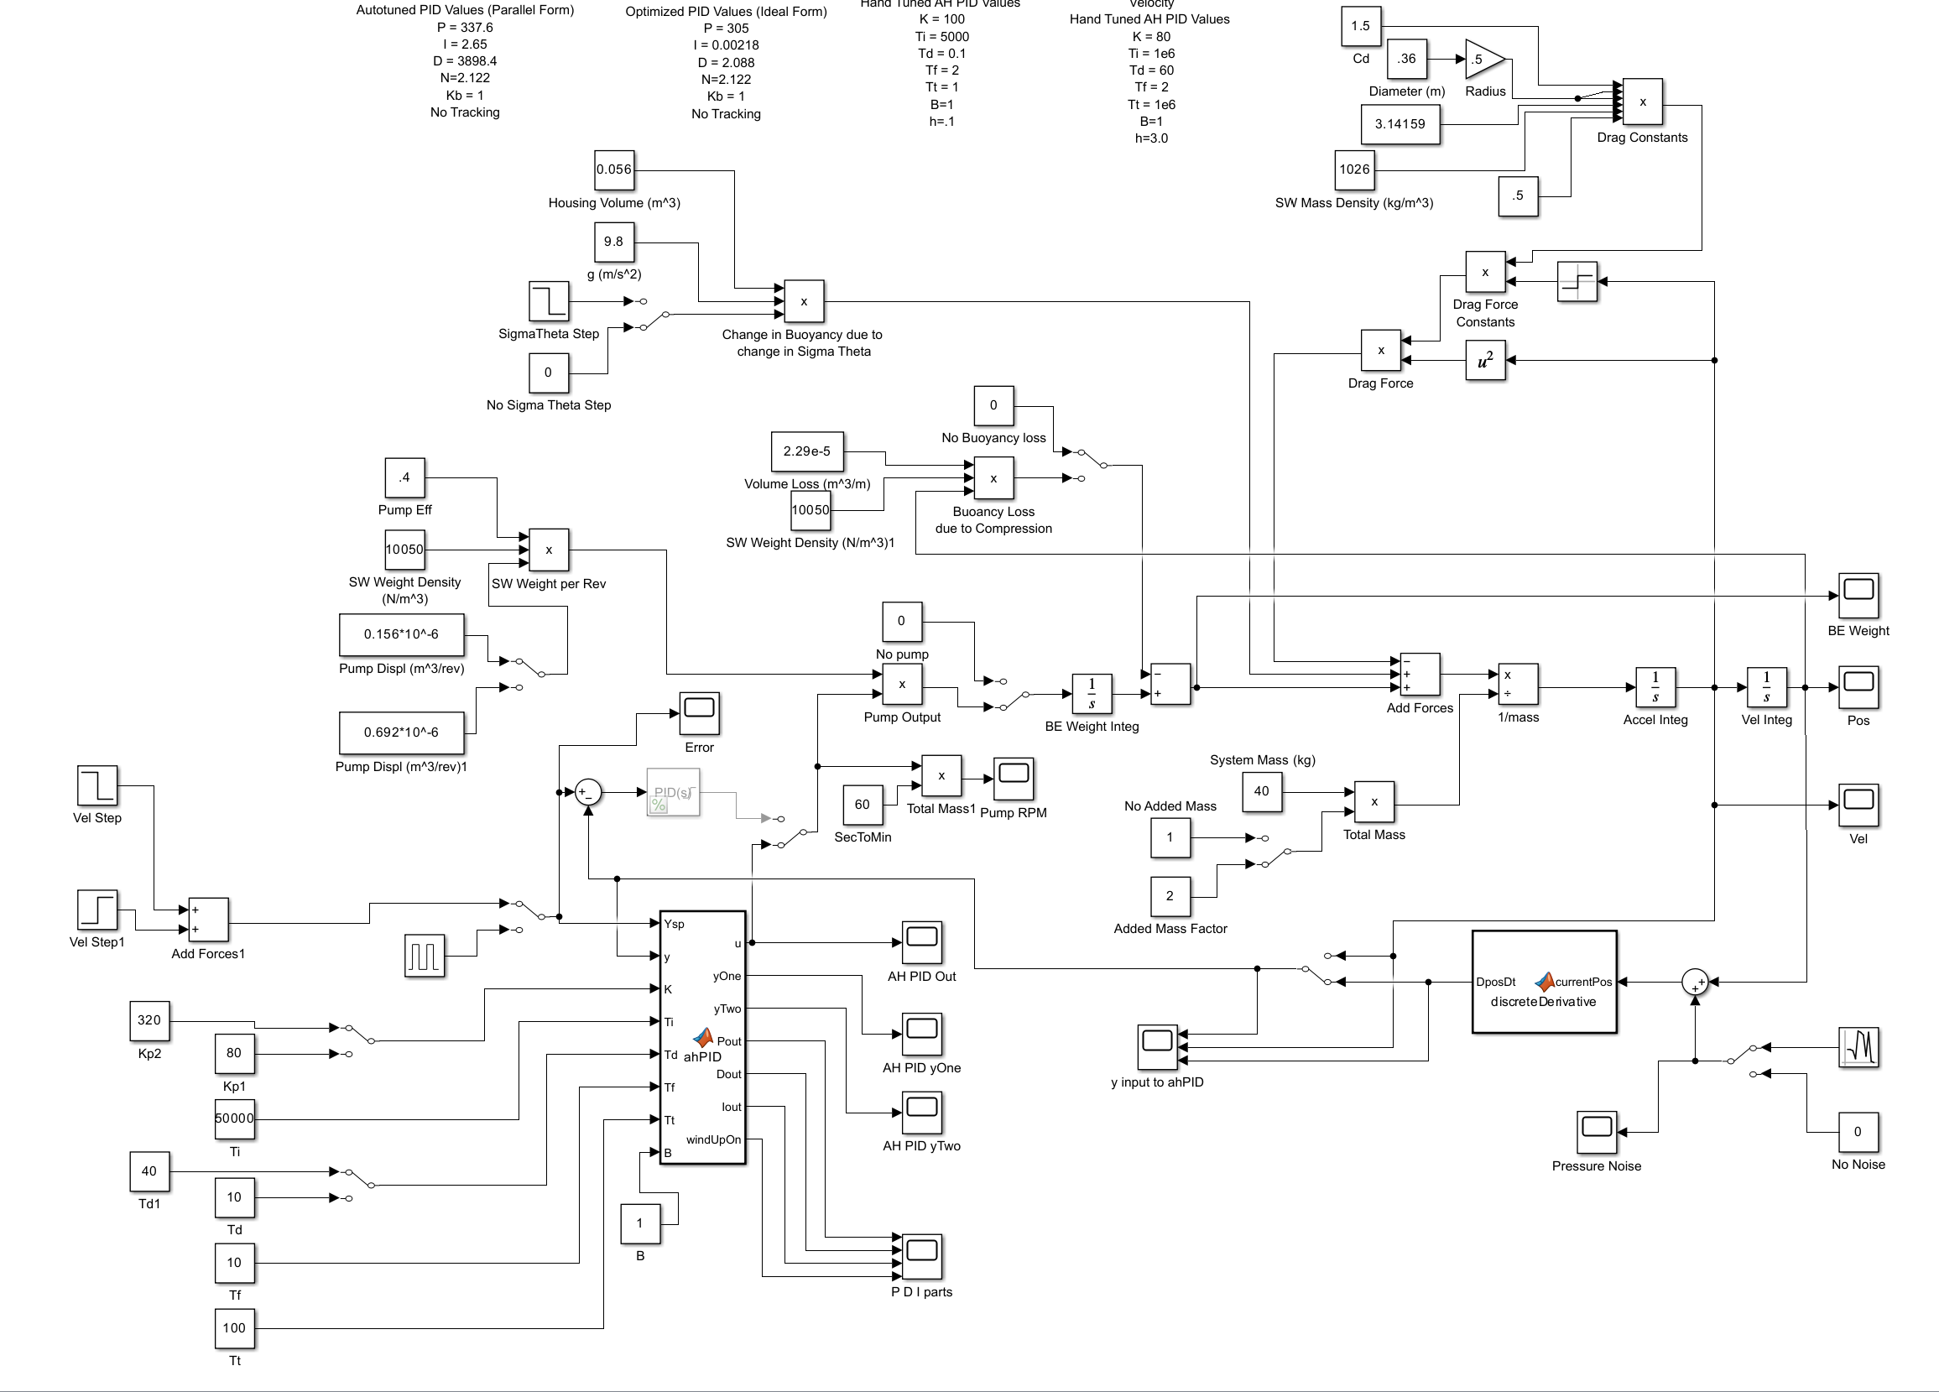

Control System Development (the CPF way)
$$\sum{Forces}=mass∗acceleration$$
$$acceleration=\frac{\sum{forces}}{mass}$$
$$\int{acceleration= \int{\frac{\sum{forces}}{mass}}}$$
$$model velocity=\int{\frac{\sum{forces}}{mass}}$$
$$Error=Desired Platform −model velocity$$
$$buoyancy change=f(Error)$$
Buoyancy_{force}
CPF
Perturbation_{forces}
Drag _{force}
Dynamic model of CPF motion in Simulink

Slide 31


Control System Development (the CPF way)
$$\sum{Forces}=mass∗acceleration$$
$$acceleration=\frac{\sum{forces}}{mass}$$
$$\int{acceleration= \int{\frac{\sum{forces}}{mass}}}$$
$$model velocity=\int{\frac{\sum{forces}}{mass}}$$
$$Error=Desired Platform −model velocity$$
$$buoyancy change=f(Error)$$
Buoyancy_{force}
CPF
Perturbation_{forces}
Drag_{force}
Perturbation_{forces}
Buoyancy_{force}
Drag _{force}
$$\sum{forces}$$
$$\int{acc}$$
buoyancy change
divide
Error
mass
velocity
Dynamic model of CPF motion in Simulink
f(Error)

Slide 32
Open Source Ecosystem vs. Commercialization
  Commercialization
    Pros:
      Anyone can buy a CPF (theoretically)
    Cons (based on my experience):
      CPFs will be expensive
      Development stagnates
      Degraded reliability
      Sole source risks
      Only provides a product, not the rest of the system required for successful projects
      Limited (or no) flexibility to address new applications
      Individual buyers have to cover all the capital costs even if they only deploy CPFs a couple of months a year
  Open Source Ecosystem
    Pros:
      CPFs will be minimum cost
      Development enabled
      Improved reliability
      No sole source risks
      Provides the entire system required for successful projects
      Unlimited flexibility to address new applications
      CPFs and expertise may be available as part of the Open Source Community
    Cons:
      A critical mass of users is required for feasibility

Slide 33

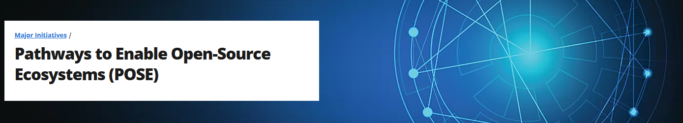
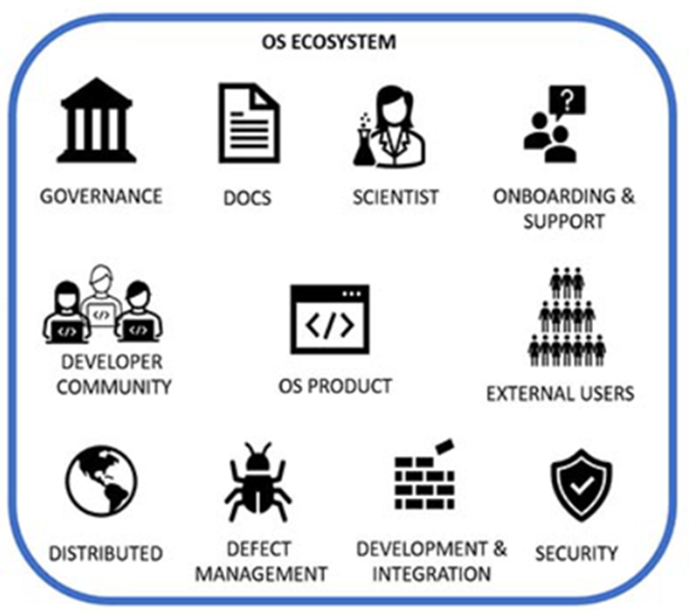
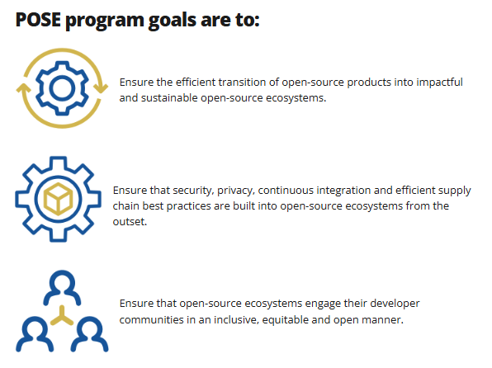
Open Source Ecosystem vs. Commercialization
& Engineers
& other experts

Slide 34

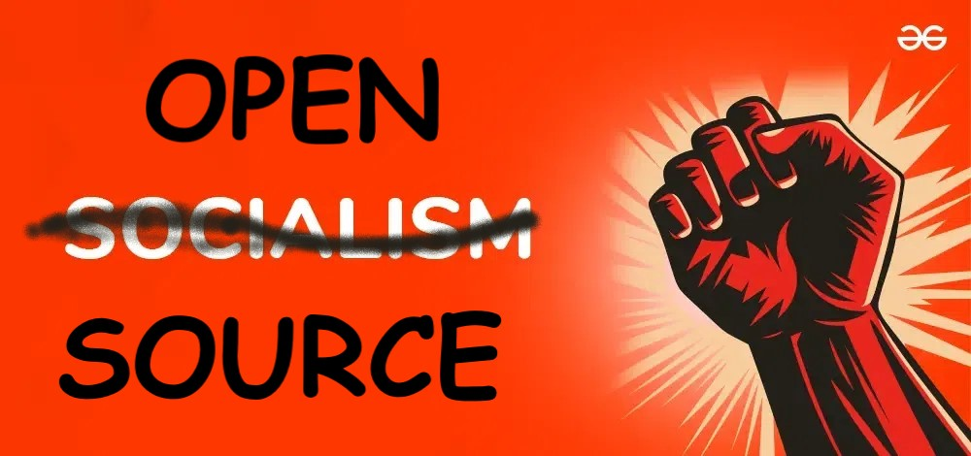
My Preference

Slide 35


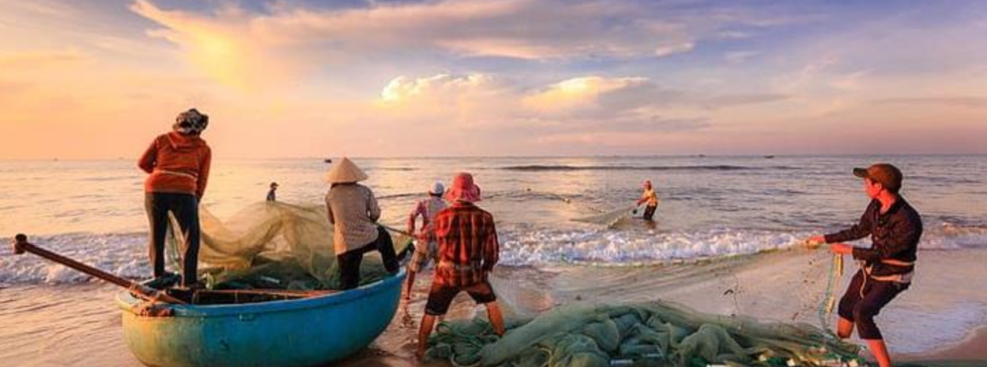
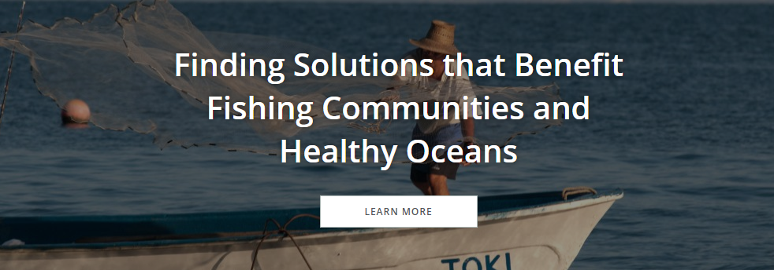
One of my Pipe Dreams
A team of bright, energetic, fearless UCSC science and engineering students write a proposal with the UCSC Fisheries Collaborative Program to support “sustainable fisheries through research, education and outreach”
They work with Sustain Lake Tanganyika to develop a fit-for-their-purposes Observing System
They run a collaborative pilot project using a few CPFs to build a baseline data set describing the current state of the Lake
Subsequent field programs build a time series that can be used to build a more sustainable fishery, educate the community and create jobs
Funded by:
Committed to safeguarding the Lake Tanganyika ecosystem whilst improving the welfare of her local communities. Vision: A healthy Lake Tanganyika with thriving fish populations, forests and people. https://www.sustaintz.org/
Notes:
, edu

Slide 36

Thanks for listening
$10 Million of CPFs
The CPF Village includes: Jerry Allen, Magdalena Carranza, Paul Conen, Jared Figurski, Ken Johnson, Chad Kecy, Eric Martin, Tanya Maurer, James McClure, Paul McGill, Ed Mellinger, Jim Montgomery, Josh Plant, Jose Rosal, Aaron Schnittger, Ray Thompson, Mark Tynes, Joe Warren
This work has been generously supported by the David and Lucille Packard Foundation
magene@mbari.org

Slide 37
Additional Material
Notes:
7: Prototype system, process, product, service or tool demonstrated in an operational or other relevant environment (functionality demonstrated in near-real world environment; subsystem components fully integrated into system).
8: Finalized system, process, product, service or tool tested, and shown to operate or function as expected within user’s environment; user training and documentation completed; operator or user approval given.
9: System, process, product, service or tool deployed and used routinely.

Slide 38
Technology Transfer
Possible tech transfer options:
    Collaborations
    Commercialization
    Open Source
    Others?
MBARI’s Biological Oceanography Group has been running 2 CPFs for several years (and setting the fashion standard)

Slide 39


CPF Open Source Ecosystem (COSE)
Critical Infrastructure
  The critical component is an appropriate size group of users
    ~10 CPFs a year for a couple of years
    OR
    3-5 Projects a year
    OR
    1 large volume need and everyone else tags along ➔ MRV for mCDR
Pathways to Enable Open-Source Ecosystems (POSE)
PROGRAM SOLICITATION NSF 23-556
Notes:
This is where the talk goes off the rails

Slide 40
COSE Critical Infrastructure
  2nd most critical: 1 committed, motivated CPF group
ENGINEER
Pathways to Enable Open-Source Ecosystems (POSE)
PROGRAM SOLICITATION NSF 23-556

Slide 41
COSE Critical Infrastructure
  3rd most critical: A source of CPFs
    Contract Manufacturer
    Equipment supply pool
      NSF Ocean Bottom Seismograph Instrument Center
      UNOLS Ships and ROVs
      Philanthropic Organization
    Sponsored builder workshops
    DIY documentation
    Cooperative CPF-centric groups
    Non-exclusive licensees
Pathways to Enable Open-Source Ecosystems (POSE)
PROGRAM SOLICITATION NSF 23-556

Slide 42

COSE Critical Infrastructure
  Also critical: Expertise
    Proposal development
    Project planning
    Project Execution
    “Rent-a-Tech”
      Field work design, prep, deploy, operations, recover
    One-stop-shop providers
      If there’s a high-volume application
Pathways to Enable Open-Source Ecosystems (POSE)
PROGRAM SOLICITATION NSF 23-556

Slide 43
COSE Critical Infrastructure
  Open sourcing an appropriate data pipeline is critical
  Argo-BGC is a model for research data
    Excellent docs but can it be open-sourced?
  Outflow should be scalable, relevant data products
    Need data product developers
    NOAA Future Seas might be an example
Pathways to Enable Open-Source Ecosystems (POSE)
PROGRAM SOLICITATION NSF 23-556

Slide 44
COSE Risks
  Sensor maturity
    e.g., Measuring pH in the ocean requires significant expertise
    Interpreting FLBB and OCR data is an active conversation
  Argo data centers probably don’t have the bandwidth to support non-Argo data streams
  The problem with TRLs is they don’t capture who’s doing the demo
    Demo by the system developers is one thing, demo by others is an entirely different kettle of fish
Pathways to Enable Open-Source Ecosystems (POSE)
PROGRAM SOLICITATION NSF 23-556

Slide 45

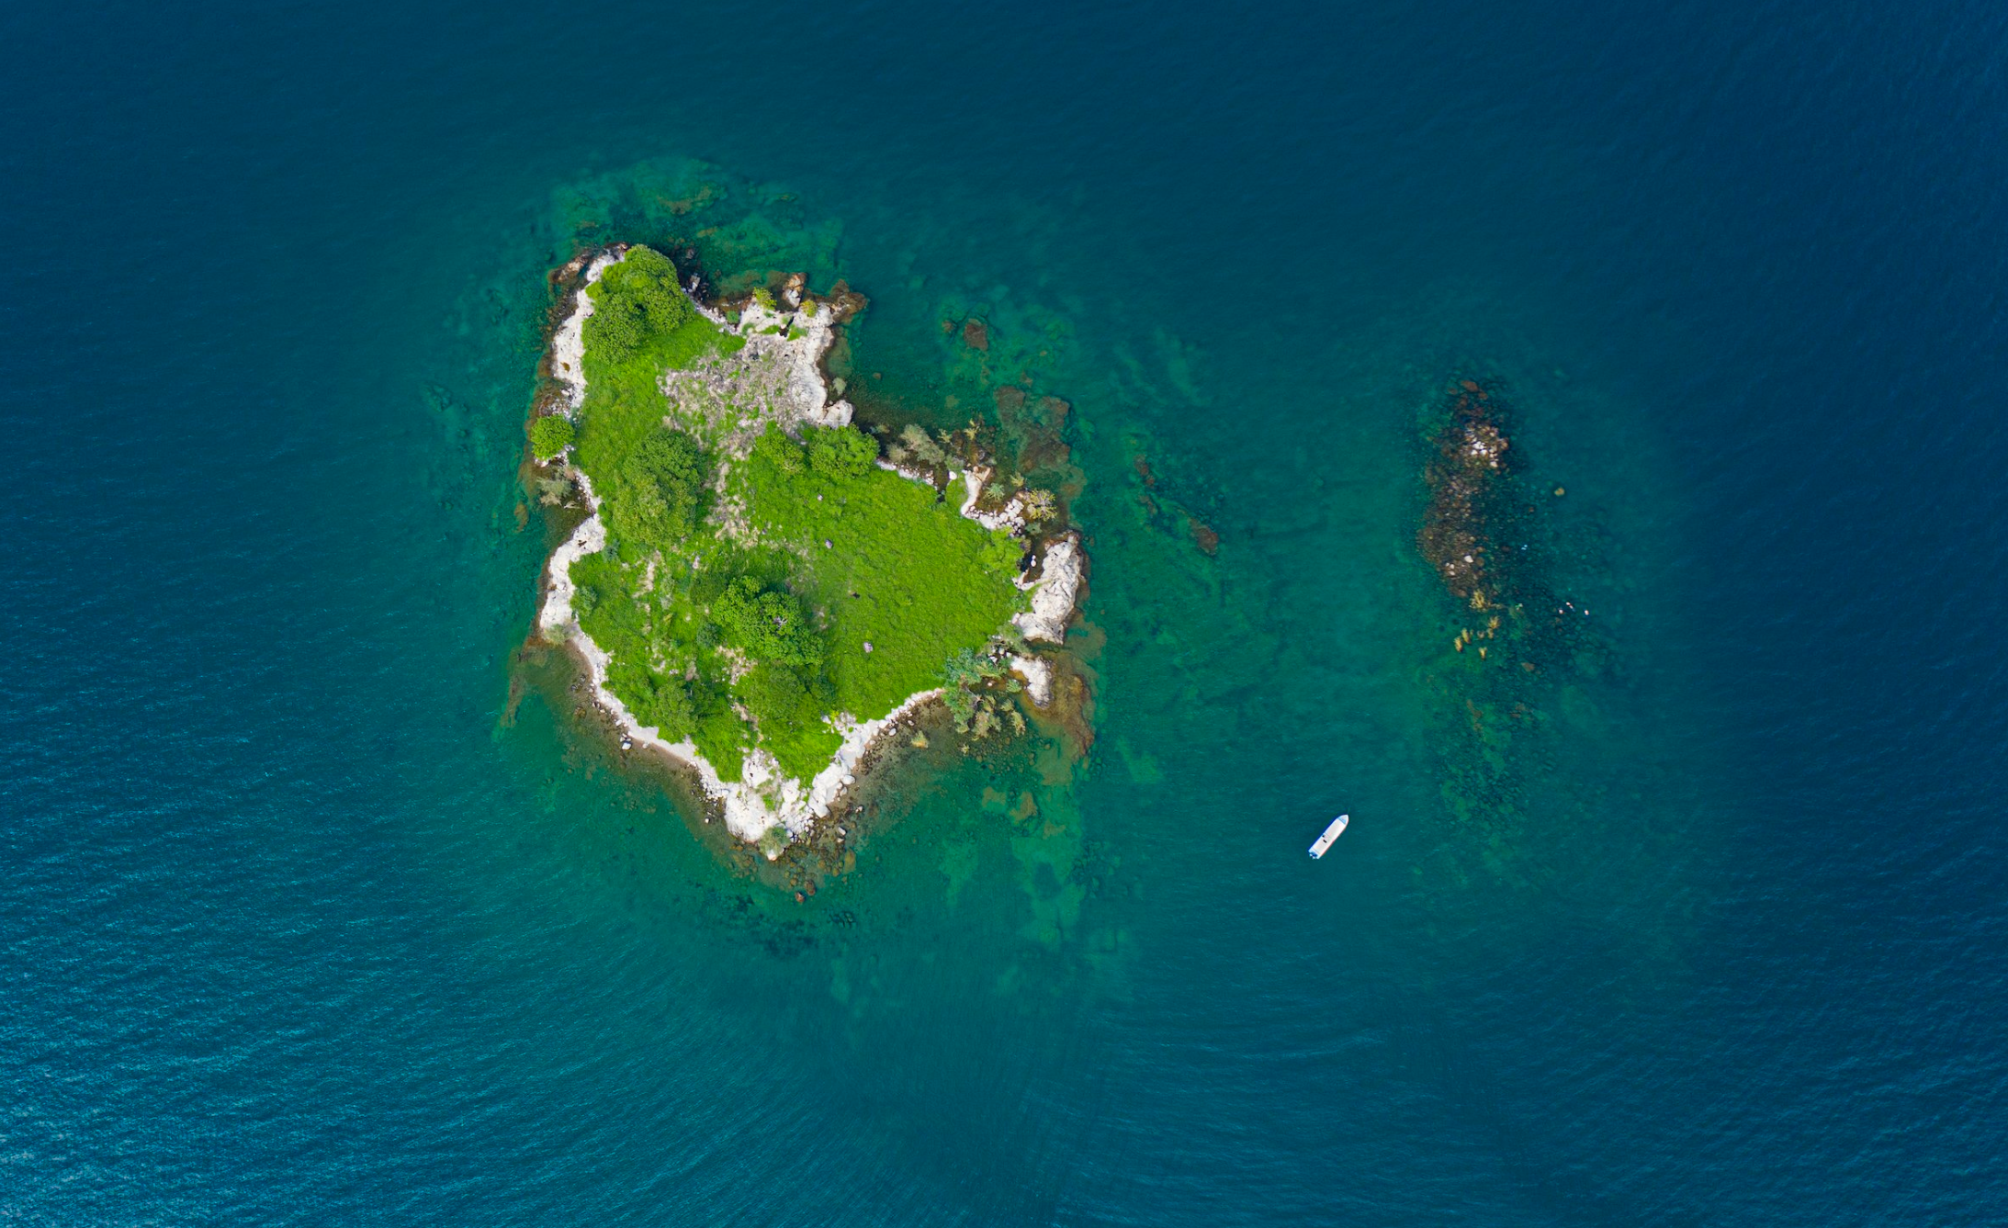
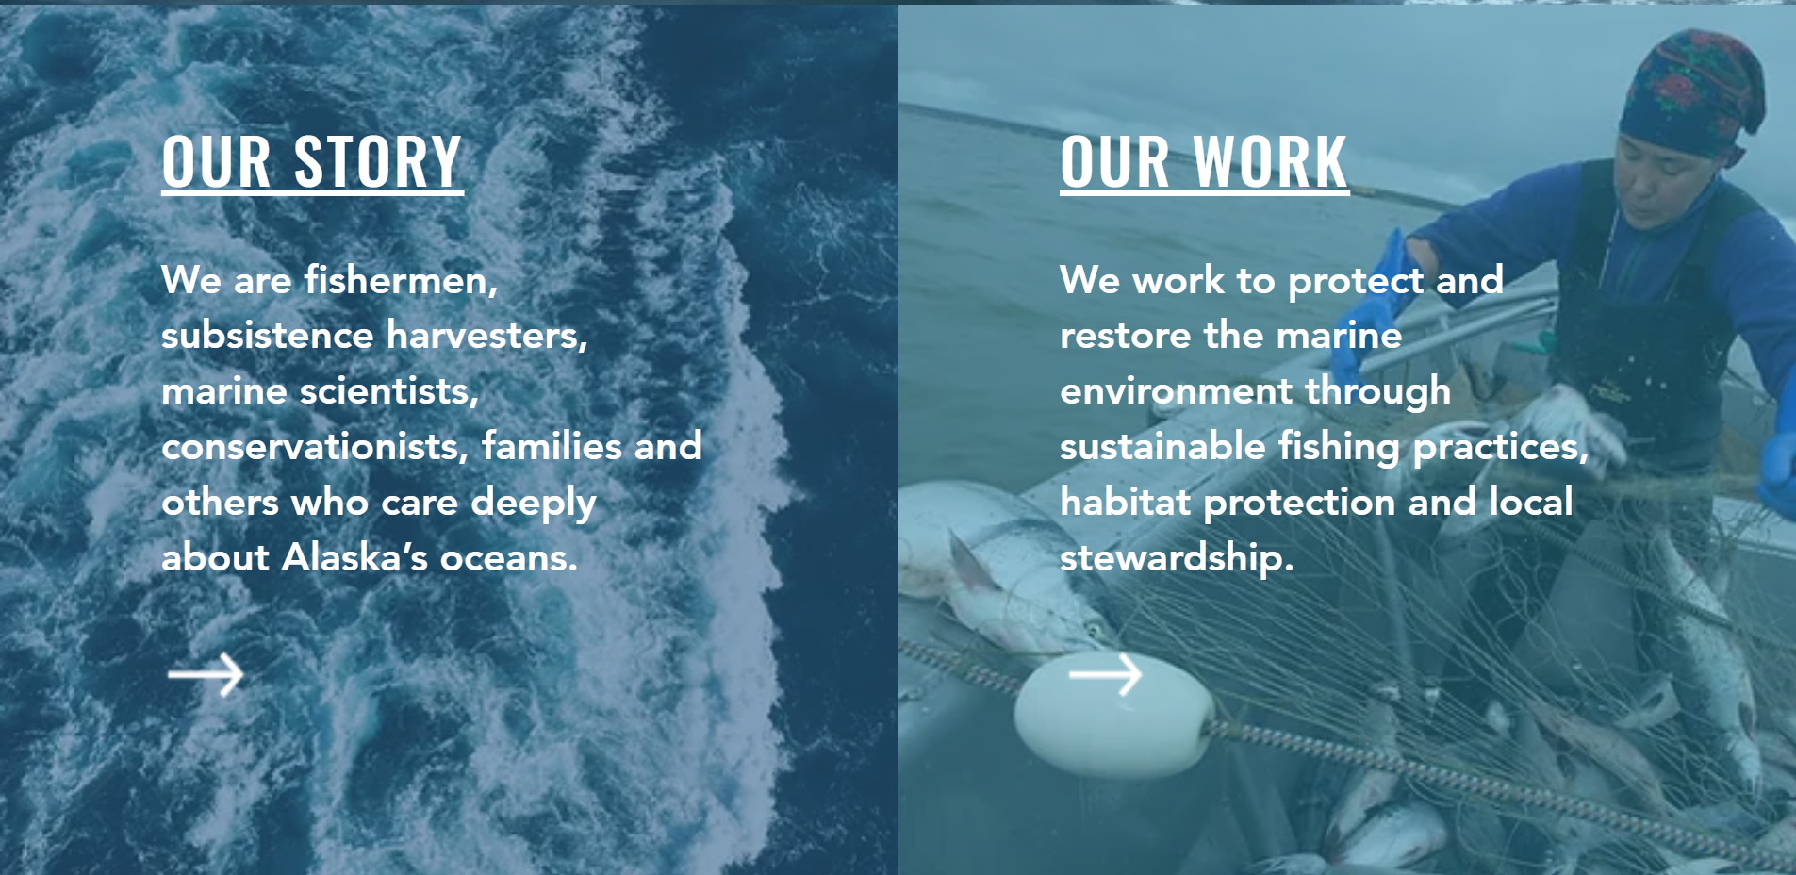
COSE Targets
    US Regional Fishery Management Councils
    NOAA Integrated Ecosystem Assessment program
      Future Seas “Physics to Fisheries” projections and predictions
    mCDR MRV mandated by the government
    Non-MBARI research groups
    NGOs
INSERT COSE DATA HERE
Alaska Marine Conservation Council
Sustain Lake Tanganyika
Committed to safeguarding the Lake Tanganyika ecosystem while improving the welfare of her local communities

Slide 46
Is a COSE a Realistic Possibility?
    Step 1: POSE Phase I
      are for open-source research products with a small community of external users .. may not necessarily have external content developers. The objectives are (1) enable scoping activities 2) provide training to teams interested in building such an OSE (<1 Year and <$300K)
      Develop risk mitigation plan
    Step 2: Simultaneously find funding to support a pilot project with existing CPF assets
    If (POSE Phase 1 == success) then
    Step 3: Pose Phase II
      transition into a sustainable and robust OSE (<2 Years and <$1.5M)
      Execute risk mitigation plan
    Step 4: Execute POSE Phase II with the pilot project as the case study

Slide 47


More Motivation
“Further development of event-scale observing capacity (e.g., novel autonomous platforms) in all continental margin systems to better quantify impacts of episodic events on coastal carbon budgets”
A Science Plan for Carbon Cycle Research in North American Coastal Waters 2016, Ocean Carbon and Bio. Program and NA Carbon Program
Notes:
Additional motivation include the Coastal Carbon Synthesis Group’s community workshop report where the recommended more development of observing systems for continental margins.
Community workshops sponsored by Ocean Carbon and Biogeochemistry Program and North American Carbon Program
NSF also published their 10 big ideas, the areas that will drive their research agenda for the near future. One of the 10 big ideas is Navigating the New Arctic and again, they point out the lack of data limiting our understanding.
While the arctic was not one of our initial research topics, we think it is within the capability of the CPF.

Slide 48



Float Navigation
Experiment: Park the CPF at various depths and compare track to ROMS nowcast and previous missions that anchored on the bottom after every profile
ROMS Predicted Trajectories at 1 m (red, 20 m purple, 30 m yellow
March 2017 Un-navigated, 5km Anchor on Bottom Track
2 km
July 2017 Navigated, Park at User Specified Depth Track
Notes:
This slide is pretty dense, I’ll try to unpack it for you.
I talked about the challenge of keeping the CPF in the coastal zone and not on the beach of off-shore.
We identified this risk at the beginning of the project and suggested we could mitigate this risk to some extent using operational, 3D numerical current models.
The ROMS model runs every day and give a 3 day 3D forecast of currents in the Monterey Bay.
So if the CPF was drifting west, in many coastal zones there would be a high probability there is a sub-surface current heading roughly east and we could park at that depth to move back toward the target volume. This is much like the way Hot air balloons navigate.
So, we ran an experiment, here’s the target area …
Need to run ROMS at higher resolution particularly given the bathymetry
Maybe crop the ROMS window and add a velocity vs depth plot.

Slide 49
ROMS Predicted Trajectories at 1 m (red, 20 m purple, 30 m yellow
March 2017 Un-navigated, 5km Anchor on Bottom Track
2 km
July 2017 Navigated, Park at User Specified Depth Track
Notes:
This slide is pretty dense, I’ll try to unpack it for you.
I talked about the challenge of keeping the CPF in the coastal zone and not on the beach of off-shore.
We identified this risk at the beginning of the project and suggested we could mitigate this risk to some extent using operational, 3D numerical current models.
The ROMS model runs every day and give a 3 day 3D forecast of currents in the Monterey Bay.
So if the CPF was drifting west, in many coastal zones there would be a high probability there is a sub-surface current heading roughly east and we could park at that depth to move back toward the target volume. This is much like the way Hot air balloons navigate.
So, we ran an experiment, here’s the target area …
Need to run ROMS at higher resolution particularly given the bathymetry
Maybe crop the ROMS window and add a velocity vs depth plot.

Slide 50
Can a COSE Become a Reality?
Step 1:
  POSE Phase 1: “The objectives of Phase I projects are … enable scoping activities that will inform the transition of promising research products … into sustainable and robust OSEs that will have broad societal impacts .. provide training to teams interested in building such an OSE” (<1 year <$300K)
Step 2:
  POSE Phase 2: “projects are for open-source research products with a small community of external users and external content developers. The objective of Phase II projects is to support the transition of a promising open-source product into a sustainable and robust OSE” (<2 years <$1.5M)
Step 3:
  In parallel with POSE Phase 1 and 2: Win a grant for a marine CO2 removal MRV system pilot project (or ?) using the COSE developed through POSE
Notes:
This is where the talk goes off the rails

Slide 51


Engineering Results
2 m Dead Band
Std Dev = 0.90 m
Notes:
Working in shallow water is a challenge as I mentioned earlier. If you’re working in 20 meters of water you don’t want to spend 15 of those meters getting to a stable vertical velocity
The zoomed inset is for getting off the surface which is harder due to wave action and the fact that we descend at 20 cm/sec and ascend at 10 cm/sec
Sampling is typically done during park, anchor and ascent but can be done on descent if desired.
The depth control has a dead band which in this case is set for +/1 meter.
Tuned for maximum stability and noise rejection and moderate performance
6 meters of overshoot

Slide 52

More Engineering Results
No Dead Band
Std Dev = 0.14 m
Notes:
Exact same control algorithm with no dead band.
After trying several other subsurface Lagrangian floats, the MBARI BOG built 2 for their twice a year field deployments
Ballast in 350 gram increments in the test tank
Control algorithms designed for maximum stability and noise rejection and minimal performance
Pick up truck of the sea

Slide 53
Risks
Risks:
  Working in shallow, coastal water
    Can’t drift on or off-shore
    Need accurate velocity and depth control
  Biofouling
Notes:
If you’re working in 20 meters of water you don’t want to spend 15 of those meters reaching a stable profiling velocity
Profiling floats have been very effective platforms for the pH and Nitrates sensors we’ve developed in our lab but so far, only in deep water, open ocean applications
Profiling floats are kind of a base line for evaluating platform concepts and were the only approach that scaled up to the scales we were targeting at a cost that was consistent with reasonable funding assumptions
Say bottom station ocean profiler
https://www.researchgate.net/publication/4010558_Design_and_initial_results_of_a_bottom_stationing_ocean_profiler
Arvor-C FLOAT DIMENSIONS Overall length: 195cm with antenna Hull length: 140cm Hull diameter: 11cm Weight: 22kg
Talk about anchoring, fast profiling, numerical model

Slide 54
Next Steps
  Run science missions with all 6 sensors
    The influence of lateral nutrient transfer from upwelling plumes versus canyon upwelling on the development of high chlorophyll levels in the Monterey Bay “upwelling shadow”
Notes:
Use action verbs
The primary science focus will be the influence of lateral nutrient transport from upwelling plumes versus canyon upwelling on the development of high chlorophyll levels in the Monterey Bay “upwelling shadow”

Slide 55
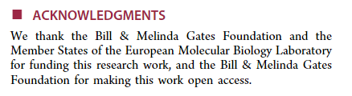


Open Source Examples
  Open source ecosystems (OSEs):
    Arduino (inexpensive, embedded hardware and software)
    Linux (27+ million lines of code, 1000s of developers)
    Open Source Malaria (https://opensourcemalaria.org/)
    NSF Pathways to Enable OSEs program
    Open Source Initiative (software centric https://opensource.org/ )
    Open Source Hardware Association (https://www.oshwa.org/ )
Notes:
This is where the talk goes off the rails

Slide 56
Next Steps
  Run science missions with all 6 sensors
  Extend the mission duration
Notes:
Use action verbs

Slide 57
Next Steps
  Run science missions with all 6 sensors
  Extend the mission duration
  Continue enhancing reliability
Notes:
Use action verbs

Slide 58
Next Steps
  Run science missions with all 6 sensors
  Extend the mission duration
  Continue enhancing reliability
  Finish new rechargeable battery pack with 3X higher energy per cm³
Notes:
Use action verbs

Slide 59
Next Steps
  Run science missions with all 6 sensors
  Extend the mission duration
  Continue enhancing reliability
  Finish new rechargeable battery pack with 3X higher energy per cm³
  Supplement/replace ROMS current forecasts with small, low power current sensor based on new tactical grade moderately expensive Inertial Measurement Unit
Notes:
Use action verbs

Slide 60
Next Steps
  Run science missions with all 6 sensors
  Extend the mission duration
  Continue enhancing reliability
  Finish new rechargeable battery pack with 3X higher energy per cm³
  Supplement/replace ROMS current forecasts with small, low power current sensor based on new tactical grade moderately expensive Inertial Measurement Unit
  Make our data freely available on MBARI FloatViz
Notes:
Use action verbs

Slide 61
Next Steps
  Run science missions with all 6 sensors
  Extend the mission duration
  Continue enhancing reliability
  Finish new rechargeable battery pack with 3X higher energy per cm³
  Replace/supplement ROMS model current forecasts with small, low power current sensor e.g. tactical grade MEMS Inertial Measurement Unit
  Make our data freely available on MBARI FloatViz
  Make the CPF tech. available to the community
Notes:
Use action verbs

Slide 62
NOAA scientists are reviewing unusual environmental conditions in the Pacific Ocean as the likely culprit for the dramatically low returns of Chinook and coho salmon to rivers and streams along the West Coast of the United States in 2007.
Researchers from NOAA's Northwest and Southwest Fisheries Science Centers are comparing data on the low food production of the California Current in 2005 that occurred when this year's returning salmon would have been entering the ocean from their natal streams to feed and grow.
The cold waters of the California Current flow southward from the northern Pacific along the West Coast and are associated with upwelling, an ocean condition caused by winds that bring nutrients to the ocean's surface and is the main source of nourishment for the ocean's food web. In 2005 a southward shift in the jet stream, delayed favorable winds and upwelling for the California Current, which normally begins in spring. The winds instead arrived in mid-July, causing high surface water temperatures and very low nutrient production within the near-shore marine ecosystem.
"We are not dismissing other potential causes for this year's low salmon returns," said Usha Varanasi, NOAA Fisheries Service Science Center Director for the Northwest Region. "But the widespread pattern of low returns along the West Coast for two species of salmon indicates an environmental anomaly occurred in the California Current in 2005."
New data released by the Pacific Fisheries Management Council indicate the 2007 returns of fall Chinook salmon to the Sacramento River in California's Central Valley were approximately 33 percent of what fishery biologists expected. Projections for 2008 are substantially lower than last year's estimate.
Coho salmon returning to spawning streams in California and Oregon are also considerably lower than predicted. A preliminary analysis found an average 27 percent of the parental stock returning in 12 streams monitored in California. Even though coho returns appear to improve along the coast from south to north, Oregon Coast coho salmon had less than 30 percent of their parental stock return.
Coho salmon are listed as either endangered or threatened under the Endangered Species Act in the Central/Northern California and Southern Oregon watersheds.

Slide 63
Title
Good afternoon, I appreciate this opportunity to talk about our Coastal Profiling Float project
Initial Motivation
This project started during a conversation I had with Ken Johnson. Ken runs the chemical sensor lab at MBARI and we had just finished a couple of projects that went pretty well. I asked Ken what else he had on his list of future projects and he showed me this press release from NOAA Marine Fisheries. It was released in 2008 and it attributes the low return of Salmon along the West Coast in 2007 to a lack of nutrients in 2005. You don’t have to read very far between the lines to realize that fisheries managers have an exceptionally difficult job to do and very little data, virtually none in real time, to do it with.
More Motivation
Along the way there was more motivation for this project. The US Ocean Carbon and Biogeochemisty Program and the North American Carbon Program held a series of community workshops and released “A Science Plan for Carbon Cycle Research in North American Coastal Waters” A key recommendation of this plan is further development of autonomous platforms for use in continental margins. This is the target for the CPF.
NSF also released their 10 Big Ideas: 10 research topics that will be a focus of their efforts for the near future. One of the Big Ideas is “Navigating the New Arctic” where they point out that observations are “sparse and inadequate”. While the arctic is not an immediate target for our work, it does seem within the capabilities of the CPF.
Science Requirements
We started the project with the usual process of defining the specific science requirements, identifying risks and developing initial concepts. It is a fairly detailed document but I can summarize the important points here …

Slide 64
Risks and relevant examples
The most important risks we identified were first “Working in Shallow Water’. There are a couple of issues here. Most obvious is winding up on the beach or way off shore. So we need a way to “navigate” the floats that doesn’t take any power, doesn’t take up much volume and will continue working without failure for several years. Next, biofouling is always a problem when working in shallow water and I’ll talk about our mitigation strategies for both these issues in a minute.
My standard concept development process starts with looking around to see what good ideas I can beg, borrow or steal. There a plenty of very effective profiling floats to learn from. The Argo array and the SOCCOM project are great examples of using these profiling floats to provide a cost effective observing system at global and regional scales for deep water, open ocean applications. There are even several examples of profiling floats for coastal application but we thought there was an opportunity here to help advance this technology for coastal applications.
Current CPF
Here’s what the CPF looks like today. It has the usual bits and pieces that any profiler has. An external expandable oil bladder. An oil pump, batteries, an internal oil reservoir, the electronics need to run the whole mess and the science sensor suite. We have 2 versions, one with the external bladder mounted concentrically with the pressure housing and a second version with the external bladder mounted coaxially underneath the pressure housing. Earlier, I mentioned the challenge of keeping the floats from winding up on the beach. One of our strategies for minimizing this risk is anchoring on the bottom between profiles. The concentric design minimizes the horizontal surface areas that could serve as places that might accumulate mud every time we anchor and interferes with the expansion and contraction of the external bladder. But this design is more awkward to deploy and recover. The coaxial design is pretty robust but has the potential of building up mud in the protective cover. Everything is identical in the 2 versions above the lower end cap and while we haven’t done it, it is theoretically possible to swap between the versions. We will be fielding both versions to evaluate the relative pros and cons.

Slide 65
The depth range is down to 500 meters. One of the ways we’ve optimized the CPF for coastal applications is the buoyancy engine. We knew we wanted to anchor on the bottom with some modest negative buoyancy, we knew we wanted to descend fast to minimize drift while we were in the water column and we knew we weren’t going to solve the biofouling issue on this project so we needed extra buoyancy to counteract the weight of the crud fouling the float, at least until the fouling made the sensors ineffective. On way to evaluate the capability of a buoyancy engine is to look at its ratio of delta V to V. Delta V is the amount the float can change it volume, basically the amount of oil we can pump from the internal bladder to the external bladder. V is the overall volume of the float. In our case, we have a deltaV / V of about 9%. For reference, if you want to work in an environment that has fresh water at the surface and typical density water at depth, you need a deltaV/V of 2.5% just to make up for the density gradient in the water column. For further reference, the profiling floats I’m aware of have deltaV/Vs of between 1 and 4%.
We knew we wanted to support the standard BGC sensor suite plus a few other, yet to be determined sensors. The current design supports the 6 BGC sensors and provides for at least 3 more. And we Iridium communications both the standard SBD, which is like 1900 byte text message, and RUDICS which is like a really slow, old school, dial up, 2400 baud internet connection.
Science Data Products
I used to work in the Engineering department at MBARI and now I work in the chemical sensor lab. One of the lessons I learned very soon after this move and continue to learn on a regular basis is that you could have the best engineered platform in the world but if you aren’t generating high quality science data you’re still failing. So we’ve been working on the tools we need to turn the files uploaded by the CPF into standard data products. Here’s a few plots from one of our missions; temperature, oxygen, chlorophyll and backscatter. I’m going to play my engineer card and not try to explain the science here but even to my unscientific engineer’s eye, you can see a blob of cold, low oxygen water. This data is from an early version of the CPF that didn’t have the full suite of sensors. The CPFs we’ll be fielding this year have the full suite of instruments and the science story should get more interesting.

Slide 66
Float Navigation
This slide is pretty dense, I’ll try to unpack it for you. I talked about how we were going to keep the floats in the coastal zone and not in the beach without using any power on the platform. One strategy we have is to make use of the 3D current models that are run operationally, that is they get run every day and the data is available to the community. The idea is to find a current somewhere in the water column that is somewhat opposite to the overall drift of the float. UCLA and Remote Sensing Solutions run the Regional Ocean Modeling System, ROMS, which covers the California Coast. It runs every day and make a 3 day forecast. We ran an experiment where instead or our usual strategy of anchoring on the bottom between profiles, we parked at a couple of different depth and compared the track to another mission where we did anchor between profiles. You can see the big picture in the inset. Here’s the northern part of the Monterey Bay, Santa Cruz to the north, MBARI is here in the middle of the Bay and here’s where we have done most of our testing. Here’s a blowup of the 2 missions. The un-navigated, anchoring mission has a pretty clear east west track. The so called navigated track has an overall south north trend but you can see 3 parts of the track with east/west and west/east movement which suggest the possibility of zigging west for a few profiles and then finding a depth that allows us to zig back east. This is the ROMS model output for the same time as the navigated mission. It has a very nice drop a drifter feature that is actually used in search and rescue missions where you can drop a drifter at a depth or your choosing and ROMS will predict the track based on its current forecast. There isn’t an obvious correlation between the ROMS forecast and the observed track. This is very likely due to the fact that they’re running the operational ROMS model with a 3 km spatial resolution for practical reasons which isn’t accurate enough for our needs. The ROMS model can run at higher resolution and we’ve talked to Yi Chao about doing this. We are a long way from solving this problem but our initial experiment provides a slim glimmer of hope for the future.

Slide 67
Engineering Results
There are some engineering results that I hope are worth discussing. This is a typical depth profile. We start at the surface, descend at 20 cm/second hold depth in the water column and ascend at 20 cm/second. I mentioned the challenge of working in shallow water. One potential issue is if you’re working in 20 meters of water you don’t want to spend 15 of those meters trying to reach a stable profiling velocity. The inset is a zoom the first 10 meters and you can see that we acquire the desired profiling velocity in about the first 3 meters. You can also see a fair amount of oscillation while holding depth. Holding depth is expensive in terms of battery usage. Our depth control algorithm has a dead band that we can set where we don’t run the buoyancy engine as a way to conserve energy. In this case we set the dead band to +/- 1 meter and, not surprisingly, the standard deviation while holding depth is about 0.9 meters.
I should point out that when you design a control system, you have to balance performance and stability. Both our depth and velocity control algorithms are designed to maximize stability and noise rejection but we’re still getting pretty decent performance.
More engineering results
We also did a profile with no dead band, the buoyancy engine was running full time. In this case we were able to hold depth with a standard deviation of 14 cm.
Even more engineering results
There’s a couple of points to be made here. First, MBARI’s biological oceanography group built a couple of the earlier versions of the CPF for their CANON missions. Here you can see the BOG team deploying one with more stuff bolted the CPF then there is CPF. There’s a sediment trap, an acoustic modem and room for a second sediment trap around the back. I think it’s fair to say the CPF is much more of a pick-up truck of the sea and not so much a formula 1 race car.
The second and more important point is that it is demonstrably possible to pull off pink sea boots and a pink hard hat at sea as long as you have the right attitude as Marguerite so capably proves here.

Slide 68


Measurement, Reporting and Validation for mCDR
Interesting Conversations
What are you trying to do?
  What variables?
  What spatial scale?
  What temporal scale?
  How’s the data processed?
  What’s the budget?
Is it only about quantifying the amount of carbon removed?
Is it equally, more or less concerned with the effect on the ecosystem?
Is modelling all that’s required now or in the future?
Science News April 26, 2024
Notes:
Will stashing more CO2 in the ocean help slow climate change?
By Carolyn Gramling Science News April 26, 2024 at 1:15 pm
Cross, J.N., Sweeney, C., Jewett, E.B., Feely, R.A., McElhany, P., Carter, B.,
Stein, T., Kitch, G.D., and Gledhill, D.K., 2023. Strategy for NOAA Carbon
Dioxide Removal Research: A white paper documenting a potential NOAA CDR
Science Strategy as an element of NOAA’s Climate Interventions Portfolio.
NOAA Special Report. NOAA, Washington DC. DOI: 10.25923/gzke-8730

Slide 69

CPF Status Summary
1 CPF with dozens of science and engineering missions in Monterey Bay, some with only modest engineering involvement
2 CPFs nearing completion, operational Q4 2024
Data pipeline demonstrated
2 early CPF prototypes used routinely by MBARI’s BOG group
1 BOG CPF being re-purposed for Colleen Durkin’s carbon export work
TRL 7
TRL 8
TRL 9
  8: Finalized system shown to operate within user’s environment, training and documentation completed
  9: System deployed and used routinely [by non-developers]
NOAA TRL 7-ish: Prototype system demonstrated in near-real world environment; subsystem components fully integrated into system
Notes:
7: Prototype system, process, product, service or tool demonstrated in an operational or other relevant environment (functionality demonstrated in near-real world environment; subsystem components fully integrated into system).
8: Finalized system, process, product, service or tool tested, and shown to operate or function as expected within user’s environment; user training and documentation completed; operator or user approval given.
9: System, process, product, service or tool deployed and used routinely.

