Slide 1
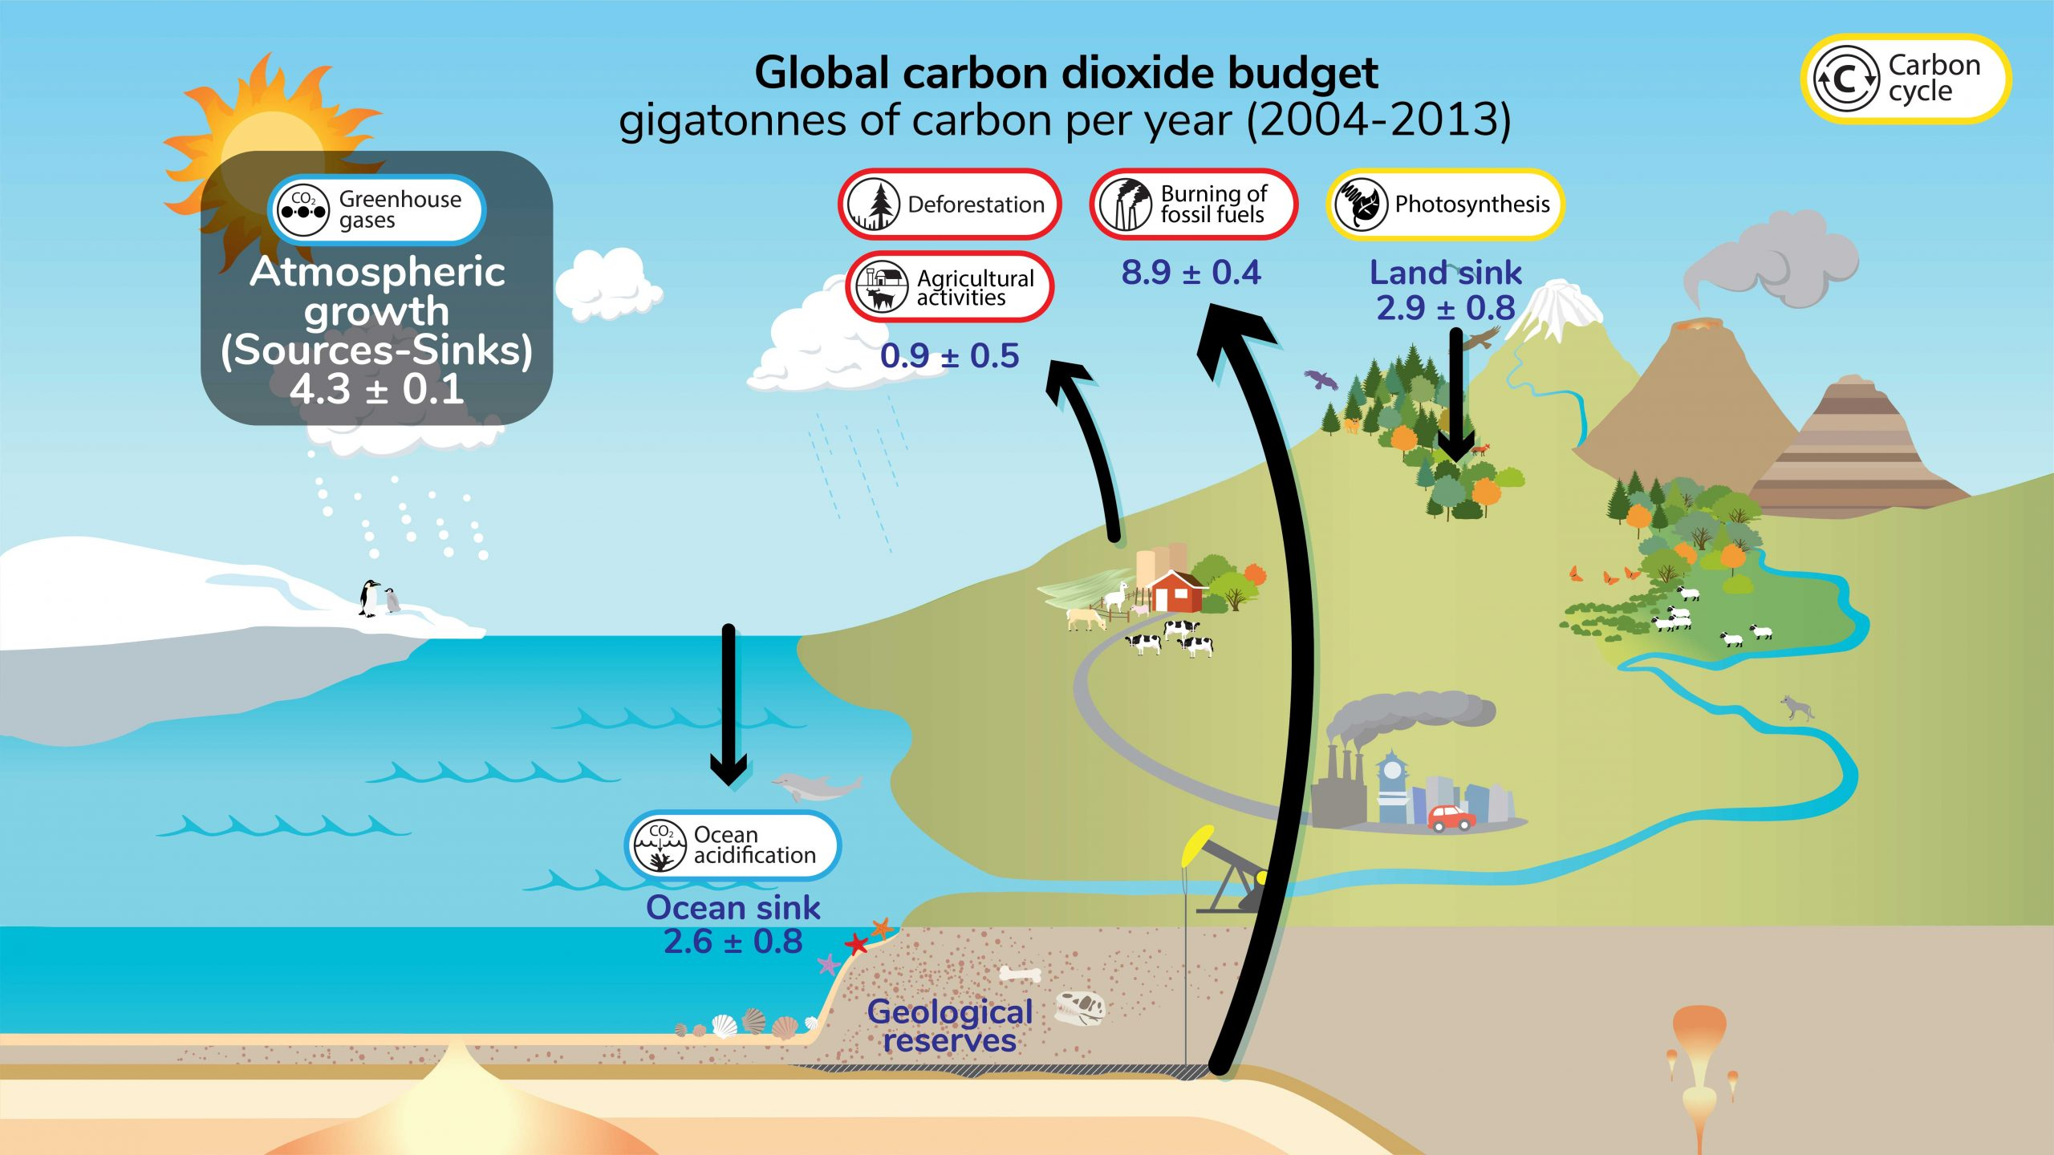
Climate Change: A Wicked Problem
Key recommendations: “Further development of event-scale observing capacity (e.g., novel
autonomous platforms) in all continental margin systems to better quantify impacts of episodic events on coastal carbon budgets”
A Science Plan for Carbon Cycle Research in North American Coastal Waters 2016, Ocean Carbon and Bio. Program and NA Carbon Program
Notes:
I’ll start with a few wicked problems with the goal of getting to a wicked challenge that you can address in this programme
Climate change is an exceptionally complex and pretty obvious problem. Here’s a very brief superficial description of a small part of the problem.
Climate change is driven in large part by the so-called green house gases we, the human race, throw into the atmosphere
Green house gases in the atmosphere work like, you guessed it, a green house. They allow heat to pass through the atmosphere from the sun but reduce the amount of heat from the earth to the universe.
C02 is a potent green house gas, So quantifying where CO2 is coming from and where it’s going is critical to understanding this part of the problem. This is what Climate Scientists call the carbon cycle
Good news: There is a lot of money funding a lot of smart people around the globe trying to understand the hows and whys of climate change
There have been lots of workshops trying to plan effective ways to spend this money.
Here’s one but they all make similar recommendations …
In other words: we need observing systems that generate defensible data products to drive our understanding of climate change and develop strategies to mitigate the negative consequences

Slide 2
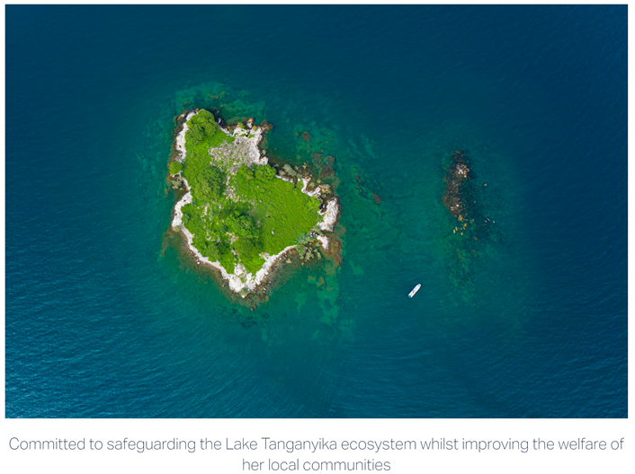

Collapsing Fisheries: Another Wicked Problem
Predictability of Species Distributions Deteriorates Under Novel Environmental Conditions in the California Current System
Front. Mar. Sci., 29 July 2020, Sec. Marine Fisheries, Aquaculture and Living Resources, Volume 7 - 2020
i.e., Fishery Managers need defensible, relevant data products in a timely fashion to develop science-base policies
Sustain Lake Tanganyika
At All Scales
⬅ Local NGOs
US NOAA Fisheries ➔
Need Data Here
Notes:
The initial motivation for this project came from a conversations I had with Ken Johnson, the PI of MBARI’s chemical sensor group
He showed me this press release from NOAA marine fisheries from 2008 when only a third of the expected Salmon returned to their breeding streams during the 2007 season and suggested it was primarily due to low food production in 2005
The problem was pretty clear; managing fisheries is a complex task, and data is sparse, real time or near real time data is even less available.
I was hooked even before I knew that ensuring sustainable fisheries is an explicit goal of the David and Lucille Packard foundation, which funds MBARI, makes this an even more compelling challenge

Slide 3

Ecosystem Degradation: AnotherWicked Problem
Navigating the New Arctic
“Current Arctic observations are sparse and inadequate for enabling discovery or simulation of the processes underlying Arctic system change or to assess their environmental and economic impacts on the broader Earth system”
The arctic is important, we need more and better data products and soon to understand and mitigate problems in the arctic
Notes:
Additional motivation include the Coastal Carbon Synthesis Group’s community workshop report where the recommended more development of observing systems for continental margins.
Community workshops sponsored by Ocean Carbon and Biogeochemistry Program and North American Carbon Program
NSF also published their 10 big ideas, the areas that will drive their research agenda for the near future. One of the 10 big ideas is Navigating the New Arctic and again, they point out the lack of data limiting our understanding.
While the arctic was not one of our initial research topics, we think it is within the capability of the CPF.

Slide 4
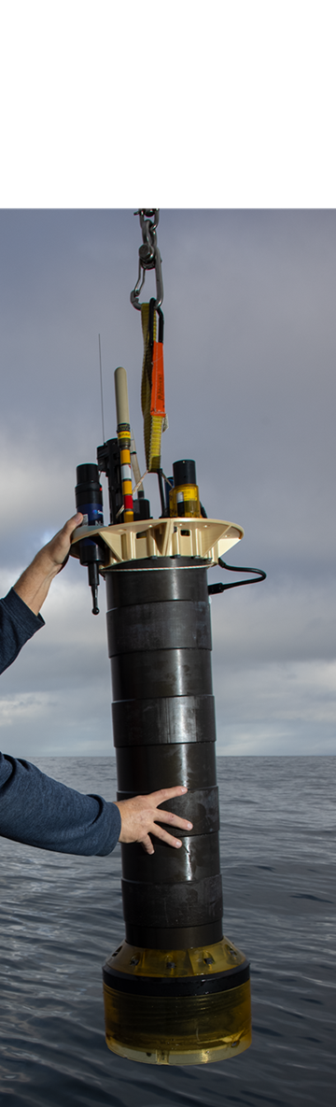
Take Home Message
A large number of globally important challenges require observing systems that put defensible, relevant, timely data products into the hands of decision makers at all levels
Assumptions
Economical, scalable, fit for purpose observing systems probably don’t exist for any of the wicked problems described previously
Partial solutions exist in academic research labs, in local communities, in industry and …
As an example, the Monterey Bay Aquarium Research Institute has developed a Coastal Profiling Float system targeting our research goals that might be re-purposed to provide part of a solution

Slide 5

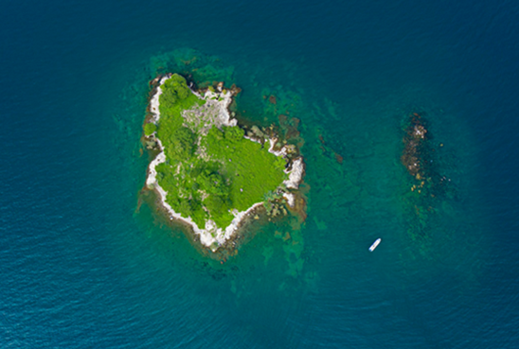
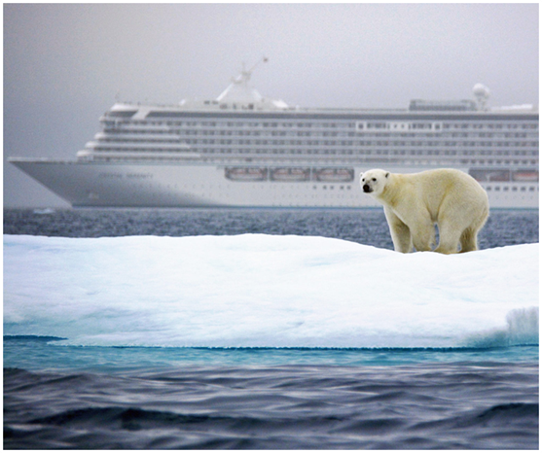
The Wicked Imperial Module Problem Statement
Can academic research technology combined with local knowledge, industrial know-how and other ingredients provide solutions to a critically important, global challenge?
Potential Beneficiaries
  Government agencies and NGOs can develop better, science based policies to protect our planet
  Local conservation groups can better understand how to manage their local fishery that may provide most of the protein for their community
  Research groups without access to state-of-the-art oceanographic technology can contribute to developing fundamental knowledge about what’s changing our planet
Notes:
Additional motivation include the Coastal Carbon Synthesis Group’s community workshop report where the recommended more development of observing systems for continental margins.
Community workshops sponsored by Ocean Carbon and Biogeochemistry Program and North American Carbon Program
NSF also published their 10 big ideas, the areas that will drive their research agenda for the near future. One of the 10 big ideas is Navigating the New Arctic and again, they point out the lack of data limiting our understanding.
While the arctic was not one of our initial research topics, we think it is within the capability of the CPF.

Slide 6
Tasks
Identify the stakeholders
  Government agencies, local NGOs, non-profits, research labs, industrial partners, …
Ask them “what are you trying to do?” and “what do you need to do it?”
Identify potential solution systems (hopefully the CPF is one)
Evaluate these solutions in a systematic way
  Functionality, economics, scalability, risk, political and cultural barriers, …
Define your challenge, develop a minimum viable system and an implementation plan
Notes:
Additional motivation include the Coastal Carbon Synthesis Group’s community workshop report where the recommended more development of observing systems for continental margins.
Community workshops sponsored by Ocean Carbon and Biogeochemistry Program and North American Carbon Program
NSF also published their 10 big ideas, the areas that will drive their research agenda for the near future. One of the 10 big ideas is Navigating the New Arctic and again, they point out the lack of data limiting our understanding.
While the arctic was not one of our initial research topics, we think it is within the capability of the CPF.

Slide 7

Required Skills Include (but aren’t limited to)
Marine and Environmental Science and Policy
Market analysis and business development
Mechanical, Electrical, Software, Ocean, Industrial and System Engineering
Data Science
People Skills
Thanks for listening
Notes:
Additional motivation include the Coastal Carbon Synthesis Group’s community workshop report where the recommended more development of observing systems for continental margins.
Community workshops sponsored by Ocean Carbon and Biogeochemistry Program and North American Carbon Program
NSF also published their 10 big ideas, the areas that will drive their research agenda for the near future. One of the 10 big ideas is Navigating the New Arctic and again, they point out the lack of data limiting our understanding.
While the arctic was not one of our initial research topics, we think it is within the capability of the CPF.

