Slide 1
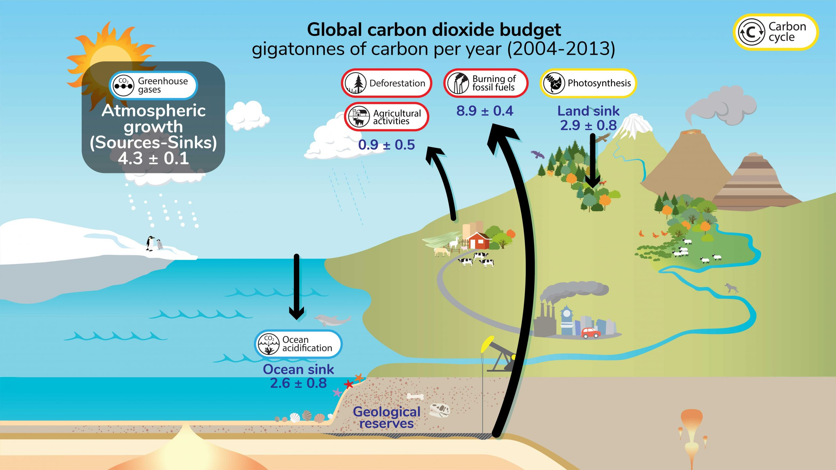
Climate Change: A Wicked Problem
Key recommendations: “Further development of event-scale observing capacity (e.g., novel
autonomous platforms) in all continental margin systems to better quantify impacts of episodic events on coastal carbon budgets”
A Science Plan for Carbon Cycle Research in North American Coastal Waters 2016, Ocean Carbon and Bio. Program and NA Carbon Program
https://ugc.berkeley.edu/background-content/carbon-cycle/
Notes:
I’ll start with a few wicked problems and wind up with a wicked challenge you may be interested in pursuing as part of this programme.
Climate change is an exceptionally complex and pretty obviously wicked problem. This graphic shows what climate scientists and oceanographers describe as the carbon cycle or the carbon budget. I won’t go into the details but the basic problem is we, the human race, are throwing far more carbon dioxide (that’s the carbon in carbon budget) into the atmosphere than the earth can absorb, what isn’t absorbed remains in the atmosphere and warms the earth.
That’s the bad news.
The good news is a lot of work is going into understanding the problem. Lots of research by lots of smart people. And lots of studies and workshops planning that work.
Here’s the recommendation from one of those studies: we need to develop more and better observing capacity. And more and better ocean observing systems to provide that needed capacity is the theme for the rest of this talk.

Slide 2
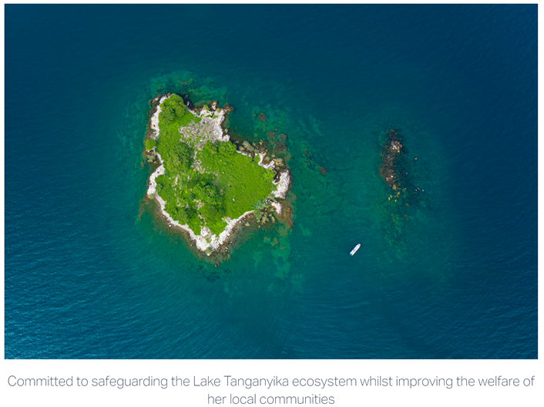

Threatened Fisheries: Another Wicked Problem
Predictability of Species Distributions Deteriorates Under Novel Environmental Conditions in the California Current System
Front. Mar. Sci., 29 July 2020, Sec. Marine Fisheries, Aquaculture and Living Resources, Volume 7 - 2020
i.e., Fishery Managers need defensible, relevant data products in a timely fashion to develop science-base policies
Sustain Lake Tanganyika
At All Scales
⬅ Local NGOs
US NOAA Fisheries ➔
Need Data Here
Notes:
Threatened fisheries is another wicked problem
Lot of work by lots of smart people with the same conclusion: we need more data, better data and we need the data faster to address this problems
And this is true at all scales: From community led fishery management groups working to safeguard their local ecosystem like Sustain Lake Tanganyika in Tanzania up to the government agencies responsible for managing globally important fisheries like NOAA in the US and the Marine Management Organisation in the UK. These groups are developing ambitious, sophisticated model based approaches to manage globally important fisheries.
Same bad news, they all need more and better observing systems scaled to their needs.

Slide 3
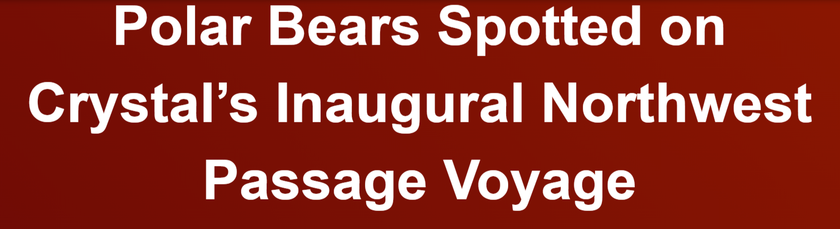
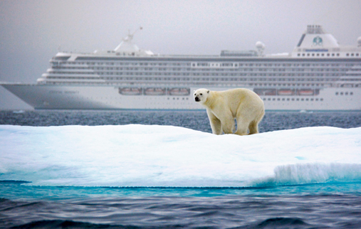

Ecosystem Change: Another Wicked Problem
Navigating the New Arctic
“Current Arctic observations are sparse and inadequate for enabling discovery or simulation of the processes underlying Arctic system change or to assess their environmental and economic impacts on the broader Earth system”
Notes:
The last wicked problem I’ll talk about today is Ecosystem Change.
I worked in the Arctic for 4 springs so changes in the Arctic Ecosysem are particularly near and dear to my heart
This photo show the problem quite dramatically, polar bears and cruise ships never had to share the same ecosystem in the past. Now they do and while it’s a new opportunity for travel companies to make money (this in advertisement right off one of those companies websites), It’s a problem for my friends the polar bears and all of their friends.
Same good news: lots of effort is going into this problem
For example: The National Science Foundation (NSF) is the major source of academic research funding in the US and they’ve identified this new arctic as one of their top 10 priorities for the next decade.
Same conclusion: not enough observations

Slide 4
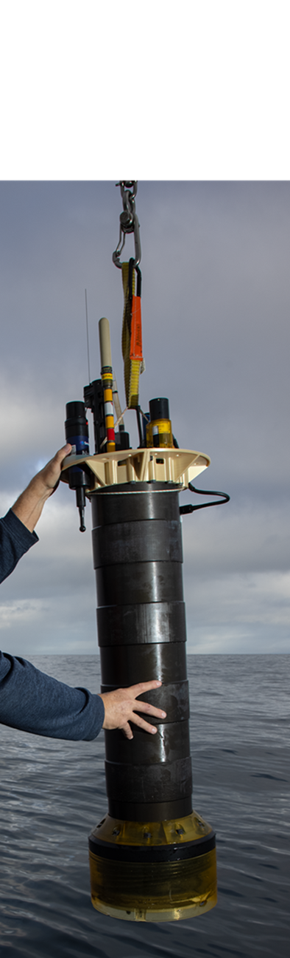

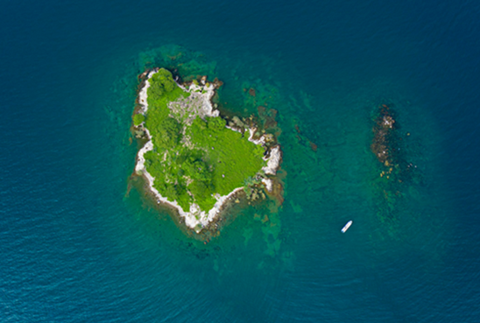
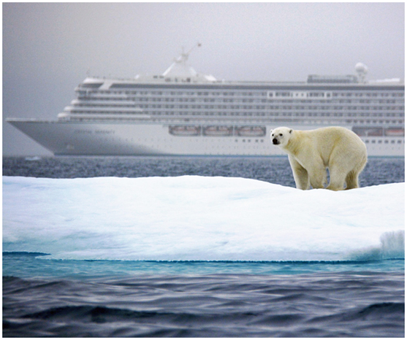
The Wicked Imperial Module Challenge Statement
Can current academic research technology, like MBARI’s Coastal Profiling Float observing system, combined with local knowledge, industrial know-how and other ingredients provide effective, sustainable, scalable ocean observing systems that get the right data products to the right people at the right time to address current, critically important, global challenges?
Notes:
With those problems as a backdrop, here’s a possible wicked challenge for you Wicked Imperial Module program.
This is the coastal profiling float

Slide 5
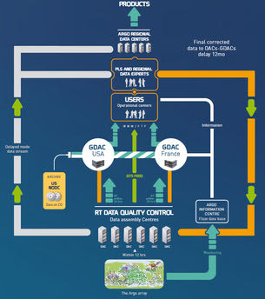
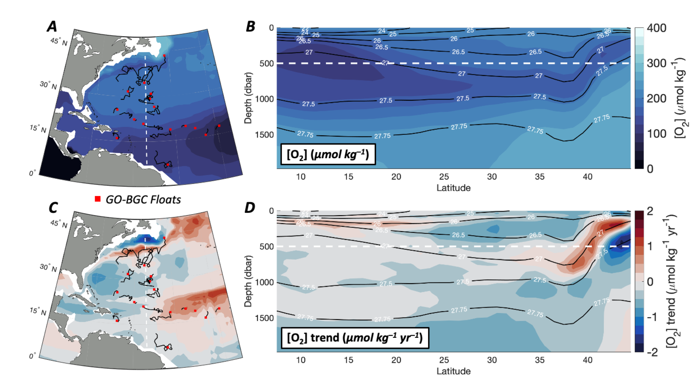


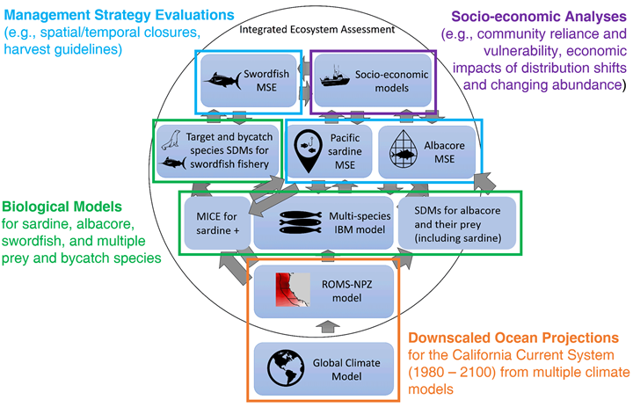
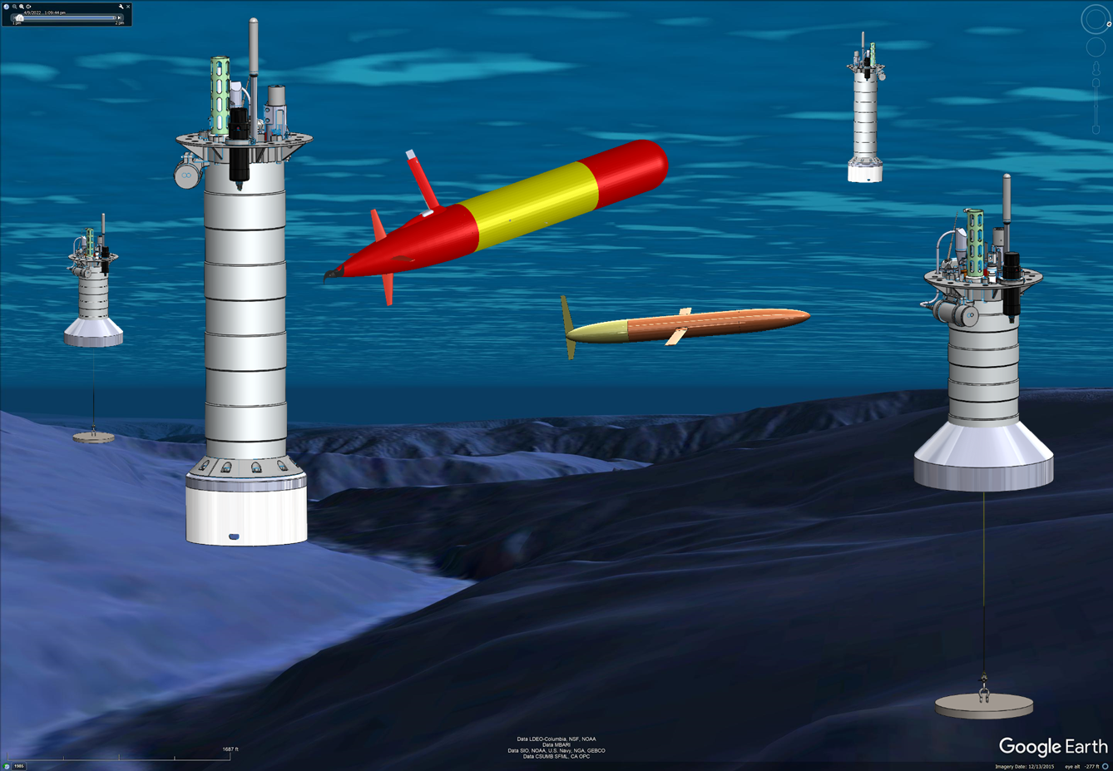

What is an Ocean Observing System?
What’s Missing: Tools to Generate a Range of Data Products
Defensible, QC’d Research Data
Data
Center
The Argo system is arguably the only example of an ocean observing system and it has ~$50M USD annual budget
Instrumented observing platforms
Notes:
It’s fair to ask What is an Ocean Observing Systems.
Starting in the lower left, there’s a 3D array of properly instrumented observing platforms in the ocean
Which are accquiring and sending raw to an on-shore data processing center
Which generates defensible, quality controlled research quality data.
Before I get to the stuff on the right, I’d like to point that there is arguably only one ocean observing system like this in existence, the Argo Array of Profiling floats. And some of it’s research data is being used directly by the Intergovernmental Panel on Climate Change. But it’s an international program with a $50M a year annual budget, which is considerably more expensive than most users can afford.
What’s needed is a cost-effective observing system that can be scaled to provide the data products required by a wide range of users: other climate change researchers, local and national fishery managers and one application I haven’t mentioned is has to do with various proposals for ocean based carbon dioxide removal. All of the proposed systems will need ocean observing systems to make sure they’re doing the things they say they’re doing and not doing things that further harm our planet.

Slide 6

Tasks
Identify the stakeholders
  Government agencies
  Non-government organizations
  Community led resource management groups
  Local fisher men and women
  Philanthropic Foundations
  Industrial, for-profit partners
  Researchers
  And others
Notes:
Some of the task you’ll need to do as part of this challenge are

Slide 7
Tasks
Identify the stakeholders
Have several conversations with the stakeholders
  What are you trying to do?
  What do you need to do it that you don’t already have?
  What other barriers are getting in the way?
  What can you provide?
  What’s your budget?
And there may be travel funding to meet with selected stakeholders in person

Slide 8
Tasks
Identify the stakeholders
  Government agencies, local NGOs, non-profits, research labs, industrial partners, …
Have several conversations with the stakeholders
Identify all the technologies that need to be combined to meet stakeholder needs
  Existing products
  New technology
  Hopefully the CPF is part of the solution

Slide 9
Tasks
Identify the stakeholders
  Government agencies, local NGOs, non-profits, research labs, industrial partners, …
Have a conversation with the stakeholders
Identify technology that can be combined to meet stakeholder needs
Compare and evaluate these systems in a systematic way
  Functionality, economics, scalability, risk, political and cultural barriers, …

Slide 10
Tasks
Identify the stakeholders
  Government agencies, local NGOs, non-profits, research labs, industrial partners, …
Have several conversations with the stakeholders
Identify technology that can be combined to meet stakeholder needs
Evaluate these solutions in a systematic way
Define your specific challenge, develop a minimum viable system, and an implementation plan

Slide 11

Required Skills Include
Marine and Environmental Science and Policy
Market analysis and business development
Electrical, Software, Ocean, Industrial Mechanical and System Engineering
Data Science of all kinds
People Skills
Thanks for listening
Notes:
In order to address this challenge, your team will need a wide range of skills including this list and more. I’ll let you read the list but the one I’d like to emphasize is People Skills. You’ll be talking to a wide range of people: scientists, for-profit business people, engineers, fisher men and women, philanthropic organizations, local community leaders and a host of others. Even if they all speak the Queen’s English, they will not be speaking in the same dialect. It will be your job to make sure you understand their needs, they understand what you have to offer, translate for the rest of your team and then pitch your product. I’m an engineer. It’s fair to say we aren’t really well known for our people skills. I’ve worked hard to overcome my genetic people skill challenges and I’ve found that working effectively with diverse teams to accomplish a common goal is one of the most satisfying parts of my job. And I hope to share that experience with you.
I’ll end with that and thanks for listening. My polar bear friends and I appreciate your time.

Slide 12
Take Home Message
A large number of globally important problems require observing systems that put defensible, relevant, timely data products into the hands of decision makers at all levels

Slide 13
Take Home Message
A large number of globally important challenges require observing systems that put defensible, relevant, timely data products into the hands of decision makers at all levels
Assumptions (to be verified)
Economical, scalable, fit for purpose observing systems probably don’t exist for any of the wicked problems described previously
Partial solutions exist in academic research labs, in local communities, in industry and …
As an example, the Monterey Bay Aquarium Research Institute has developed a Coastal Profiling Float system targeting our research goals that might be re-purposed to provide part of a solution
Notes:
Some assumptions on my part that you’ll have to verify as part of this program

