Slide 1
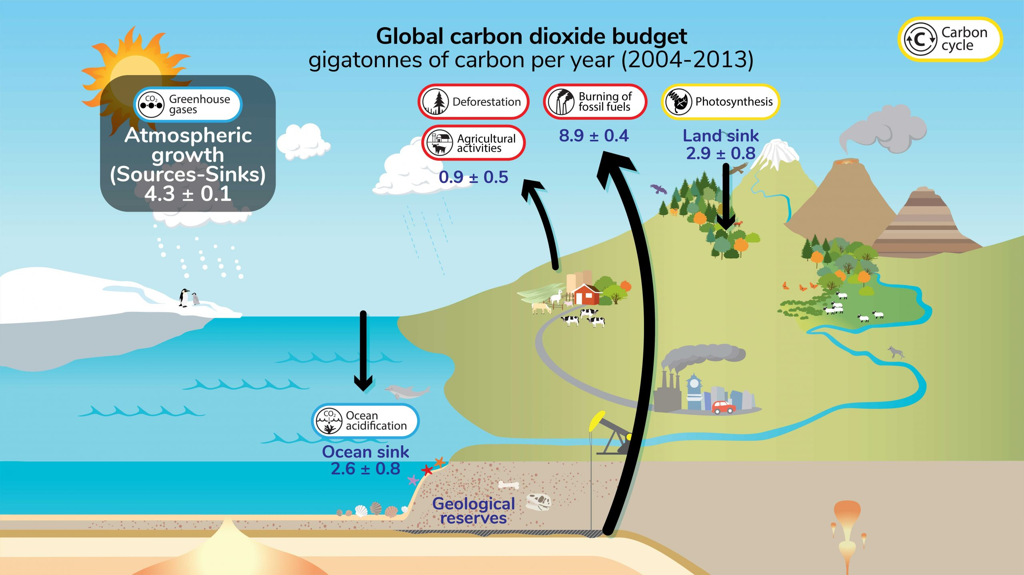
Climate Change: A Wicked Problem
Key recommendations: “Further development of event-scale observing capacity (e.g., novel
autonomous platforms) in all continental margin systems to better quantify impacts of episodic events on coastal carbon budgets”
A Science Plan for Carbon Cycle Research in North American Coastal Waters 2016, Ocean Carbon and Bio. Program and NA Carbon Program
https://ugc.berkeley.edu/background-content/carbon-cycle/
Notes:
I’ll start with a few wicked problems and then describe a wicked challenge I hope you’ll be interested in.
I think most people would agree that climate change is a wicked problem. This graphic shows the carbon cycle part of climate change. The basic problem is we, the human race, are throwing up far more carbon dioxide (that’s the carbon in carbon cycle) into the atmosphere than the earth can absorb and what isn’t absorbed remains in the atmosphere and warms the earth.
That’s the bad news. The good news is a lots of work by lots of smart people is going into understanding this problem. And, not surprisingly, lots of studies and workshops.
Here’s one recommendation from one of those studies we need “Further development of event-scale observing capacity” which means better observing systems, particularly in the ocean, to provide that capacity.

Slide 2
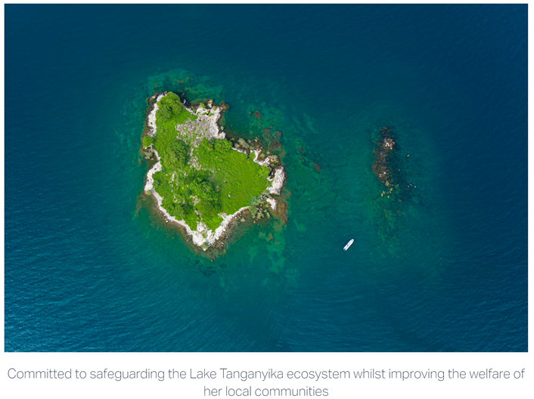

Threatened Fisheries: Another Wicked Problem
Sustain Lake Tanganyika
NOAA Physics-to-Fisheries Management
Need Data Here
Predictability of Species Distributions Deteriorates Under Novel Environmental Conditions in the California Current System
Front. Mar. Sci., 29 July 2020, Sec. Marine Fisheries, Aquaculture and Living Resources, Volume 7 - 2020
i.e., Fishery Managers need defensible, relevant data products in a timely fashion to develop science-base policies
Notes:
Threatened fisheries is another wicked problem
And this is true at all scales: From community led fishery management groups working to safeguard their local ecosystem like Sustain Lake Tanganyika in Tanzania up to government agencies responsible for managing globally important fisheries like DEFRA (Department for Environment, Food and Rural Affairs) in the UK and NOAA (National Oceanic and Atmospheric Agency) in the US.
Again, lots of work with the same conclusion: we need more data, better data and we need the data faster

Slide 3
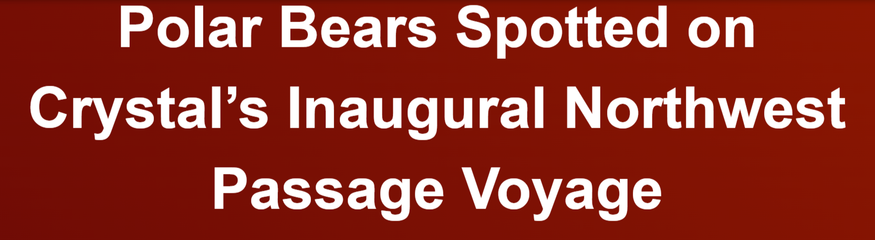
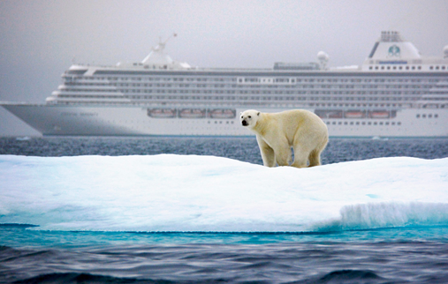

The New Arctic: Another Wicked Problem
Navigating the New Arctic
“Current Arctic observations are sparse and inadequate for enabling discovery or simulation of the processes underlying Arctic system change or to assess their environmental and economic impacts on the broader Earth system”
Notes:
I did a lot of work in the arctic a couple of decades ago.
Back then, polar bears didn’t have their arctic with cruise ships.
In today’s New Arctic, they do.
And while that’s a new opportunity for travel companies to make money (this in advertisement right off one of those companies websites), it’s a problem for my friends the polar bears.
Same good news: lots of effort is going into this problem.
For example: The National Science Foundation (NSF) in the US has identified this new arctic as one of their top 10 funding priorities for the next decade but that effort is limited by the same need for more and better observations.

Slide 4
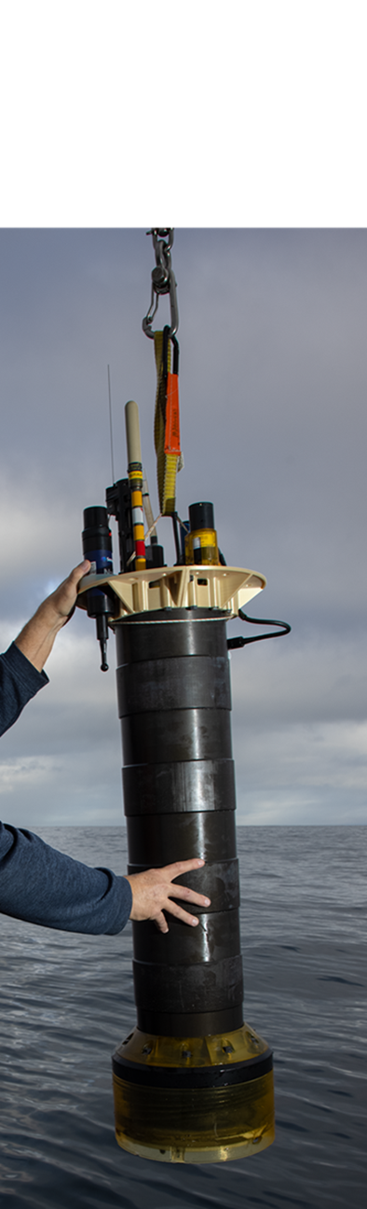

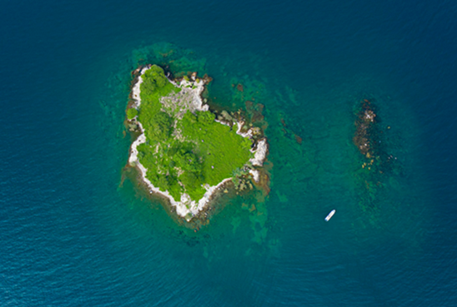
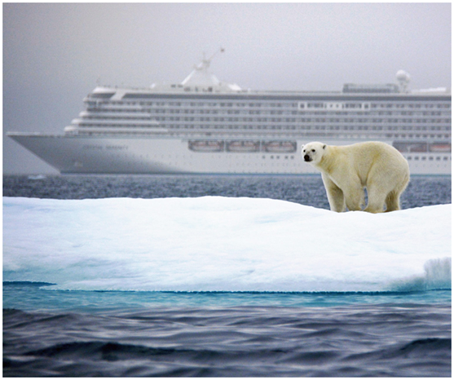
The WIM Challenge Statement
Can we provide effective ocean observing systems that get the right data products to the right people at the right time to address a range of current, critically important, global ocean health challenges using current research technology, like MBARI’s Coastal Profiling Float observing system, combined with other ingredients ?
Photo: Lori Eanes/Monterey Bay Aquarium
Notes:
So here’s a wicked challenge for your consideration.
Can we provide effective ocean observing systems that get the right data products to the right people at the right time to address a range of current, critically important, global ocean health challenges using current research technology, like MBARI’s Coastal Profiling Float observing system, combined with other ingredients?
BTW, I use the term ocean observing system for convenience. Everything I’m saying applies equal well to fresh water ecosystems like Lake Tanganyika.
For reference, this is a MBARI coastal profiling float.

Slide 5
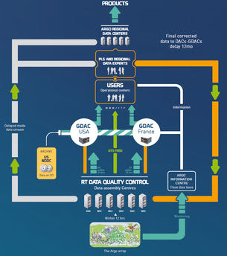
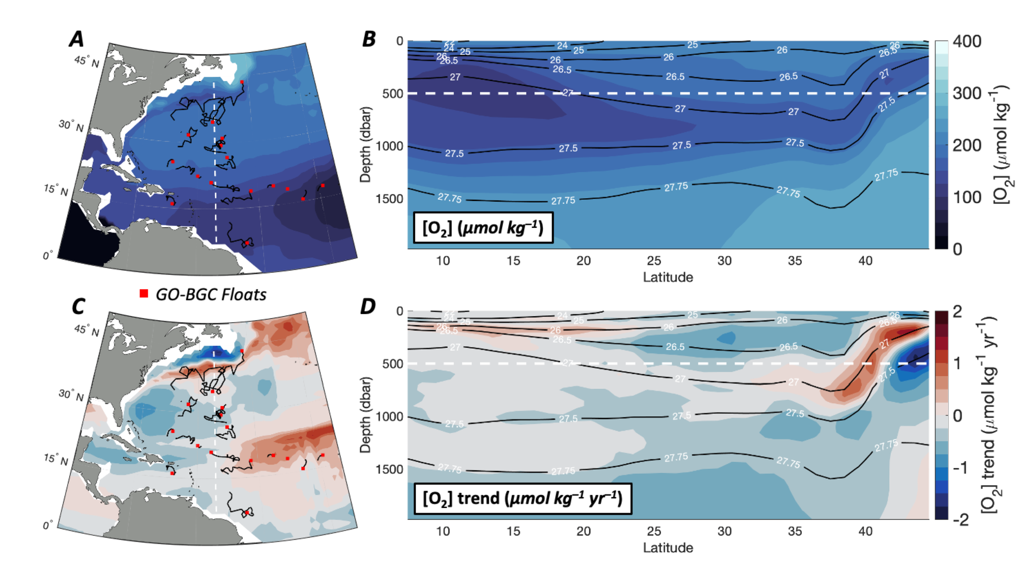

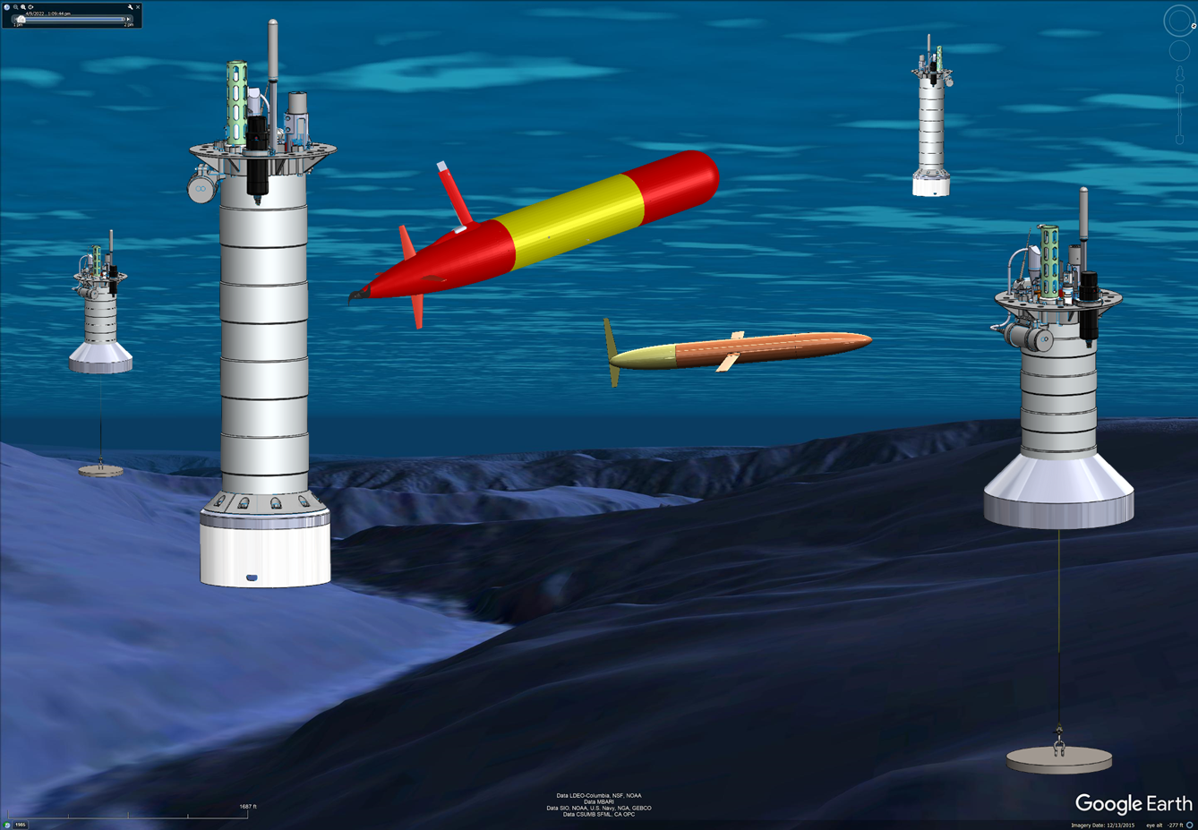
What is an Ocean Observing System?
What’s Missing: Tools to Generate a Range of Data Products
Defensible, QC’d
Research Data
Data
Center
Instrumented observing platforms
Notes:
If that’s the challenge, it’s fair to ask what is an Ocean Observing System?
Starting in the lower left, an ocean observing system has a 3 dimensional array of properly instrumented platforms in the ecosystem of interest,
acquiring and sending raw data to an on-shore data processing center, which generates defensible, quality controlled essential ocean variable research data suitable for experts users.
What’s mostly missing are the tools and technologies that can turn research data suitable into data products suitable for a wider range of non-expert users.
One application I haven’t mentioned has to do with new technologies for removing carbon from the ocean.
All of these technologies will need ocean observing systems to quantify the amount of carbon they say they’re removing without doing further harm to our planet. Again, no observing systems exists to meet this need.

Slide 6

WIM Challenge Tasks
Identify the stakeholders and have a conversation about their needs and contributions
Define your challenge, develop a minimum viable system and a realistic implementation plan
Give the final presentation
Potentially execute your plan
iterate (a lot)
Photo: Lori Eanes/Monterey Bay Aquarium
Notes:
Here’s some tasks you might be working on as part of this challenge.
First, identify a comprehensive group of stakeholders
and have conversations aimed at understanding their needs.
The conversations may include questions like
What are you trying to do?
What do you need to do it that you don’t already have?
What’s your budget?
Then, narrow in on the specific challenge your team is interested in,
And develop the first draft for a minimum viable system and an implementation plan.
Then it’s back to the stakeholders for more conversations and you iterate like this until everyone is mostly happy.
And a little teaser, there is funding to visit key stakeholders

Slide 7

Required Skills Include
Market analysis and business development
Environmental Science and Policy
Electrical, Software, Ocean, Industrial Mechanical and System Engineering
Data Science of all kinds
People Skills
Thanks for listening
Notes:
In order to address this challenge, your team will need a wide range of skills.
I’ll let you read the list but the one I’d like to emphasize is People Skills.
Even if your stakeholders all speak the Queen’s English, they will use different dialects. Your team will have to understand all these dialects in order to keep work effectively with your stakeholders.
I’m an engineer. It’s fair to say engineers as a group aren’t particularly well known for our people skills.
However, working effectively with diverse teams to accomplish a common goal is the second most satisfying part of my job.
And I hope to share that experience with you.
I’ll end with that and thanks for listening. My polar bear friends and I appreciate your time.

