Slide 1
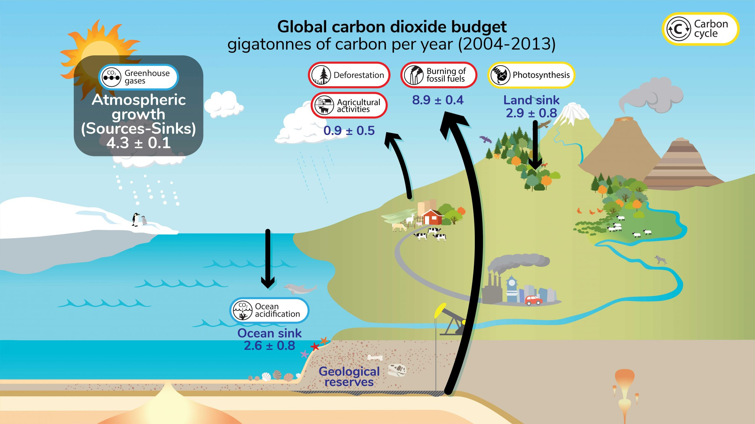
Climate Change: A Wicked Problem
Key recommendations: “Further development of event-scale observing capacity (e.g., novel
autonomous platforms) in all continental margin systems to better quantify impacts of episodic events on coastal carbon budgets”
A Science Plan for Carbon Cycle Research in North American Coastal Waters 2016, Ocean Carbon and Bio. Program and NA Carbon Program
https://ugc.berkeley.edu/background-content/carbon-cycle/
Notes:
I’ll start with a few wicked problems and then describe a wicked challenge I hope you’re interested in.
I think most people would agree that climate change is a wicked problem. This graphic shows carbon cycle or the carbon budget part of climate change. The basic problem is we, the human race, are throwing up far more carbon dioxide (that’s the carbon in carbon budget) into the atmosphere than the earth can absorb and what isn’t absorbed remains in the atmosphere and warms the earth.
That’s the bad news. The good news is a lot of work is going into understanding the problem. Lots of research by lots of smart people. And, not surprisingly, lots of studies and workshops. Here’s one
And one of the recommendations from that study is we need “Further development of event-scale observing capacity” which means better observing systems, particularly in the ocean, to provide that capacity.

Slide 2
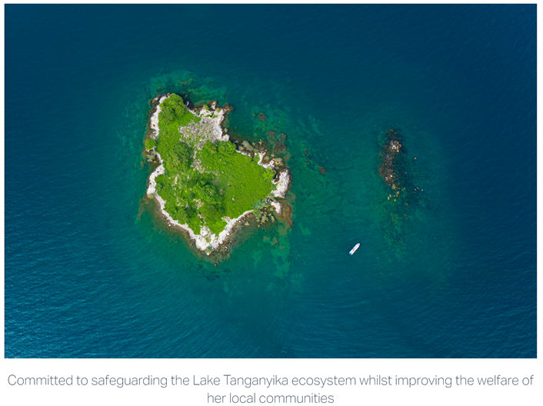

Threatened Fisheries: Another Wicked Problem
Sustain Lake Tanganyika
Need Data Here
Predictability of Species Distributions Deteriorates Under Novel Environmental Conditions in the California Current System
Front. Mar. Sci., 29 July 2020, Sec. Marine Fisheries, Aquaculture and Living Resources, Volume 7 - 2020
i.e., Fishery Managers need defensible, relevant data products in a timely fashion to develop science-base policies
Notes:
Threatened fisheries is another wicked problem
And this is true at all scales: From community led fishery management groups working to safeguard their local ecosystem like Sustain Lake Tanganyika in Tanzania up to government agencies like NOAA in the US and the Department for Environment, Food and Rural Affairs and the Marine Management Organisation in the UK who are responsible for managing globally important fisheries .
Again, lots of work with the same conclusion: we need more data, better data and we need the data faster

Slide 3
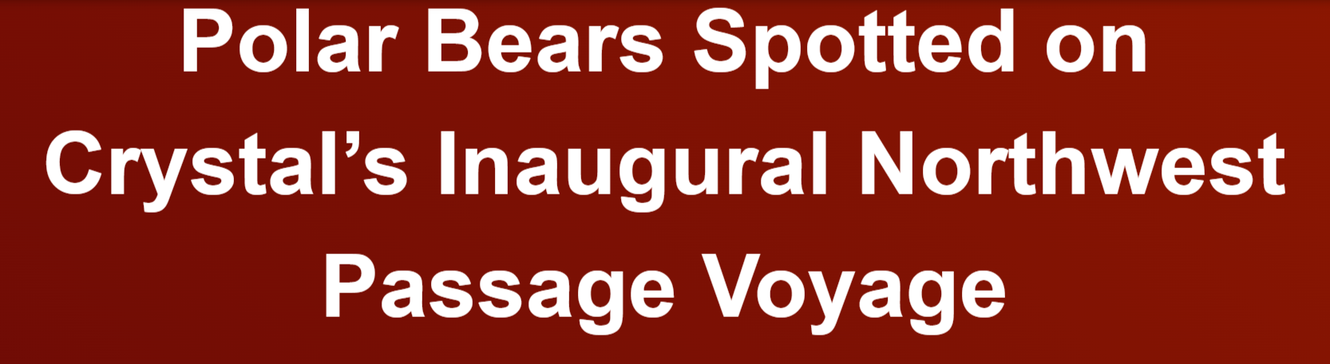
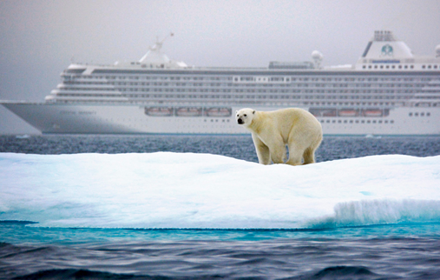

The New Arctic: Another Wicked Problem
Navigating the New Arctic
“Current Arctic observations are sparse and inadequate for enabling discovery or simulation of the processes underlying Arctic system change or to assess their environmental and economic impacts on the broader Earth system”
Notes:
I did a lot of work in the arctic a couple of decades ago.
Back then, polar bears didn’t have to share their ecosystem with cruise ships.
In today’s New Arctic, they do.
And while that’s a new opportunity for travel companies to make money (this in advertisement right off one of those companies websites), it’s a problem for my friends the polar bears and all of their friends.
Same good news: lots of effort is going into this problem.
For example: The National Science Foundation (NSF) in the US has identified this new arctic as one of their top 10 funding priorities for the next decade.
And the same bad news: not enough observations

Slide 4
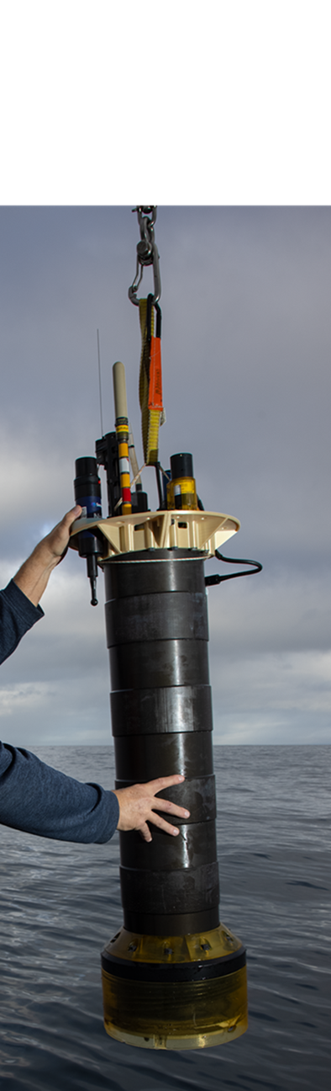

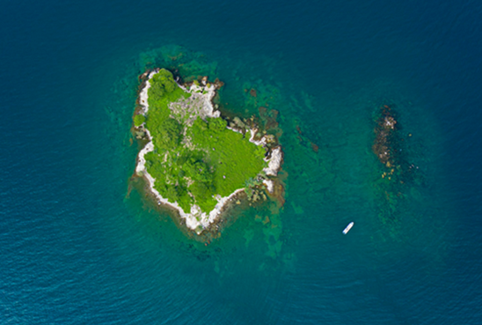
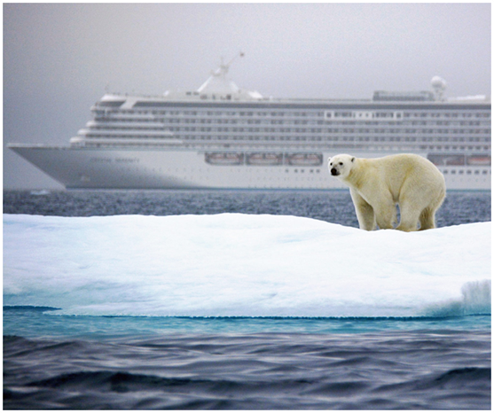
The Wicked Imperial Module Challenge Statement
Can current research technology, like MBARI’s Coastal Profiling Float observing system, combined with other ingredients provide effective ocean observing systems that get the right data products to the right people at the right time to address a range of current, critically important, global challenges?
Notes:
So here’s a wicked challenge for your consideration.
Can current research technology, like MBARI’s Coastal Profiling Float observing system, combined with other ingredients,
provide effective ocean observing systems
that get the right data products to the right people at the right time
to address current, critically important, global challenges?
For reference, here’s a MBARI coastal profiling float.

Slide 5
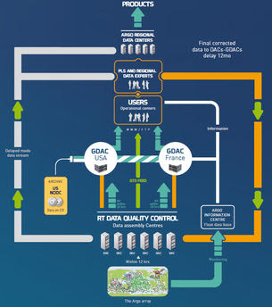
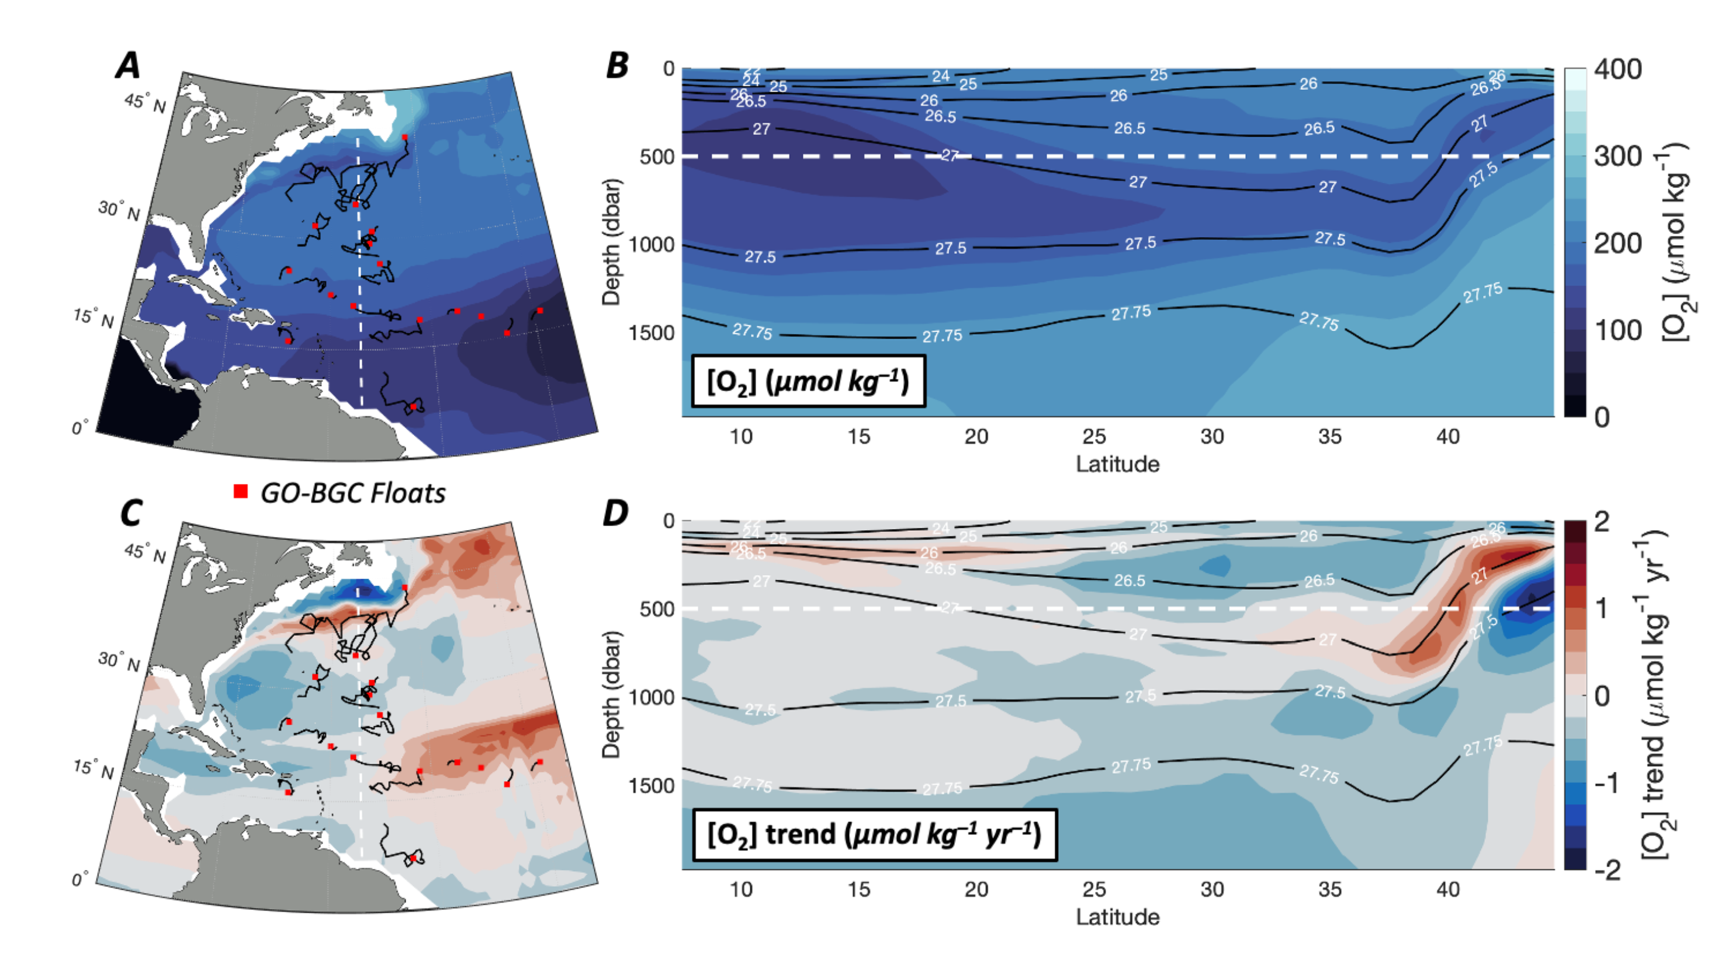

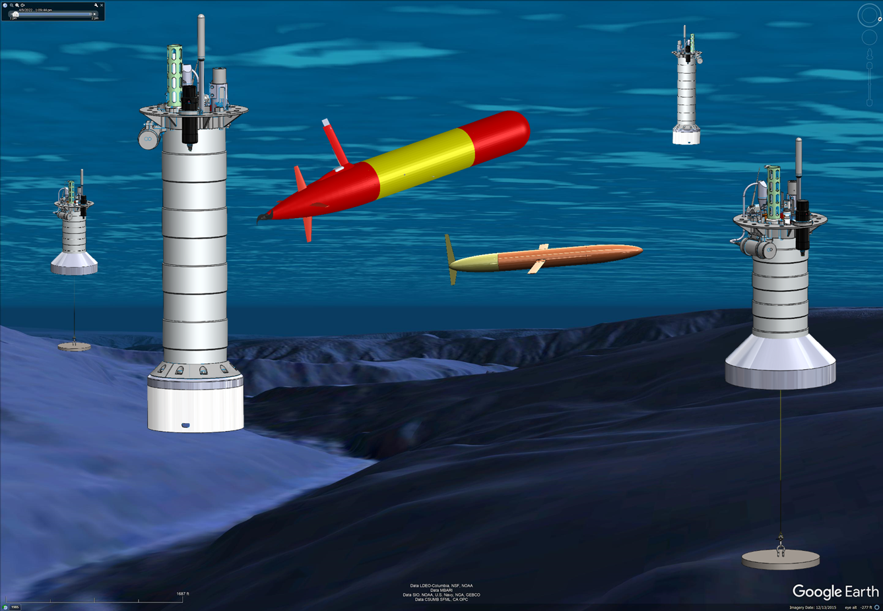
What is an Ocean Observing System?
What’s Missing: Tools to Generate a Range of Data Products
Defensible, QC’d
Research Data
Data
Center
Instrumented observing platforms
Notes:
If that’s the challenge, it’s fair to ask what is an Ocean Observing System?
Starting in the lower left, an ocean observing system has a 3 dimensional array of properly instrumented observing platforms in the ocean,
accquiring and sending raw data to an on-shore data processing center,
which generates defensible, quality controlled research data.
What’s mostly missing are the tools and technologies that can turn research data into data products suitable for a wide range of non-expert users.
One application I haven’t mentioned is has to do with various proposals for ocean based carbon dioxide removal technologies.
All of the proposed technologies will need ocean observing systems to quantify the amount of carbon they say they’re removing and not doing other things that further harm our planet.

Slide 6

Tasks
Identify the stakeholders and have a conversation about their needs
Define your challenge, develop a minimum viable system and a realistic implementation plan
Give the final presentation
Potentially execute your plan
iterate (a lot)
Notes:
Here a high level description of how you might go about working on this challenge.
First, identify a comprehensive group of stakeholders have conversations aimed at understanding their needs.
Stakeholders may include potential clients like government agencies like MMO and DEAFRA,
Community led resource management groups like Sustain Lake Tanganyika and their local fishers,
The development team in addition to your WIM team may include
Engineers and scientists
Philanthropic foundations who may be interested in investing,
Industrial for-profit partners with relevant technologies
And others
The conversations may include questions like
What are you trying to do?
What do you need to do it that you don’t already have?
What other barriers are getting in the way?
What can you provide?
What’s your budget?
Next, you might take a first pass at defining the specific challenge your team is interested in,
develop the first draft for a minimum viable system and a realistic implementation plan.
Then it’s back to the stakeholders for more conversations and you iterate like this until everyone is mostly happy.
And a little teaser, there is funding to visit key stakeholders

Slide 7

Required Skills Include
Marine and Environmental Science and Policy
Market analysis and business development
Electrical, Software, Ocean, Industrial Mechanical and System Engineering
Data Science of all kinds
People Skills
Thanks for listening
Notes:
In order to address this challenge, your team will need a wide range of skills.
I’ll let you read the list but the one I’d like to emphasize is People Skills.
Even if all your stakeholders speak the Queen’s English, they will not necessarily be speaking the same dialect.
Potential clients will be telling you their needs in their words
You need speak in their dialect to make sure they understand what you are offering,
Then you’ll have to translate this into all the dialects you team speaks
And keep the team pulling in the same direction
Through multiple iterations between your team and the stakeholders
In the end, your minimum viable system and implementation plan have to convince all the stakeholders that they want to invest their time, skills, energy and money in your challenge.
I’m an engineer. It’s fair to say engineers as a group aren’t particularly well known for our people skills.
However, working effectively with diverse teams to accomplish a common goal is the second most satisfying part of my job.
And I hope to share that experience with you.
I’ll end with that and thanks for listening. My polar bear friends and I appreciate your time.

