Slide 1
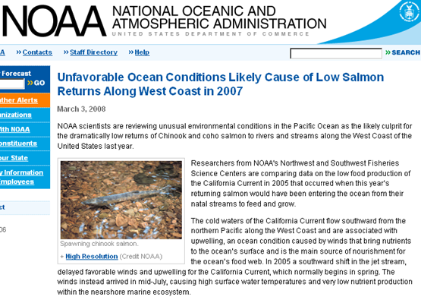

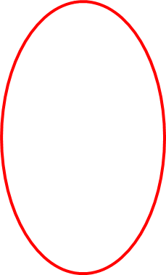
Coastal Profiling Float Science
The Science Motivation
Scientists and Policy Makers need plankton biomass and rate data (carbon stocks and production rates) in the coastal zone at the scale of large ecosystems, such as the California Current, for proper understanding and management
  NOAA Fisheries Science Centers are making progress towards science base policy making but needs dramatically more and better biogeochemical data at much lower cost
This MODIS chlorophyll satellite image conveys the complexity and scale of the data required to understand a large ecosystem

Slide 2
The CPF Plan 2018-2020
In collaboration with Fassbender and Takashita labs; run a series of science missions with a minimal fleet of 5 CPFs with increasing levels of risk and science return on investment
Year 1 – Detect diel variability in pH, oxygen, particle backscatter, and perhaps nitrate and look at the spatial coherence for the signals
  Diel signals in these properties reflect the balance between gross primary production and community respiration in the water column.
  ~1 month, ~100 miles off shore to minimize risk of grounding
  Operate the waveglider around the array
    pH, pCO2 and possible nitrate
    Work with WG team to ensure adequate data quality
Year 2 - Move the array into the coastal zone and conduct longer term experiments
Year 3 – Similar to year 2 and build the support needed to successfully transition the CPF to the ocean science community

Slide 3
First year science experiment: demonstrate capabilities of CPF by measuring diel cycles in oxygen, pH, and backscatter. Look for events driven by upward nitrate transport.
Example of diel oxygen variability over light (yellow) dark (grey) cycles near HOT. Black line is mixed layer depth.

Slide 4
The proposed science experiment with a CPF array in offshore waters addresses this question
The Gross Primary Production determined from diel cycles of O2 (Nicholson et al., 2015). Large excursions! What drives them?
Episodic injections of nitrate into the mixed layer seen by floats near Hawaii (Johnson et al., 2010). Are these processes related?

Slide 5
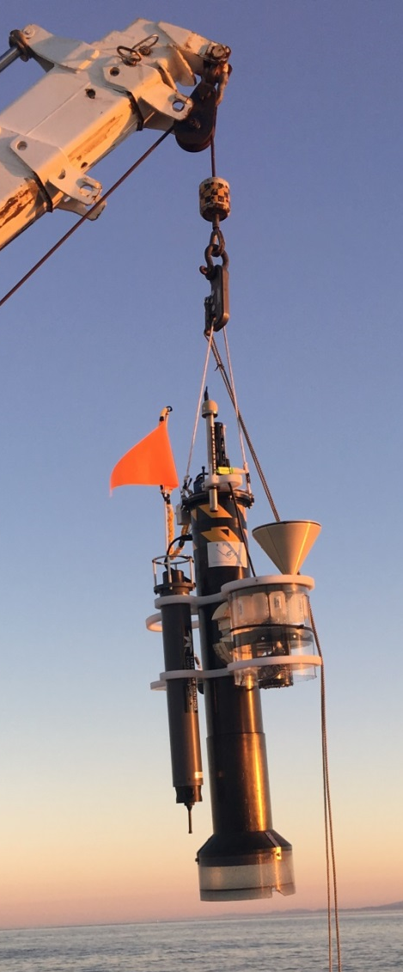
Links to Strategic Plan, Packard Foundation Ocean Visions Grantmaking Policies and the Technology Roadmap
Strategic Plan Overarching Goals
  Develop or adapt innovative technologies … to advance our understanding of the ocean
  Utilize those developments to explore and understand how natural ocean systems operate …
  Transfer … the technology developed to communities outside of MBARI
The Packard Foundation Strategic Framework for Oceans Grantmaking concentrates on three interlinked objectives …
  1) Restoration of ecologically important fisheries, 2) Improved coastal management, 3) Enhanced scientific understanding of the functioning of marine ecosystems
The Technology Roadmap
  Advancing a persistent presence
  Biogeochemical cycles and Ecosystem processes are target challenges in the TR
The Chavez Lab CPF

Slide 6
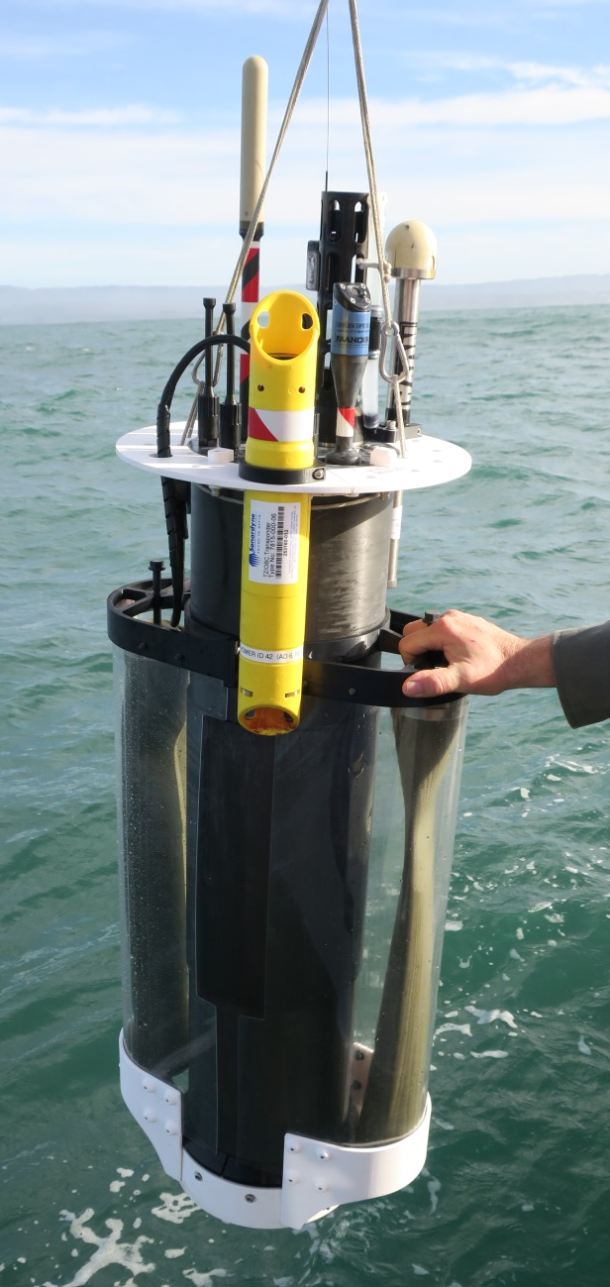
The Coastal Profiling Float (CPF)
Ecosystem Scale Observing Systems must be economically sustainable over decades
The CPF platform is designed to support our biogeochemical sensor suite targeted at understanding the fundamental chemical properties necessary to understand ecosystem health
  Sensor suite: Salinity, temperature, Oxygen, fluorescence, backscatter, pH, Nitrate, multispectral radiometer
  Projected mission duration of several hundred profiles spread over months to years
  Profiles to 500 meters
  Improved buoyancy control for shallow water operations
  Near real time, satellite data telemetry of each profile
  Ability to (gently) anchor and de-anchor on the bottom
  Make use of subsurface currents to “keep” a float in the desired measurement volume

Slide 7
CPF Current Status
Prototypes are currently underdoing long term (days to weeks), unattended deployments
New electronics with power management functionality is being
Ready for initial science missions by the end of 2017
High resolution profiles of biogeochemical properties
Profiles every ~4 hours

Slide 8
Some Engineering Development
By the end of 2017 we should be able to say that the CPF has moved from 80% engineering, 20% science to 80% science, 20% engineering
Engineering plan
  Refinement and maintenance of the new electronics
  Refinement of energy saving strategies
  Completion of the “navigation” capability based on 3D current predictions from CeNCOOS ROMS model and possibly on board inertial current measurements (based on 2016 intern work)
  Constant improvement in software/algorithms
    Recent software work ahs been mostly refining the functionality we have, not developing new functionality
    I have a dream: Development of formal unit/functional test process (based on 2017 intern work)

