Slide 1
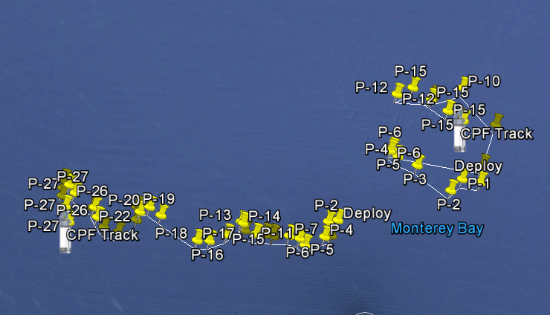
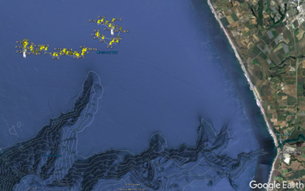
July 2017
Navigated Track
March 2017
Un-navigated Track

