Slide 1
CPF Software Design Review
Gene Massion
2015 March 13 (Friday)

Slide 2
Goals
Review the architecture and identify areas that need improvement
  See TODO list in code
  like better abstraction
  better use of methods
Pay particular attention to further developing an effective test strategy
Pay particular attention to the right amount of error detection and correction
Identify short term tasks for Laughlin

Slide 3
Outline
Quick overview of the system
Top level scan of the software
Line by line review of Program.cs
Overview of the other classes with particular attention to key methods
We’ll keep track of action items as we go through the design review (that would be you Laughlin)

Slide 4
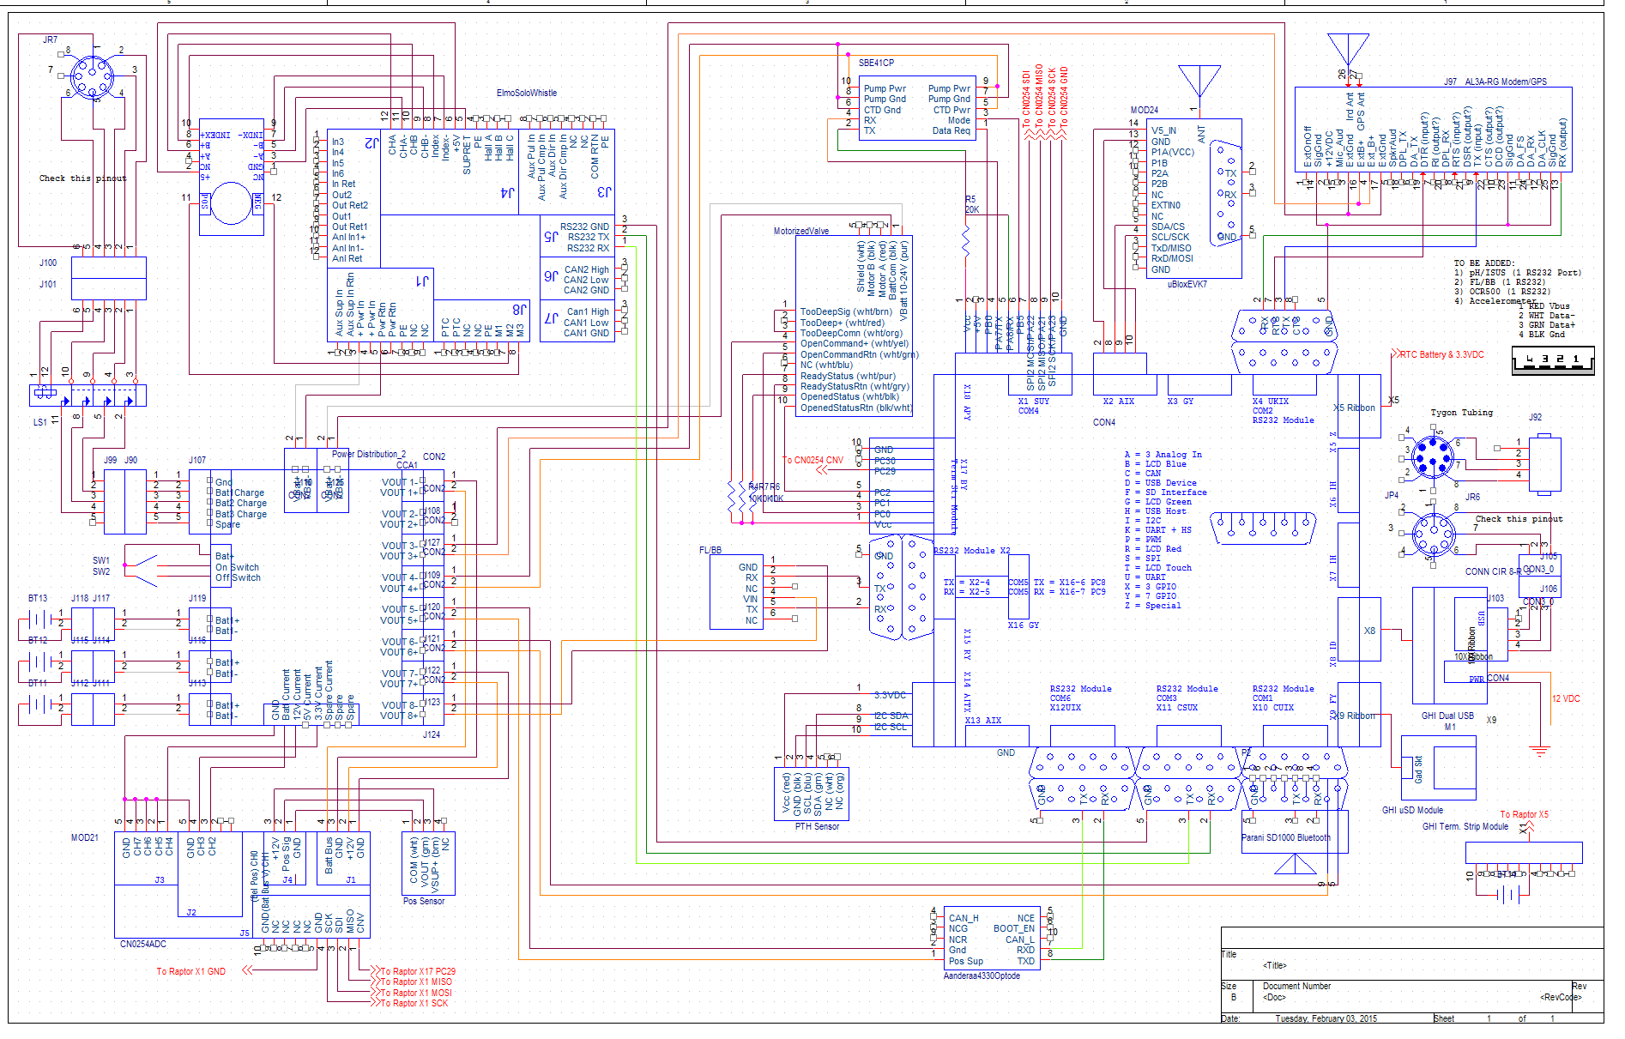

Slide 5
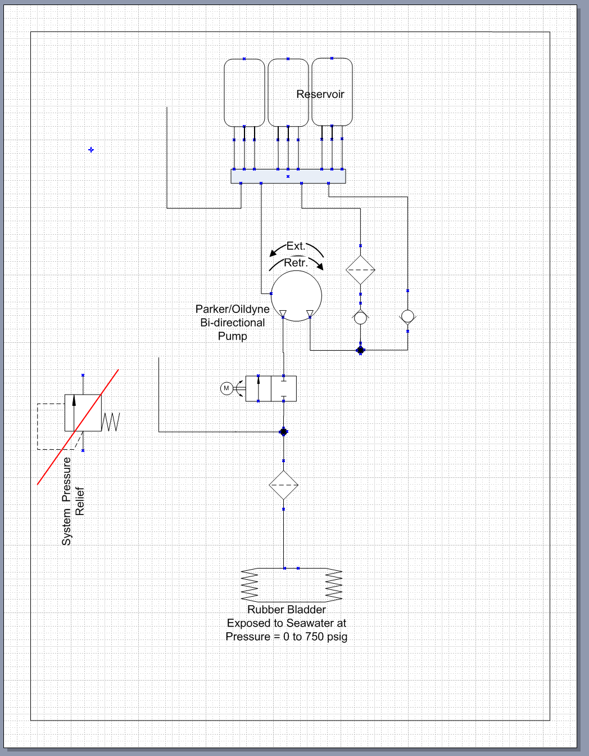

Slide 6
Design “Rules”
Assume GM is responsible for maintaining the code forever i.e., find the simplest possible solution
Based on APEX float experience, we have a pretty good understanding of the requirements i.e., we don’t need to design for some killer unknown future need
Everything must run-to-completion
  No “blocking” calls
  Short Thread.Sleep(<1 sec) may be acceptable
  Every state should transition when done or after a defined timeout period
Log everything and decimate when required
  Reading and analyzing log file should be nearly effortless
Global decisions are only made in the state machine and the processQueue method
Writes to SD card are only done in the state machine and processQueue

Slide 7
Garbage Collection (GC)
C# doesn’t require (or support) memory allocation/deallocation but it does GC
GC happens whenever it wants and can take minutes if there is a lot of garbage
Value types aren’t subject to GC (I’m pretty sure)
  int, float, double, bool, char and struct
Reference types are subject to GC if they aren’t referenced anymore
  Any variable that requires a “new” definition: arrays, StringBuilder, DateTime, TimeSpan, objects, …
Declaring a reference type as static prevents GC
Strings are just plain bad, const or readonly strings are OK
StringBuilders are OK if they don’t have to get redimensioned
Ideally, GC would never run, alternatively run for a short time at some non-critical moment like SurfaceOps

Slide 8
My post about GC on GHI Forum and a very knowledgeable user’s responses
1) Anything allocated private static outside a method will not be GC'ed
- Correct as long as you are not dynamically changing the reference value that the static is holding while the application is running. The GC runs it finds all objects that are no longer accessible either directly accessible or indirectly via some other root. If you change the reference value of the private static and the previous reference no longer has any roots then that instance will be eligible for GC if/when the GC kicks in.
2) If everything in my app is declared private static outside any method, the GC should never run.
- Assuming that you do not dynamically allocate objects and assign the references to the private static variable. See previous answer.
3) Declaring value type variables (int, double, long, etc.) inside a method should not cause the GC to run.
- Correct, but beware that user defined value types (struct) in .NETMF are treated like reference types from the perspective of the GC so this only holds true for .NETMF native value types. This is different to the desktop .NET Framework.
4) Declaring any variable that requires "new" inside a method will eventually cause GC to run.
- Correct, assuming the method or other allocations in the system occur enough times so that the memory threshold is exceeded and the GC is educed. Just allocating an object will not mean that the GC will execute.
5) Every string operation (like append, split, substring) will eventually cause GC.
- Correct, because strings are immutable any changes to a string actually creates a new string and orphans the previous instance, but only if/when the GC is actually induced.
6) Some of the StringBuilder operations (like clear and append) do not cause GC.
- Clear would not cause GC, but of course eventually the StringBuilder probably goes out of scope (unless it is global) and then it and the internal buffer etc. are eligible for GC. Append however could result in GC, the internal buffer has to eventually grow if what you append exceeds the current buffer size. To grow the buffer an new larger buffer is created and the old one will be orphaned and potentially eventually GC'd. However, using StringBuilder is good because GC will happen much less frequently than with straight string concatenation.
I have tried to be reasonably accurate without being overly fussy about the terminology, but if required I would be happy to delve a little deeper. I hope this helps.
7) It is generally not a good idea to force GC with Debug.GC(true) but maybe in my situation where I do several hours of moderately time critical stuff and then sit idle for a while, it might be a good idea to force a GC during the idle time.
- Well, since .NETMF GC is not auto-tuning calling Debug.GC(true) is not as much of a "sin" as it is in the desktop framework. I call it after allocating large amounts of data that I am going to discard and do not want to pay the price for later. Normally I try to allocate everything I need up front so that I do not have any (or as few as possible) allocation during the run time of the application. Of course some of the module drivers do not follow this approach and therefore you sometimes incur additional GCs. When doing things that I know the GC might throw my routine for a loop, I check the driver code for the modules I am using to assess the potential "hidden" impact.
https://www.ghielectronics.com/community/forum/topic?id=15274&page=1

Slide 10
Line by line review of the main Program.cs and critical classes e.g. EngrLogger, StructQueue, SBE41 and maybe a few others

