Slide 1
My look at ph Data from 18340
2020 Aug 10
Goal: Look for trends and changes in the GDF data that are a function of the new GDF design
Method: Add proc18340GM.m front end to lightly modifed versions of Josh’s Merge_dura.m and phcalc.m scripts
phcalc.m cal file in a copy of \\atlas\chem\ARGO_PROCESSING\DATA\CAL
Vk statistics came from Josh’s ph_profile_diagnostics.txt

Slide 2
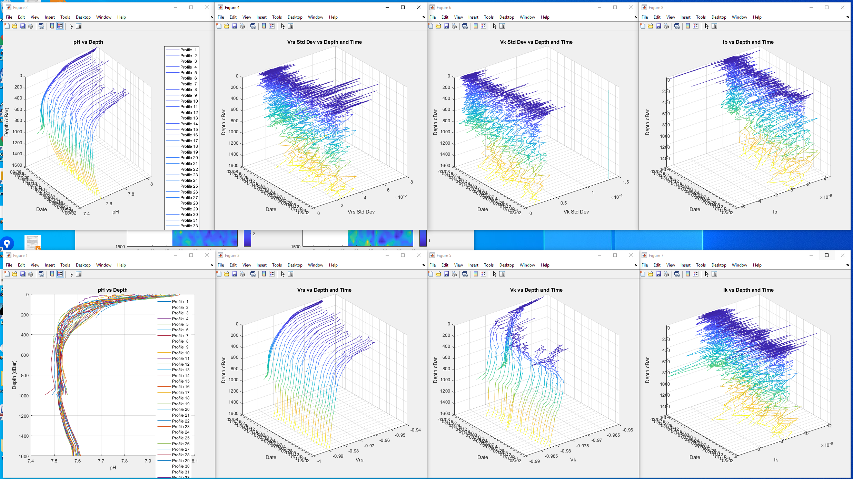

Slide 3
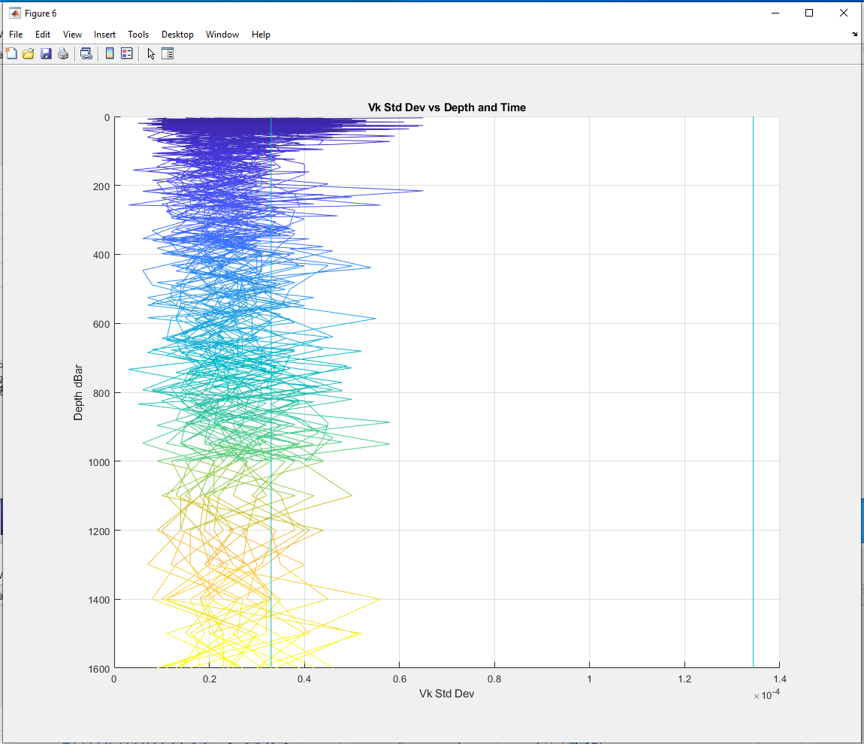
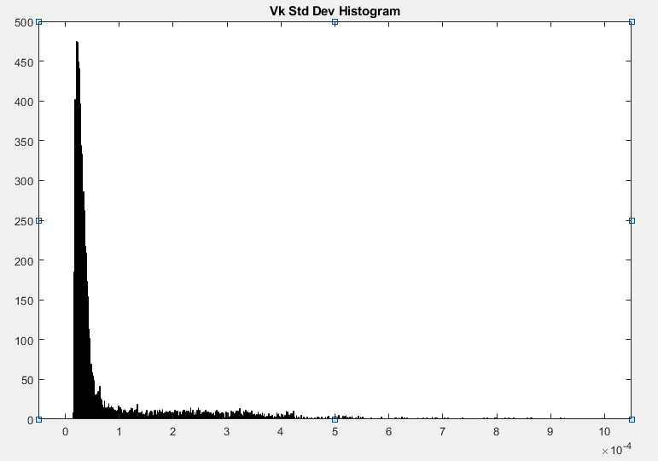
Median and Mean value from ph_diagnostics.txt
Does this seem right re: Luke’s 100uV threshold?

Slide 4
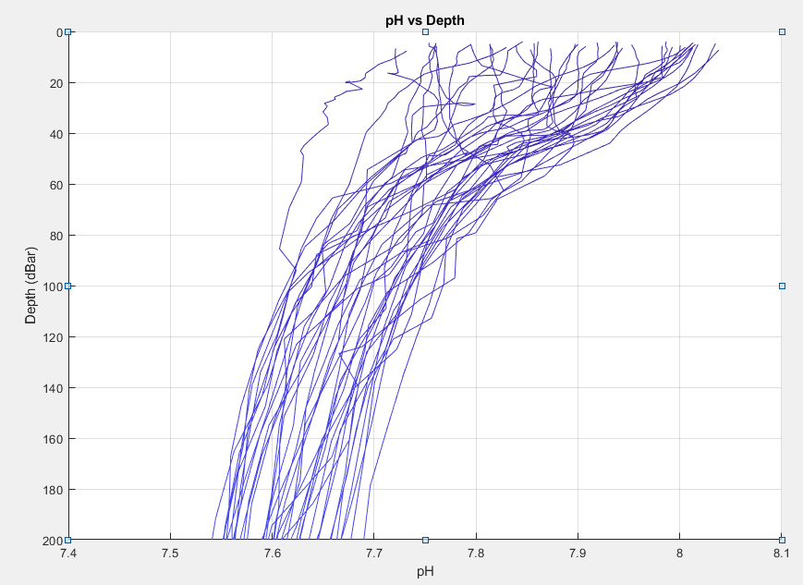
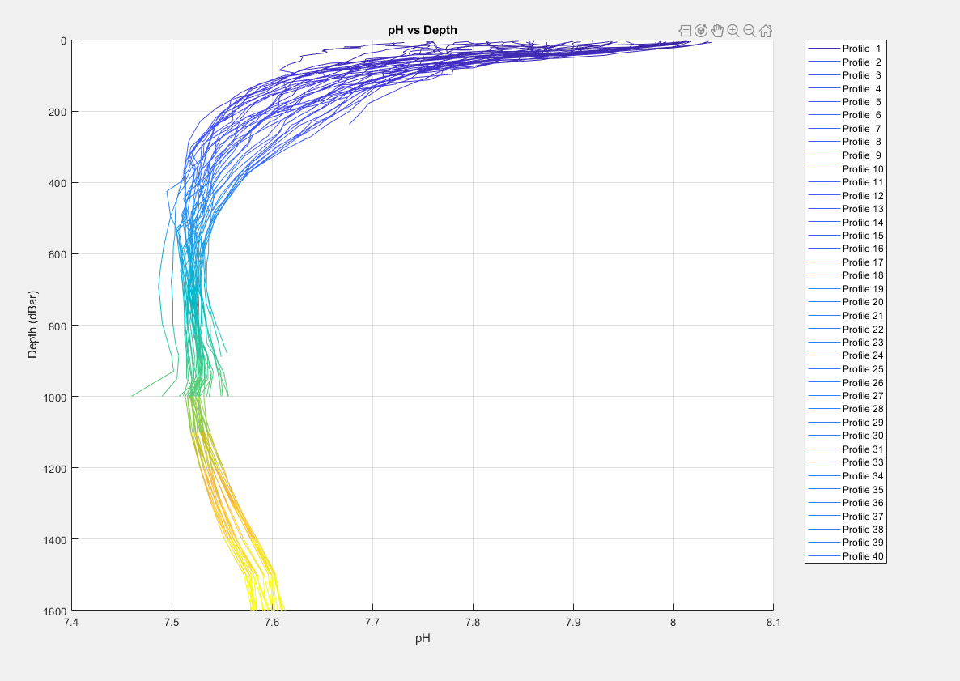
Are the wiggles int top 80-ish meters due to an incorrect F(p)?

Slide 5
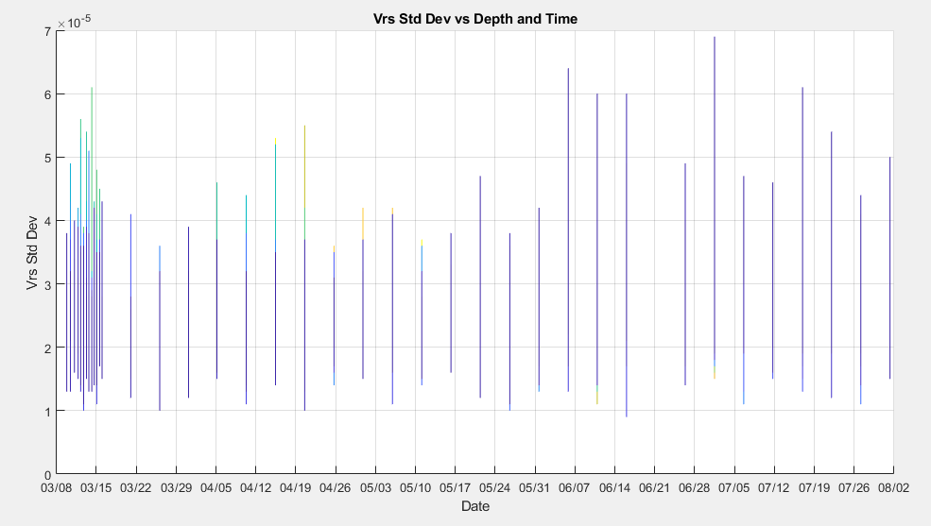
Has Vrs been getting wonky since early June?

