Slide 1
Summary of Various GDF Performance Metrics

Slide 2
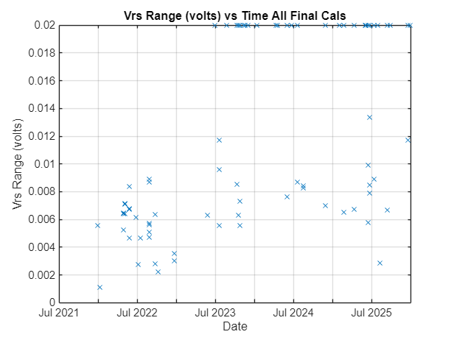
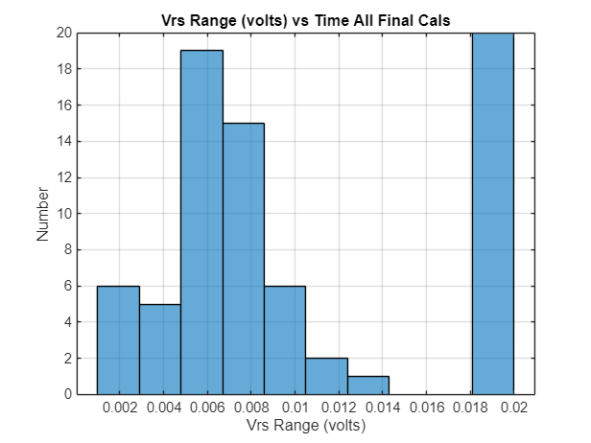
Scrape Vrs Range = max(Vrs.k0) – min(Vrs.k0) (aka f(p)) from \\atlas\chem\DuraFET\CALIBRATION\FinalMatlabCalibrations\*.TXT
By: Gene Massion 2026 Jan 7
Matlab script: \\atlas\ProjectLibrary\ChemSensors\GeneM\GDF pH Sensor\Data\Cal Data\Calcs\ProcessFinalCalsAllFiles.mlx

