Slide 1
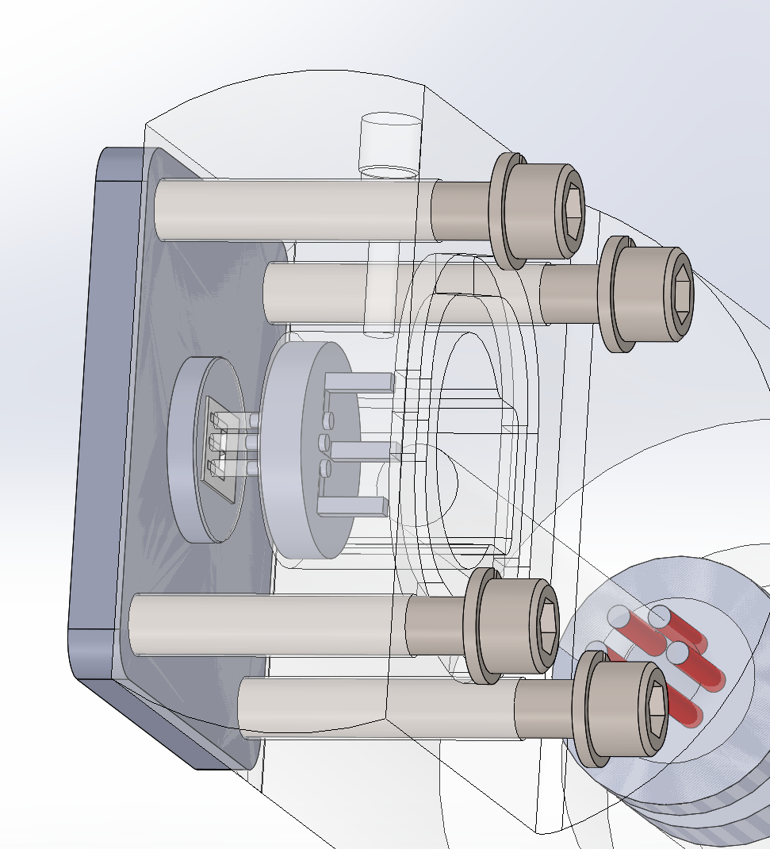
PCB WITH SOLDER
PINS
IC DIE
IC DIE TRACES
FUZZ BUTTON GOES HERE
SOLDER PIN ON PCB
HOUSING

