Slide 1
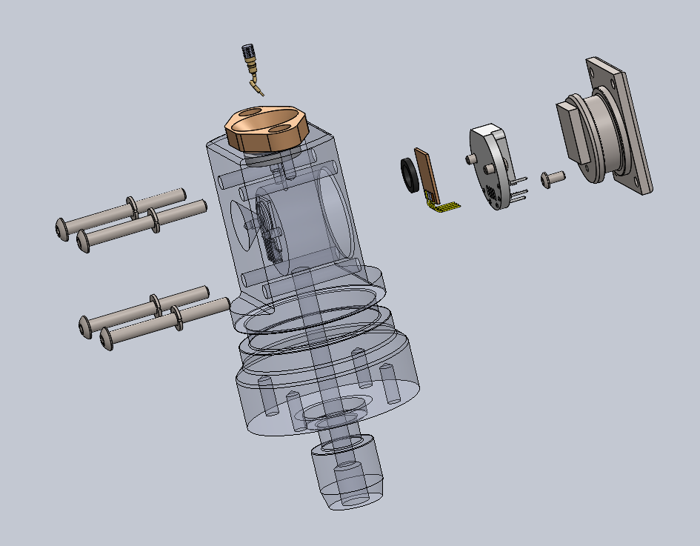
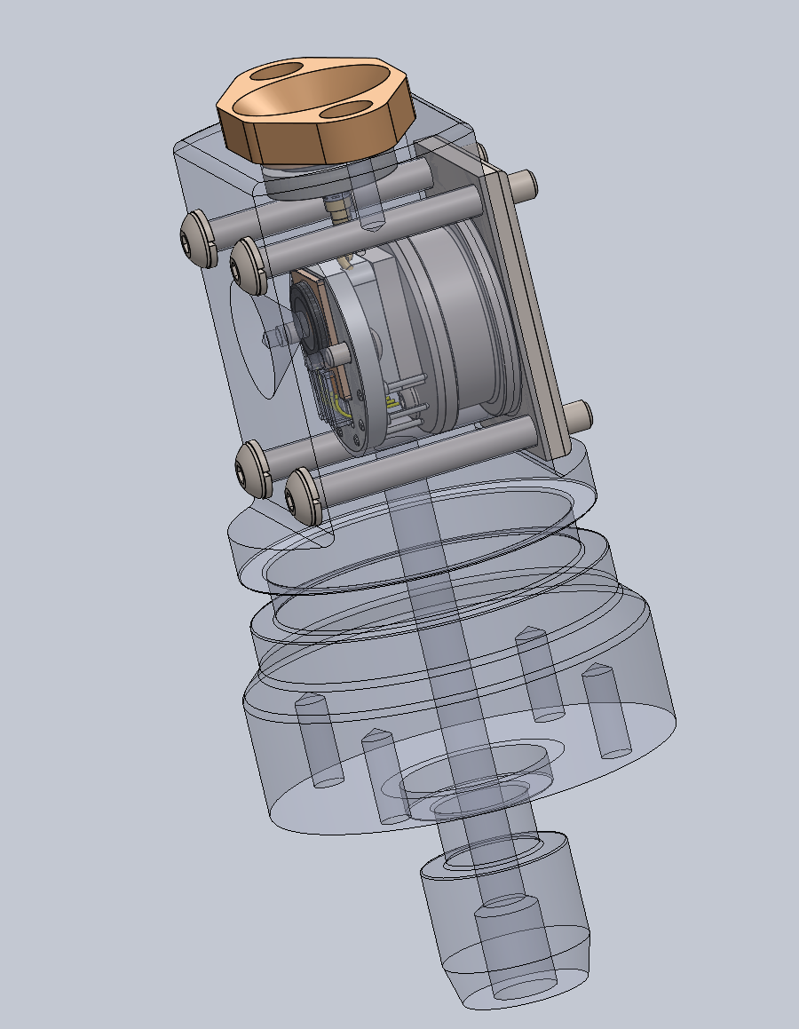
No front cover plate so no shoulder/no-shoulder decision
Either VL pellet cover will work
Still some risk associated with real-world manufacturability that we can probably only answer by building one.
Submit to our shop (hopefully) tomorrow (also hopefully)

