Slide 1
GDF 009

Slide 2
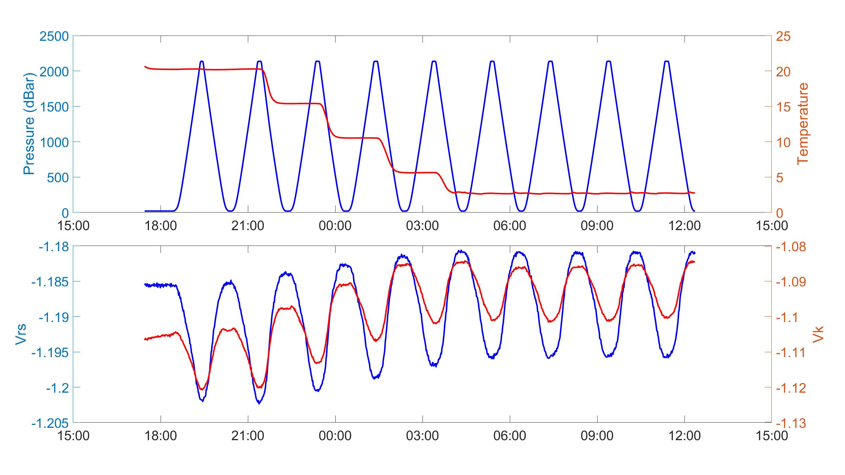
PT cycle with Vrs and Vk

Slide 3
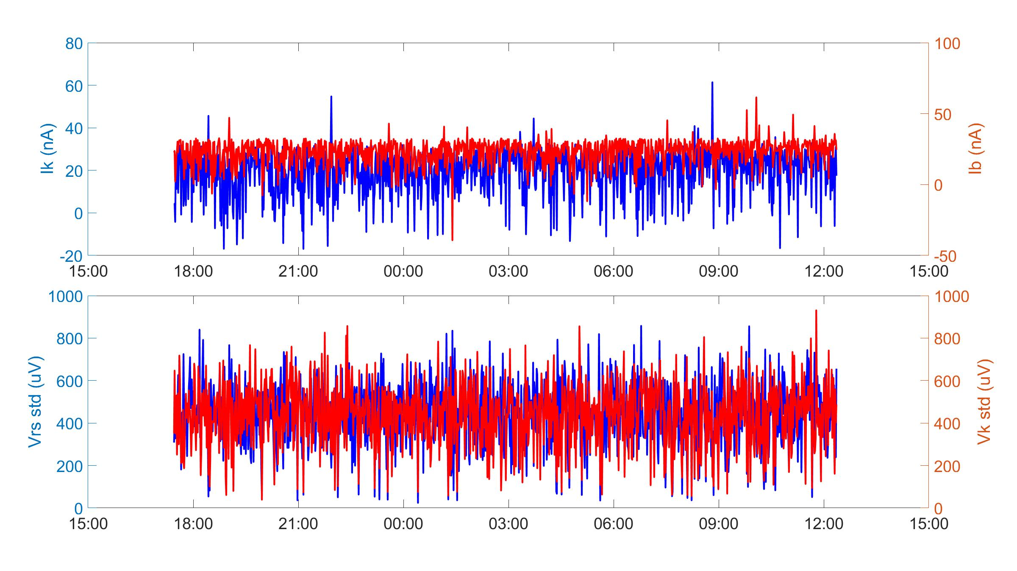
Diagnostics

Slide 4
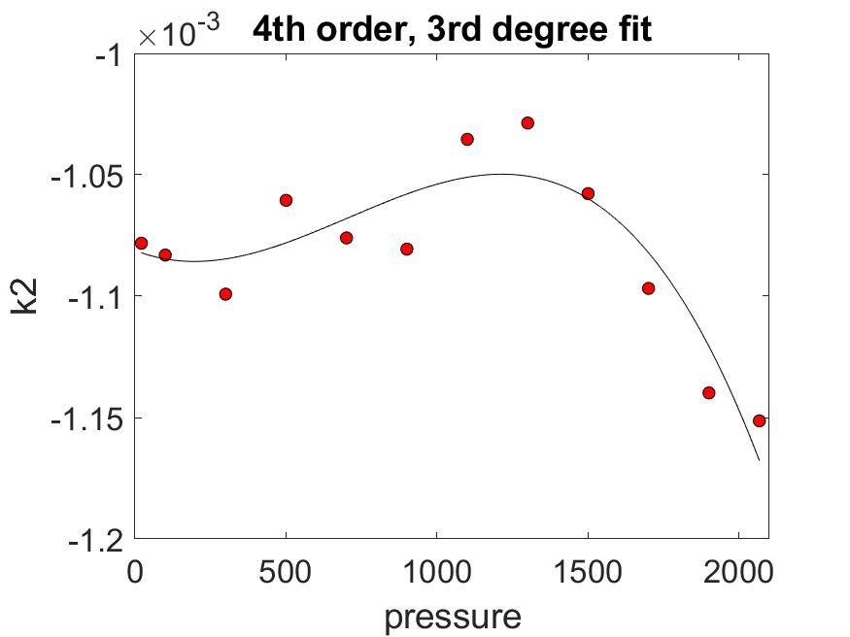
k2

Slide 5
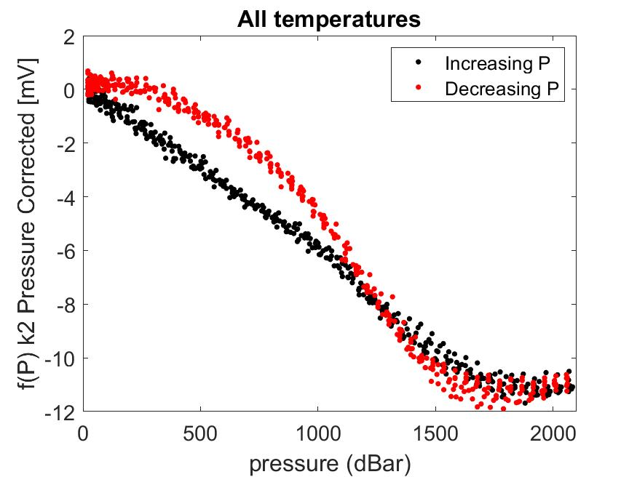
f(P)

