Slide 1

GDF RELIABILITY
Chapter 2
Question1: How reliable are the MBARI GDF pH sensors?
Question 2: Why does a GDF fail?
Question 3: Can we please come up with a different name than “Gasketed DuraFET”?
New Testament: AT&T Rel. Hdbk
Old Testament: MIL-HDBK-217F

Slide 2
Some Numbers
46 GDFs deployed
4 failures
563,970 total deployed hours
2869 profiles performed
265 profiles for WMO5906507

Slide 3
Some Calculations
One very standard reliability metric is the failure per time (FIT) rate
  FIT rate = number of failures/billion hours
  1 billion hours = 114,160 years
Another very standard reliability metric for non-repairable equipment is the mean time to failure (MTTF)
  MTTF = 1/FIT rate
GDF FIT Rate = 7,092 failures / billion hours
GDF MTTF = 140,990 hours

Slide 4
For Reference
The most reliable “product” on (or off) the planet may be a submarine telecommunications repeater
  FIT rate < 10 failures / billion hours
  <10,000 repeaters deployed
A high-reliability, Mil-Spec power supply FIT rate is around 2,252

Slide 5
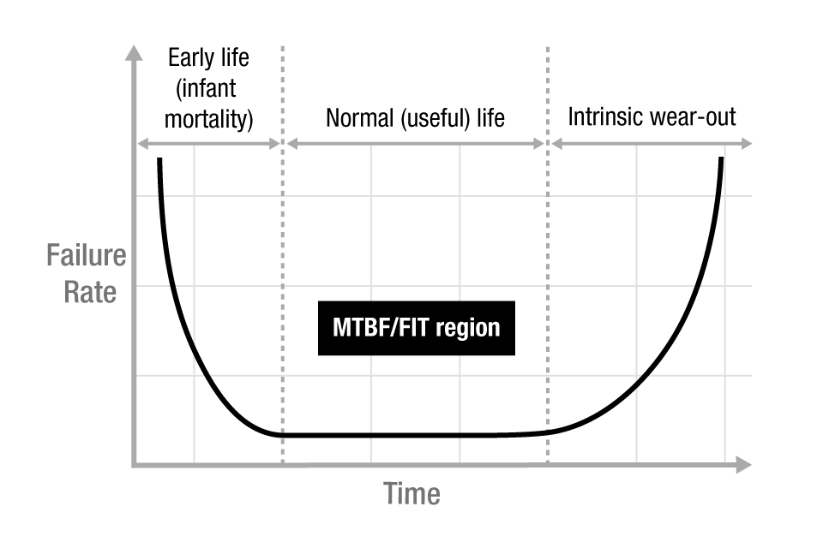
Question 2: Why does a GDF fail?
WMO2903473 failed on profile 17, the other 3 all failed on profile 1 or 2
  Those 3 were built by non-standard manufacturing personnel (shouldn’t be a problem) who weren’t using the manufacturing. Instructions (definitely a problem)
  Can we call them training exercises and ignore them? FIT rate drops 4X = 1773
We do a pretty good job of identifying “infant mortality” failures during calibration, so why do we get early life deaths on initial deployment?
  Shipping?
  If so, what did the NS assemblers do wrong?
Is the FIT rate going up, down or staying the same?
  Only time and more deployments will tell
  Deploy 10 more GDFs, no more failures, FIT drops by 954
  Deploy 10 more GDFs, 1 more failure, FIT increases by 581
“Bathtub” curve: typical Failure Rate vs time for components and systems

Slide 6
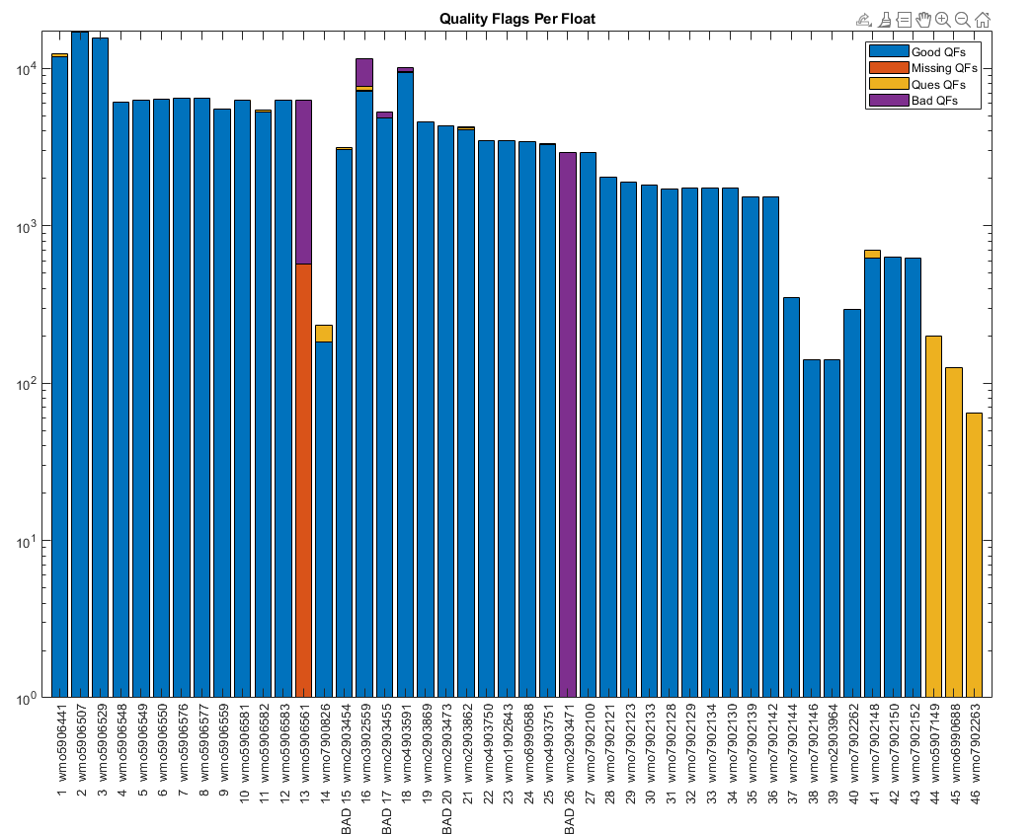
Future Work
Finalize algorithm for marking a GDF “bad”
Address post-cal infant mortality problem
Figure out why WMO2903473 and other floats died
Address large hysteresis in gasketed design

