Slide 1
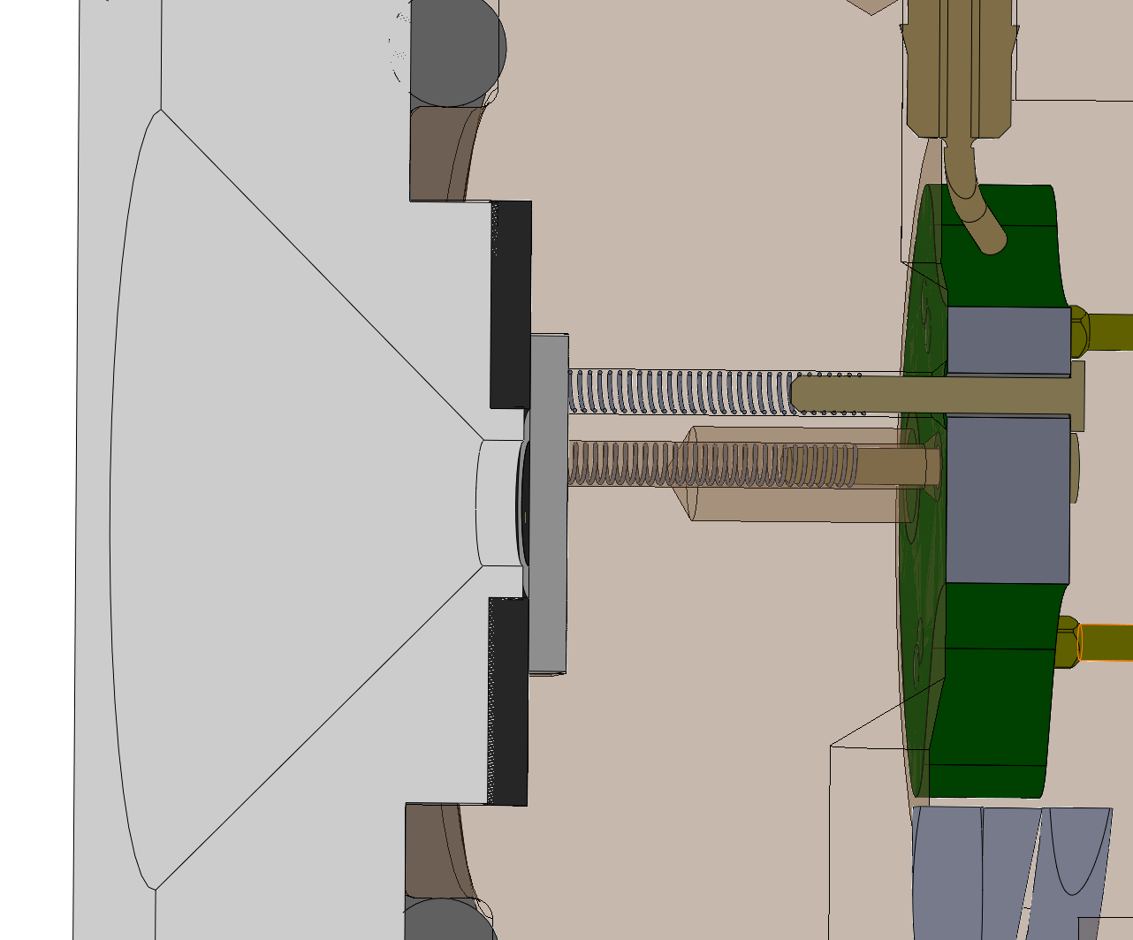
Gasket
Annular dead volume
This face probably presses against the ISFET at some pressure
Front cover
plate
ISFET

