Slide 1
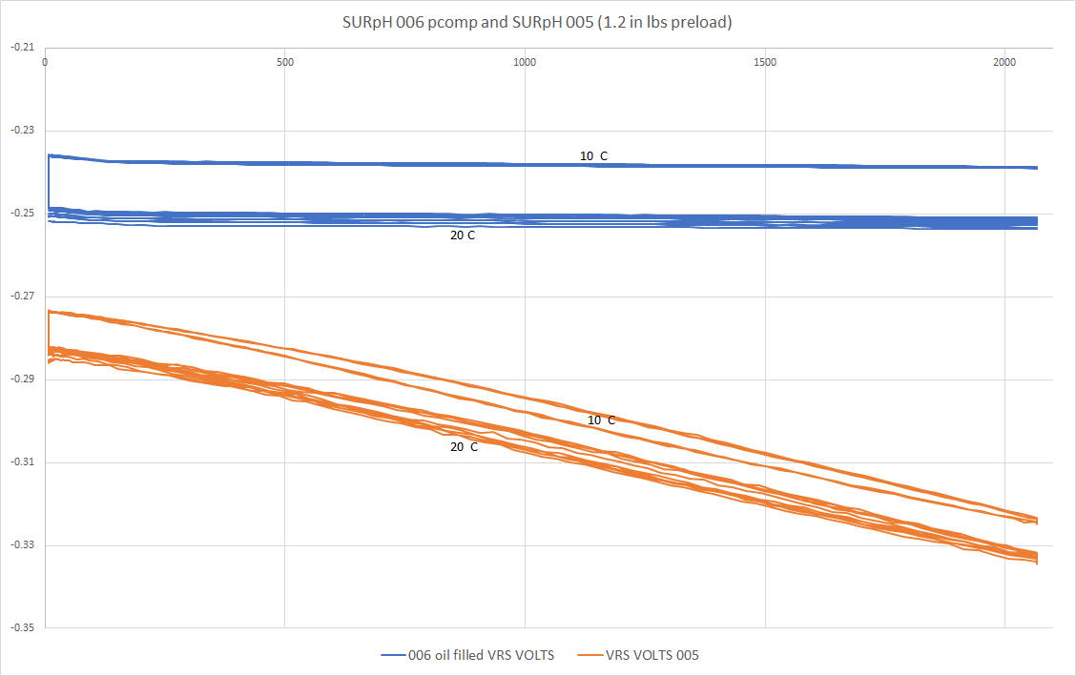
Pressure Balanced SURpH Sensor: First Results
<5 mV SURpH006 (Pressure Balanced)
~45 mV
SURpH005 (not PB)

