Slide 1
Progress in Oceanographic pH Sensors
Gene Massion, Ben Davis, Kenneth S Johnson, Jessica Metter,
Josh N Plant, Yuichiro Takeshita and Peter M Walz
Monterey Bay Aquarium Research Institute
Moss Landing, United States
Ocean Sciences Meeting 2026, Glasgow Scotland
2026 Feb 23

Slide 2
Motivation
Defensible pH measurements are critical to understanding ocean health
  Ocean acidification: how fast, where and why
  Marine Carbon Dioxide Removal: how effective and what are the consequences
  General Carbonate Chemistry
  And Others

Slide 3
Background
MBARI’s chem sensor lab has developed on of the few viable oceanographic pH sensors
  Started in 2008
  Mostly deployed autonomously: no operator intervention for 3-5+years
  >670 sensor deployed
    Mostly on Argo floats

Slide 4
Background
Commercialized in 2010
We are continuing to improve our sensors
  Performance
  Manufacturability
  Reliability
  Cost

Slide 5
7 Generations of pH Sensors
Original MBARI Deep Sea DuraFET (DSD)
Commercial version of MBARI DSD
Gasketed DuraFET (GDF)
Pressure balanced GDF
Lionix ISFET semiconductor underwater pH sensor (SURpH sensor)
Pressure balanced SURpH sensor

Slide 6
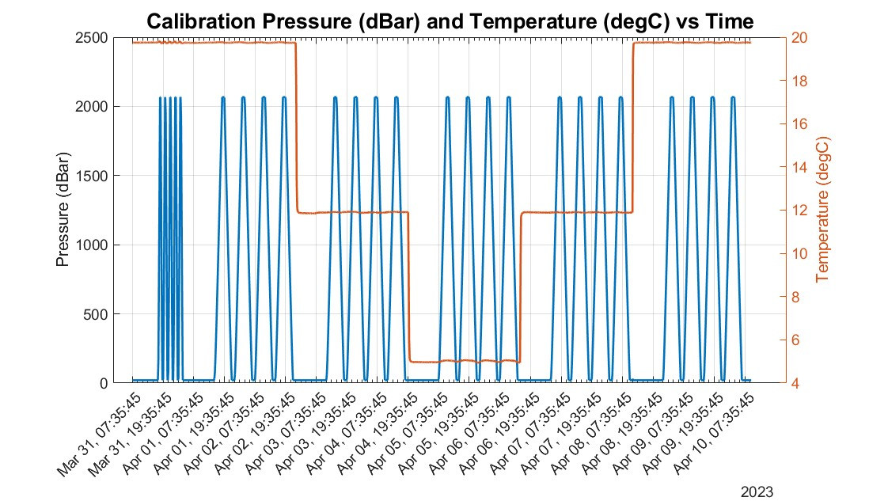
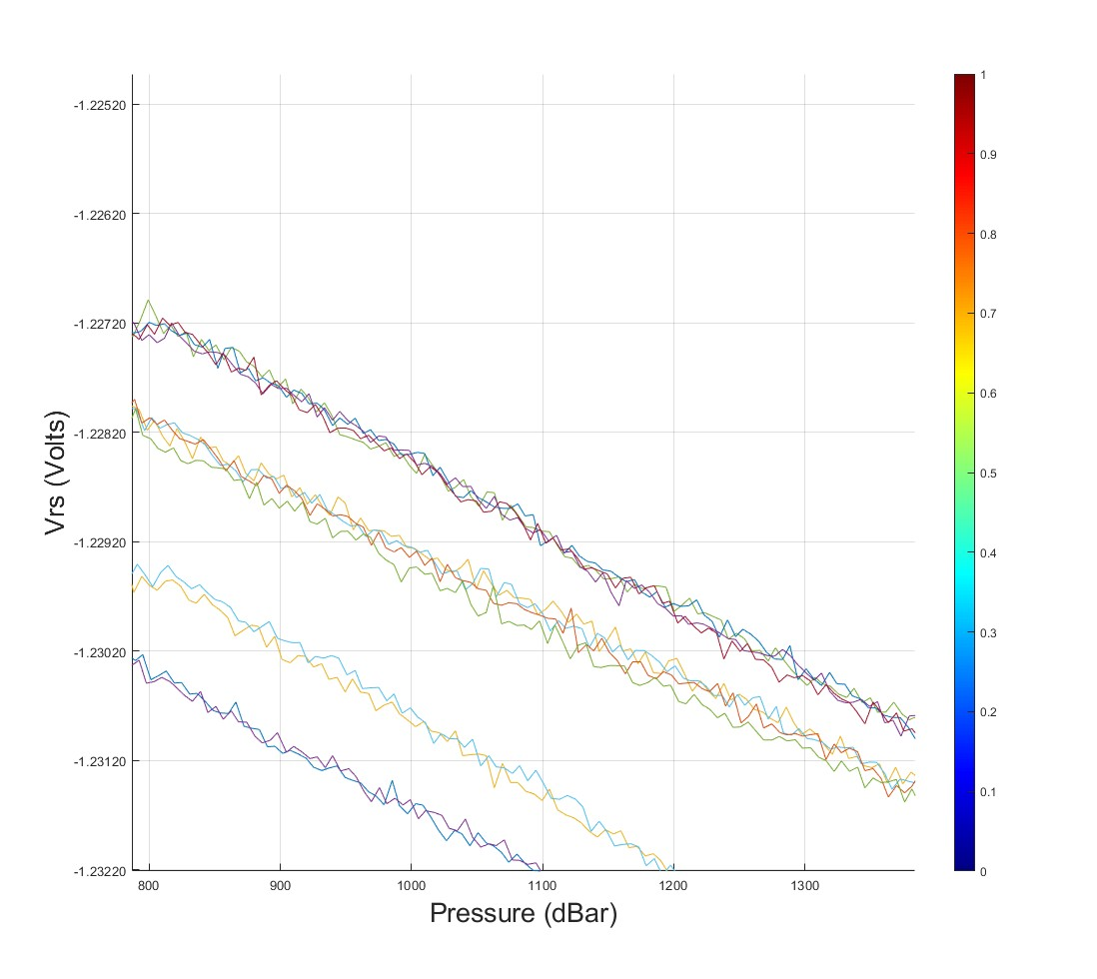
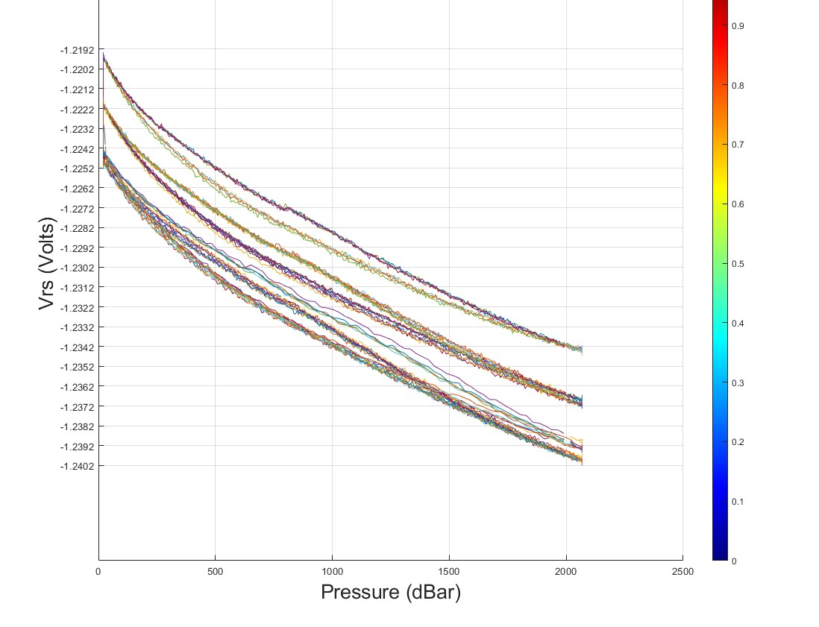
Details
Every sensors gets calibrated for f(pressure), f(temperature), bulk offset
Increasing Pressure→
Decreasing Pressure→
Historical Problems:
  Large, complicated ∆pH vs. pressure f(p)
  Hysteresis
  Large Sensor to Sensor
  Variability
  Drift
Hysteresis
~1 mVolt
f(p)
~15 mVolts
←Decreasing Pressure
1 mVolt ~= 17 mpH units
Increasing Pressure→

Slide 7
Performance Progress
Pressure balanced (oil filled) sensors work really well!
  Same charts
Improved flow
  Still minimizing bubbles
  Flow path aimed directly at sensor face
  Improved response time

Slide 8
Manufacturability, Cost, and Reliability Cost Progress
Contract Manufacturers are our friends
  Many CMs are setup specifically to deliver small quantities of highly complex, high quality highly technical products for demanding customers
  We have transferred most of our manufacturing work to Applied Engineering
    10-50 of our pH sensors per year
    Better vendor control and incoming inspection
    Well documented process procedure
    Incoming inspection and rejected material process
    Trained and qualified manufacturing technicians
    For the same price (or slightly less) than we can produce sensors in our lab
Design and Manufacturability Improvements Better reliability
  Standard reliability metric is FIT rate (failures/billion hours) ~5X lower

Slide 9
Current Status
Hundreds of sensors deployed across the world’s oceans generating defensible 4D pH data
  Accuracy: ~0.01 pH units
  Precision: ~0.005 pH units
All data is publicly available along with a broad suite of additional essential ocean variables through Argo Data Centers
  With rigorous on-going QC process

Slide 10
Next Steps
Move pressure balanced design into production
Reduce the variance in performance metrics
  Replace the custom gasket with an off the shelf seal
Develop a numerical model that estimates seawater pH as an function of structural loads
Combined pH and total alkalinty sensor

Slide 11
Acknowledgments
The MBARI pH sensor village includes
The entire Chem Sensor lab
The entire Ocean Biogeochemical Sensing lab,
The MBARI technicians: Chris Beebe, Paul Coenen, Yamir Hernandez, Roman Marin, James McClure, Jim Montgomery, Jose Rosal,
The MBARI machine shop: Jerry Allen, Ray Thompson, Mark Tynes
Generous funding from the David and Lucille Packard Foundation and the US National Science Foundation.

Slide 12
Abstract
The MBARI Chemical Sensor lab has been developing pH sensor for oceanographic applications since 2008. The original technology was commercialized in 2010. Since that time, the Chem Sensor lab has continued to improve our pH sensor technology. More than 670 sensors have been deployed for a range of science missions, and various failure modes have been identified. Improvements have been made in performance, manufacturability, reliability and cost, which address many of these issues. The current status of and future plans for our continual improvement process will be discussed in this presentation. Performance improvements will be of general interest to the ocean sciences community. The processes we've developed to improve manufacturability, reliability and cost may be of particular interest to the ocean sciences technology development community.

