Slide 1
Progress in Oceanographic pH Sensors
Gene Massion, Ben Davis, Kenneth S Johnson, Tanya Maurer, Jessica Metter, Josh Plant, Yuichiro Takeshita, and Peter Walz
Monterey Bay Aquarium Research Institute
Moss Landing, CA, United States
Ocean Sciences Meeting 2026, Glasgow Scotland
2026 Feb 23

Slide 2
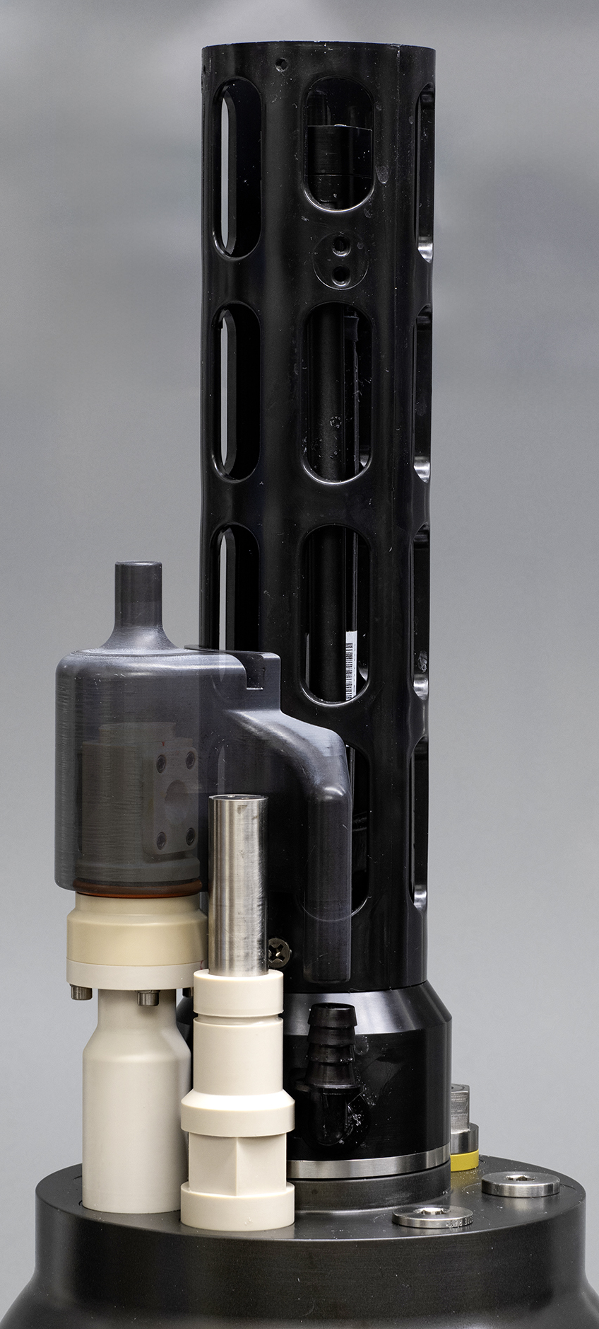
Motivation
Defensible pH time series are critical to understanding ocean health challenges
  Ocean acidification: how fast,
  where and why?
  Marine Carbon Dioxide Removal:
  how effective and what is the impact on the surrounding ecosystem?
  Fishery management
  Production and Respiration
  Coral reef health, …

Slide 3
Background
MBARI’s chem sensor lab has developed one of the few viable oceanographic pH sensors
Started in 2008
ISFET semiconductor technology
Mostly deployed autonomously: no operator intervention for 3-5+ years
921 sensor deployed
Mostly deployed on Argo floats

Slide 4
Background
Commercialized in 2010 w/Seabird
We continue to improve our sensor
  Performance
  Manufacturability
  Reliability
  Cost

Slide 5
6 Generations of pH Sensors
Original MBARI Deep Sea DuraFET (DSD)
Commercial version of
MBARI DSD
Gasketed DuraFET (GDF)
Pressure balanced GDF
Lionix ISFET SURpH
sensor
Pressure balanced
SURpH sensor
G1 G3 G4 G5 G6
G2

Slide 6
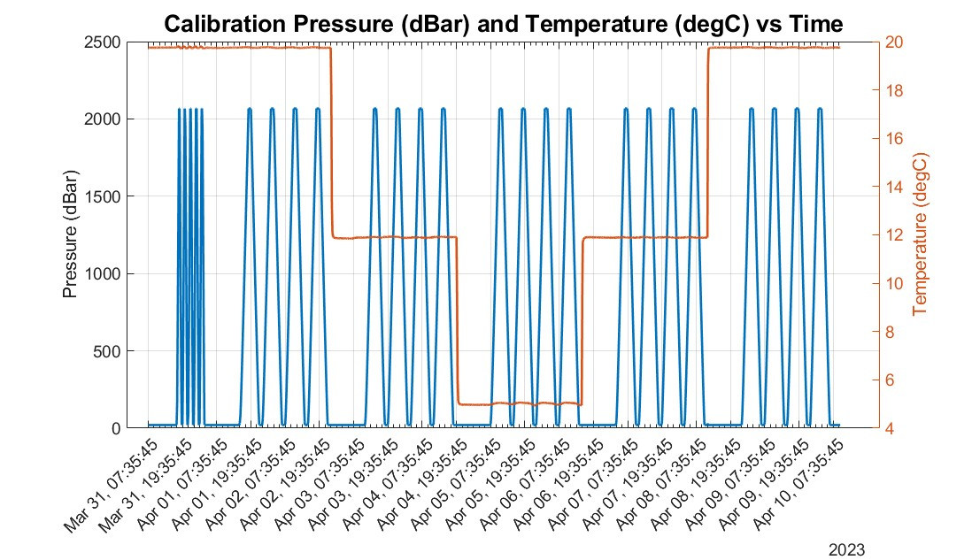
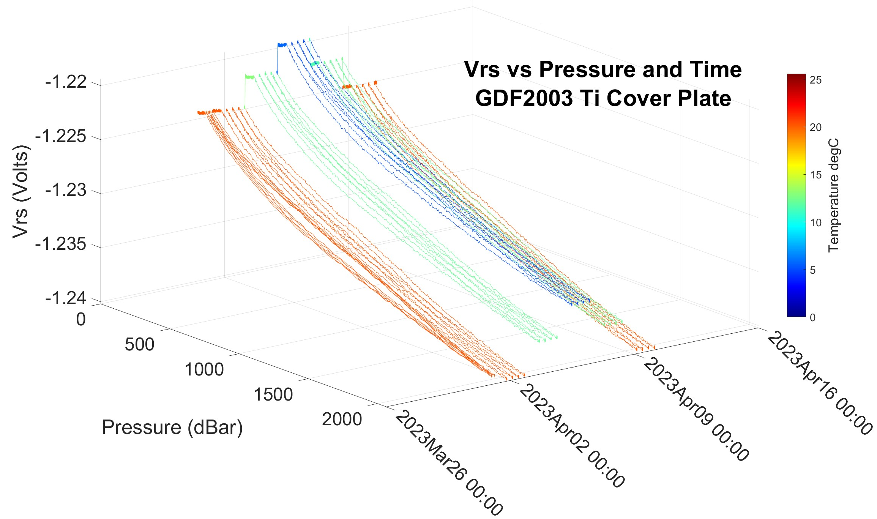
Details
Every sensor gets calibrated for pressure, temperature, bulk offset
f(p) ~15 mVolts
Increasing Presure→
Decreasing Pressure→

Slide 7
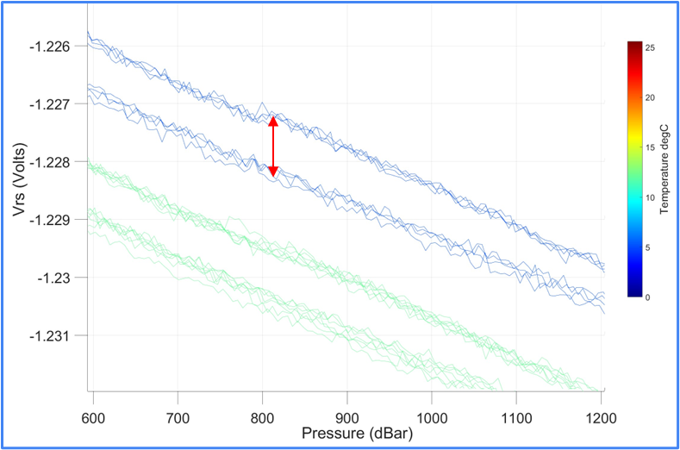
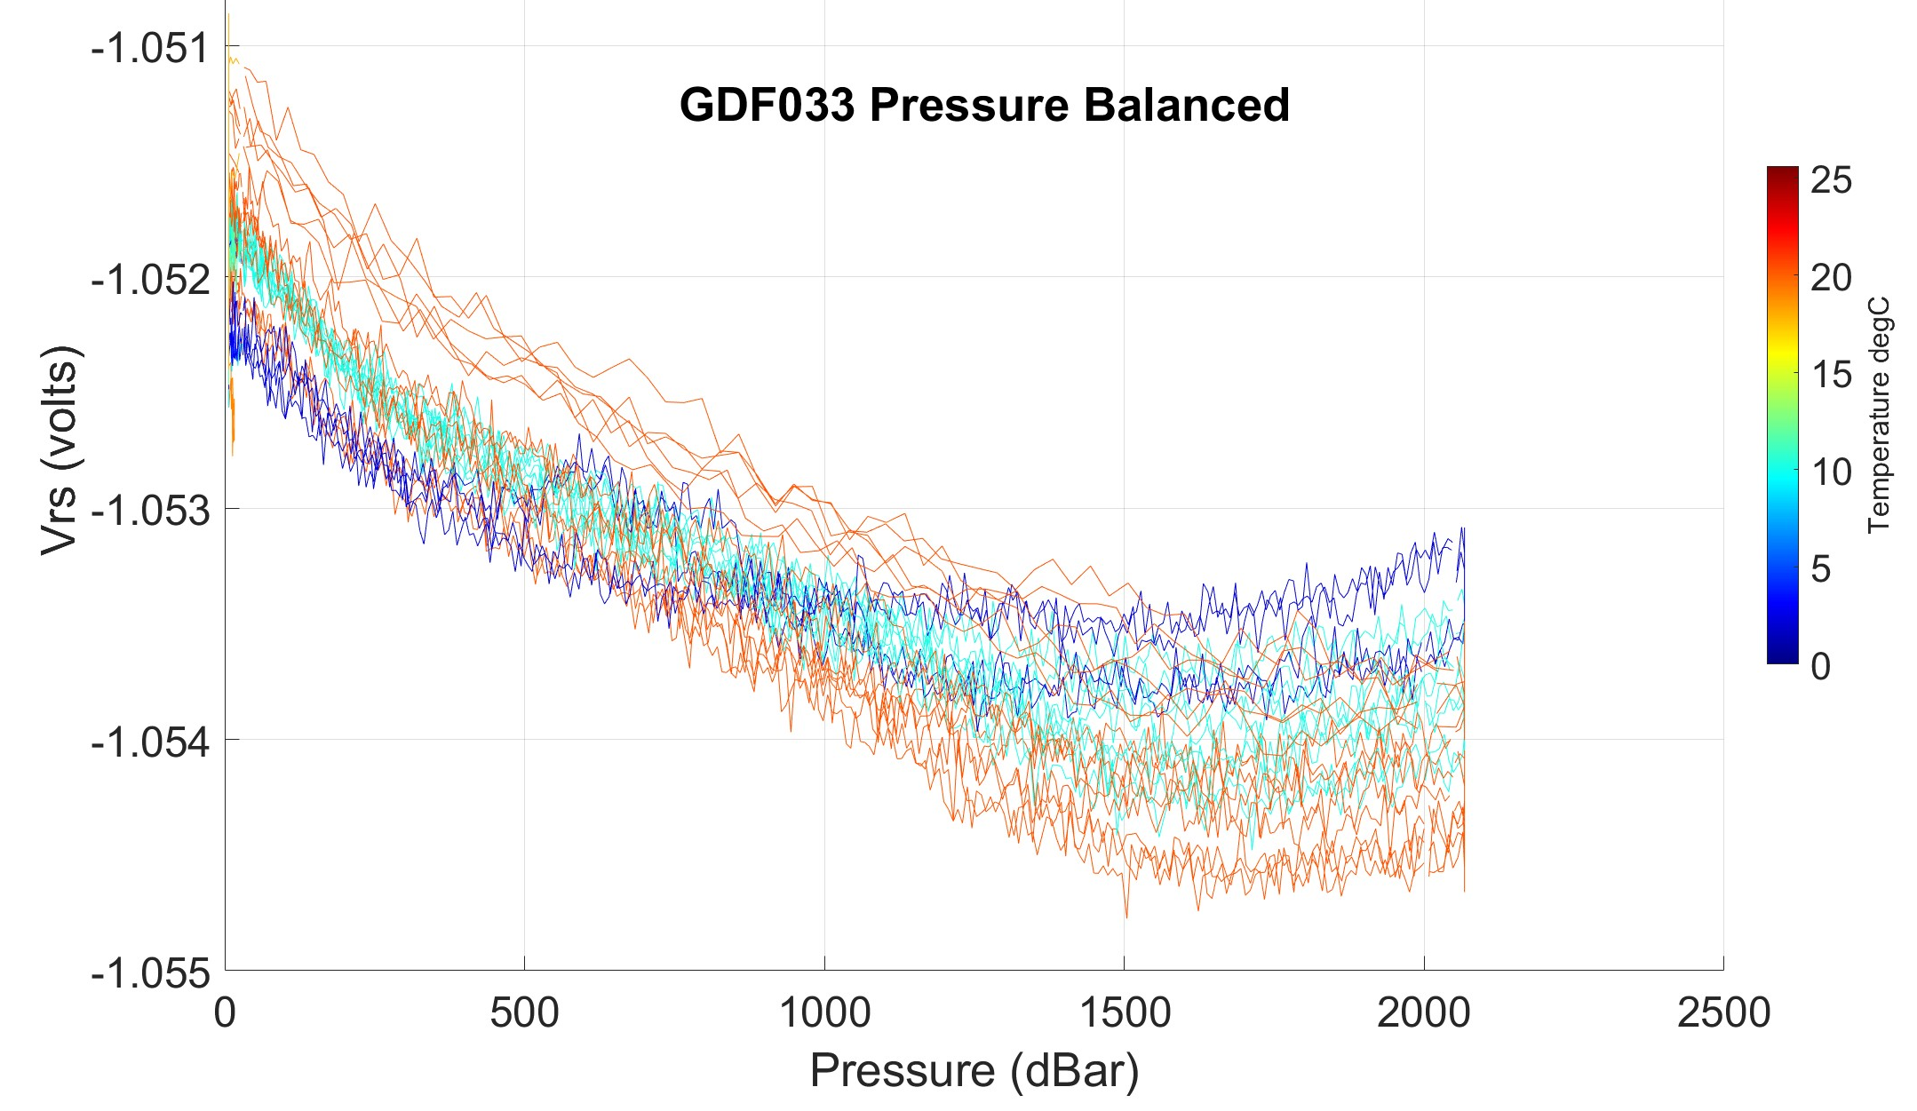
Performance Progress
Pressure balancing helps (a lot)
  Minimizes asymmetrical deflection
  Same compressive load on all 6 ISFET faces
GDF2003 Non-Pressure Balanced
~1 mV Hysteresis
= ~17 mPh
~0 mV
Hysteresis
<0.4 mV
Hysteresis
f(p) ~2 mVolts

Slide 8
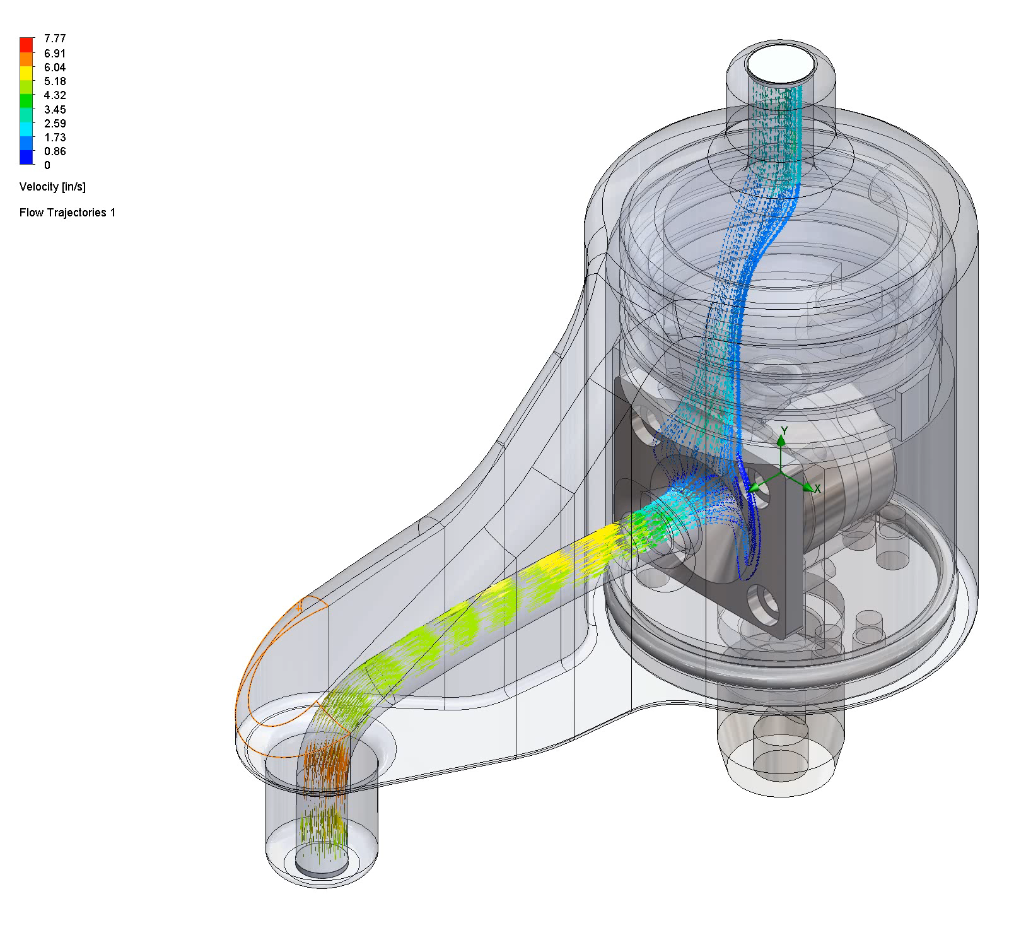
Performance Progress
Improved flow over ISFET
Aligning the inlet with the ISFET face +/-11 degrees is acceptable

Slide 9
Manufacturing and Cost Progress
Contract Manufacturers are great (mostly)
  We have transferred most of our manufacturing work to Applied Engineering
    10-50 of our pH sensors per year
    Better vendor control and incoming inspection processes
    Well documented assembly procedure process
    Better incoming inspection and rejected material process
    Trained and qualified manufacturing technicians
We’re still responsible for some problems
We’re getting sensors built for about the same price we were building them for (maybe less)

Slide 10
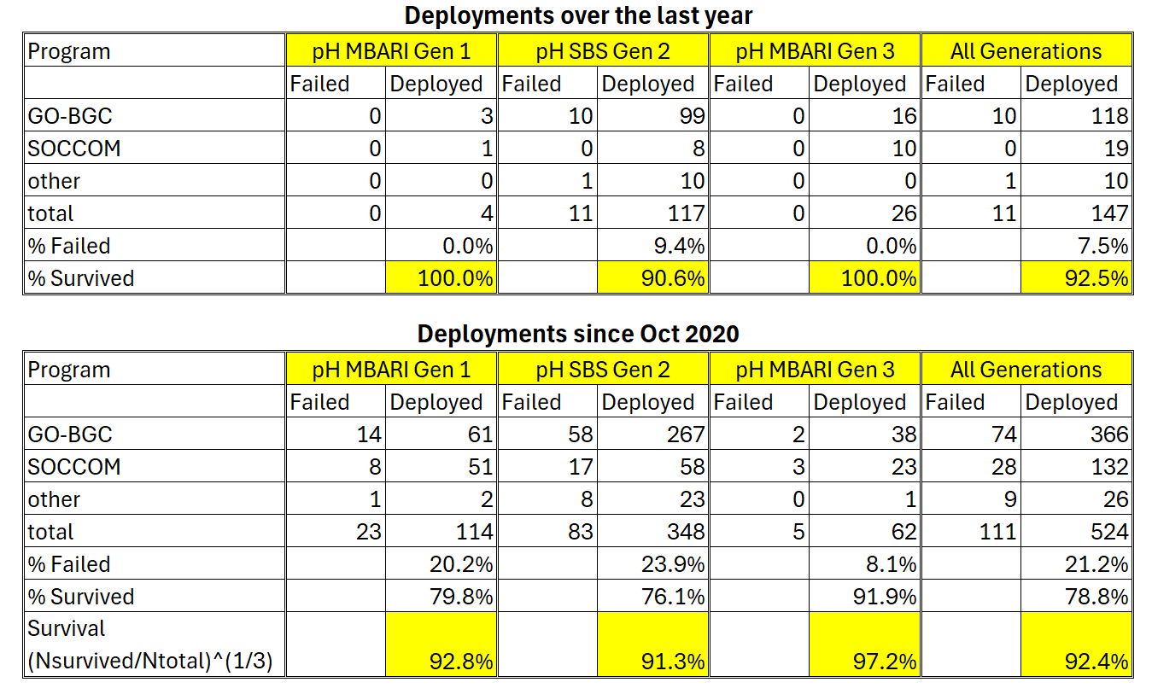
Reliability Progress
Design and Manuf. Progress = Better reliability

Slide 11
Current Work
Move pressure balanced design into production
Reduce the variance in performance metrics
Combined pH and total alkalinty sensor
Understand and mitigate reliability issues
  Shipping mortality, non-electronics failures
Predict seawater pH as an function of sensor mechanical and electrical design

Slide 12
Acknowledgments
The MBARI pH sensor village includes
The entire Chem Sensor lab
The entire Ocean Biogeochemical Sensing lab,
The MBARI technicians: Chris Beebe, Paul Coenen, Yamir Hernandez, Roman Marin, James McClure, Jim Montgomery, Jose Rosal,
The MBARI machine shop: Jerry Allen, Ray Thompson, Mark Tynes
Generous funding from the David and Lucille Packard Foundation and the US National Science Foundation.

Slide 13
Abstract
The MBARI Chemical Sensor lab has been developing pH sensor for oceanographic applications since 2008. The original technology was commercialized in 2010. Since that time, the Chem Sensor lab has continued to improve our pH sensor technology. More than 670 sensors have been deployed for a range of science missions, and various failure modes have been identified. Improvements have been made in performance, manufacturability, reliability and cost, which address many of these issues. The current status of and future plans for our continual improvement process will be discussed in this presentation. Performance improvements will be of general interest to the ocean sciences community. The processes we've developed to improve manufacturability, reliability and cost may be of particular interest to the ocean sciences technology development community.

