Slide 1
Progress in Oceanographic pH Sensors
Gene Massion, Ben Davis, Kenneth S Johnson, Jessica Metter,
Josh N Plant, Yuichiro Takeshita and Peter M Walz
Monterey Bay Aquarium Research Institute
Moss Landing, United States
Ocean Sciences Meeting 2026, Glasgow Scotland
2026 Feb 23

Slide 2
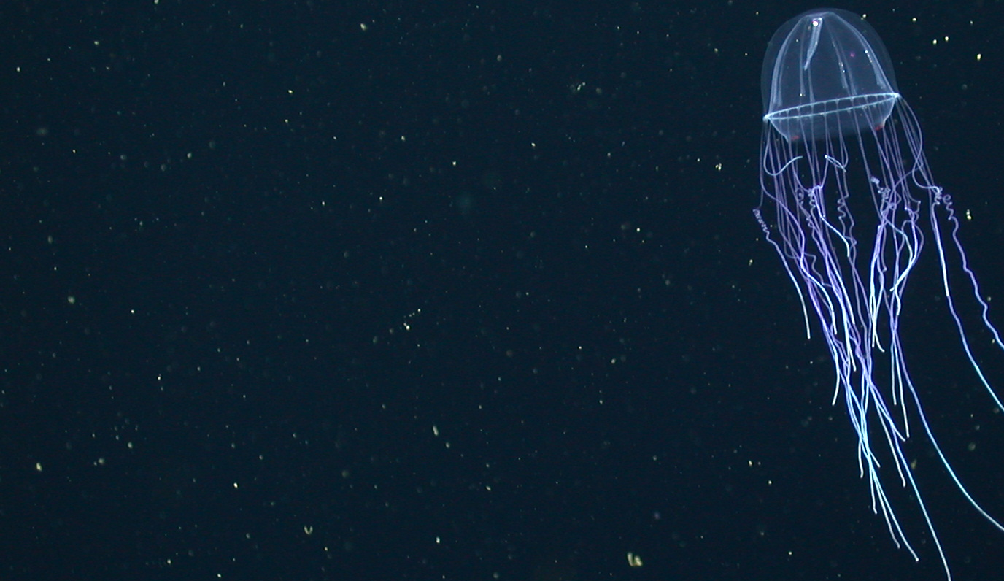

Progress in Oceanographic pH Sensors
Gene Massion, Ben Davis, Kenneth S Johnson, Jessica Metter, Josh N Plant, Yuichiro Takeshita Peter M Walz
Monterey Bay Aquarium Research Institute

Slide 3
Motivation
Oceanographic pH measurements are critical to understanding ocean health
  Ocean acidification
  Marine Carbon Dioxide Removal
  Carbonate Chemistry …

Slide 4
Motivation and Background
Oceanographic pH measurements are critical to understanding ocean health
  Ocean acidification, Marine Carbon Dioxide Removal, Carbonate Chemistry, …
MBARI’s Chemical Sensor lab has been developing deep water, autonomous (multi-year deployment) pH Sensors since 2008
Commercialized in 2010
>670 pH sensors have been deployed
We are continuing to improve our sensors

Slide 5
Motivation and Background
Oceanographic pH measurements are critical to understanding ocean health
MBARI’s Chemical Sensor lab has been developing deep water, autonomous (multi-year deployment) pH Sensors since 2008
Commercialized in 2010
>670 pH sensors have been deployed
We are continuing to improve our sensors

Slide 6
Motivation and Background
Oceanographic pH measurements are critical to understanding ocean health
MBARI’s Chemical Sensor lab has been developing deep water, autonomous (multi-year deployment) pH Sensors since 2008
Commercialized in 2010
>670 pH sensors have been deployed
We are continuing to improve our sensors

Slide 7
Motivation and Background
Oceanographic pH measurements are critical to understanding ocean health
MBARI’s Chemical Sensor lab has been developing deep water, autonomous (multi-year deployment) pH Sensors since 2008
Commercialized in 2010
>670 pH sensors have been deployed
  Mostly on Argo profiling floats
We are continuing to improve our sensors

Slide 8
Motivation and Background
Oceanographic pH measurements are critical to understanding ocean health
MBARI’s Chemical Sensor lab has been developing deep water, autonomous (multi-year deployment) pH Sensors since 2008
Commercialized in 2010
>670 pH sensors have been deployed
We are continuing to improve our sensors
  Performance
  Manufacturability
  Reliability
  Cost

Slide 9
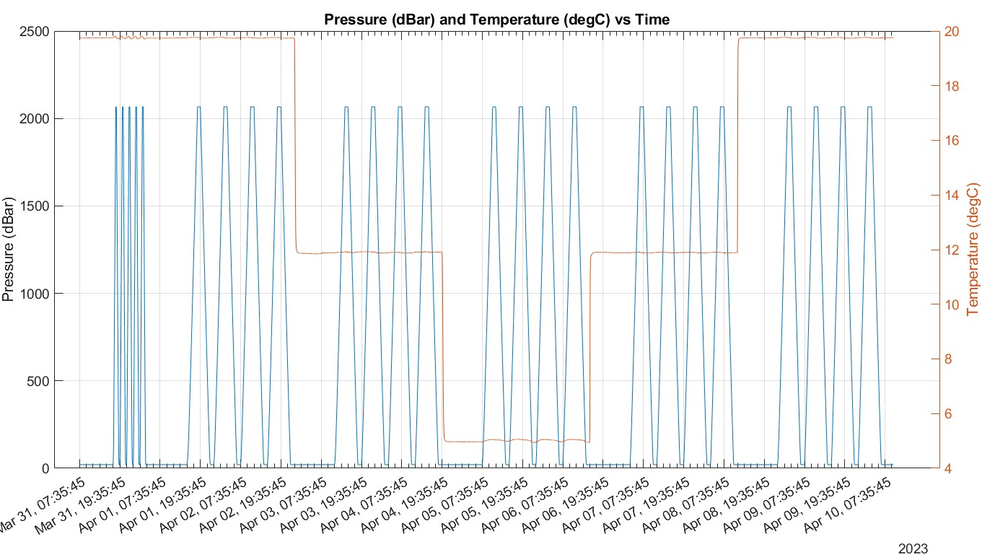
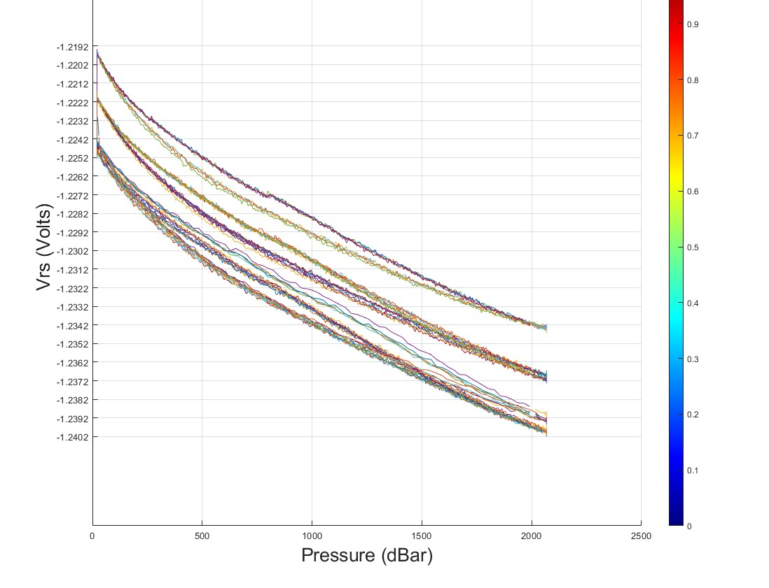
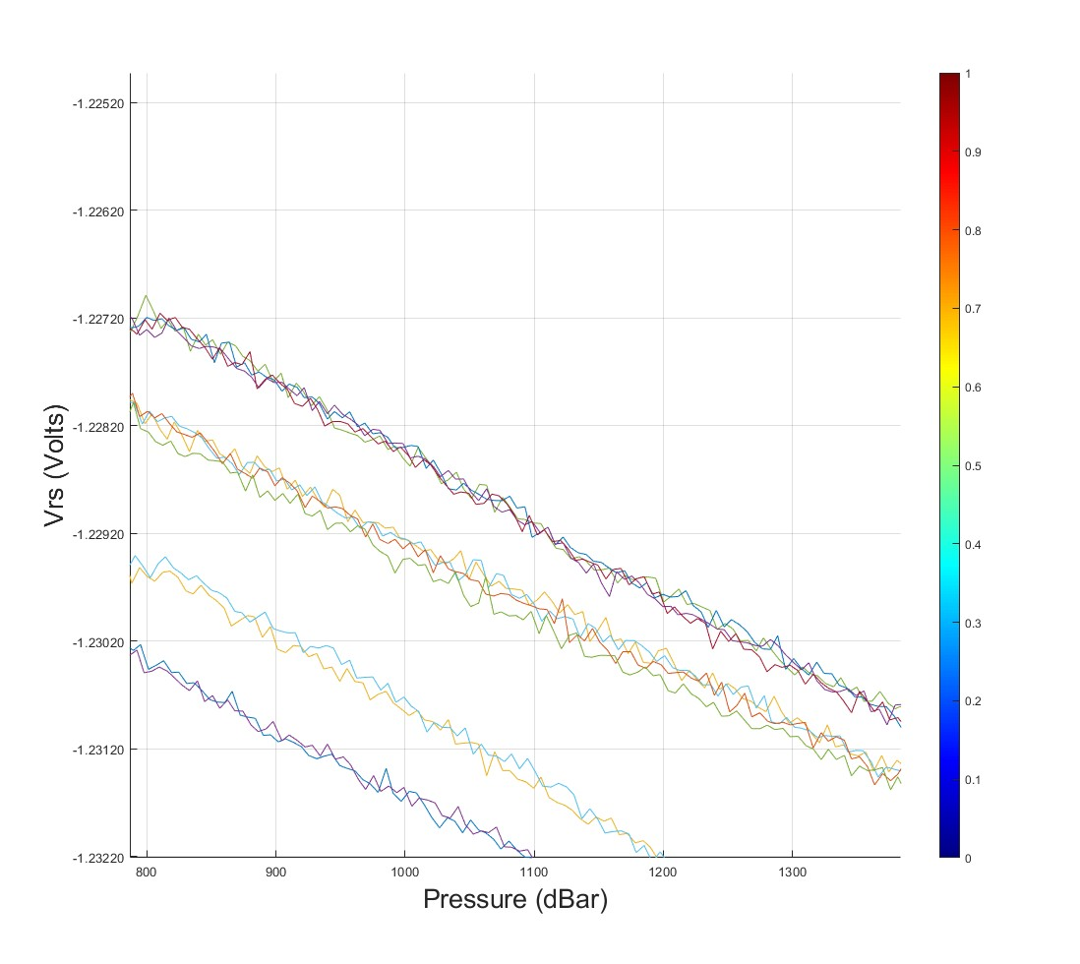
Details
Every sensors gets calibrated for f(pressure), f(temperature), bulk offset
The Historical Problems:
  Hysteresis
  Large, complicated ∆pH as a function of pressure f(p)
  Large Sensor to Sensor
  Repeatability
  Drift
Increasing Pressure→
Decreasing Pressure→
f(p)
~15 mVolts
Hysteresis
~1 mVolt
←Decreasing Pressure
1 mVolt ~= 17 mpH units
Increasing Pressure→

Slide 10
Performance Progress
Pressure balanced (oil filled) sensors work really well!

Slide 11
Manufacturability Progress
Eliminated epoxy potting steps
Replaced hand bent wire contacts with fuzz buttons and a PCB assembly
Reduced parts count
Increased size of parts
Calibrate the complete deployable sensor across pressure and temperature
Doubled the number of qualified ISFET vendors (2 X 1 vendor = 2 vendors)
Moved manufacturing from MBARI Chem Sensor Lab to Applied Engineering (a contract manufacturer)

Slide 12
Reliability Progress
FIT rate
DSD fit rate
Chem sensor lab GDFs
AE GDFs

Slide 13
Next Steps
Reduce the variance in performance metrics
  Replace the custom gasket with an off the shelf seal
Develop a model that estimates seawater pH as an integrated function of parameters other than seawater pH to better understand design decisions
  Strain in the ISFET due to structural loads
  Temperature
  Pressure

Slide 14
Acknowledgments

Slide 15
Abstract
The MBARI Chemical Sensor lab has been developing pH sensor for oceanographic applications since 2008. The original technology was commercialized in 2010. Since that time, the Chem Sensor lab has continued to improve our pH sensor technology. More than 670 sensors have been deployed for a range of science missions, and various failure modes have been identified. Improvements have been made in performance, manufacturability, reliability and cost, which address many of these issues. The current status of and future plans for our continual improvement process will be discussed in this presentation. Performance improvements will be of general interest to the ocean sciences community. The processes we've developed to improve manufacturability, reliability and cost may be of particular interest to the ocean sciences technology development community.

