Slide 1
Quantifying GDF Performance
Goal: Build a data base of relevant GDF and SURpH sensor performance measurements extracted from the cal runs so we can semi-quantitatively call a sensor good or bad relative to selected subsets of all the previous data
  This GDF vs. all delivered GDFs
    Decreasing pressures only
    Increasing pressures only
    Both pressure ramps
  This GDF vs. all AE built GDFs
  This GDF vs. all broached corner GDFs (just an example)

Slide 2
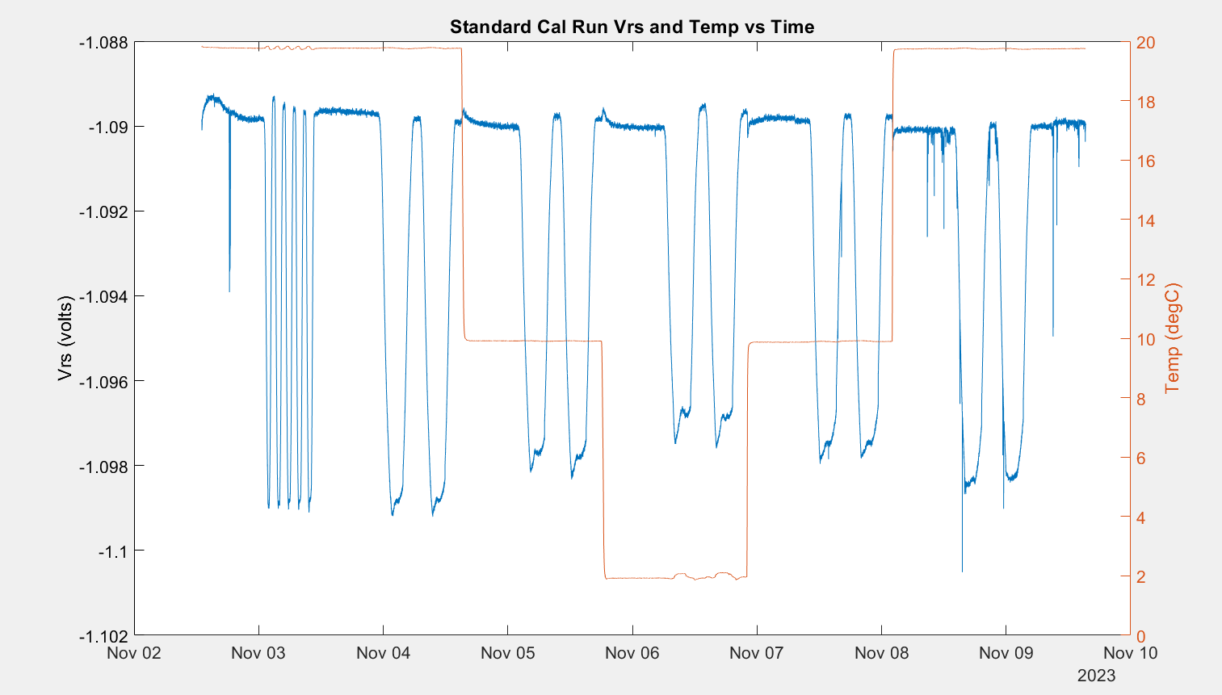
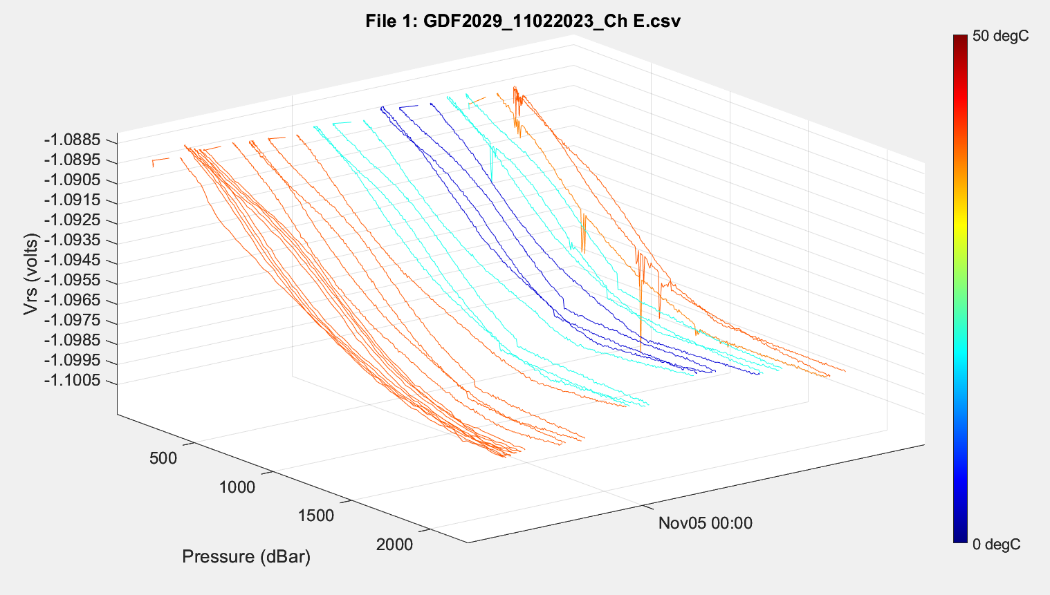
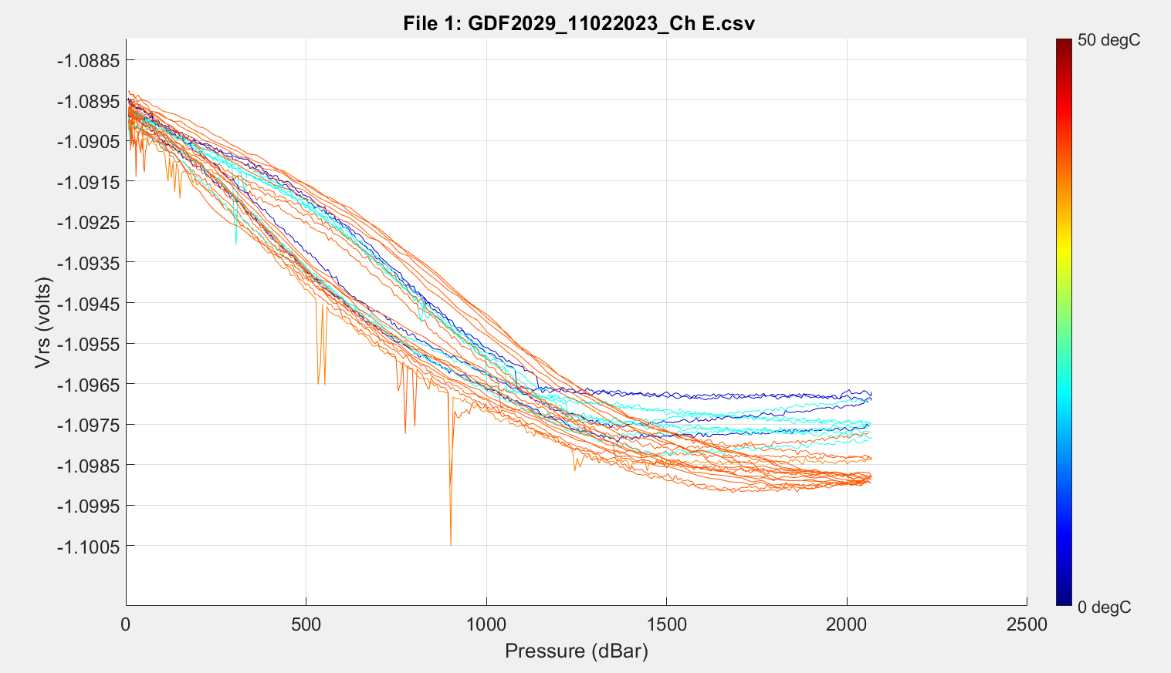
Current Calibration Run

Slide 3
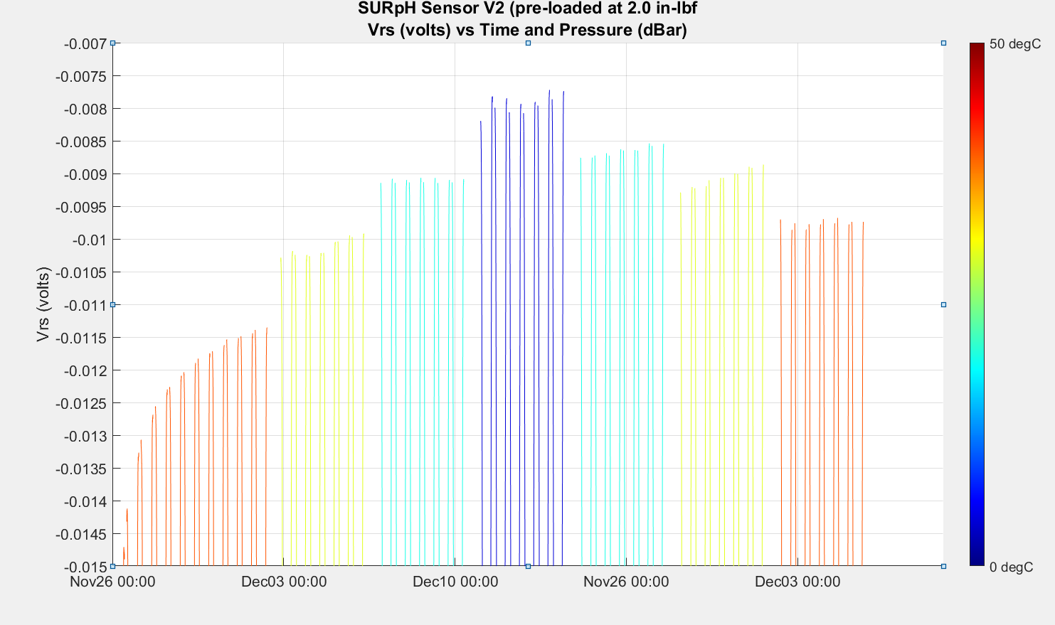
Non-ideal Behavior (0.001 volt ~= 0.017 pH)
Burn in/warmup/drift (sensor or solution)?
Random Noise?
Burn in or
warmup?

Slide 4


Definitions
Incr P residual
Cycle = 0-2000-0 dBar with an increasing pressure ramp and a decreasing pressure ramp
Residuals Increasing = Vrs_{measured} – Vrs_{fit} for increasing ramp
Residuals Decreasing = Vrs_{measured} – Vrs_{fit} for decreasing ramp
Residuals Both = Vrs_{measured} – Vrs_{fit} for the entire cycle (both increasing and decreasing ramps)
Vrs
Data set grouping:
Individual ramps
Individual cycles
All incr ramps, post warmup incr ramps
All decr ramps, post warmup decr ramps corrected for drift
All cycles, post warmup cycles
Calculations
Fits do not include pressure hold data
Residuals for 1-5 above (vector)
Mean of residuals for 1-5 above (scalar)
Maximum residuals for 1-5 above (scalar)
Decr P residual
Pressure

Slide 5
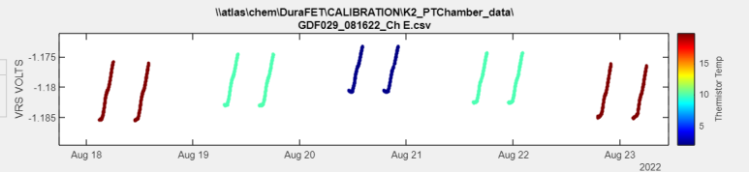
4. Mean Decreasing Pressure Residual per Cycle
(This is what we use for the deployed fit)
Data set grouping:
Individual ramps
Individual cycles
All incr ramps, post warmup incr ramps
All decr ramps, post warmup decr ramps
All cycles, post warmup cycles
Calculations
Residuals for 1-5 above (vector)
Mean of residuals for 1-5 above (scalar)
Maximum residuals for 1-5 above (scalar)
Decr P residual

Slide 6
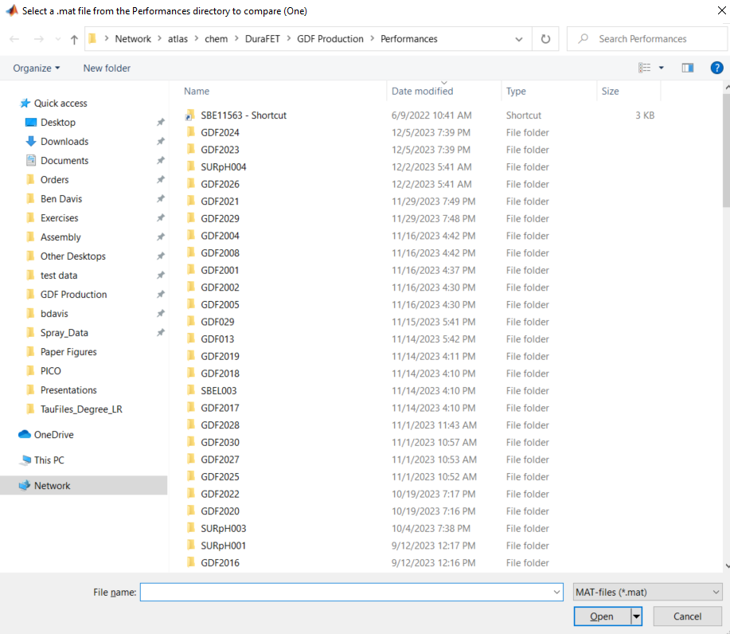
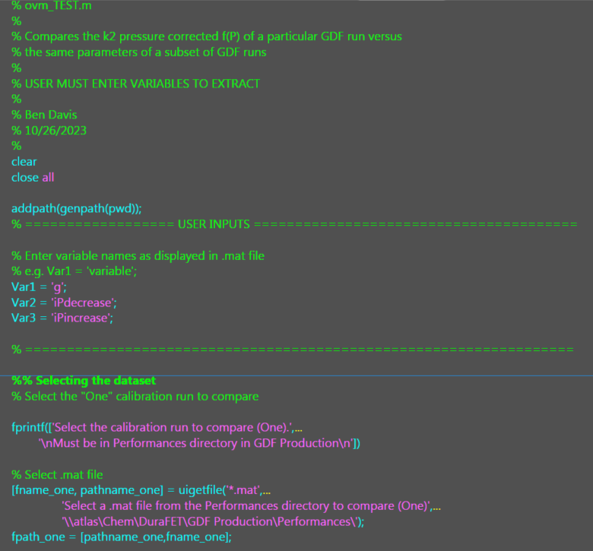
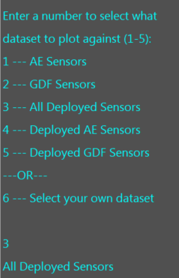
One vs. Many Script

Slide 7
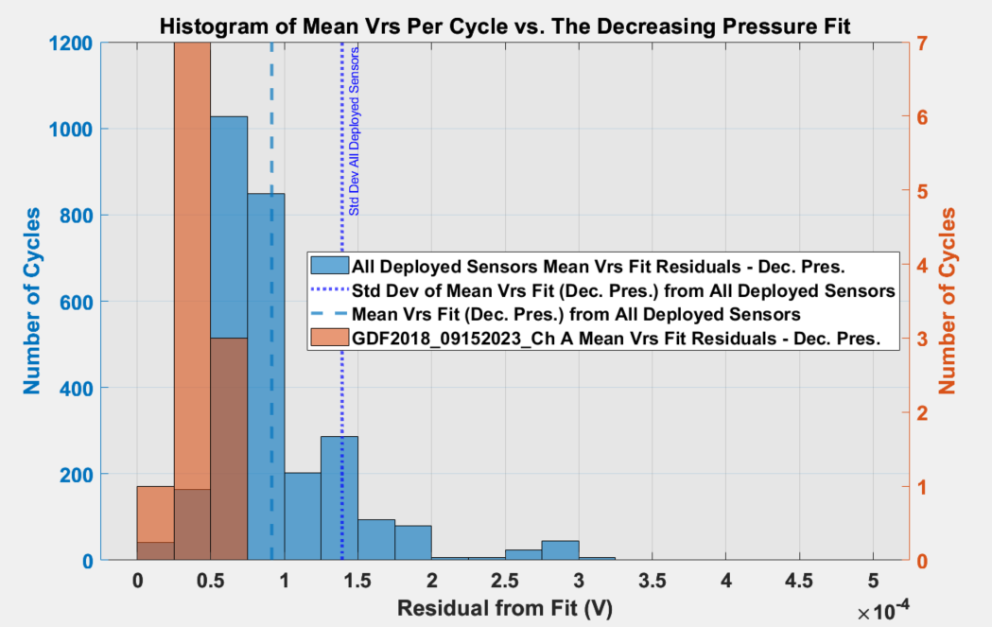

Slide 8
One f(P) curve from a Deployed GDF (or AE) sensor
All f(P) curves from All Deployed GDF (or AE) sensors

Slide 9
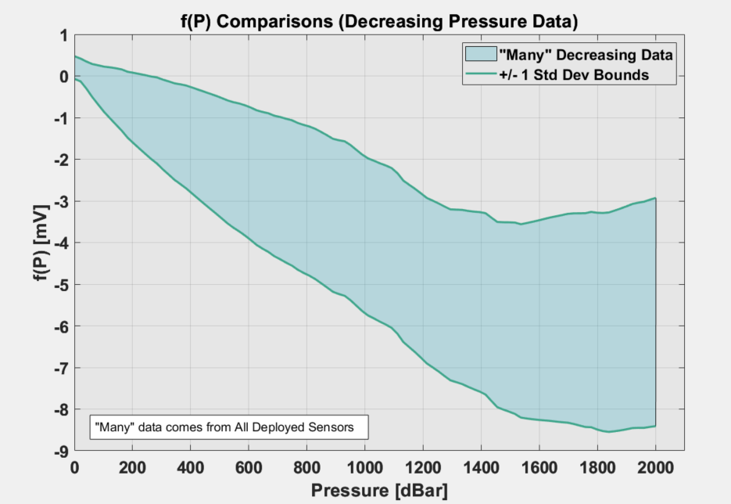

Slide 10
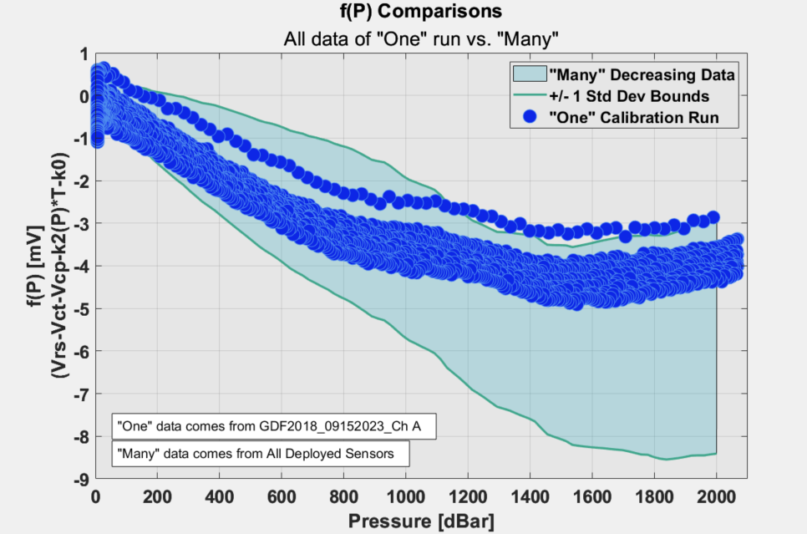

Slide 11
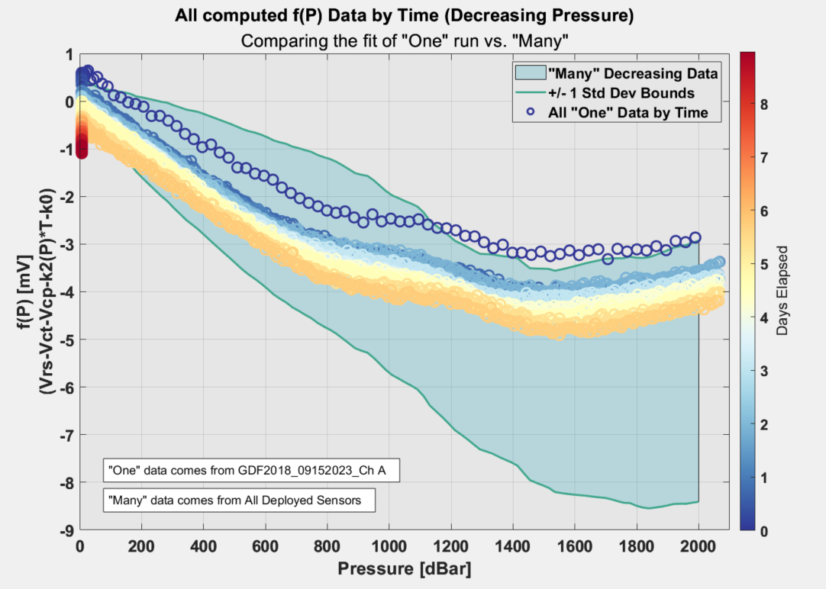

Slide 12
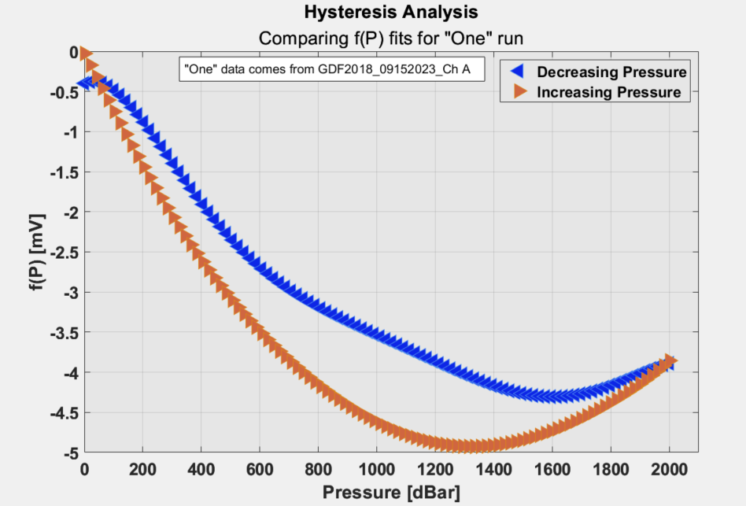

Slide 13
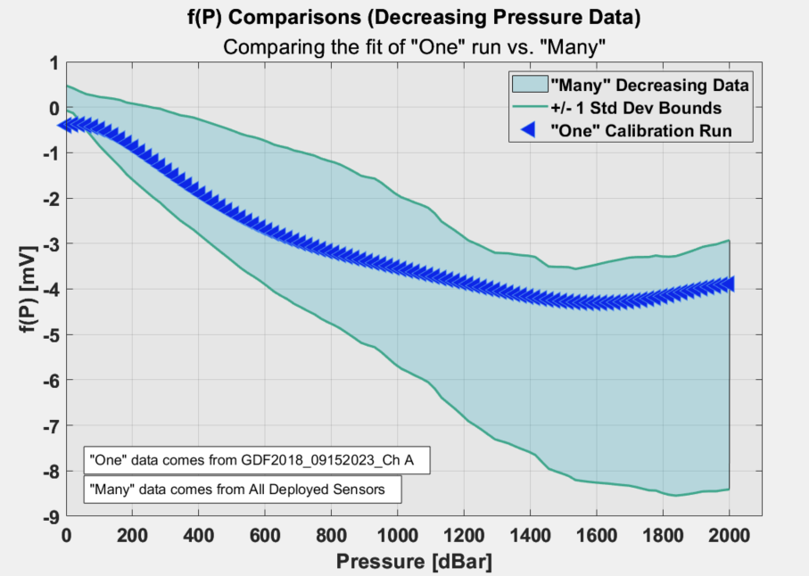

Slide 14
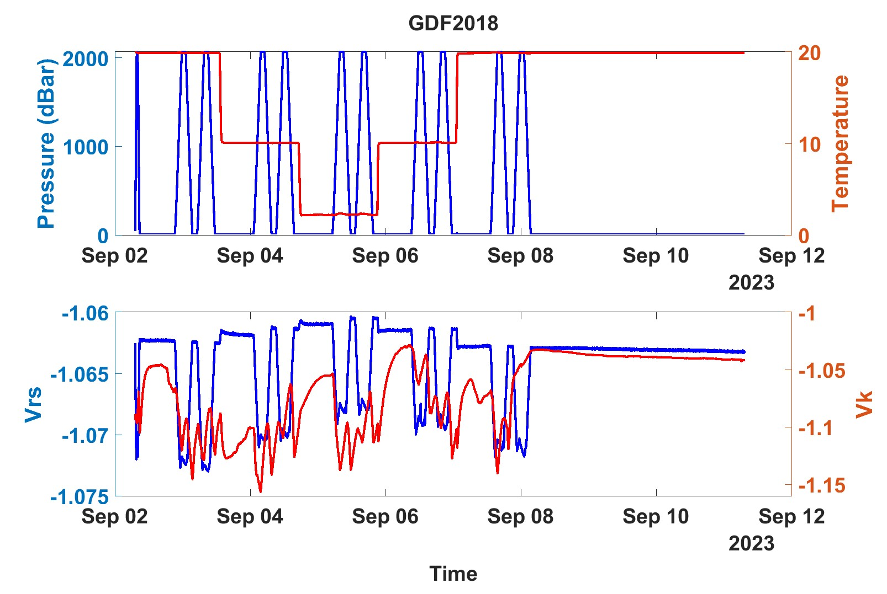
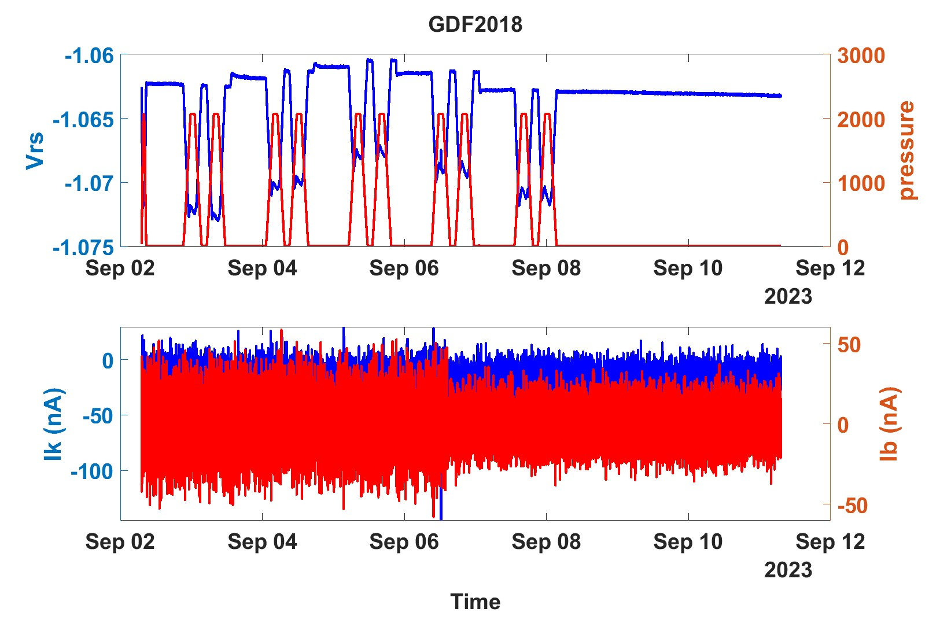
Bad Sensor

Slide 15
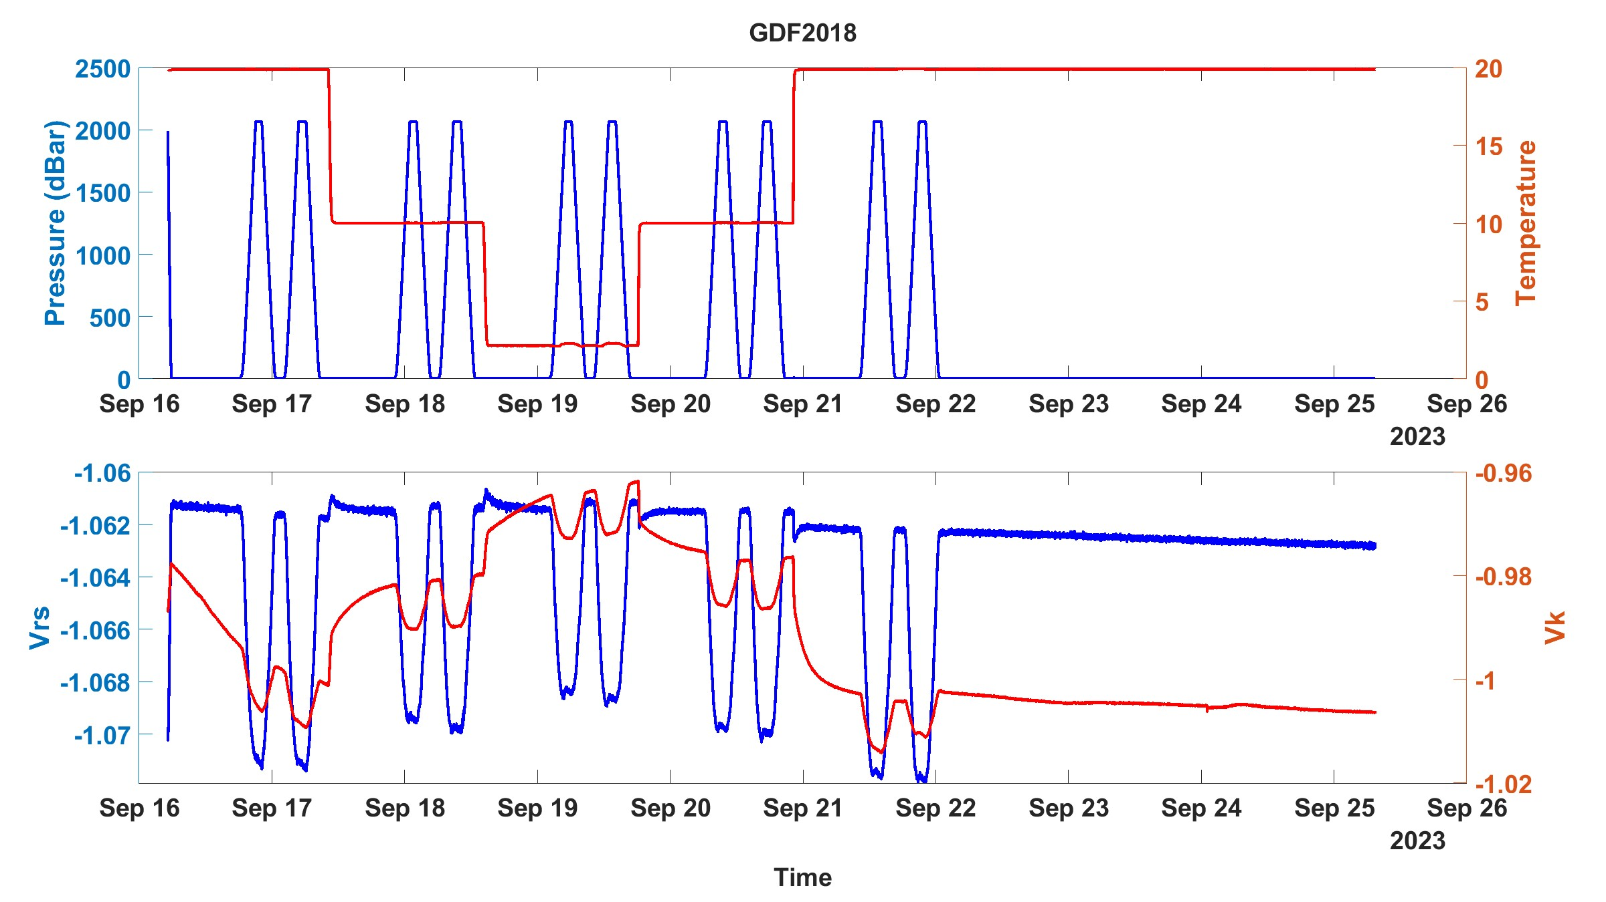
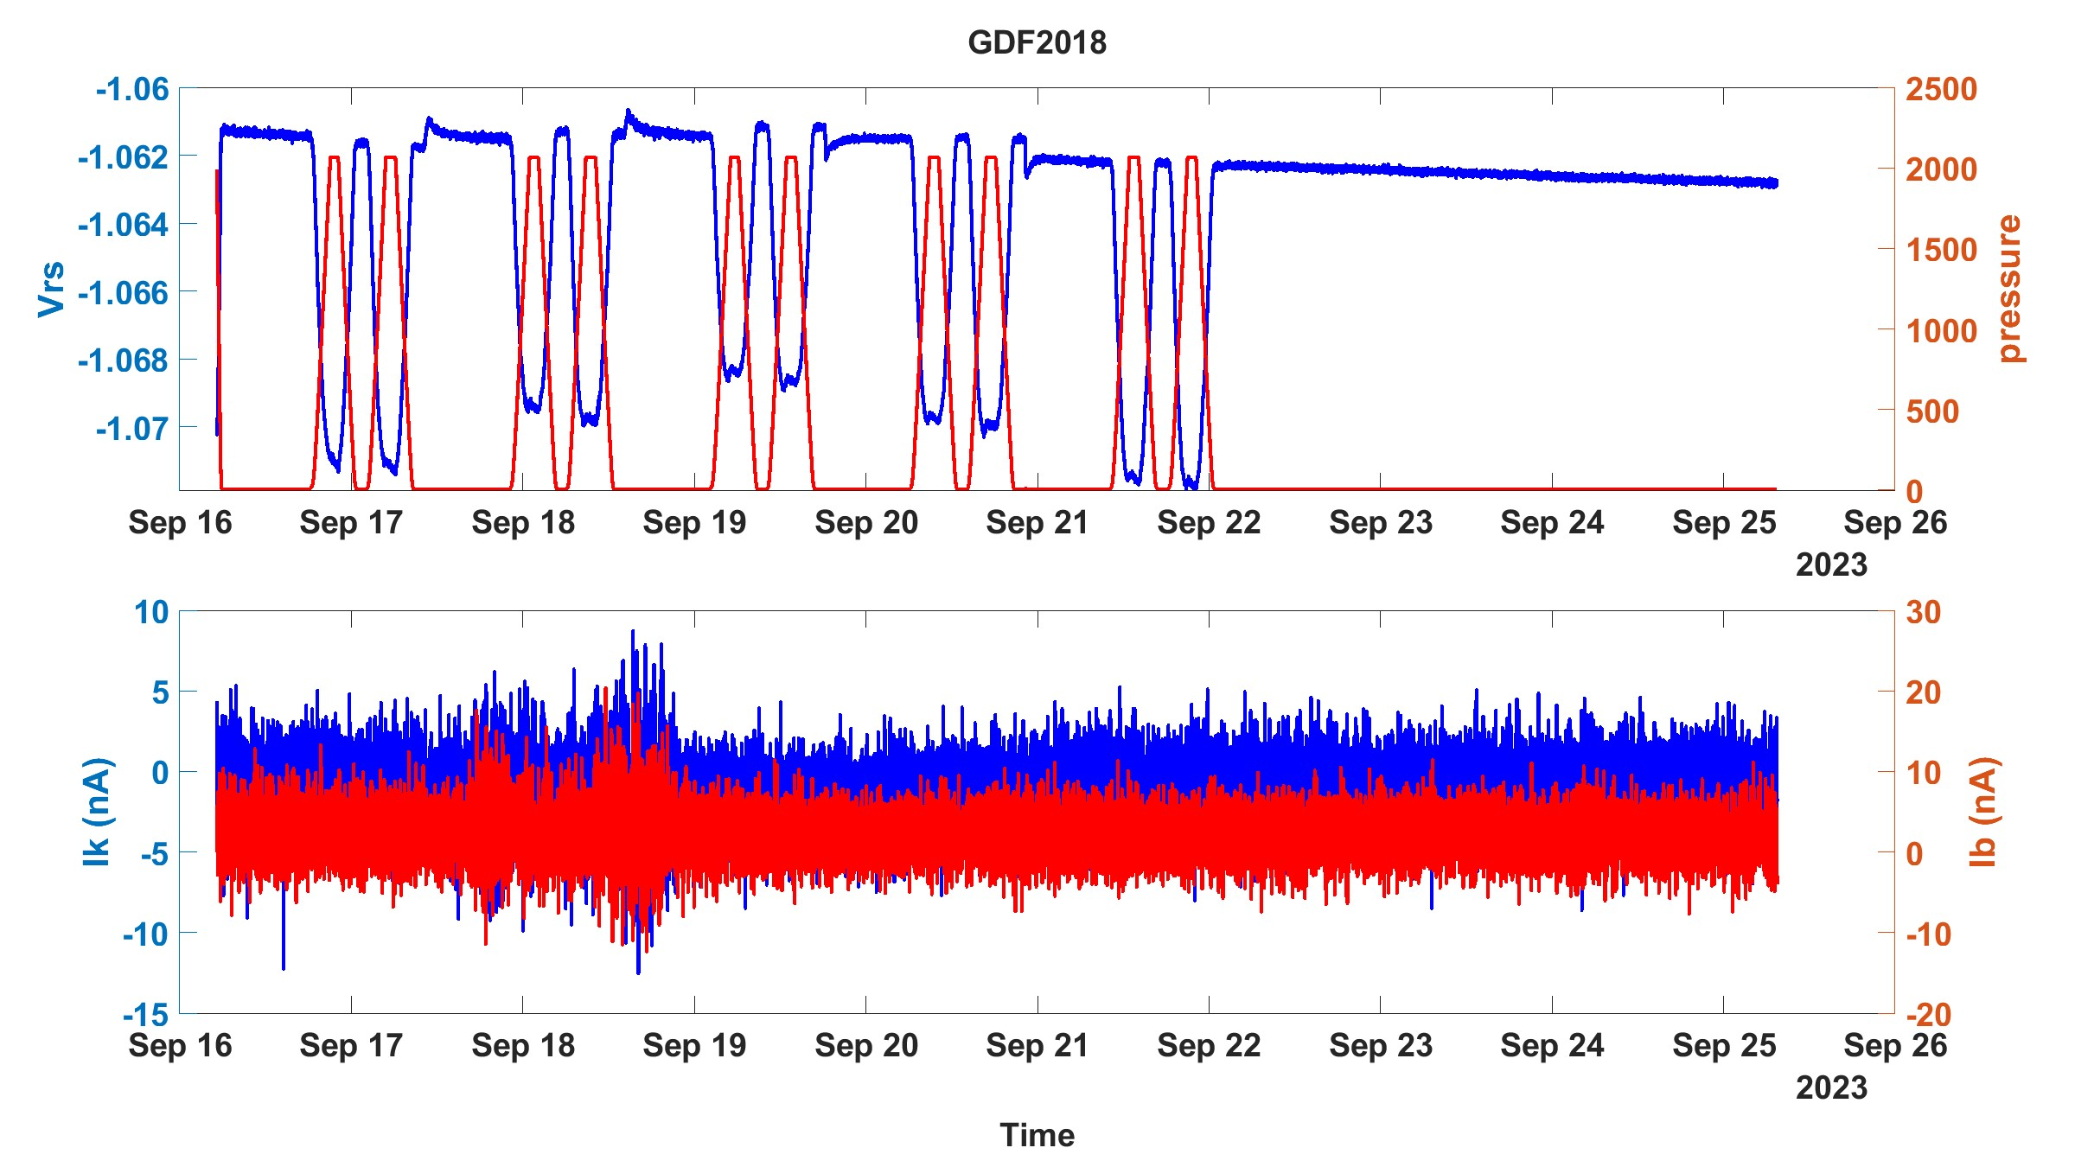
Bad Sensor
Bad
Good
(reworked)

Slide 16
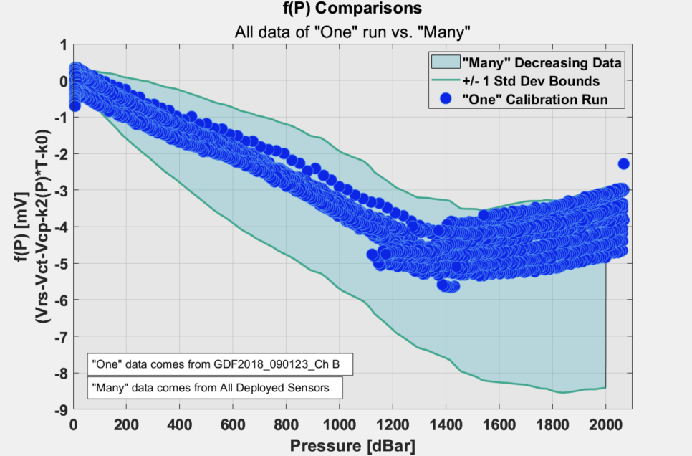

Slide 17
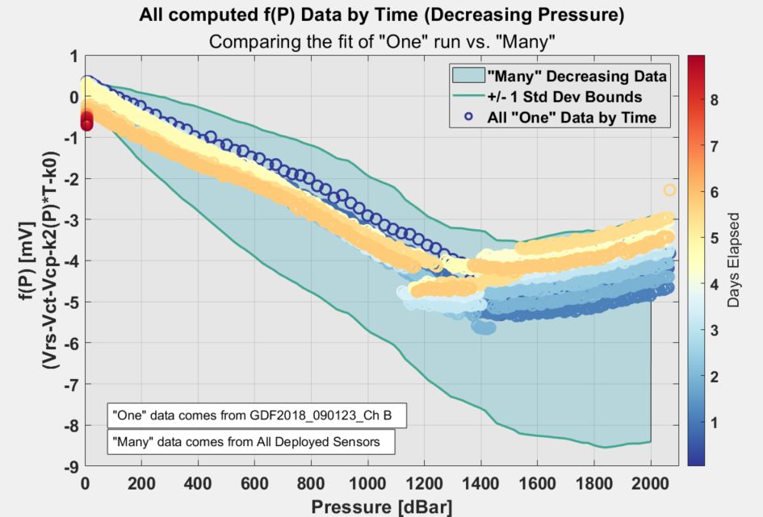

Slide 18
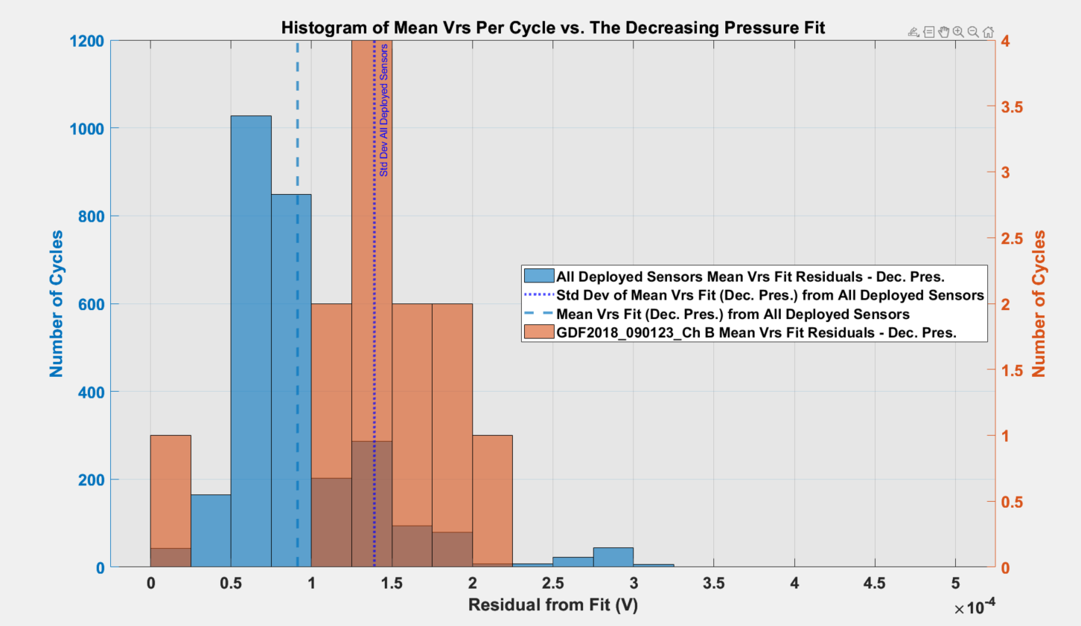

Slide 20
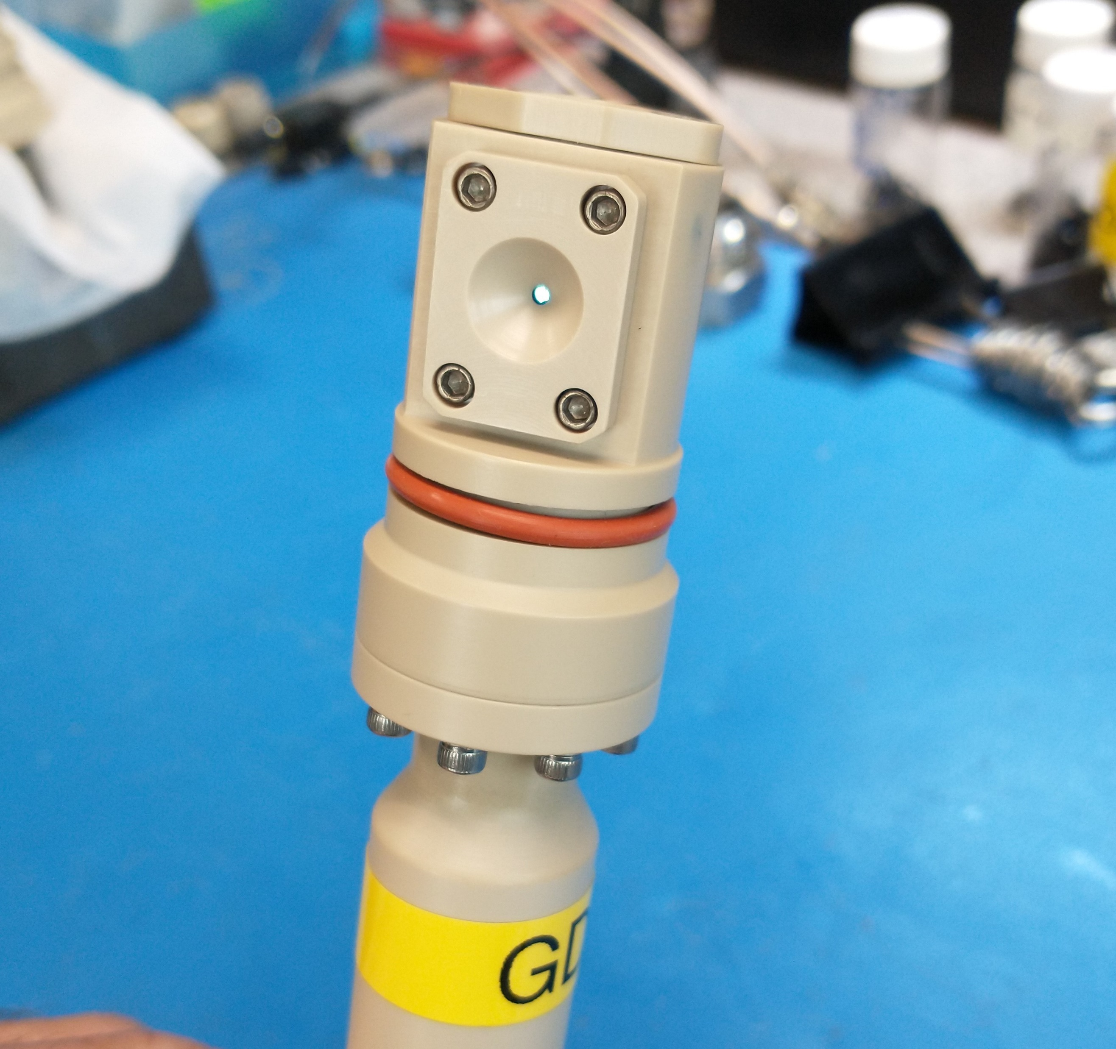
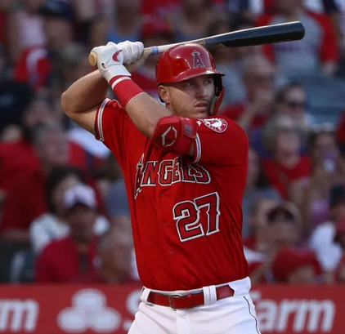
What do Mike Trout and the GDF pH sensor have in common??

Slide 21
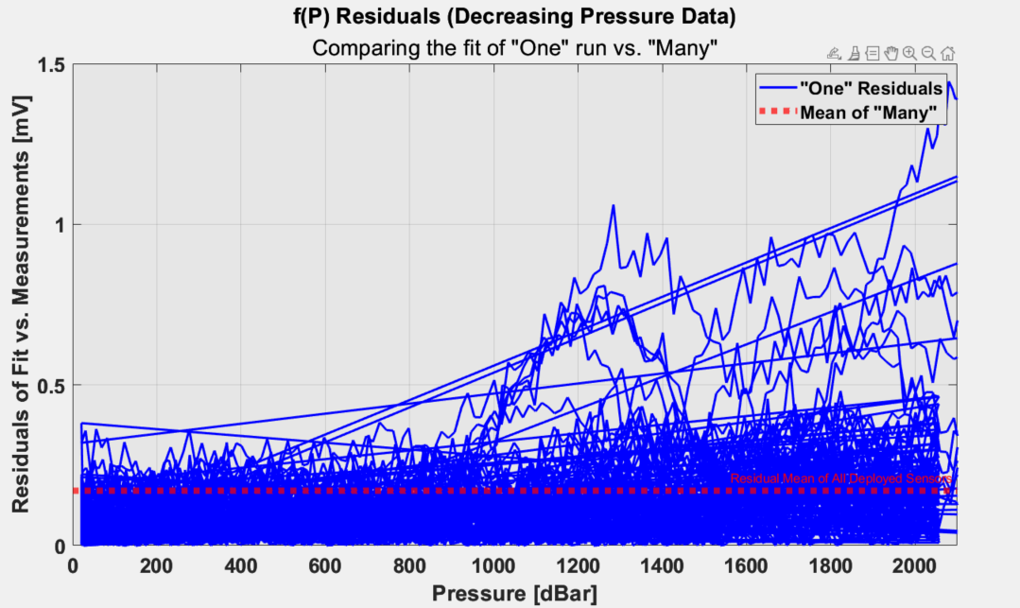
OPS+

Slide 22
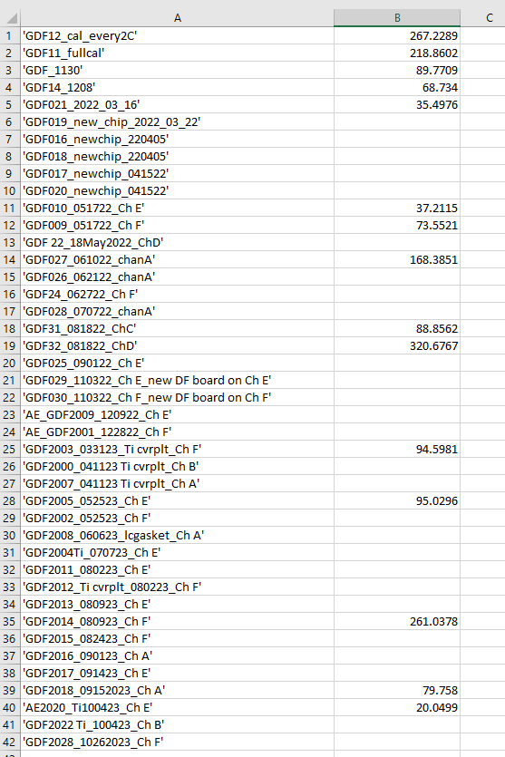
When complete, develop a ‘red-line’ number?
Notice GDF32 has highest OPS+ (Davis-Trout) number, failed in situ

Slide 23
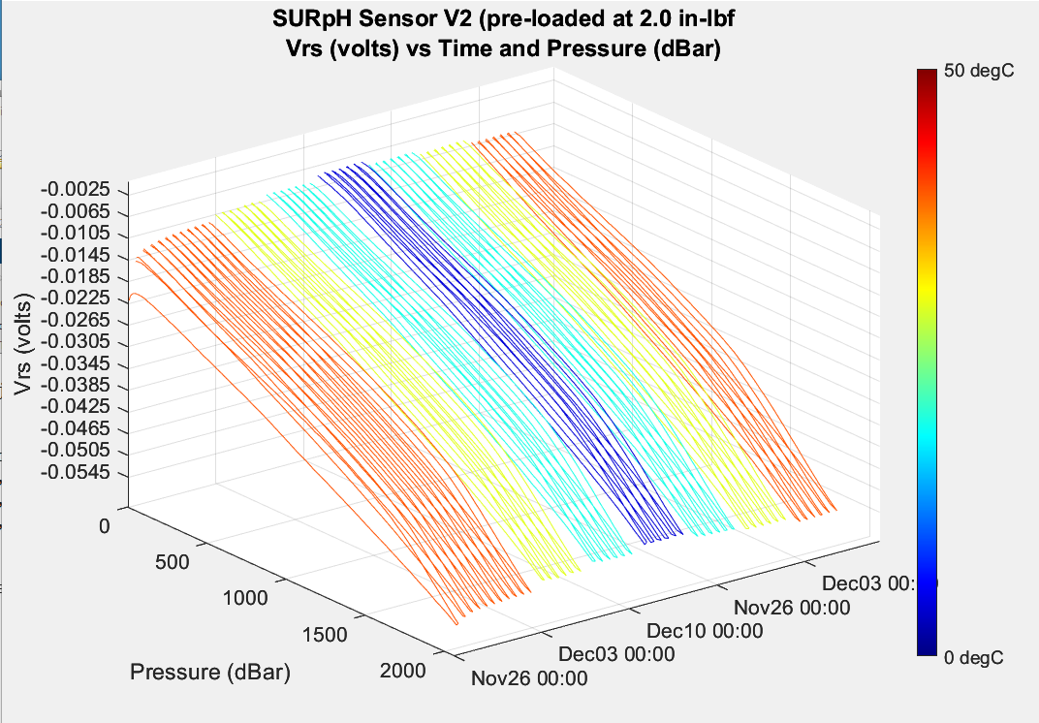
First SURpH Ver2 Sensor with correct pre-load pTC run
NOT corrected for P or T
First cycle “sets” the piston?

Slide 24
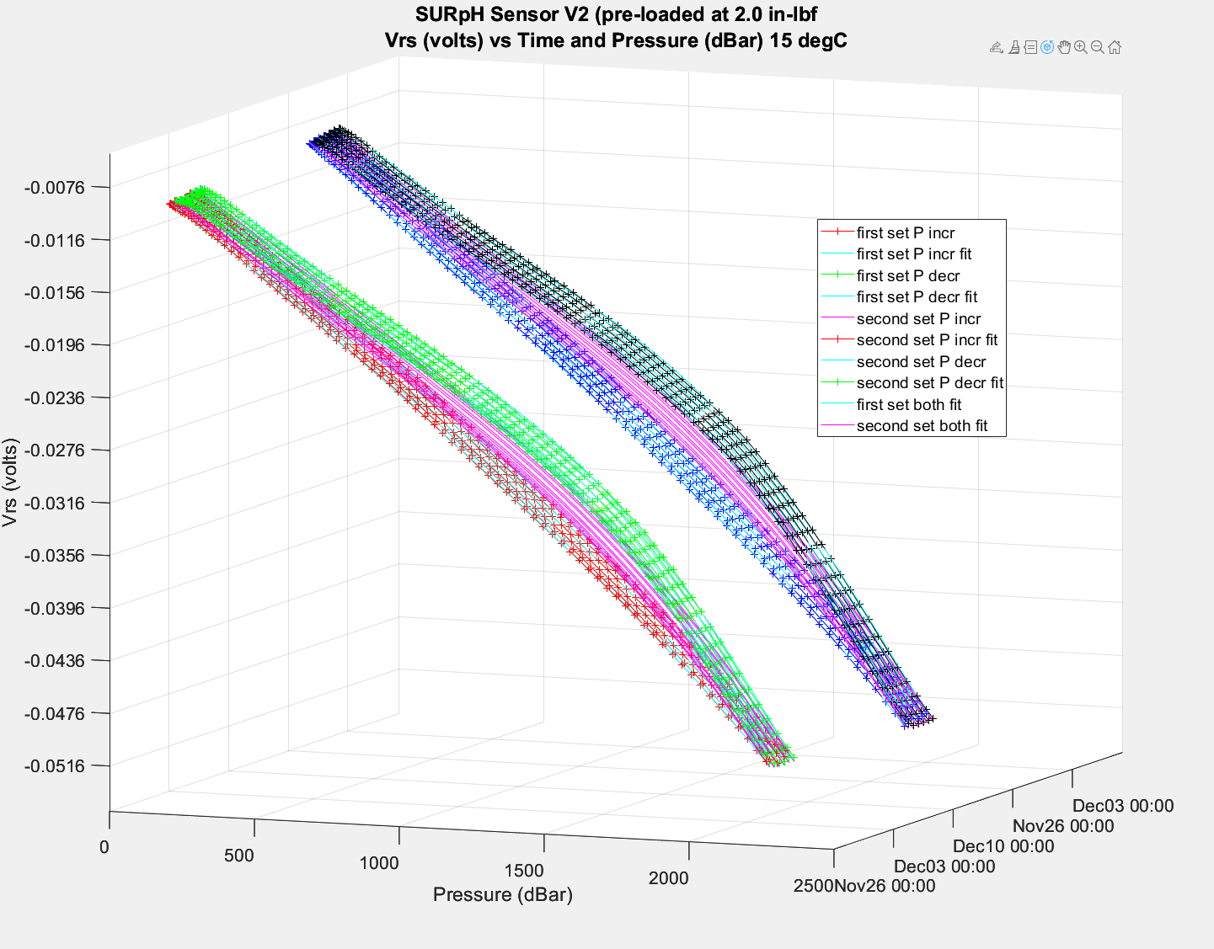
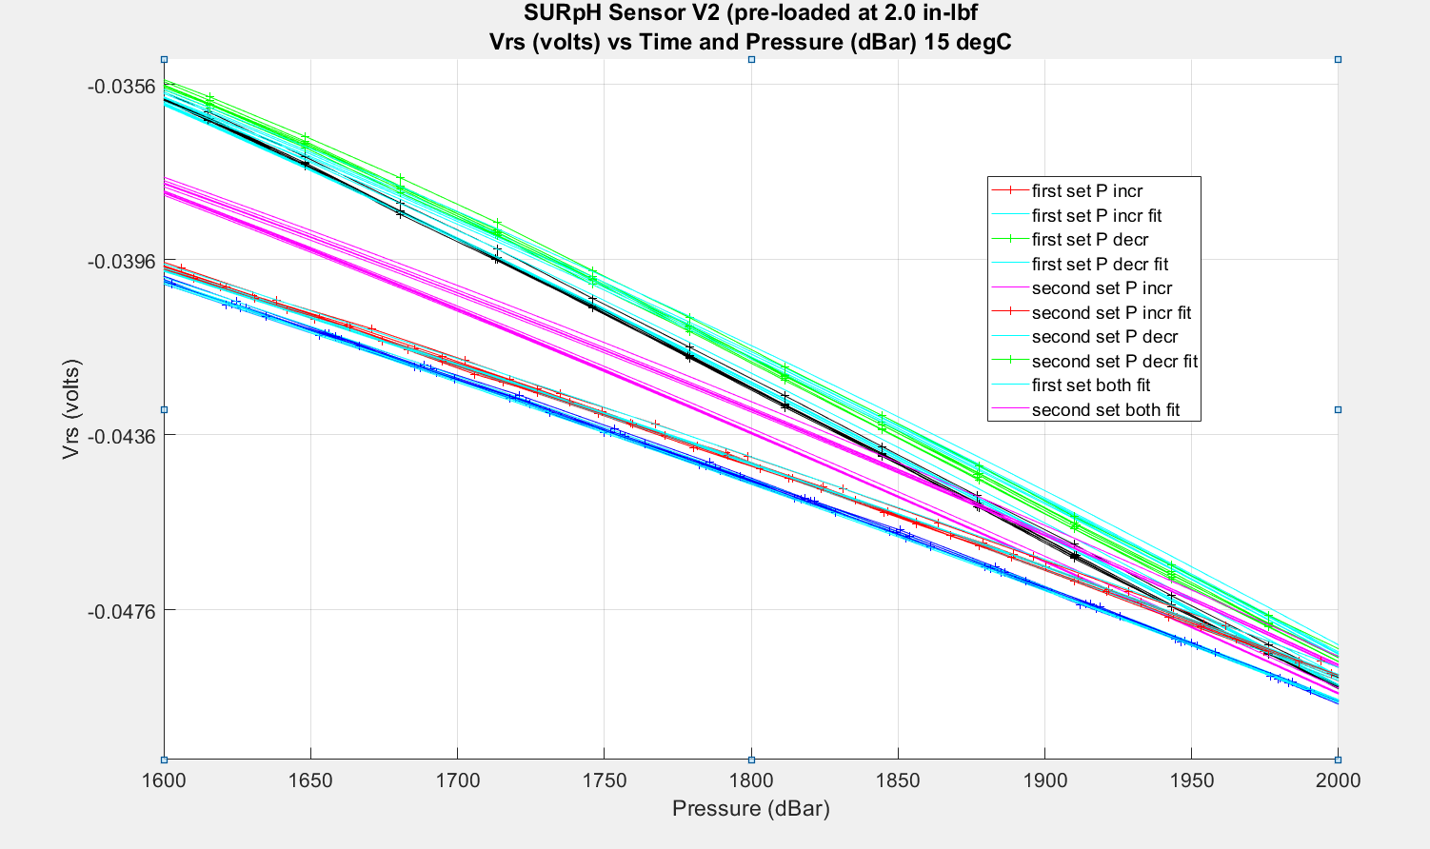
First and Second 15 degC cycles
red = first set, increasing pressure
green = first set, decreasing pressure
blue = second set, increasing pressure
black = second set, decreasing pressure

Slide 25
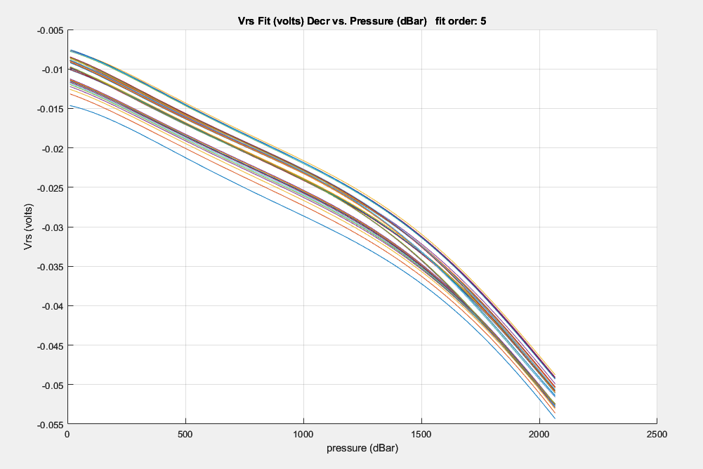
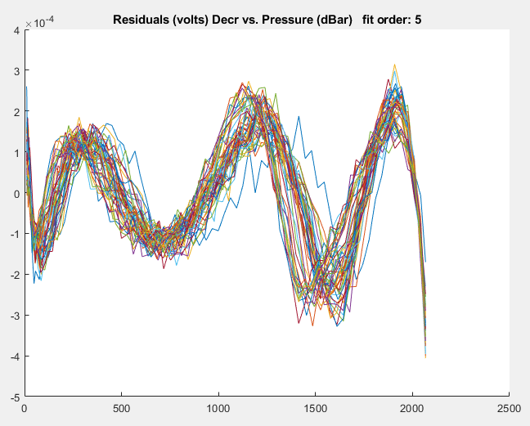
How can we evaluate “goodness of fit” Graphical:
Biggest errors located at the extremes
Generally speaking, graphical measures are more beneficial than numerical measures because they allow you to view the entire data set at once, and they can easily display a wide range of relationships between the model and the data. Ref: Mathworks

Slide 26
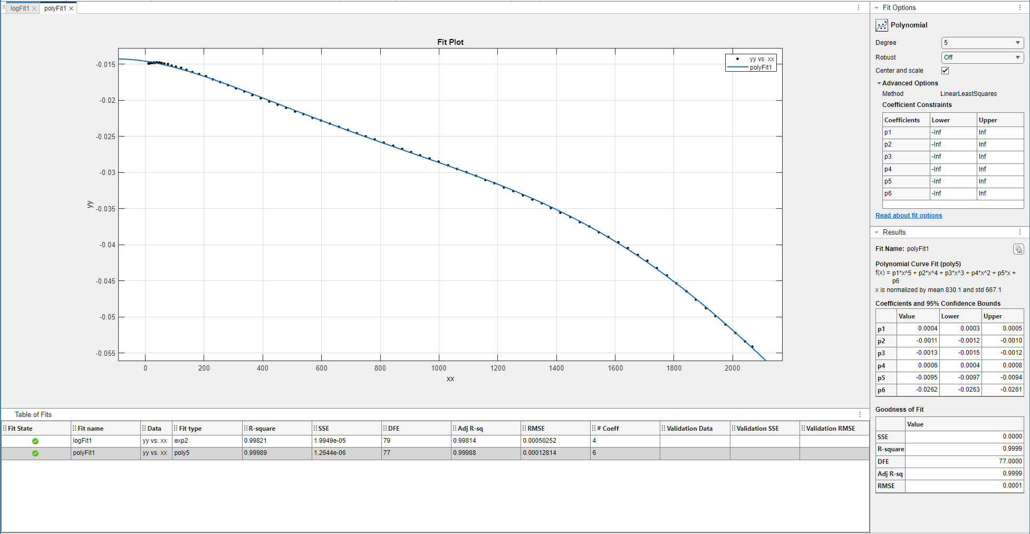
Numerical:
The numerical measures are more narrowly focused on a particular aspect of the data and often try to compress that information into a single number. Ref: Mathworks

Slide 27
Preliminary recommendations for each new sensor
Plot this sensor final decreasing f(P) vs all delivered sensors final decreasing f(P) (1X std dev)
Plot this sensor residuals from final decreasing f(P) fit vs all delivered sensors final decreasing f(P) fit residuals (1X std dev)
Keep track of the histogram of “Davis-Trout” values in the hopes of coming up with a pass/no-pass value or at least a definitely pass value, a definitely no-pass value and a band of questionable values

Slide 28
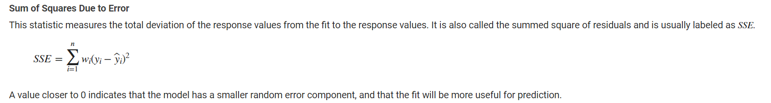
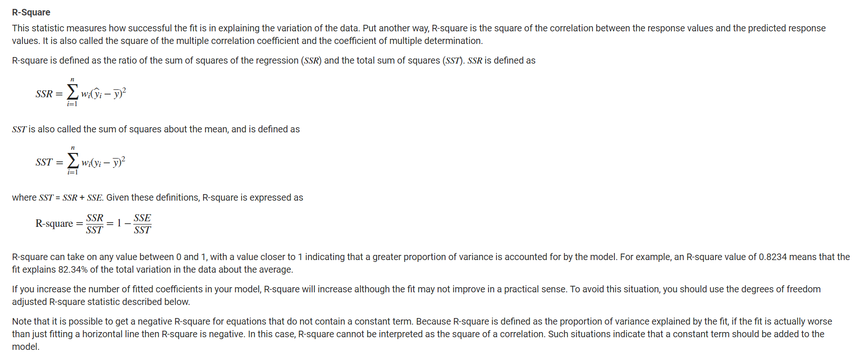
https://www.mathworks.com/help/curvefit/evaluating-goodness-of-fit.html

Slide 29
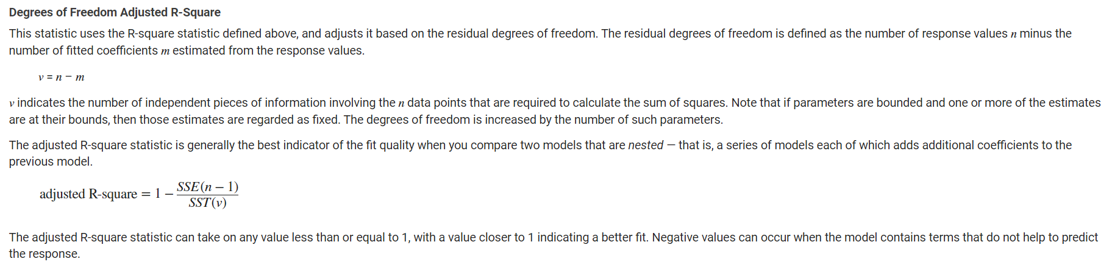
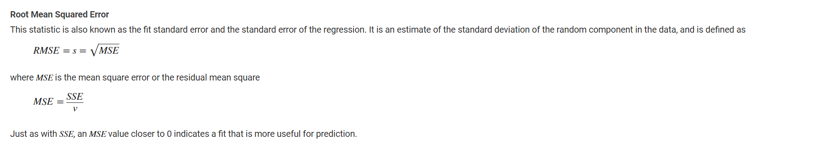
https://www.mathworks.com/help/curvefit/evaluating-goodness-of-fit.html

