Slide 1
Semiconductor Physics and MBARI’s pH Sensor Program
2025 October 10

Slide 2
Agenda (very flexible)
Introduction to MBARI pH sensor
Discussion of how to improve the design with a better understanding of semiconductor device physics, design and fabrication
Brief discussion of what the state of the art is and might be in the near future
Brief discussion of BioFETs

Slide 3
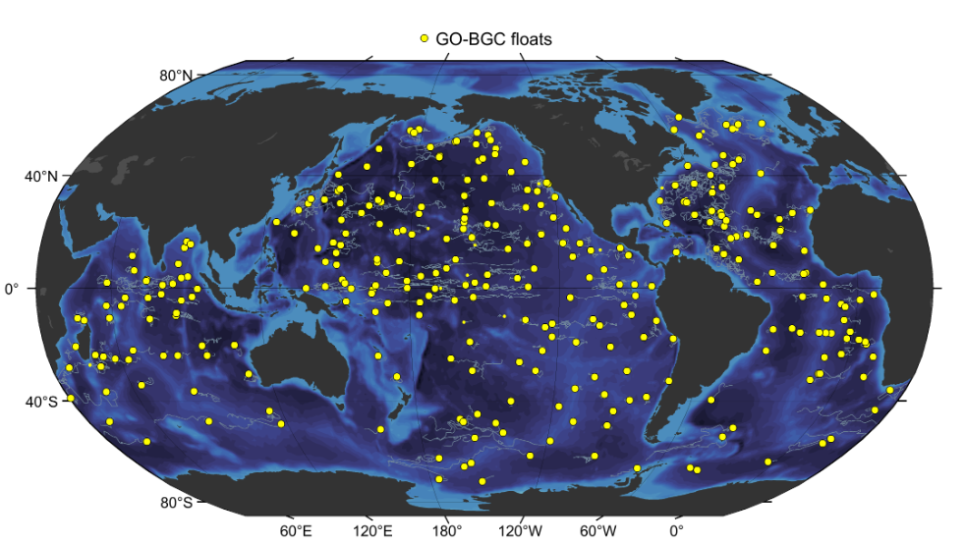
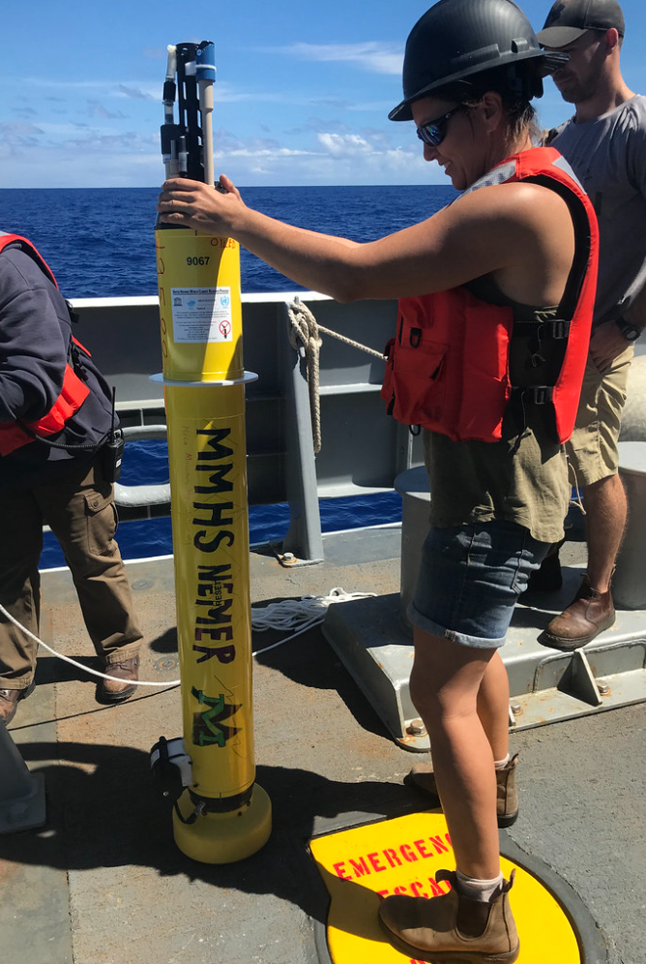
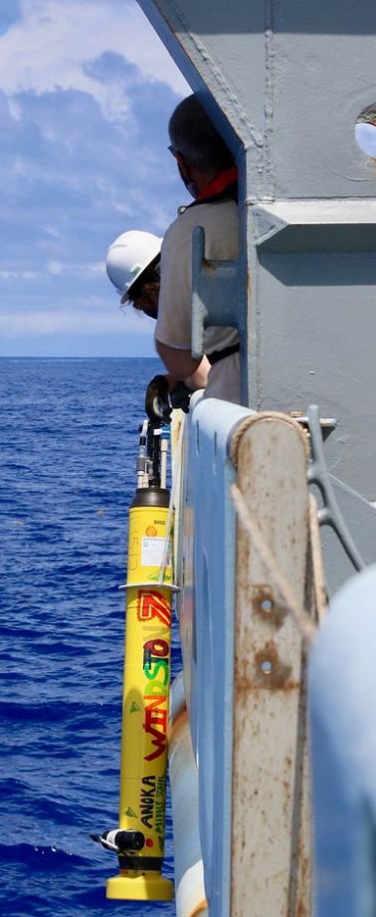
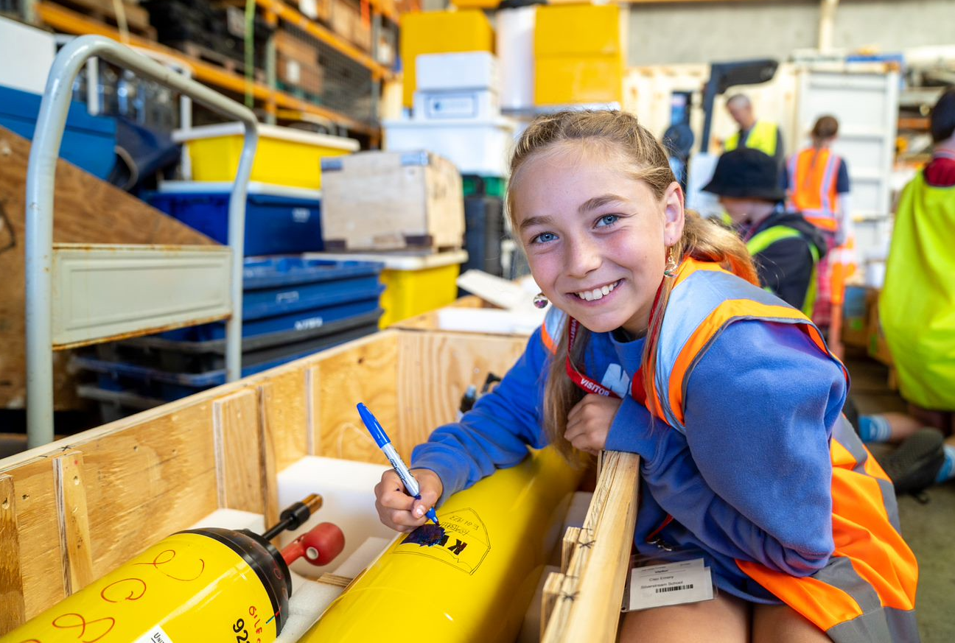
Background and Goals
MBARI’s Chem Sensor lab has been developing autonomous ISFET based pH sensors for deep water (2000 meter) oceanographic applications since 2008.
  We commercialized the technology with Seabird Scientific in 2010
  We have deployed 100’s of pH sensors on profiling floats across the world’s oceans and expect/hope to continue
  With extensive on-going QC, our current accuracy is ~0.01 pH units over several years
We continue to improve our sensor but would benefit from more expertise in semiconductor physics, design and fabrication
GOAL #1: Discuss how we might develop a better understanding of how our sensor responds to pressure, temperature, structural design, manufacturing variations, etc.
GOAL #2: Get a big picture view of our ISFET design vs. what’s possible

Slide 4
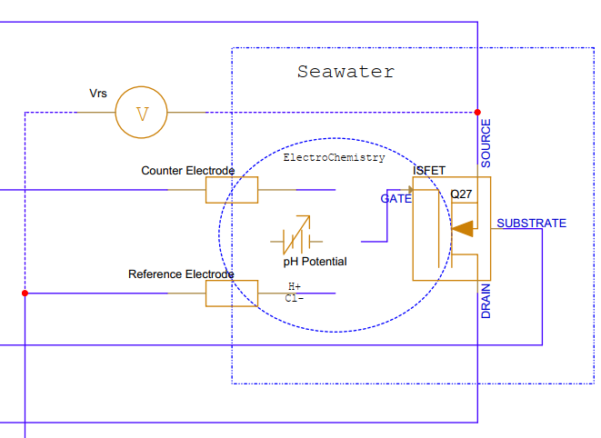
Some Details
188 uA
Gen 1 and 2 use ISFETs from Honeywell
  3.2mm x 4.2mm
  Backside (non-sensing side) contacts using proprietary technique
Gen 3 uses ISFET from Lionix International (Netherlands)
  5mm x 9mm
  Front side (sensing side) contacts
We run a constant current through the ISFET by adjusting current to a counter electrode and measure voltage from the reference electrode to the ISFET source
Feedback Current
We calibrate every sensor for pressure (f(P)), temperature (k0) and a “bulk” offset (k2)
  We see a lot of variability in the data and would like to understand why
Generation 2 is more reliable and easier to manufacture than Gen 1
  But has increased change in Vrs with pressure and increased “hysteresis” between increasing pressure and decreasing pressure regimes
Pressure balanced Gen 2 and Gen 3 designs have the smallest change in Vrs with pressure and the least hysteresis

Slide 5
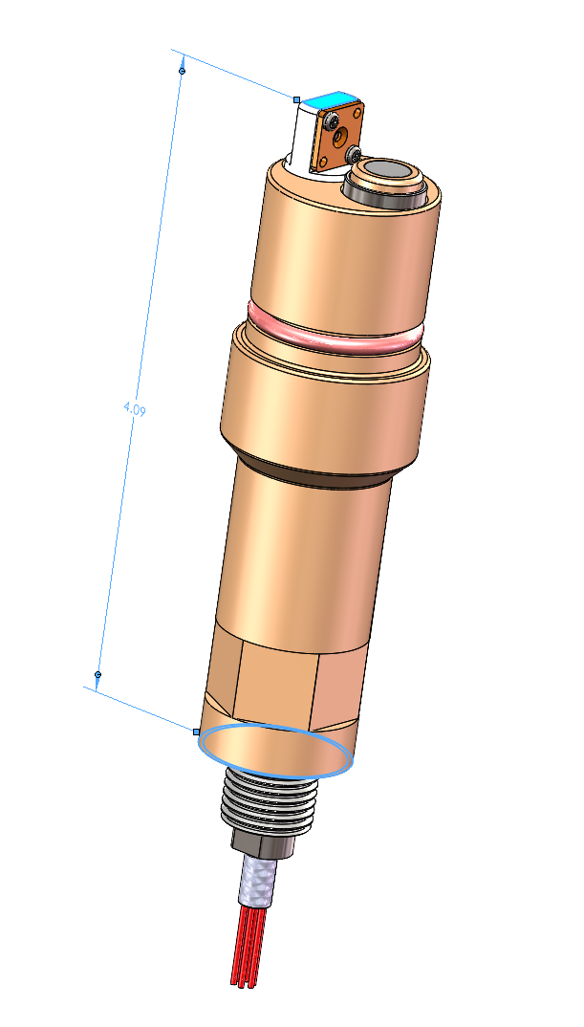
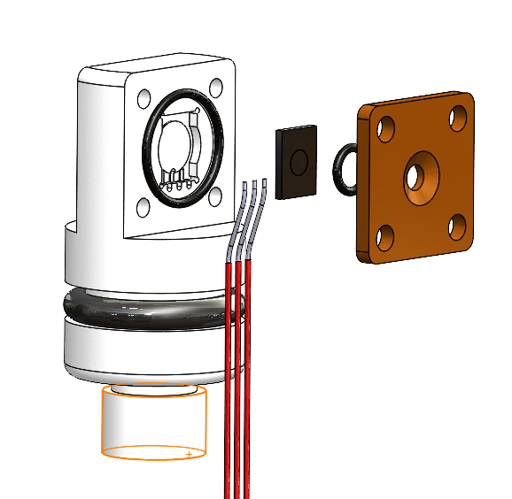
Mechanical Details
Generation 1
Counter Electrode
Reference Electrode
Pedestal
Outer O-Ring
ISFET
Sits on a pedestal
  ISFET is unsupported at corners
Uses a 0.020” (0.5mm) cross section O-Ring on face of the ISFET
Uses bent wires for electrical contacts on the backside of the ISFET
Cover Plate
Face O-Ring
Bent Wires

Slide 6
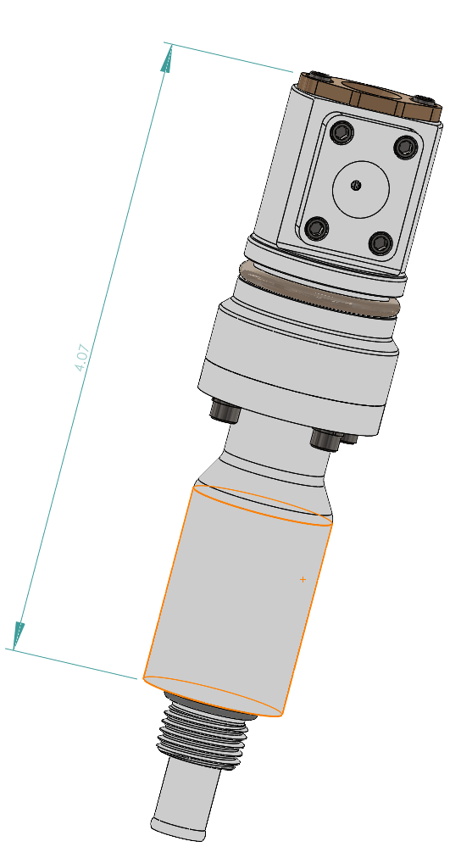
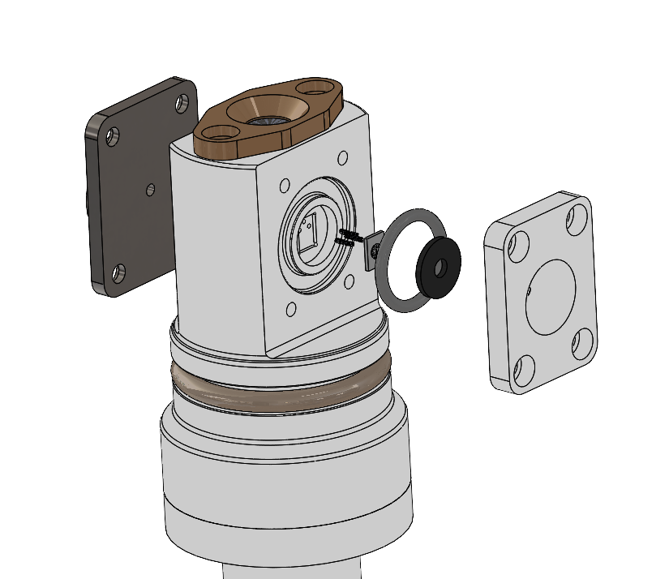
Generation 2
Back Cover Plate and Counter Electrode
Integrated ISFET and Electrodes in one housing
ISFET is fully backed up on back side
Face seal gasket completely covers everything but the sensing trace on the front side of the ISFET
Springy “Fuzz Buttons” for contacts
Reference Electrode
Fuzz Buttons
ISFET
Cover Plate
Face Gasket
Outer O-Ring

Slide 7
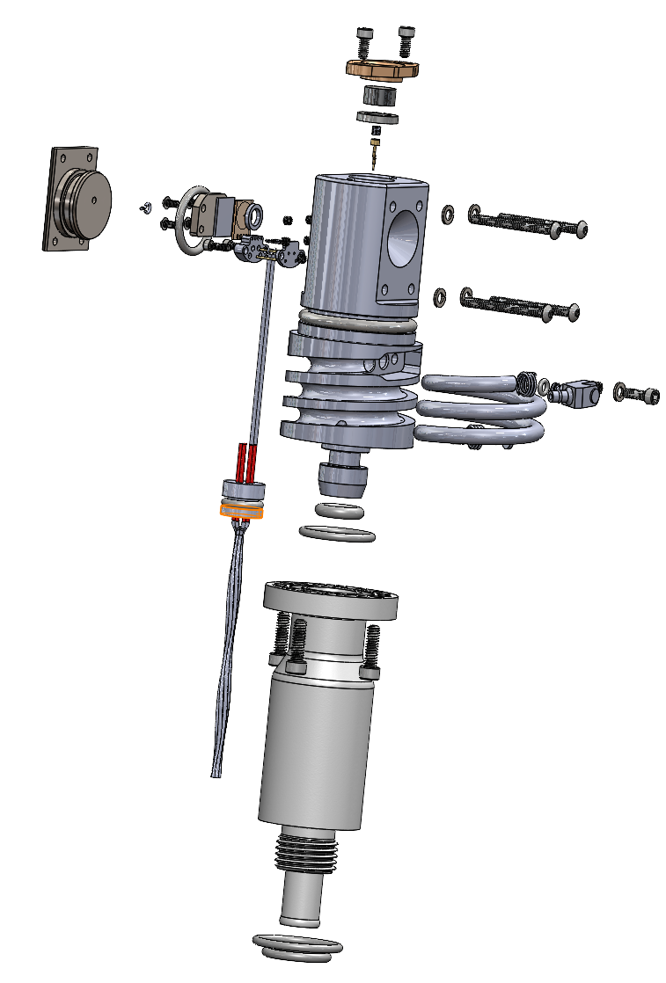
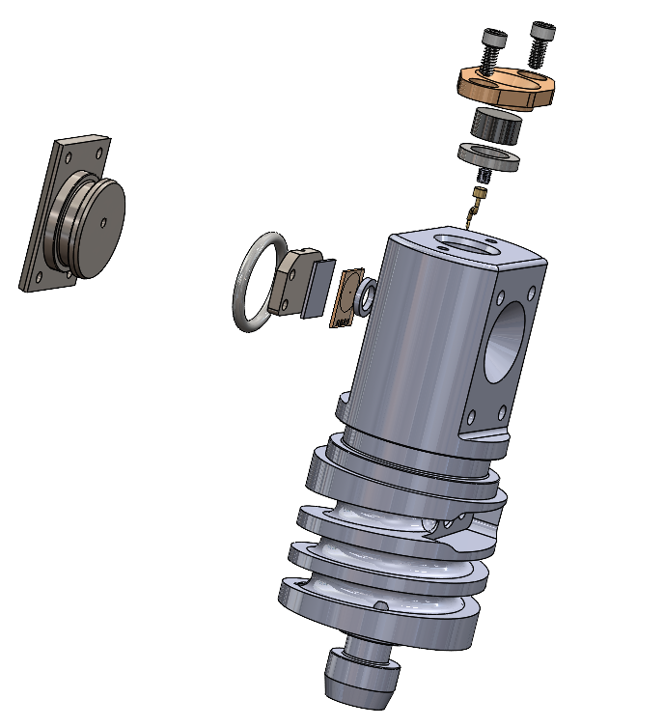
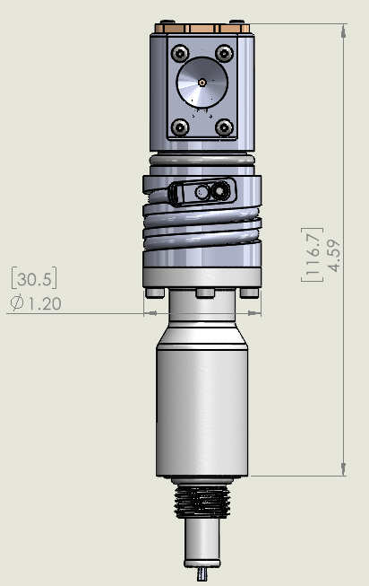
Generation 3
Similar to Gen 2 with larger Lionix ISFET
ISFET can be pressure balanced on all faces by filling the housing with oil exposed to seawater pressure through flexible tube
Reference Electrode
Back Cover Plate and Counter Electrode
Oil filled flexible tube
ISFET
Outer O-Ring
Metal Backing Plate
Insulator
Face O-Ring

Slide 8
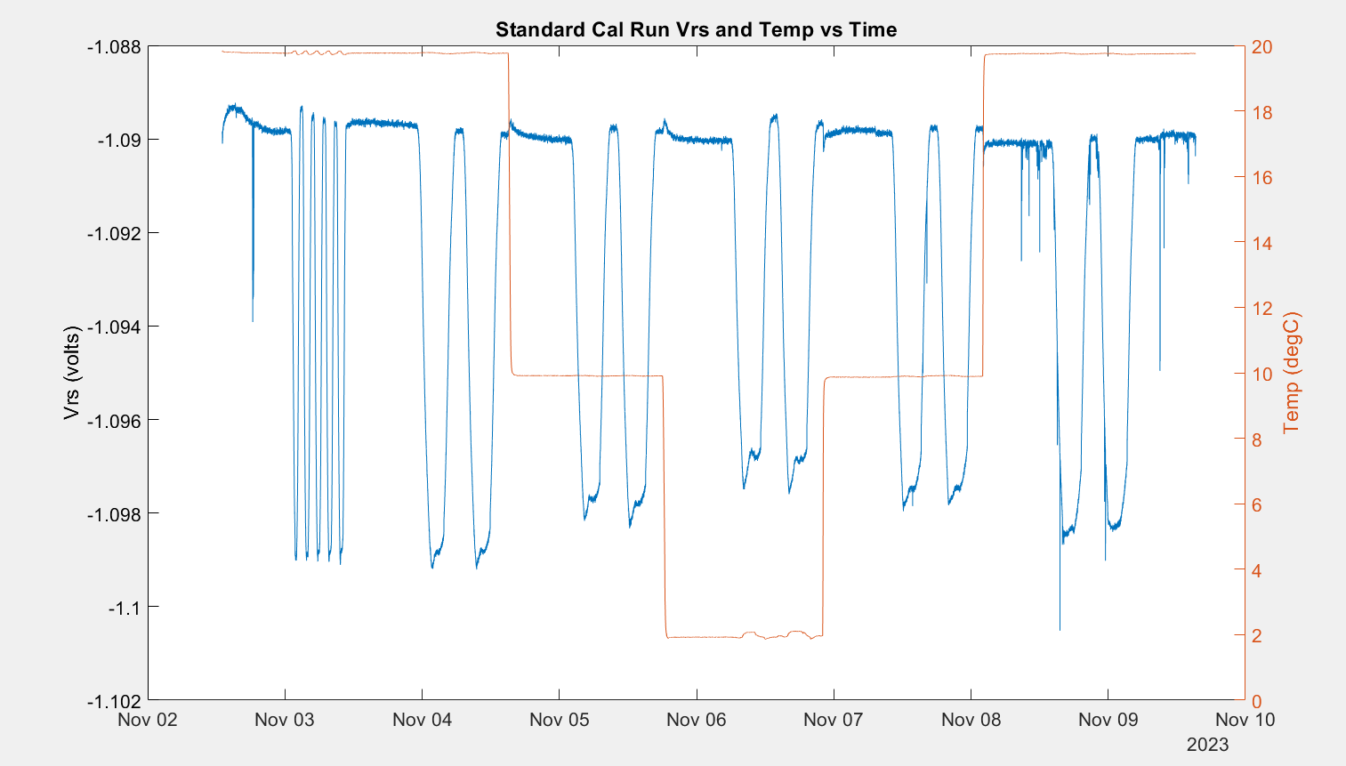
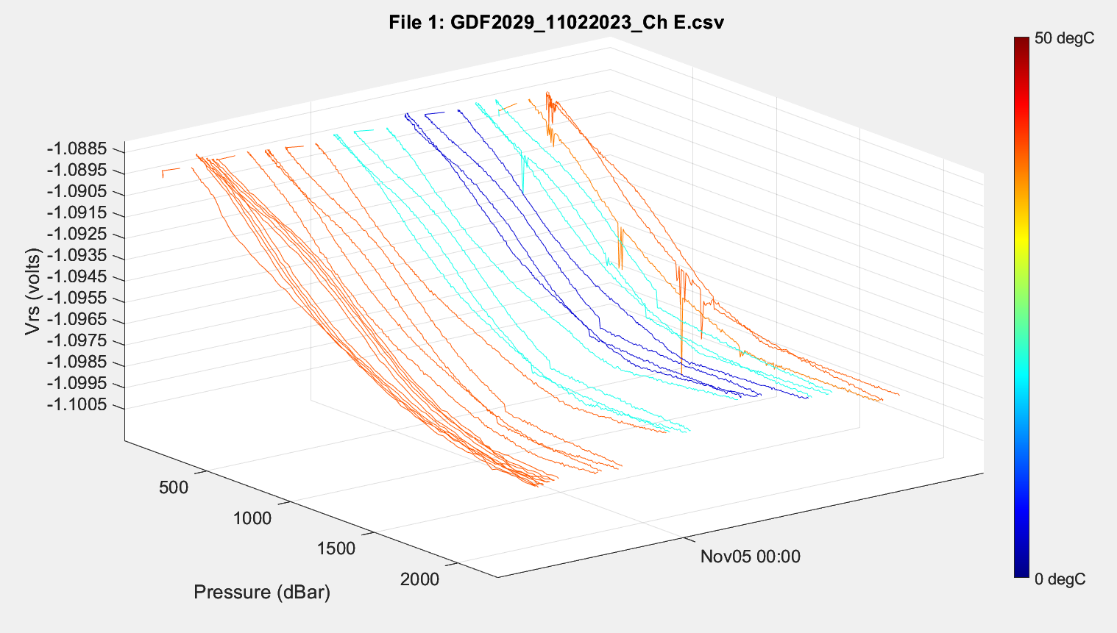
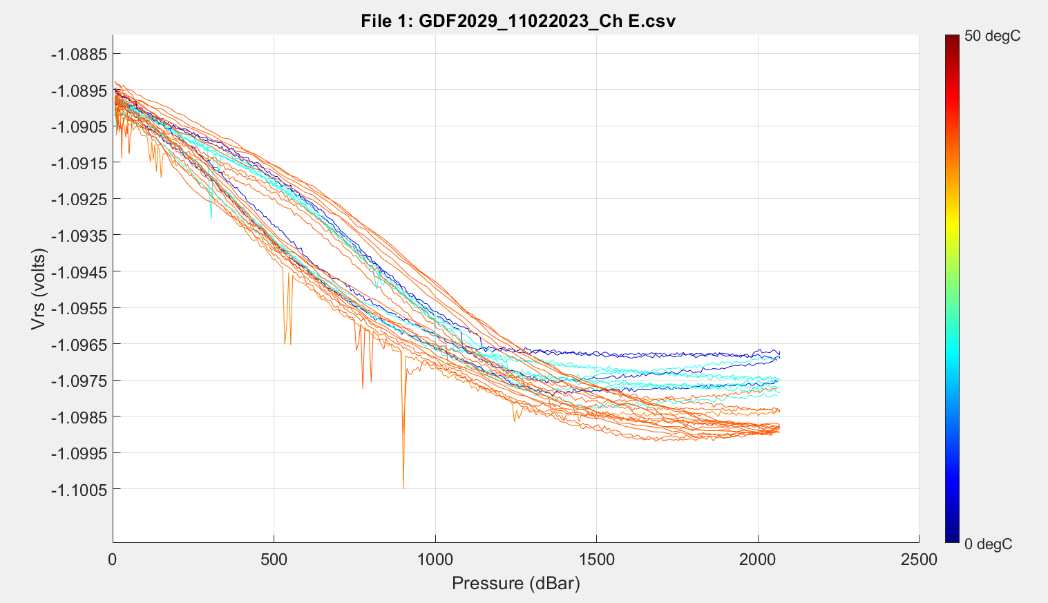
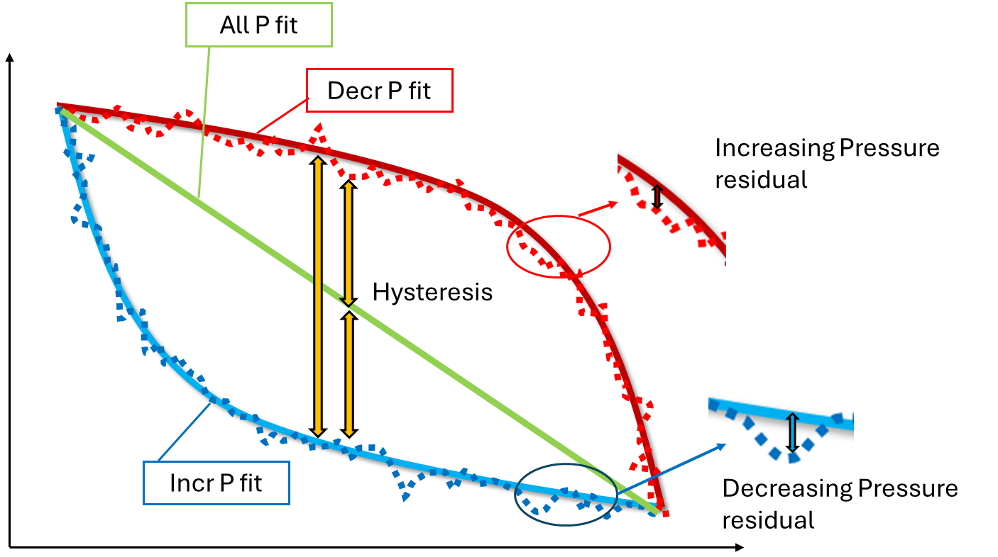
Typical Calibration Run

Slide 9
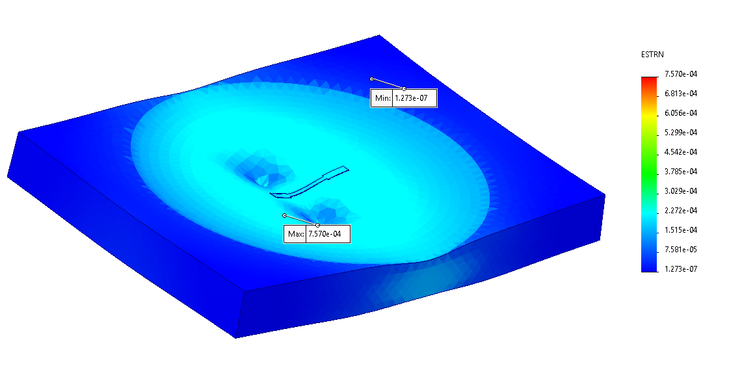
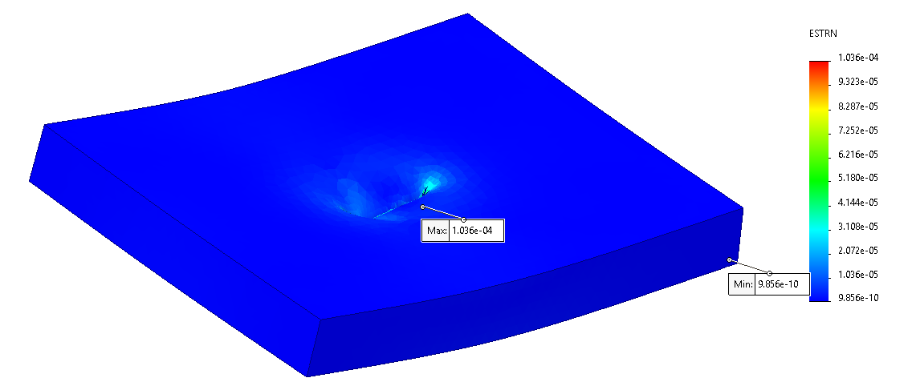
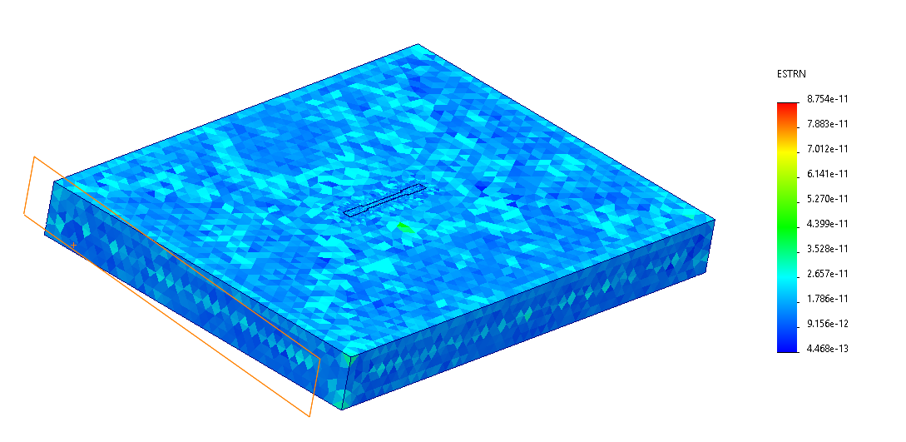
Questions for discussion
How do semiconductor designers model mechanical effects? Is strain the right parameter?
Can we model Vrs(pressure, temperature, ???) in order to predict and reduce the effect on measured pH?
What is the state of the art for semiconductor pH (and other) measurements? And how does it compare to what we’re doing?
Gen 1
Gen 2
Strain = 1/7 Gen 1
Gen 3 Pressure
Balanced Strain = 1/10^7 Gen 1

Slide 10


All P fit
Decr P fit
Increasing Pressure residual
Hysteresis
Incr P fit
Decreasing Pressure residual

