Slide 1
Quantifying GDF Performance
Goal: Build a data base of relevant GDF (Honeywell and Lionix) performance measurements so we can semi-quantitatively call a sensor good or bad relative to selected subsets of all the previous data i.e, this GDF vs all other deployed GDFs

Slide 2
Quantifying GDF performance
Performance Measurements:
  Vrs (volts measured between reference and ISFET source) vs Pressure “goodness of fit” i.e., how large are the residuals between the measured Vrs values and the polynomial fit
  Vrs vs Temperature “goodness of fit”
  Overall range of Vrs as a function of pressure
  Overall range of Vrs as a function of temperature
  Vrs drift vs time

Slide 3
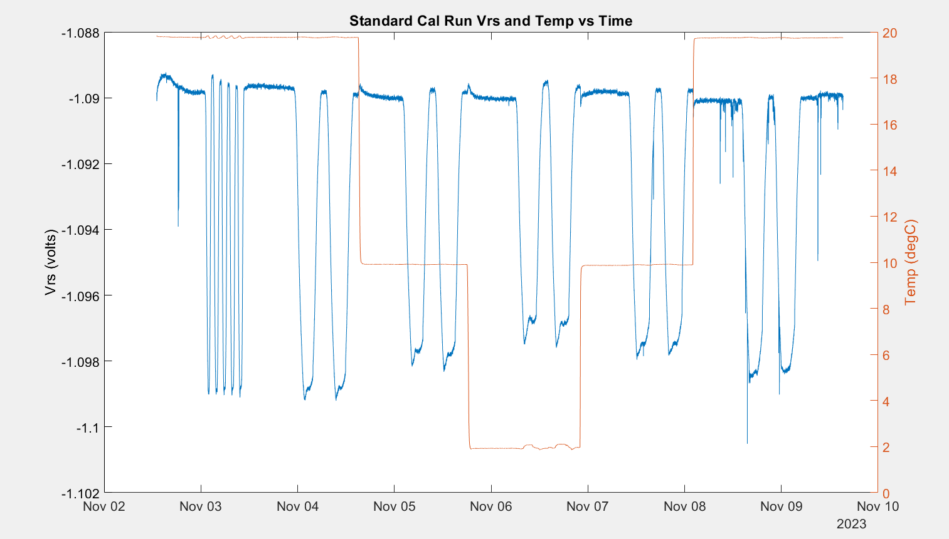
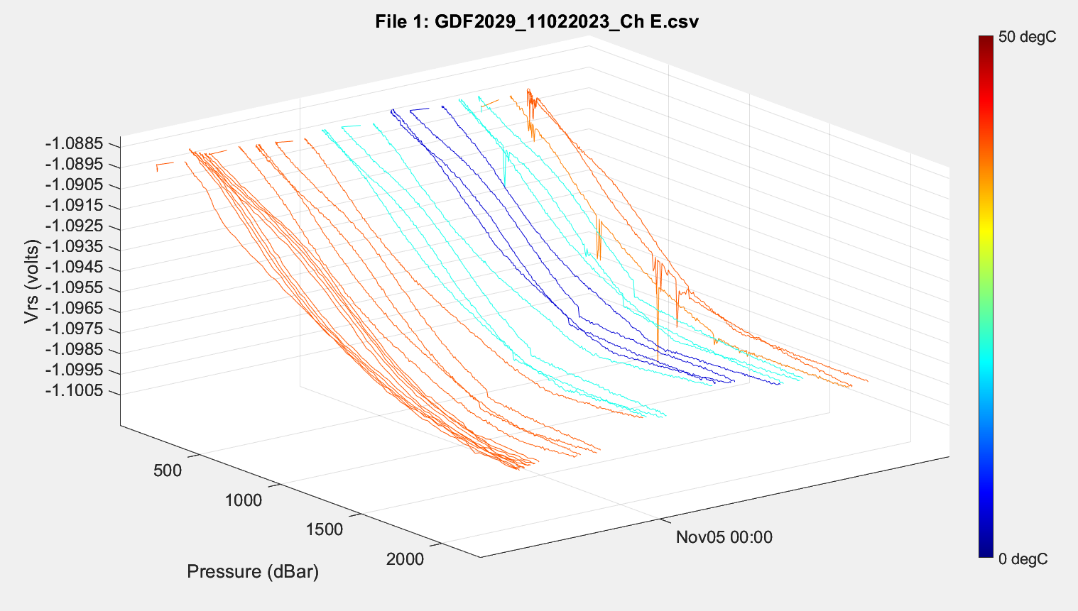
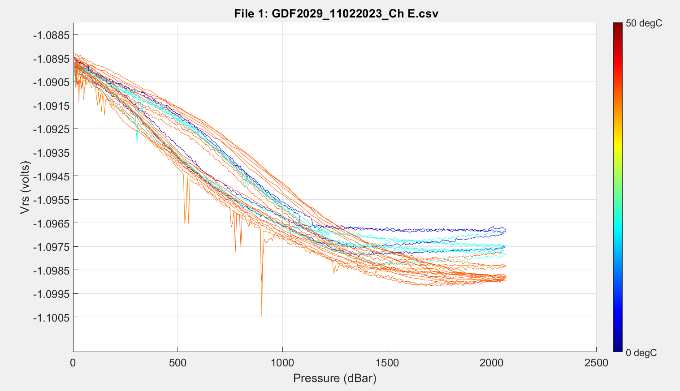
Current Calibration Run

Slide 4


Definitions
Incr P residual
Cycle = 0-2000-0 dBar with an increasing pressure ramp and a decreasing pressure ramp
Residuals Increasing = Vrs_{measured} – Vrs_{fit} for increasing ramp
Residuals Decreasing = Vrs_{measured} – Vrs_{fit} for decreasing ramp
Residuals Both = Vrs_{measured} – Vrs_{fit} for the entire cycle (both increasing and decreasing ramps)
Vrs
Data set grouping:
Individual ramps
Individual cycles
All incr ramps, post warmup incr ramps
All decr ramps, post warmup decr ramps
All cycles, post warmup cycles
Calculations
Residuals for 1-5 above (vector)
Mean of residuals for 1-5 above (scalar)
Maximum residuals for 1-5 above (scalar)
Decr P residual
Pressure

Slide 5
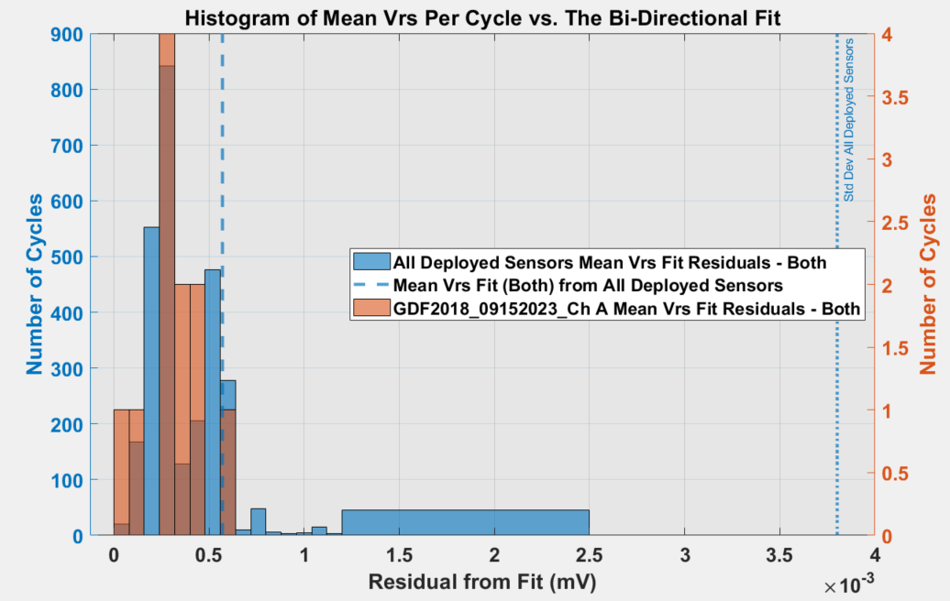
Ben’s section

Slide 6
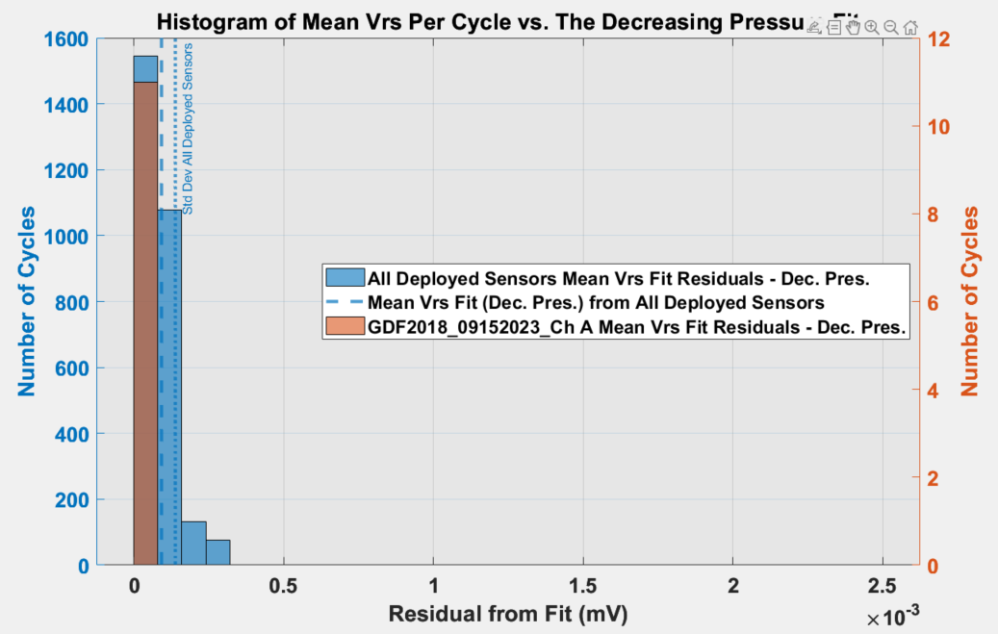

Slide 7
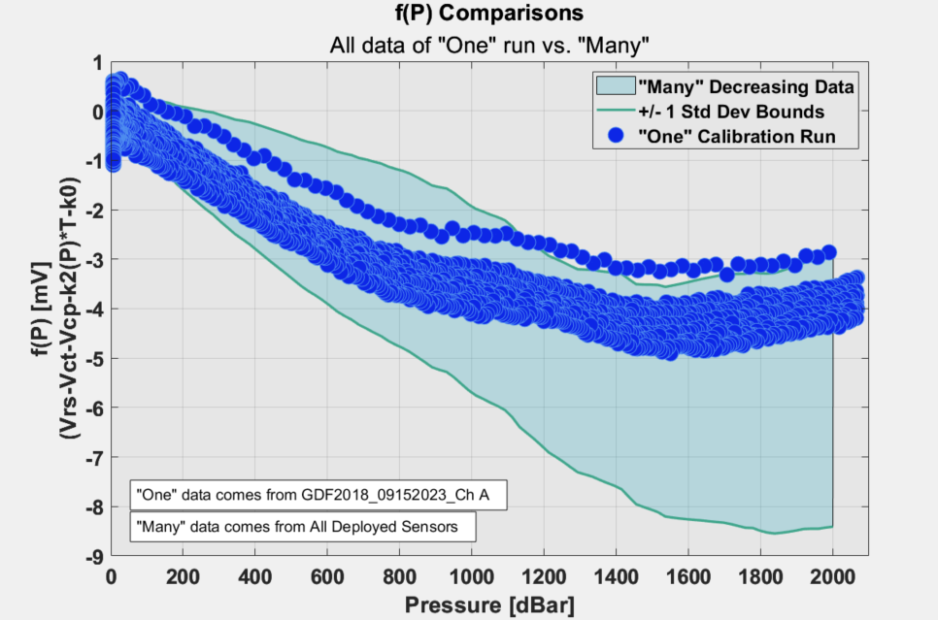

Slide 8
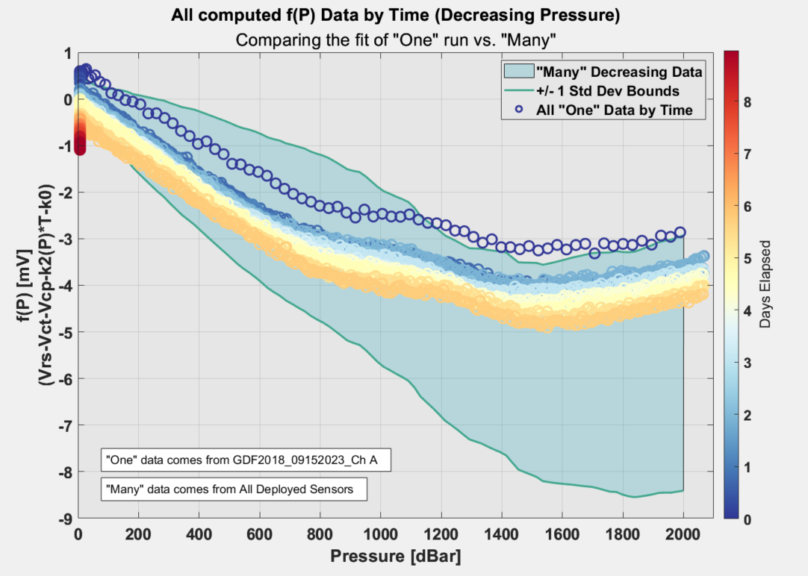

Slide 9
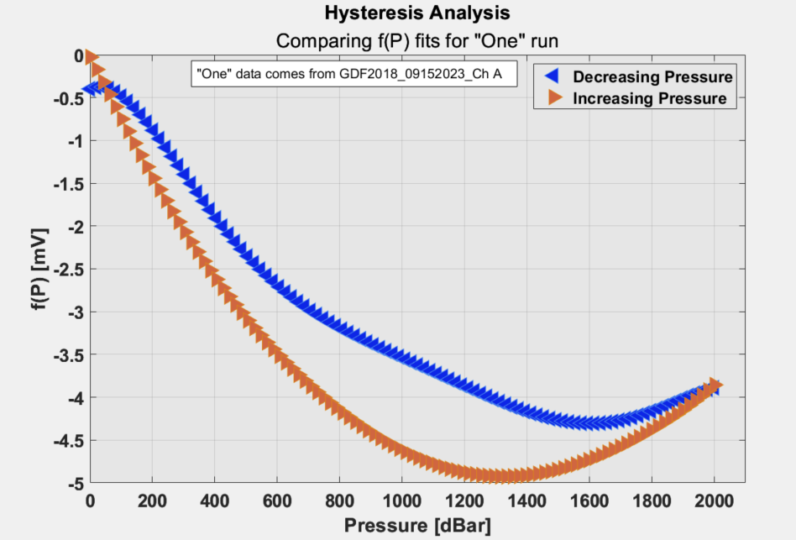

Slide 10
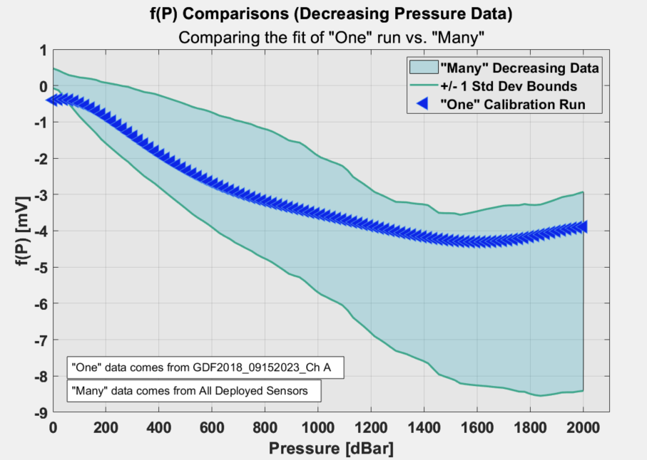

Slide 11
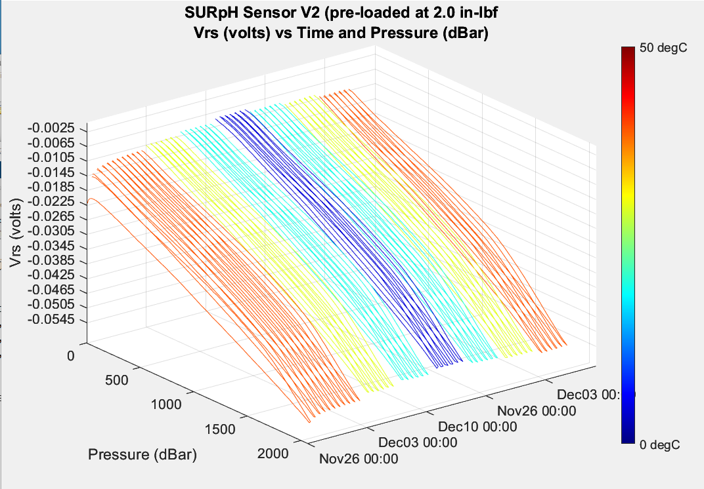
First SURpH Ver2 Sensor with correct pre-load pTC run
First cycle “sets” the piston?

Slide 12
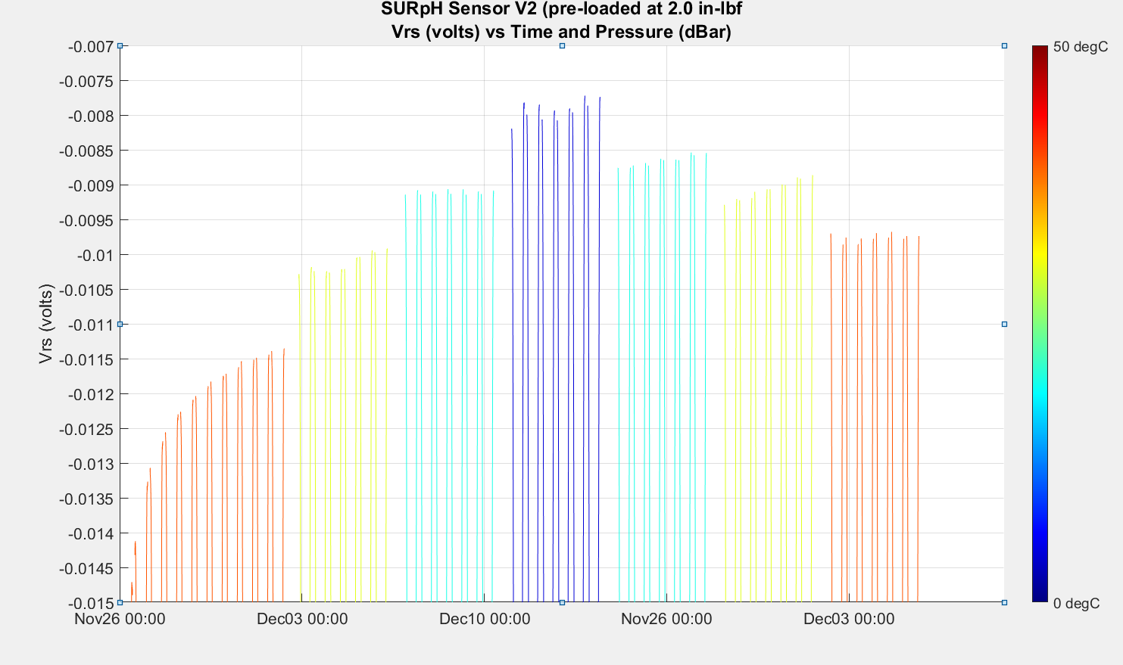
Non-ideal Behavior (0.001 volt ~= 0.017 pH)
Burn in/warmup/drift (sensor or solution)?
Random Noise?
Burn in or
warmup?

Slide 13
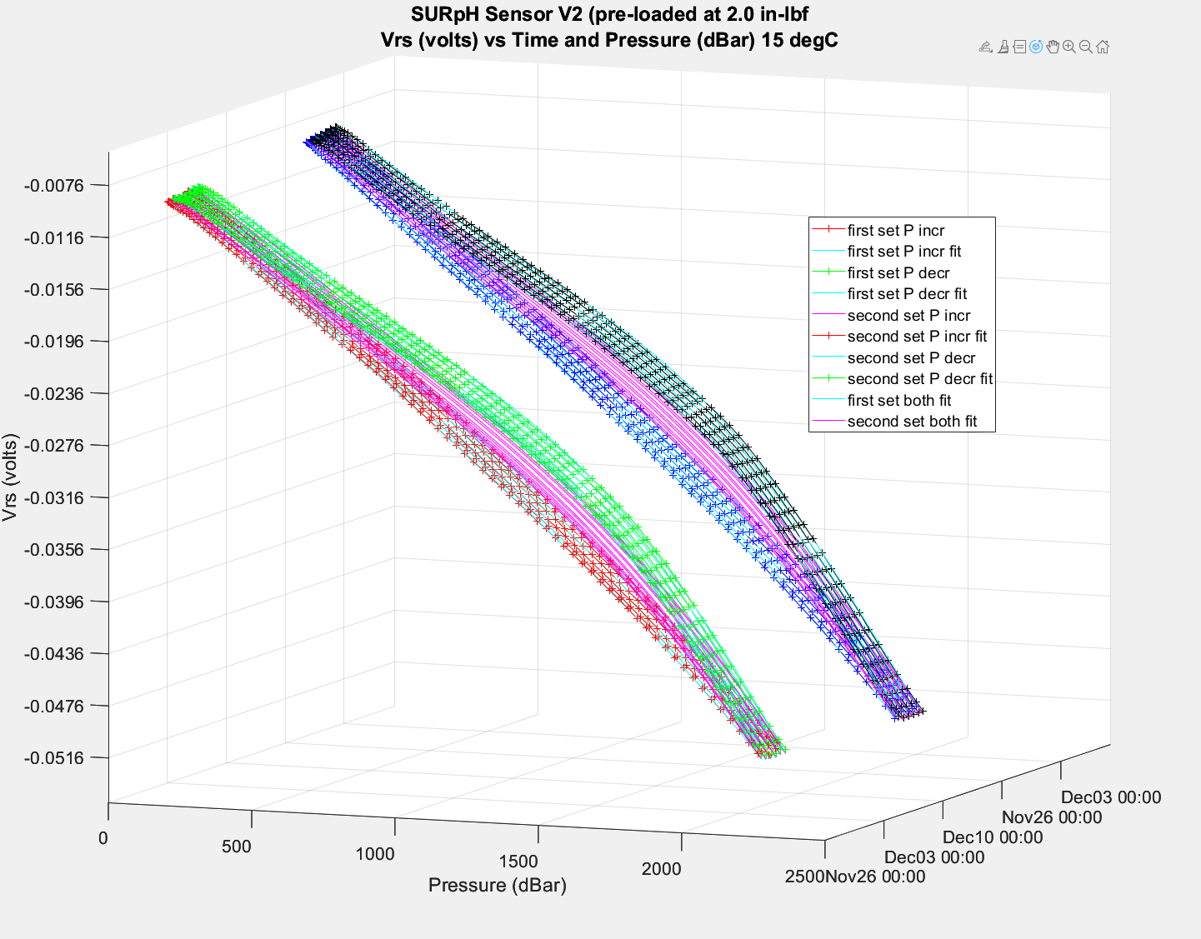
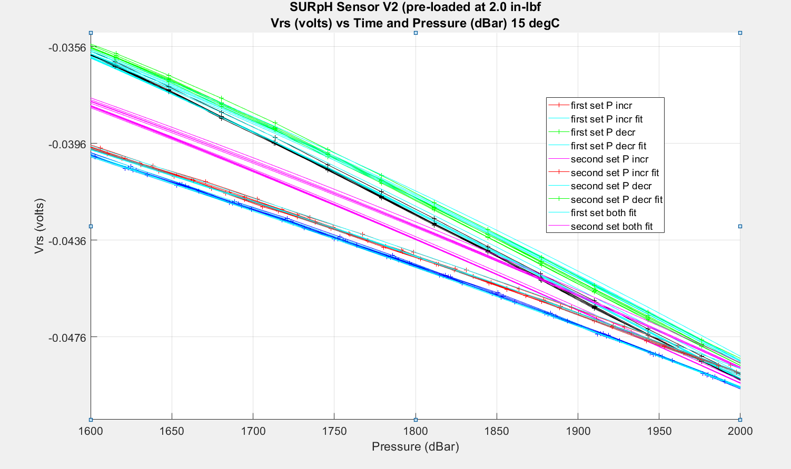
First and Second 15 degC cycles
red = first set, increasing pressure
green = first set, decreasing pressure
blue = second set, increasing pressure
black = second set, decreasing pressure

Slide 14
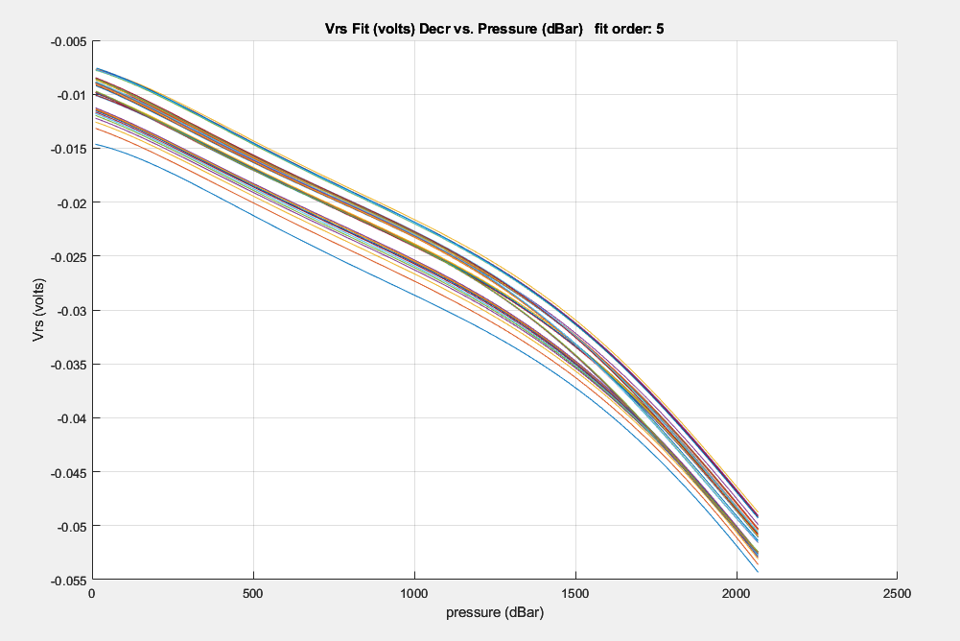
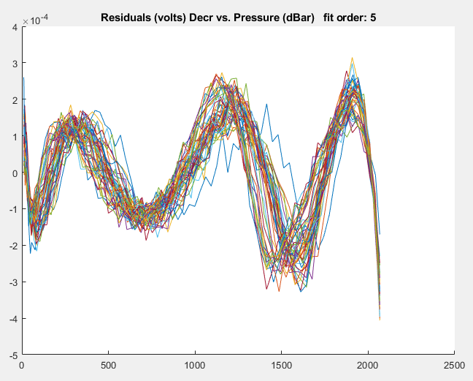
How can we evaluate “goodness of fit” Graphical:
Generally speaking, graphical measures are more beneficial than numerical measures because they allow you to view the entire data set at once, and they can easily display a wide range of relationships between the model and the data. Ref: Mathworks

Slide 15
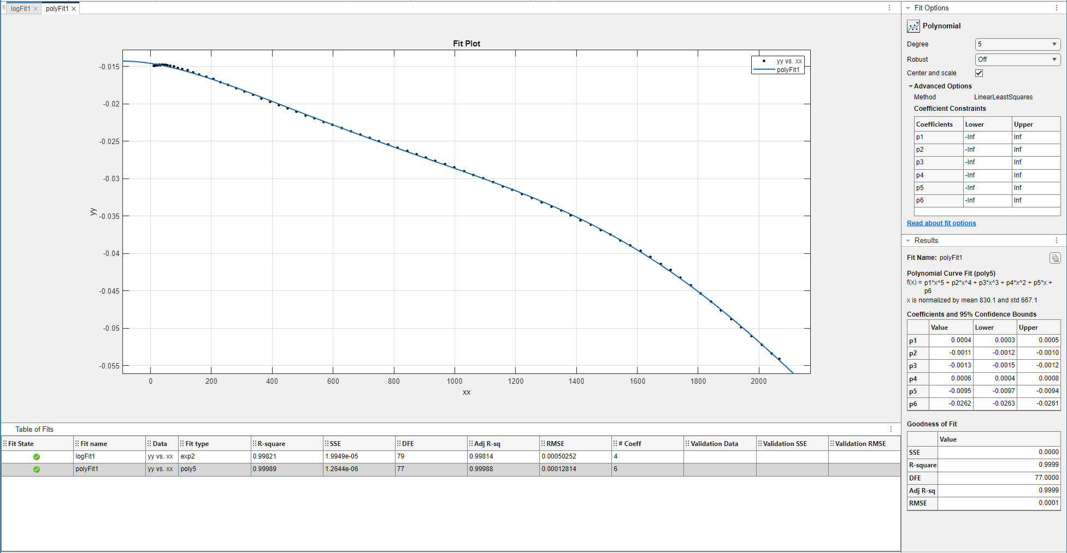
Numerical:
The numerical measures are more narrowly focused on a particular aspect of the data and often try to compress that information into a single number. Ref: Mathworks

Slide 16
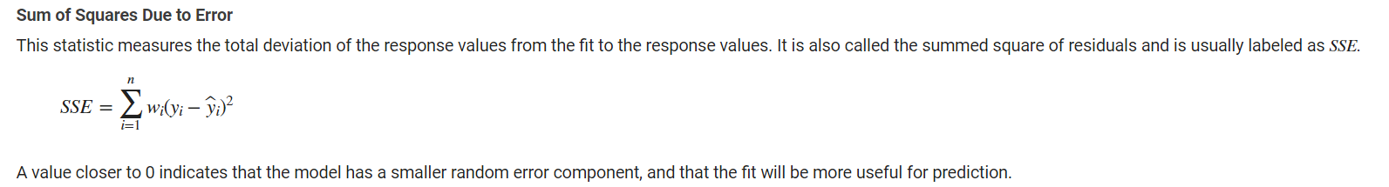
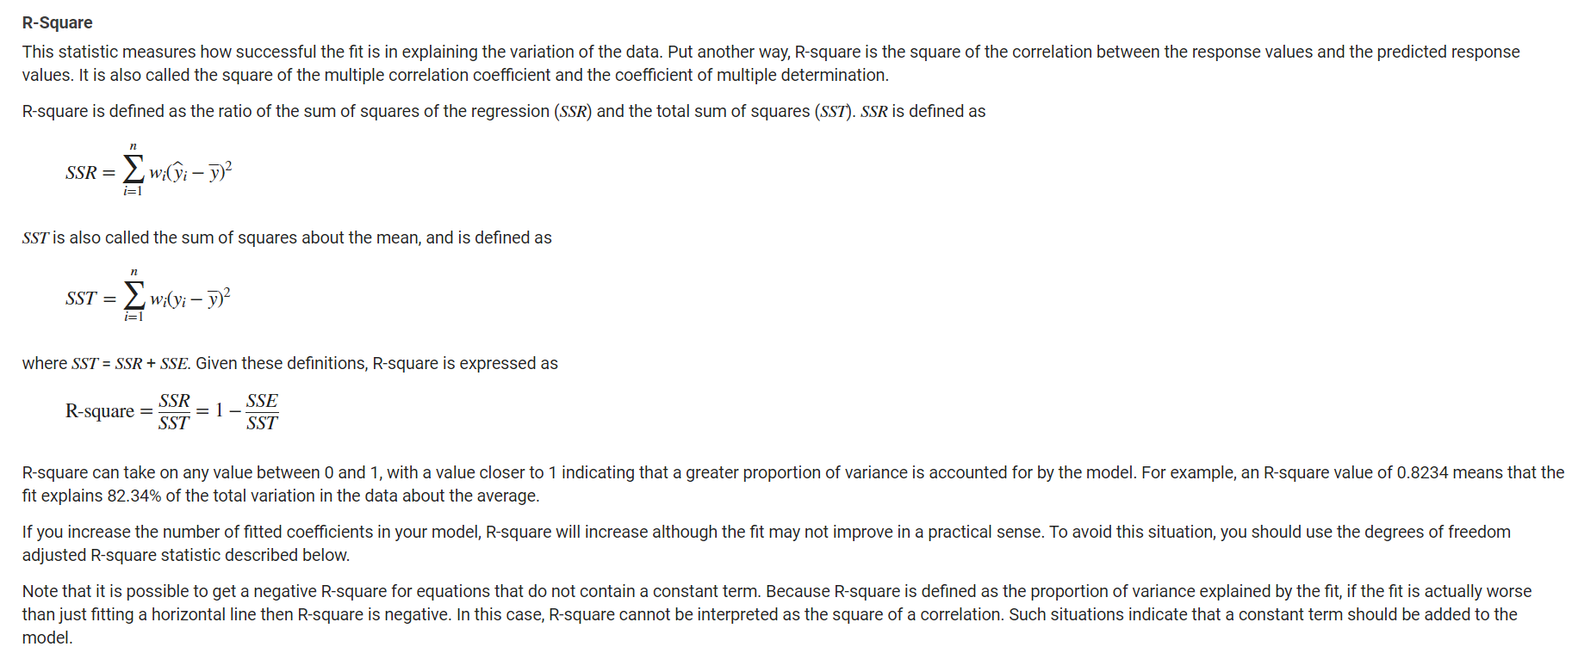
https://www.mathworks.com/help/curvefit/evaluating-goodness-of-fit.html

Slide 17
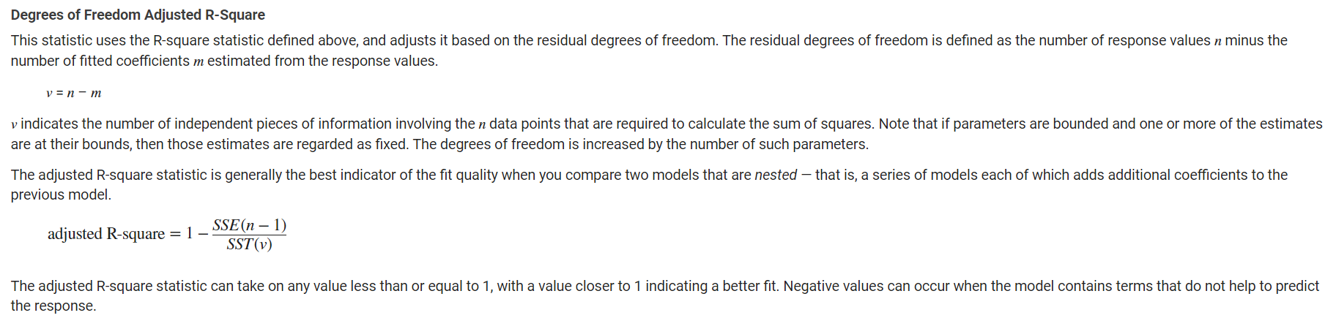
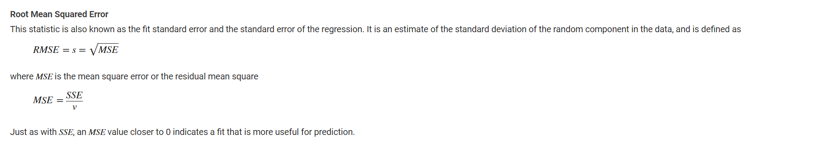
https://www.mathworks.com/help/curvefit/evaluating-goodness-of-fit.html

Slide 18
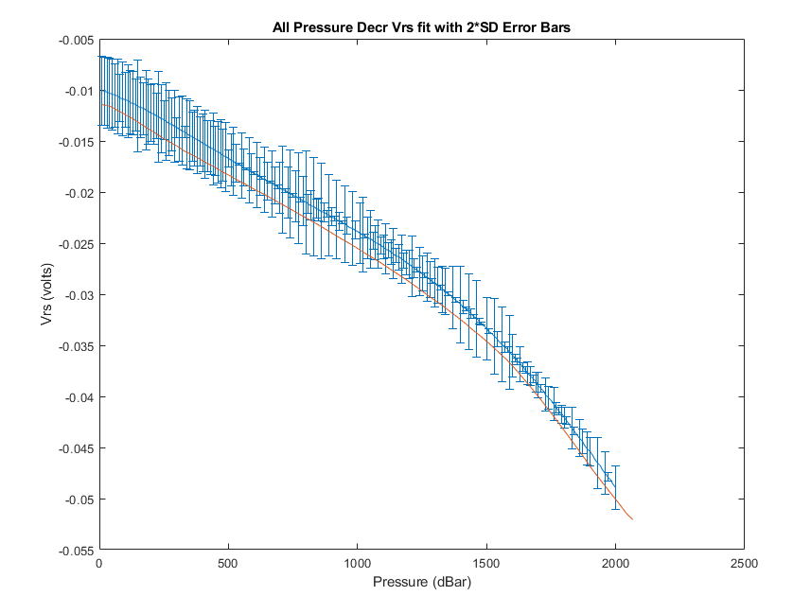
One measure of goodness of fit
For all deployed sensors:
  Fit a polynomial to all the decreasing pressure Vrs fit data across all depths and temperatures
  Calculate the standard deviation for every depth bin
Plot the sensor under test’s decreasing Vrs fit data against the N*std dev Vrs data for all sensors (one vs many) plot

Slide 19
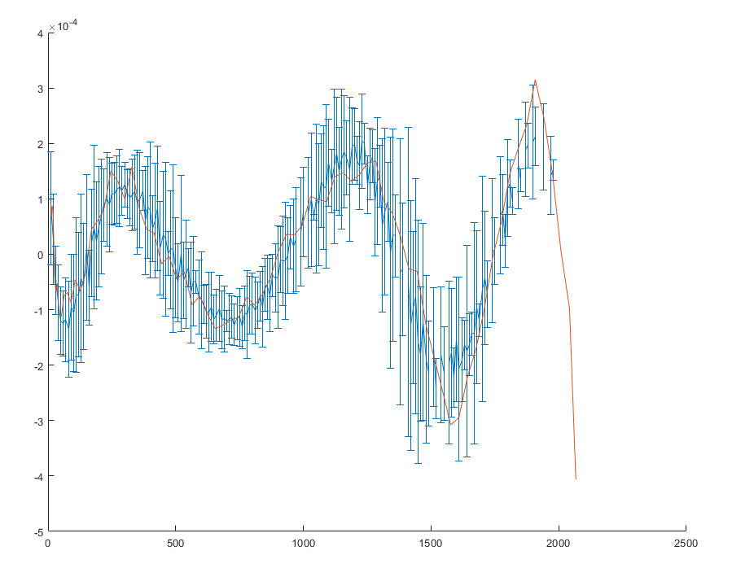
Another measure of goodness of fit
For all deployed sensors:
  Calculate the square error (Vrs_{measured} – Vrs_{fit})² for every sensor’s Vrs values across all depths and temperatures
  Calculate the standard deviation for every depth bin
Plot the sensor under test’s Vrs residuals against the N*std dev residuals for all sensors (one vs many) plot

