Slide 1
Semiconductor Physics and MBARI’s pH Sensor Program
2025 October 10

Slide 2
Background and Goals
MBARI’s Chem Sensor lab has been developing ISFET based pH sensors for deep water oceanographic applications since 2008.
  We commercialized the technology with Seabird Scientific in 2010
  We’ve deployed 100’s of pH sensors on profiling floats across the world’s oceans
We continue to improve our sensor but would benefit from more expertise in semiconductor physics and fabrication
GOAL #1: Develop a plan for an analytical model of our sensor to better predict effects of pressure, temperature, etc. as a function of structural design
GOAL #2: Get a big picture view of our ISFET design vs. what’s possible

Slide 3
Generation 1
Generation 1

Slide 4
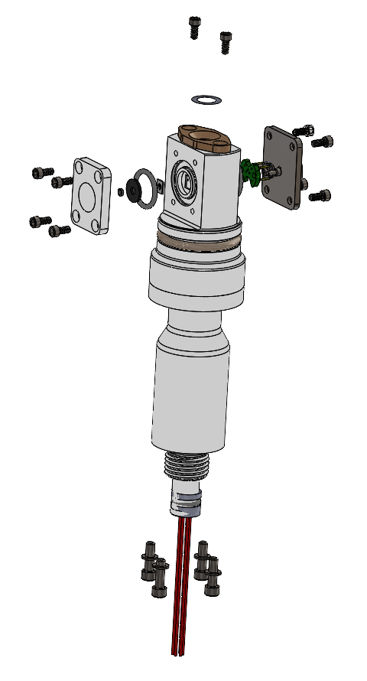
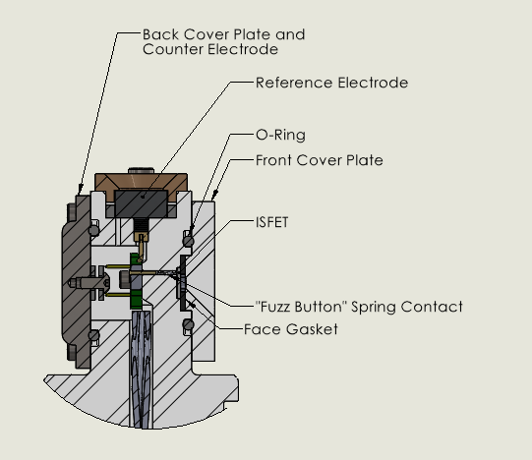
Generation 2
ISFET is fully backed up on back side
Face seal gasket completely covers everything but the sensing trace on the front side of the ISFET
Springy “Fuzz Buttons” for contacts
ISFET

Slide 5
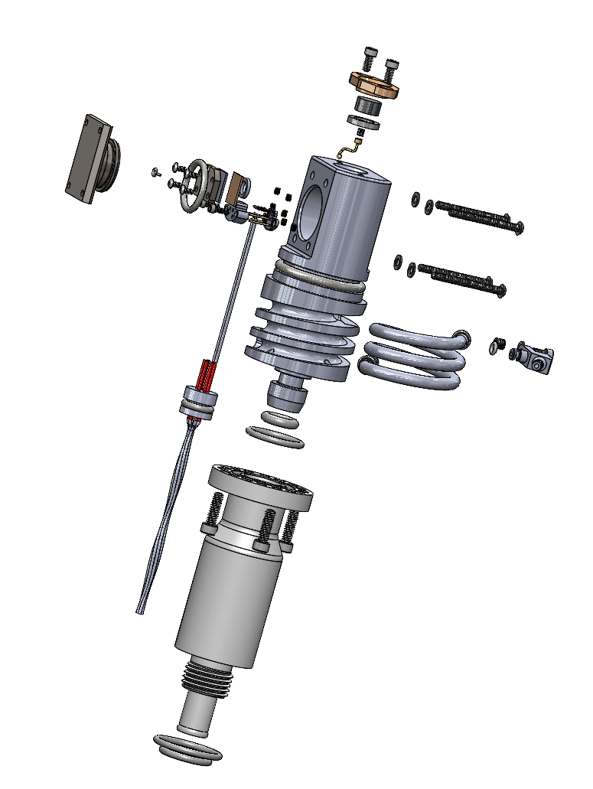
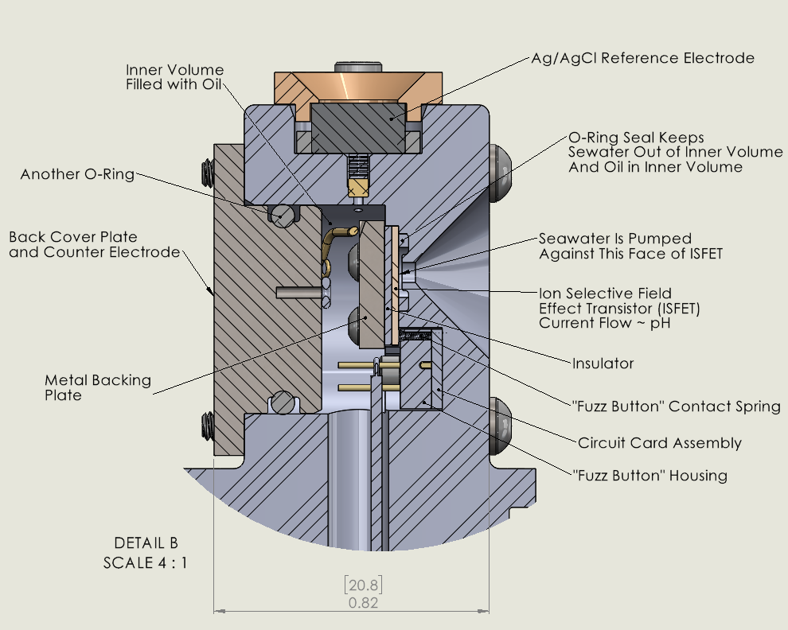
Generation 3
ISFET is completely supported on the backside
Housing can be pressure balanced or not
ISFET

