Slide 1
“Surge” function in GDF data due to environmental changes
Typically written in medical journals as “surge” when talking about concentration of drugs in a system after test study takes a certain amount
https://digitalcommons.usf.edu/cgi/viewcontent.cgi?article=4942&context=ujmm
https://www.tandfonline.com/doi/pdf/10.1080/10511970608984137
And also written as surge in terms of voltage delivered over time when power surges the grid. But is also called “Pulse” function in other applications and can pertain any concentration/state change of something from its equilibrium—temp change, hydrogen ion concentrations change, etc.
https://en.wikipedia.org/wiki/Impulse_response
https://en.wikipedia.org/wiki/Transient_response

Slide 2
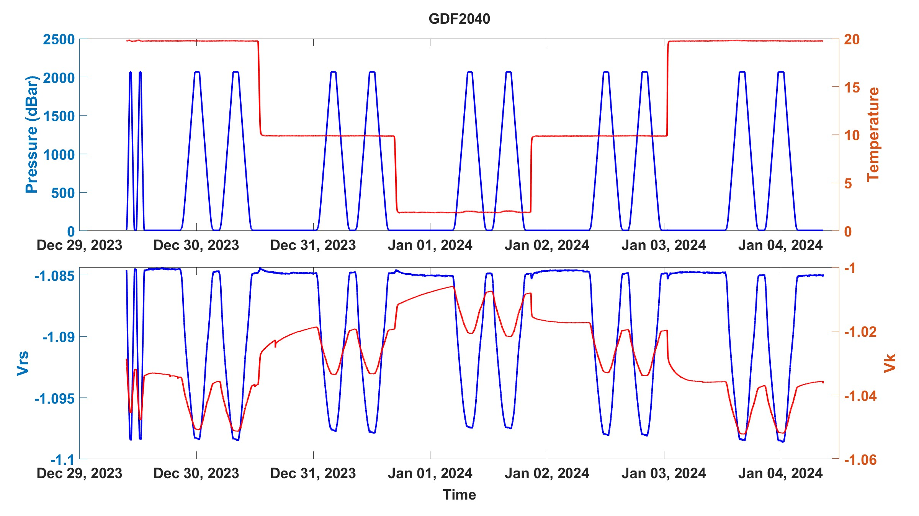


“Surge” function in GDF data due to environmental changes
We can see it in our calibration data, mostly with temperature change
Going from 10 C to 2 C
Going from 2 C to 10 C

Slide 3
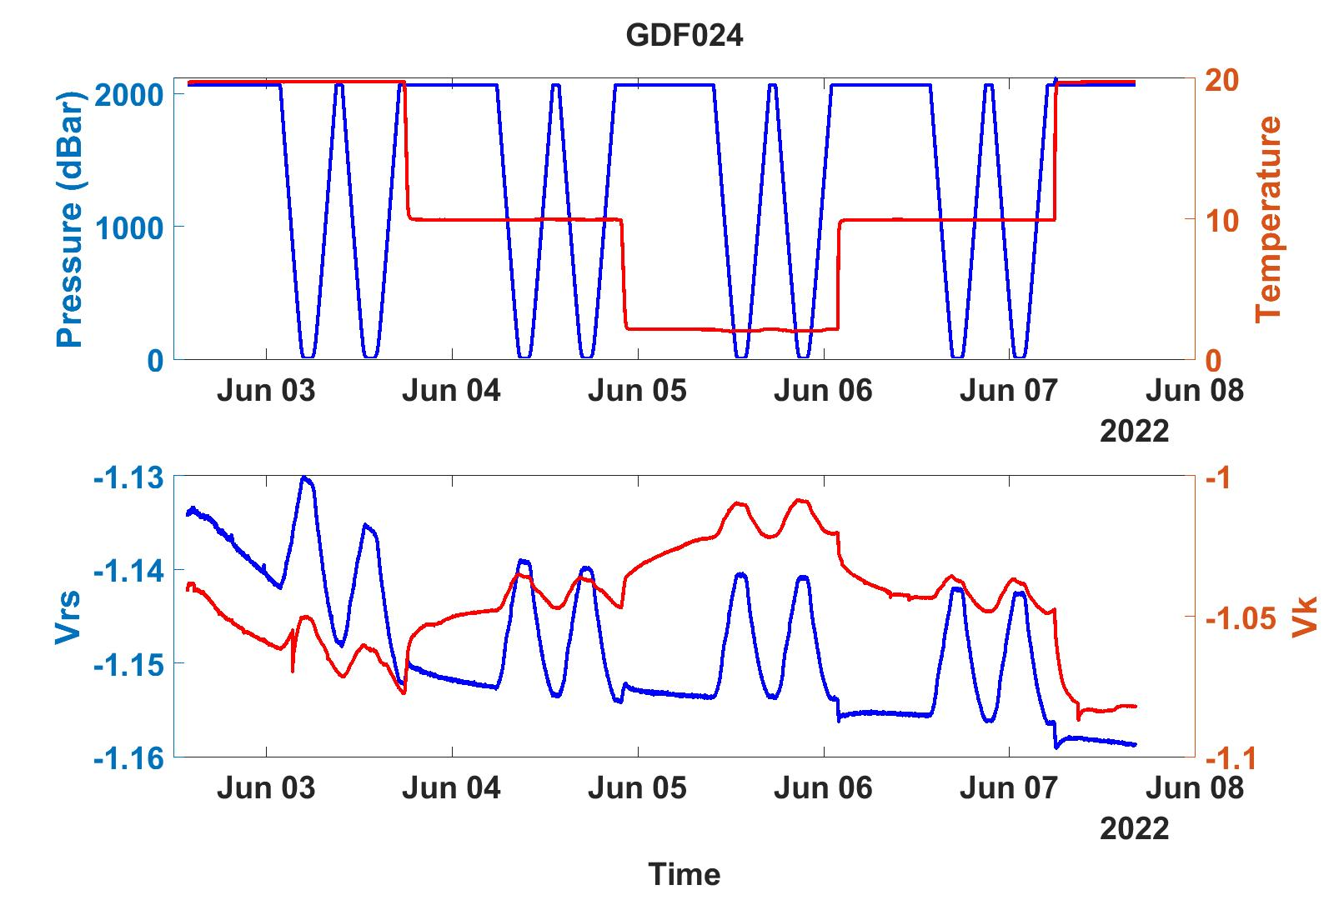
“Surge” function in GDF data due to environmental changes
And this is not to be confused with the well studied (maybe not here lol) equilibration pattern that arises from applying a voltage to a circuit.
All in this to say that it’s hard to tell how well these sensors are doing when we analyze them after first powering them up or after they endure a “shock” of temperature.
In the field it may be better/faster to equilibrate since the environment changes faster
Fun tangentially related paper
https://neuronaldynamics.epfl.ch/online/Ch2.S2.html

