Slide 1
pH sensors
What a long way we have come
(in a very short amount of time)
Josh Plant Tanya Maurer Peter Walz Yui Takeshita Luke Coletti
& Ken Johnson
9th BGC Argo Meeting, ADMT 21
November 30 – December 1, 2020
Virtual

Slide 2
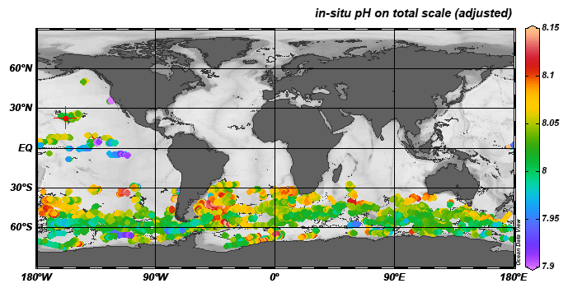
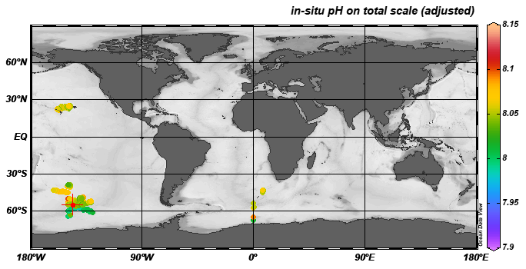
Today!
900,000 QC’ed pH measurements
Largely due to SOCCOM project in the Southern Ocean
Enabling Southern Ocean estimates of CO₂ flux, Aragonite Saturation
Just 5 years ago
35,000 QC’ed pH measurements
Largely due to SOCCOM project in the Southern Ocean

Slide 3
pH pump offset
pH profiles exhibit a step change for some MBARI APEX floats
Occurs when CTD shifts to constant profiling mode (CTD pump continuously on) at 985m
5906000, Cycle 9
Oxygen & Temperature profiles smooth & linear
pH above 985m drops by ~0.007
Magnitude can vary from float to float
Magnitude of offset can vary from profile to profile
Rarely seen in NAVIS floats
Pump ON
(CP mode)
Pump OFF
(spot samples)

Slide 4
pH pump offset estimates for SOCCOM array
Affects a small % of total profiles
Overall bias small & within sensor precision (-0.005)
Some floats affected more than others
-1 milli pH offset => +1 µatm pCO2
Find root cause & fix sensor
Correct existing data at GDAC affected by problem

Slide 5
Find root cause & fix sensor
Partially Related to flow over reference electrode or FET (preliminary lab work)
Good news – Mostly isolated to 2018-2019 deployment season
Interesting behavior over time (2018-2019 deployments)
New sensor design may eliminate the problem completely
2018-2019
Deployment season
2019-2020
&
2020 -2021
Deployment seasons
% profiles with
abs(offset) > 0.01
Total profiles
Cycle #
Cycle #

Slide 6
Correct existing data stored in the GDAC
  Correction methods that have been considered:
Single, static offset per float
B) Perform adjustments
in SAGE at 980 m vs
1500m
C) Auto-calculation of
offset per float, per
profile

Slide 7
Correct existing data stored in the GDAC
  Correction methods that have been considered:
Single, static offset per float
B) Perform adjustments
in SAGE at 980 m vs
1500m
C) Auto-calculation of
offset per float, per
profile
  Original method when few floats were affected and observed magnitudes were on the order of millipH
  Does not address time-varying nature of offset

Slide 8
Correct existing data stored in the GDAC
  Correction methods that have been considered:
Single, static offset per float
B) Perform adjustments
in SAGE at 980m vs
1500m
C) Auto-calculation of
offset per float, per
profile
  Maintains accuracy of adjusted surface data
  Deep data would remain unadjusted
  Assumes offset in SAGE is independent of ref depth (980 vs 1500m)

Slide 9
Correct existing data stored in the GDAC
  Correction methods that have been considered:
Single, static offset per float
B) Perform adjustments
in SAGE at 980m vs
1500m
C) Auto-calculation of
offset per float, per
profile
  No algorithm is perfect
  Thresholds must be set
  How to record magnitude of correction and impact on error/uncertainty??
  Delayed mode or real time corrections?
  Metric for success?

Slide 10

Correct existing data stored in the GDAC
C) Auto calculation of pump offset – one possible approach………
Assume pH is a smooth function of pressure over a narrow data window centered at 985m
Break data window above & below 985m
Add offset to shallower part of data window
Iterate offset value to optimize polynomial fit over data window (minimize SSR)
Calculate a signal to noise ratio = offset / std(fit residuals)
Set offset & signal to noise thresholds (+/- 0.005 & +/- 10 ??)
Add offsets which exceed thresholds to all data shallower than 985m
Raw
data
7th
iteration
final
iteration

Slide 11
Example
5906000 Cycle 9
Negative pH offset (-0.03)
High signal to noise ratio (-21)
Apply correction

Slide 12
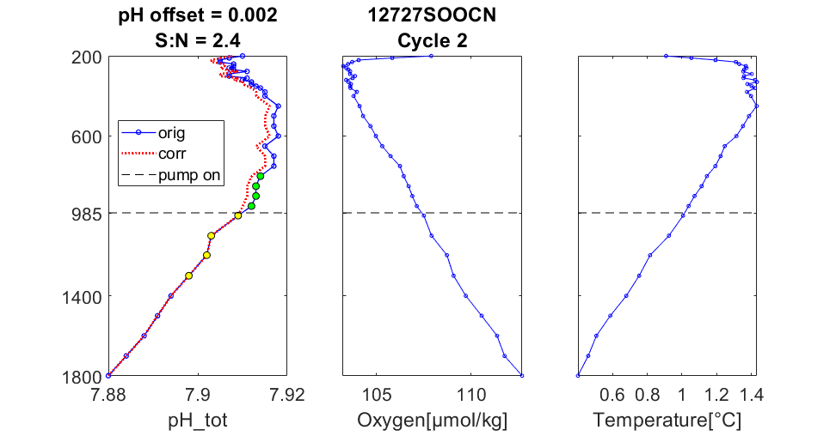
Example
5905998 Cycle 2 - No offset
Offset small
Signal to noise ratio low (2.4)
No correction
applied

