Slide 1
SUMMARY
Looking mostly at 12XXX floats
Pump offset coincident with ~0.4 mA increase in System amps in CP region (0-985m)
Floats without pump offsets show a decrease in or constant current over same region
Floats with pump offsets tend to have larger drifts in Vk
Vk shows ~5 mV decrease in CP zone
Vk pump offset shows curvature, while Vrs, pH offset more of a step function

Slide 2
Floats with large pump offsets

Slide 3
12701

Slide 4
12878

Slide 5
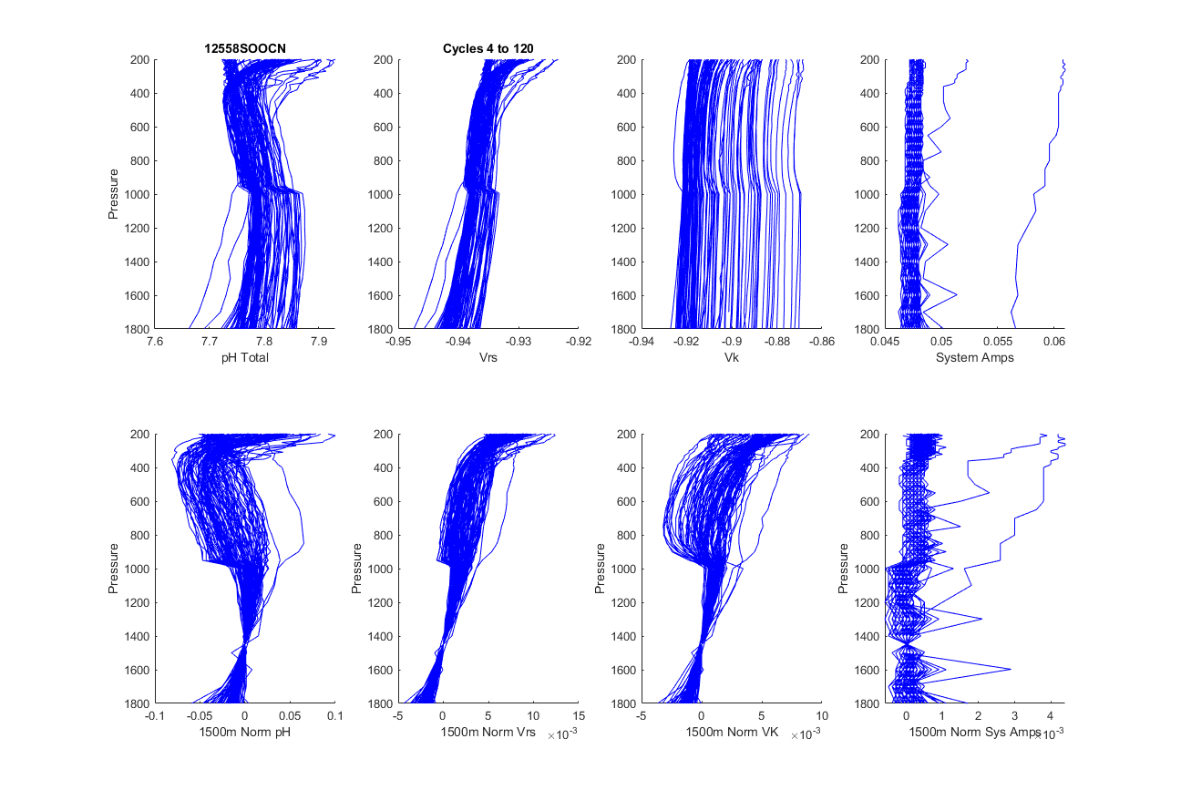
12558

Slide 6
12884

Slide 7
12734

Slide 8
12711

Slide 9
12709

Slide 10
12701

Slide 11
Floats with small pump offsets

Slide 12
12745

Slide 13
12396

Slide 14
12883

Slide 15
12696

Slide 16
12549

Slide 17
12727

