Slide 1
Git, Bitbucket and SourceTree a quick overview
Git is an open source version control system originally designed for controlling the Linux kernel
Bitbucket is a commercial, web hosting service offered by Atlassian providing version control using Git
MBARI has a non-profit arrangement with Atlassian so MBARI projects get Bitbucket for free

Slide 2
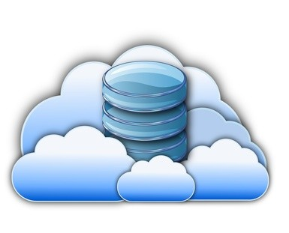

Remote Repository (origin)
Access with Bitbucket
Push file(s) up to remote
Fetch Status
Pull file(s) down from remote
Ken
Josh
Tanya
Push/Pull file(s) between local repos
Local Repositories
Create and edit files and directory structure, Stage and Commit changes locally, Push/Pull to Remote Repository using
DOS window, Git Bash, Git GUI, Sourcetree

Slide 3
Git: https://www.atlassian.com/git/?utm_source=bitbucket&utm_medium=link&utm_campaign=help_dropdown&utm_content=learn_git
Bitbucket: https://bitbucket.org/dashboard/overview
Sourcetree: https://www.sourcetreeapp.com/

Slide 4
Online Bitbucket Tutorial
https://confluence.atlassian.com/bitbucket/tutorial-learn-git-with-bitbucket-cloud-759857287.html

Slide 5
Notes

