Slide 1
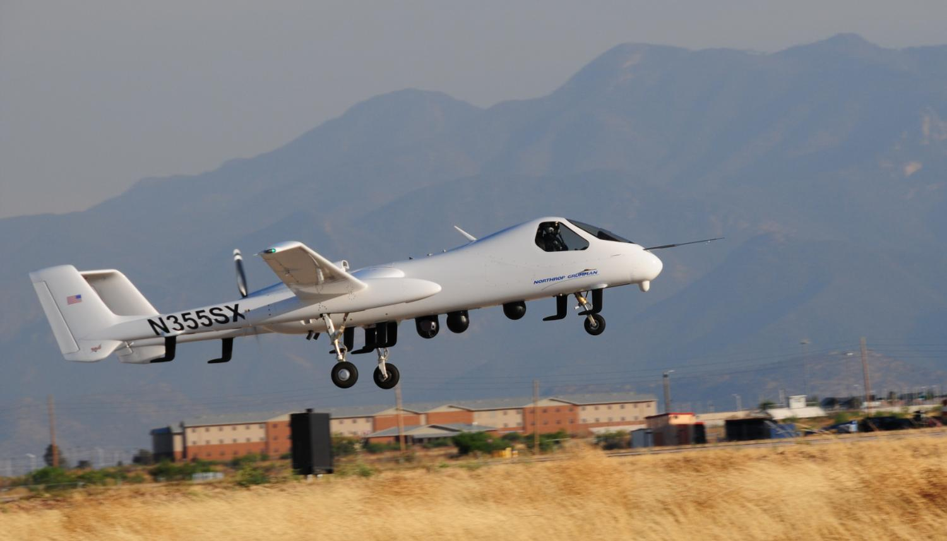

Firebird: Multi-INT ISR
Unmanned Systems North America
Steve Nichols
Firebird Business Development Manager
Advanced Programs and Technology Division
Northrop Grumman Aerospace Systems
August 2011
Approved for Public Release, Northrop Grumman Case 11-0842 dated July 19, 2011

Slide 2
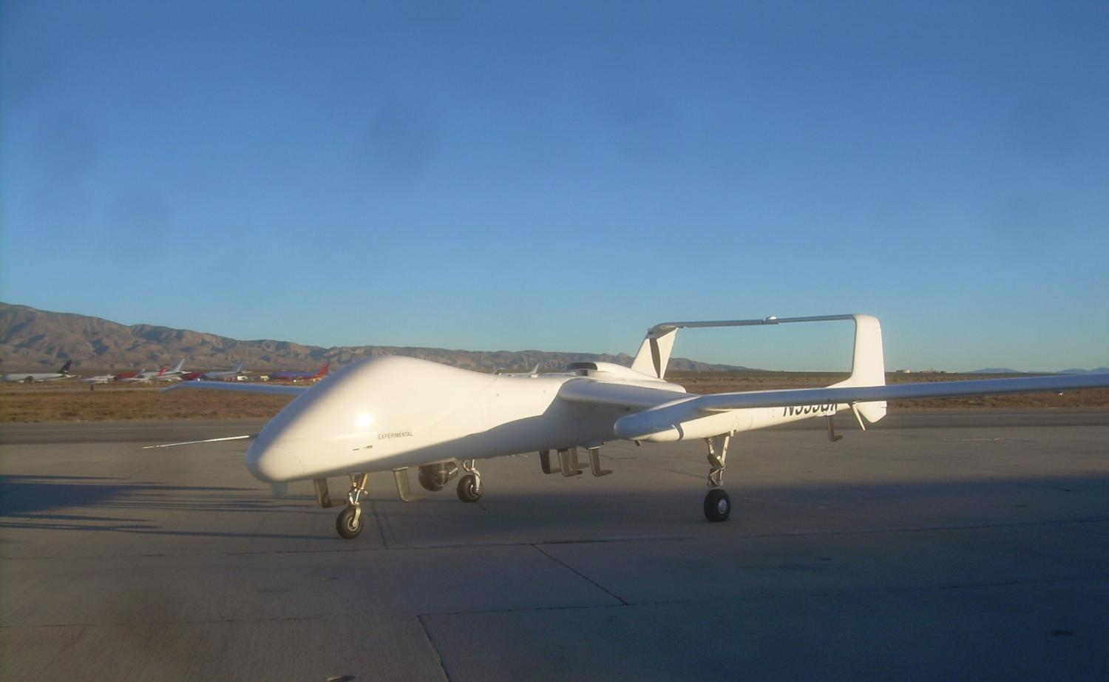
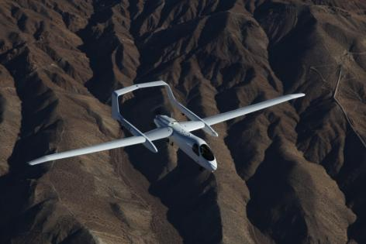
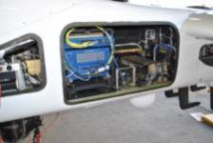
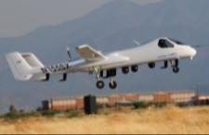
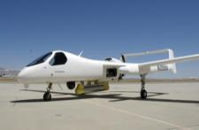
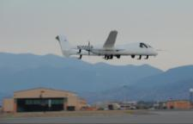
Firebird: Persistent Multi-INT ISR with Precision Strike
Single Platform, Persistent Multi-INT Integrated ISR Capability
Manned or Unmanned Operation – Optionally Piloted by Design
Reconfigurable – Accessible Network Enabled IP Architecture
Medium Altitude – Tactical ISR with Precision Strike
Payload Plug-n-Play with Large Internal Bay
Mission Ready – Flying Today
Large Internal Payload Bay
Tri IMINT with Quick-Disconnects
GMTI/DMTI/SAR
Multi-INT (4)
GTOW 5000 lbs
70-200 KTAS
24-40 hr Endurance
1240 lb Payload
Multi-Fuel Option
LOS/BLOS
Approved for Public Release, Northrop Grumman Case 11-0842 dated July 19, 2011

Slide 3









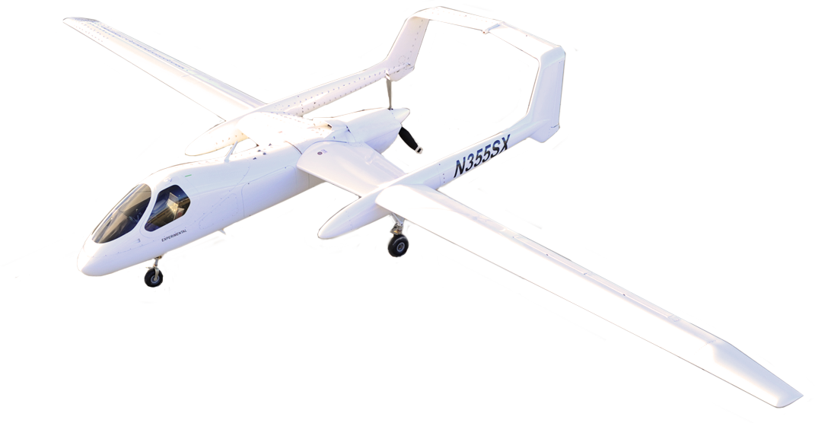





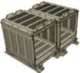
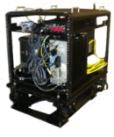

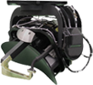








Modular Plug-n-Play
Multi-INT Payload Options
ORGANIC EO/IR FOR DAY / NIGHT SURVEILLANCE AND TARGET DESIGNATION
MX-20 HD
Axsys V14
BRITEStar
Star SAFIRE 380HDL
Star SAFIRE HD
MX-15 HD
QE2
Payload Interfaces
Gigabit Ethernet
RS-170, 1553, 1760, 232/422/485, HD-SDI-SMPTE 292M Video Inputs
ARINC 429
Synchronous Serial, TTL, Digital Discrete I/O
RADAR FOR WIDE AREA SEARCH
SIGINT FOR SIGNAL ANALYSIS AND LOCATION ID
Modular Payload Bay
Dedicated EO/IR
Modular Attach-Ring Concept
COMMUNICATIONS PAYLOAD/RELAY
DEPLOYABLE/WEAPONS OPTION
NORTHROP GRUMMAN PRIVATE / PROPRIETARY LEVEL I
Approved for Public Release, Northrop Grumman Case 11-0842 dated July 19, 2011

Slide 4


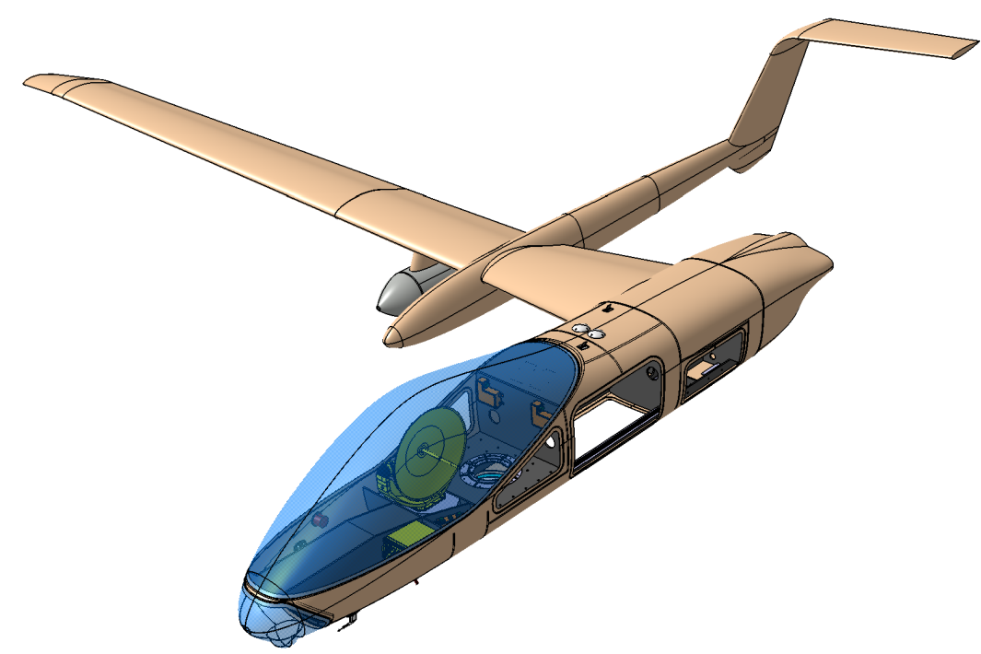
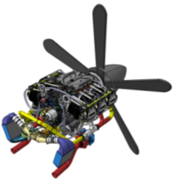
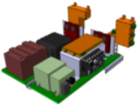
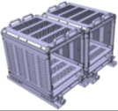
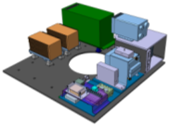
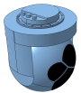

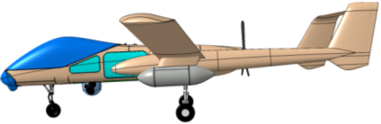
Unmanned Firebird Model
Retractable Gear
(2) Fuel Tanks (1000 -1300 lbs)
Lycoming TEO-540E (AV1)
Growth Hardpoints:
  (2) Additional Outboard Wing (LH/RH)
  (1) Additional Centerline
(2) Inboard Hardpoints (LH/RH) w/
18 “ x 69 “ Standard Payload Pods
Aft Avionics Bay
30” Satcom Dish
Vehicle Management & Power Distribution Systems Pallet
Large Internal Payload Bay
Satcom Modem Assembly
Fwd Avionics Bay
Nose Landing Gear
Aircraft Racks
Nose Radome
Communications & Mission Management Systems Pallet
HD EO/IR
Weather Radar
TCDL Antenna
Omni-Directional Antenna
TCDL RFE
TCDL Modem
Air Data Sensors
4
Approved for Public Release, Northrop Grumman Case 11-0842 dated July 19, 2011

Slide 5
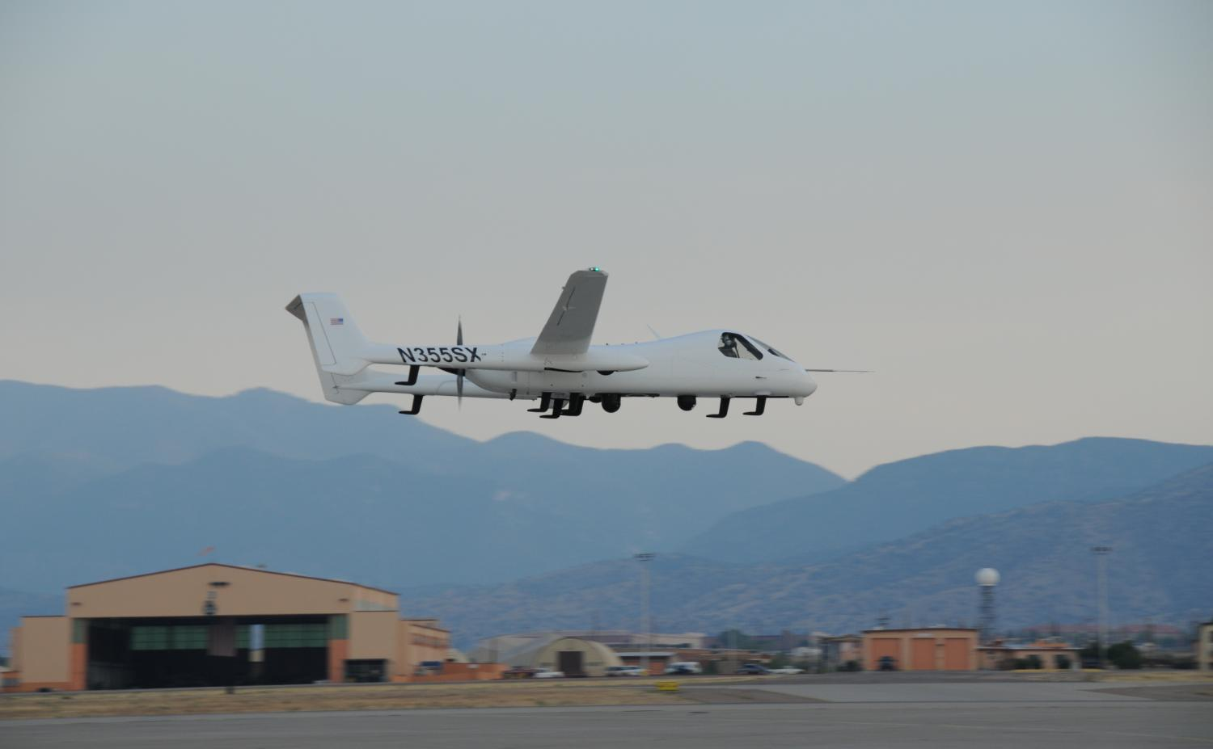



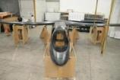


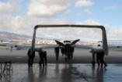

Concept to Flight: 12 Months
Feb | Mar | Apr | May | Jun | Jul | Aug | Sep | Oct | Dec | Jan | Feb
1 | 2 | 3 | 4 | 5 | 6 | 7 | 8 | 9 | 10 | 11 | 12
Concept
9-Feb 2009
Loft Freeze
Fabrication
Staging
Assembly
Installations
Roll-Out
First Flight
9-Feb-2010
Approved for Public Release, Northrop Grumman Case 11-0842 dated July 19, 2011

Slide 6
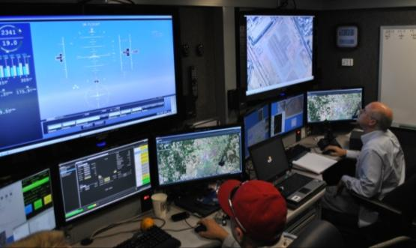
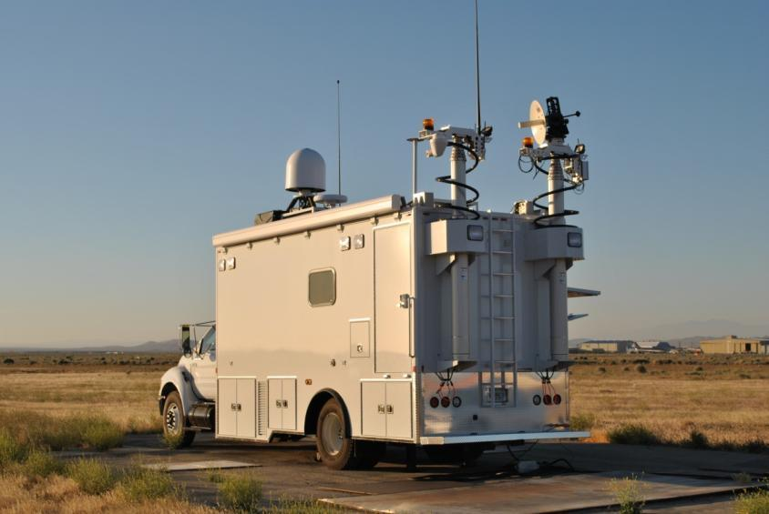
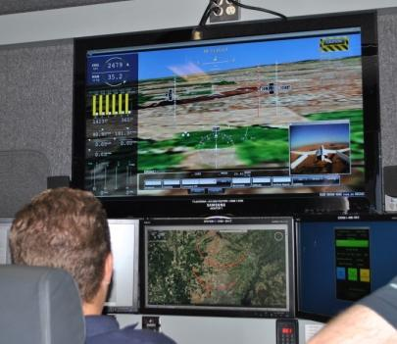
Mobile Demonstration Support Vehicle
Open System – Flexible GCS Capability
Standards-Based
Provides Payload Integration / Test PED
Remote Connectivity
Approved for Public Release, Northrop Grumman Case 11-0842 dated July 19, 2011

Slide 7
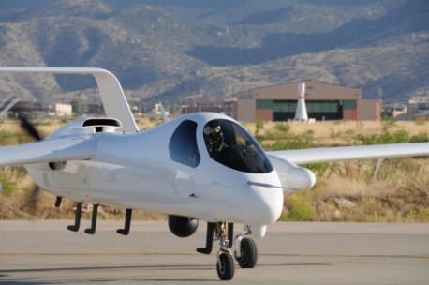
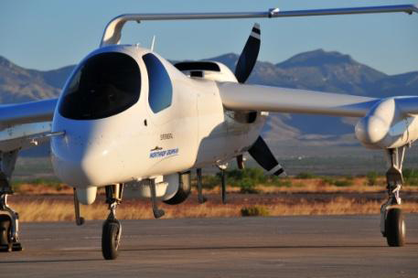
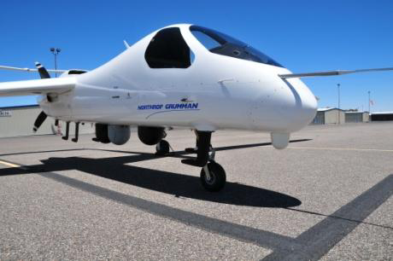
Empire Challenge 2011 Accomplishments
30 Sorties, 99 flight hours over four weeks
100% operational availability
Eight unique payloads integrated – five for the first time at the exercise
Multiple quad-sensor configurations flown
RITE 3G network elements flown including the Harris HNR Radio
Rapid payload reconfigurations at 28 to 57 minutes
Demonstrated real-time cross cueing between all onboard sensors
All payloads operations and exploitation run by the warfighter
Approved for Public Release, Northrop Grumman Case 11-0959 dated Aug 9, 2011

Slide 8
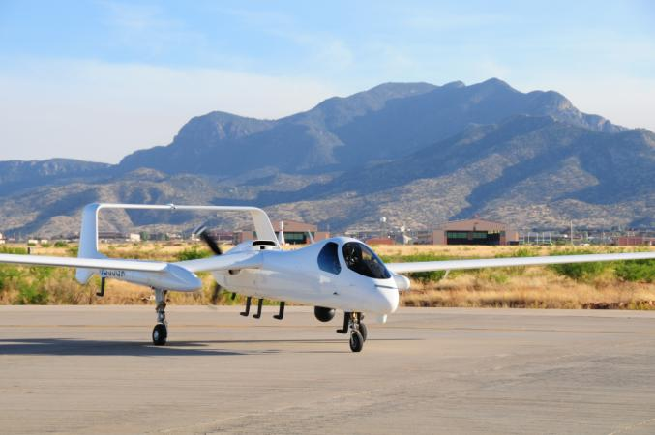
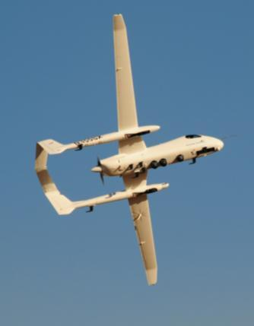
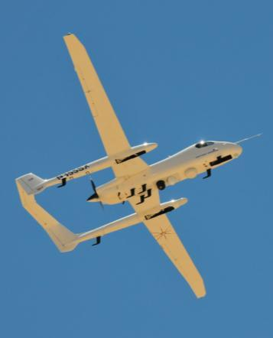
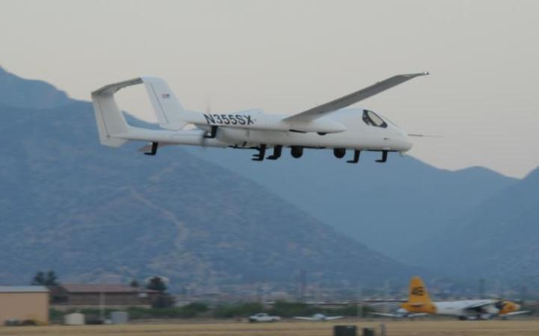
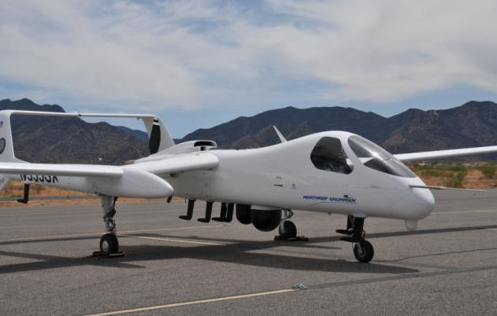
Empire Challenge 2011 Sensor Payloads
Dual Sensor:
IMINT: FLIR Safire HD
ESDF: CSS-1500
Quad Sensor:
IMINT: (3) FLIR Safire HD
ESDF: CSS-1500
Quad Sensor:
IMINT: FLIR Safire HD
Radar: STARLite
COMMS: Harris HNR
ESDF: CSS-1500
Tri-Sensor:
IMINT: (2) FLIR Safire HD
ESDF: CSS-1500
Tri-Sensor:
IMINT: FLIR Safire HD
Radar: STARLite
ESDF: CSS-1500
Approved for Public Release, Northrop Grumman Case 11-0959 dated Aug 9, 2011

Slide 9
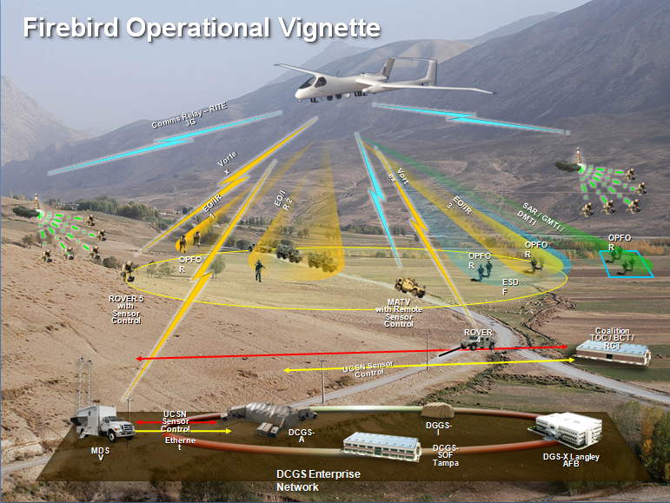
Meeting U.S. Army UAS Mid-Term Requirements (2025)
Eight Roadmap Themes
Soldiers are the strategy’s backbone
Synchronize the human, networking, and equipment
“Commonality” and “open architecture systems” are UAS strategy foundation
Dynamically re-taskable assets
Actionable intelligence to the lowest tactical level
Shorten “sensor-to-shooter” timeline
Support full-spectrum operations
Allow commanders to employ a variety of capabilities
Simultaneous use of multiple sensors provides valuable resource to the warfighter
Approved for Public Release, Northrop Grumman Case 11-0959 dated Aug 9, 2011

Slide 10
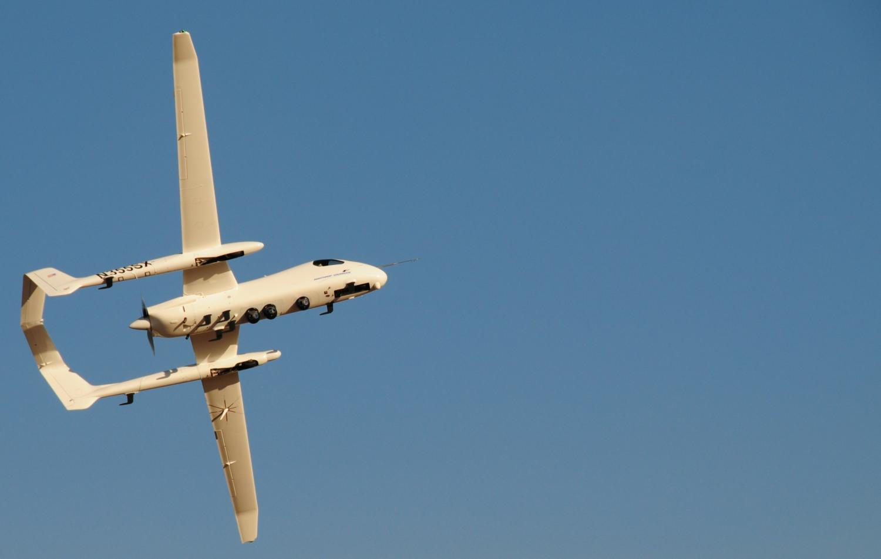
Going “Back to the Future”
Leap frog current enhancements and modification efforts to build tomorrow’s system and make it ready today
Adapt the system to the capability needed, not the other way around
Bridge manned and unmanned ISR – no longer need multiple systems for various missions
Provide an open architecture with common ground control station solutions
Approved for Public Release, Northrop Grumman Case 11-0959 dated Aug 9, 2011

Slide 11
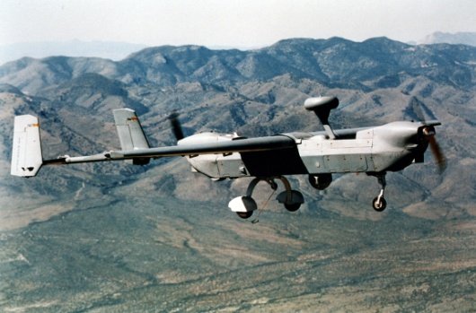
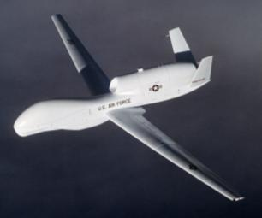
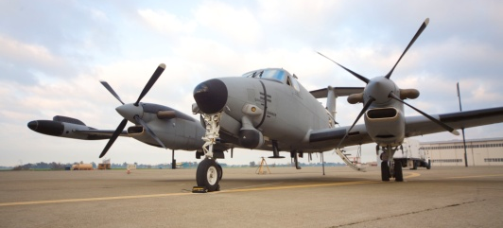
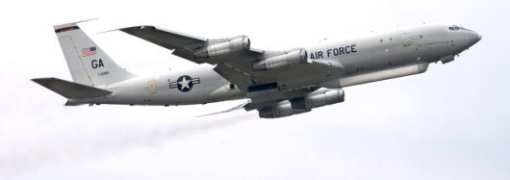
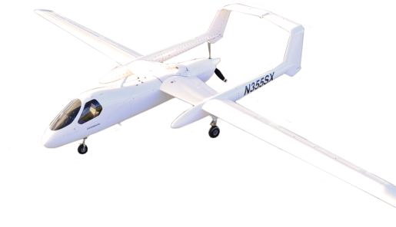
Bridging Manned & Unmanned ISR platforms
– Why it’s important
Manned Strengths
Unmanned Strengths
More control and tasking capability to tactical commanders on the ground
Seamless operation in the U.S. national airspace
Accommodates larger sensor payloads
Less cost to integrate new capabilities
Agility and responsiveness
Greater endurance than manned platforms
Lower operational cost than manned ISR platforms
Keeps people out of immediate danger
Lower maintenance and manpower costs
Flexibility
Utility
Plug-and-Play architecture
IP-based connectivity
Kit-based OPV
Common mission management
Large internal payload bay
Interface with ground units
Multi-sensor, multi-mission
Approved for Public Release, Northrop Grumman Case 11-0959 dated Aug 9, 2011

Slide 12
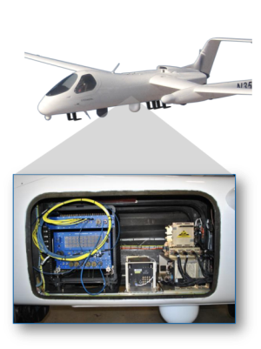
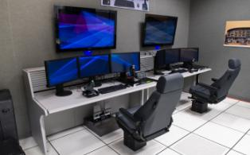
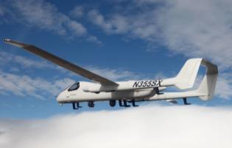

Firebird: Multi-INT ISR capability – by design
Its About The Architecture
Multi-INT, Not Multi-Platform
Manned and Unmanned Operation
Large Internal Payload Bay
Hardware-Software-Network Architectures
Modular, Open and Accessible
Plug-n-Play
Service Based, Standards Based
Mission – Vehicle Management Systems Segregated
Library Approach, CMMS
Multi-Sensor, Mission Ready
On-Board/Off-Board Processing w/Network Attached Storage
Modular Integration (hardware/software)
Flexible requirements based Bandwidth Management
Optionally Piloted by Design
Multi-Mission
Simplified Airspace Integration
Expeditionary Flexibility
Supports Border Protection and First Responders
Manned Single Place with Full UAS Capability
Eliminates complex payload POD’s
Reduces time and cost of payload integration
Accelerates capability to the field
Reduces payload development and sustainment cost
Approved for Public Release, Northrop Grumman Case 11-0959 dated Aug 9, 2011

