Slide 1
Technology Roadmap: Observing at the Global Scale
The agenda:
Background on the TR process
Why do we want to observe at the global scale?
  The science drivers that tie to Strategic Plan
What are we considering that fits with our guidance?
  Sensor arrays that scale to large numbers
  Platforms – vehicles, ships that may have a global reach
  Efficient use of ships of opportunity
    Adaptable vehicles (hybrid ROV’s, AUV’s…)
The report:
  How do we select focii?
  What else do we need to talk about?
  trglobalscale@listserver.mbari.org

Slide 2
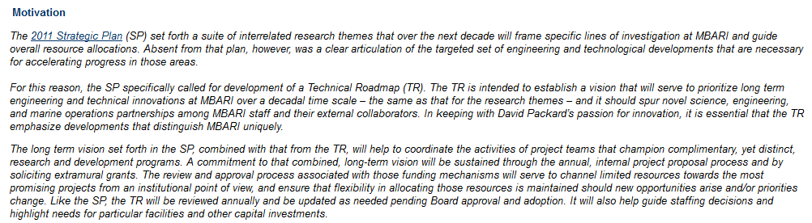
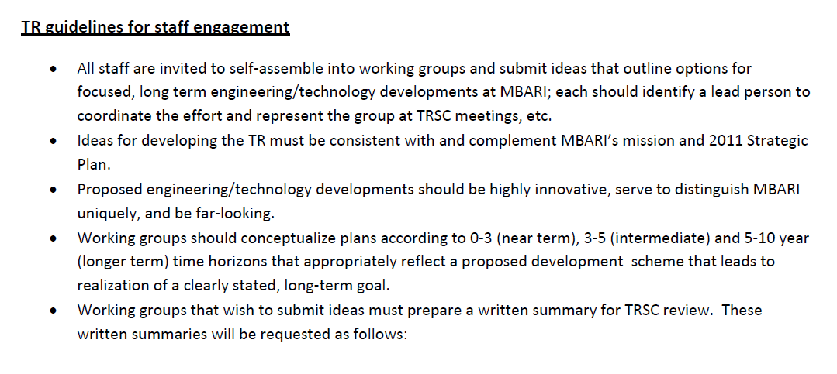

Slide 3
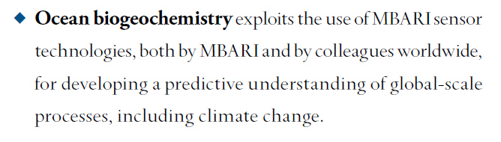
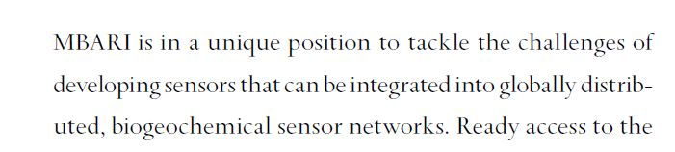

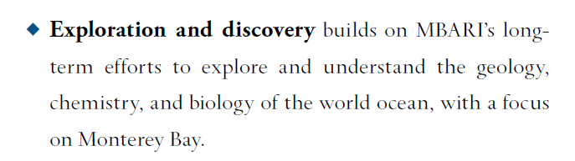
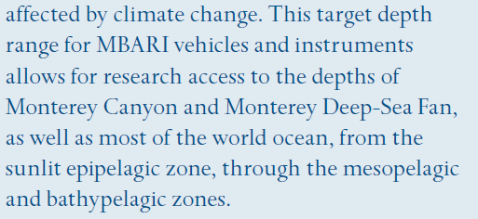

Slide 4


Slide 5
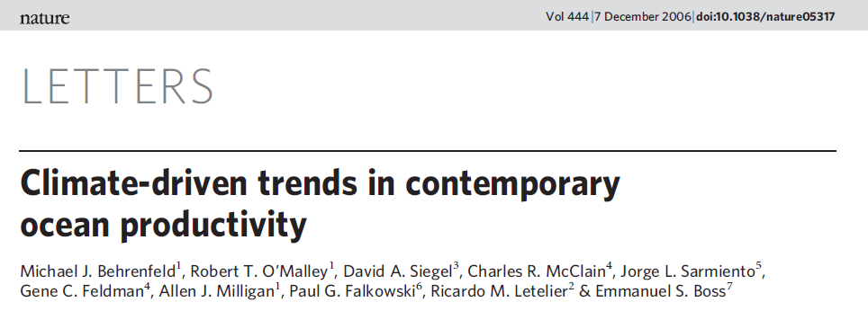
Numerous studies point to changing ocean phytoplankton/ productivity.
Results are often criticized because of problems in underlying data sets.
We need better data
Global
In Situ/Resolve Z
DIrectly Linked To Pri. Prod./ Biomass

Slide 6
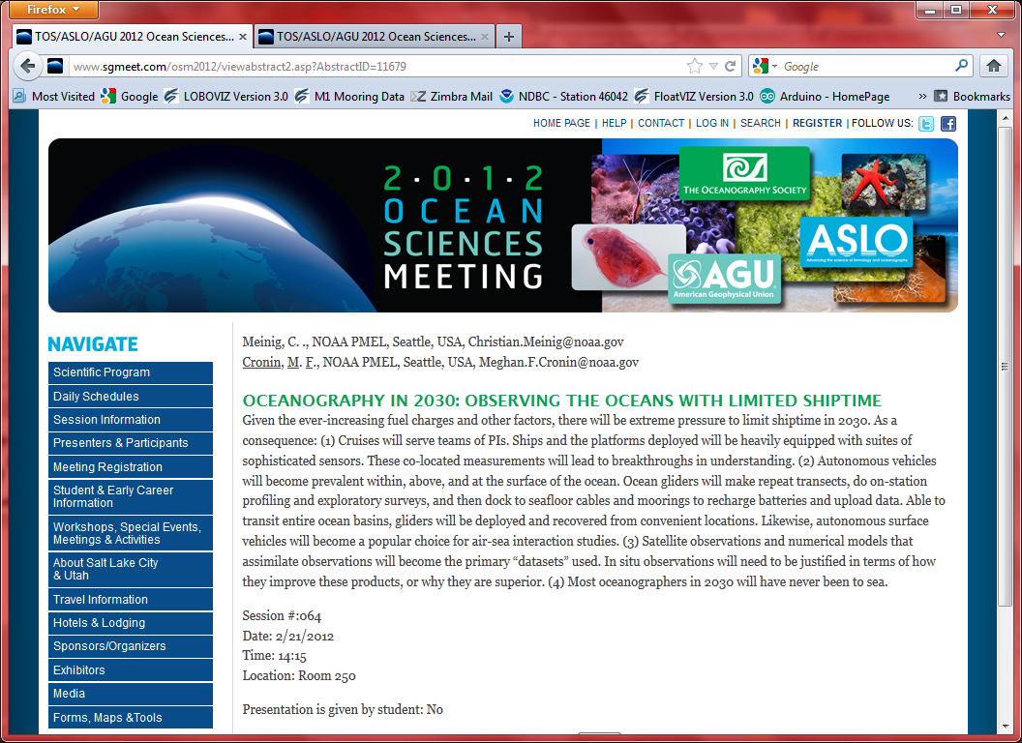

Slide 7
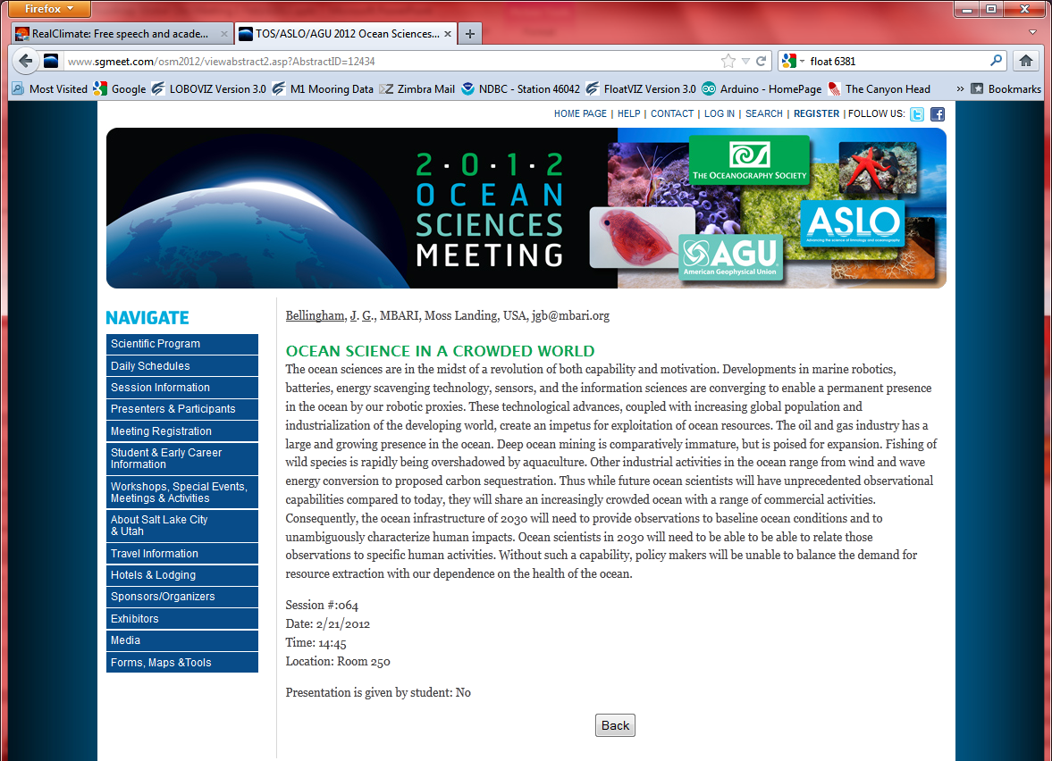

Slide 8
Technology Roadmap: Observing at the Global Scale
The agenda:
Why do we want to observe at the global scale?
  The science drivers
What are we considering that fits with our guidance?
  Sensor arrays that scale to large numbers
  Platforms – vehicles, ships that may have a global reach
  Efficient use of ships of opportunity
    Adaptable vehicles (hybrid ROV’s, AUV’s…)
The report:
  How do we select focii?
  2. What else do we need to talk about?

Slide 9
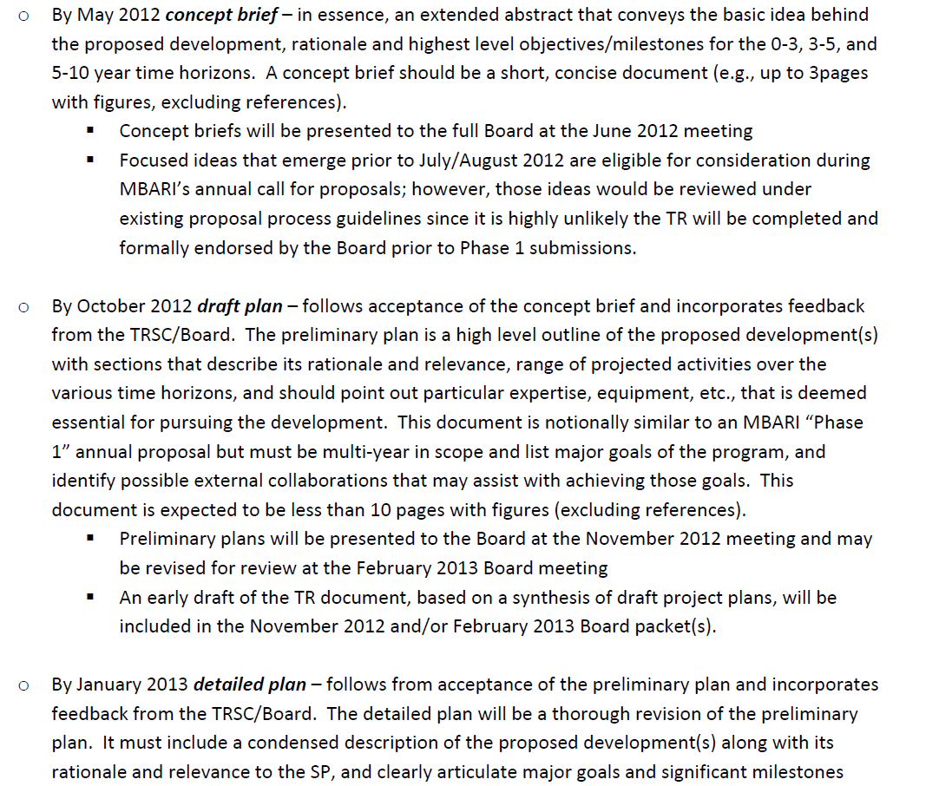

Slide 10
Example of what is needed by May 1:
Title:
Working group lead (POC):
Working group team:
Project overview in brief (1-2 paragraphs):
Relevance to the SP (1 paragraph):
Envisioned technology developments (short bullets under each heading):
a. 0-3y
b. 3-5y
c. 5-10y
Opportunities for external collaboration and/or funding (1 paragraph):

Slide 11
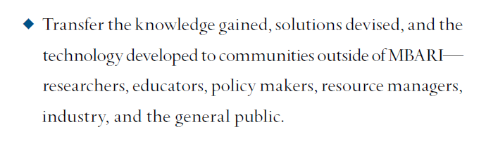
Technology Roadmap: Observing at the Global Scale
The agenda:
3. The process to refine the report (10 pages plus figures):
  The report needs to be
    credible,
    forward looking,
    feasible,
    affordable
  How do we select focii?
    Science Impact
    Feasibility
    Affordability
    Transferability
    MBARI interest and consistency with Strategic Plan
    Fit to MBARI, can MBARI have an impact
    What are the negatives, can they be mitigated
  3. What else do we need to talk about?

Slide 12
Technology Roadmap: Observing at the Global Scale
The agenda:
2. What are we considering that fits with our guidance?
  Sensor arrays that scale to large numbers
  Platforms – vehicles, ships that may have a global reach
    Satellites?
    Unmanned Aerial Vehicles (UAV’s)
    Using ships of opportunity – volunteer observing ships
  Efficient use of ships of opportunity
    Adaptable vehicles (hybrid ROV’s, AUV’s…)
Submit short (or long) topics to
trglobalscale@listserver.mbari.org
I’ll collate and we can have a discussion regarding: science impact, feasibility, affordability, transferability, MBARI interest, fit to MBARI, negatives. Ultimately, we’ll rank and select?

