Slide 1
↓Oxygen
↑Acidity
↑↓? Nitrate
↑Carbon Dioxide
↑Heat
↓Carbonate
The Ocean
↓Sea Ice
↑Density stratification
What happens to chemical cycles (C, N, O) and biological processes that drive them? What is the impact on the planet?

Slide 2
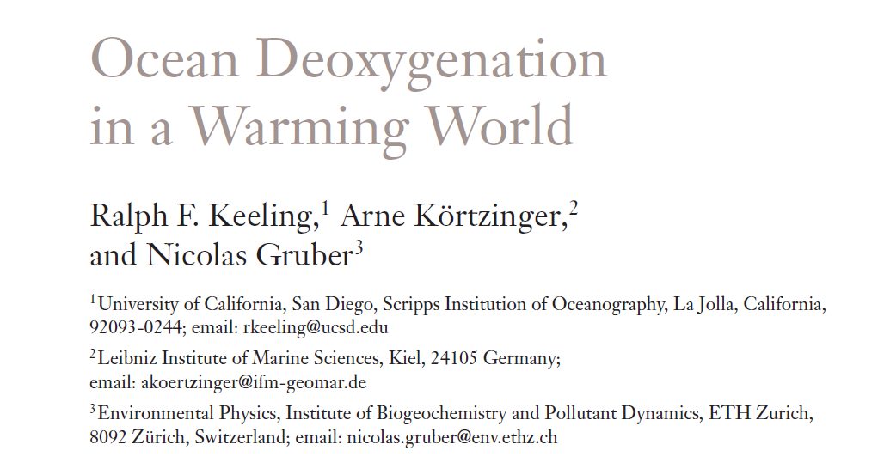
Annual Review of Marine Science, 2, 2010

Slide 3
Fig. 2 Red dots are regions with sufficient oxygen data to compute temporal trends according to a minimal set of criteria for data availability (from Gilbert et al., 2010).

Slide 4
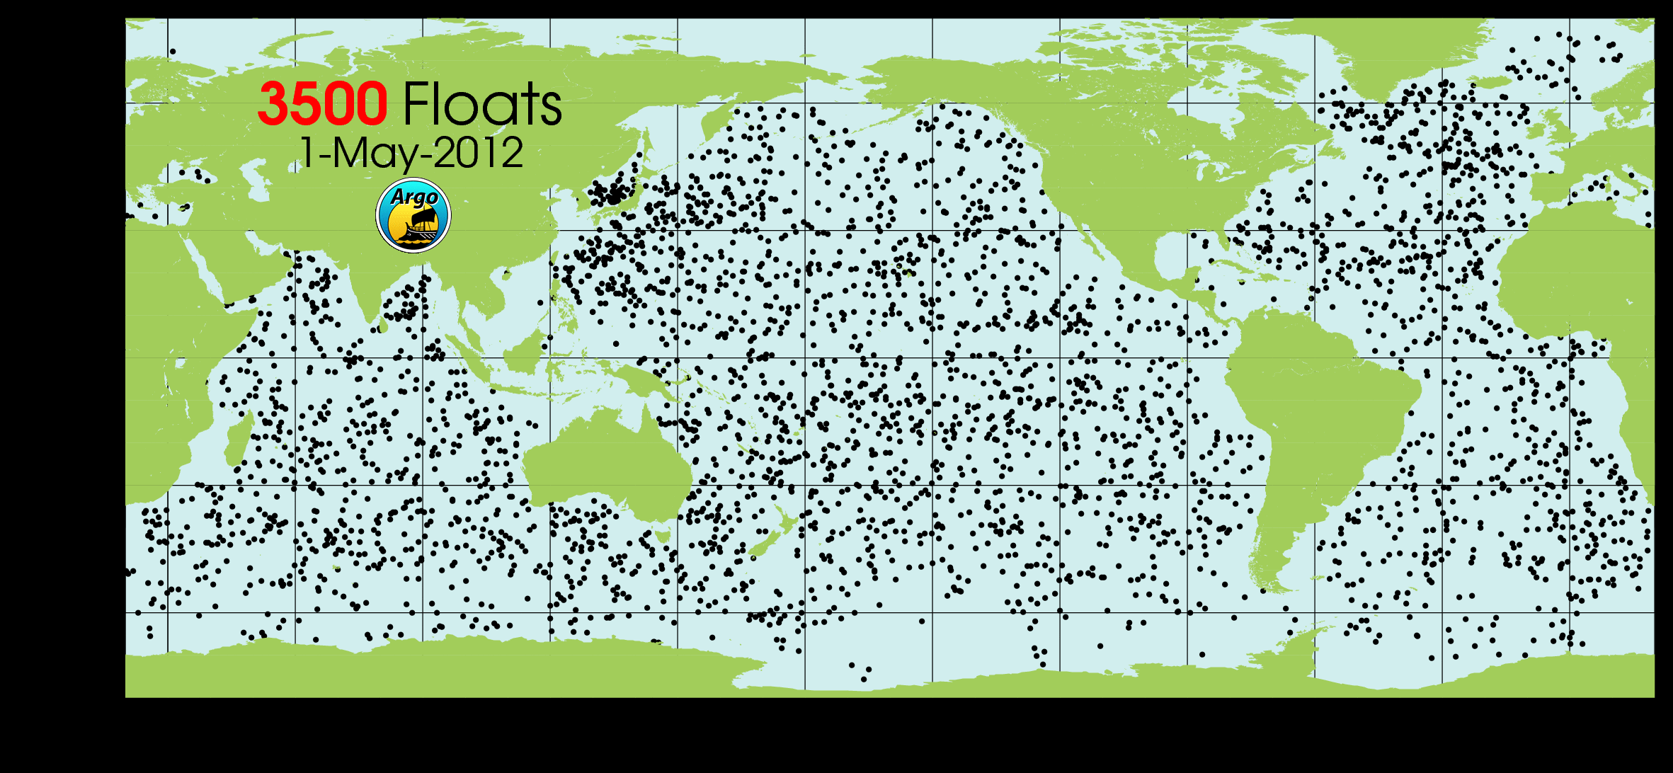

Slide 5
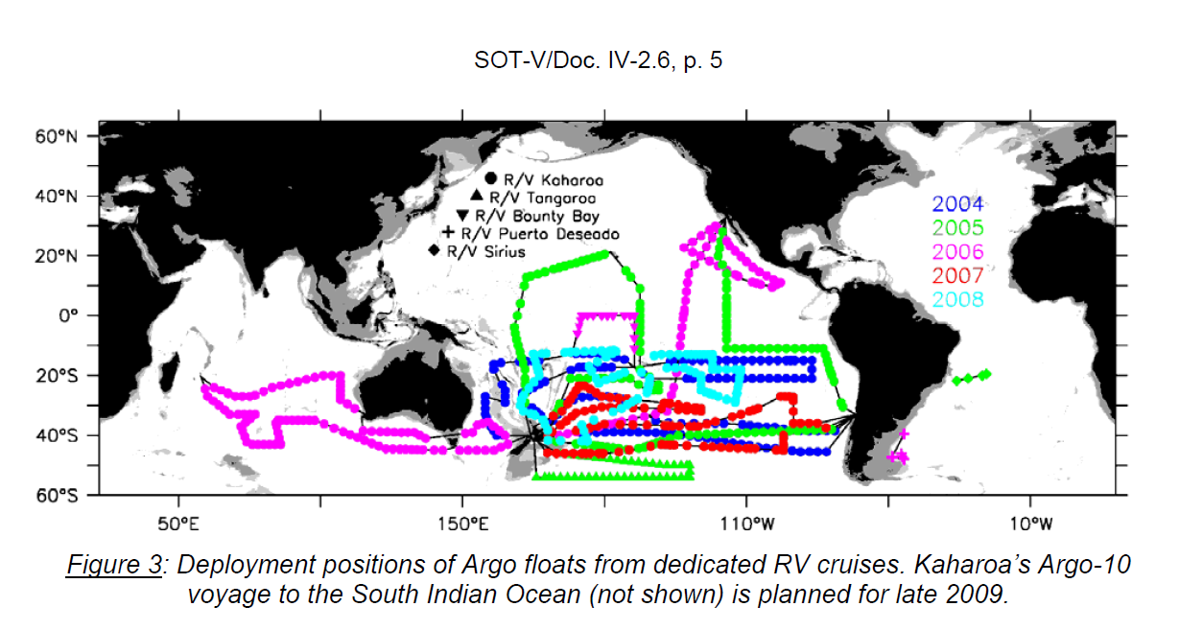
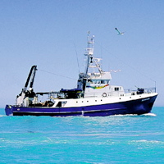
30 meters, $8000/day
No scientists for Argo deployments

Slide 6
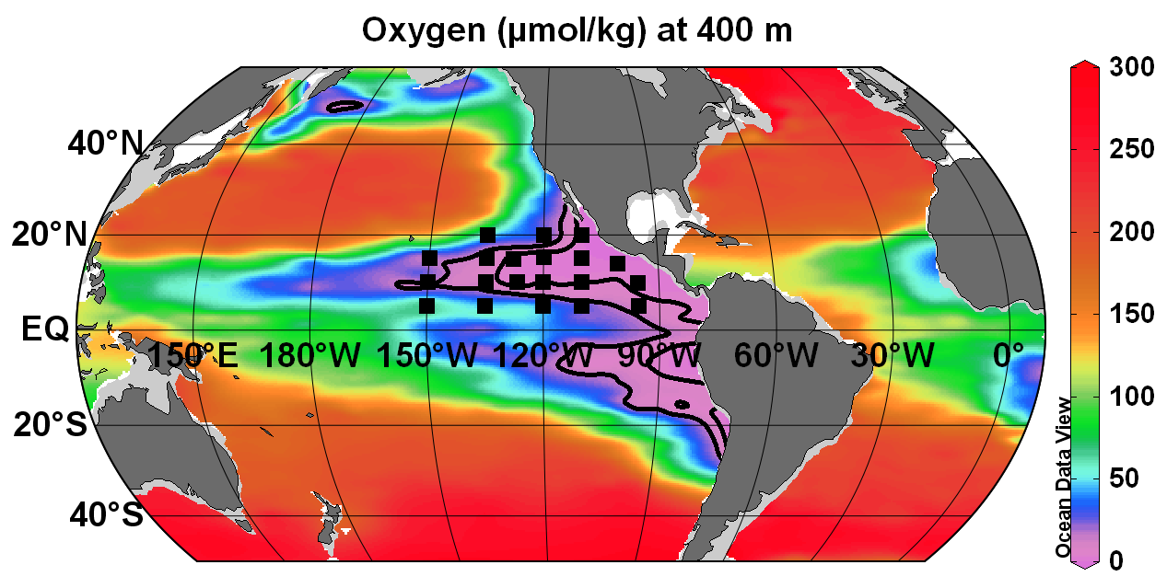
Fig. 1. Dissolved oxygen concentration at 400 m depth. Contour lines are drawn at 5 and 10 µmol/kg. Black squares are possible deployment locations for 20 profiling floats. Oxygen data from the e-WOCE Atlas were accumulated over the past 25 years.

Slide 7
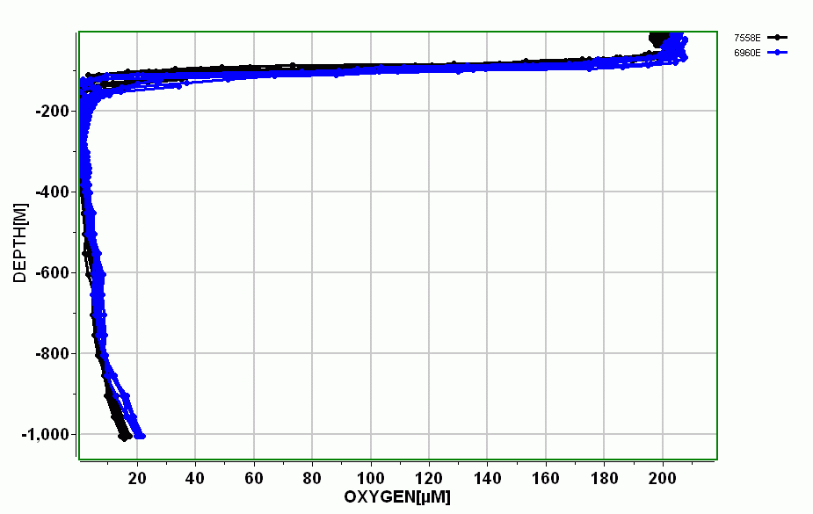
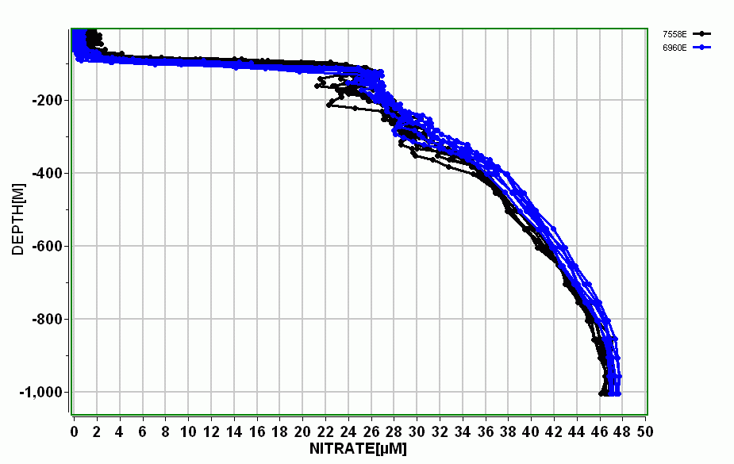
Eastern Tropical North Pacific – largest volume of suboxic (O2 < 4.5 µmol/kg) water in the world ocean – almost no historical data from which a time series of O2 be generated. So interesting we dropped two floats in last month – data on www.mbari.org/chemsensor/floatviz.htm
Suboxic water
Losing nitrate due to denitrification – what happens to long term balance of ocean nitrate? Models now suggest rapid response to O2 loss.

Slide 8
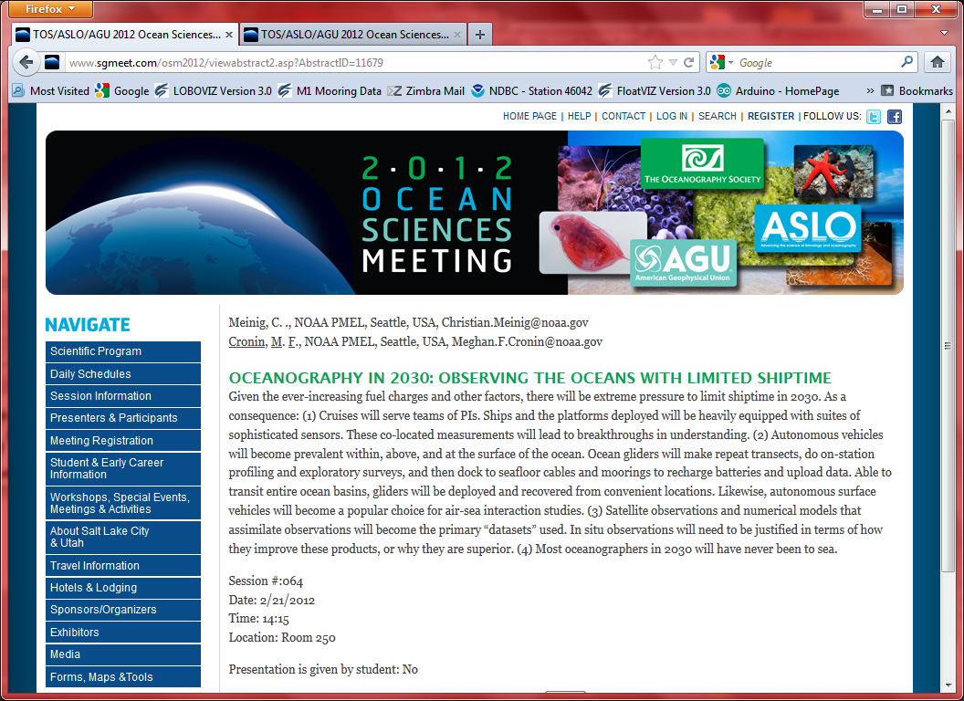

Slide 9
Technology Roadmap: Observing at the Global Scale
2. What are we considering that fits with our guidance?
  Sensor arrays that scale to large numbers
    Floats – proven model – they scale $60k/5 yrs = $12k/y
    Gliders – not yet demonstrated in large arrays, operational cost probably too high ($250k+$50k/y*5)/5 = $100k/y, use judiciously only in select places
    AUV’s – likely similar
  Platforms – vehicles, ships that may have a global reach
    Satellites?
    Unmanned Aerial Vehicles (UAV’s)
    Using ships of opportunity – volunteer observing ships
  Efficient use of ships of opportunity
    Adaptable vehicles (hybrid ROV’s, AUV’s…)
  Sensor metrology

Slide 10
Are we just focused on sensor arrays or is there a global access component using low cost ships to deliver autonomous packages like AUV’s or gliders or benthic rovers to interesting areas?
  Corollary is efficient use of low cost ships to access remote regions with new MBARI technology
    Adaptable vehicles (hybrid ROV’s, AUV’s…)

Slide 11
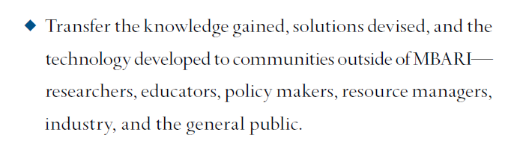
Technology Roadmap: Observing at the Global Scale
The agenda:
3. The process to refine the report (10 pages plus figures):
  The report needs to be
    credible,
    forward looking,
    feasible,
    affordable
  How do we select focii?
    Science Impact
    Feasibility
    Affordability
    Transferability
    MBARI interest and consistency with Strategic Plan
    Fit to MBARI, can MBARI have an impact
    What are the negatives, can they be mitigated
  3. What else do we need to talk about?

Slide 12
Concept Brief Due Dates
May 8, 2012: Steering Committee meets
May 14: TR brief 1st draft due (Submit BRIEF documents using the Template for submitting Concept Briefs.)
May 21: Comments back to teams as necessary
May 29: TR brief 2nd draft due
June 4: "Final," binned briefs compiled for TRSC/Board and shipped out
June 18: TRSC meeting to discuss briefs and formulate next steps
Tentative time line for remainder of process
Draft plans due by October 2012
Detailed plans due by January/March 2013
Final plan due by June 2013
Foundation Reviews Conservation and Science program in 2013
Foundation makes budget adjustments 2014

