Slide 1
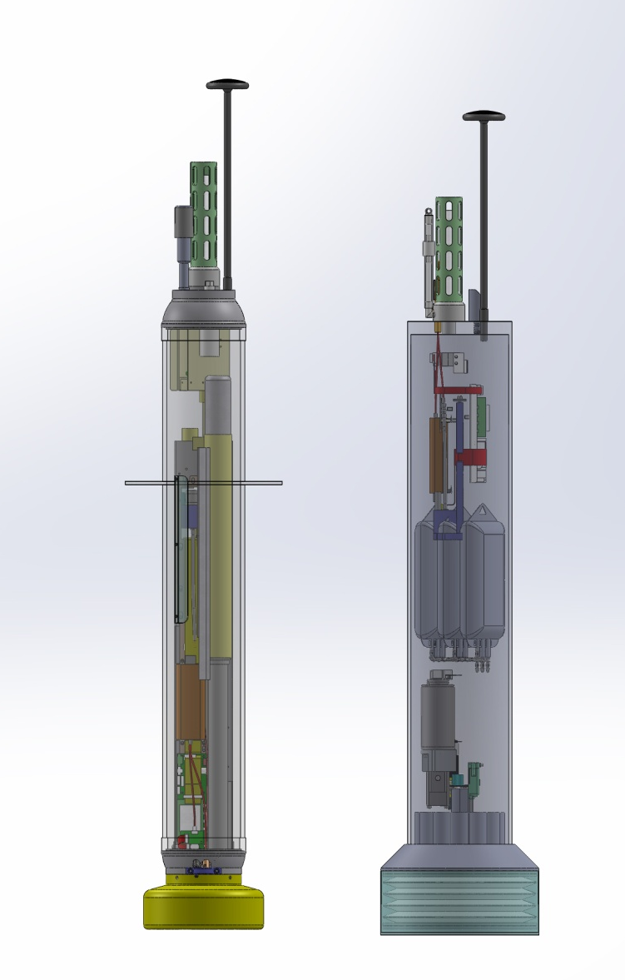
COTS Webb MBARI Prototype
APEX Profiler Coastal Profiler
MBARI Coastal Profiling Float Project

