Slide 1
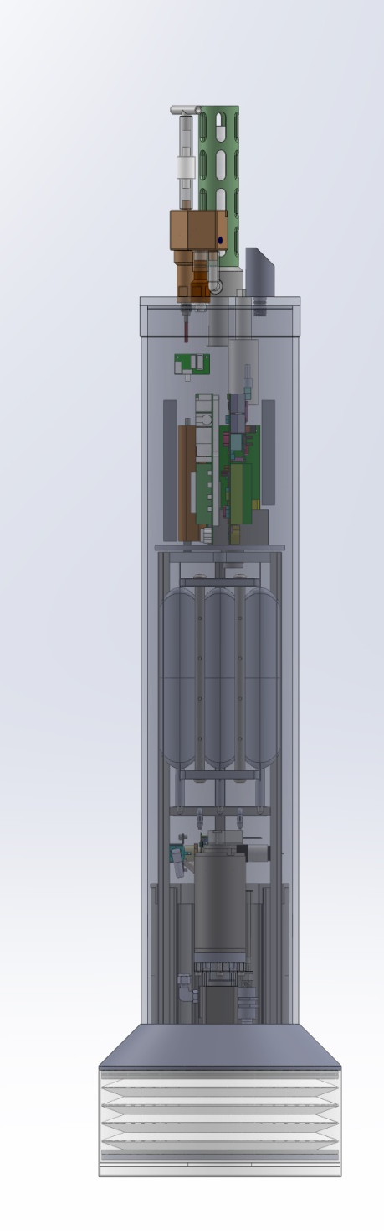
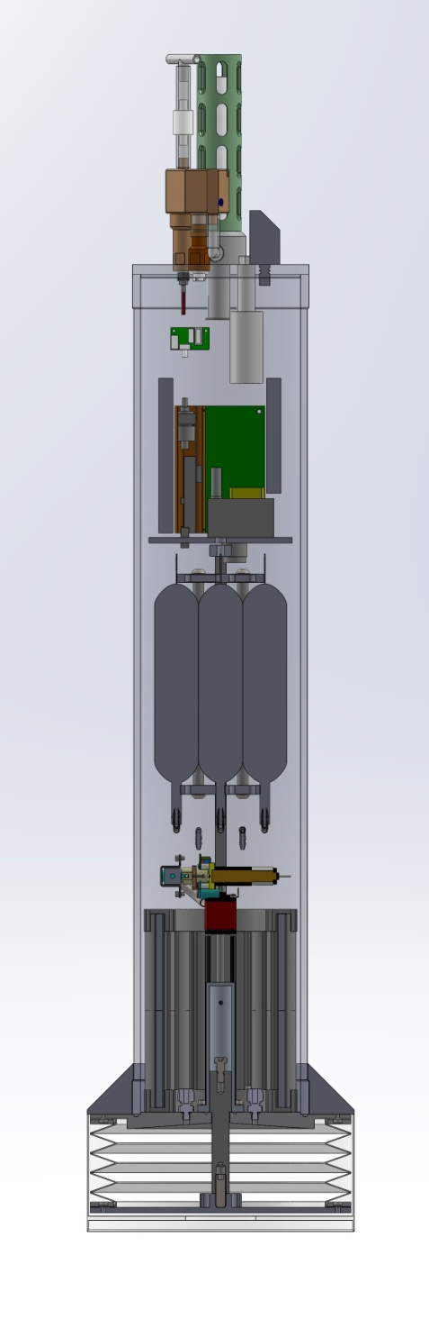
Coastal Profiling Float
Design Review
June something, 2013

Slide 2
Why a Coastal Profiling Float (CPF)?
Relevant Science drivers
  Understand variability in the coastal environment
  Coastal hypoxia/acidification is a new and growing issue
  The effect of human generated point source pollutants is a coastal problem
The specific science mission
  Is net production changing on the West Coast of the US
    What is changing, where, at what rate?
Overarching technology requirements
  Need to flood the measurement volume with economical, sustainable, capable instruments suites.
    Both initial capital costs and on-going O&M costs are important
    So, the question is what platform

Slide 3
Why a CPF? (cont)
The Argo array has been and should continue to be a successful example of an economically viable (~$50M), sustainable global observing system
Argo floats are the preferred platform for new Chem Sensor lab instrumentation
Conclusion:
  While there are certainly some risks, adapting Argo open ocean profiling float technology for coastal oceanographic applications may provide important new observing capabilities

Slide 4
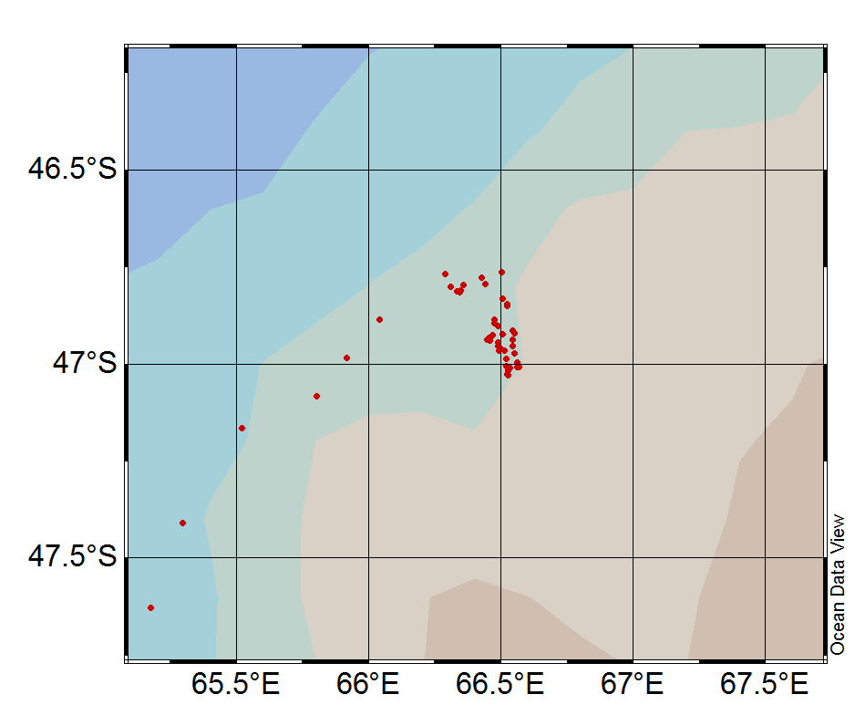
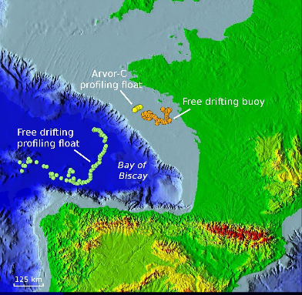
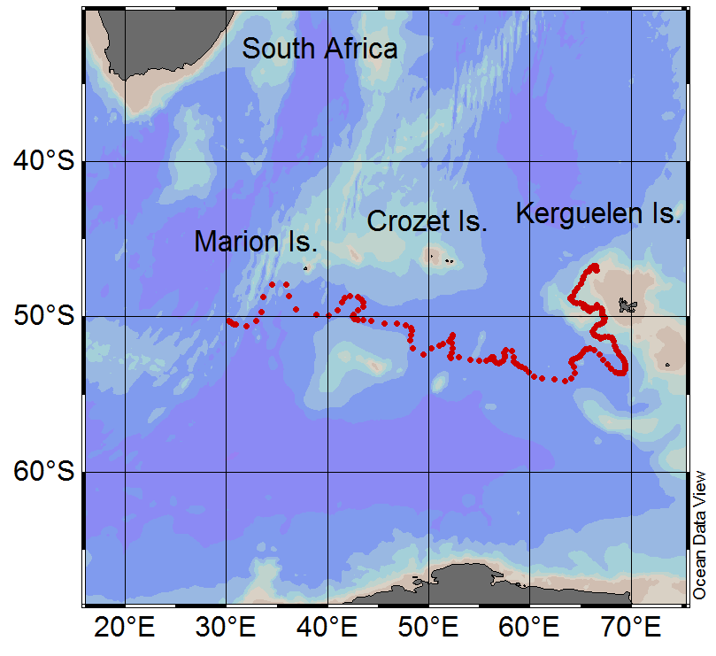
Argo 7647: 9 months parked at ~1000m
Some evidence this may work
0.25⁰=28km
ARVOR-C 200m/day
Buoy @ 50m = 4000m/day
Drifting profiler = 4300m/day

Slide 5
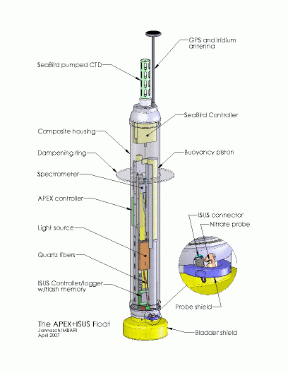
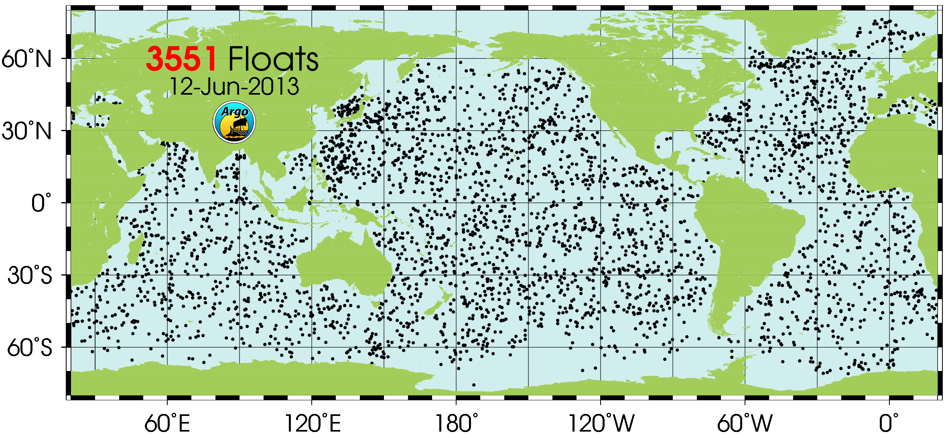
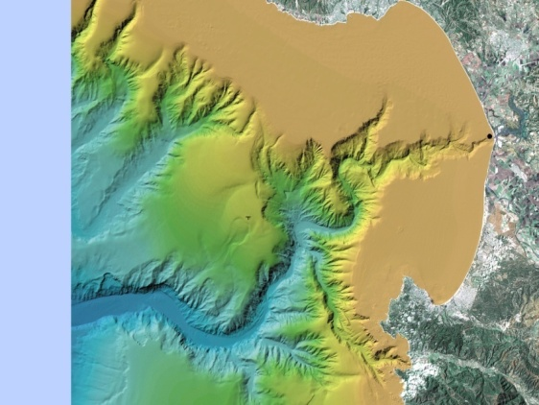
The Big Picture
Replace existing buoyancy engine with more efficient, better form factor engine with enough buoyancy control to anchor/de-anchor on the bottom.
Re-organize components to allow more sophisticated instrument suites better suited for coastal measurements
Improve controller to support more sophisticated instrument suites
Redesign float base to function as a “parking brake”

Slide 6
Requirements Summary
Profile from 500 meters to the surface
  Park anywhere in the water column
1000 profiles from 200 meters to the surface over 3 years (goal: 1800 profiles over 5 years)
Support a biogeochemical instrument suite
  CTD, pH, O₂, Nitrate, Fluorescence/Backscatter, PAR
2.5 liter buoyancy engine (BE) to support anchoring/de-anchoring capability
Size, weight, deployment scenario similar to existing APEX profiling float
Provide some instrument expansion capability

Slide 7
Significant Risks
Can we keep an array of profiling floats in a “coastal” measurement volume for the desired mission duration
Biofouling in the 500 meter range
Can we build a robust profiling float i.e. buoyancy engine, with significantly more ΔV/V (volume change divided by total platform volume) than existing floats

Slide 8
Risk Mitigation Calculations
Anchor/deAnchor force vs. current velocity
  Simple force balance equations with some geotechnical anchoring calculations
Energy budget with 10X buoyancy engine and expanded instrument suite
  Modified version of existing APEX energy model
Depth/velocity control for a limited depth
  Matlab/Simulink dynamic model with our PID controller
Float residence time in a coastal measurement volume
  Sergei Frolov built some nice tools using JPL/ROMS model

Slide 9
Some Background & Motivation
Existing profiling floats have been used for coastal applications with some success
  No significant optimization for coastal application is apparent
  Not currently an active area of development
Different class of hydraulic pump may mitigate some of the problems of the LeDuc pump currently used in gliders and other existing designs
Bellows style diaphragm may allow significantly larger external bladder size
High resolution, operational numerical model (JPL/UCLA ROMS ) may provide some ability to keep a float inside the desired measurement volume by taking advantage of serendipitous currents

Slide 10
Typical Mission Scenario
Define a grid of initial float deployment positions
Deploy the floats
Anchor, profile, telemeter results, repeat
Track all the floats in real time
Re-program individual float “park” depths to take advantage of serendipitous currents when possible
If necessary, recover/redeploy as necessary
  Paragon, Moss Landing orange RHIB size boat

Slide 11
Science User Interface
3 step Science user interface for mission definition
  Step 1: User fills out an Excel (or similar) spreadsheet to define mission parameters and depth vs. sample table; review and edit the mission
  Step 2: Run the sanity check macro, repeat step 1 and 2 as necessary
  Step 3: Convert the Excel file to mission description file which is downloaded to CPF
Same shore side infrastructure developed for Argo floats
  Files get telemetered ashore and are “rsynched” from MBARI Argo server to Atlas.shore.mbari.org\XXX

Slide 12
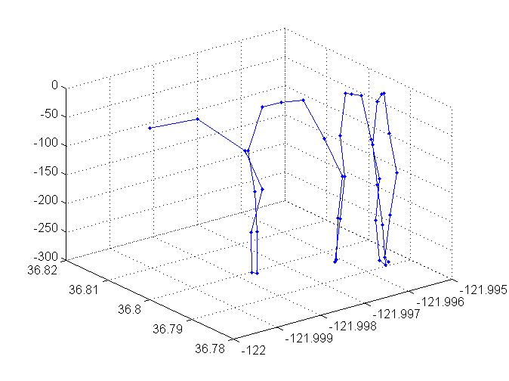
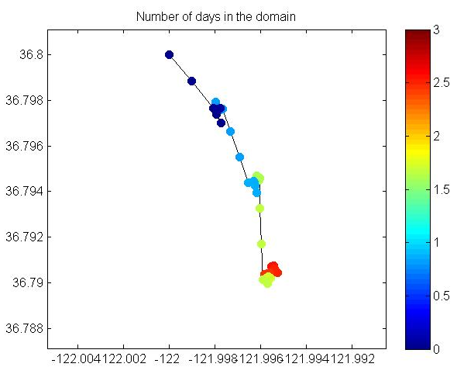
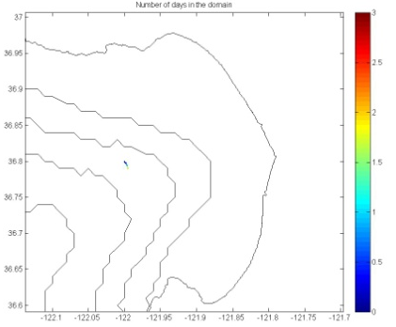
ROMS Model Initial Results
408m
1025m

Slide 13
Design Philosophy
Design a float test platform that allows us to address big picture questions and ignore important but pretty well understood issues
  e.g., Can we keep the CPF in the measurement volume? So the BE is (hopefully) oversized so we can test various anchor/deAnchor strategies
  e.g., more efficient power distribution, lighter housing may wait until phase 2

Slide 14

What do you get for a 5 year $10M experiment?
Profiling float costs
  CSOBOM float = $60K capital costs + $0/year
  Minimal small boat deployment costs
Glider costs (per Oscar S. and Dan R.)
  $250K capital costs + $50K/year maintenance
  Somewhat greater small boat costs due to ~3 month refurb.
CPF and CSOBOM float costs are roughly similar
  Minor differences in BE and pressure housing
166 floats, 20% loss = 133 in the array for 5 years
20 gliders w/4 on shore for refurbishment = 16 in the array at any 1 time
MODIS Chlorophyll June 28, 2011
htttp://podaac-tools.jpl.nasa.gov/soto/

Slide 15
Argo 7647: 9 months parked at ~1000m
Some evidence this may work
0.25⁰=28km
ARVOR-C 200m/day
Buoy @ 50m = 4000m/day
Drifting profiler = 4300m/day

Slide 16
End of Science Overview
Engineering Details
  Mechanical Subsystem
    Buoyancy Engine
  Electrical Subsystem
    Power Budget
  Software Subsystem
  Test Plan
  Tech Transfer

Slide 17
Mechanical Subsystem
Except for the BE the CPF is a pretty typical mechanical design
(ΔVolume/Total Volume) matters
  Existing designs can’t always descend/surface through strong pycnoclines
  If ΔV/V matters then weight & volume matter
The APEX float uses a center tie rod, single face seal O-ring pressure vessel

Slide 18
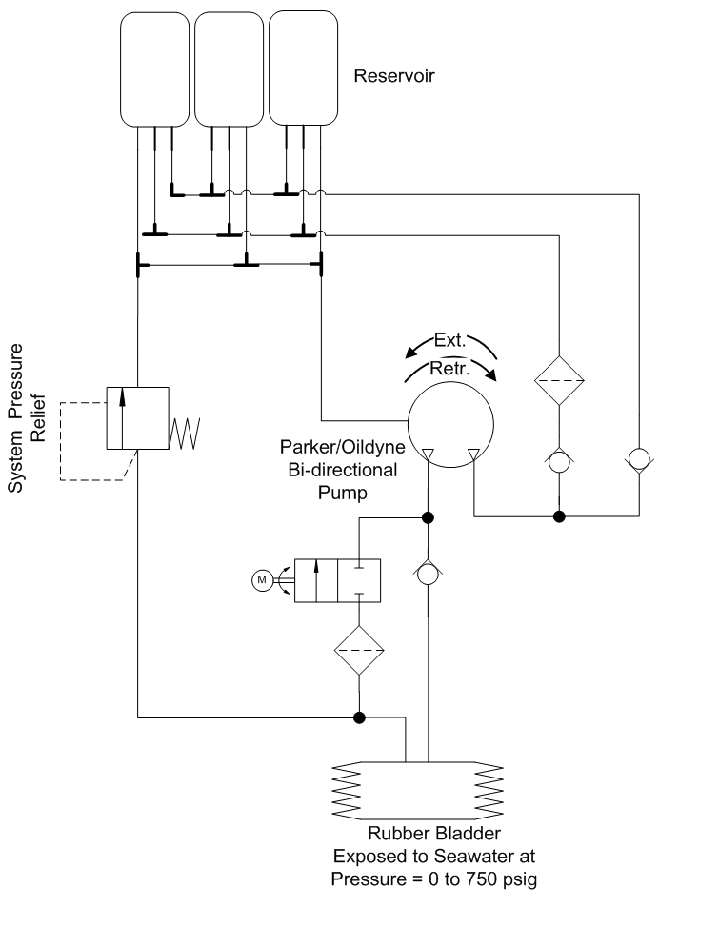
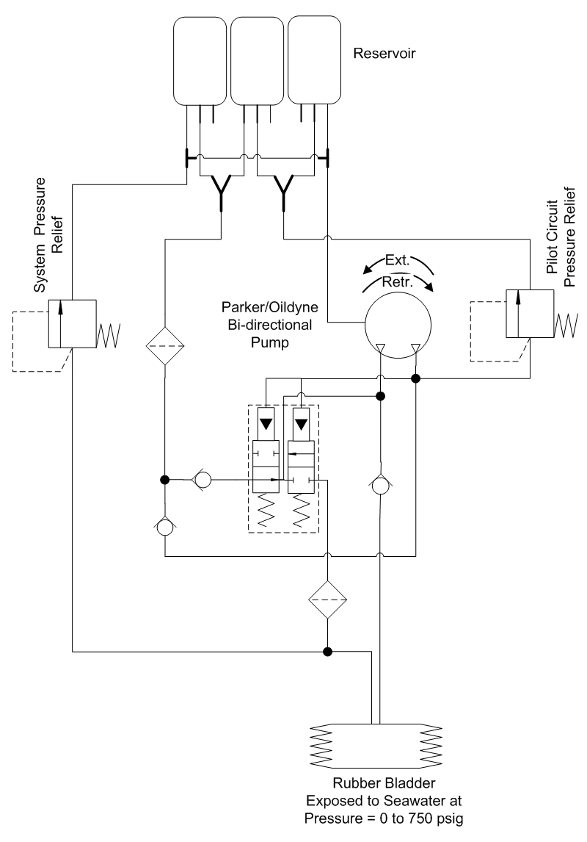
Buoyancy Engine
2 design options
  single stroke = driven hydraulic cylinder
  multi-stroke = hydraulic pump
Efficiency is the deciding factor
  Cylinder – high volumetric efficiency, high frictional and gear head losses, difficult form factor
  Pump – lower volumetric efficiency, lower frictional losses, no gear head, flexible form factor
Zero-leak hydraulic valves are a myth

Slide 19
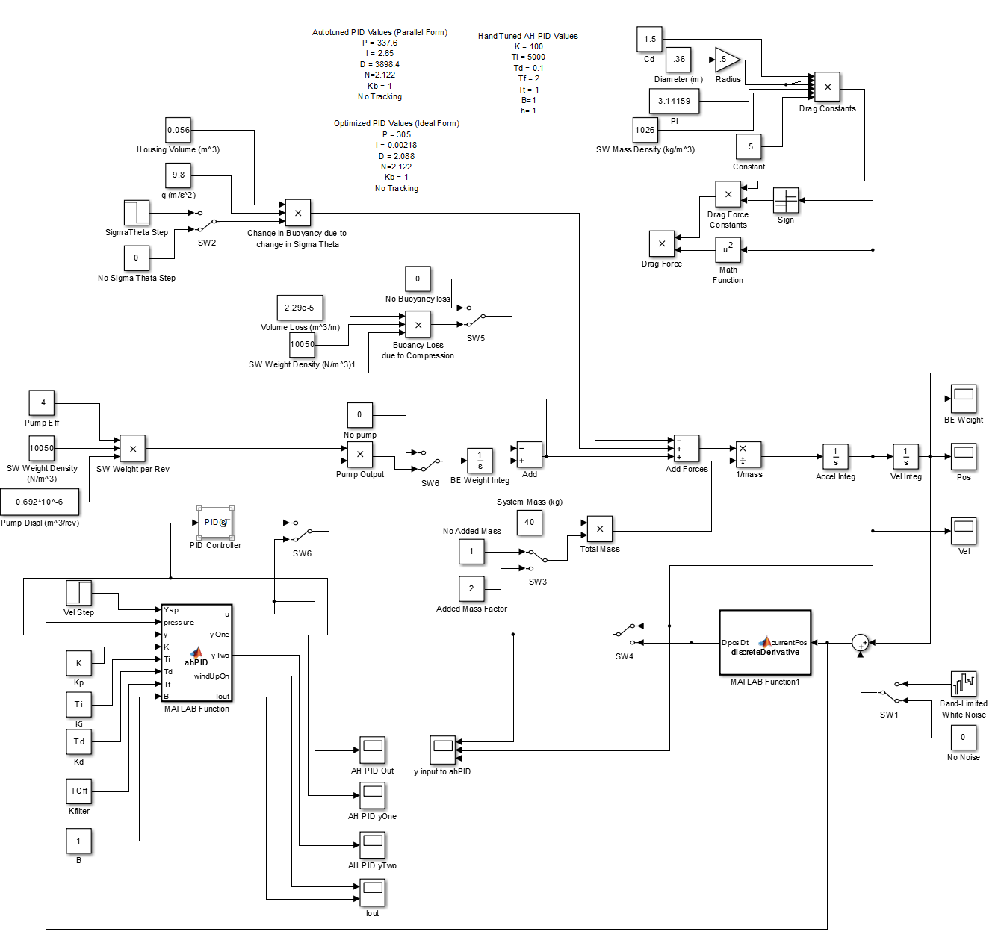
Simulink Buoyancy Control Model

Slide 20
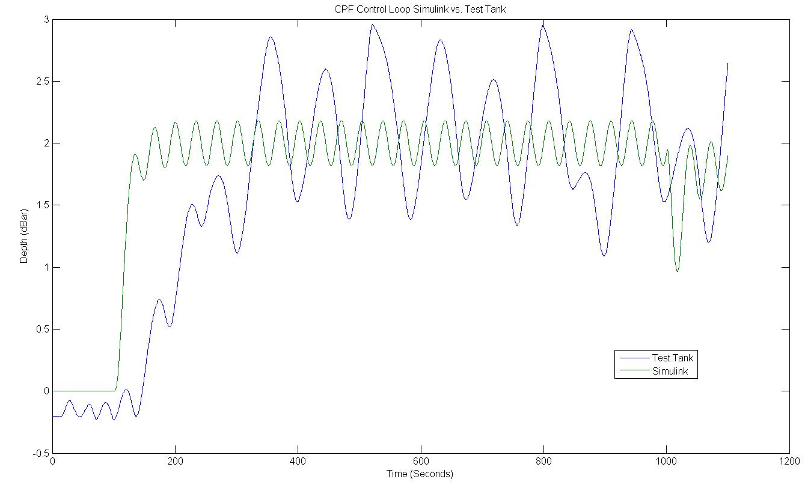
Simulink vs. Reality

Slide 21
Electrical Subsytem

Slide 22
Power Distribution
Need 24 VDC to achieve desired motor speeds
Primary batteries for full mission, rechargeable batteries for testing
Electrochem 3B0076 Li-BrCl primary 3.0–3.9 VDC
Tenergy 18650 Li-ion rechargeable 3.0-4.2 VDC
8 cells in series = 24-33.6 VDC Battery Bus
  Run the BE motor directly off the Battery bus
Buck converters for 3.3VDC electronics, 12 VDC instruments and 23VDC position sensor
Switched power to instruments
Independent micro power sleep controller for overall system (eventually).

Slide 23
Gadgeteer?
Problem: Software development is hard, time consuming and can impede progress in other areas
A set of tools that provides effective embedded development testing to move forward in parallel with production software development would be very valuable
Ideal solution would have
  Cheap, readily available, embedded hardware
  The ability to support current and future Chem Sensor lab work
  An easy to learn, easy to use, powerful development environment
  Existing interfaces (both hardware and software) to a wide range of devices
I’ve never found anything suitable until I stumbled across the Gadgeteer/.NET Micro Framework/Visual Studio and it looked worth an experiment

Slide 24
Initial Gadgeteer Experiment
Building a working test tank prototype to test buoyancy engine performance and control strategies
An unequivocal success
  Complete ignorance to full BE control test program in 2 weeks
  10 Hz PID loop, event driven serial IO, SPI, USB, Bluetooth and a file system
So successful we asked the question whether it is worth looking at .Net Gadgeteer for the production software

Slide 25
Software Details

Slide 26
State diagrams

Slide 27
Gadgeteer
Overview
  Gadgeteer = hardware spec, .net micro framework, Visual studio C#
  Microsoft labs development, MS commitment,
Mostly open source (some vendor drivers may be prop.)

Slide 28
Pros/cons
Pros
  Rapid development
  Low cost tools and hardware
  Low level details are abstracted so we can concentrate on the application
    At many levels
  After initial investment in Software Engineering, very maintainable by Chem Sensor Lab

Slide 29
Cons
API documentation sucks
Interpreted language with escape to C++
  Performance won’t be the highest (but should be adequate)
GC
Not the lowest power

Slide 30
Software Components
Mission control, instrument drivers, buoyancy engine
Scheduler controls instrument sampling from the mission description file
WiFi and Iridium networking
Telnet server for UI to CPF
FTP for data and configuration file transfer

Slide 31
Implementation
HSM
  Why?
JSON
  Why?

Slide 32
Power Budget

Slide 33
Test Plan

Slide 34
Tech Transfer

