Slide 1
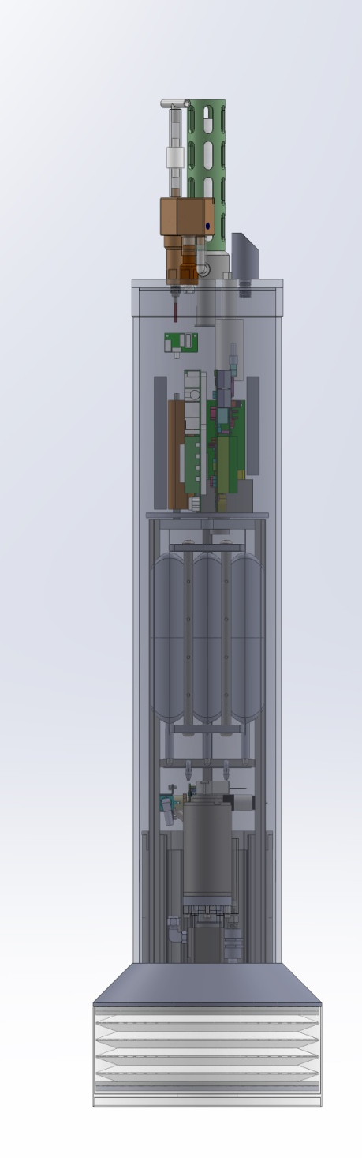
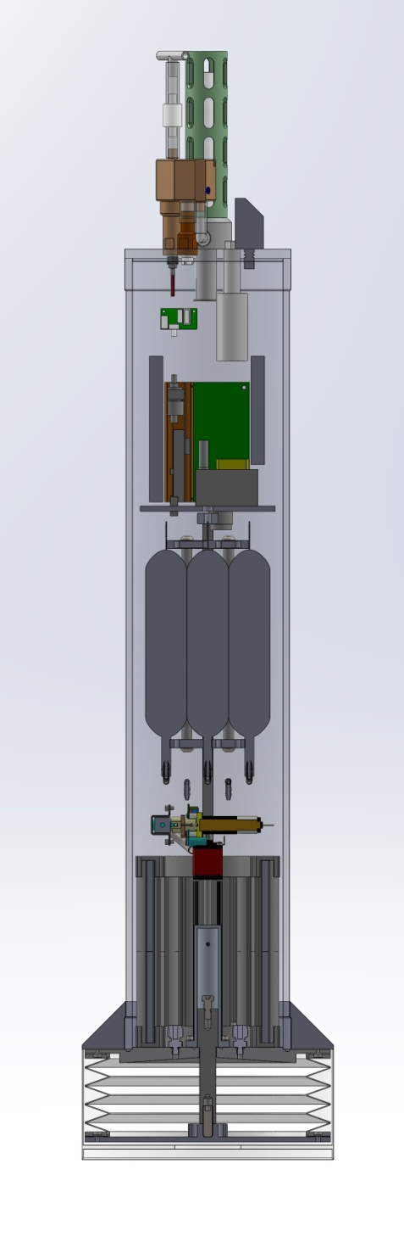
Coastal Profiling Float
Design Review
June 26, 2013

Slide 2
Why a Coastal Profiling Float (CPF)?
Relevant Science drivers
  Understand variability in the coastal environment
  Coastal hypoxia/acidification is a new and growing issue
  The effect of human generated point source pollutants is a coastal problem
The specific science mission
  Is net production changing on the West Coast of the US
    What is changing, where, at what rate?
Overarching technology requirements
  Need to flood the measurement volume with economical, sustainable, capable instruments suites.
    Both initial capital costs and on-going O&M costs are important
    So, the question is what platform(s)

Slide 3
Why a CPF? (cont)
The Argo array has been and should continue to be a successful example of an economically viable (~$50M), sustainable global observing system
Argo floats has been used successfully by the Chem Sensor lab for instrumentation development
Conclusion:
  While there are certainly some risks, adapting Argo open ocean profiling float technology for coastal oceanographic applications may support large coastal scale observing systems

Slide 4
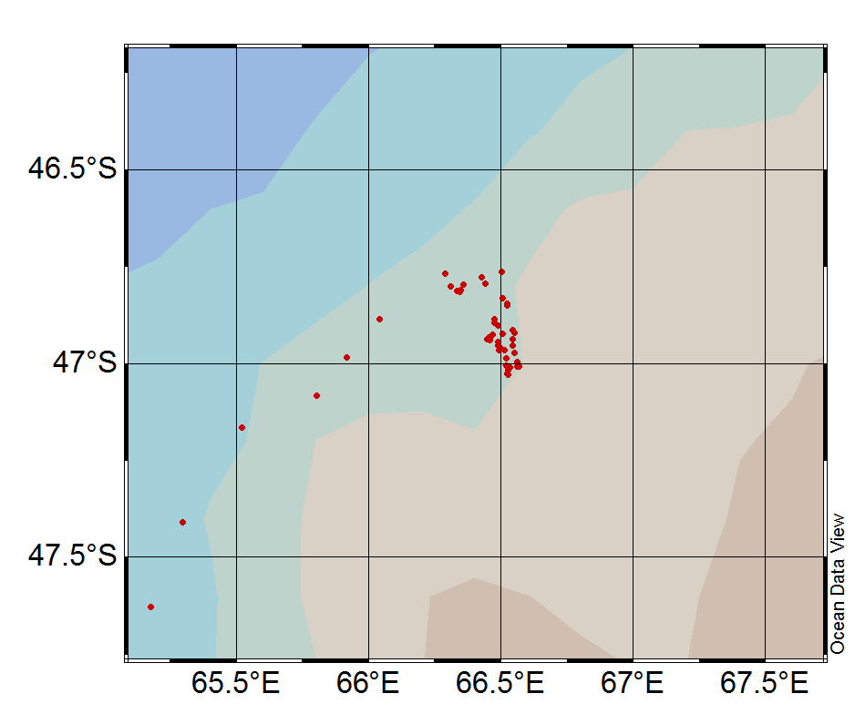
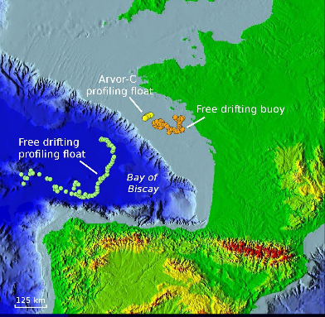
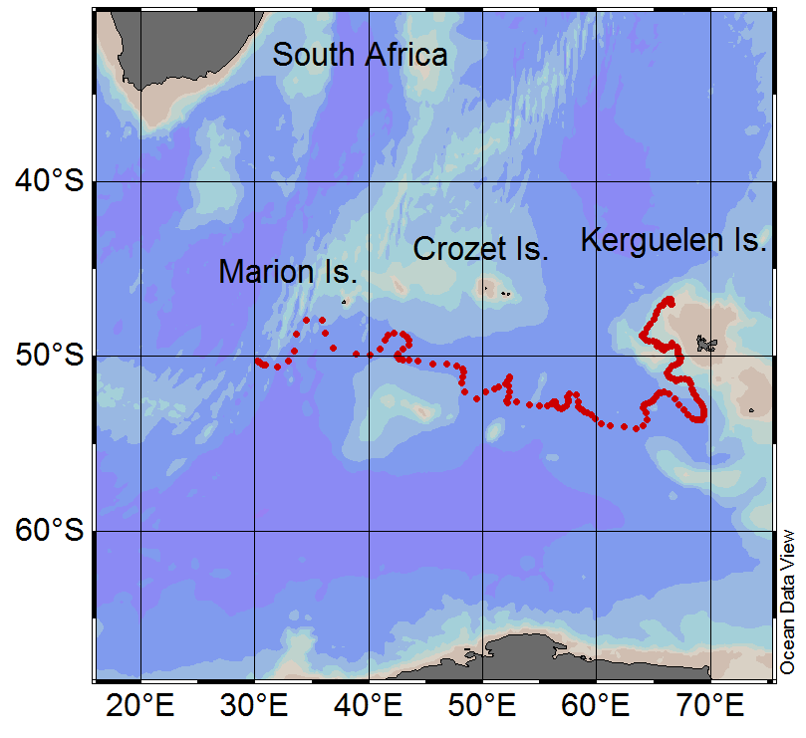
Argo 7647: 9 months parked at ~1000m
Some evidence this may work
0.25⁰=28km
ARVOR-C 200m/day
Buoy @ 50m = 4000m/day
Drifting profiler = 4300m/day

Slide 5
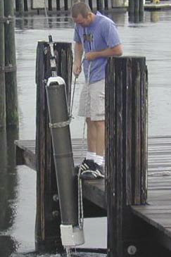
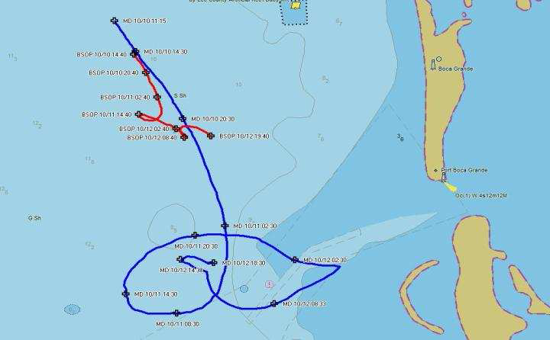
U of So. Florida Bottom Stationed Ocean Profiler
Bottom Stationing Ocean Profiler, A Coastal Profiling Platform
Free drifting platform with station keeping by bottom rest between cycles
Average deployment 20+ days, longest to date 55 days
Drift rates for entire deployments typically one to five km
Specifications:
  Size: 8” Dia x 66” (+ antennas)
  Weight: ~90 lbs
  Power: 380 Whr (Lead Acid Battery Pack) or 800 Whr (NiMH Battery Pack)
  Deployment duration: 50-150 cycles
• Storage: 128 kb expandable
• Low power sleep mode, <2 mA
2+ days
1.3 km

Slide 6
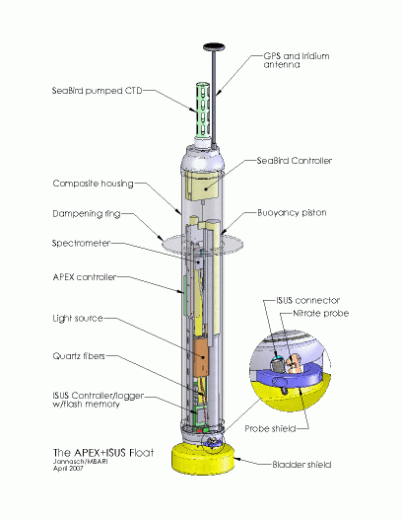
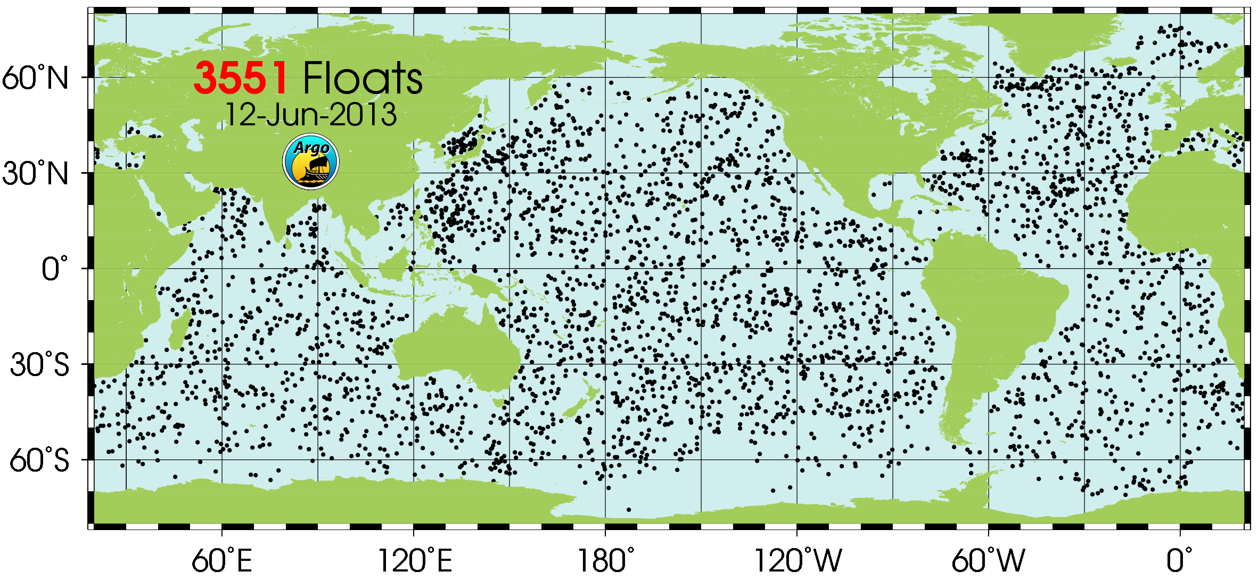
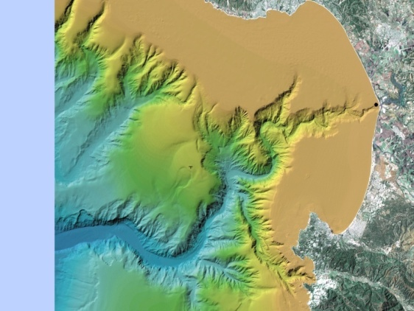
The Big Picture
Increase volume capability of buoyancy engine to support anchoring/de-anchoring on the bottom, ability to deal with bigger density gradients, decrease need for precise pre-ballasting
Re-organize components to support Biogeochemical instrument suite
Redesign float base to function as a “parking brake”

Slide 7
Requirements Summary
Profile from 500 meters to the surface
  Park anywhere in the water column
1000 profiles from 200 meters to the surface over 3 years (goal: 1800 profiles over 5 years)
Support a biogeochemical instrument suite
  CTD, pH, O₂, Nitrate, Fluorescence/Backscatter, PAR
Size, weight, deployment scenario similar to existing APEX profiling float
Provide some instrument expansion capability
Initial Calculations suggest 2.5 liter buoyancy engine (BE) to support anchoring/de-anchoring capability

Slide 8
Significant Risks
Can we keep an array of profiling floats in a “coastal” measurement volume for the desired mission duration
Biofouling in the 500 meter range
Engineering Challenge: Can we build a robust profiling float i.e. buoyancy engine, with significantly more ΔV/V (volume change divided by total platform volume) than existing floats

Slide 9
Risk Mitigation Calculations
Anchor/deAnchor force vs. current velocity
  Simple force balance equations with some geotechnical anchoring calculations
Energy budget with 10X buoyancy engine and expanded instrument suite
  Modified version of existing APEX energy model
Depth/velocity control for a limited depth
  Matlab/Simulink dynamic model with our PID controller
Float residence time in a coastal measurement volume
  Sergei Frolov built some nice tools using JPL/ROMS model
And a ton of Mathcad spread sheets

Slide 10
Some Background & Motivation
Existing profiling floats have been used for coastal applications with some success
  No significant optimization for coastal application is apparent
  Not currently an active area of development
Different class of hydraulic pump may mitigate some of the problems of the LeDuc pump currently used in many gliders and other existing BE designs
Bellows style diaphragm may allow significantly larger external bladder size
High resolution, operational numerical model (JPL/UCLA ROMS ) may provide some ability to keep a float inside the desired measurement volume by taking advantage of serendipitous currents

Slide 11
Typical Mission Scenario
Define a grid of initial float deployment positions
Deploy the floats
Descend, anchor, deAnchor, profile to surface, telemeter results, repeat
Track all the floats in real time
Re-program individual float to “park” on descent at a user specified depth to take advantage of serendipitous currents when possible
If necessary, recover/redeploy as necessary
  Paragon, Moss Landing orange RHIB size boat

Slide 12
Science User Interface
3 step Science user interface for mission definition
  Step 1: User fills out an Excel (or similar) spreadsheet to define mission parameters and depth vs. sample table; review and edit the mission
  Step 2: Run the sanity check macro, repeat step 1 and 2 as necessary
  Step 3: Convert the Excel file to mission description file which is downloaded to CPF
Same shore side infrastructure developed for Argo floats
  Files get telemetered ashore and are “rsynched” from MBARI Argo server to Atlas.shore.mbari.org\XXX

Slide 13
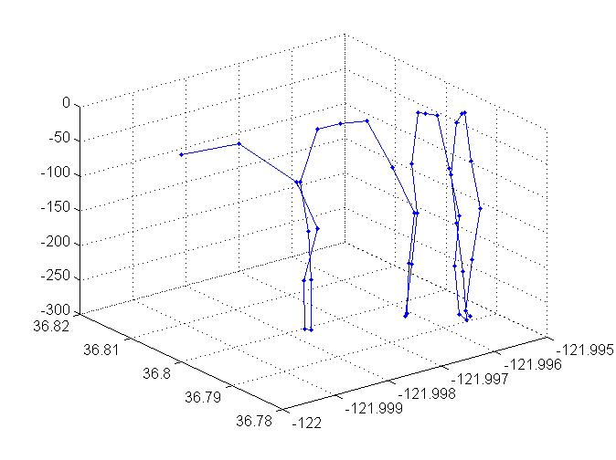
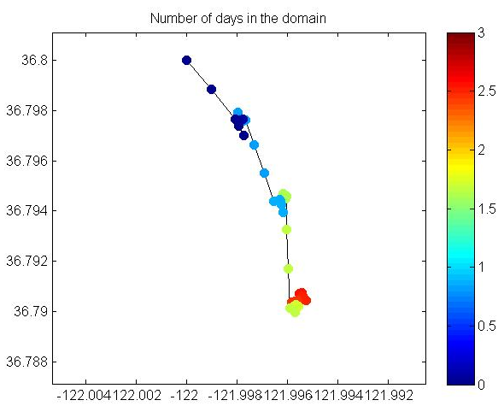
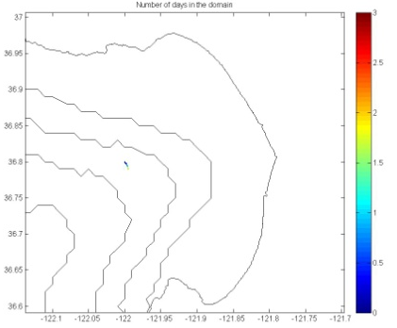
ROMS Model Initial Results
408m
1025m

Slide 14
Design Approach
Design a float test platform that allows us to address big picture questions and ignore important but pretty well understood issues
  Big Picture: Can we keep the CPF in the measurement volume? So the BE is (hopefully) oversized so we can test various anchor/deAnchor strategies
  Not so big: more efficient power distribution, lighter housing may wait until phase 2

Slide 15

What do you get for a 5 year $10M experiment?
Profiling float costs
  CSOBOM float = $60K capital costs + $0/year
  Minimal small boat deployment costs
Glider costs (per Oscar S. and Dan R.)
  $250K capital costs + $50K/year maintenance
  Somewhat greater small boat costs due to ~3 month refurb.
CPF and CSOBOM float costs are roughly similar
  Minor differences in BE and pressure housing
166 floats, 20% loss = 133 in the array for 5 years
20 gliders w/4 on shore for refurbishment = 16 in the array at any 1 time
MODIS Chlorophyll June 28, 2011
htttp://podaac-tools.jpl.nasa.gov/soto/

Slide 16
End of Science Overview
Engineering Details
  Mechanical Subsystem
    Buoyancy Engine
  Electrical Subsystem
    Power Budget
  Software Subsystem
  Test Plan
  Tech Transfer

Slide 17
Argo 7647: 9 months parked at ~1000m
Some evidence this may work
0.25⁰=28km
ARVOR-C 200m/day
Buoy @ 50m = 4000m/day
Drifting profiler = 4300m/day

Slide 18
Mechanical Subsystem
Except for the BE the CPF is a pretty typical mechanical design
(ΔVolume/Total Volume) matters
  Existing designs can’t always descend/surface through strong pycnoclines
  If ΔV/V matters then weight & volume matter
Minimizing bubble traps in the BE is important
  Tapers on horizontal surfaces, vent at top, ???
The APEX float uses an economical center tie rod, single face seal O-ring pressure vessel, so will we

Slide 19
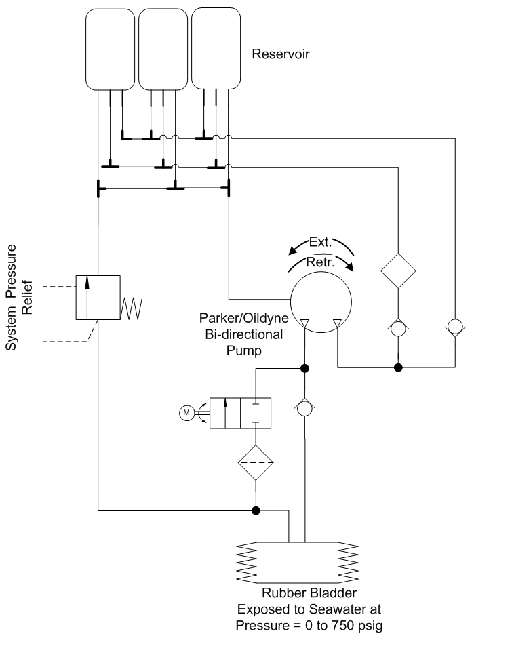
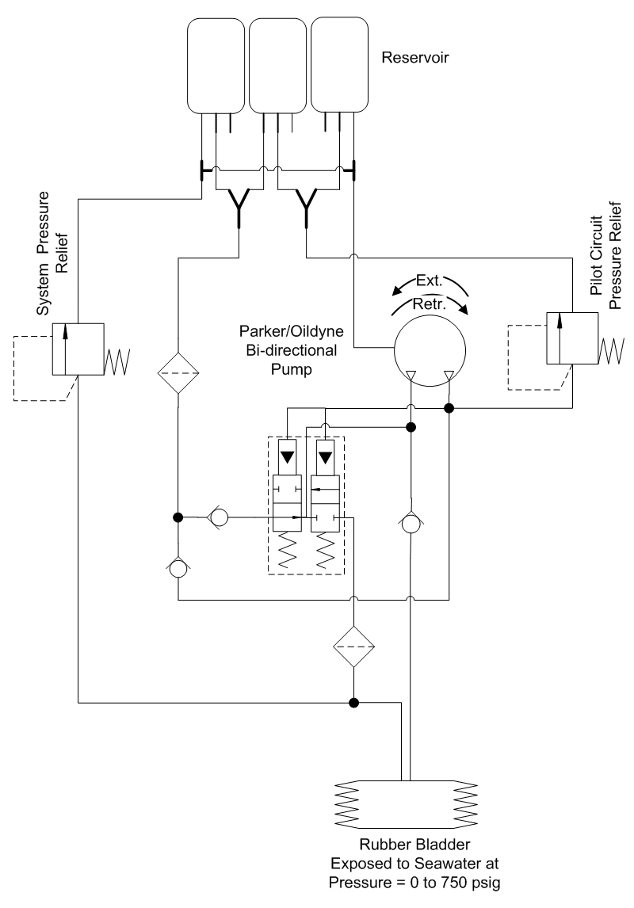
Buoyancy Engine
2 multi-stroke design options
  Pilot operated valve: automatic but somewhat more complex
  Motor operated Swagelok valve: simpler but requires control to switch between extend and retract
2 design options
  single stroke = driven hydraulic cylinder
  multi-stroke = hydraulic pump
Efficiency is the deciding factor
  Cylinder – high volumetric efficiency, high frictional and gear head losses, difficult form factor
  Pump – lower volumetric efficiency, lower frictional losses, no gear head, flexible form factor
Zero-leak hydraulic valves are a myth

Slide 20
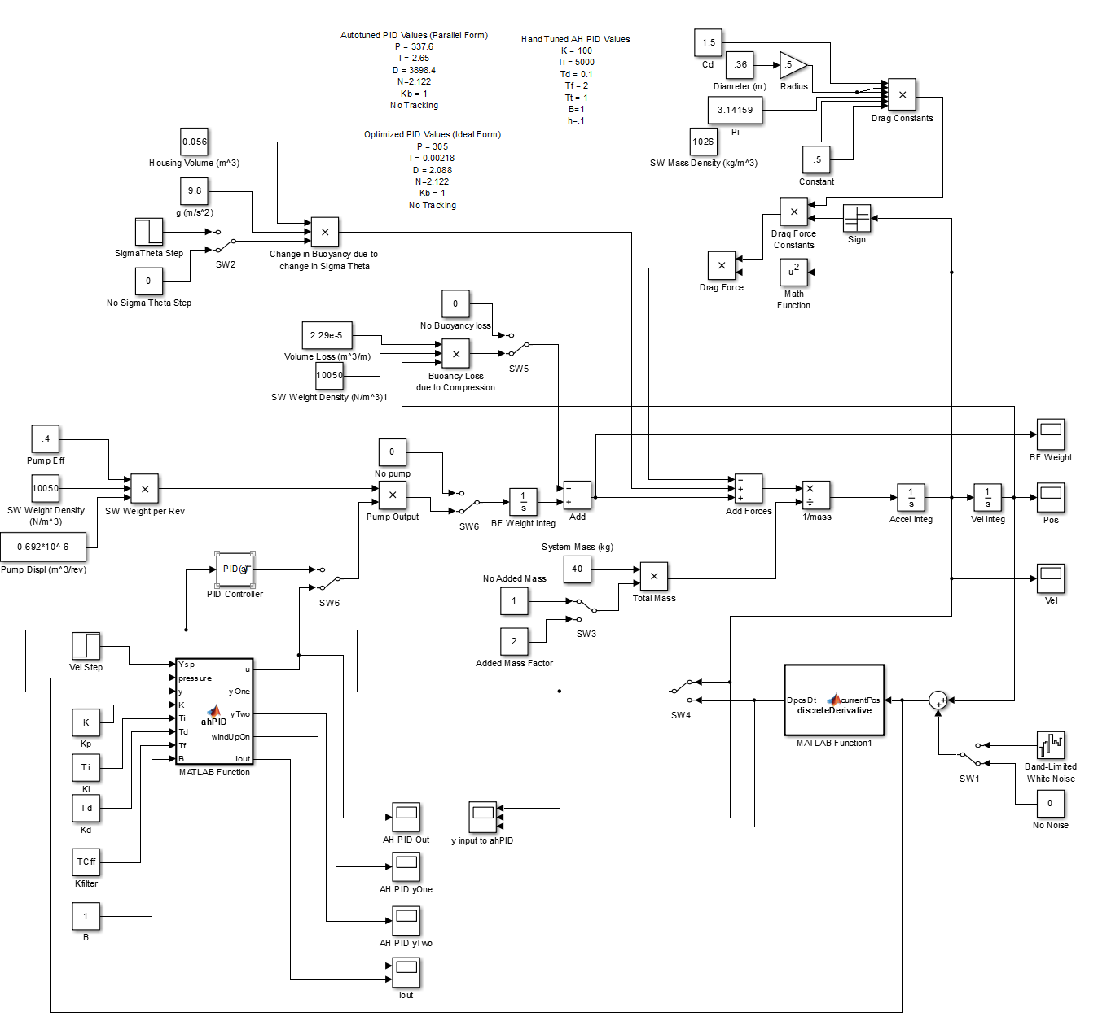
Simulink Buoyancy Control Model
Estimate PID constants
& understand control system trends
Drag
Water column density profile
∫∫a=F/m to get Position and Velocity
System
Compressibility
Hyd. Pump
Added mass
PID controller
w/filtering and anti-windup

Slide 21
First Tank Tests
(after initial fumbles)
End of Test
Start Hold Velocity
Start Autoballast

Slide 22
Simulink vs. Reality
Inner Velocity Loop, Outer Position Loop
First Tests = Inner loop OK, Outer loop needs work

Slide 23
Electrical Subsystem

Slide 24
Power Distribution
Need 24 VDC to achieve desired motor speeds
Primary batteries for full mission, rechargeable batteries for testing
Electrochem 3B0076 Li-BrCl primary 3.0–3.9 VDC
Tenergy 18650 Li-ion rechargeable 3.0-4.2 VDC
2 banks of 8 cells in series = 24-33.6 VDC Battery Bus
  Run the BE motor directly off the Battery bus
Buck converters for 3.3VDC electronics, 12 VDC instruments and ~22VDC position sensor
Switched power to all science and engr. instruments
Probably need an independent micro power sleep controller for overall system (eventually).

Slide 25
Gadgeteer?
Problem: Software development is hard, time consuming and can impede progress in other areas
A set of tools that provides effective embedded development testing to move forward in parallel with production software development would be very valuable
Ideal solution would have
  Cheap, readily available, embedded hardware
  The ability to support current and future Chem Sensor lab work
  An easy to learn, easy to use, powerful development environment
  Existing interfaces (both hardware and software) to a wide range of devices
I’ve never found anything suitable until I stumbled across the Gadgeteer/.NET Micro Framework/Visual Studio and it looked worth an experiment
  Simultaneously, Luke is investigating it

Slide 26
Initial Gadgeteer Experiment
Can GM build a working test tank prototype for buoyancy engine performance and control strategy testing without impacting the SE?
An unequivocal success
  Near total ignorance to full BE control system tests underway in 2 weeks. Rapid iterations thereafter
  10 Hz PID loop, event driven serial IO, SPI, USB and Bluetooth interfaces and a microSD file system
So successful we asked the question whether it is worth looking at .Net Gadgeteer for the production software with the priority being effective software development in this first 3 year prototype effort

Slide 27
Power Budget
APEX floats have a pretty detailed power budget
CPF BE benchtop prototype measurements very similar to APEX without anchoring
  BE energy with anchoring is 2X to 5X no anchoring energy
CPF Gadgeteer hardware is roughly the same energy in active state, way more in “sleep” state
  Need an external, micropower sleep controller to meet requirements
APEX power budget:

Slide 28
Software Details

Slide 29
Test Plan
Benchtop BE test fixture
  Is it robust re: bubbles and contaminants?
  Estimate power consumption vs pressure
  Control loop testing at pressure
Test Tank prototype
  Does it work as a system?
  Control loop development
  Software subsystem testing
CPF Prototype
  First article w/ROV babysitting (< 1 day)
  First article w/Paragon babysitting (<1 day)
  First article 5 day tests
  Final tests ?? days

Slide 30
Tech Transfer
Solicit existing float vendors
We expect the vendor to use their existing hardware/software designs and tool chain
Some additional design for production will probably be required

