Slide 1
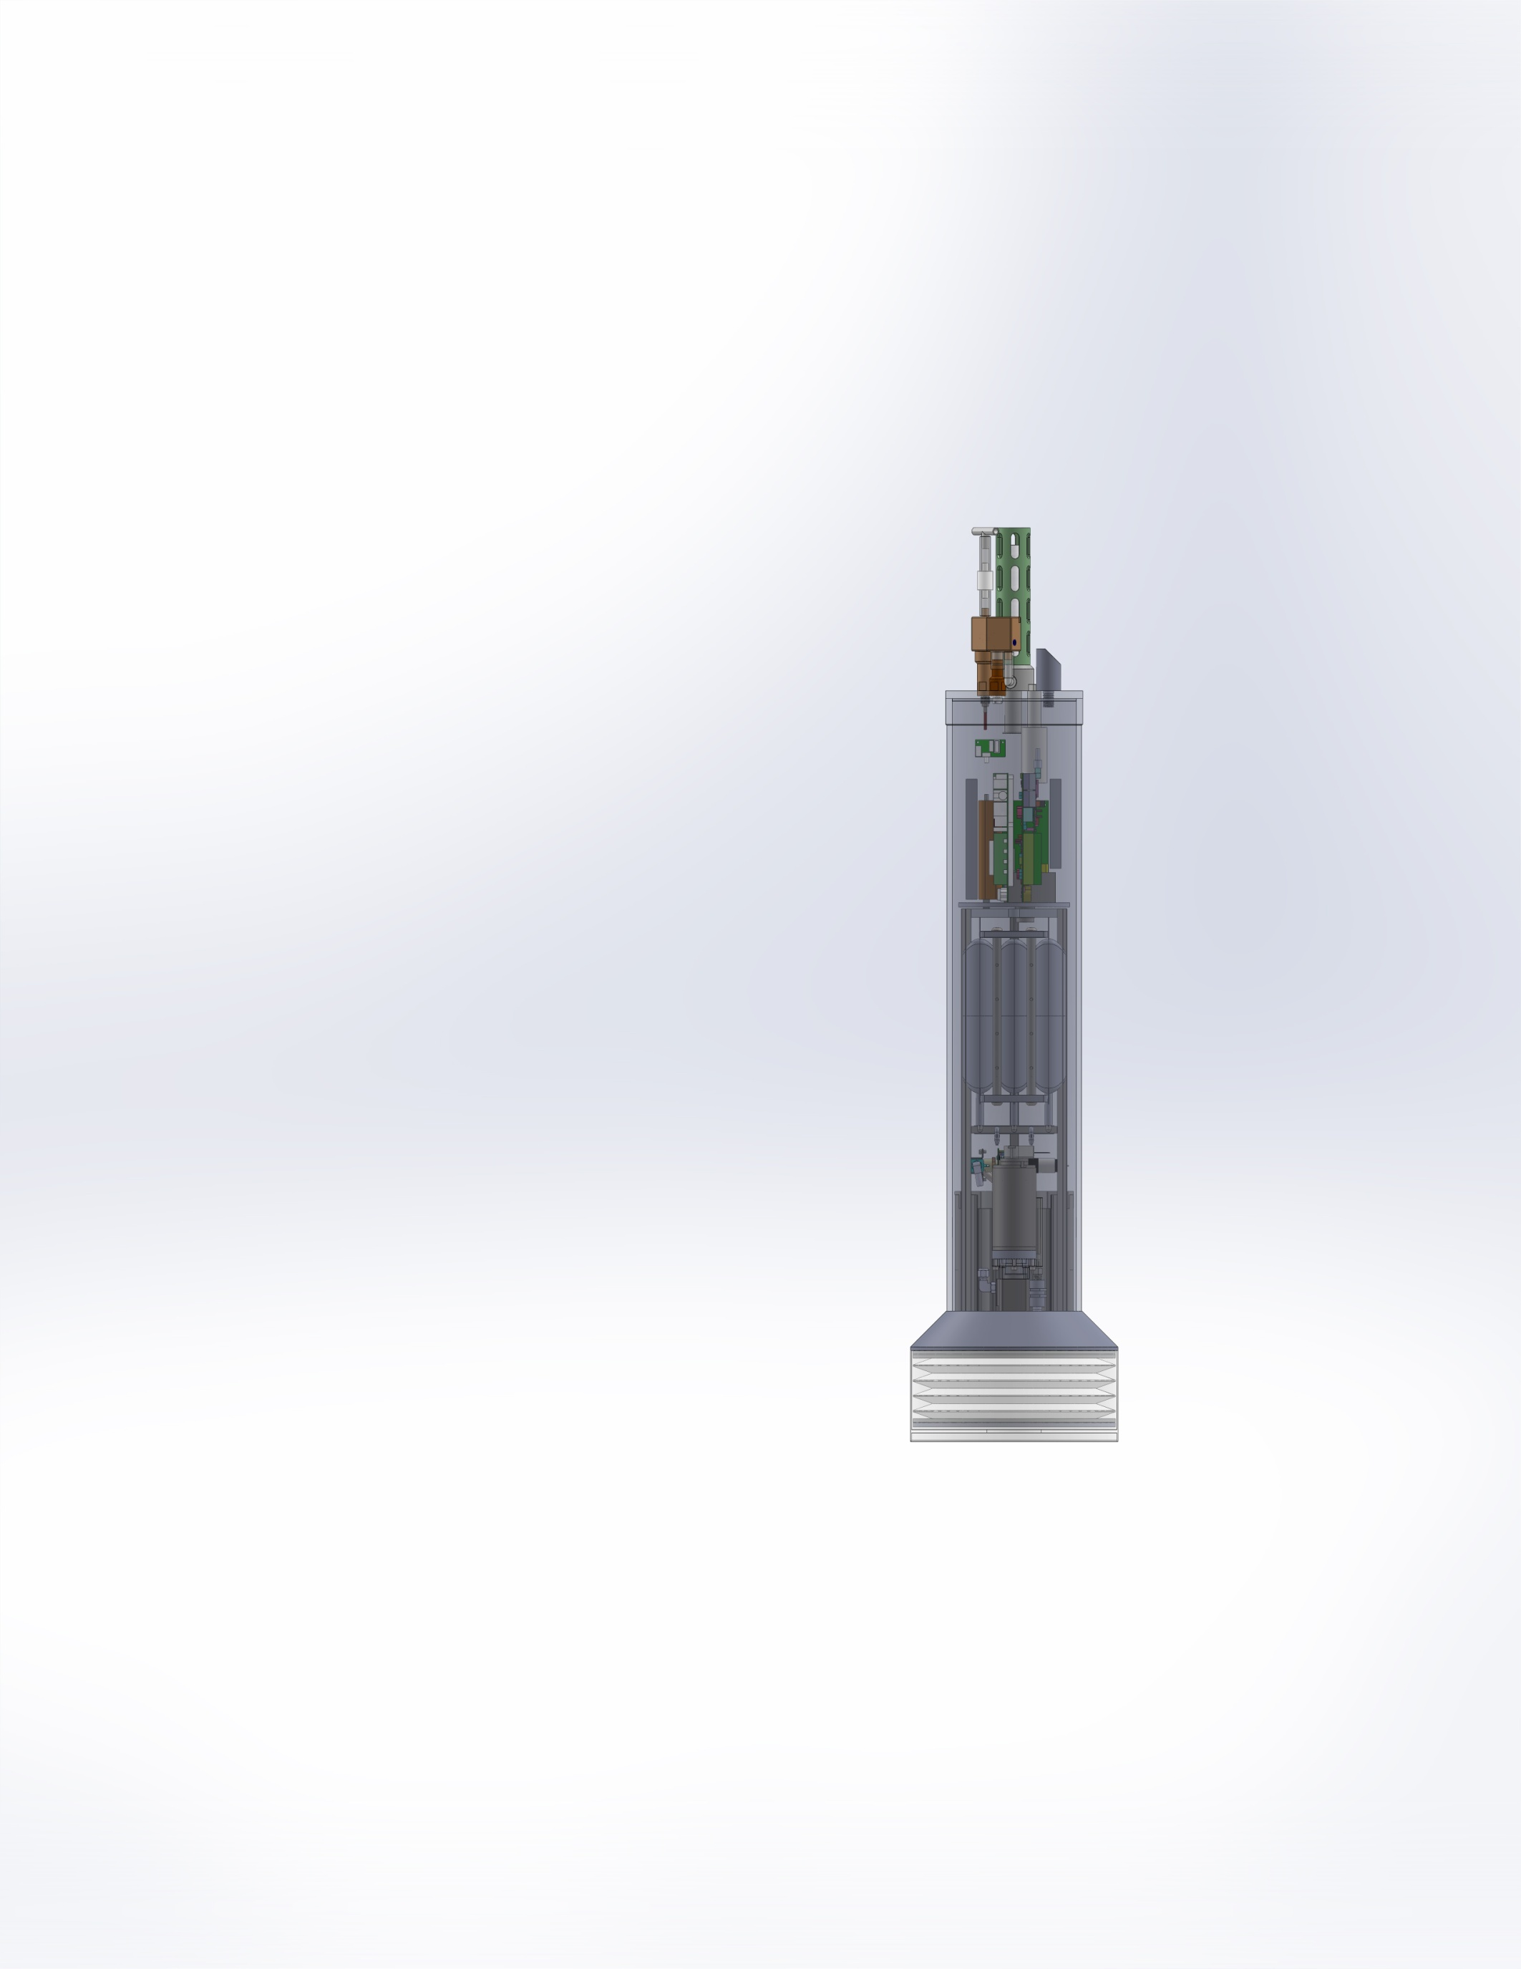
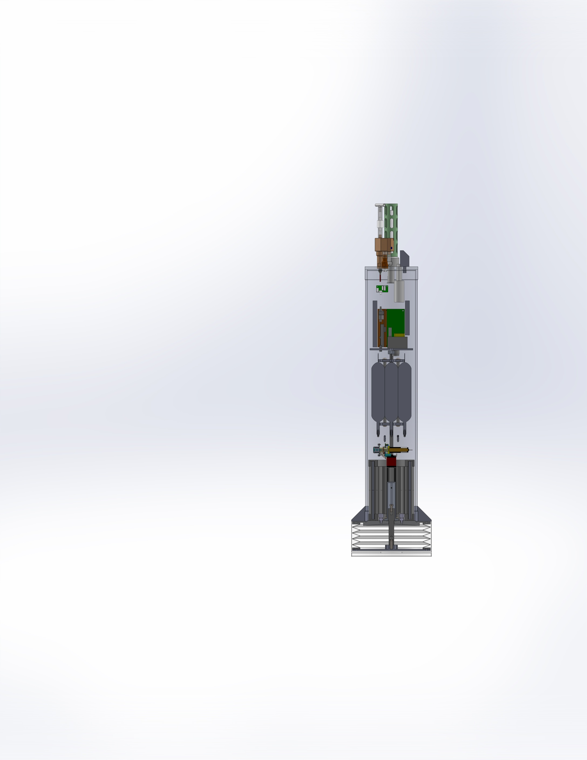
Coastal Profiling Float
Software Design Review
June 26, 2013

Slide 2
Profiler Software Ecosystem
Based on Gene’s successful experience, we decided to use Microsoft’s NETMF/Gadgeteer toolkit, C# and COTS hardware to develop embedded software for the Coastal Profiler.
This portion of the CPF design review will
  Thumbnail the NETMF software environment
  Present an overview of the application software architecture for the Coastal Profiler

Slide 3
NETMF
A subset of Microsoft’s “Dot Net” environment
  Developed by Microsoft Labs for embedded systems
  Completely open source, except for tools and certain drivers (WiFi). No license required for use.
  Arguably “best of breed” tools for embedded software development.
  Tools are freely downloadable from Microsoft.
NETMF provides useful software components
  A FAT32 file system
  TCP/IP networking
  Threads
  Timers

Slide 4
Gadgeteer
Gadgeteer is a toolkit for building event driven systems from COTS hardware, NETMF and C#.
Typical events:
  Characters arriving on a serial port
  Indications of elapsed time
  Arrival of a packet on a network interface
  Software signals
Hardware and software interrupts are mapped into C# events. These events are queued and then delivered to clients by Gadgeteer.

Slide 5
Gadgeteer System
A Gadgeteer system is composed of
  A mainboard containing an embedded processor that runs a byte code interpreter(CLR)
  A variety of COTS hardware modules which connect to the mainboard through a simple HW interface
  The NETMF framework that provides threads, timers, TCP/IP networking and a FAT32 file system
  Device drivers provided by Microsoft or hardware vendor that represent I/O devices as a C# class.
  Embedded software that implements the application using C# and NETMF software components.

Slide 6
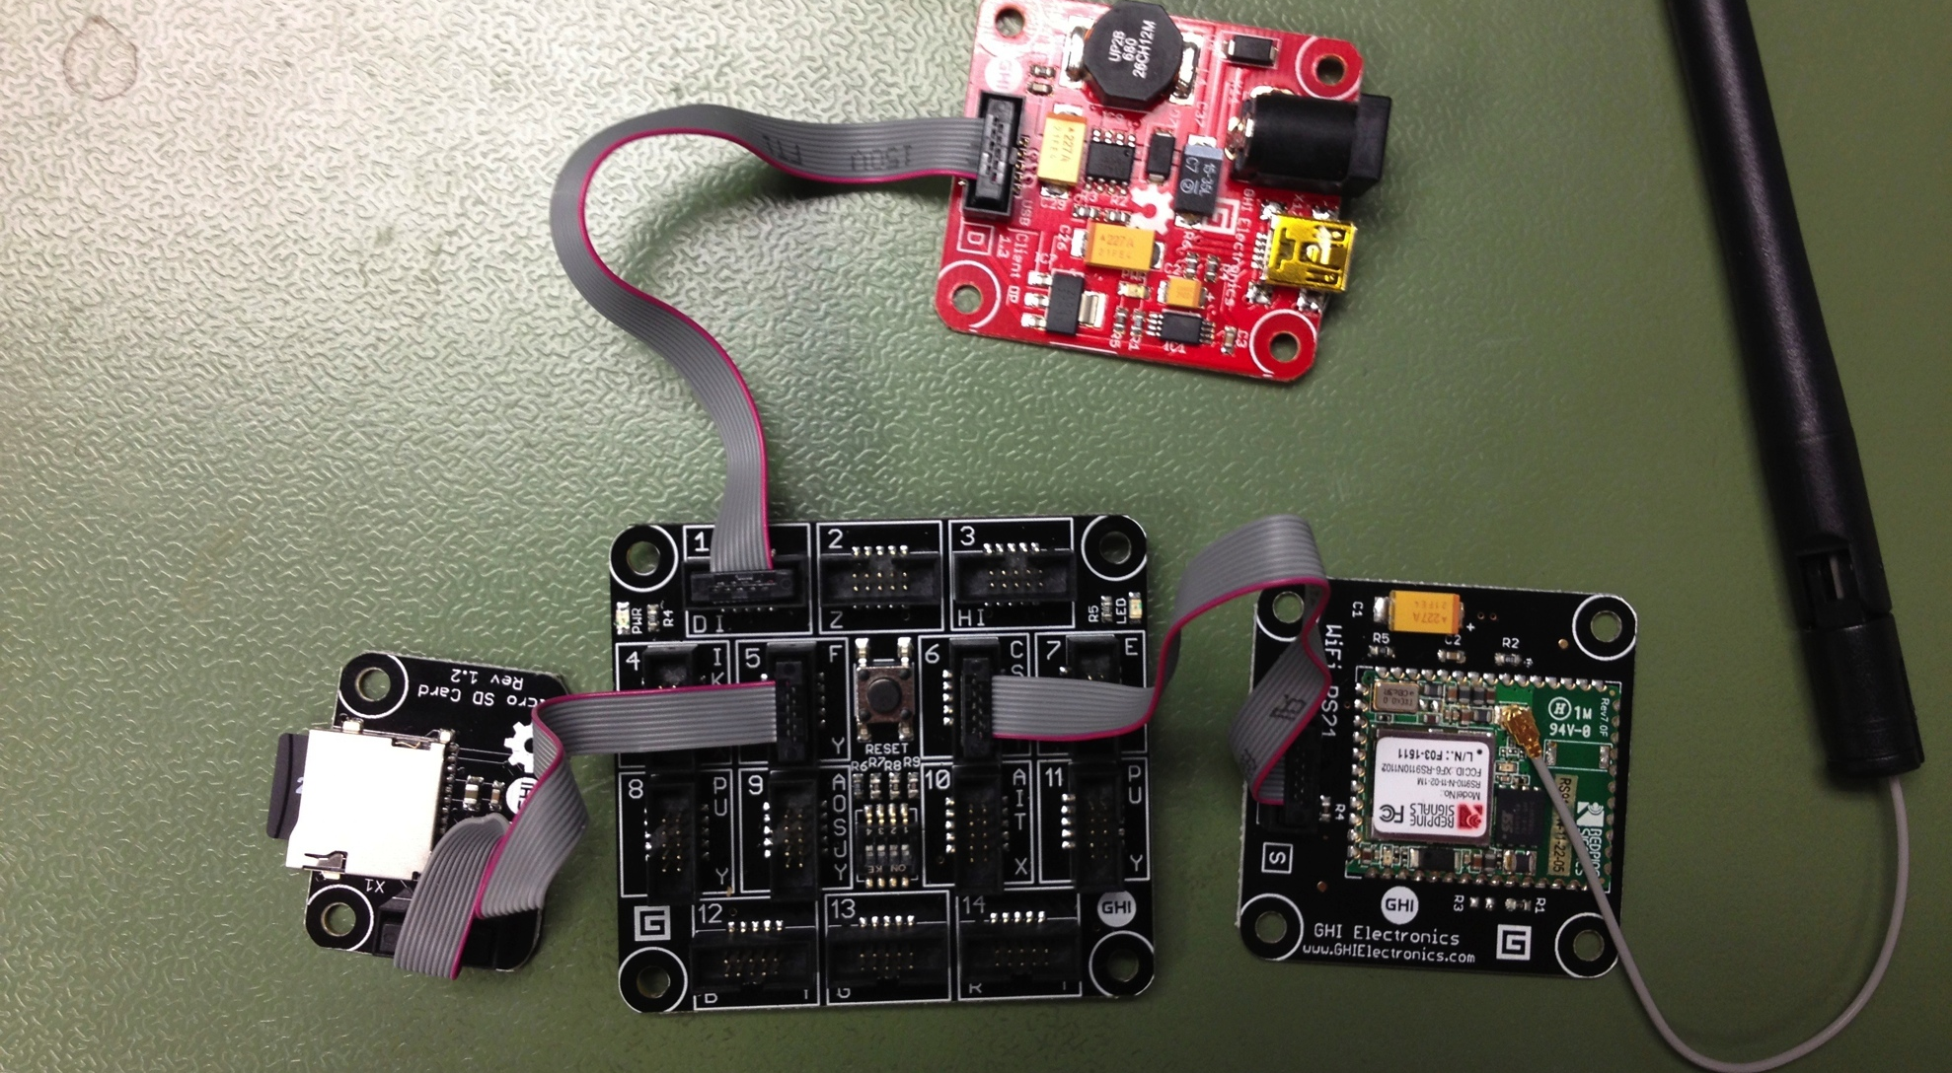
Gadgeteer Hardware

Slide 7
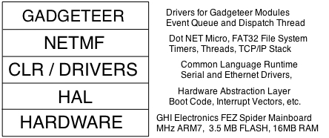
Gadgeteer Software

Slide 8
Gadgeteer Main Program
namespace FTP_Test
using Gadgeteer;
using GTM = Gadgeteer.Modules;
public partial class Program : Gadgeteer.Program {
private Gadgeteer.Modules.GHIElectronics.WiFi_RS21 wifi_RS21;
private Gadgeteer.Modules.GHIElectronics.SDCard sdCard1;
public static void Main() {
// Initialize the Mainboard first
Program.Mainboard = new GHIElectronics.Gadgeteer.FEZSpider();
Program p = new Program();
p.InitializeModules();
p.ProgramStarted();
// Starts Dispatcher
p.Run();
}
private void InitializeModules() {
this.sdCard1 = new GTM.GHIElectronics.SDCard(5);
this.wifi_RS21 = new GTM.GHIElectronics.WiFi_RS21(6);
}
}
}

Slide 9
NETMF vs. Embedded Linux
NETMF
Embedded Linux
Potential for truly low power consumption(no DRAM)
Quick development for prototyping
Ease of interface to custom HW, no “driver” development
World class development tools for C#
Well known API
Better performance and determinism when native code (C/C++) is used
Stable
Huge and growing user community
Different development styles (C/C++, scripting languages like Ruby)

Slide 10
NETMF, The Good
C# is intended to be a “simple” language for object oriented programming.
Relatively easy to port code from C/C++
Download and debug code over Bluetooth (or USB with a cable)
  An elegant mechanism (“delegates/events”) for implementing callbacks

Slide 11
NETMF, the Bad…
“C# is sort of Java with reliability, productivity and security deleted.” – James Gosling
NETMF systems use byte code interpreters
  C# translated to CLR (common language runtime).
  10X to 100X loss of performance compared with native C/C++ code for simple integer math.
A C# “char” is Unicode not ASCII,
  尽快学习普通话！(Learn Mandarin soon!)
  Nothing inherently wrong, just surprising to the ignoscenti

Slide 12
NETMF, The Ugly
C# is a managed (aka garbage collected) language,
  Impacts deterministic code execution.
  Little or no control over GC’s execution.
The NETMF libraries are confusing to use
  Poor documentation, that’s often out of date
  Hard to determine which assemblies(object code libraries) are needed for linking
Existing NETMF COTS hardware isn’t really that “low power” (0.25 watts running, 0.1 watt standby)

Slide 13
Mine is not to reason why…
Despite the known and unknown problems with C#, NETMF and Gadgeteer; Gene has made very rapid progress on BE control loop testing.
The impact of byte code performance and non determinism introduced by garbage collection is believed to be modest. Control loops only run at 1 to 10 Hertz.
Standby power consumption (100 mW) of the COTS Gadgeteer might be the most challenging problem to overcome.

Slide 14
The back up plan…
C# will be written to allow an easy (if tedious) back port to C++ .
Freescale’s FRDM evaluation board running MBED will be used as target.
MBED avoids having to write our own TCP/IP stack and FAT32 file system.
A C++ template class emulating C# delegates was developed to facilitate a hasty retreat.
Most of the hardware can be re-used without modification but the motherboard will probably be different.

Slide 15
Profiler Software Components
A collection of Hierarchical State Machines implement the overall mission, PID loop and instrument control (one HSM per instrument).
A scheduler that determines when to sample and power manages instruments.
FTP and Telnet servers running in their own threads.
An event queue that contains events waiting to be processed by the HSMs.
A logger that saves science and engineering data on an SD card.

Slide 16
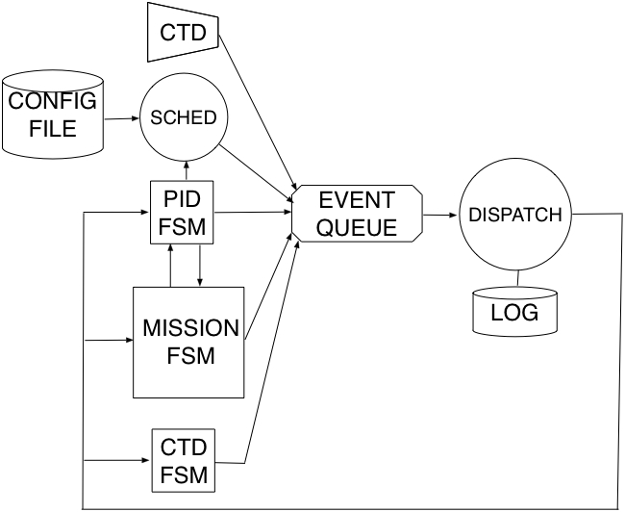
CPF Software Architecture

Slide 17
Hierarchical State Machines
Shamelessly stolen from Miro Samek’s QP framework and textbook. Code generation for C#, not supported by the graphical HSM tools only C/C++.
No NETMF C# implementation available, so one was developed.
Minimize the “state explosion” that can result from modeling complex behavior using flat Finite State Machines.
Roughly analogous to Brook’s “layered control” (similar to LRAUV).
A number of Hierarchical State Machines (HSMs) implement the desired mission behavior
  One HSM runs the “mission” (ascend, descend, etc.)
  Another HSM runs the PID depth control loop
  One HSM per instrument implement a specific instrument driver
HSMs can send events to themselves or other HSMs via an event queue.

Slide 18
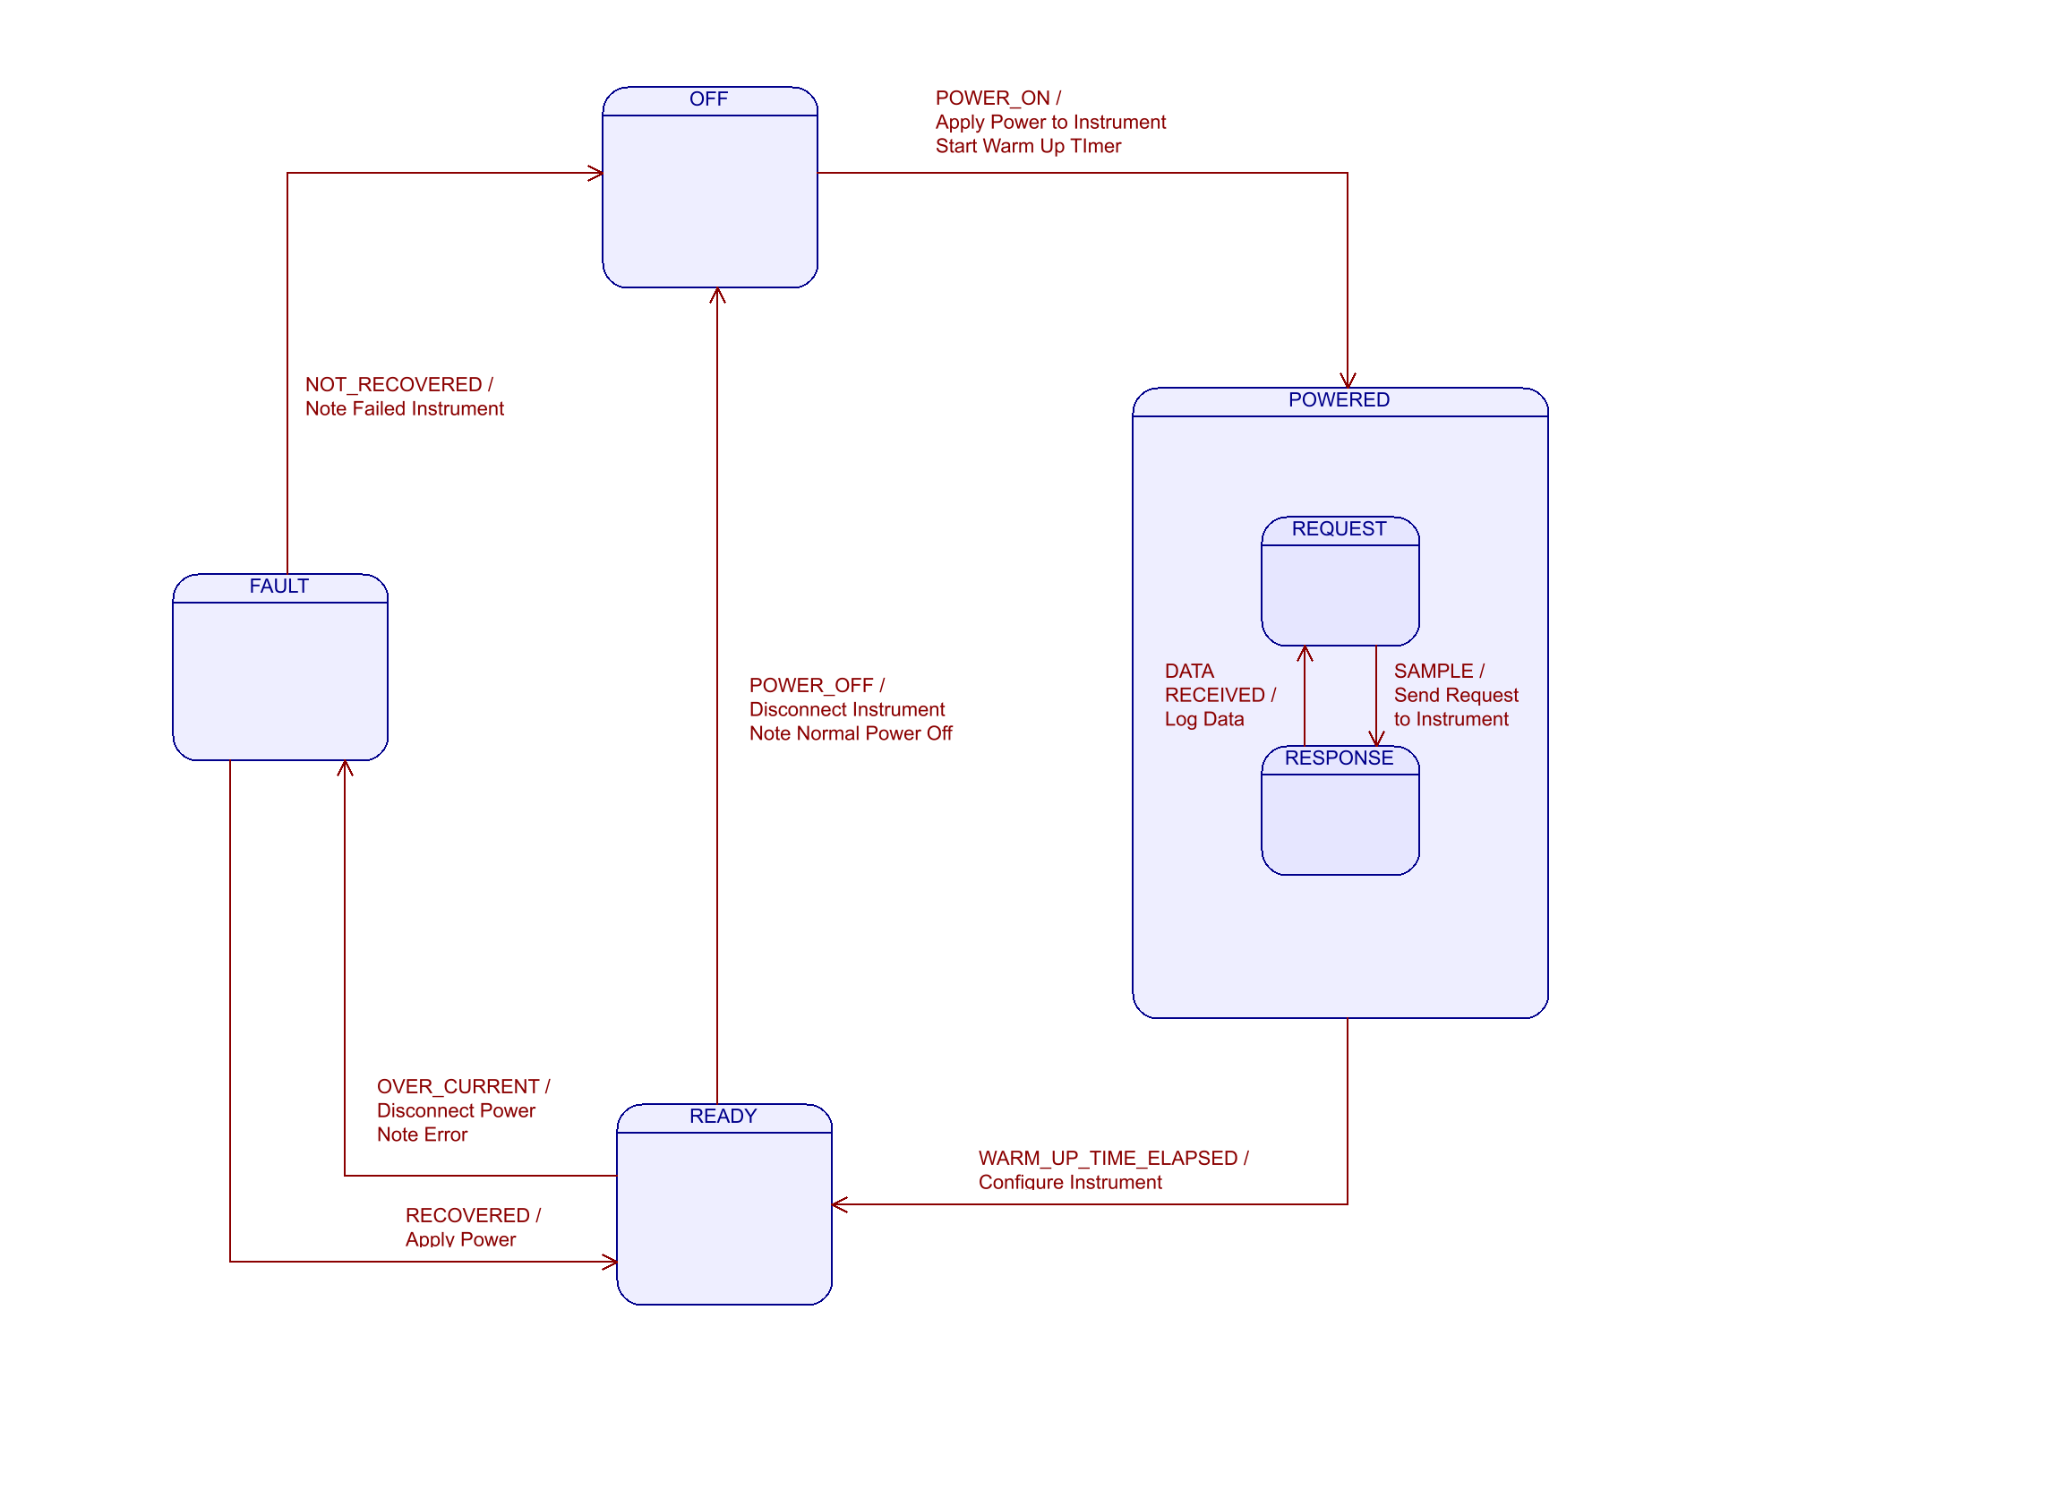
Example Hierarchical State Machine

Slide 19
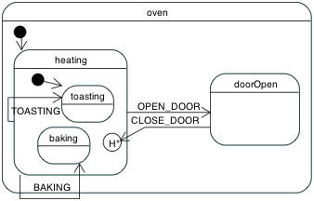
A simple HSM example
Burn-Well's Toaster Oven

Slide 20
HSM Implementation
States.cs
HSM.cs
namespace HSM
{
public enum Signal
{
Null = 0,
Init = 1,
Entry = 2,
DeepHistory = 3, // Record Deep History
Exit = 4,
User = 5
};
public class Event
{
public Event(Signal signal)
{
m_signal = signal;
}
public Signal m_signal;
}
public delegate State State(Event e);
}
namespace HSM
{
public class Hsm
{
protected void Initialize(State topState);
protected Boolean IsParent(State parentState, State childState);
protected void TransitionState(State newState, bool toDeepHist);
protected void TransitionState(State newState);
protected void InitTransitionState(State newState) ;
public void SignalCurrentState(Event e);
protected Boolean IsInState(State state) ;
private History StateHistory = new History();
private State curState = null;
private State topState = null;
}
}

Slide 21
HSM Test Code and Output
using HSM;
namespace CPF_Test
{
public enum OvenEvents {
OpenDoor = Signal.User, CloseDoor, Toasting, Baking };
// Oven State Hierarchy
// oven
// heating
// toasting
// baking
// doorOpen
class Program
{
static void Main()
{
OVEN_HSM oven = new OVEN_HSM();
oven.SignalCurrentState(new Event((Signal) OvenEvents.Baking));
oven.SignalCurrentState(new Event((Signal) OvenEvents.OpenDoor));
oven.SignalCurrentState(new Event((Signal) OvenEvents.CloseDoor));
}
}
}
Entering Oven State
Initializing Oven State
Entering Heating State
Initializing Heating State
Entering Toasting State
Initializing Toasting State
Heating: BAKING signal!
Exiting Toasting State
Entering Baking State
Heating: OPEN_DOOR signal!
Exiting Baking State
Exiting Heating State
Entering Door Open State
Door Open: CLOSE_DOOR signal!
Exiting Door Open State
Entering Heating State
Entering Baking State

Slide 22
The “Door Open” State in C#
State doorOpen(Event e)
{
switch (e.m_signal)
{
case Signal.Entry:
Debug.Print("Entering Door Open State");
return null;
case Signal.Init:
return null;
case Signal.Exit:
Debug.Print("Exiting Door Open State");
return null;
case (Signal) OvenEvents.CloseDoor:
Debug.Print("Door Open: CLOSE_DOOR signal!");
TransitionState(heating, true); // “true” implies transition to history
return null;
}
return ovenOff;
}

Slide 23
Event Queue
If the event queue is not empty, a dispatch thread will
  1) Remove the oldest event in the queue
  2) Call an appropriate HSM to the handle the event.
The dispatch thread will block whenever the event queue is empty.
HSMs run to completion minimizing problems with concurrency between multiple threads.
Gadgeteer’s “Program.Run()” method is hijacked and used as the System’s event dispatcher.
Gadgeteer’s “Program.CheckAndInvoke()” method is used to send events to all software components.

Slide 24
Events
An event is a
  Pointer to an instance of an HSM with a member function to be called (RX UART character arrived)
  Ancillary data (RX character received) for that event.
Events include
  UART RX interrupt with received character
  Timeouts
  HSM to HSM communication
  Telnet/FTP server to HSM communication
Whenever an event is placed in or remove from the event queue, it is time stamped and logged

Slide 25
Scheduler
Profiler’s mission is described in a internal form, generated from an Excel spreadsheet.
Scheduler thread
  Reads the mission profile from a configuration file
  Observes the depth and time as reported by the PID HSM
  Sends “sample”, “power on” and “power off” events to the appropriate HSM as specified by the mission configuration file at the specified depth and/or time.

Slide 26
Logger
A (very) tiny implementation of the Java “log4j” API
FAT32 used for expediency
  Provided natively NETMF
  Supports SD cards out of the box
But…
  NETMF FAT32 implementation is not thread safe
  FAT32 loses data during power failures
  I/O transfer rates are still not known

Slide 27
Communications
Bluetooth
  Facilitates code download and debug
  NETMF doesn’t support TCP/IP debug ☹
WiFi for engineering deployments
  FTP Server for file transfer
  Telnet server for user interface
Iridium for science missions
  Uses existing shore based Argo APEX float infrastructure
  ZMODEM to “push” files to shore via shell
  Bandwidth too limited for anything other than the simplest debugging and observation.

