Slide 1

The coastal profiling float: depth and velocity control
Laughlin barker
Chemical sensors lab
Mentor: gene massion

Slide 2

Outline
In the global carbon budget, coastal waters matter
Profiling floats can scale as a monitoring solution
Existing floats are not suited for shallow waters
An MBARI float & buoyancy engine for shallow waters
Simulation & tests of buoyancy system
Looking towards a regional deployment

Slide 3
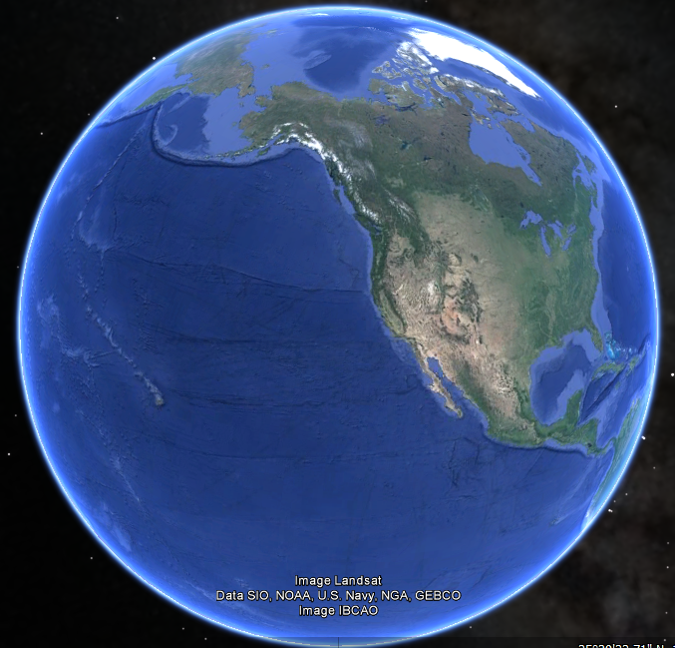
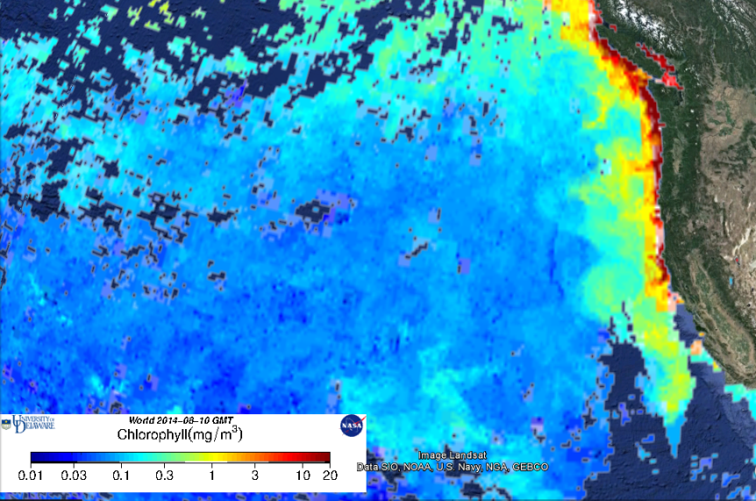
Motivation: carbon cycle
Coastal (shelf) Waters:
  7-10% ocean surface area^{1,2}
  10-30% marine primary production²
  40-50% net primary production³
Google Earth
Notes:
~10% global carbon fixation⁴

Slide 4
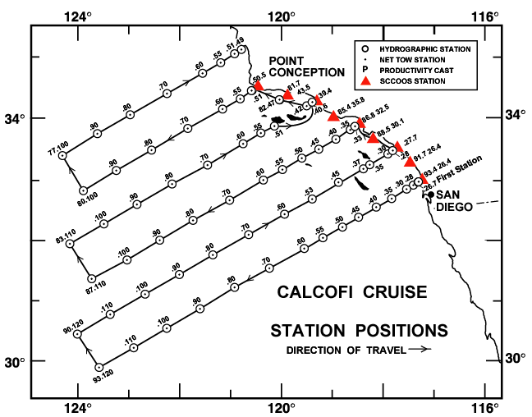
Challenge: scale
“Because of the large degree of heterogeneity in the main coastal subsystems and concomitant lack of data, most carbon fluxes in these subsystems have relatively high uncertainties.”
(“The changing carbon cycle of the coastal ocean” Bauer, J., et al, Nature, 2013)
Moorings
Cruises
Historical
Approaches
Mbari.org
Cascadiaresearch.org

Slide 5
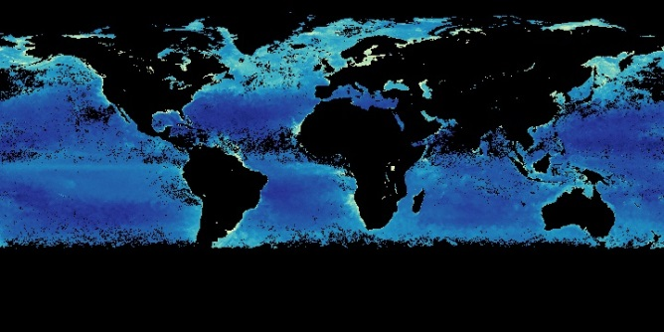
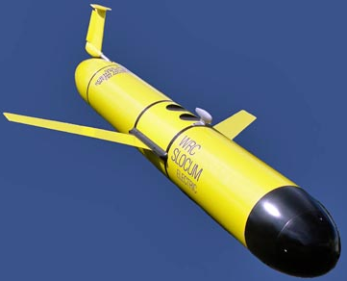
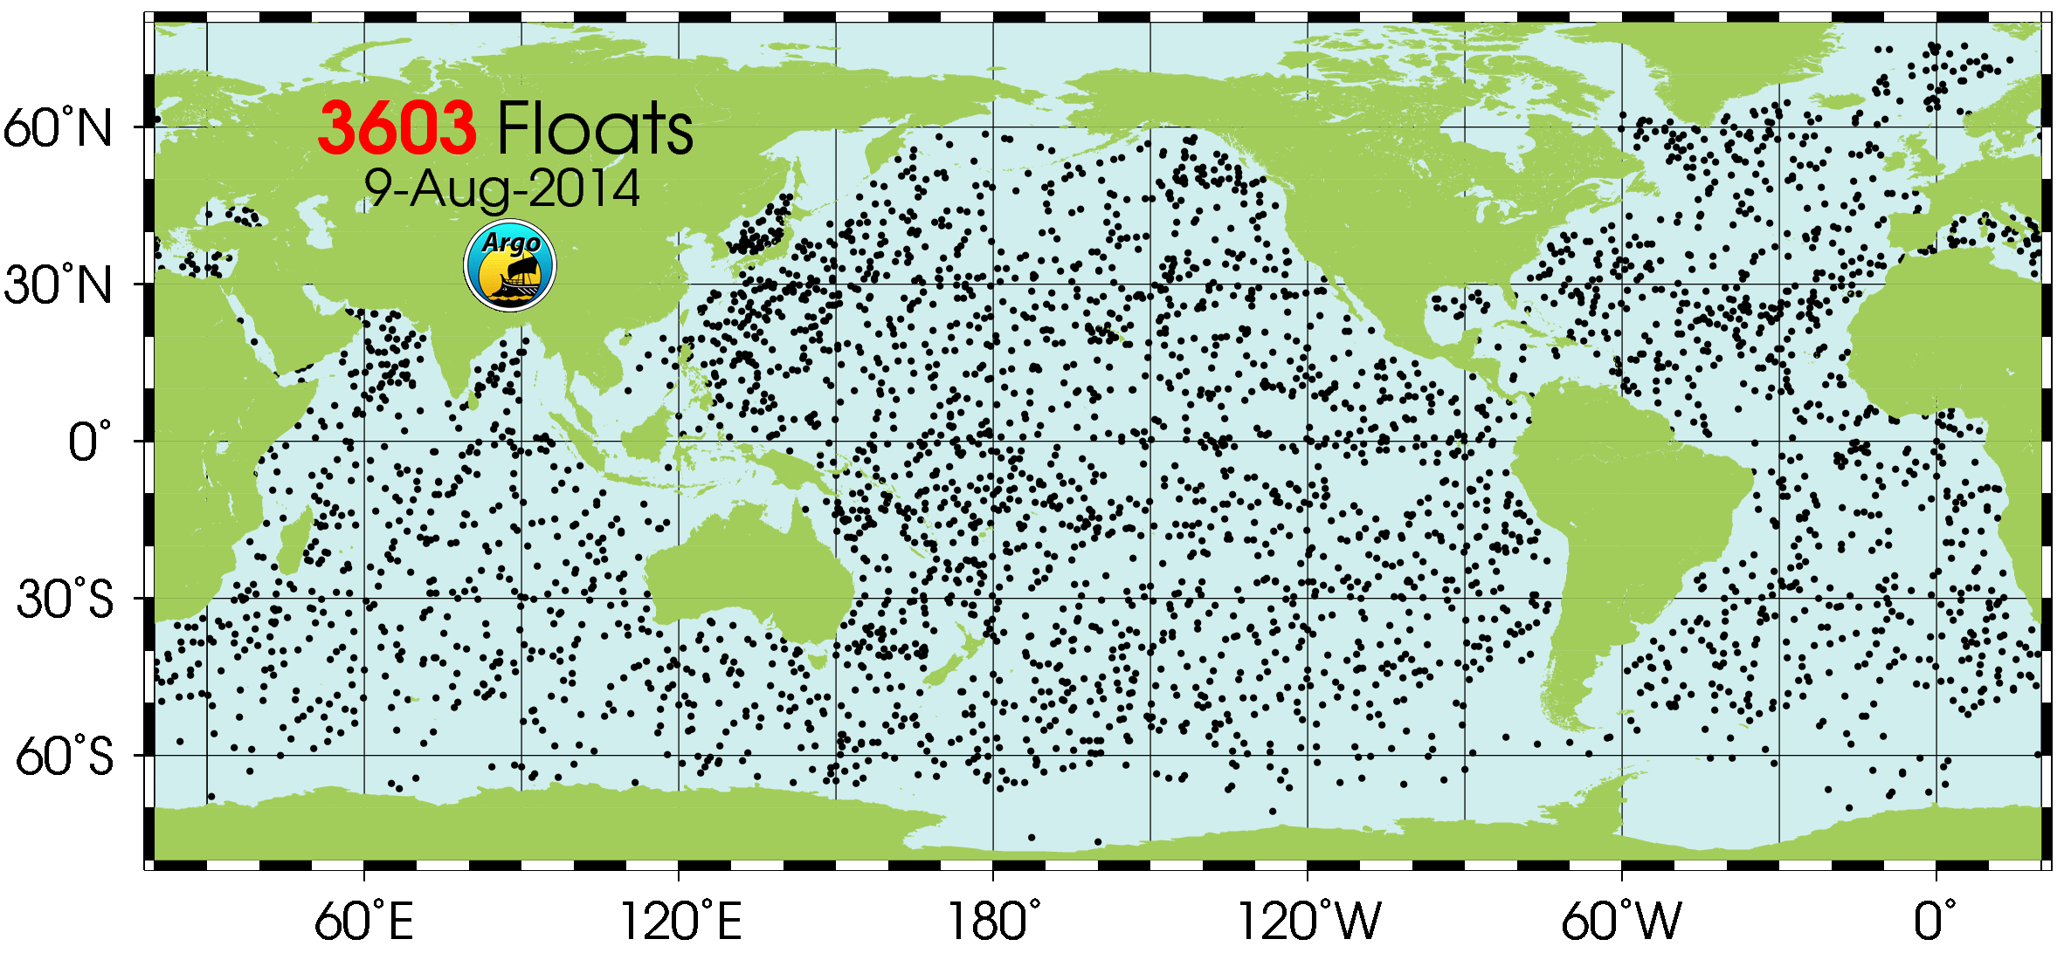

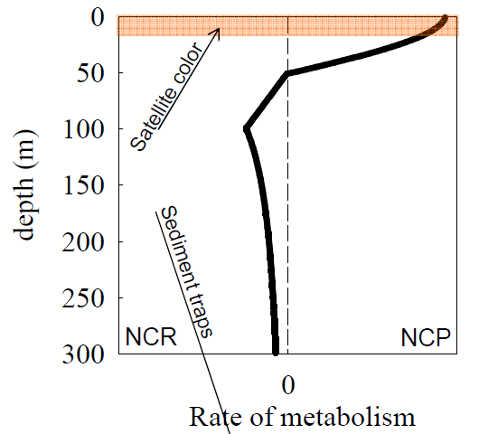
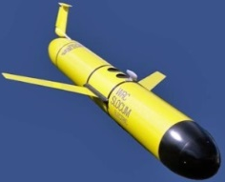
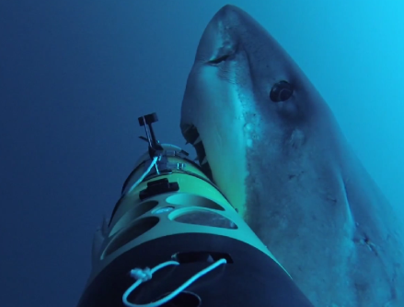
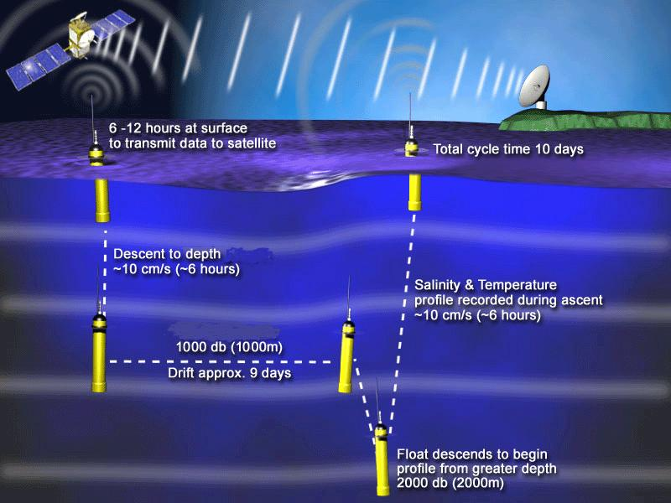
Scalable approaches
Remote Sensing
AUVs
Profiling Floats
Auvac.org
http://nasa.gov/ (June 2014 MODIS)
Argo.ucsd.edu
2 gliders: $300 k
MRO: $60 k/yr
5 yrs: $600k
Depth = <500m
Marts, T. OCB Floats and Gliders Workshop 2009.
WHOI REMUS Shark Cam
Argo.ucsd.edu
Notes:
MODIS: data produced at 1km resolution daily, with monthly composites to create cloud-free datasets.
Gliders
AUVs: costs roughly $150K, approx $60K/yr operate (numbers from CPF project proposal, convos with O. Schofield, C. Lee and D. Rudnick
Floats: Explain what float is. Need picture of float. Argo program is THE model. Largest ocean sensor network in the world. Started in 1999, and has deployed over 3600 floats to date

Slide 6
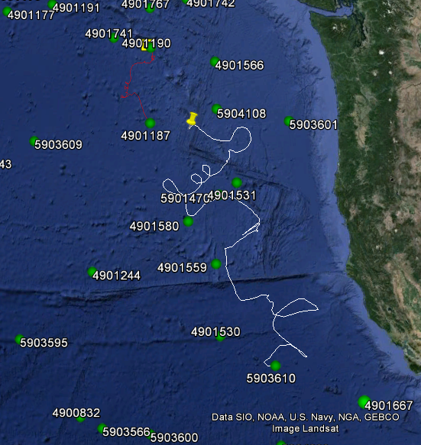
Apex (ARGO) floats
Not suitable for coastal environments
Excessive drift
Coarse depth control
860 km
1,020 d
8 Aug 2014
Google Earth
Notes:
The 108 float is an MBARI modified ISUS Nitrate system
http://runt.ocean.washington.edu/argo/homographs/index/6879.html
300 (1000 m) profiles, 220 (1000 m on ¾ profiles, 2000 m 4th), 160 2000 m profiles. - http://www.argo.ucsd.edu/apex_users_group.pdf

Slide 7
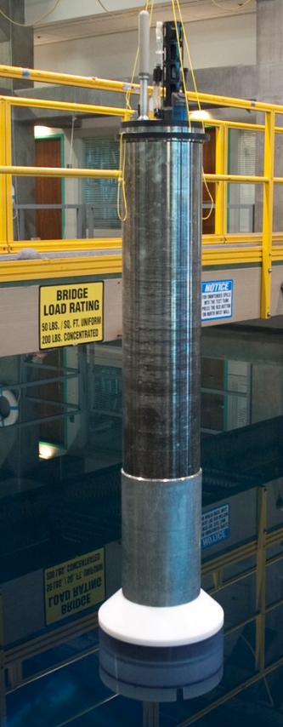
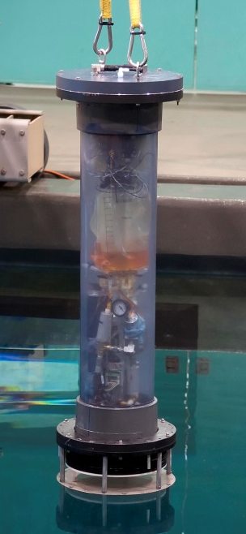
The coastal profiling float
Sea
Prototype
  In Development - MBARI Chemical Sensors Lab
    500 m capable
    ~300 profile battery life
    6 (soon 9) instruments/sensor ports
    “Anchor” between profiles (minimize drift)
    Precise depth control (shallow water ops)
Tank
Prototype
Closed-Loop Buoyancy Engine
DC motor with piston pump
3 kg adjustable ballast
Photos: Todd Walsh

Slide 8
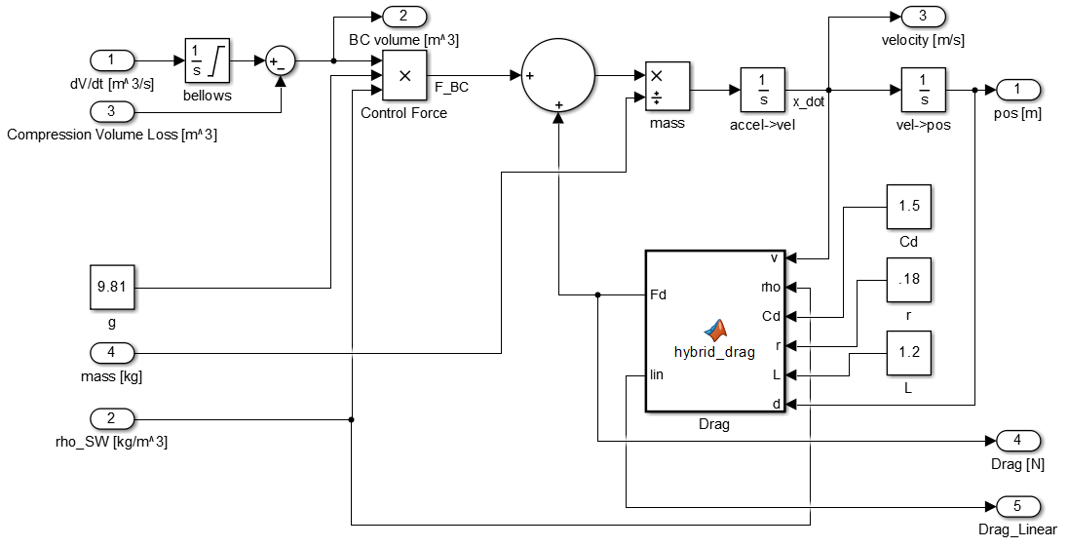
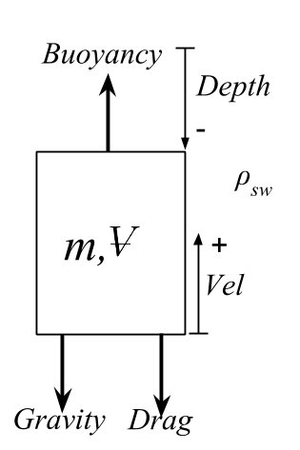
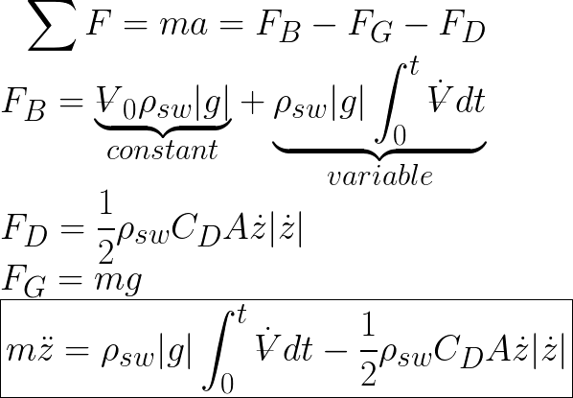
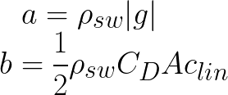
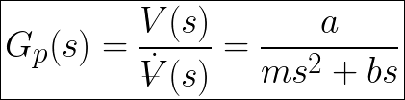
Modeling the cpf
Equation of Motion
& Linearized
Transfer Function
Free Body Diagram
Dynamic Model
a
v
d
BUOYANCY
DRAG
linearization
Root Locus Design:
PID Velocity Controller
Notes:
For 0.05 m/s velocity ~20g of force on 40kg float (factor of 2,000)
To put that in perspective, that’s like pushing a car with ones index finger

Slide 9
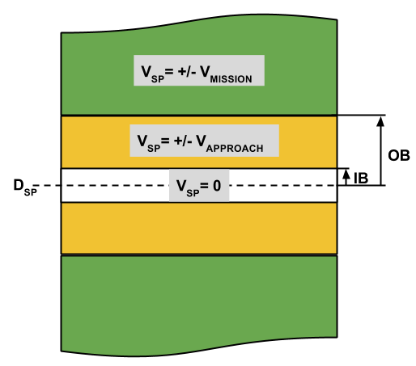
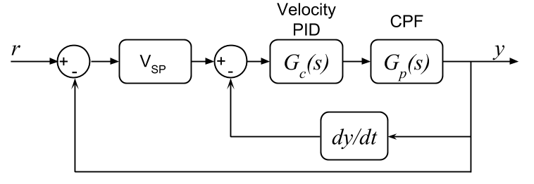
Implementation & Results
Cascade Control

Slide 10
Recommended next steps
Improve neutral buoyancy routine (mid-water parking)
Identify & mitigate source of bellows compressibility
Maximize motor runtime at maximum efficiency.

Slide 11
Acknowledgements
Gene Massion
Paul Coenen, Jonny Ferreira and Jim Montgomery
Ken Johnson
George Matsumoto & Linda Kuhnz
MBARI & George and Lucile Packard Foundation

Slide 12
Sources
1: Laruelle, G. G. et al. Global multi-scale segmentation of continental and coastal waters from the watersheds to the continental margins. Hydrol. Earth Syst. Sci. 17, 2029–2051 (2013).
2: Mackenzie, F. T., Andersson, A. J., Lerman, A. & Ver, L. M. in The Sea Vol. 13 (eds Robinson, A. R. & Brink, K. H) 193–225 (Harvard Univ. Press, 2005).
3: Ducklow, H. H. & McCallister, S. L., in The Sea Vol. 13 (eds Robinson, A. R. & Brink, K. H) 269–305 (Harvard Univ. Press, 2004).
4: Geider et al. Primary productivity of planet earth: biological determinants and physical constraints in terrestrial and aquatic habitats. Global Change Biology. 7, 849-882 (2001).
5: UW Float data: http://runt.ocean.washington.edu/argo/homographs/index/7138.html

Slide 13
Anticipatory Question Slide
Root Locus stability of depth & velocity
  Taking into account linearization

Slide 14
Anticipatory Question Slide
Full extent of dynamic model
  What elements were built into model?

Slide 15
Anticipatory Question Slide
Discrete vs. Continuous control
  Root locus in Z-plane

Slide 16
Anticipatory Question Slide
Filtering
  Delay
  Overshoot
  Order
  Root Locus

Slide 17
Anticipatory Question Slide
Wave Noise
  Decay with Depth
  LPF
  Power Histogram

